Slide 1
GEO Programme Board Report
Ivan DeLoatch, US, Co-chair
October 26, 2017
Tim Haigh, EEA Co-Chair
Albert Fisher, IOC Co-Chair
Programme Board Members

Slide 2
GEO Programme Board Report
Background Information
The Programme Board supports the on-going development and implementation of the GEO Strategic Plan 2016 – 2025: Implementing GEOSS through the GEO Work Programme
Works to ensure the overall coherence and alignment of the GEO Work Programme with GEO’s Strategic Objectives and Core Functions;
Works to align the scope and substance of tasks -- GEO Flagships and Initiatives with the resources committed by Members and Participating Organizations;
Supports and enables cross-cutting coordination and knowledge exchange, especially best practices; and
Promotes GEO Work Programme and engagement of stakeholders in their implementation

Slide 3
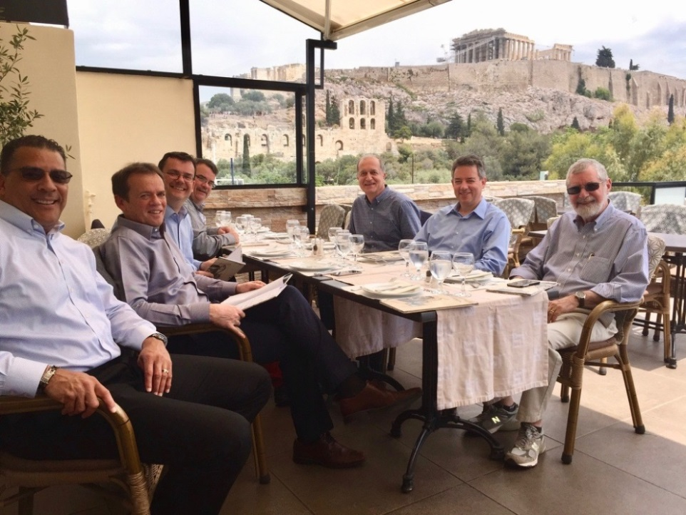
GEO Programme Board Report
2017 Priorities Established by the Program Board
Objective 1
ALIGN ACTIVITES TO THREE GEO PRIORITIES
WORK PROGRAMME REFINEMENT & IMPROVEMENTS
IMPROVE CROSS-CUTTING COORDINATION
Objective 2
Objective 3
Notes:
Optimize work programme to better align geo resources

Slide 4
GEO Programme Board Report
Progress Aligning Activities to GEO Priorities
Objective 1
What are GEO’s priorities?
GEO’s global priorities include supporting the UN 2030 Agenda for Sustainable Development, the Paris Agreement on Climate Change, and the Sendai Framework for Disaster Risk Reduction.
The Programme Board developed an engagement strategy and work plan to align the 2017–2019 Work Programme to the 3 priorities
Notes:
Progress Aligning to GEO Priorities
Remind community of the priorities agreed to in plenary XIII

Slide 5
GEO Program Board Report
Progress Aligning Activities to GEO Priorities
Objective 1
Program Board Work Plan for Aligning Activities to GEO Priorities
1
Assessment
Contact Initiatives/Flagships to identify/refine contributions
2
3
Workshops
with Initiatives/Flagships to discuss alignment, synergies and “cross-pollination”.
Outreach
highlighting how GEO is responding to engagement priorities
Virtual Workshops
Engagement at GEO Work Program Symposium (WPS)
User focus
Broad community outreach
……..
Notes:
Action: initiate contact with Initiatives/Flagships to identify/refine contributions (mapping process) to engagement priority areas
Action: organize virtual workshop with Initiatives/Flagships to discuss synergies and “cross-pollination”.
Working through challenges – Not all GEO activities bin neatly to 3 engagement priorities.
Action: produce communication product, appended to WP, highlighting how GEO is responding engagement priorities (linked to engagement strategy) (DL: 15 Aug)

Slide 6
GEO Program Board Report
Work Programme Refinement/Improvements
Objective 2
Program Board developed and is working with EXCOM/GEOSEC to implement new processes to support the Work Programme to align to priorities
1
2
3
Realignment
developed a new workflow process to realize goals and objectives
New Initiatives
developed process to asses new proposals for flagships
and initiatives
Monitoring & Evaluation
Worked with GEOSEC to improve the M&E process
Validates resources and institutional commitment
Applied process to current activities
Ensures alignment & reduces duplication of effort
Resource availability
Process was applied to 4 new initiatives
Proposed key performance indicators (KPI’s)
Revised M&E provides improved insight to accomplishments
Notes:
Agreed process for reviewing new proposals for initiatives or flagships
GEO BON (rev), AquaWatch, EuroGEOSS, GEO-GNOME (rev) accepted by PB into Work Programme to be presented to Plenary for approval.
GEO-CRADLE, GEOARC CAs accepted by Secretariat.

Slide 7
2017 Program Board Report
Use Case – How GEO can add value in monitoring SDG’s
Objective 1
Target 3.4: By 2030, reduce by one third premature mortality from non-communicable diseases through prevention and treatment and promote mental health and well-being
Indicator 3.4.1: Mortality rate attributed to cardiovascular disease, cancer, diabetes or chronic respiratory disease
GEO answer:
Global observation system for mercury (Flagship),
Copernicus Atmosphere Monitoring service (community activity)
Data/Information on aerosol components (PM2.5, PM10, Dust, Mercury …) on atmosphere with impacts on respiratory health allowing to measure the behavior of this components and the impacts of decisions
Notes:
.
Better alignment of GEO Initiatives to support SDG’s will help us demonstrate the value of EO

Slide 8
GEO Program Board Report
Improve Cross-cutting Coordination
Objective 3
Program Board implementation strategy to improve cross-cutting coordination
1
Promote Interactions
among WP activities to work collaboratively to achieve strategic plan
2
Promote Regional Coordination
considered a best practice to improve collaboration
3
Commercial Sector Engagement
Working with GEOSEC to improve communications
Regional initiatives highlighted at the WPS
Gaining momentum
Increasing Adoption
Encouraging activity for engagement(s)
Engaging potential partners
Communicated to WP activity leads
Restructured Work Plan Symposium
Notes:
Promote interactions (‘clustering’) among WP activities so that they work collaboratively to achieve Strategic Plan, if needed re-orient activities to fill gaps and avoid overlaps.

Slide 9
GEO Program Board Report
Looking Ahead?
Proposed 2018 Body of Work
Maintain balanced board, expertise and representation of the community (governments and participating organizations) with continuity
Continue to promote an action and results oriented Work Programme
Apply assessment process to the other 2 priorities
Build on network and community capacities while being flexible and opportunistic
Make use of initiative on KPIs as part of evidence base approach in making decisions and apply resourcing. Decisions should lead to progress towards objectives, if not, then not relevant.
Notes:
Promote interactions (‘clustering’) among WP activities so that they work collaboratively to achieve Strategic Plan, if needed re-orient activities to fill gaps and avoid overlaps.

