Slide 1
Youth Track Day 1
Accelerating Action with Youth
22nd November 2021

Slide 2
What is GEO ?
GEO is an international partnership bringing together Member States, Participating Organizations and Associates.
60+ activities to facilitate collaboration among all GEO partners in various domains.
Currently 3 Engagement Priorities: Sustainable Development Goals, Climate Action, and Disaster Risk Reduction.
https://www.earthobservations.org/geoss_wp.php
Notes:
GEO envisions a future where decisions and actions for the benefit of humankind are informed by coordinated, comprehensive and sustained Earth observations.

Slide 3
Agenda & Objectives
Message from the GEO Secretariat Director - Yana Gevorgyan
Perspectives on Equality, Diversity and Inclusion - Nathalie Pettorelli
Open discussion: How can a Youth Community of Practice act to help more young people to be included in GEO? - Moderator: Francis Omondi
Get to know you
Gather your insights: what are your thoughts, experience and ideas to create a GEO Community of Practice (CoP) focused on and led by young people ?

Slide 4
Meeting Protocol
This session is recorded. Replay will be made available in Airmeet immediately after the session has ended.
Make comments at any time directly in the chat.
If you want to intervene, please raise your hand and we will give you the floor.
Please answer the polls in the “Polls” tab”, results with be shown live.
Never be afraid to speak up ! Your inputs to the discussion will help to build the GEO Youth Community of Practice. Everyone is welcome !

Slide 5
Yana Gevorgyan is the Director of GEO Secretariat since July 2021. Ms. Gevorgyan is an expert in international relations whose career spans humanitarian relief and development, international think tanks, and government organizations.
Prior to her selection as the next Director of GEO Secretariat, Ms. Gevorgyan was the GEO Program Manager at the U.S. National Oceanic and Atmospheric Administration’s (NOAA). She had represented the United States to GEO in many capacities, including as a Co-Chair of the GEO Programme Board until May 2021.
As a member of the United States delegation, Ms. Gevorgyan spearheaded several key initiatives in GEO, including the landmark policy on GEO Associates, the GEO Awards and GEO Pledge Campaign.
Yana Gevorgyan
Director
GEO Secretariat

Slide 6
Research interests: climate change ecology, the use of remote sensing in conservation, and nature-based solutions. Co-chair of the new IUCN inter-commissional working group on rewilding.
UK principal on GEO's Programme Board, Chair of the Equality, Diversity and Inclusion subgroup.
Co-founded Soapbox Science in 2011, an international science outreach project for promoting women and non-binary scientists and the science they do. Since 2011, Soapbox Science has grown from one event in London to events in >60 cities in 14 countries, involving 1000s of speakers, volunteers & organisers.
Dr Nathalie Pettorelli
Senior Scientist
Zoological Society of London

Slide 7
GEO Equality, Diversity & Inclusion Sub-group
Early 2020, GEO Programme Board recommended the creation of an Equality, Diversity, and Inclusion Subgroup (EDI SG)
The SG supports the strategic aim of developing GEO as an institution that provides a fair, supportive and encouraging networking environment. It also aims to ensure that equality, diversity, and inclusivity are fully considered, addressed, and embedded within GEO activities and decisions.
Initial focus on 3G – Gender, Geography, Generation

Slide 8
GEO Equality, Diversity & Inclusion Sub-group
Initial discussions within the Subgroup quickly highlighted the need for GEO to establish and widely promote its vision and commitment to EDI through the production of a GEO-wide statement
A GEO EDI statement was submitted to Programme Board early 2021; it was approved by the GEO Executive Committee at its March 2021 meeting.

Slide 9
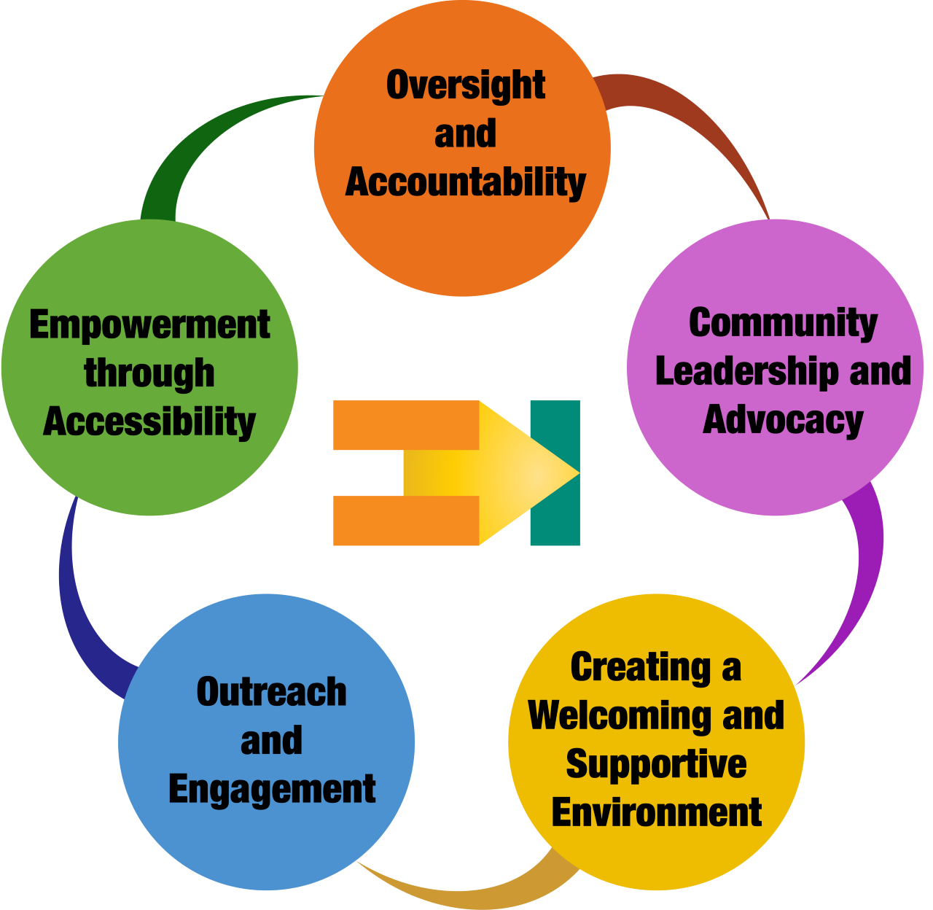
GEO EDI statement
Commitment to (1) supporting the development of a dynamic, diverse & inclusive EO community in which everyone is valued, respected & given the opportunity to participate, (2) broadening the benefits of EO, including to historically and/or geographically disadvantaged groups.
5 pillars outlining a vision for equality, diversity & inclusion in every aspect of GEO

Slide 10
Community consultation
People identified well with the 5 pillars and there was a general feeling that the actions articulated for each pillar are appropriate
This statement is a starting point for mainstreaming EDI discussions in GEO & unveiling+addressing issues relating e.g. to accessibility, representation and transparency

Slide 11
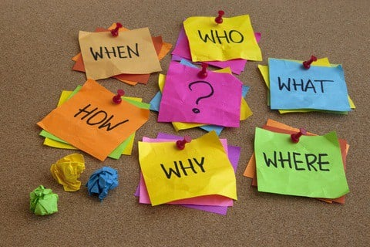
What else are we up to?
Listening mode: surveys, consultations with GEO regions, appointment of a GEO EDI contact point
Monitoring framework: agree on indicators & frequency
Trust building: regular reports on activities & achievements; focus on positive actions
Network building: engagement with like-minded organisations & initiatives; connection with other GEO SG/WG

Slide 12
Why a talk about the EDI SG at this Youth Track?
Awareness: Insuring youth representation in GEO activities is one of the 3 EDI SG priorities
Connection & input: If you have ideas/comments related to progressing the EDI agenda in GEO, we want to hear from you!
Representation: We lack early career professional voices in the SG

Slide 13
Thank You!
Nathalie Pettorelli / 22 November 2021
@Pettorelli / Nathalie.Pettorelli@ioz.ac.uk
#EO4Impact

Slide 14
Francis Omondi is a practitioner of IT and GIS based in Nairobi, Kenya. He holds an undergraduate degree in IT and currently pursuing a Master’s Degree in Geographic Information Systems and Remote Sensing at the University of Nairobi.
His area of interest is in space and satellite communications. He is a Cohort 6 Fellow of Development in Africa with Radio Astronomy (DARA).
Francis Omondi
Senior GIS and ICT Officer
NEPAD/APRM Kenya Secretariat.

Slide 15
Open discussion: How can a Youth Community of Practice act to help more young people to be included in GEO?
Make comments at any time directly in the chat.
If you want to intervene, please raise your hand and we will give you the floor.
Never be afraid to speak up ! Your inputs to the discussion will help to build the GEO Youth Community of Practice. Everyone is welcome !

Slide 16
Next Youth Track events this week
Cross-regional dialogue: Americas and Africa
Hosted in Zoom
Cross-regional dialogue: Europe, The Commonwealth of Independent States and Asia-Oceania

Slide 17
Next Youth Track events this week
Hosted in Zoom
Youth Indigenous perspective, wrap up of the week and launch of the GEO Youth Community of Practice (CoP)
The CoP will be community-driven, with support from the GEO Secretariat. We need volunteers to lead on specific tasks and for the general CoP leadership.
To volunteer, write to : ffranziskakis@geosec.org with subject “Youth Track” by Thursday 25th

Slide 18
Thank You!

