Slide 1
Youth Track Day 2
Accelerating Action with Youth
24th November 2021

Slide 2
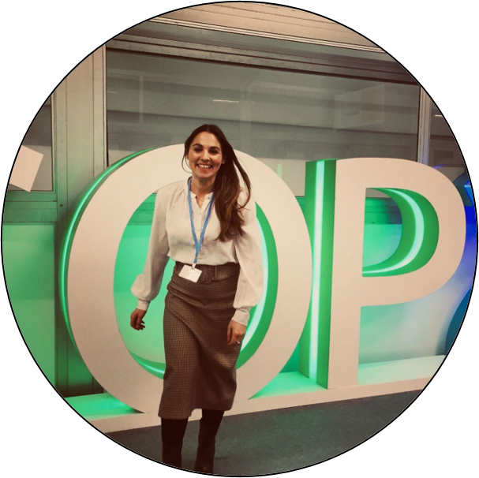
Veronika is a Sustainability Professional with over 7 years of work experience in the Caribbean, Asia and Europe, and focuses on Climate Policy, SDG action and public-private collaboration. Veronika is supporting the GEO Secretariat and the Climate Change Working Group as Climate Change Consultant.
She is the Founder of Vision Analytics.
She holds a MSc in Geography by FSU Jena, and a MSc in International Management by VU Amsterdam, and worked at the Helmholtz Association for Environmental Research (iDIV), and the World Business Council for Sustainable Development (WBCSD).
Veronika Neumeier
Climate Change Consultant
GEO Secretariat

Slide 3
Recap Youth Track Day 1
102 unique attendees
Between 60 – 70 throughout the session
Attendees from Egypt, Nepal, UK, Uganda, Ghana, South Africa, Norway, Ecuador, Indonesia
Representatives from private sector companies (ESRI, Trimble, Satellogic, SYLCAN, SpaceWill)

Slide 4
Recap Youth Track Day 1
Interest in extending mentoring programmes in GIS & EO.
Potential for GEO to act as a global partner for an internship system and to link with national agencies and companies.
Need to link more with young people already during their studies in relevant fields.
Importance of bringing forward actual opportunities, not just conferences and trainings.
See report from IISD here: https://enb.iisd.org/GEO-Week-2021-22Nov2021 (Youth Track and other events of Monday 22nd )
Notes:
Could national agencies and also companies be part of an internship system in part coordinated by GEO for young professionals? This could secure local activity and GEO affiliation. Also it secures local funding and "ownership".

Slide 5
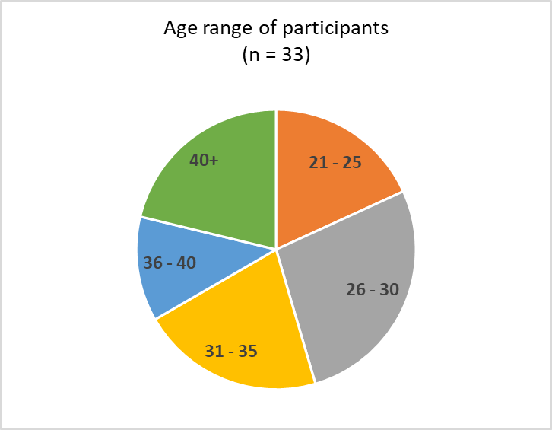
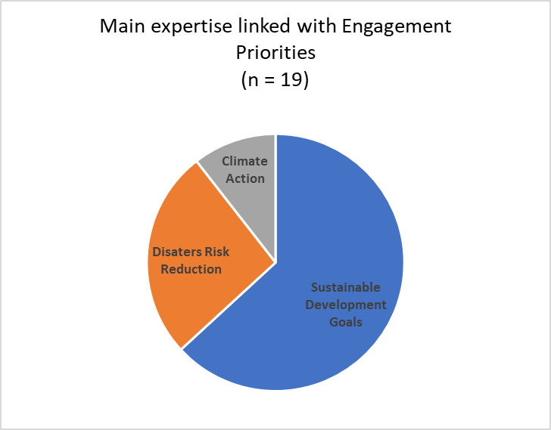
Recap Youth Track Day 1

Slide 6
Session x
Monitoring deforestation using Earth observation data in Uganda
TEOPISTA NAKALEMA
GIS and Remote Sensing Specialist, FAO
WOMEN IN GIS UGANDA - MEMBER
25 November 2021

Slide 7
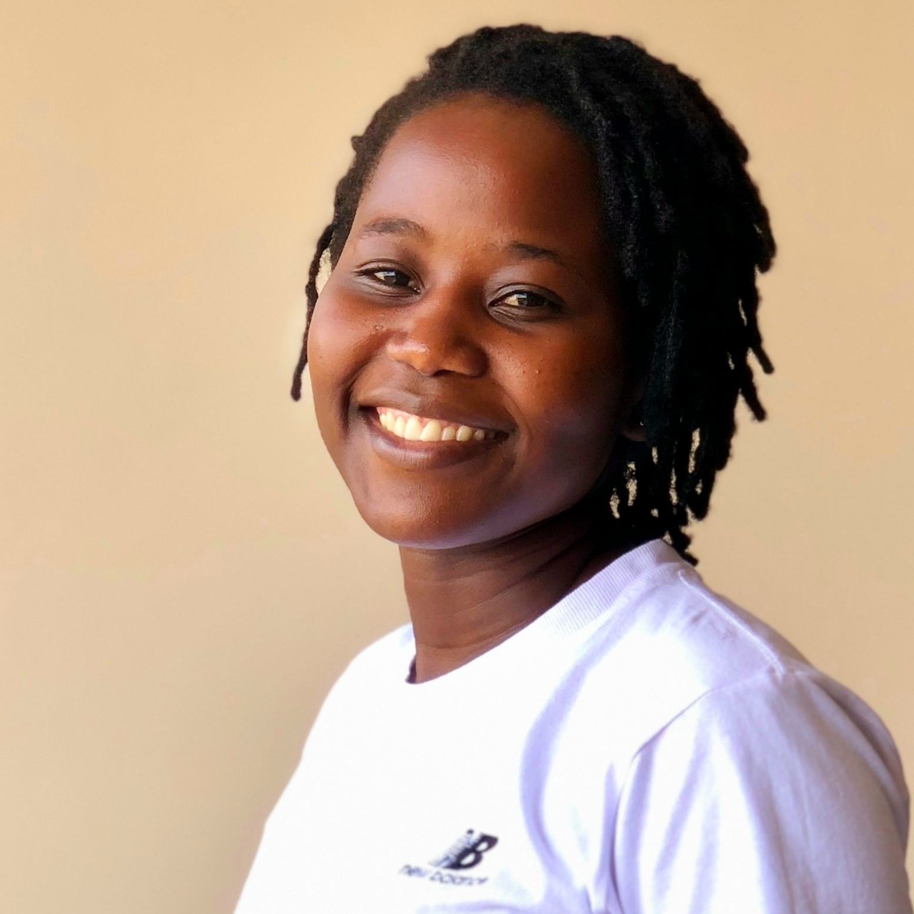
BIO Presenter
Teopista Nakalema, a GIS and remote sensing specialist working with the Food and Agriculture Organization of the United Nations (FAO) providing technical support to the GIS and Mapping Unit of the National Forestry Authority (NFA) of Uganda. She supports the unit in mapping land cover and monitoring forest changes for national and international reporting. Teopista has been part of the core national team on the REDD+ project producing data for measuring forest and forest changes for reporting to the UNFCCC since 2016. Her work encompasses all steps for land cover classifications and forest change assessments – from acquiring satellite data to accuracy assessments and area estimations.
Teopista is Ugandan and holds a Master of Science Degree in Geo-information Science and Earth Observation for Natural Resource Management obtained at ITC University of Twente, The Netherlands, and a Bachelor of Science Degree in Natural Resource Economics from Busitema University, Uganda.
Teopista Nakalema
GIS and Remote Sensing Specialist, FAO
Women in GIS Uganda- Member

Slide 8
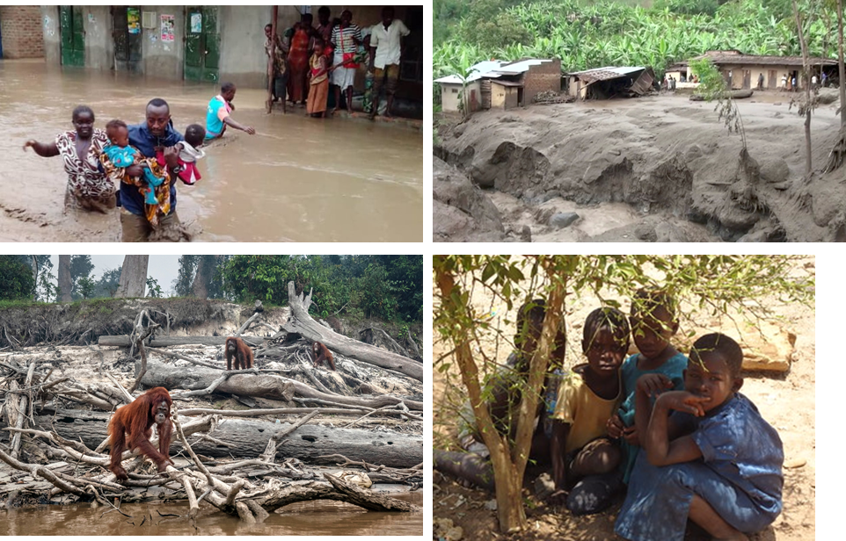
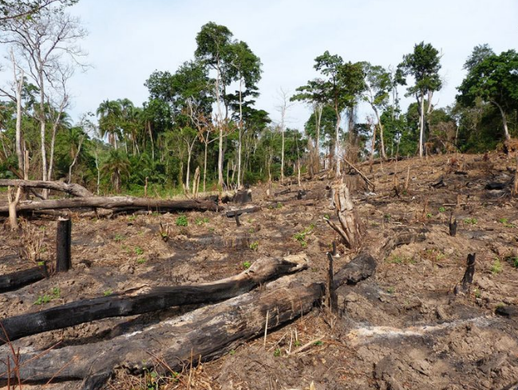
OVERVIEW
Impacts -climate change effects
Deforestation- clear cutting of trees
Drivers -poverty, population growth etc
Notes:
For better informed decisions by policy makers, it is important to map and monitor deforestation. To inform restoration strategies and initiatives in the country

Slide 9
Monitoring deforestation with Earth observation data
Helps to inform policy for better decisions
Ground based monitoring can be done, however, expensive in terms of money and time
Thus, earth observation comes in handy (inexpensive and maps at a larger scale)

Slide 10
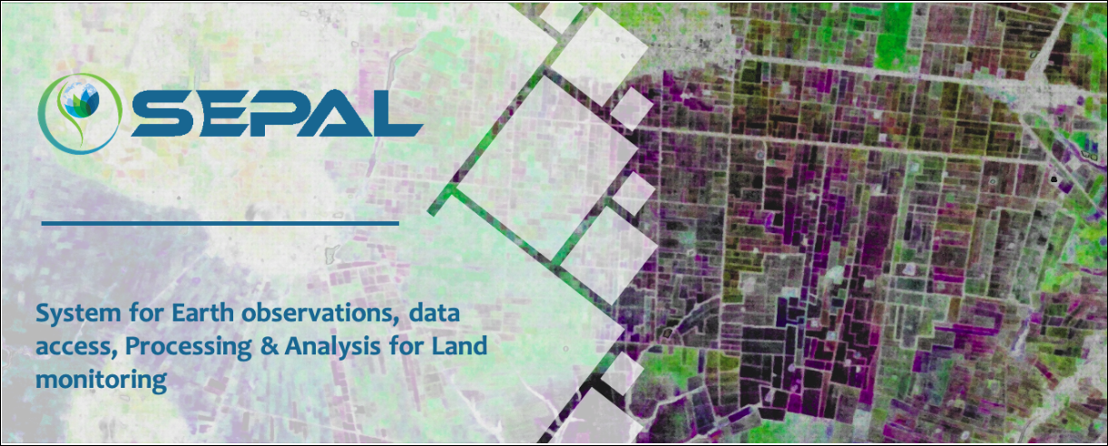
Mapping and monitoring deforestation: Earth observation data and tools
Data
  Landsat
  Sentinel 2
  NICFI Planet
Tools
  Time series analysis – BFAST
https://sepal.io/

Slide 11
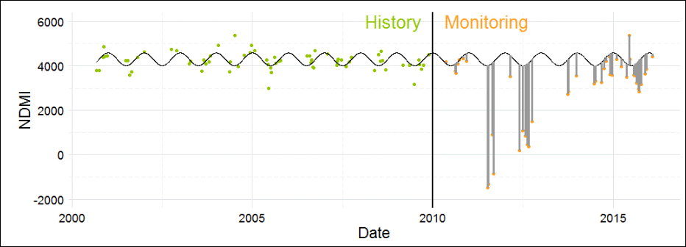
BFAST tool
BFAST (Breaks For Additive Season and Trend), a time series change detection algorithm. It iteratively estimates the time and number of abrupt changes within time series, and characterizes change by its magnitude and direction.

Slide 12
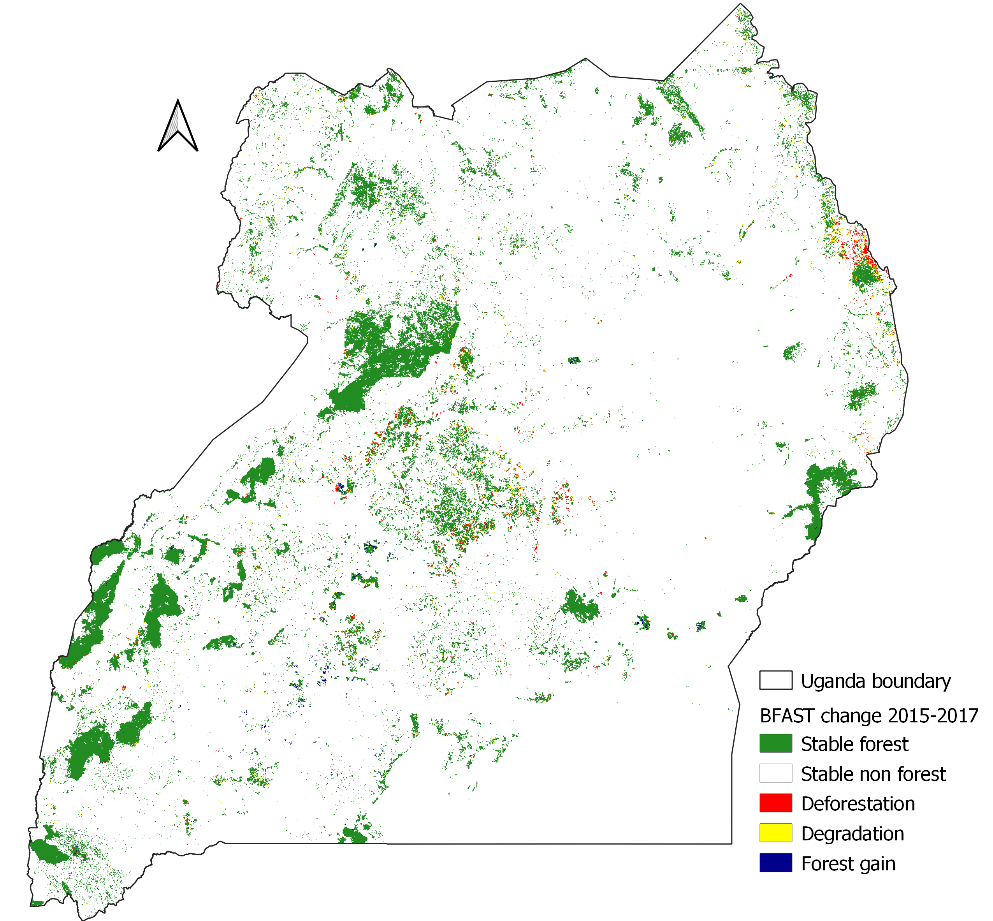
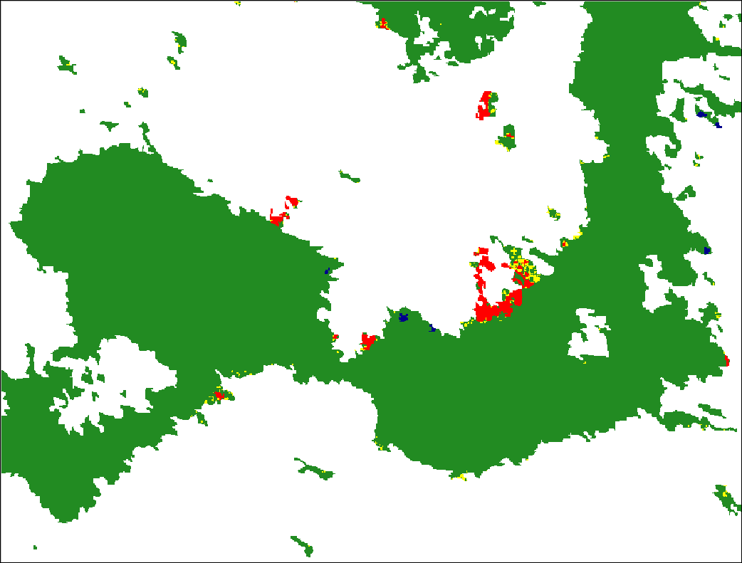
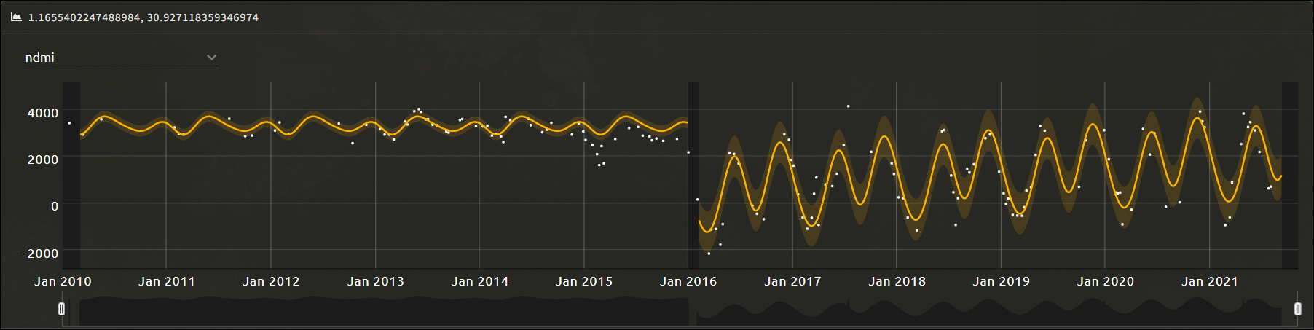
Deforestation mapping in Uganda

Slide 13
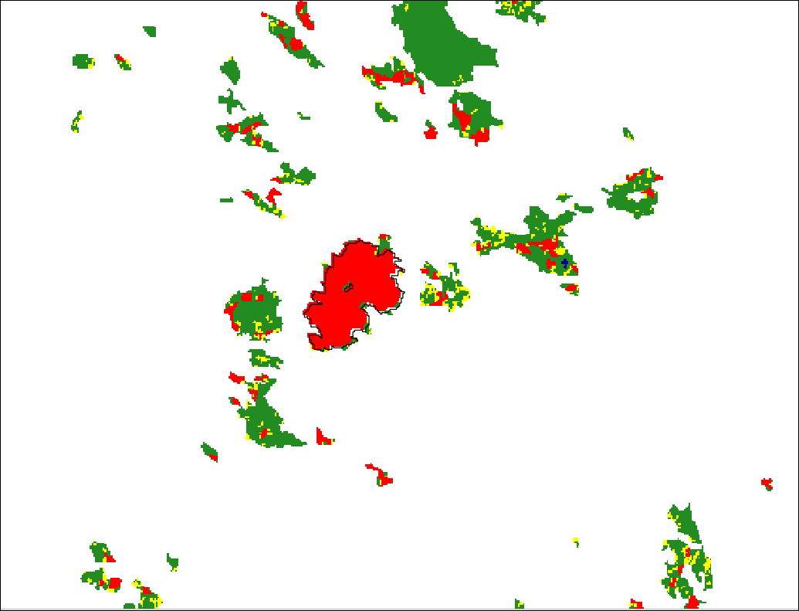
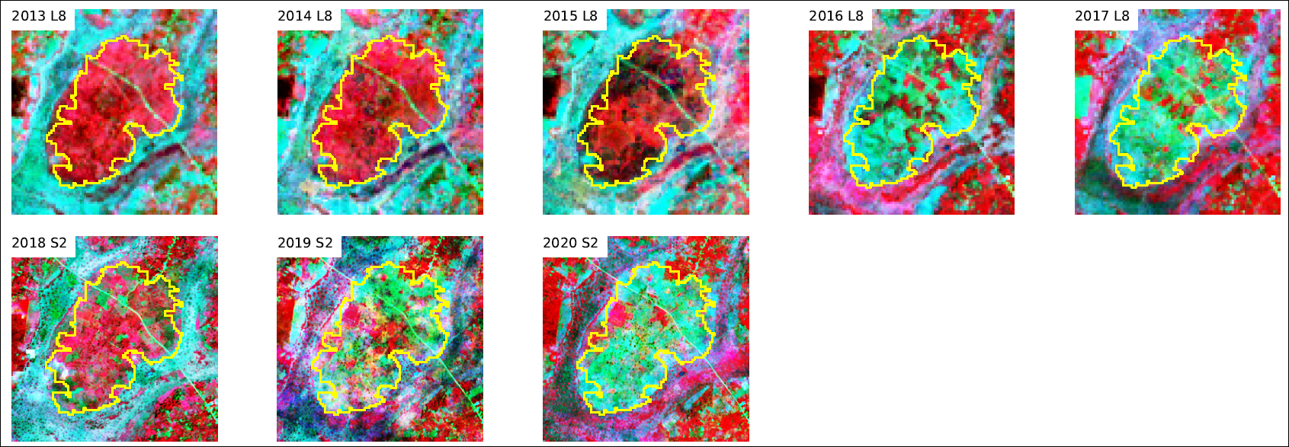

Slide 14
Youth Involvement in Earth observation
Youth involvement in is limited
Limited capacity in the use of EO tools

Slide 15
Future perspectives on Youth Involvement
Build capacity through GEO network
Provide youth networking opportunities for example through Youth track at GEO Week
Exchange visits for learning
More collaboration between GEO and Country governments with a focus on youth inclusion

Slide 16



Thank You!
Teopista Nakalema / 25 November 2021
@teo_Nakalema / teonakalema@gmail.com
#EO4Impact

Slide 17
Youth Track: Africa & Americas Cross-Regional Dialogue
Open Discussion
Moderator: Gilberto Guevara / Puerto Rico Science, Technology & Research Trust – Disaster
24 November 2021

Slide 18
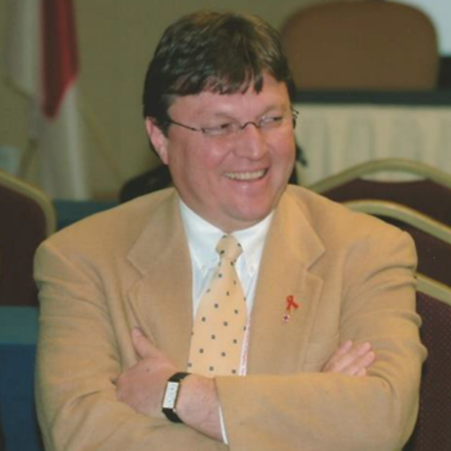
BIO Presenter
Gilberto Guevara is an Entrepreneurship and International Business doctoral candidate at the Interamerican University, in San Juan. He completed his MBA in International Commerce and Finance and a bachelor’s in finance at the University of Puerto Rico, Rio Piedras.
His entire career has been managing and leading multidisciplinary and multinational Emergency Response teams of Expats in the Americas and Asia. Worked for over 30 years in Emergency Management deploying multimillion dollar relief, recovery, and reconstruction projects in three continents.
In Turkey he led the Earthquake Research Information Center for Humanitarian Assistance (ERICHA) disbursing $62 million dollars to 12 universities to develop earthquake prevention and educational materials in alliance with the Turkish National Science Foundation and the Turkish Red Crescent.
Gilberto Guevara
Puerto Rico Science, Technology & Research Trust – Disaster

Slide 19
Youth Track: Africa & Americas Cross-Regional Dialogue
Agriculture and EO
A Southern Perspective
Liliana Castillo Villamor / Aberystwyth University
24 November 2021

Slide 20
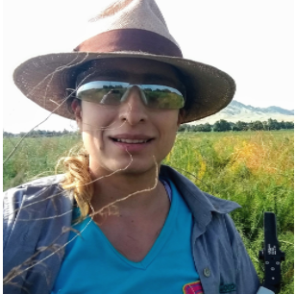
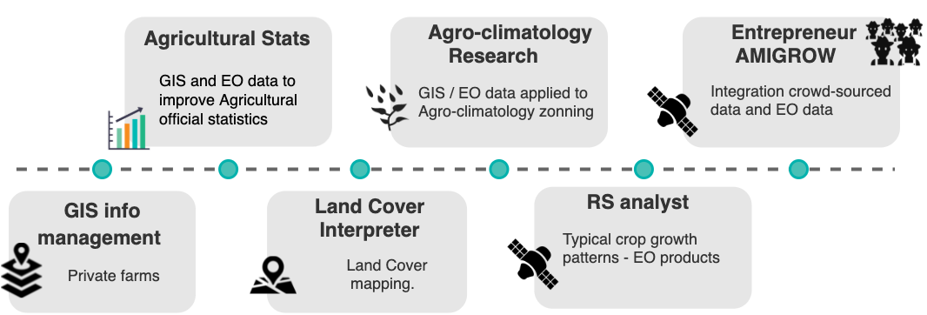
MSc in Geoinformation Science and Earth Observation - Lund University / University of Twente.
Agricultural Engineering - Universidad Nacional de Colombia.
Liliana Castillo Villamor
PhD Candidate Geography
Aberystwyth University

Slide 21

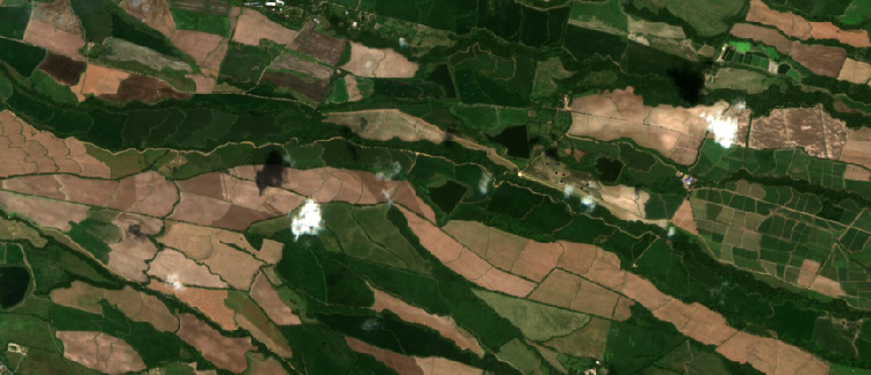
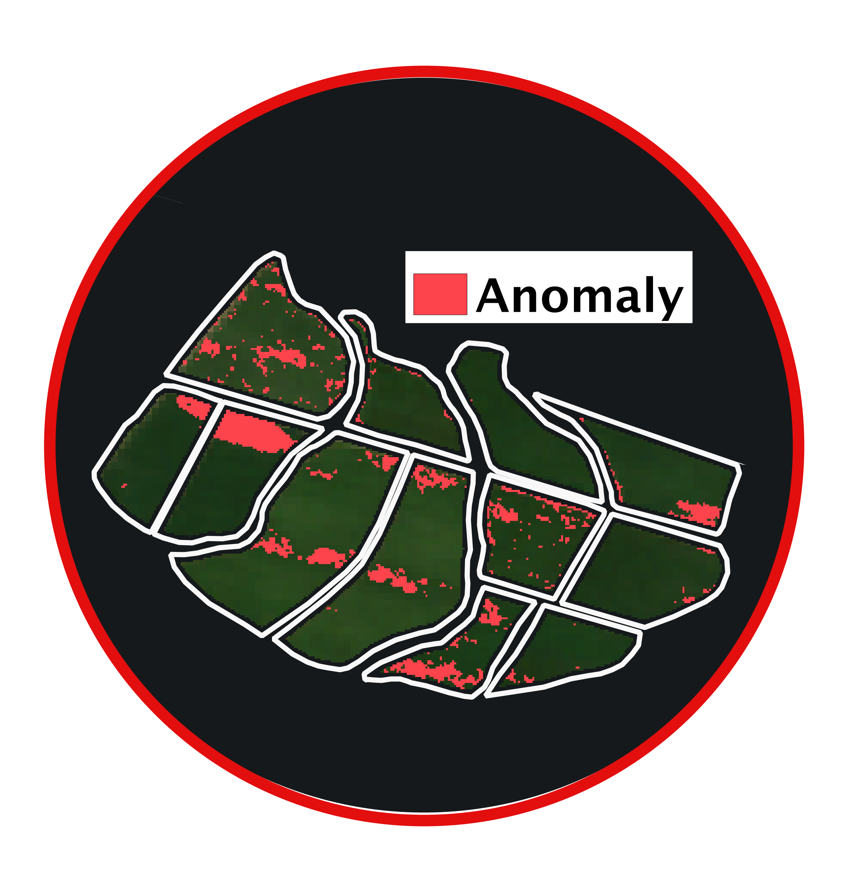

Simple and transferable in-field anomaly detection

Slide 22
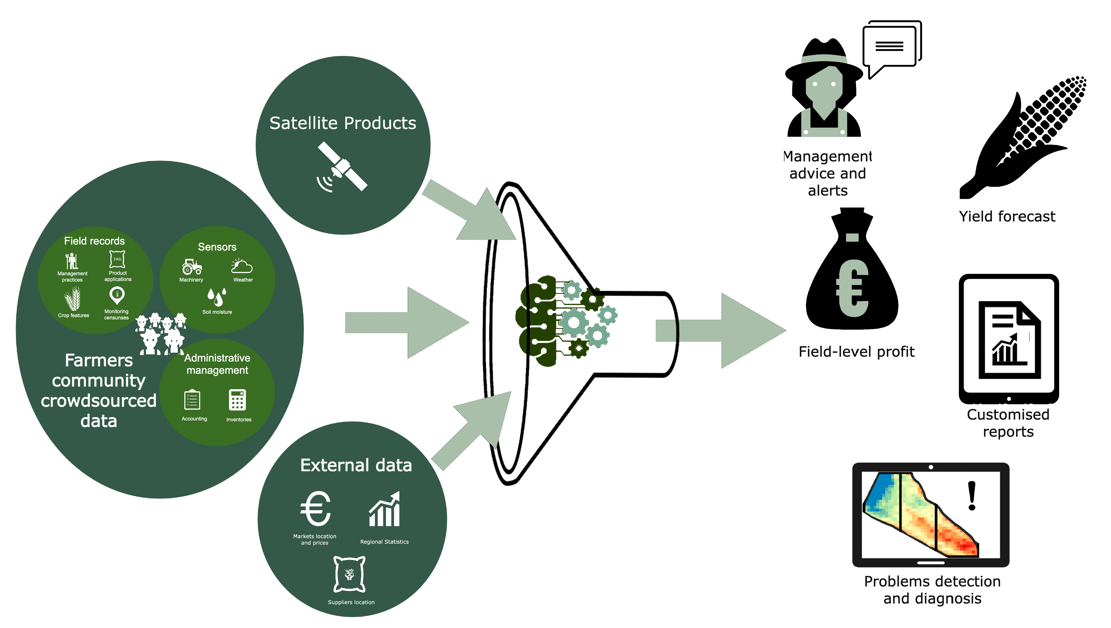
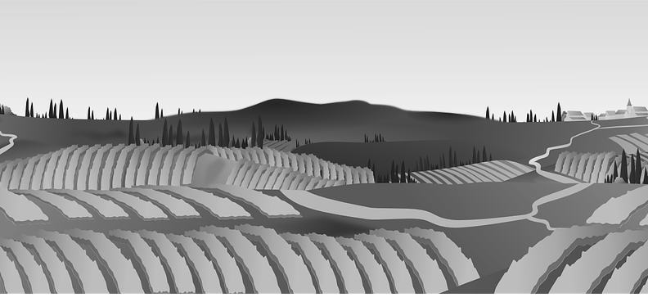


Slide 23

Towards a GEO Youth CoP
GEO Agriculture Monitoring (Ag CoP)
Energy
GEO Biodiversity Observation Network (GEOBON)
Coastal Zone (CZCP)

Slide 24
Thank You!
Liliana Castillo Villamor / 24 November 2021
@lccastillov / lic42@aber.ac.uk
#EO4Impact

Slide 25
Youth Track: Africa & Americas Cross-Regional Dialogue
Engaging Youth in Latin America
Amber Kremer/USGS
Wednesday, November 24th, 2021

Slide 26
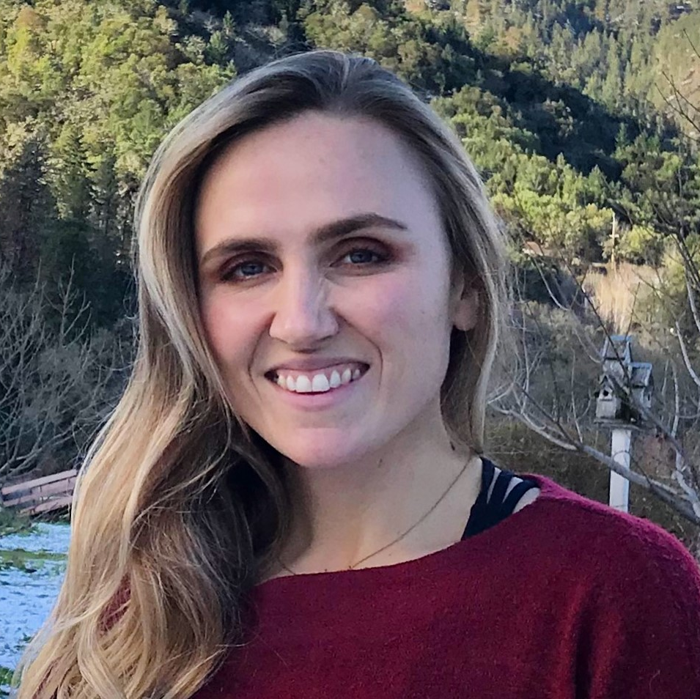
BIO
Amber has a BS in Fisheries and Wildlife Science and is currently finishing her Masters degree in Natural Resources from Oregon State University, with a focus on tropical forest conservation. She also works as a Research Assistant for OSU in forest monitoring projects in Cambodia.
She lives in Cusco, Peru and works remotely as a Contractor for USGS in the Office of International Programs. In her current position, she enjoys working with variety of groups in the Americas, especially in capacity development projects.
Amber Kremer
Contractor – International Programs
USGS
Notes:
Contractor - International Programs
Capacity building efforts in the Americas
Engaging students and young people in the Americas in geospatial science and applications.
Two parts: Mapathon and GEOPathways Peru

Slide 27
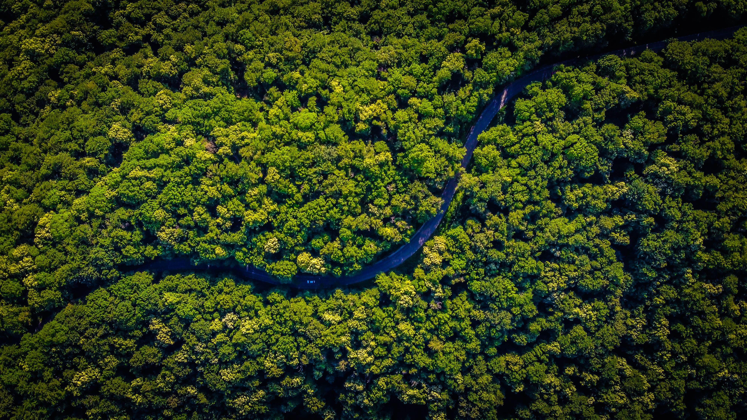
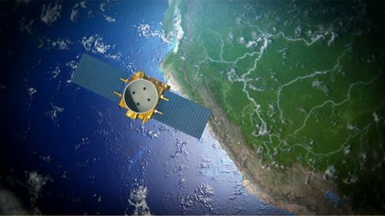
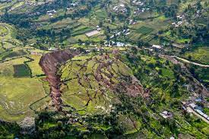
Mapathon Perú 2021
Objectives:
Commemoration of Peru’s Bicentennial celebration
Inform public on the potential of PeruSAT-1 for monitoring in DRR and environmental applications
Bring together the academic, scientific and decision-making communities across Peru and the Americas
Map vulnerable areas in Peru
Notes:
Student project lead for our US GeoPathways team in the planning and execution of the Mapathon Peru 2021 event, with the guidance of our GEOPathways leadership, in collaboration with CONIDA and various other governmental agencies in Peru (planning and organization, communications with sponsors and registrants, construction of informational sites, dashboards and other tools in the execution of the event)
Commemoration of Peru’s Bicentennial celebration
Inform public on the potential of PeruSAT-1 for monitoring in DRR and environmental applications (70-cm resolution)
Bring together the academic, scientific, and decision-making communities across Peru and the Americas
Map vulnerable areas in Peru, specifically in the Piura and Rimac watersheds, using PeruSAT-1 imagery

Slide 28
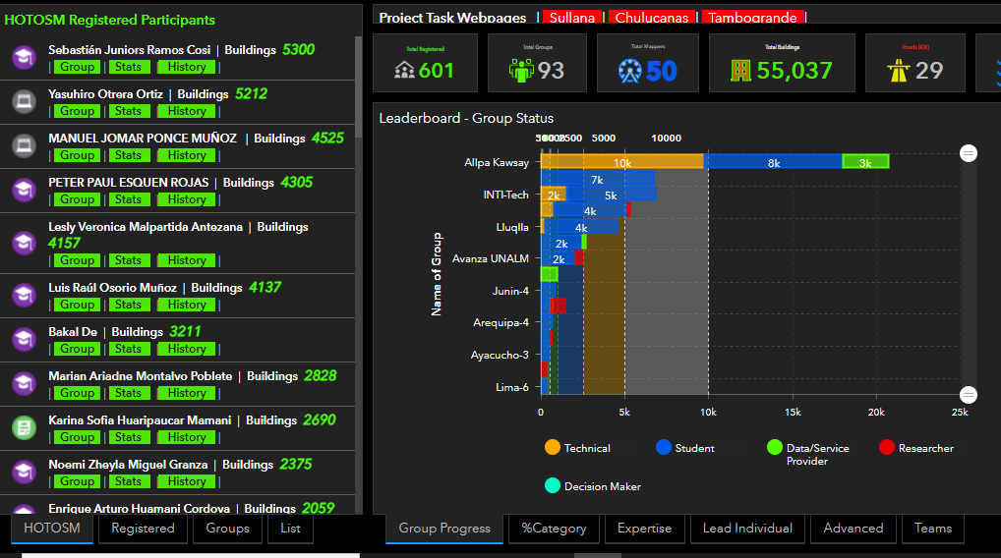
Mapathon Perú 2021
In numbers:
Sponsorship by 12 private and public organizations in the Americas
601 registrants from 5 countries
Five days of mapping
55,037 buildings mapped
7 Dashboards created
23 students selected to participate in GeoPathways Program
Notes:
Sponsorship by 12 private and public organizations in the Americas
601 registrants from five countries (USA, Peru, Colombia, Venezuela, Ecuador)
Five days of mapping; individuals and teams rallied together and supported one another; working enthusiastically, day and night, watching each other’s progress via dashboard
55,037 buildings mapped
7 Dashboards created (category of participants for automation of processes related to disaster response and management)
23 students selected to participate in GeoPathways Program

Slide 29
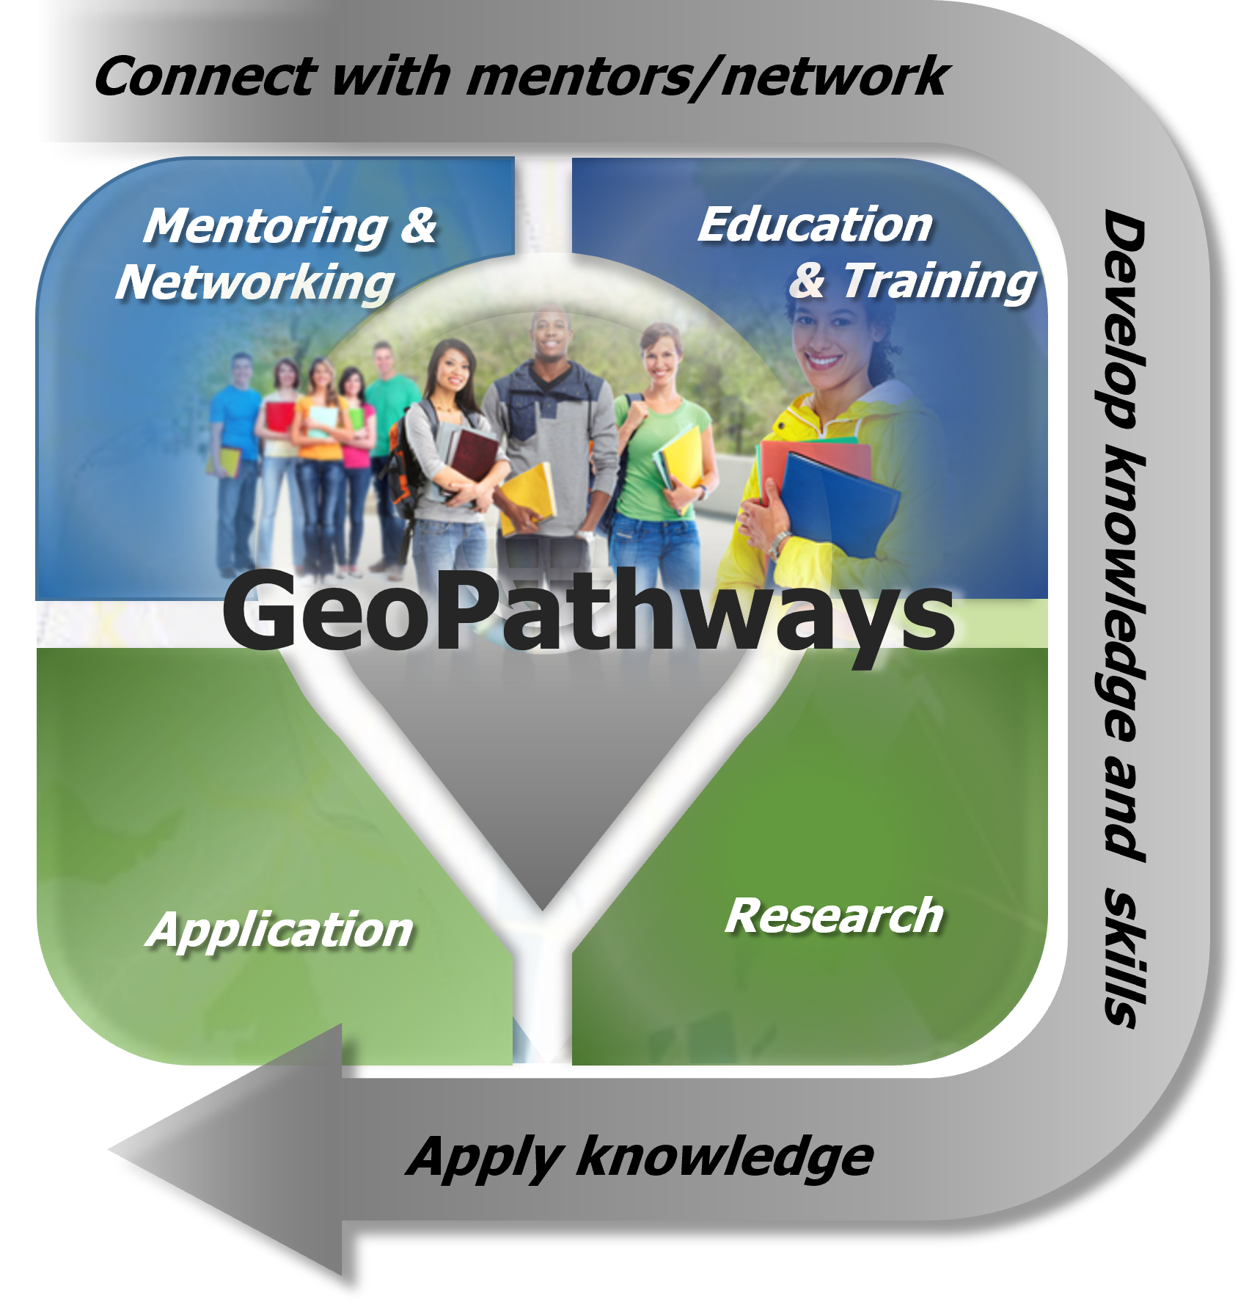
GEOPathways Perú
Connect participants with professionals in their area of interest
Develop knowledge and skills in the use of geographic information
Conduct research using geospatial data and technologies.
Apply knowledge in “real world” projects
Notes:
As a result of the Mapathon, AmeriGEO and CONIDA invited the members of the three top teams for each category to participate in the GEOPathways Peru program.
The Geopathways program began with the Federal Geographic Data Committee as an initiative to develop the next generation of geospatial professionals with the objectives to:
Connect participants with professionals in their area of interest
Develop knowledge and skills in the use of geographic information
Conduct research using geospatial data and technologies with the guidance of Geopathways leaders.
Apply knowledge in “real world”, student-led projects with the support of GEOPathways leaders and collaborators.

Slide 30
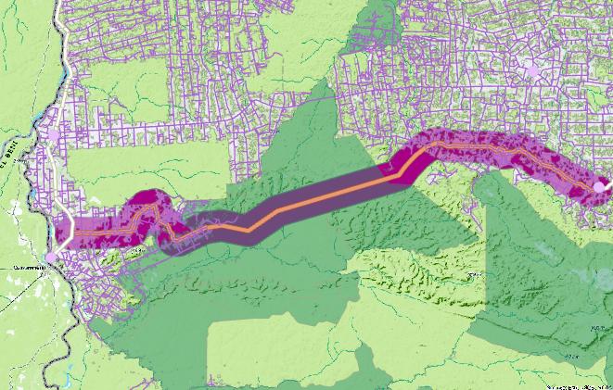
GEOPathways Perú
How it’s going:
Student-led courses in GIS and imagery analysis
Student project development in vulnerability assessments for University internship credits
Working groups and collaborations with government agencies in Peru
Notes:
The Mapathon Peru 2021 event concluded in July, and since then, we’ve met regularly with the GEOPathways Peru group, along with our US based and Peru-based mentors. During these meetings:
Student-led courses in GIS and imagery analysis
Open conversations on remote sensing and GIS applications and technologies
Student project development in vulnerability assessments for University internship credits
Working with government agencies in Peru to initiate project working groups where students can work collaboratively with professionals in projects and get a sense of how the skills their skills and knowledge can be applied in “real world” scenarios.

Slide 31
Looking Forward
Continued development and expansion of GeoPathways Program
Future community-building events across the Americas
Student leadership in future initiatives
Notes:
Summary and final thoughts:
Extremely gratifying experience to be involved in this process and to be able to work with these students regularly, and we are always learning and evolving in attempts to make the program even better. I hope this experience might one day serve as a blueprint for other GEOPathways programs and capacity development projects in the Americas and beyond, supporting the development of our next generation of scientists and geospatial professionals, as well as bring together the community.

Slide 32
Thank You!
Amber Kremer / November 24th, 2021
LinkedIn: Amber Kremer
Email: amber.m.Kremer@outlook.com
#EO4Impact
Notes:
Summary and final thoughts:
Extremely gratifying experience to be involved in this process and to be able to work with these students regularly, and we are always learning and evolving in attempts to make the program even better. I hope this experience might one day serve as a blueprint for other GEOPathways programs and capacity development projects in the Americas and beyond, supporting the development of our next generation of scientists and geospatial professionals, as well as bring together the community.

Slide 33
GEO Week 2021 Youth Track
CERES – A CITIZEN SCIENCE APPROACH MONITORING RESERVOIR OPERATION FROM SPACE FOR POORLY GAUGED RESERVOIRS
Tien L.T. Du¹, Hyongki Lee¹, Duong D. Bui², Son K. Do¹, Hoa T.P. Nguyen³, Thao P. Bui^{4,} Nuong T. Bui⁵
Presenter: Son Do/ University of Houston
[24th] November 2021
¹Department of Civil and Environmental Engineering, University of Houston, Houston, TX, USA
²National Center for Water Resources Planning and Investigation, Ministry of Natural Resources and Environment, Hanoi, Vietnam
³Department of Water Resources Management, Ministry of Natural Resources and Environment, Hanoi, Vietnam
⁴Kyoto University, Japan
⁵Hanoi University of Natural Resources and Environment, Hanoi, Vietnam

Slide 34
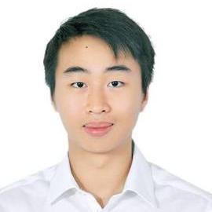
BIO
First-year Master student in Geosensing Systems Engineering and Sciences Program from the University of Houston.
Research interest: flood and reservoir forecasting
Son Do
Graduate Researcher
Department of Civil & Environmental Engineering University of Houston

Slide 35
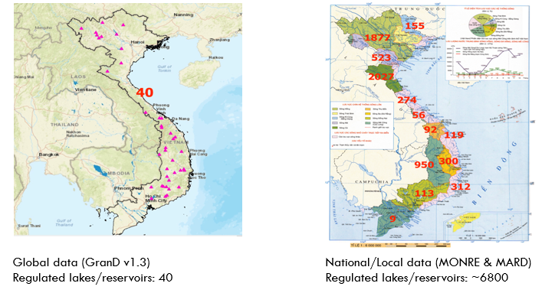
Problems
Discrepancy in number of recorded reservoirs between global and local data
Overlapping management responsibilities, lack of incentives, and technical barriers that limit data sharing

Slide 36
Motivations
Create an opportunity for two-way interaction between scientists and citizen scientists:
  (i). Allow citizen scientists to generate reservoir properties and monitor reservoir operation without relying and sharing data with scientists.
  (ii). If possible, citizen scientists could share the data or performance of CERES so developers can further improve algorithms.
  (iii). Bring science closer and more accessible to a wider range of users by visualizing science results through web apps and data visualization

Slide 37
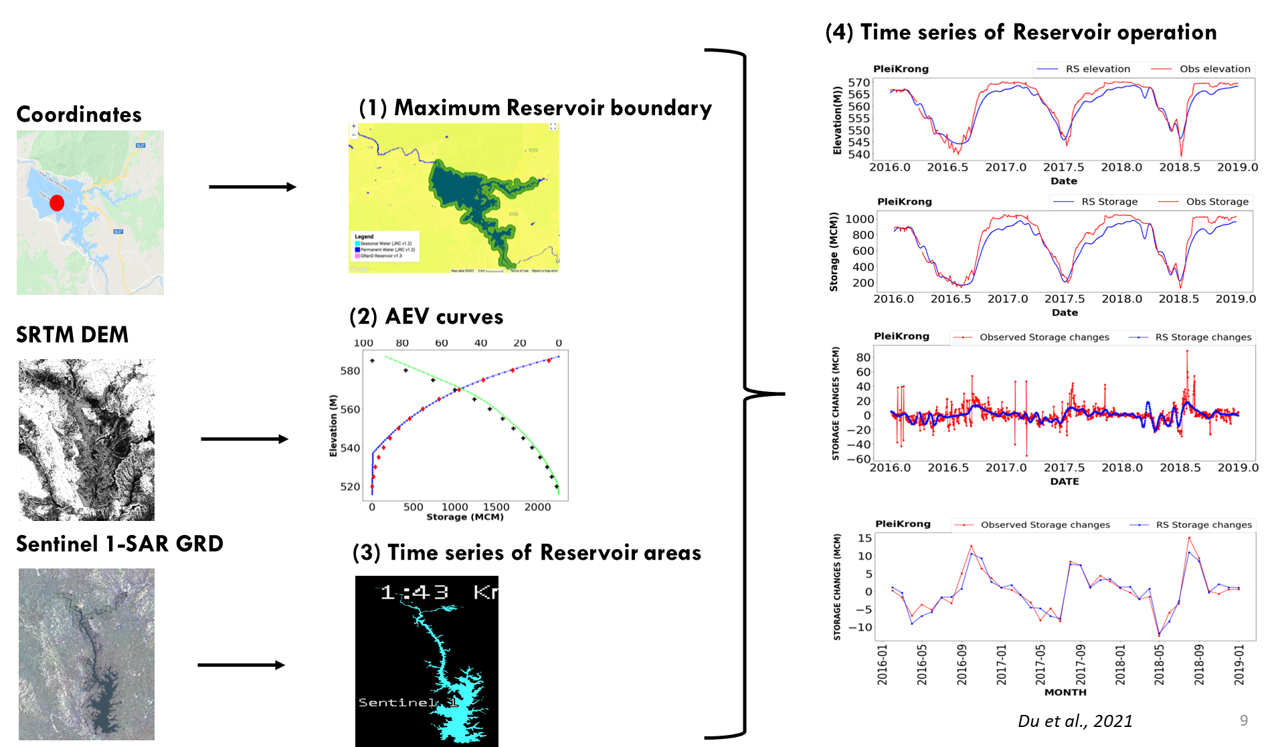
Methodology

Slide 38
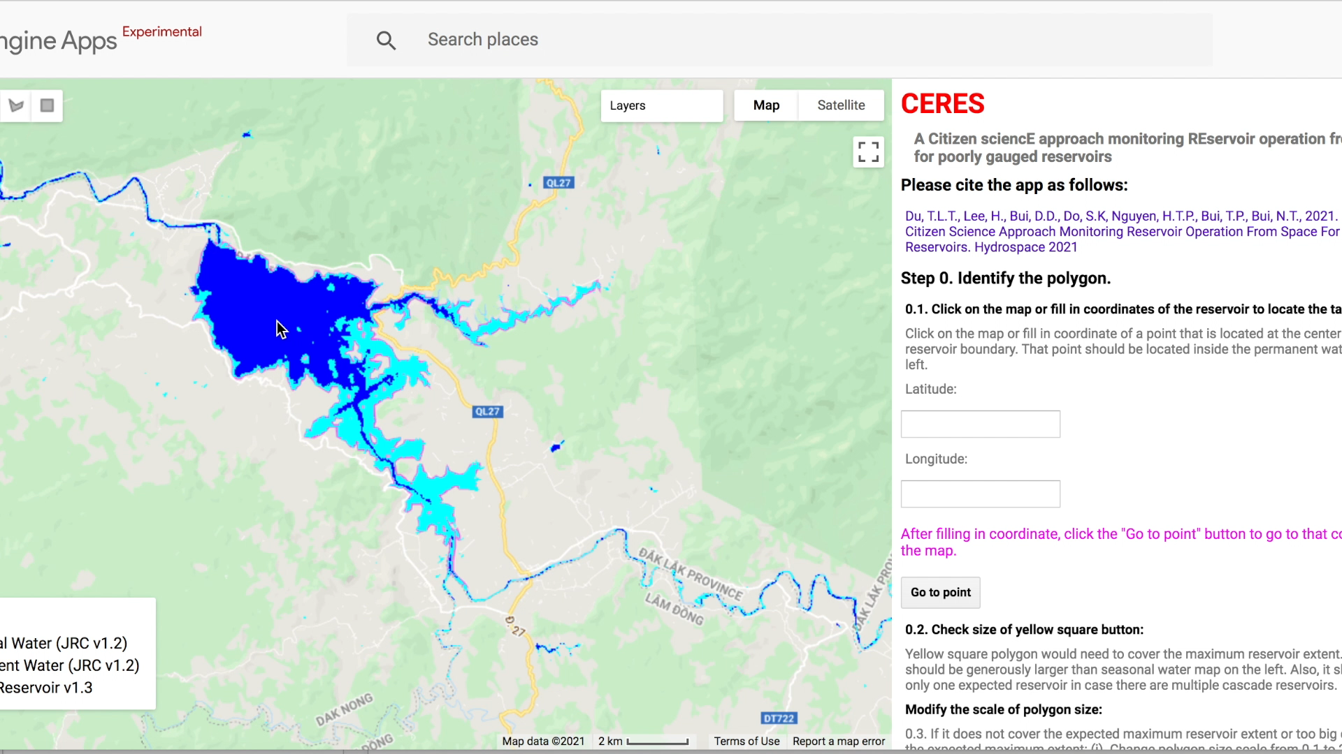
CERES Web-app
https://tienltdu.users.earthengine.app/view/uhceres

Slide 39
Discussion & GEO Role
Attract wider range of users and younger generation by visualizing science results through interactive web apps and innovative data visualization
GEO as platform to network and showcase the products to promote collaboration and high-impact works within the community.
Notes:
Since I only have 5 minutes, I don’t want to go too in-depth into the app but anyone is welcome to try them out for their region of interest and if you guys have any other question about the app, my email is listed here. So I want to use this app as an example of how we can make science more accessible to a wider range of users by visualizing science results through interactive web apps and innovative data visualization. Nowadays, you don’t have to be a full-stack developer or a front-end engineer to make an interactive web application so these kind of visualization tool is definitely not difficult to make, will do wonder in attracting wider audience appeal more to younger generation scientist or policymaker
And, to truly make an impact with their scientific findings, scientists need a platform to easily reach out and showcase the visualization and web app of their research finding and events like GEO Week from international and cross-platform organization like GEO is definitely a great place to do that. As a scientist, I want my finding to be high-impact and used by people who truly benefit from it daily, I believe GEO can host the platform and connect policymaker and end users to scientist so we can showcase new research findings and spark a discussion of how these findings can be applied in real-world situation.

Slide 40
Thank You!
Son Do / Nov 24th , 2021
skdo3@cougarnet.uh.edu
#EO4Impact

Slide 41
Additional slides

Slide 42
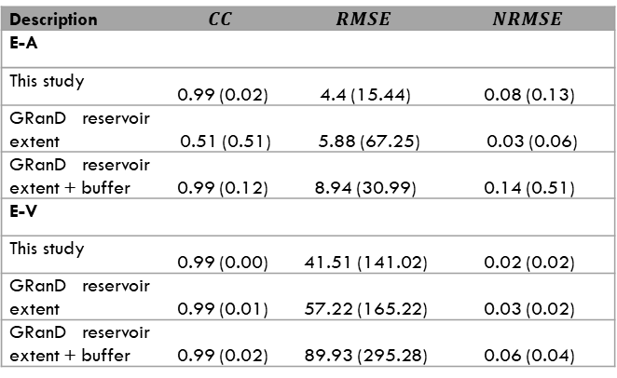
Description | $$CC$$ | $$RMSE$$ | $$NRMSE$$
E-A
This study | 0.99 (0.02) | 4.4 (15.44) | 0.08 (0.13)
GRanD reservoir extent | 0.51 (0.51) | 5.88 (67.25) | 0.03 (0.06)
GRanD reservoir extent + buffer | 0.99 (0.12) | 8.94 (30.99) | 0.14 (0.51)
E-V
This study | 0.99 (0.00) | 41.51 (141.02) | 0.02 (0.02)
GRanD reservoir extent | 0.99 (0.01) | 57.22 (165.22) | 0.03 (0.02)
GRanD reservoir extent + buffer | 0.99 (0.02) | 89.93 (295.28) | 0.06 (0.04)
Du et al., 2021
Notes:
For AEV, which is area-elevation-volume curves, we found that our approach extracting the maximum extent of water occurrence of reservoir boundary can well estimate AEV compared with the the current GRAND reservoir boundary database originally or the GRAND reservoir boundary database plus the buffering distance.
The reason is because GRAND polygon can miss the maximum state of reservoir operation whereas the buffering distance might be too small or too large compared to the actual maximum surface area of reservoir.
If you can see from the figures on the left, the bright green of elevation-area from our approach had closer agreement with observed data (black line) compared to blue and pink lines.

Slide 43
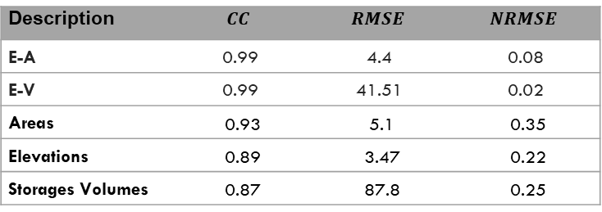
Description | $$CC$$ | $$RMSE$$ | $$NRMSE$$
E-A | 0.99 | 4.4 | 0.08
E-V | 0.99 | 41.51 | 0.02
Areas | 0.93 | 5.1 | 0.35
Elevations | 0.89 | 3.47 | 0.22
Storages Volumes | 0.87 | 87.8 | 0.25
Need easy-to-use application to support both scientists and practitioners to monitor reservoir operation at poorly gauged region.
Du et al., 2021
Notes:
Validating the reservoir operation (time series of reservoir elevation, areas and storage volumes), the app can also competently estimate time series of reservoir operation compared to observed data with high correlation and low errors.
However, for run of river reservoirs that have large storage changes within a day, with the current low temporal sampling of freely available remote sensing imagery, the app will have limited accuracy for operation of this type of reservoirs. But it has good estimates for within-year and over-year reservoirs that have longer variations within a year or over a year.
So far we saw that there are several steps to get the final product, we find that it is more practical to have easy-to-use application to support both scientists and practitioners to monitor reservoir operation across boundaries.

Slide 44
Youth Track Day 2
Applications and Development of the GEOGloWS ECMWF Streamflow Services
Alma Meyer and Kailey Mohamed
Brigham Young University Hydroinformatics Lab
24 November 2021

Slide 45
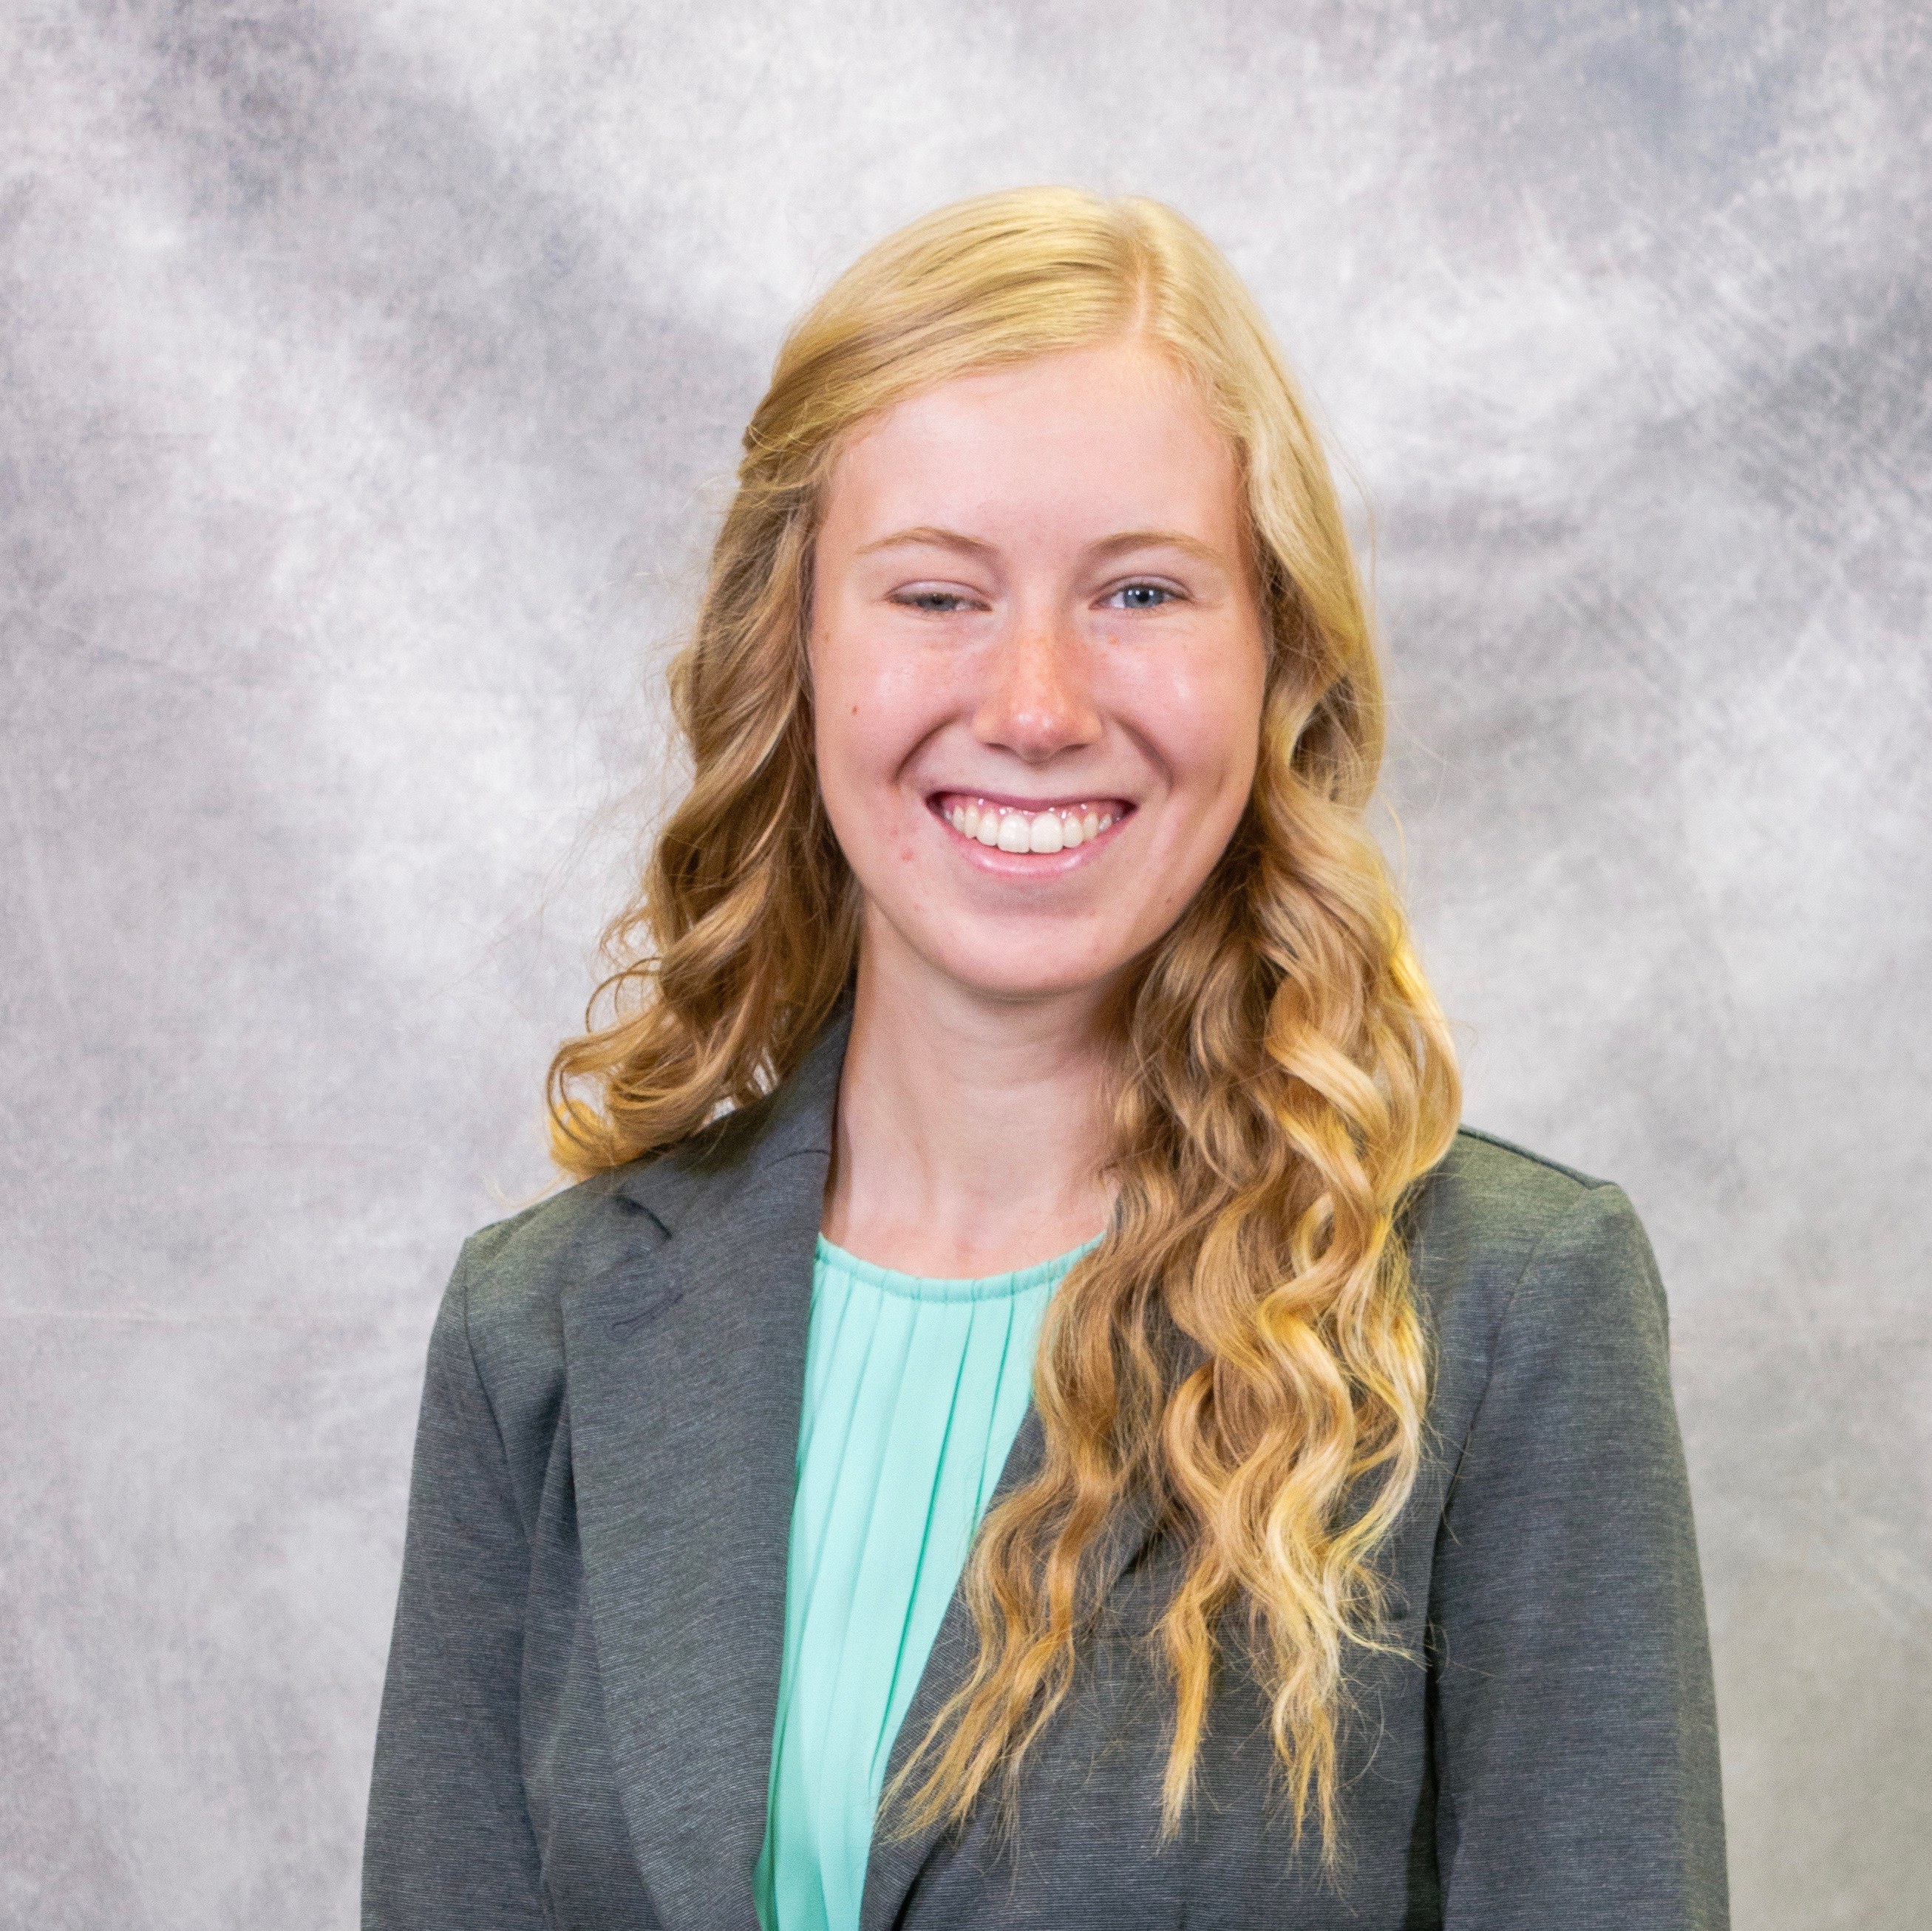
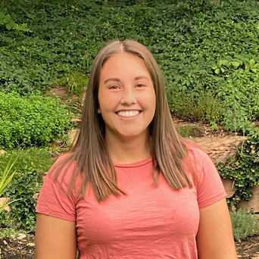
BIO Presenter
Alma Meyer
  Spokane, WA
  BS, Civil Engineering, 2021
  GEOGloWS Streamflow Services Validation and Application
Kailey Mohamed
  Seattle, WA
  BS, Civil Engineering, 2023
  Flood mapping
Alma Meyer
Kailey Mohamed

Slide 46
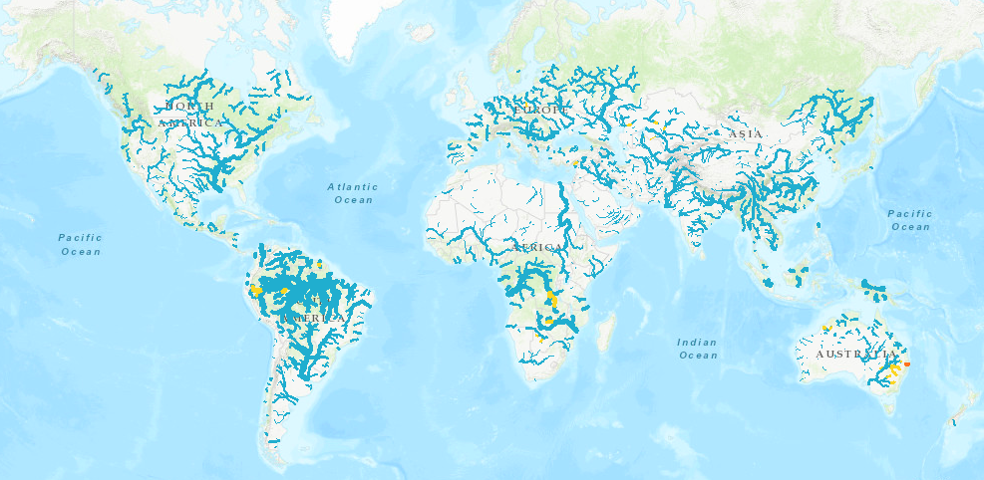
GEOGloWS ECMWF Streamflow Services
Notes:
The GEOGloWS ECMWF

Slide 47
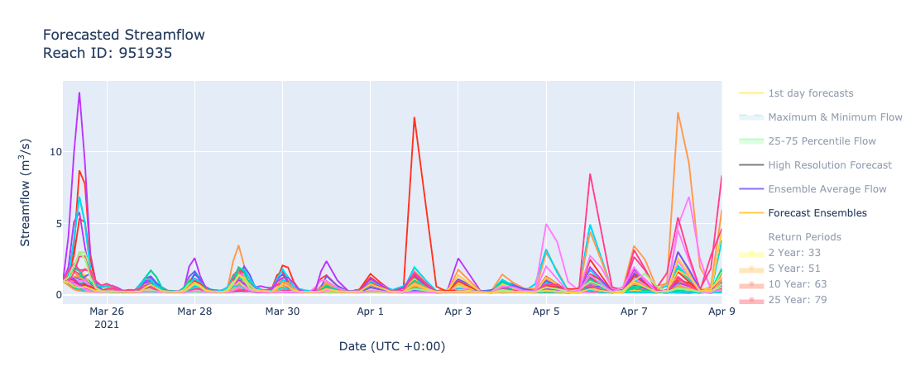
GEOGloWS ECMWF Streamflow Services

Slide 48
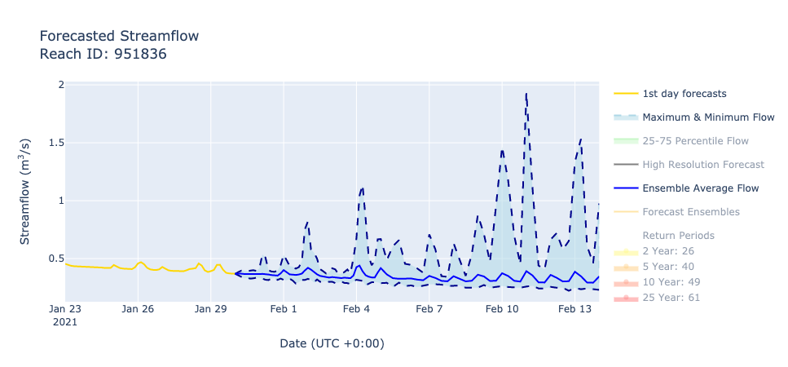
GEOGloWS ECMWF Streamflow Services

Slide 49
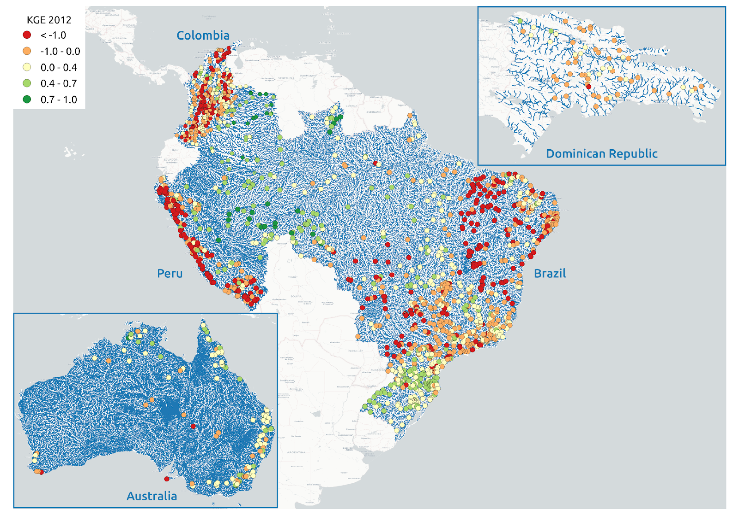

Slide 50
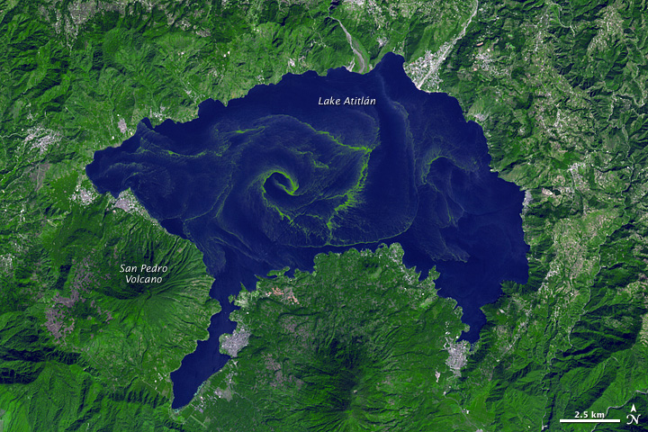
Lake Atitlán, Guatemala
Image taken by NASA’s Terra Satellite, November 22, 2009. earthobservatory.nasa.gov

Slide 51
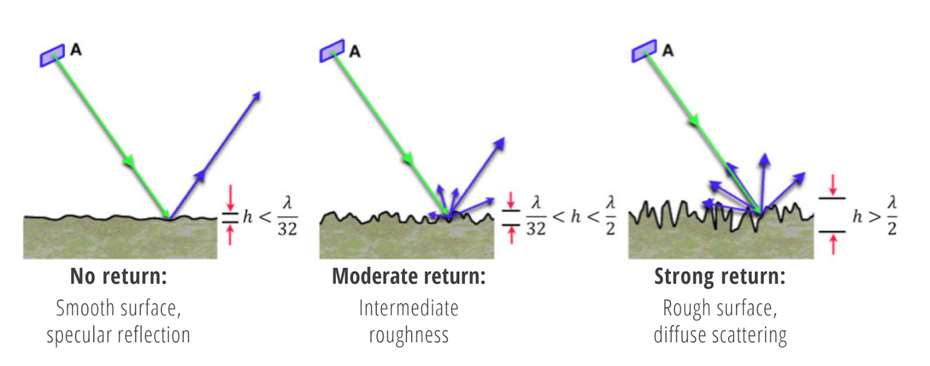
SAR Images
Synthetic Aperture Radar (SAR) is a type of active remote sensing that is available in all weather conditions
SAR measures the amount of energy returned to the sensor (backscatter)

Slide 52
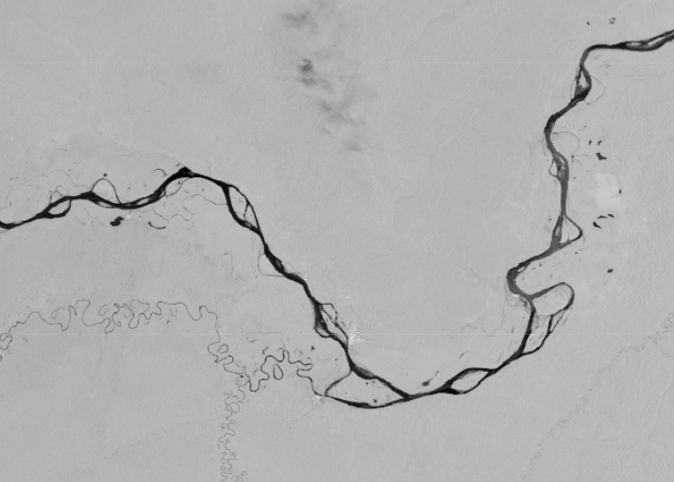
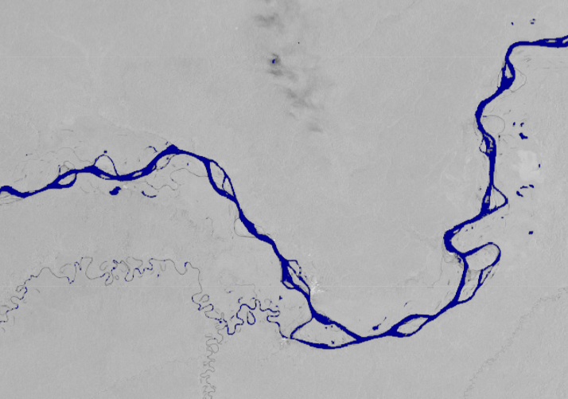
Surface Water Mapping

Slide 53
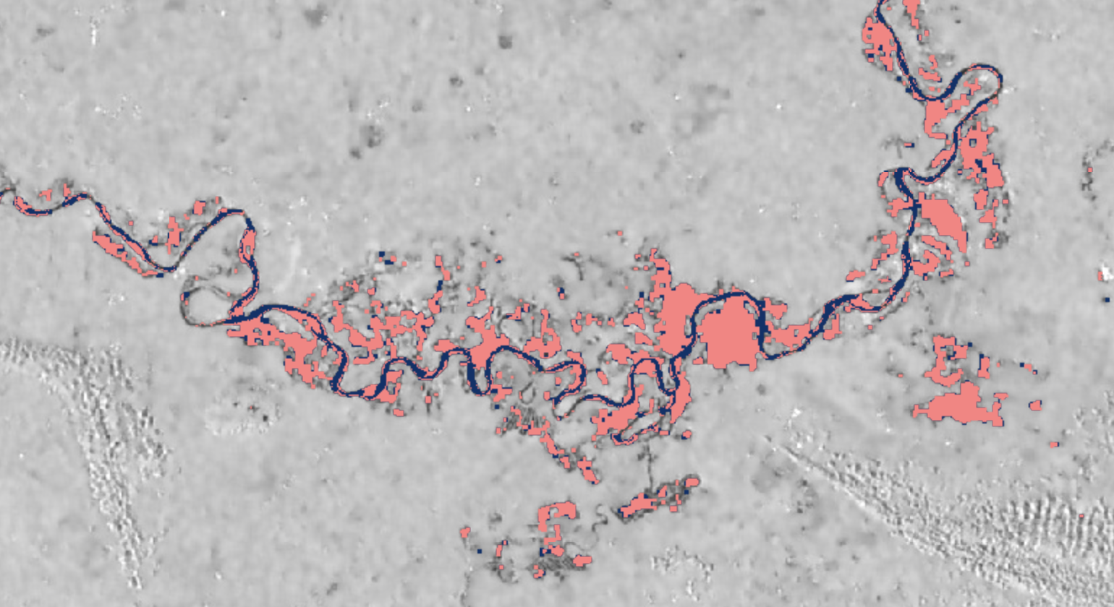
Flood Mapping

Slide 54
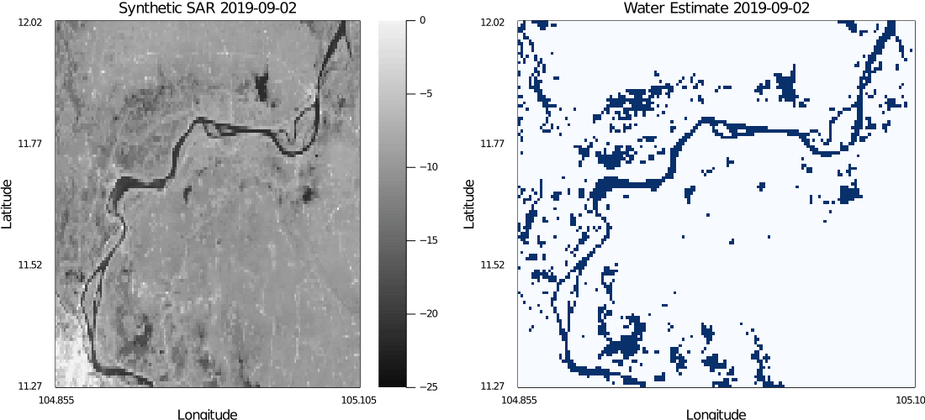
Prediction and Impact

Slide 55

Involving Youth in GEO
Connect with other professionals
Be involved in solutions
Help the world prepare better for natural disasters

Slide 56
Thank You!
Alma Meyer and Kailey Mohamed
24 November 2021
#EO4Impact

Slide 57
Youth Track: Africa & Americas Cross-Regional Dialogue
Open Discussion
Moderator: Delali Kemeh/ GEO Secretariat
24 November 2021

Slide 58
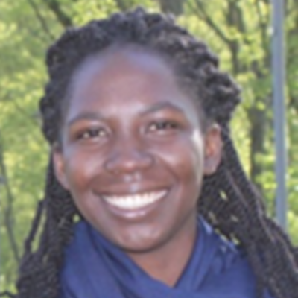
Delali is the Disaster Risk Reduction (DRR) Consultant at the GEO Secretariat’s (DRR). Since joining the secretariat on 1st May 2021, her primary responsibility has been to assist with targeted tasks around GEO’s DRR engagement priority and the GEO DRR Working Group.
Delali brings to the GEO secretariat, her working experience with multiple international development agencies such as the United Nations Office for Disaster Risk Reduction (UNDRR), the United Nations Educational, Scientific and Cultural Organization (UNESCO), and the German development agency (GIZ) on pragmatic approaches in reducing climate exacerbated disaster risks. She has a joint masters in Environmental Risk and Human Security from the United Nations University - Institute of Environment and Human Security and the University of Bonn, Germany.
Delali is also passionate about meaningful youth engagement in DRR and so has been meaningfully involved in intergovernmental processes on DRR at the African Union level. Her participation has been pivotal to formation of the Africa Youth Advisory Board on Disaster Risk Reduction (AYAB DRR) of which she is its current chairperson. AYAB is the first board established under the AUC to meaningful engage youth in DRR
Delali Kemeh
DRR Consultant
GEO Secretariat

