Slide 1
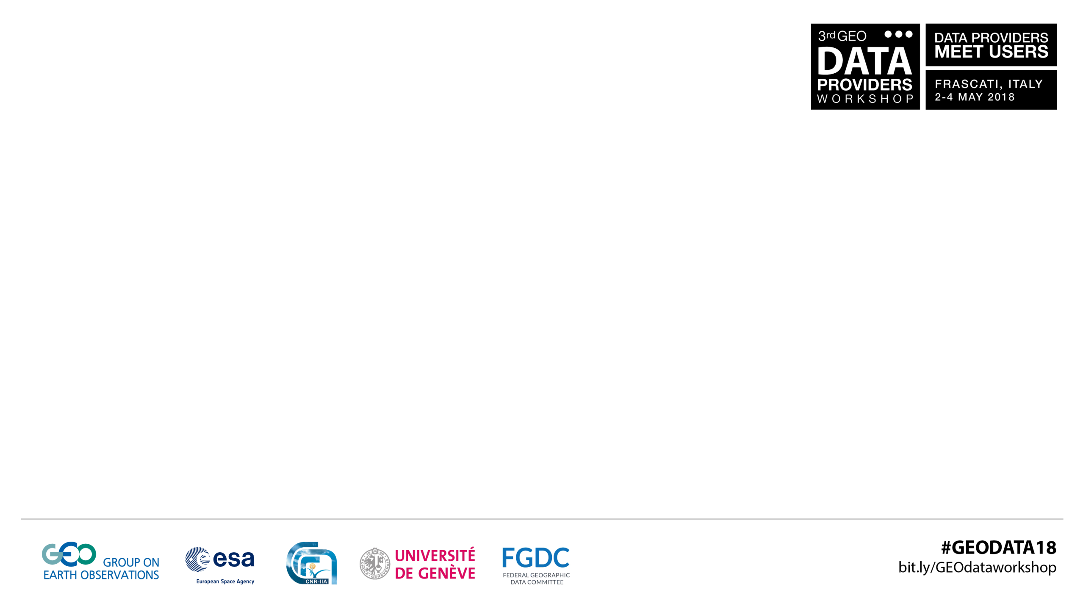
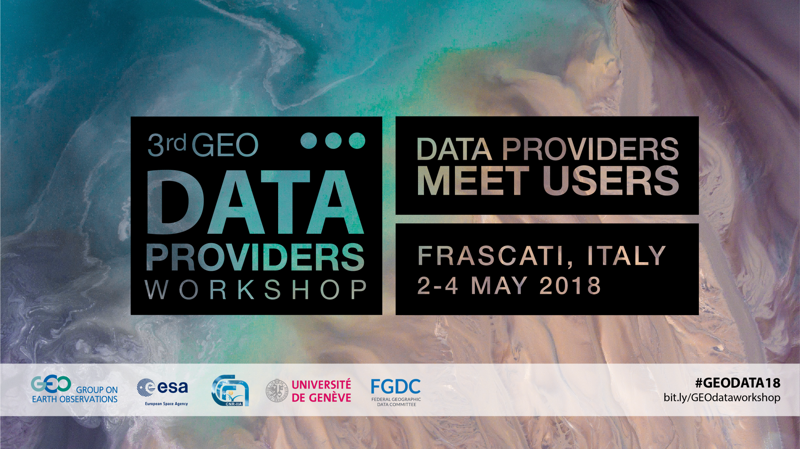

Slide 2










GEOSS Platform Journey: story 1
The GEOSS Platform Journey
GEOSS Mirror
GEOSS View
GEOSS Like
GEOSS
Status Checker
GEOSS Yellow
Pages
GEOSS Widget
GEOSS Platform Operations team
GEOSS API
Notes:
High-level overview

Slide 3





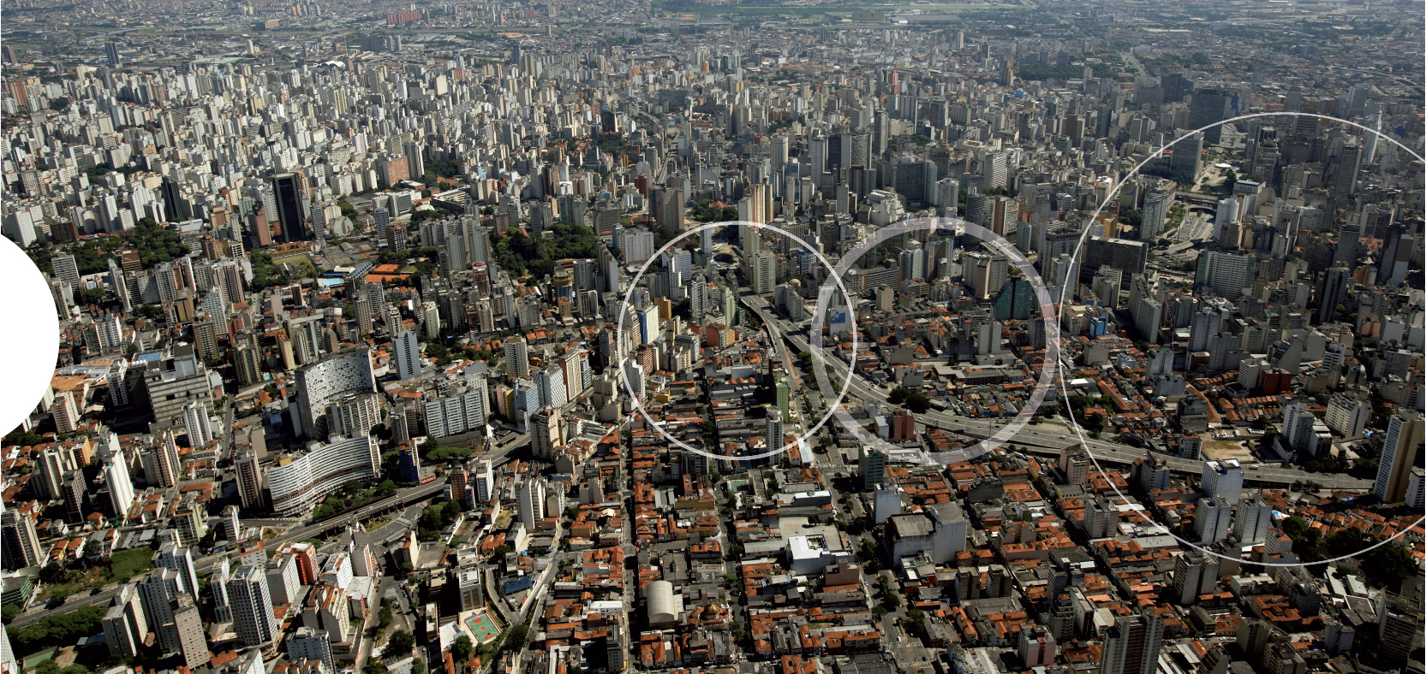
What is
… a set of coordinated, independent Earth observation, information and processing systems …
… access to diverse information for a broad range of users in both public and private sectors …
… strengthens the monitoring of the state of the Earth …
… through its Common Infrastructure (GCI) (now GEOSS Platform: ), proactively linking together existing and planned observing systems around the world …
Notes:
High-level overview

Slide 4
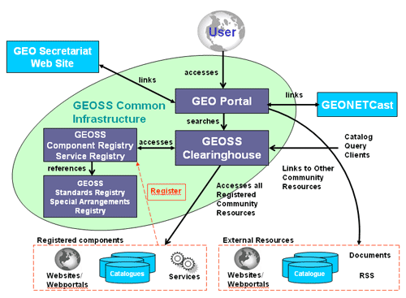

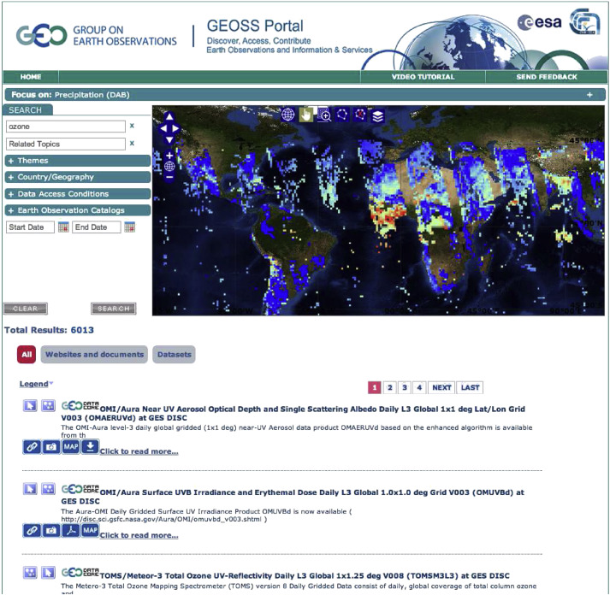

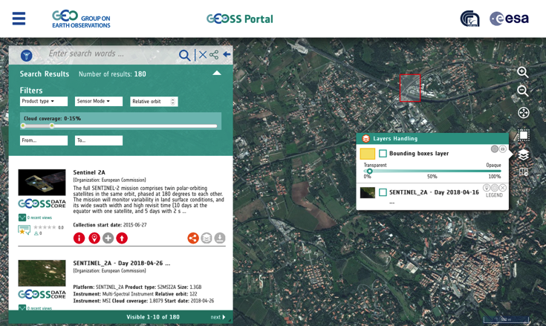



Building GEOSS: The GCI Journey
“The vision for GEOSS is to realize a future wherein decisions and actions for the benefit of humankind are informed by coordinated, comprehensive and sustained Earth observations and information.”
2005
2008
2010
2012
2016
2018
First GEOSS Portal
Launch of the new GEOSS Portal
Birth of the GCI as
Clearinghouse catalogue
GEO DAB as a new component. Evolving GCI into a Brokering Infrastructure
The GCI becomes
a GEOSS Platform
The Group on Earth Observations (GEO)
was established as an intergovernmental mechanism for coordinating all existing and future Earth observations systems and implementing GEOSS.
Notes:
Let me quickly take you on a journey across time…

Slide 5



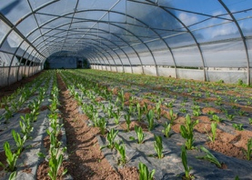



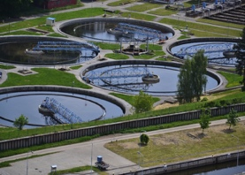








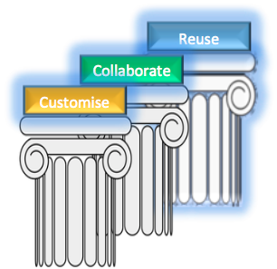








GEOSS Platform
A collaboration between
Co-financed via Grant from DG-RTD
Connecting Earth Observation Users x Resource Providers
Consisting of
Following a user-centric approach based on three pillars:
collaboration, customisation and re-use
GEOSS View
GEOSS Widget
GEOSS Mirror
GEOSS API
Evolving towards a platform of platforms linking ‘all’ EO-initiatives with access to data, services, capacity, platforms, etc.
Coordination with international players via GEO, EC, ESA

Slide 6

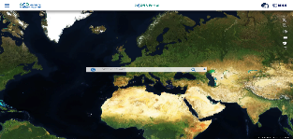



GEOSS Reusable Components (1)
  GEOSS Views: can direct community access to a subset of specifically defined resources
  using temporal, thematic and spatial criteria. The following clauses can be used:
  Discovery clauses (e.g. spatial envelope, keywords, sources, etc.)
  Access clauses (e.g. data format, access protocol, CRS, etc.)
  Defined “View” are exposed to users via the GEOSS Portal/APIs/Widgets/Mirror Sites:
  Consumer-defined View (Client-side): Views available only for the client application
  which defined the view.
  Provider-defined View (Server-side): Views available for all client applications.
  GEOSS APIs (See: http://www.geodab.net/apis)
SW agents, such as web-based or desktop client applications can exploit the GEOSS Platform functionalities implementing the client-side of one (/more) of the protocols published by the DAB for the
1. Discovery of resources from brokered sources 2. Semantics-enriched discovery 3. Access of resources.
The available protocols include: OGC Catalog Service for the Web (CSW), OpenSearch with geo, time and semantic extensions, Open Archive Initiative (OAI) PMH, OGC Web Processing Service, etc.
  Available APIs include:
 | Geospatial Expert | Web Dev. Expert
Standard Web Services (OGC Web Services, OAI-PMH, CKAN, etc.) | X
OpenSearch (Extended) | X
GEO DAB API JS |  | X
GEO DAB API REST |  | X
Notes:
Examples include the data from different satellite providers including
Satellite data providers
Insitu data providers
Sentinels 1, 2 and 3! Data from Jaxa, NASA, Indian Spare Research organisation, Vito,

Slide 7
GEOSS Reusable Components (2)
  GEOSS Widget
      A freely-available instantiation of selected GEOSS Portal widgets with various functionality made available for possible customization in various areas of application (e.g., a specific SBA, Initiatives, etc.).
  This is accomplished by publishing portal code parts (widgets) wrapped up in API
  Kernel at server side (continue maintenance, enhancements, etc., like a library)
  GEOSS Mirror: GEOSS Portal site customisation for SBAs, Flagships, Initiatives, Communities
  It is available at www.geoportal.org/community/GEO_X_Initiative (e.g. gos4m)
  The customisation will better serve the specific community interests by filtering:
  Catalogues and search results by a specific theme or GEOSS view (e.g., cold regions, mountains, etc.)
  Location of interests
  Services/Processing/Tools (in the future …)

Slide 8
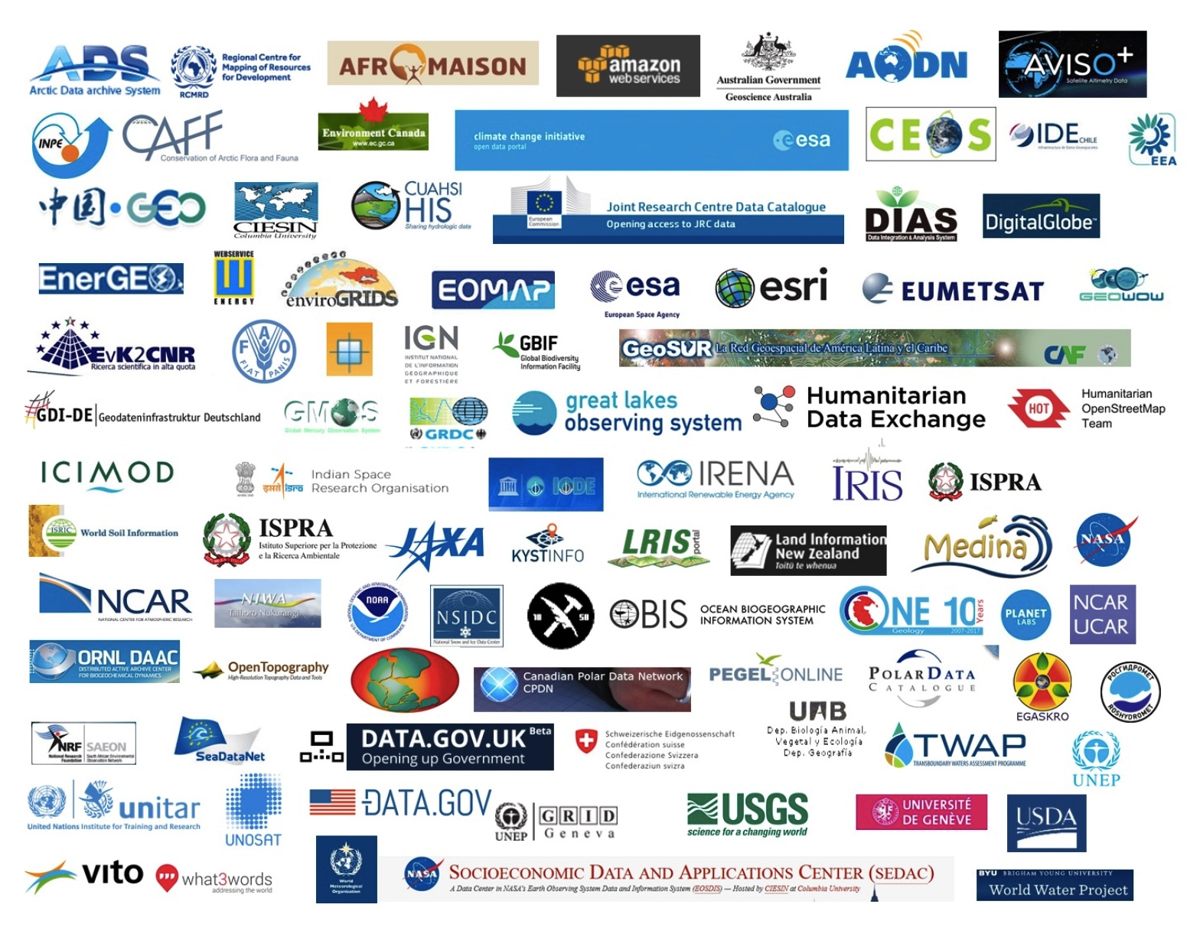


Some GEOSS Platform Numbers
The GEOSS Platform presently
brokers more than 170 open data catalogs and information systems, comprising over 414 million data and information resources.
415,000,000
Open EO Data resources
35 Languages
7000 + Contributing organisations
200,000 Keywords
HUNDREDS OF DATA PROVIDERS.
>
Notes:
Examples include the data from different satellite providers including
Satellite data providers
Insitu data providers
Sentinels 1, 2 and 3! Data from Jaxa, NASA, Indian Spare Research organisation, Vito,

Slide 9
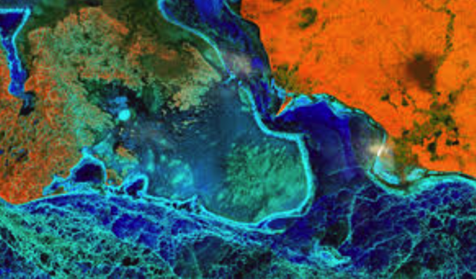
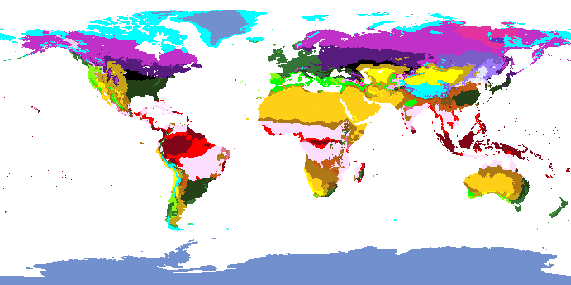
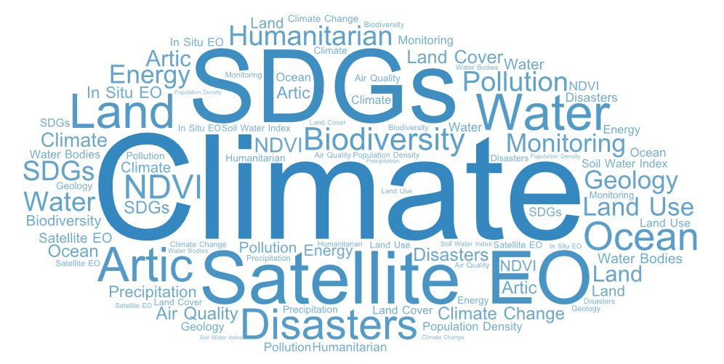
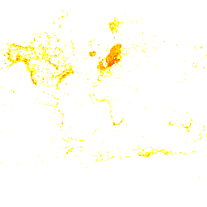

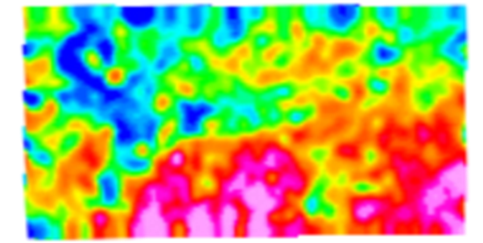
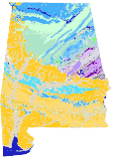
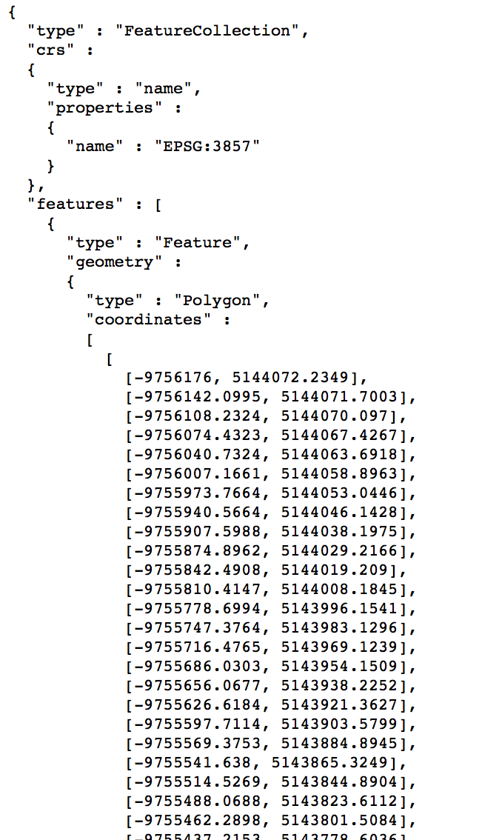
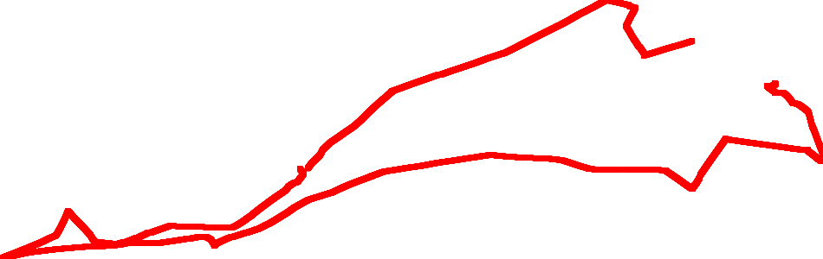
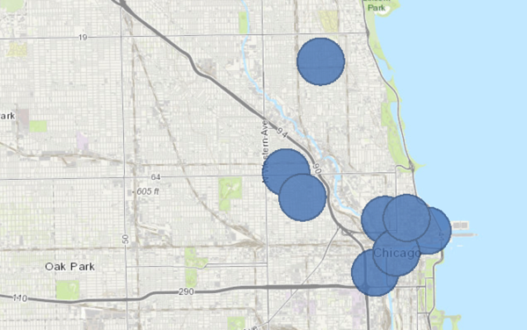
EOs Discoverable/Accessible from GEOSS Platform

Slide 10



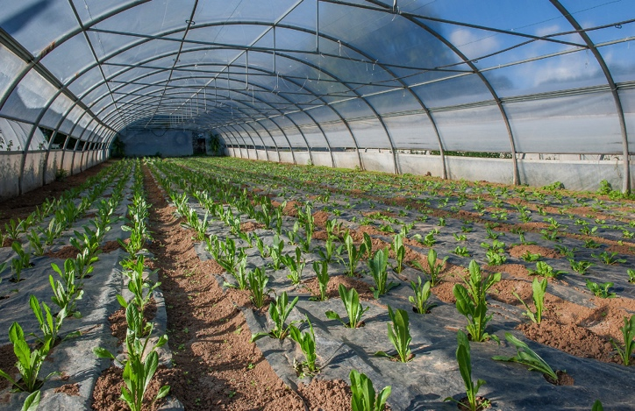



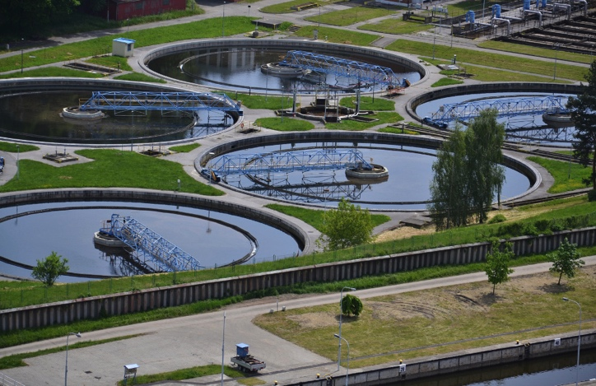
Weather
Societal Benefit
Areas
Notes:
High-level overview

Slide 11



GEOSS Platform supporting Global Policies
Sustainable Development
Climate Action
Disaster Risk Reduction
UN SDGs
Paris Agreement
Sendai Framework
Supporting Resilient Infrastructure
Measuring Status
& Progress
Monitoring & Understanding
Notes:
High-level overview

Slide 12




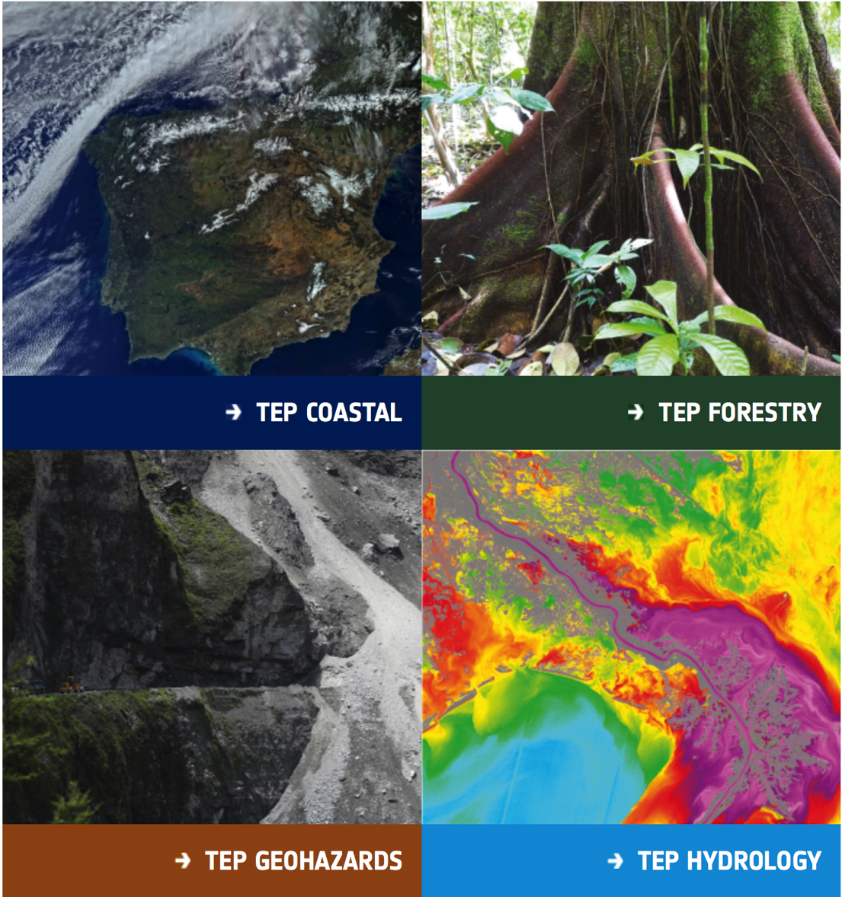
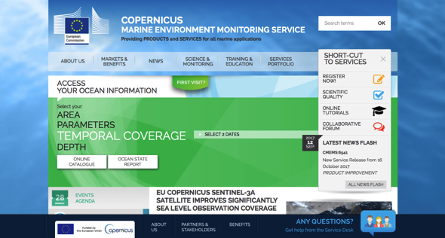
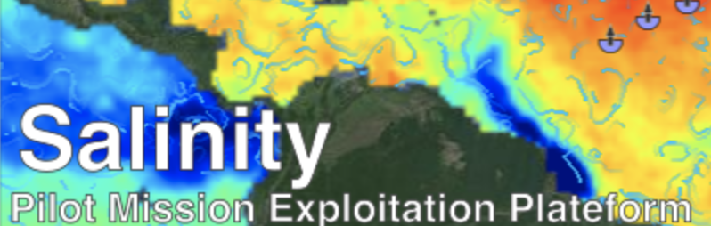
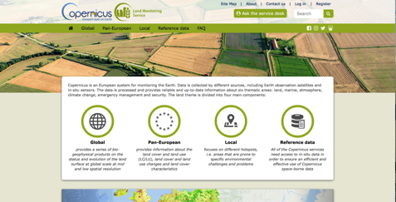

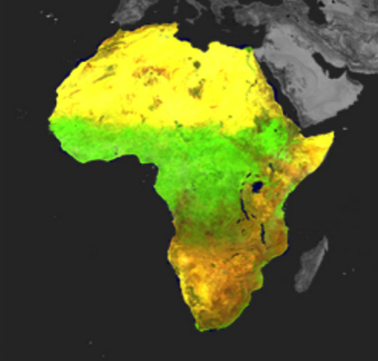




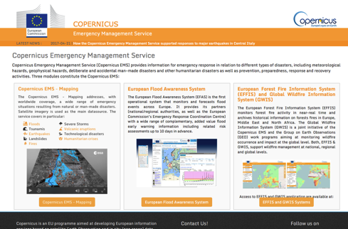
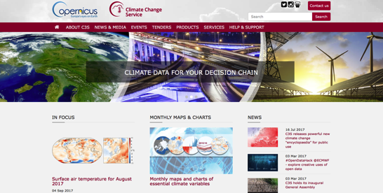



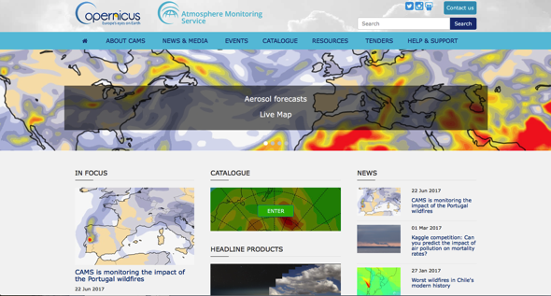


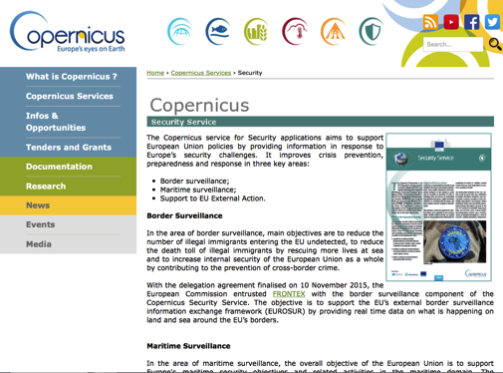









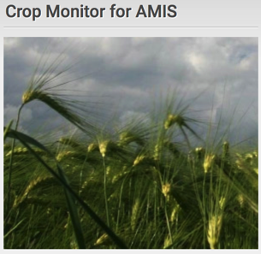

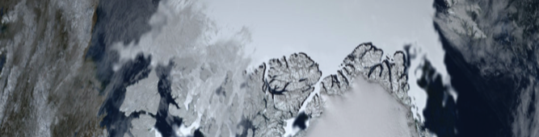
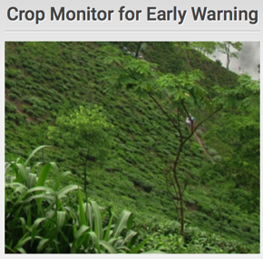

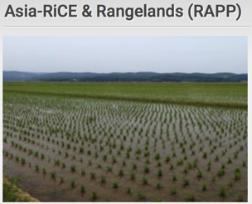
Services
Various Initiatives Linking/Linked via the
meps
Regional Initiatives
Other Initiatives/Flagships/…
Biodiversity
Observation
Network
The Global Observation System for Mercury
Geohazard Supersites
and Natural
Laboratory Initiative
Notes:
High-level overview

Slide 13













The GEOSS Platform Registration Process

Slide 14
Registration Process - Rationale & Scope
Provides clarity, simplicity and visibility in the procedures contributing to GEOSS for Data Providers
Light & operational interface for non-technical people
Aims to assign a new resource Provider to GEOSS

Slide 15
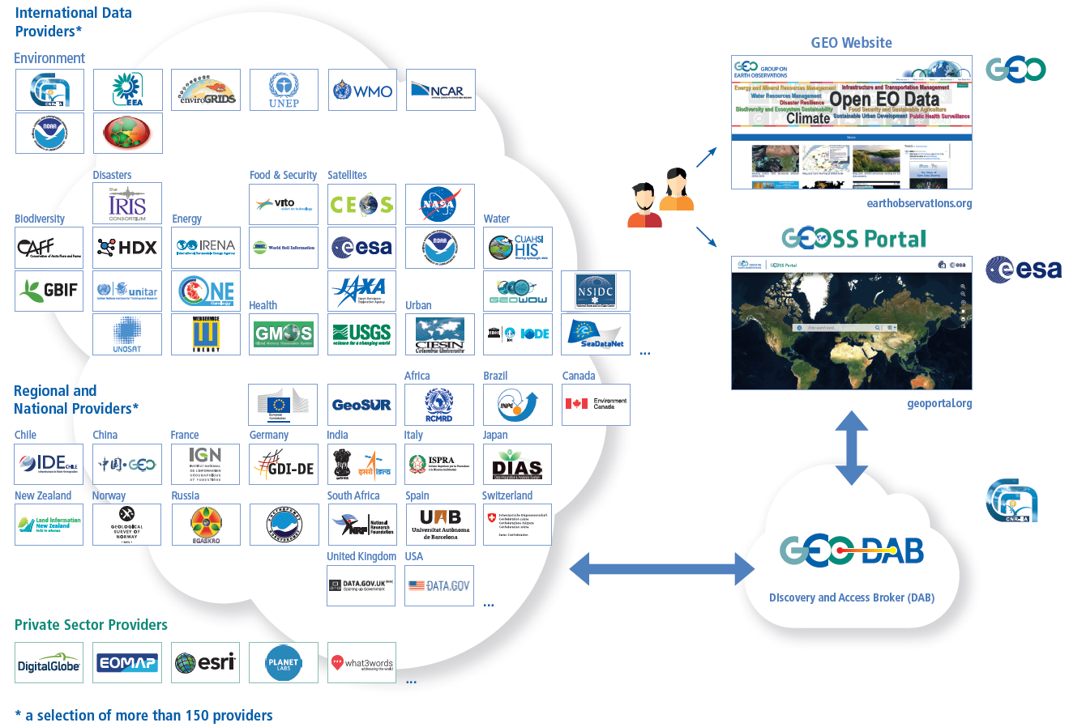
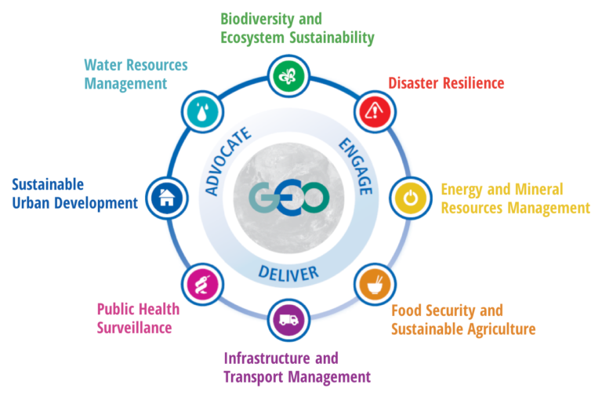

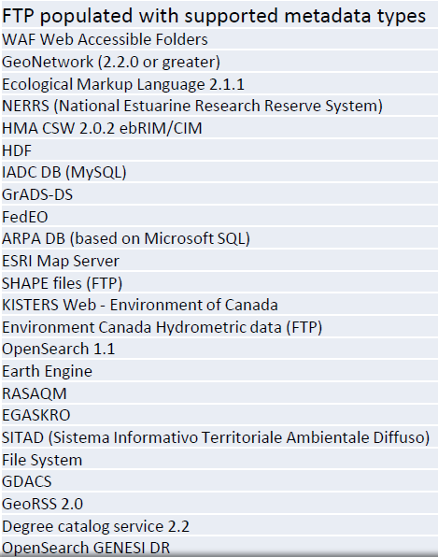

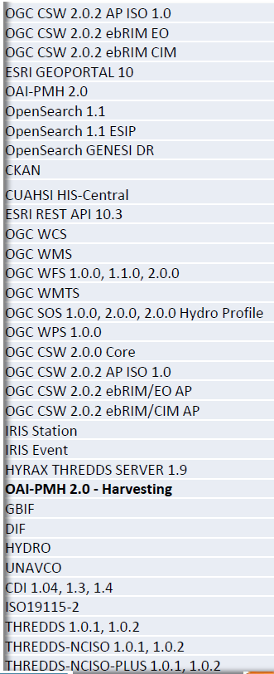

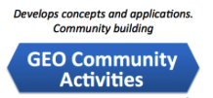
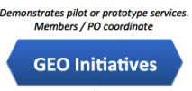
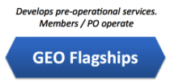
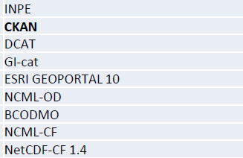
The GEOSS Platform Registration Process
Phase 1. Organisational Registration
Resource Provider Registration (GEO Sec)
GEO Sec is the entry focal point for all engagement in GEO for new resource providers
GEO Sec will engage with all new Providers to guide them on the steps to ensure a successful dialogue and technical interoperability
Asset to be registered
Data Provider fills in a GEOSS Yellow Page form
GEO Sec team validates the entry
Users
The Asset is now accessible from the GEOSS Platform
Supported
Standards
Phase 2: Technologial Registration
(Repetitive) Resources Registration (GEO DAB)
Webservice end point URL to GEO DAB Team
Interoperability
tests
GP
GEOSS

Slide 16
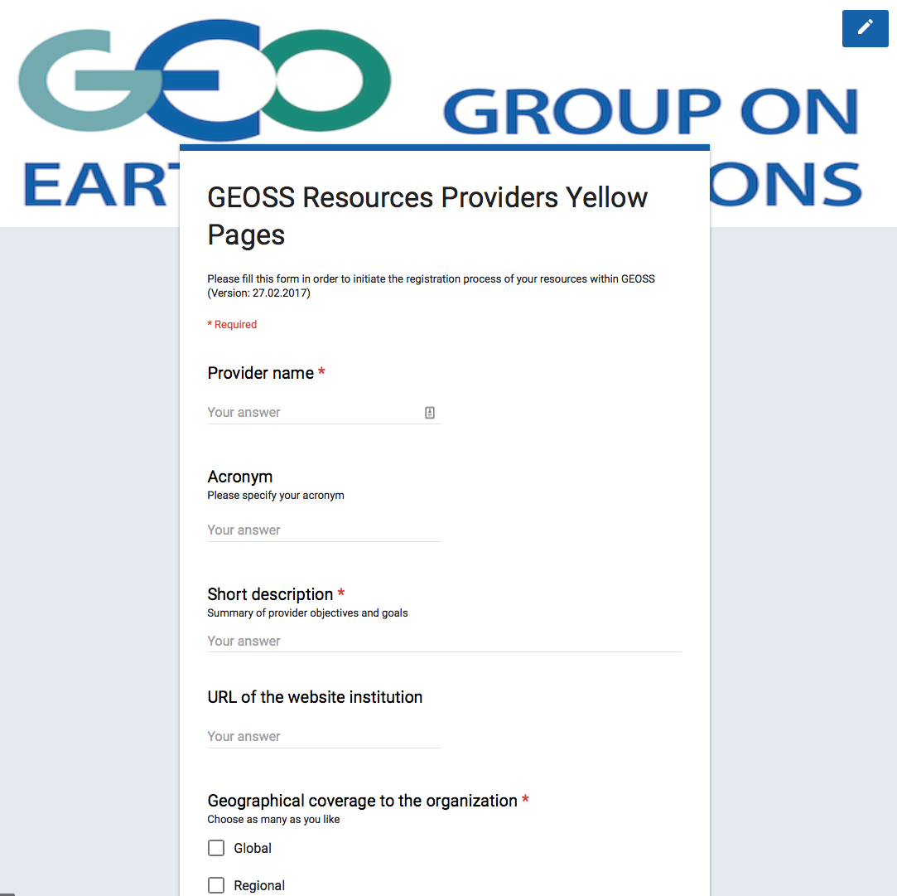
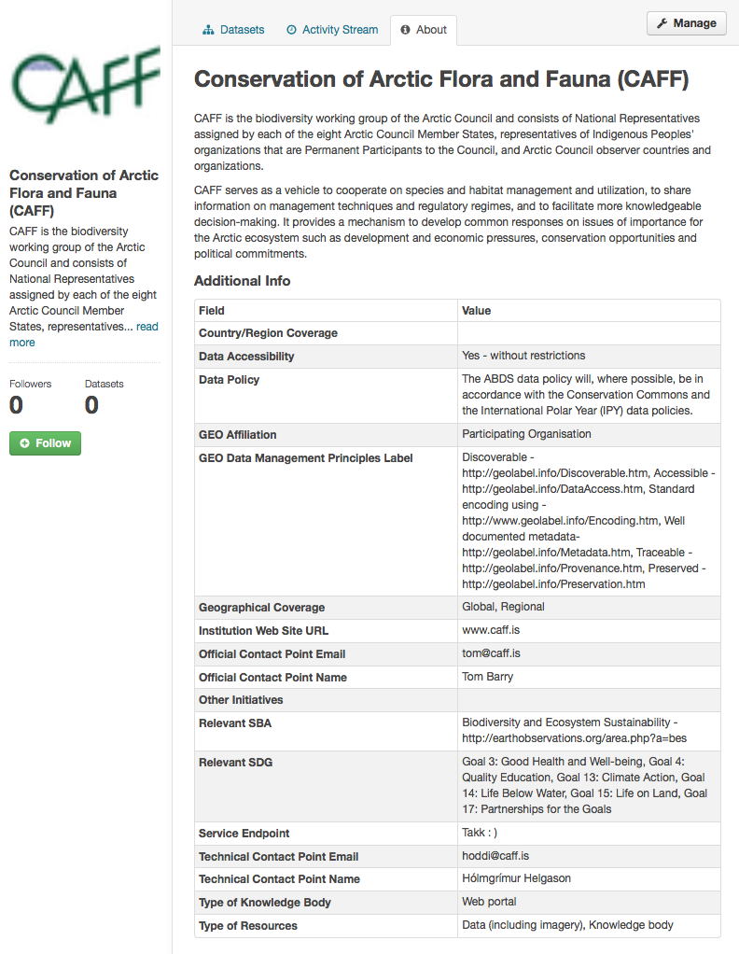
The Yellow Pages in Practice (1)

Slide 17
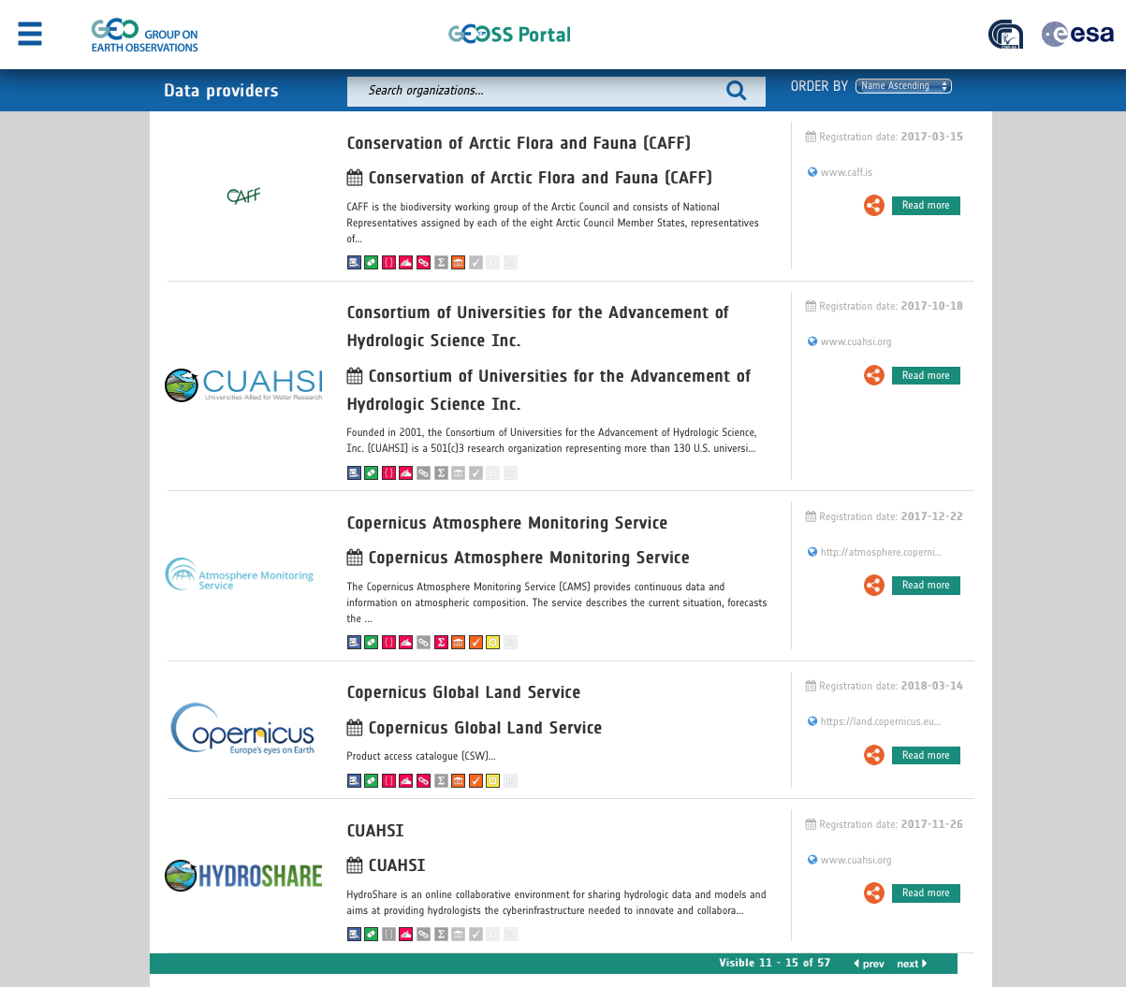
The Yellow Pages in Practice (2)

Slide 18
Yellow Pages: What’s next?
“Version 2.0 of the Yellow Page will implement:
  Simple DMP Assessment
  Specifiy Data Repository Certification
  Edit record capabilities
  Will be available in Summer 2018!

Slide 19
What Data providers say about Interoperability test
“I found the interoperability test very easy and smooth.”
“Structuring metadata for GEOSS is indeed a good exercise which improves the quality of the service to the end users.”
“The interoperability test is a critical step that helps us enourmously improve the discoverability, accessibility and usability of the Earth Observations by the Users, via the GEOSS Platform.”

Slide 20
What Data Providers and Users said:
The Benefits of the GEOSS Platform:
From Breakout session of the 2nd Data Providers Workshop
Be able to discover and access EO important for my work, of which I was not aware
It allows others to build on existing work too. It is important to scientific progress
Exposure of other communities than our own
Build new Collaborations and research
Structuring metadata for GEOSS is indeed a good exercise and service which improves our quality
The importance of GEOSS neutrality is critical for users
Expose data to bigger audience
Having access to data otherwise not available
Bring scientists in different sectors together through data of common interest

Slide 21
Next Evolution
The GEOSS Evolve Initiative

Slide 22






GEOSS-Evolve Initiative
Established in 2016
Co-chairs
Ivan DeLoatch
Max Craglia
WP1
GEOSS Architecture Evolution
(Lead:USGS and CNR-IIA)
WP3
DMP Guidelines Implementat. & Process
(Lead: ESIP and CODATA)
WP4
Standard & Interoperab. Forum
(Lead: IEEE)
WP5
Demonstration Pilots
(Lead: OGC)
WP6
Community Portals
(Lead: NOAA)
WP2
Functionality and Usability testing
(Lead:China-RADI and CNR-IIA)
GEO Secretariat
Secretarial support
Coordination with GCI Operations FT and User Requirements FT
Stakeholders' perspective and engagement session

Slide 23
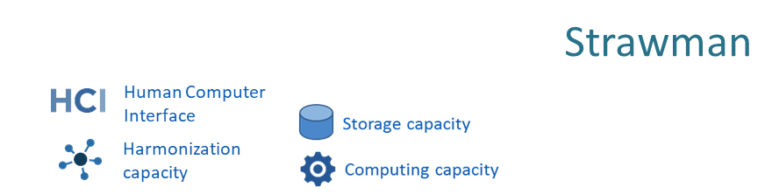









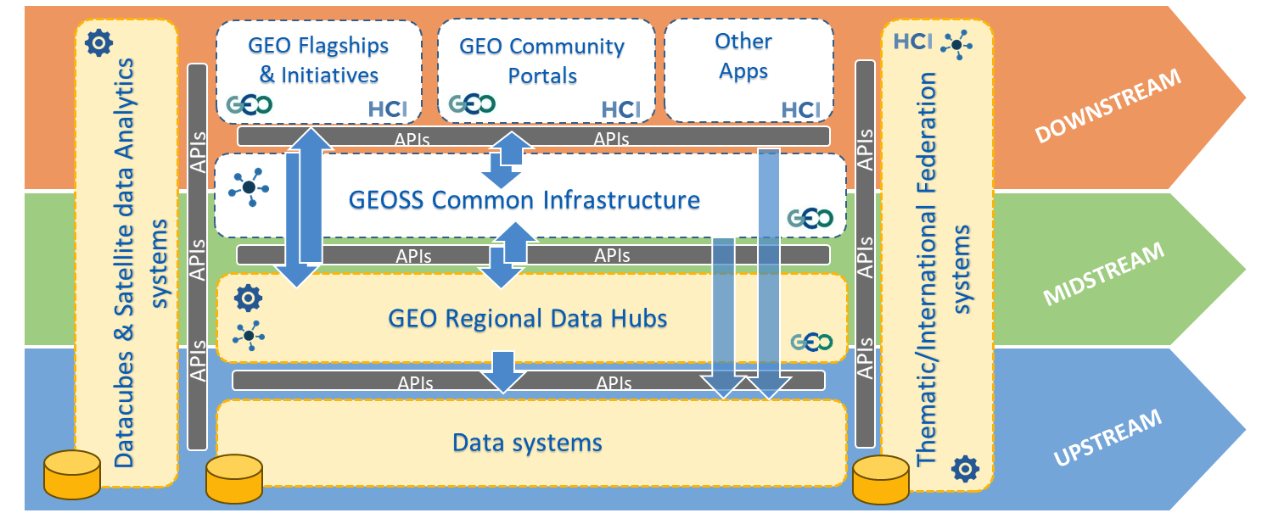

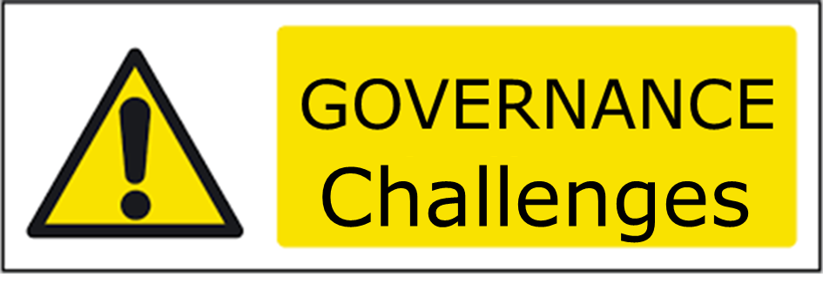








GEOSS Software Ecosystem
Evolve
Initiative
GEOSS Platform
Data Cubes and Data Analytics Systems

Slide 24
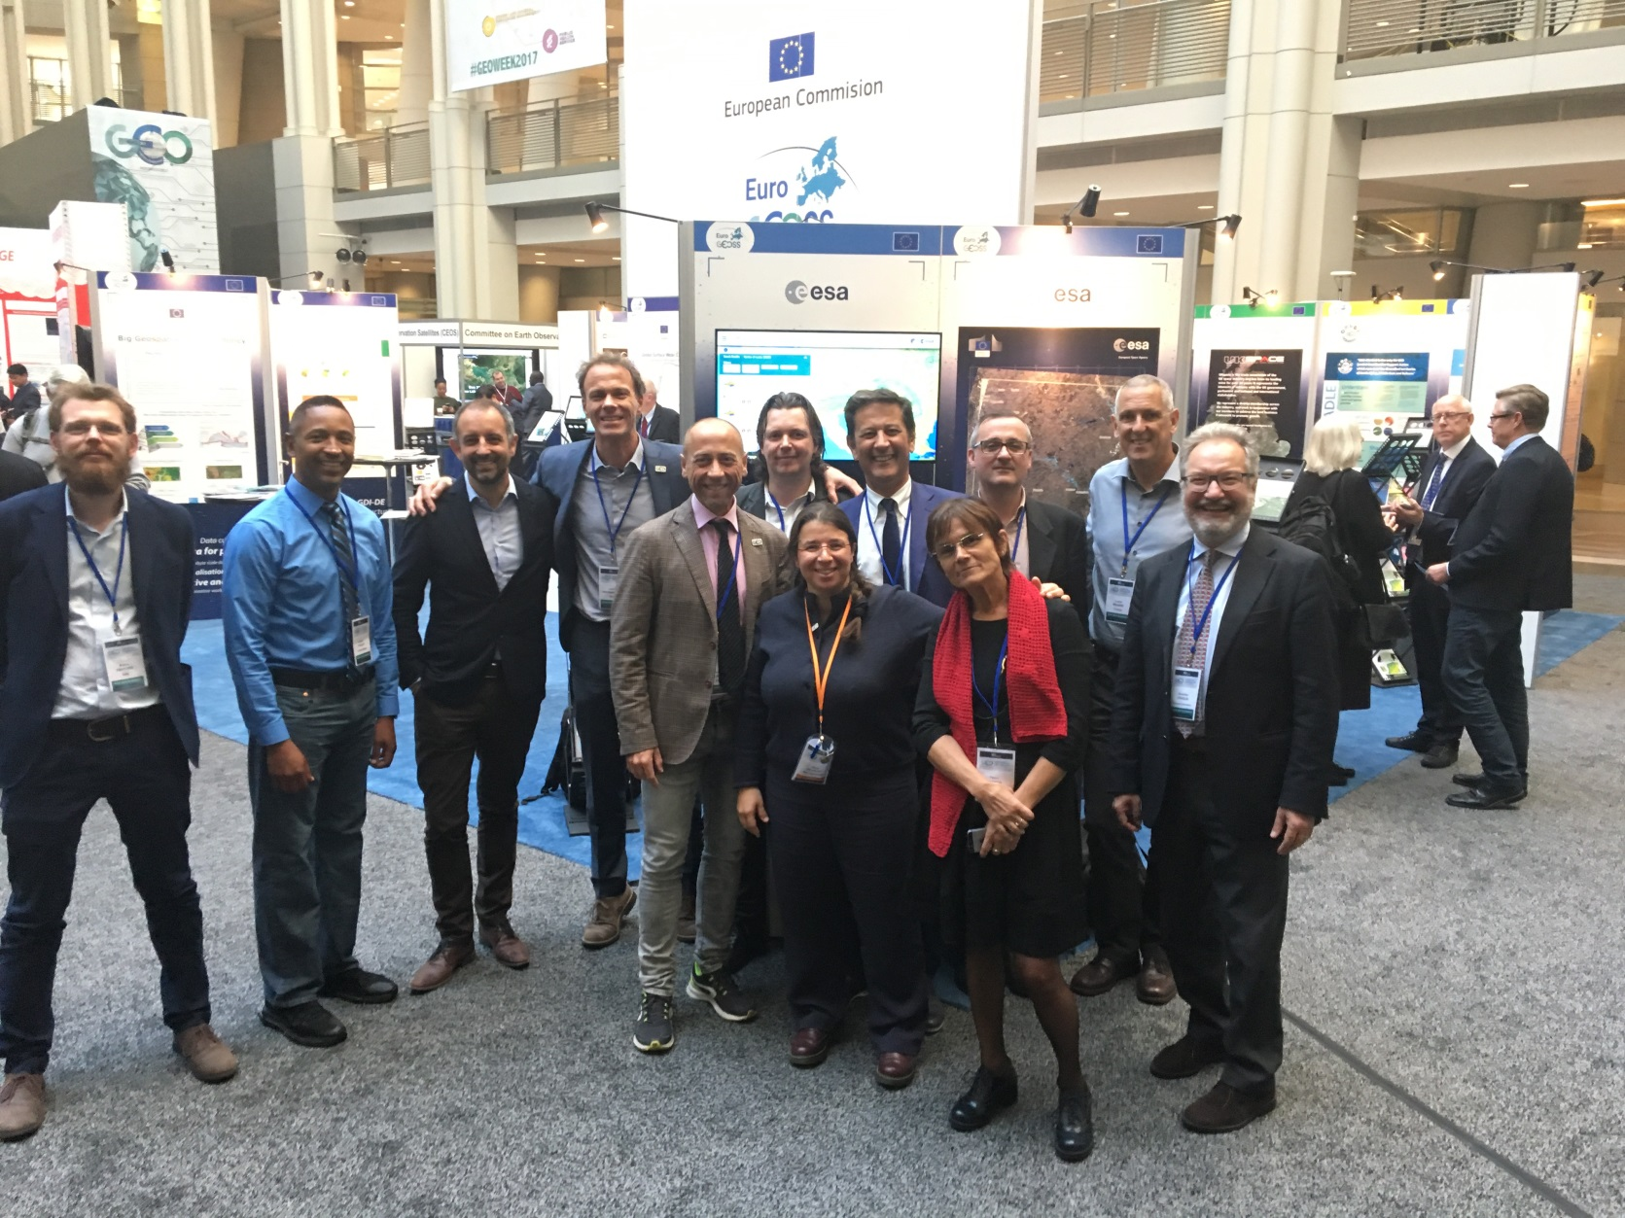


The GEOSS Platform Operations team
Some members of the International Virtual team

Slide 25
Thank you
GEOSS Operations Team

