Slide 1
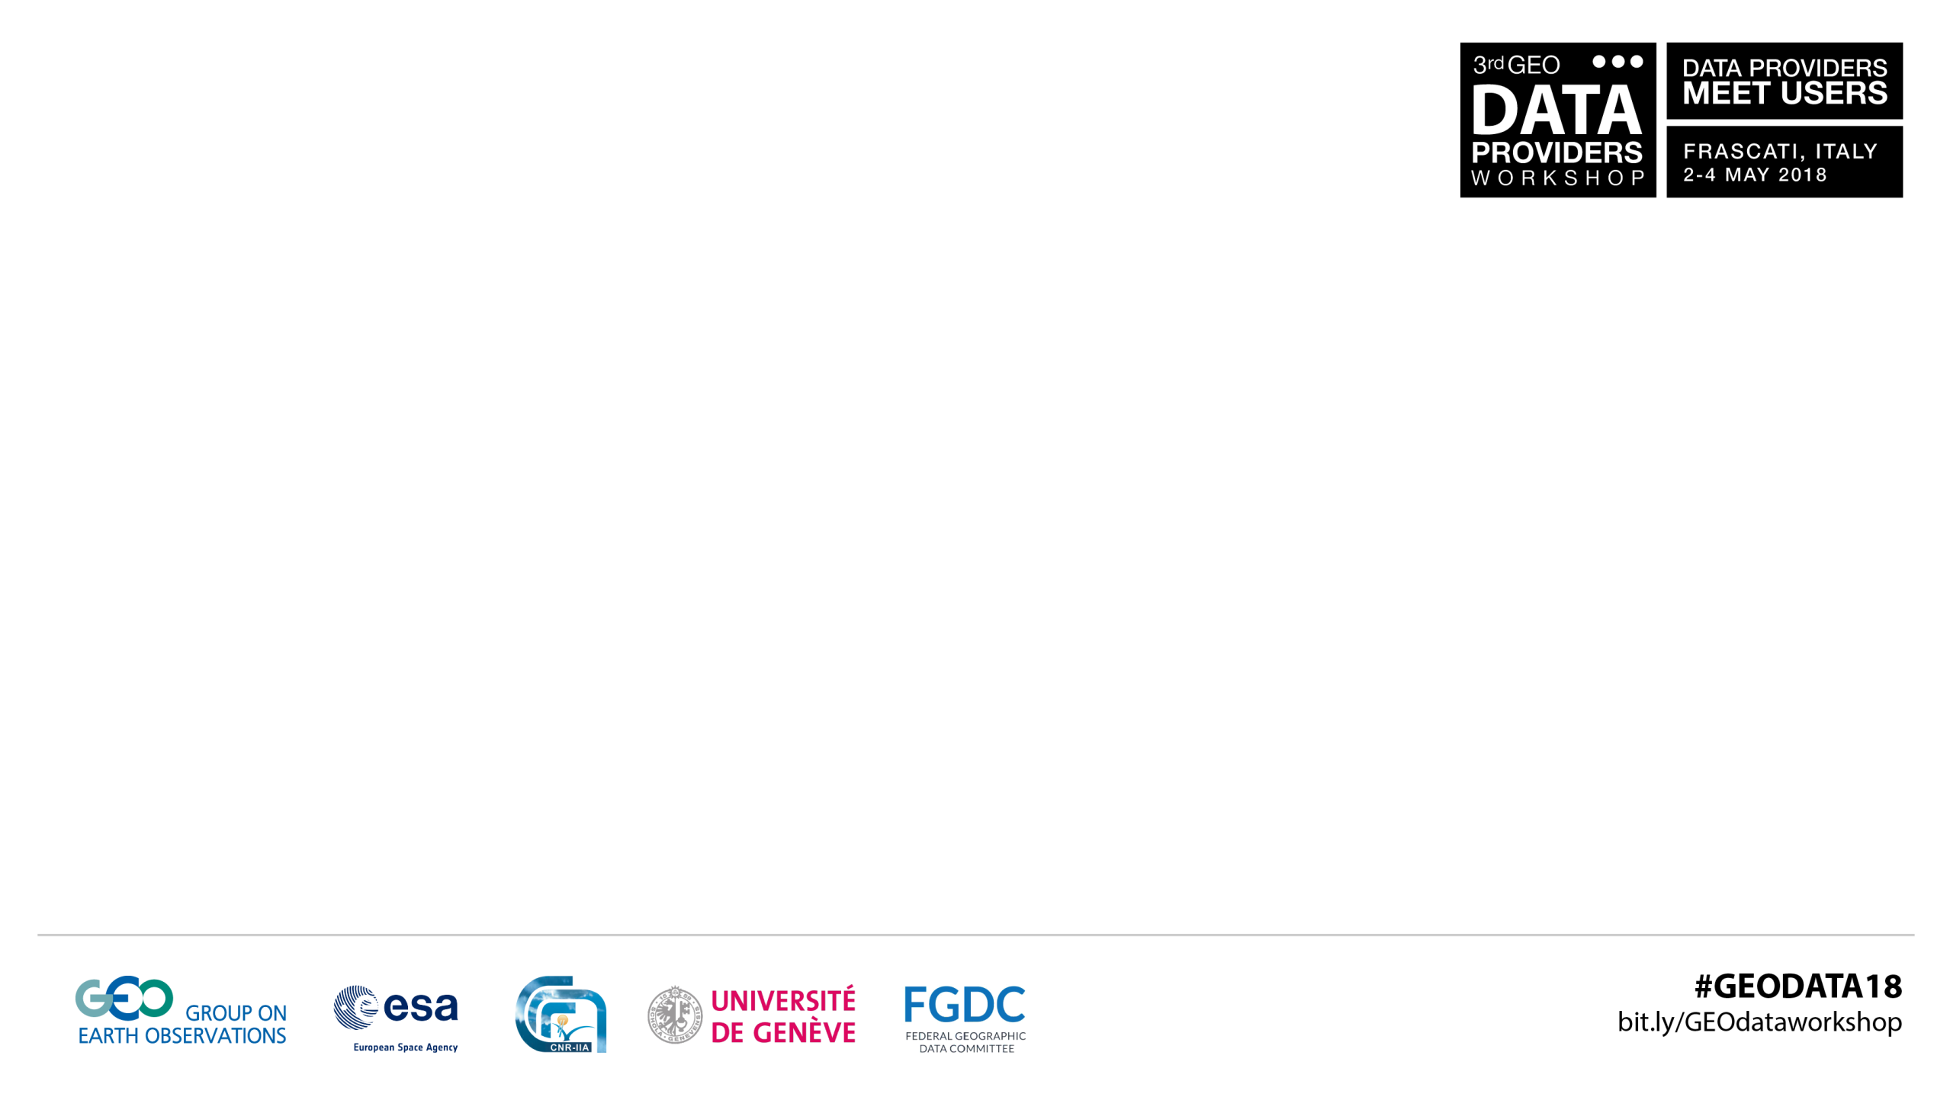
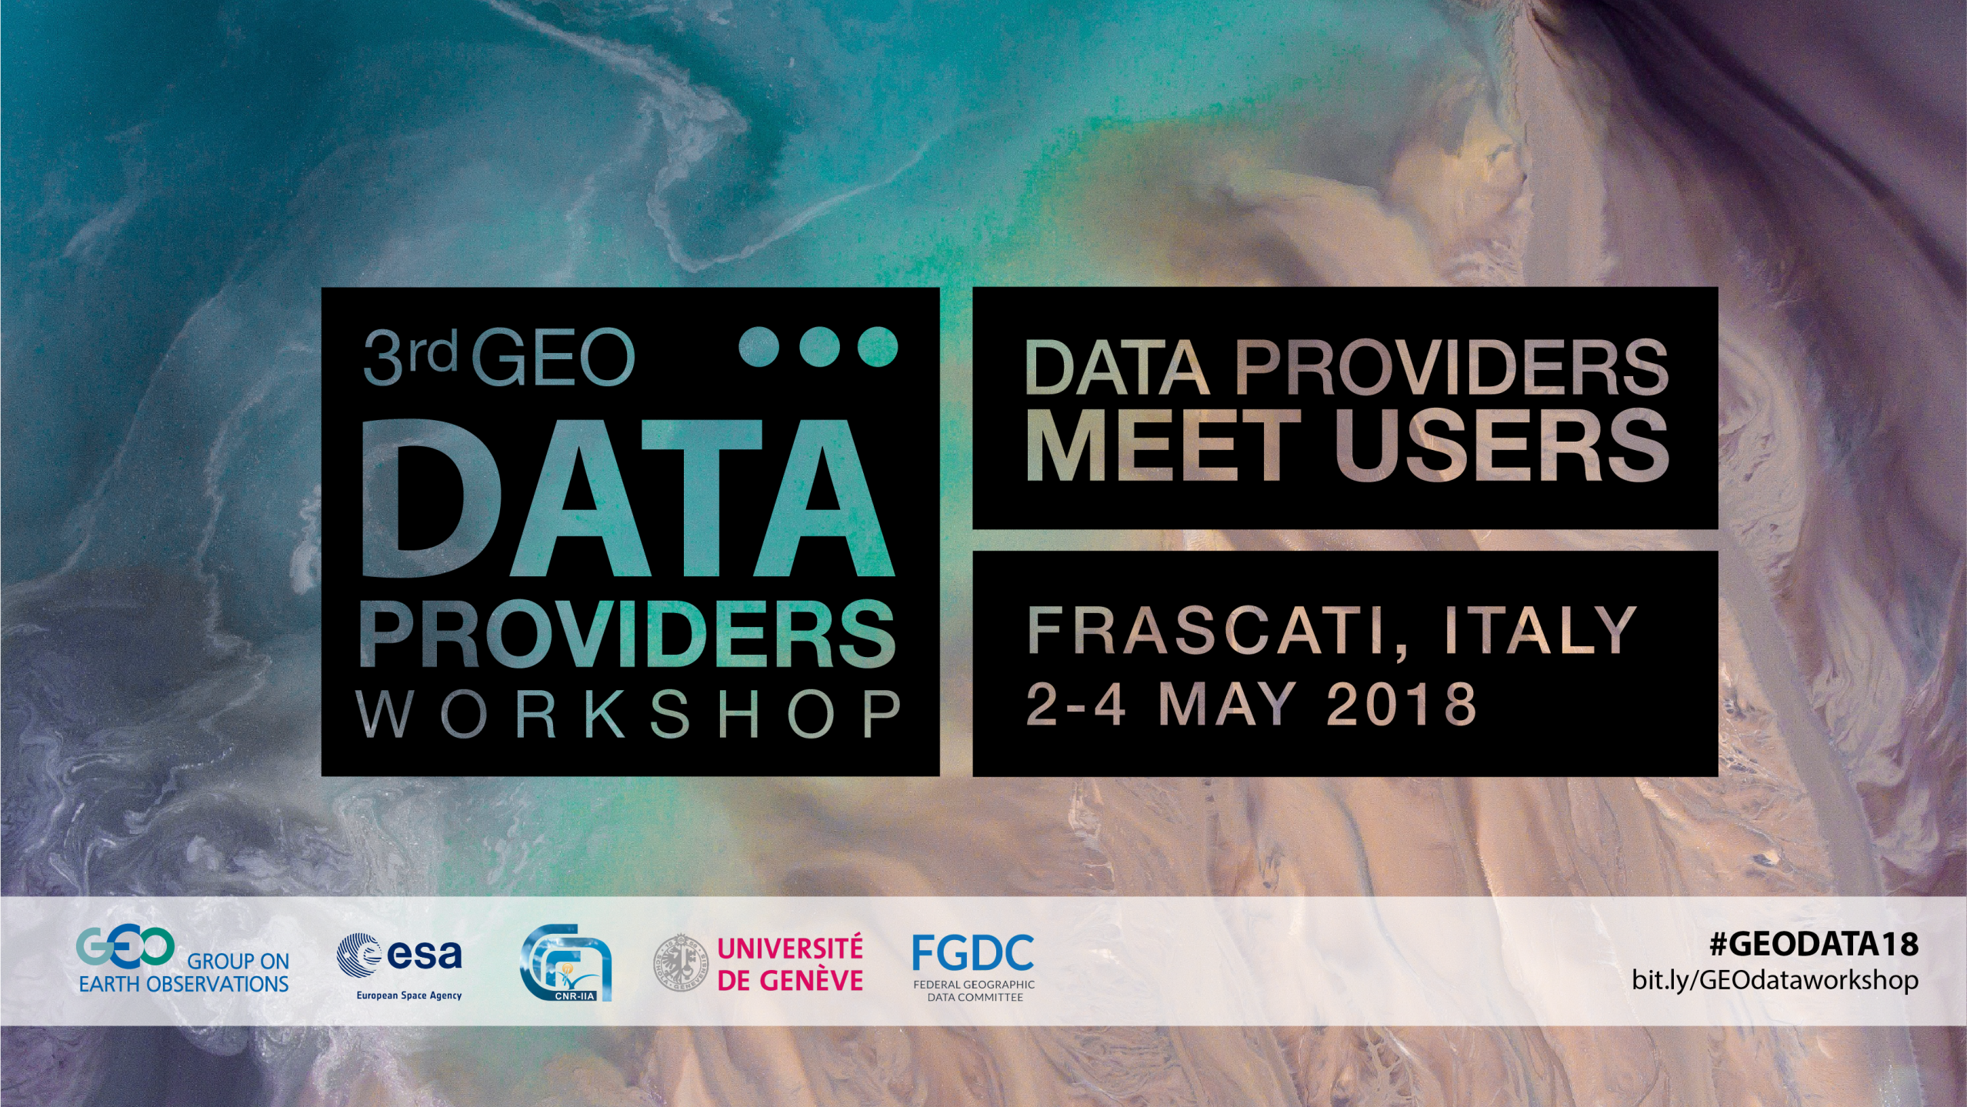

Slide 2

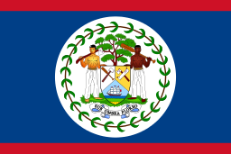

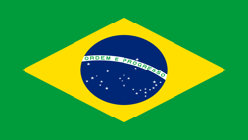


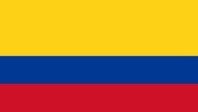
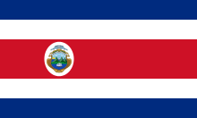

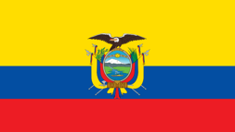
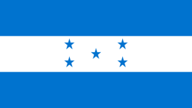






AmeriGEOSS Regional Initiative
Ivan DeLoatch / Executive Director / Federal Geographic Data Committee

Slide 3
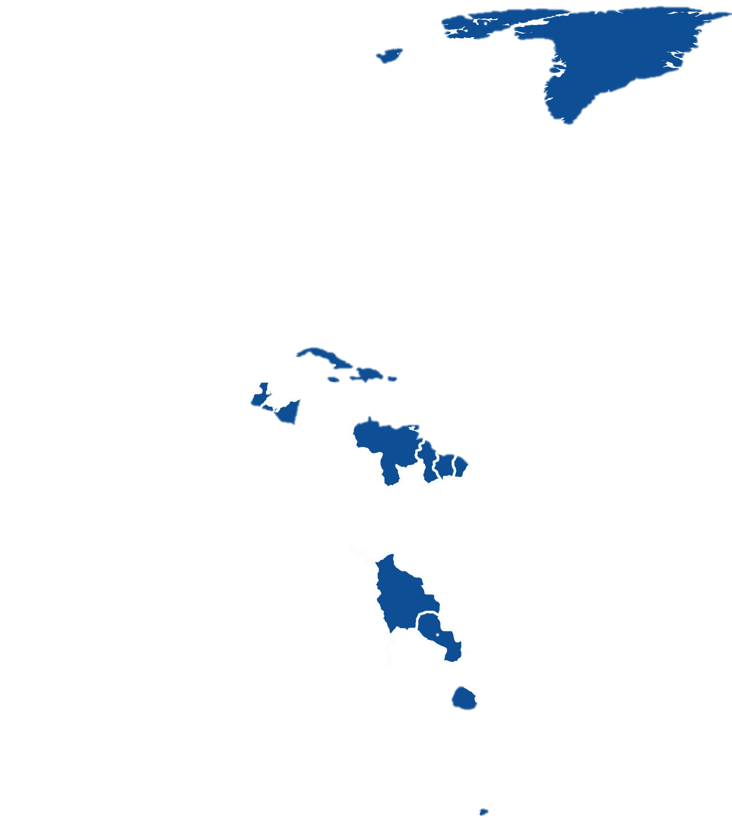
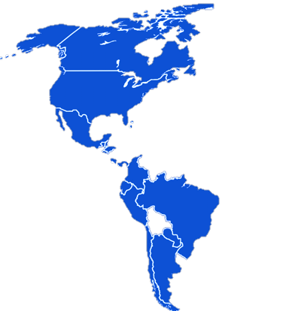

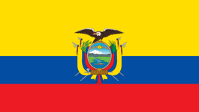
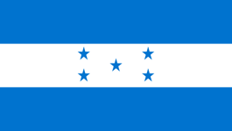






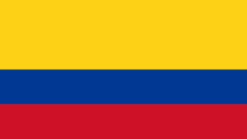


AmeriGEOSS / Background
Is a cooperative effort of the 16 GEO member countries in the Americas that:
Reflects local, national, and regional interests of the GEO country-members for short and long-term planning, development, and implementation aligned with GEO activities.
Is entrenched in the institutional and technical capabilities of its country members and in the resources of other global initiatives available for the benefit of the region.
AmeriGEOSS Members
Non-AmeriGEOSS Members
  Argentina
  Bahamas
  Belize
  Brazil
  Canada
  Chile
  Colombia
  Costa Rica
  Ecuador
  Honduras
  Mexico
  Panama
  Paraguay
  Peru
  United States
  Uruguay
Seeks to increase institutional and personal capacity and engage experts, stakeholders, and decision makers in the process of decision making.
16 Member Countries
Observers: Bolivia, Guatemala
Notes:
**Before I dive into the platform let me give you some background informaiton on AmeriGEOSS. AmeriGEOSS is an initiative under the GEO framework––launched in 2015
This is an adaptable framework that can be leveraged for capacity building.
Includes 16 nations in the Americas currently participates
Work with regional and global partners to advance the use of EO data
Develop and leverage member capacities to support stakehoder and decision-maker needs.

Slide 4


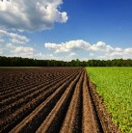
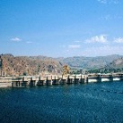
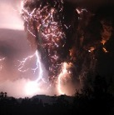
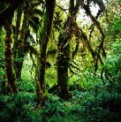

AmeriGEOSS / Priority Areas
AmeriGEOSS Initiative is a framework that seeks to promote collaboration and coordination among the GEO Members of the American Continent
Agriculture, associated with climate variability, climate change, and food security.
Water, associated with the management approach of water resources and data management.
Disaster risk reduction, particularly for data exchange associated with early warnings and for the generation of regional products of early warnings
In the context of capacity building for better monitoring, management, and maintenance of ecosystems and biodiversity they support; and to predict future changes.
Agriculture
Water
Disasters
Biodiversity & Ecosystems
The AmeriGEOSS initiative
focuses its efforts in the
four Societal Benefit Areas (SBA’s) selected and prioritized by the Americas Caucus
Data systems infrastructure and capacity building.
Foundational Task
Notes:
AmeriGEOSS is a regional initiative that promotes collaboration and coordination among GEO Members of the American Continent.
[Space bar for Animation]
The community is currently focusing its efforts in the following thematic areas
Agriculture
Water
Disaster and
Biodiversity Societal Benefit areas.

Slide 5

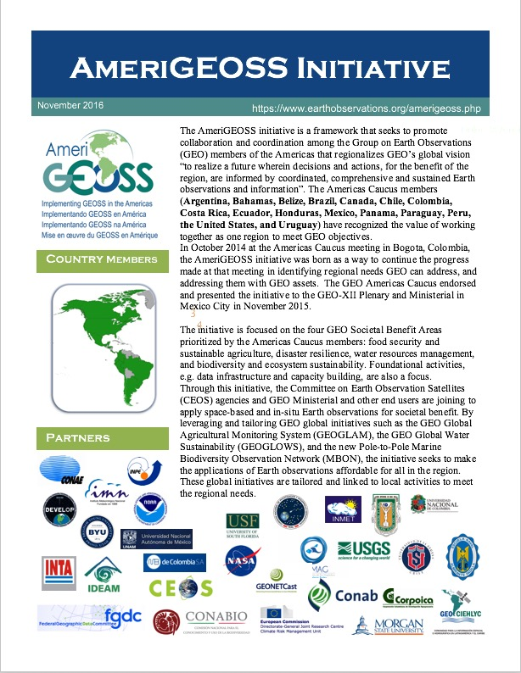

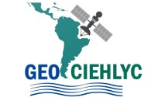







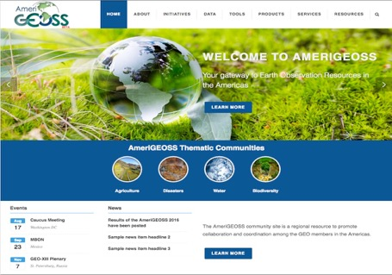



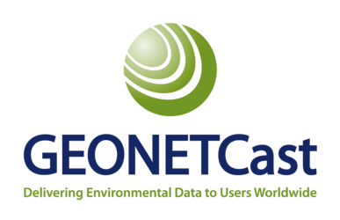

AmeriGEOSS / Capacity Building Framework
Capacity Building
Engage
1
2
Building
Partnerships
Cold
Analyze
Regions
Engaging Users
National
3
Needs Assessment and Gap Analysis
Regional
4
Partner > Mobilize > Implement
User-Driven Framework
Develop
Data
Delivering Solutions
Tools
Data Tools Products Services
Products
Share
Curate
Harmonize
Visualize
Mapping
Modeling
Publication
Reports
Acquisition
Reports
Training
Deliver
Global
Services

Slide 6







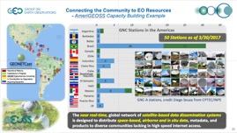
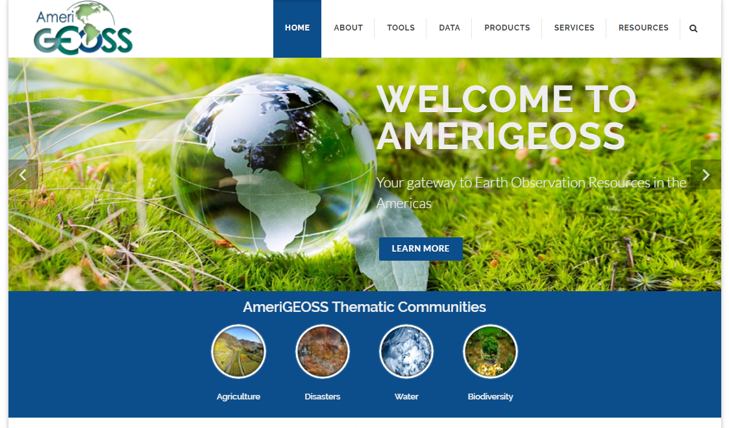
AmeriGEOSS / Activities
.
Agriculture
Water
Disasters
Biodiversity & Ecosystems
Expand Crop Monitor to all countries
Increase the number of crops monitored
Launch GEOGLOWS-America
Develop Water SDG Indicators
Mobilize data and tools for Water use/stressors, availability and Quality
Establish Working Group
Flood & Landslide–Integrate Models and Monitoring
Earthquakes & Tsunamis–Expand GNSS & SAR
Volcanos–integrate SAR & LIDAR
Establish ecosystem services
Expand MBON
Bon-in-a-box
EO4SDGs
Data Mobilization
Outreach •Workshops • Training •
Infrastructure • Data • Tools • Services
Capacity Building
Foundational Task
Climate Cross-Cutting
AmeriGEOSS Platform

Slide 7
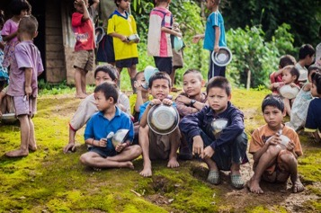
AmeriGEOSS/ Community Platform
1
3
The AmeriGEOSS Platform is a regional community resource to promote collaboration and coordination among the GEO members of the American continent.
Communities
Ameri
2
Data
Share, find, discover, learn and participate
Tools
Agriculture
Biodiversity & Ecosystems
Products
Services
Explore news, upcoming events, what’s new and other topics.
Resources
Disasters
Water

Slide 8
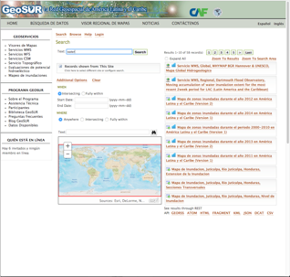
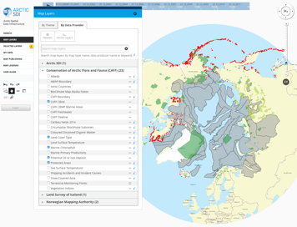
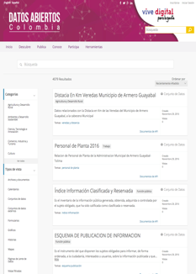



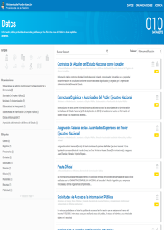
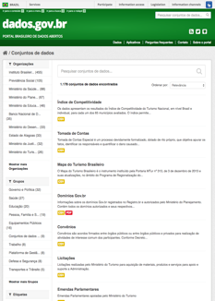
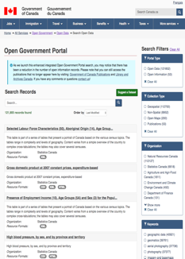
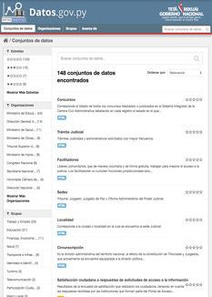



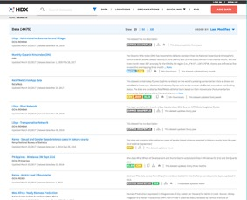
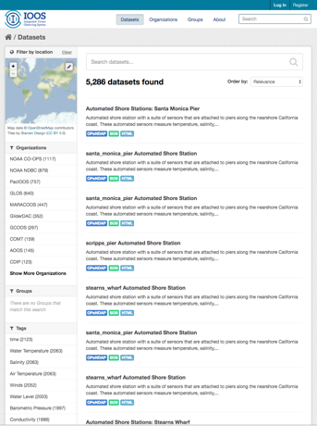
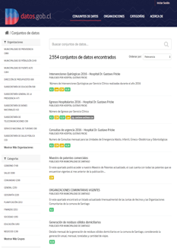
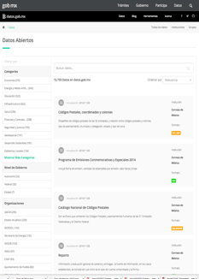
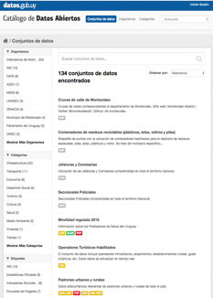
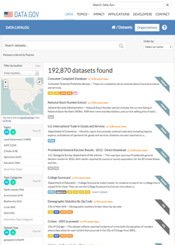



AmeriGEOSS / Community Platform
1
The platform bringing together social, economic and environmental data through open data portals at the National, Regional and Global scale.
3
Regional
Ameri
Data
2
National
Tools
4
Global
Products
Services
Resources

Slide 9
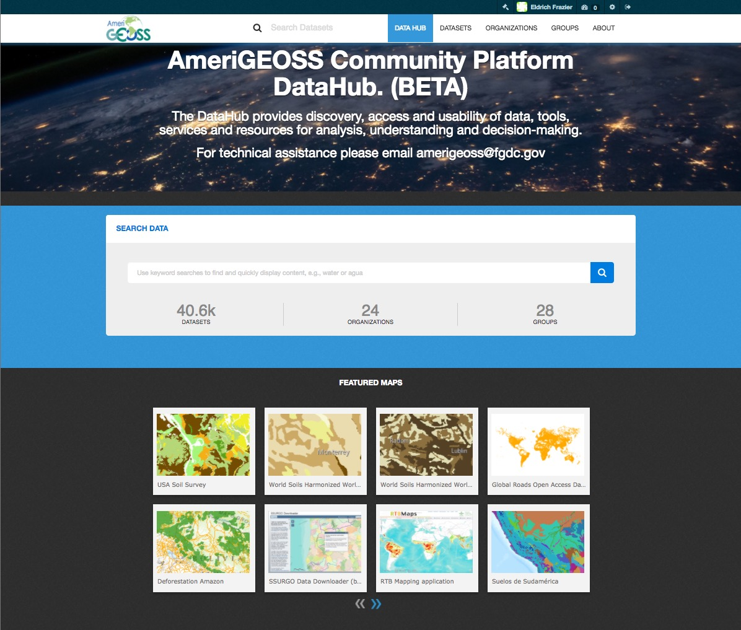

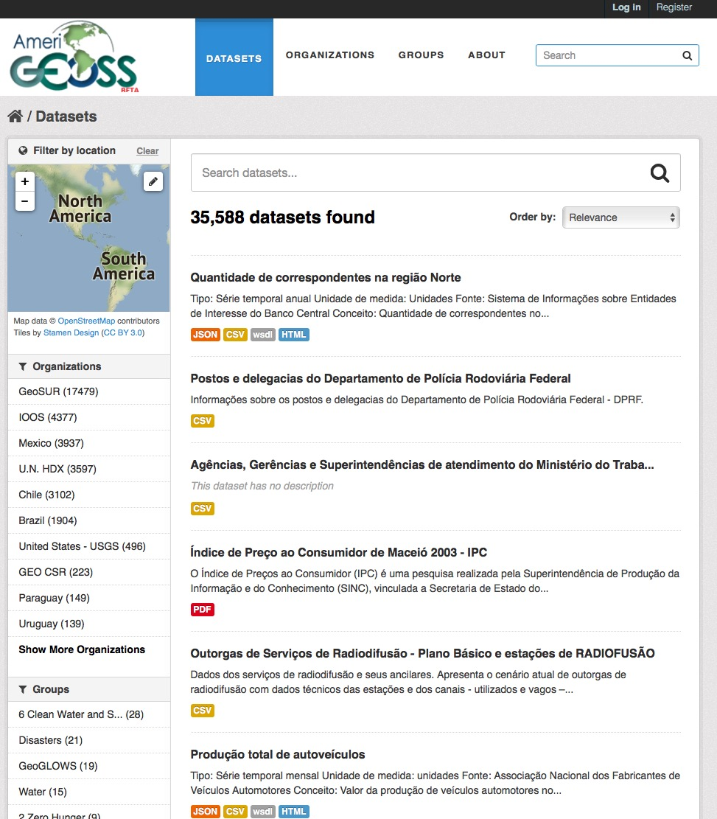
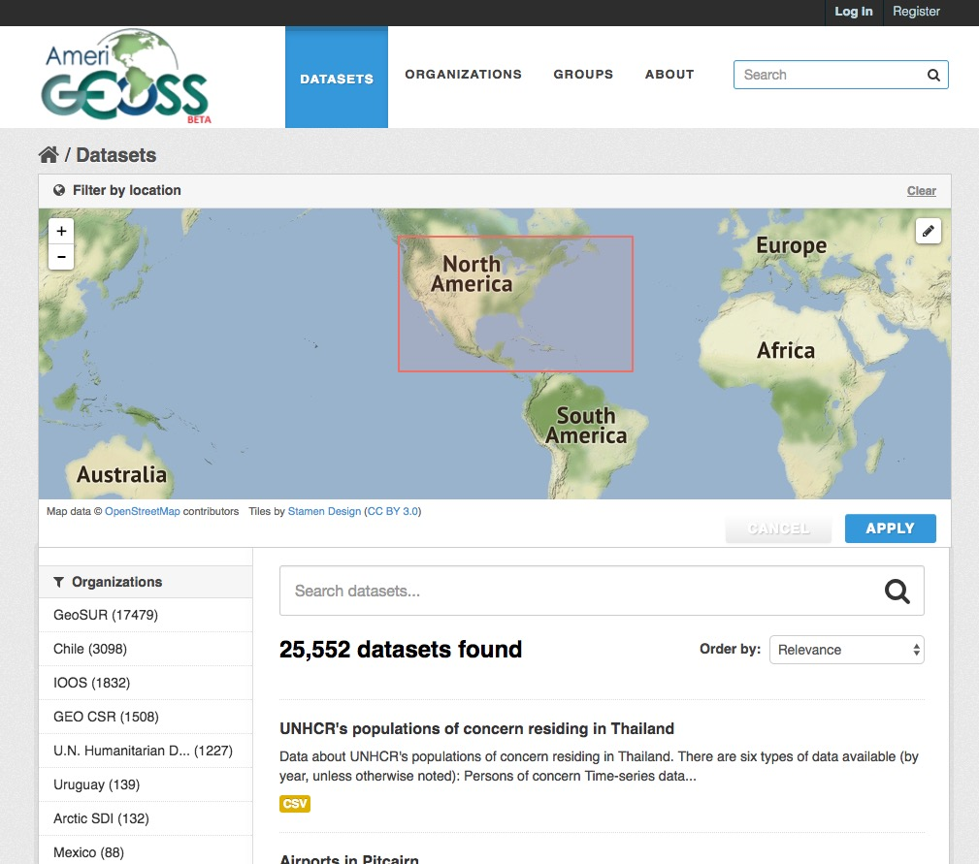
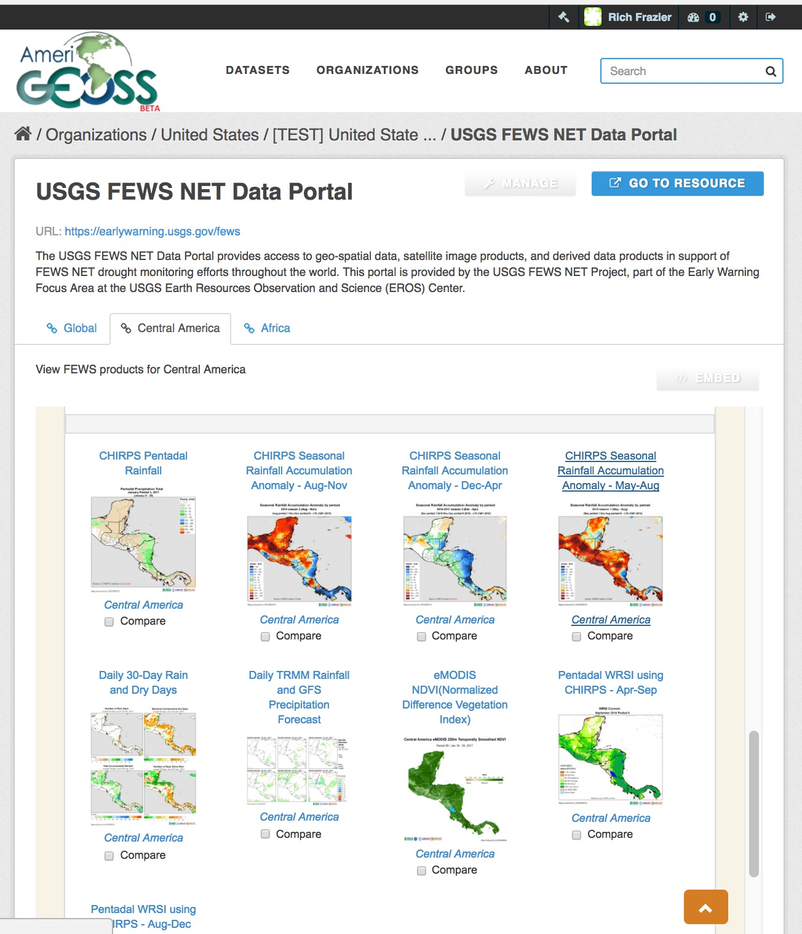
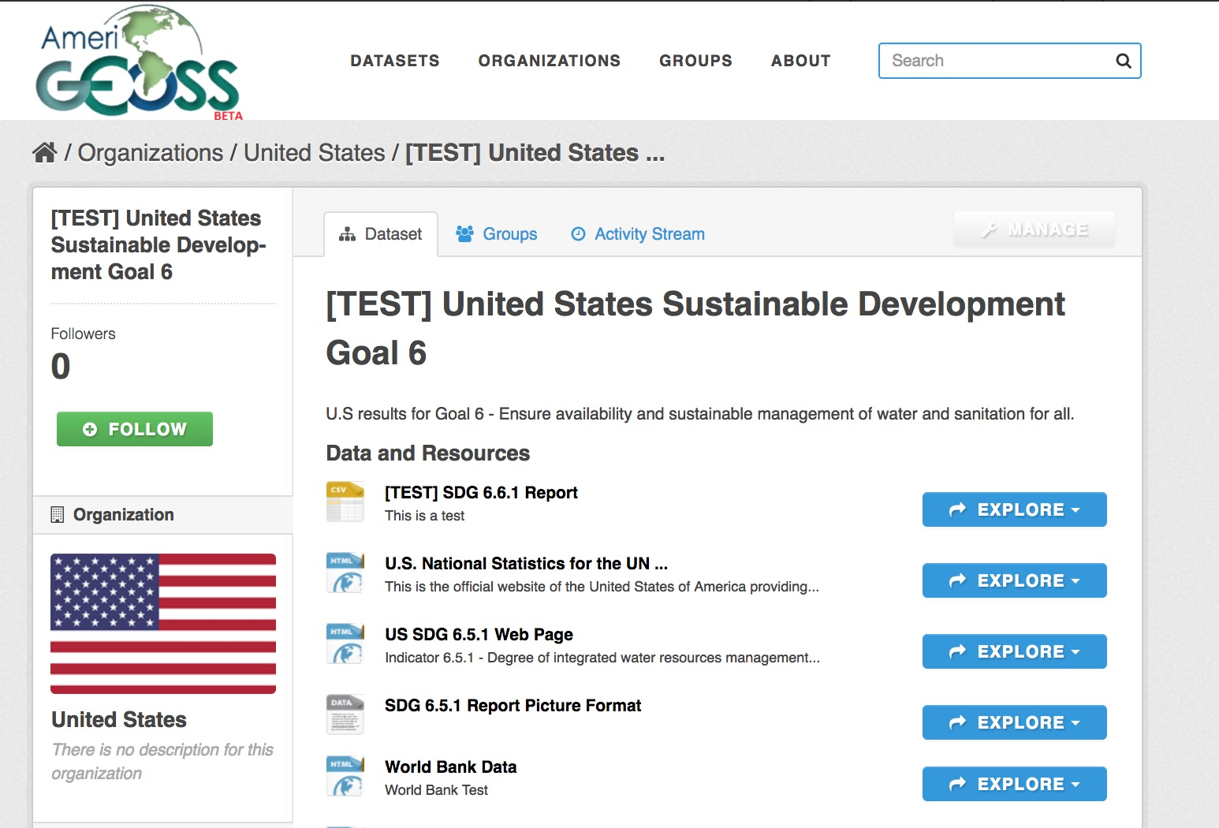
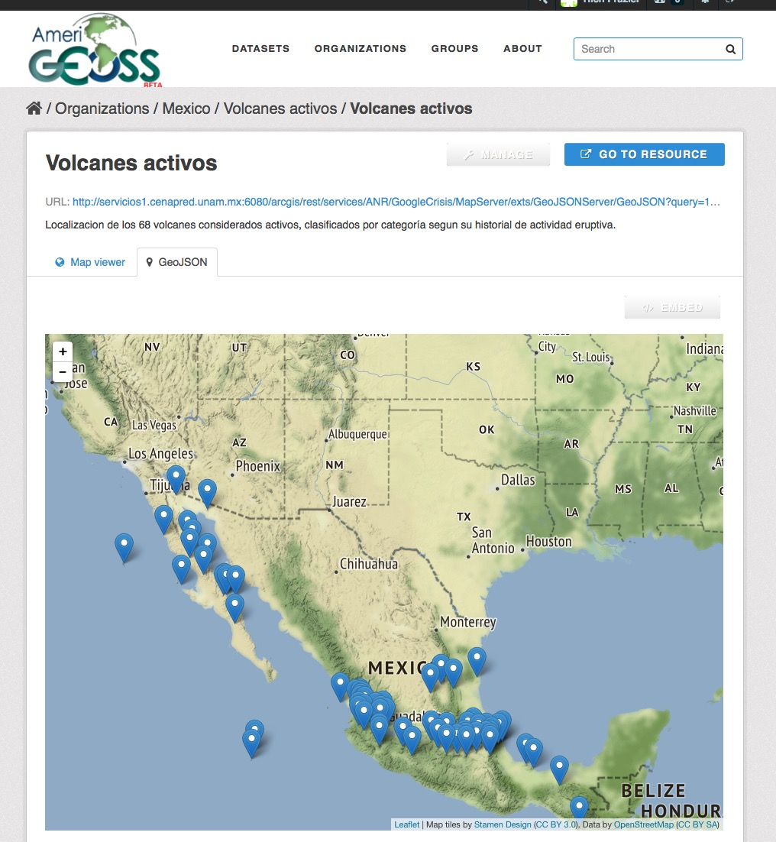
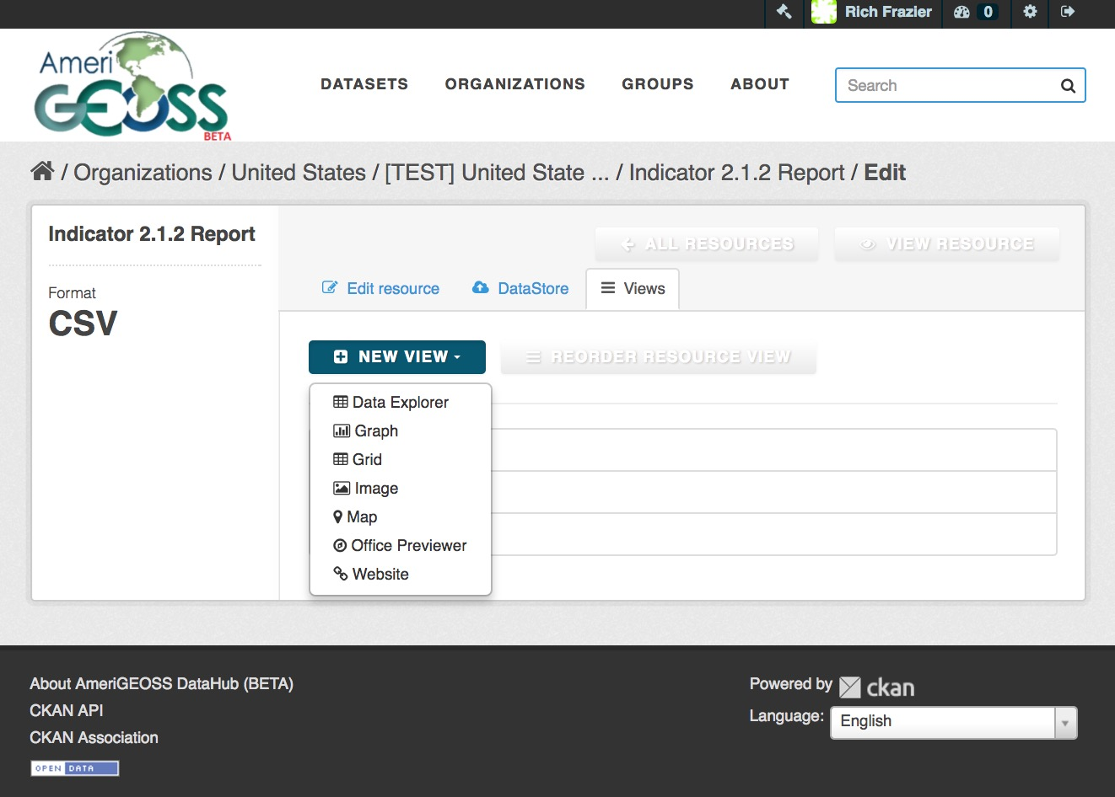
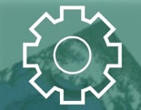
AmeriGEOSS / Community Platform
About AmeriGEOSS Initiatives | Data | Tools | Products | Services | Resources |
Data Catalog
Spatial Search
Tools and Products
Datasets
Collections
Map Viewer
The AmeriGEOSS Community Platform prototype provides a suite of resources and tools for integrating, synthesizing, analyzing, problem-solving and visualizing geographically enriched data to accelerate understanding and decision-making.

Slide 10
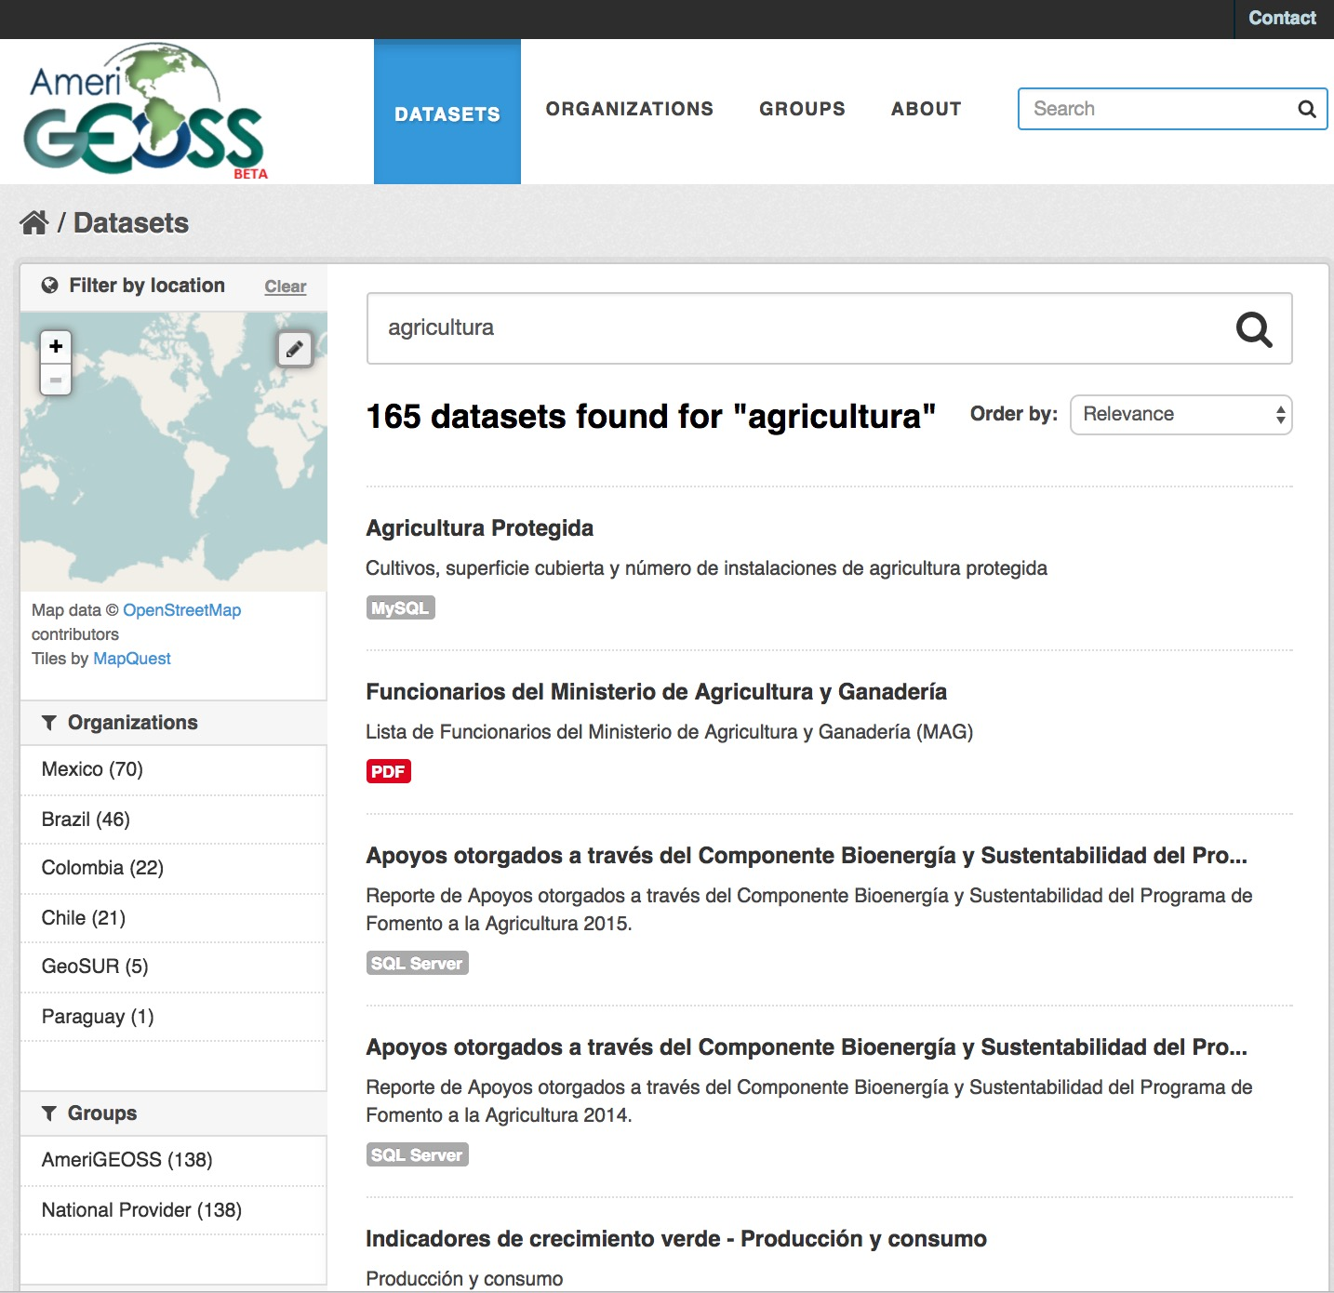
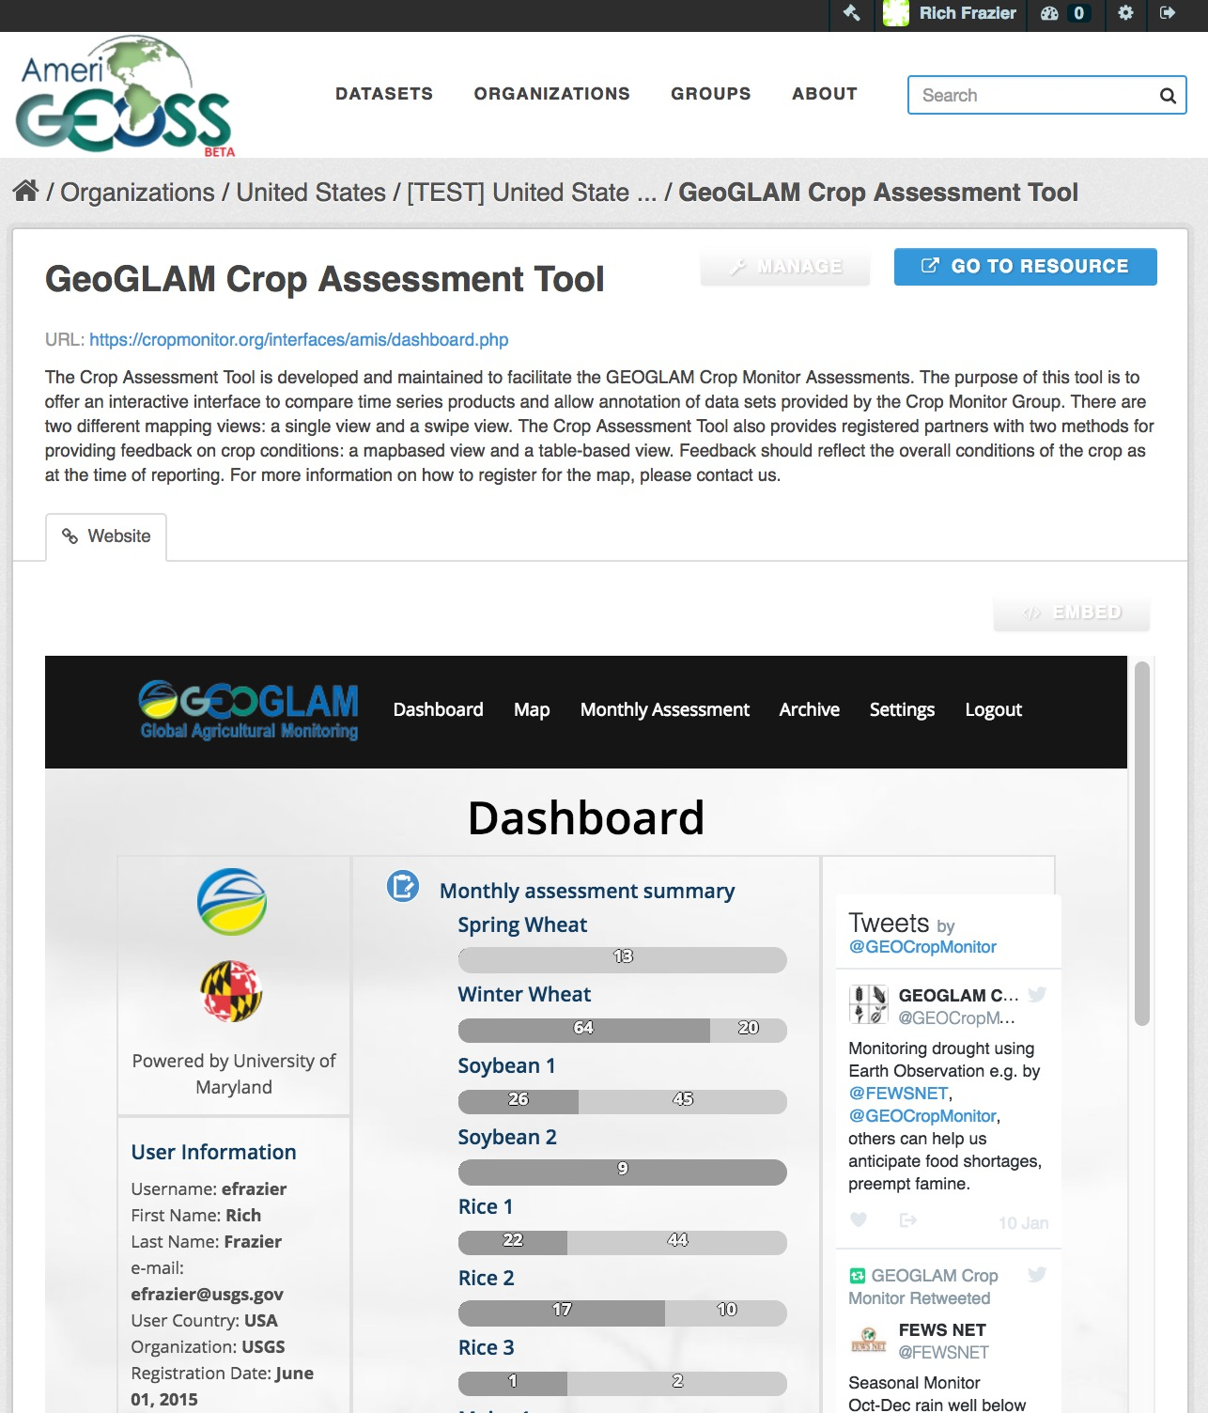
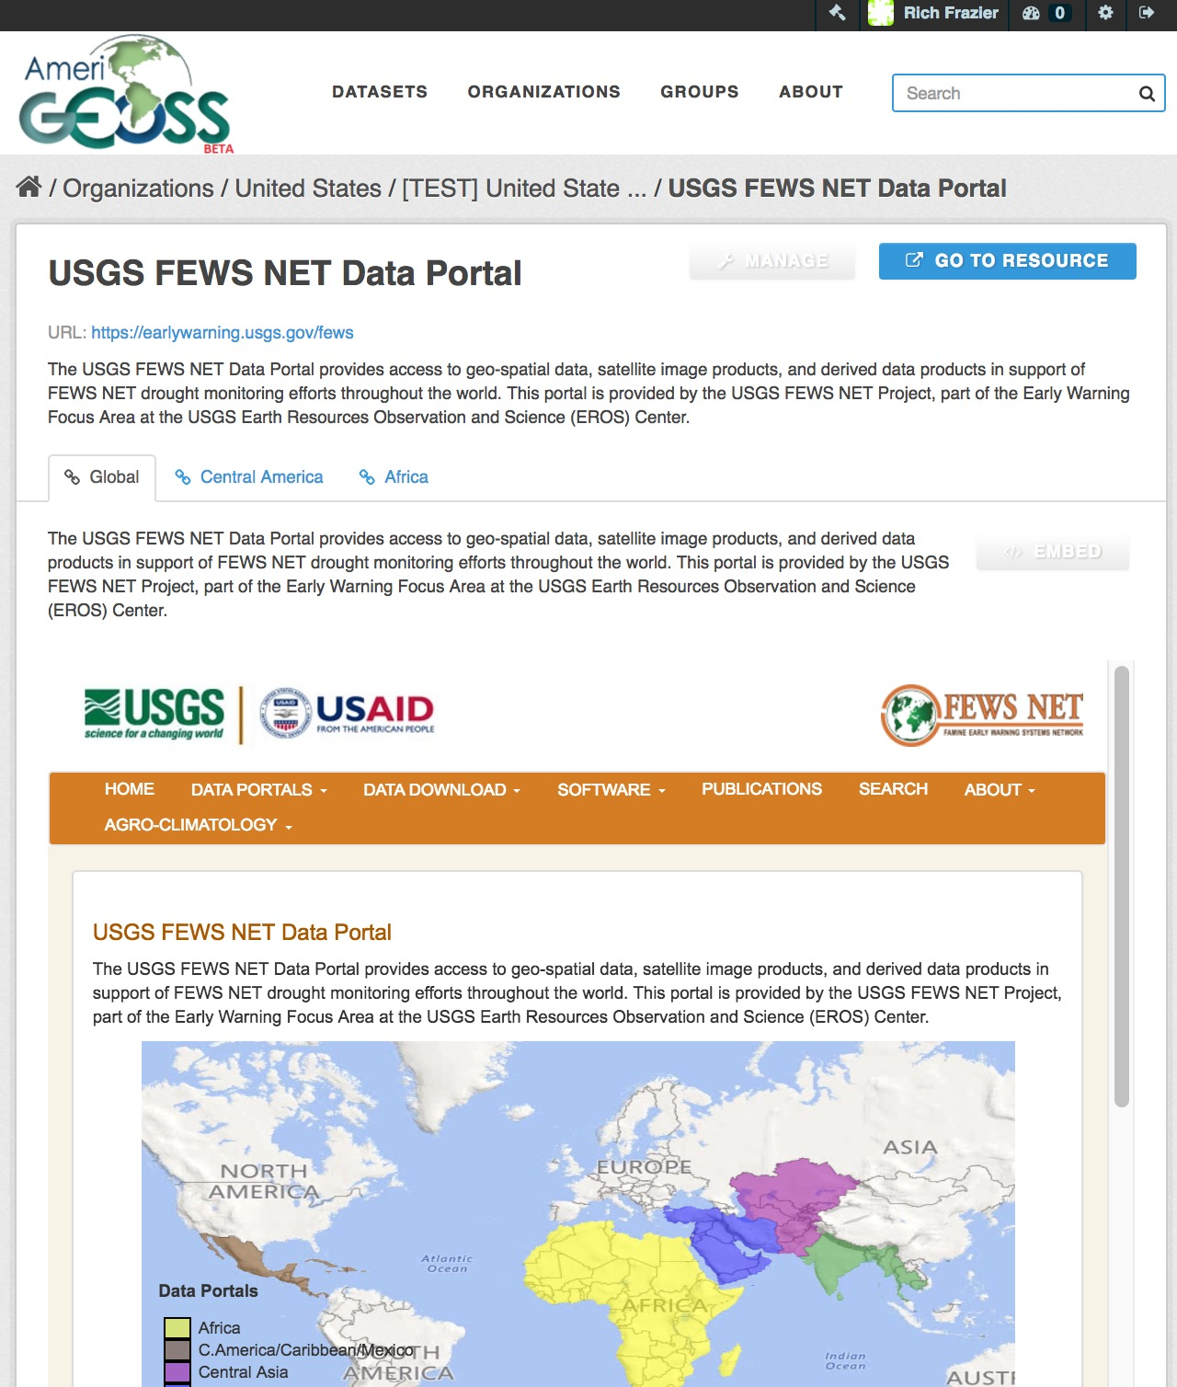
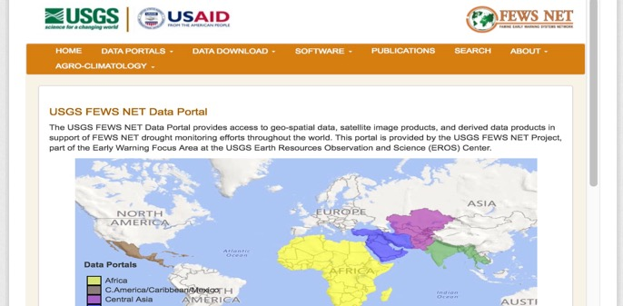
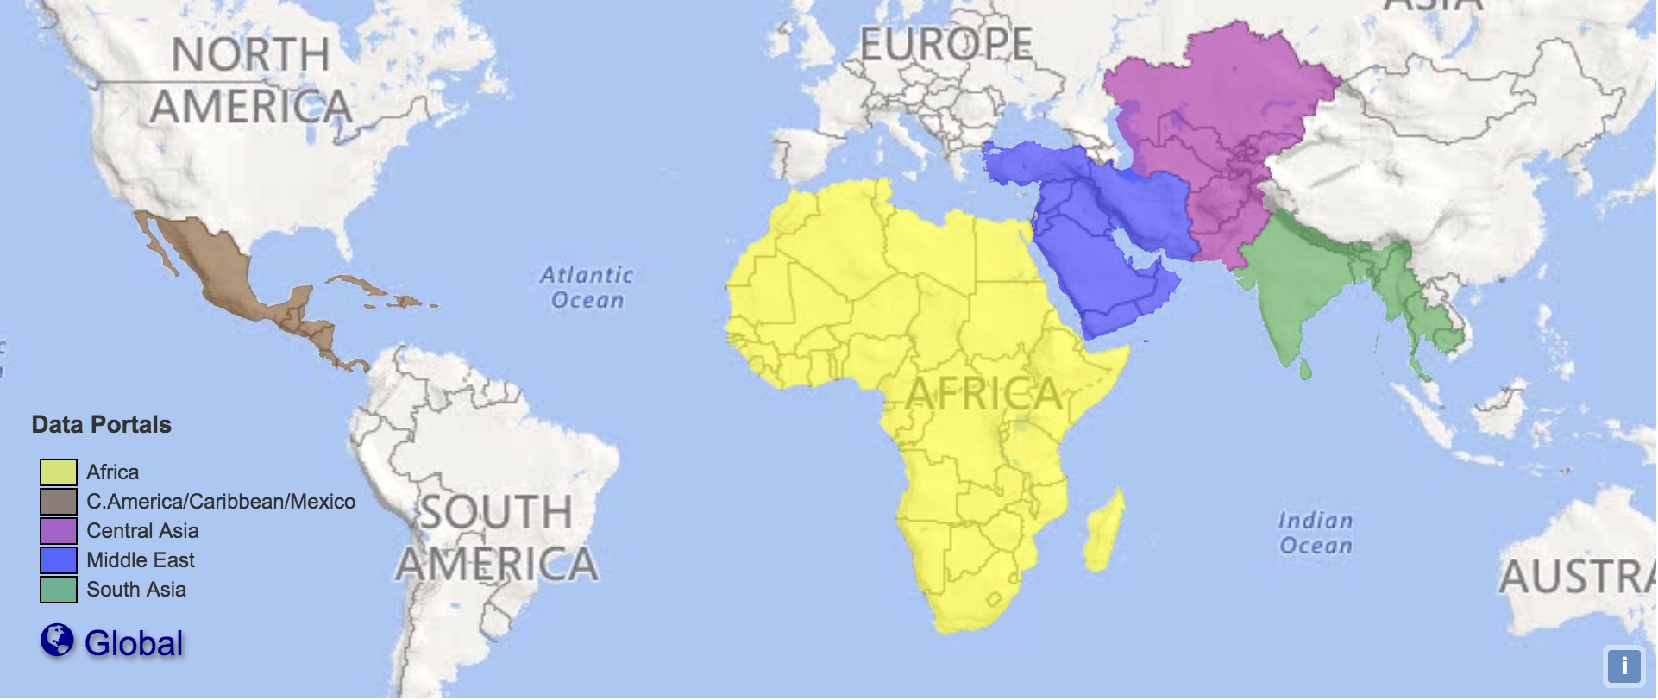




AmeriGEOSS / Community Platform Use Cases
About AmeriGEOSS Initiatives | Data | Tools | Products | Services | Resources |
Tools and Resources from
Global Providers in one Place
1
Find Data
2
Tools
3
Imagery

Slide 11











AmeriGEOSS / Community Platform Use Cases
About AmeriGEOSS Initiatives | Data | Tools | Products | Services | Resources |
Explore Social, Economic and Environmental , Reports, Information, Indicators…..and More
Find Water Data
1
Water Variables
2
3
Water Reports & Indicators
4
Use maps, applications and other analytical tools
CEOS Water Portal

Slide 12







AmeriGEOSS / Community Platform Use Cases
About AmeriGEOSS Initiatives | Data | Tools | Products | Services | Resources |
Find Disaster Data
Explore Disaster Tools and Resources
Fire Information Resource Management System
Use maps, applications and other analytical tools
Near Real-Time (NRT) active fire data

Slide 13
Thank you
AmeriGEOSS@Gmail.com/ AmeriGEOSS.ORG / @AmeriGEOSS /

Slide 14


