Slide 2
Copernicus Atmosphere
Monitoring Service
Xiaobo Yang / Senior User Support Officer / ECMWF

Slide 3
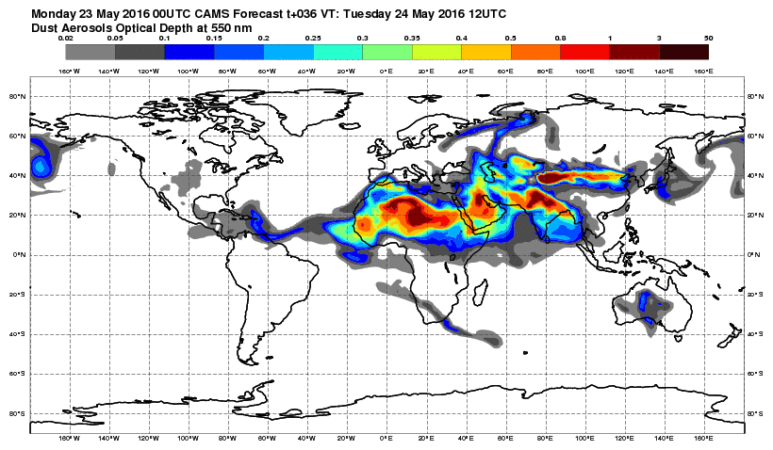
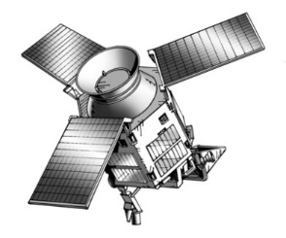
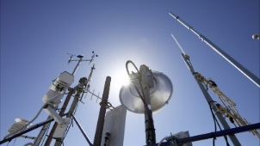
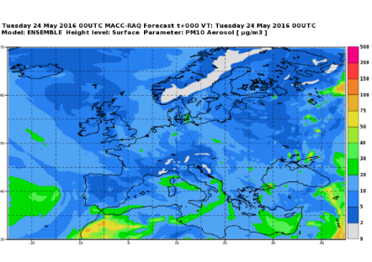
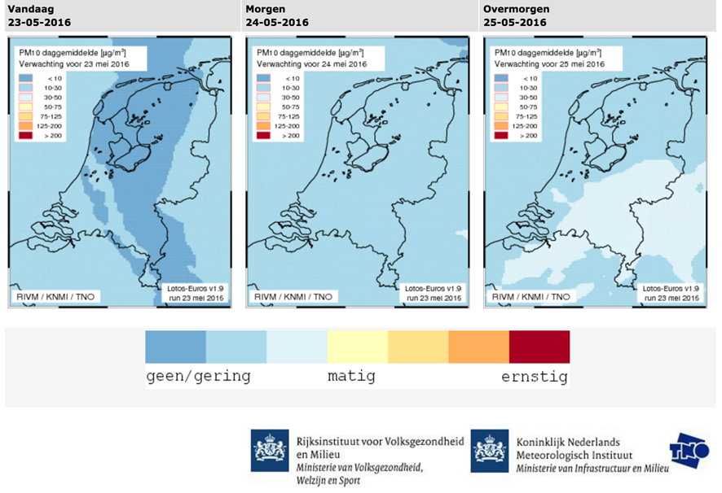
Climate / CAMS in a nutshell
In-situ observations
Space Agencies
National scale
15

Slide 4
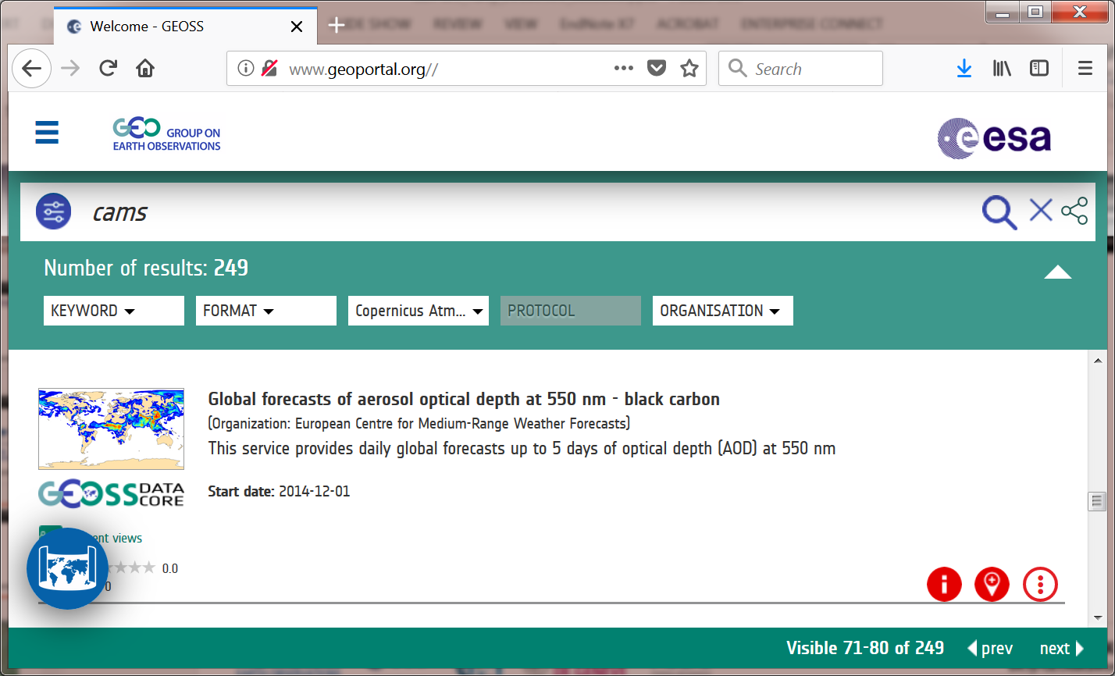
Climate / CAMS & GEOSS
GEOSS Portal started harvesting CAMS metadata in Feb 2018
Currently 249 records in 4 product categories: regional, global, supplementary and emissions products
Common interest: users!

Slide 6
Hackathon: Innovate with Open Climate Data
9-10 June 2018
ECMWF, Reading, UK
https://events.ecmwf.int/event/79/
Thank you
xiaobo.yang@ecmwf.int / http://atmosphere.copernicus.eu / @copernicusECMWF

