Slide 1
User Metrics Session
Introduction
Mirko Albani
Earth Observation Directorate
European Space Agency - ESA-ESRIN

Slide 2
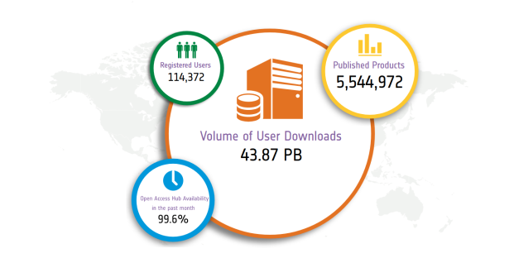
User Metrics … WHY??
… From different views …
Technologic/Platform viewpoint:
To improve the access environment
To reduce lags in the access process
To improve resources management
To improve GUI and Interfaces
Investments and ROI viewpoint:
To increase EO data usage
To include not-traditional users and countries
To improve and address funding
Earth Observation Data viewpoint:
To improve the data quality
To encourage new knowledge production
User Engagement viewpoint:
To stimulate the scientific interest
To improve Citizen outreach
To simplify the access process

Slide 3
EO Evolving Landscape
EO user base is expanding rapidly, and includes a growing number of non-experts whose main interest is the easy transformation of data into information.
Data volumes and diversity are also increasing rapidly, which requires alternatives to traditional data download dissemination schemes.
→ Development of easy-to-use data analysis platforms and tools, such as Exploitation Platforms or Data Cubes, by which users can access processed and organised data and tools for the transformation of data into relevant information.
→ Data platforms can co-exist or interact with an increasing number of EO data service environments maintained by large commercial cloud providers that have enormous capacities for data storage and processing.
Only full commitment to user needs and expectations can assure that CEOS agency initiatives will be successful. Therefore, user acceptance and user behavior need to be rigorously measured in any activity.

Slide 4
Overarching Objectives
Increase and foster the uptake of Earth Observation Data in term of Quantity and Quality.
Improve investment and ROI.

Slide 5
User Metrics: challenges
How to maintain visibility of and contact to user communities in such an evolving landscape and environment where downloading from central repositories is complemented/replaced by working within several different hosted environments?
Beyond data usage, how to capture user feedback and satisfaction?
Notes:
Example: Sentinels data accessible/usable through:
Copernicus SCIhub
Member States Collaborative Ground Segments
International Partners Platforms/Systems
Copernicus Services
Data and Information Access Services (DIAS)
Google & Amazon
Thematic Exploitation Platforms
Others…

Slide 6
User Metrics: challenges
Maintain investment in EO activities being able to measure the ROI through its use and value generation.
Consider many more third parties developing applications and business, along with massive automation and consumer use of open data.
Increased difficulty to collect metrics necessary for administrative reporting using things like user logins or agency portal access.
Consider to use alternate methods to gather such information whilst respecting privacy issues and remaining true to the principle of open data.
The risk to EO data becoming an anonymous contributor to major applications outcomes is high as increasing use sees it become taken for granted.

Slide 7
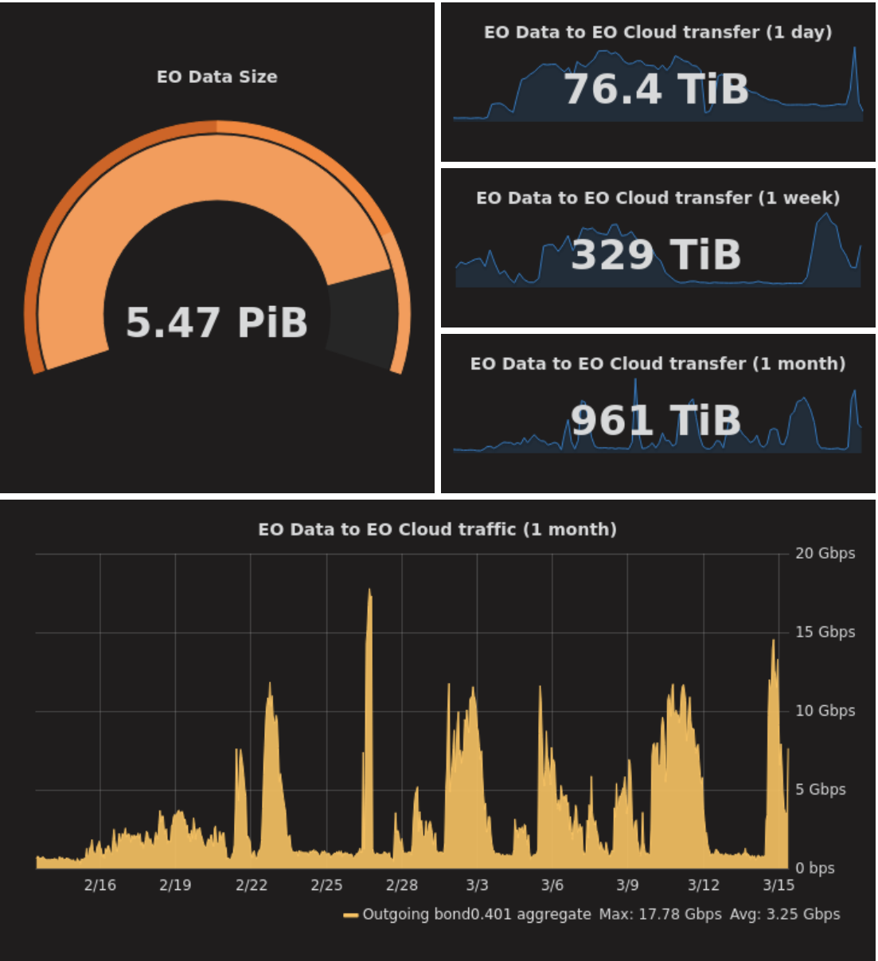
User Metrics … WHAT? Initial excerpt…
Earth Observation Data Metrics:
Use of data to create new information/knowledge
Time series requests
Data downloaded (size and numbers)
Domain/Area of interest
Location/Country
Mission/Sensors data request
Age of Datasets (versions)
Web/Platform Metrics:
Number of new registrations (new users acquisition)
Number of downloads
Average session duration
Average resolution time as regards issues that affect the users directly (keep this low to prevent rapid user disaffection)
Average number of downloaded/accessed resources per day
Percentage of accesses from mobile devices
Session duration and interval
Retention Time
Errors handling and management

Slide 8
User Metrics … WHAT? Initial excerpt…
User Engagement Metrics:
Number of active users
Number of registered users
Web referral
Cited pages
Number of scientific presentations/publications/project
Number of mentions
Social listening services might be used
User Satisfaction Metrics:
Rate of positive user feedbacks, i.e. number of positive feedbacks divided by the total number of feedbacks
Likes

Slide 9
User Metrics … WHEN??
Implicitly (During the registration):
Self-registration
Registration with approval
Registration requiring evaluation
…
Implicitly (During the user activities):
Downloading activities
Topic and Data Search
Documentation consultation
…
Explicitly: (After the end of the process)
Survey and questionnaire
Like
…

Slide 10
CEOS: User Metrics
Committee on Earth Observation Satellites
CEOS Plenary 2017 confirmed need to define a data use metrics framework through which agencies can contribute to a ‘sector wide’ view of how EO data is actually being used, not just how much is being downloaded.
→ More coordinated and coherent EO data offering, against which organisations can confidently invest their resources and leverage their distribution channels to users in an effort to realise benefits that go far beyond the traditional mono-mission approach.
CEOS Work Plan 2018-20 Action FDA-13: Develop a User Metrics Best Practice to be recommended for application by CEOS agencies
Leveraging on the experience being gained by individual agencies and collating available user metrics
Addressing the evolving user and EO data exploitation landscape
Covering a spectrum of criteria, reflecting different viewpoints, being realistic and concise
Considering approaches in other domains

Slide 11
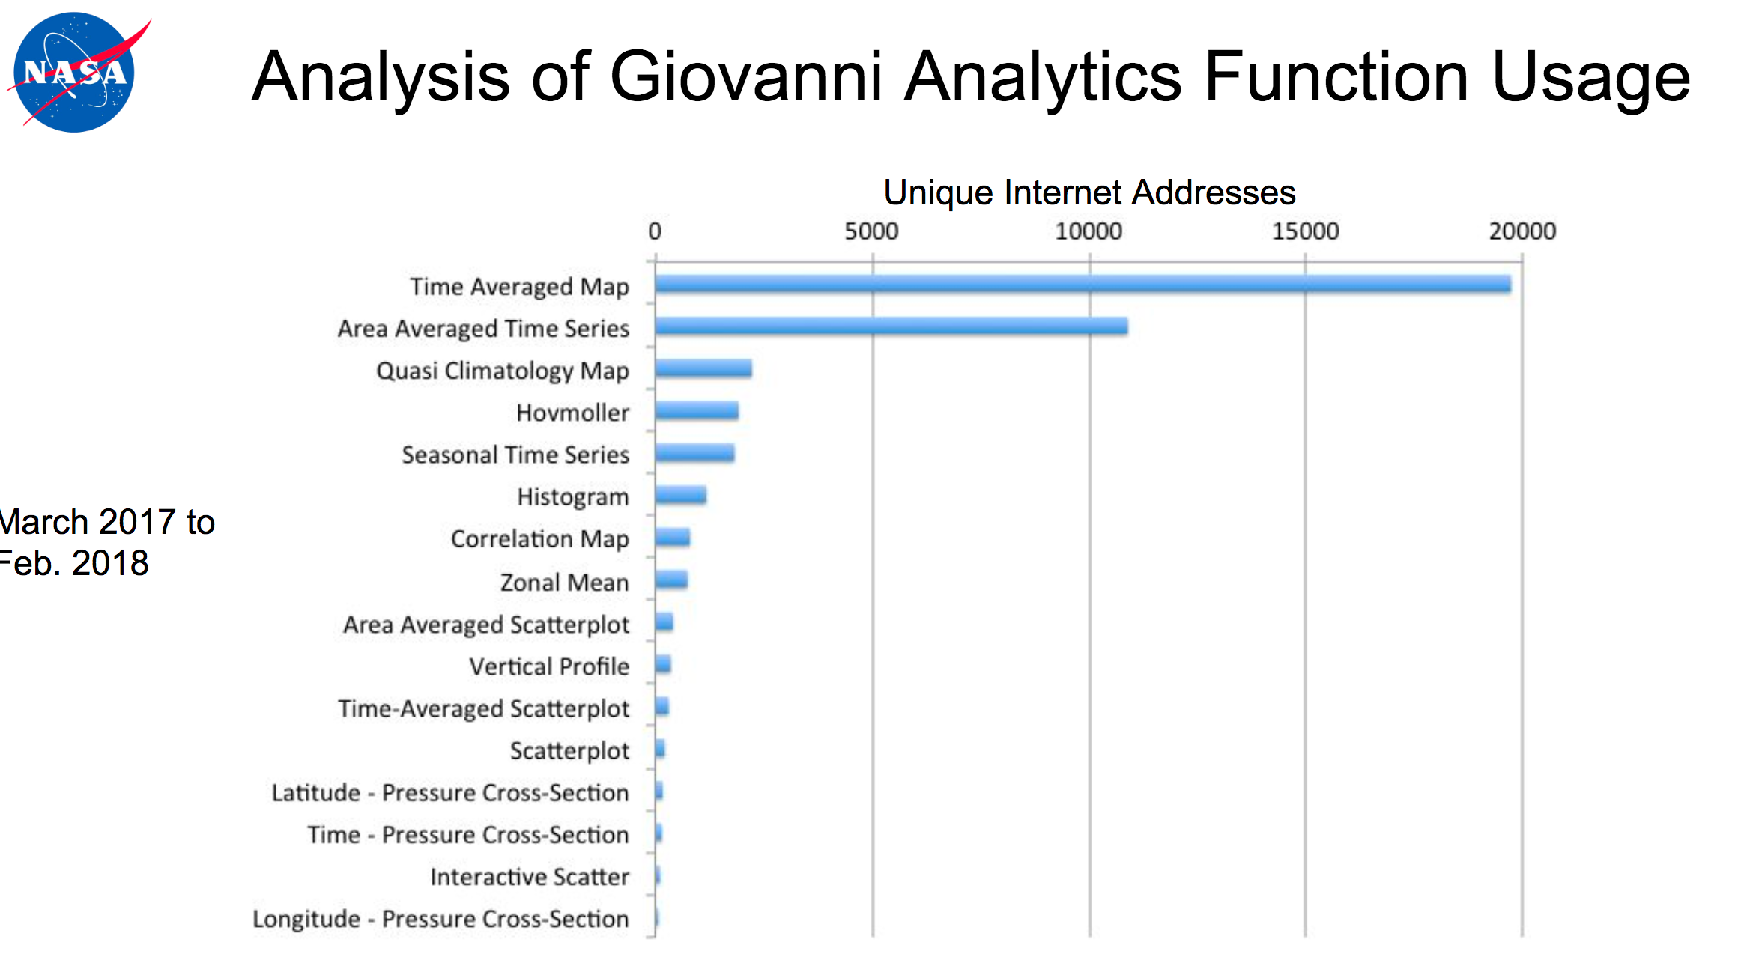
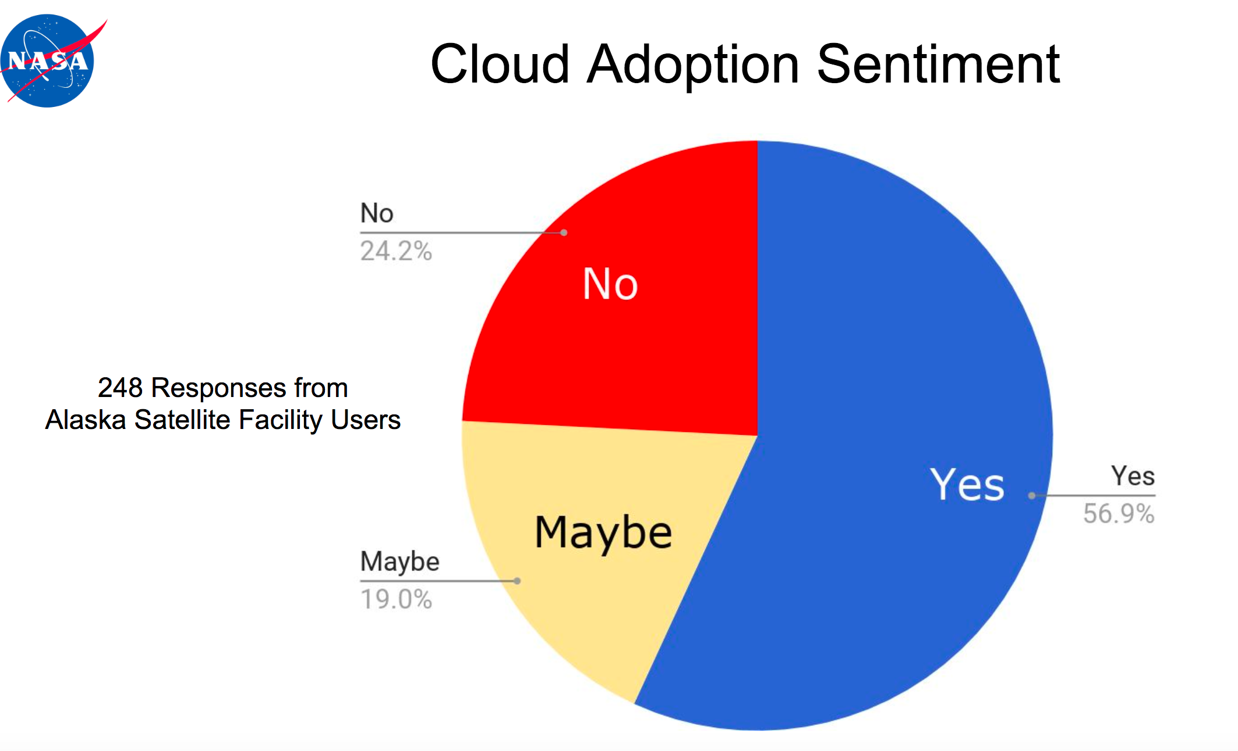
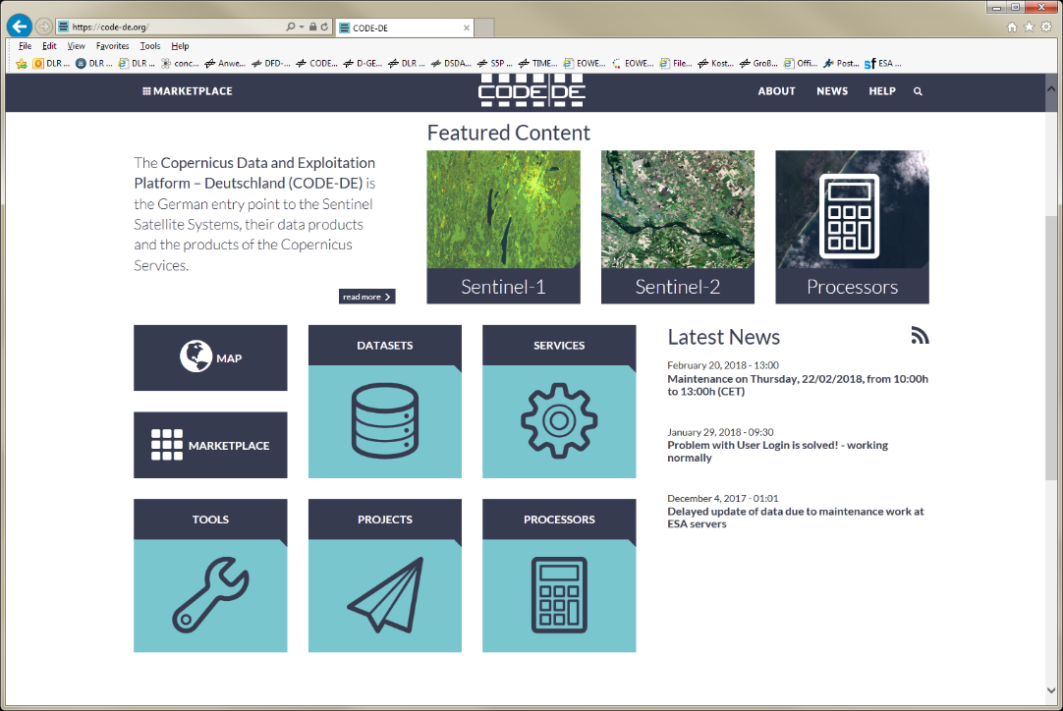
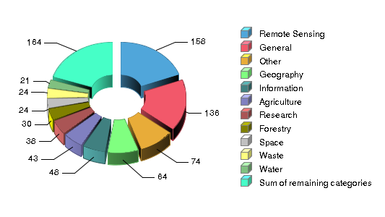
CEOS WGISS - User Metrics
Committee on Earth Observation Satellites
Presentations from several agencies (ESA, NASA, DLR) on current practices
Started work on best practice across interested agencies
Need to define purpose and choose a subset of metrics to structure inventory of EO Resources
WGISS action on ESA
1-100
100-199
200-399
400-799
>800
Number of user projects
Persistent Identifiers and Personal data Protection

Slide 12
Objectives of Panel Session
Get an insight of current user metrics capturing approaches in the GEOSS Platform and by GEOSS data providers
Collect and exchange feedback, experience and lessons learned

Slide 13
Thank you
Mirko.albani@esa.int

Slide 14
Points for Discussion
How to maintain visibility of and contact to user communities in such an evolving landscape and environment where downloading from central repositories is complemented/replaced by working within several different hosted environments?
Open data policies and fast registrations (i.e. few info from users) will increase difficulty to collect sufficient metrics. What is the right compromise? What level of insight in their activities and data use are users happy to share? What incentives could be proposed?
What can/should be done as part of the transactions within the cloud environment (monitoring) and what should be covered through user surveys? What information should be gathered by Cloud Providers?
Should the metrics be openly available? Or only be available to the data provider supplying the data?
Which approaches in the commercial/business environment and markets could be helpful to gather ideas?
Definition of “Active users”: A registered user can be defined “Active User”? Perhaps better to measure user actions like Download, etc. Number of active users := users returning more than once in the reporting period?
Once metrics are defined what are the best tools and best ways to collect them and to derive statistics?

