Slide 1

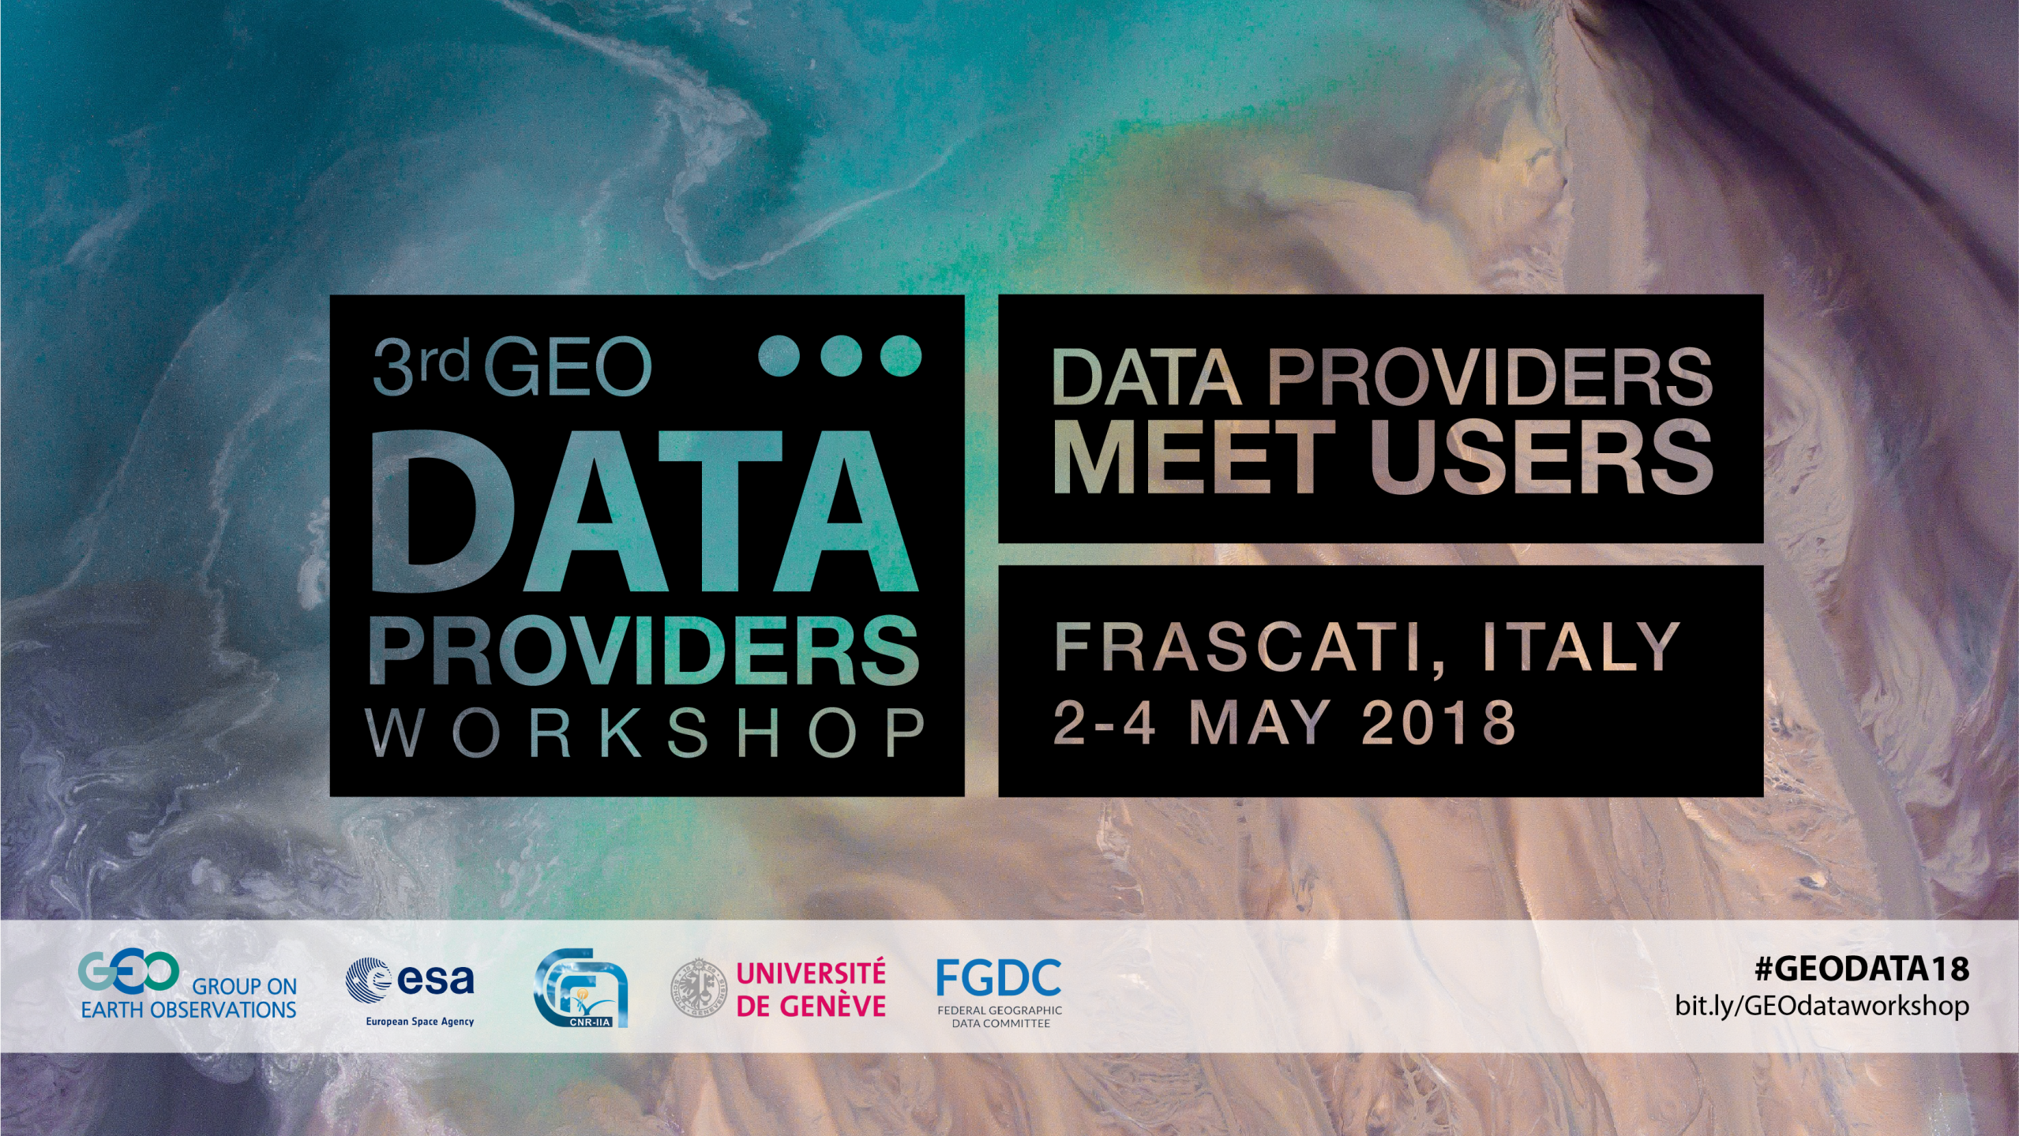

Slide 2
GOS⁴M: the GEO Flagship to support the Minamata Convention on Mercury
Sergio Cinnirella & Nicola Pirrone
CNR-Istitute of Atmospheric Pollution Research

Slide 3
The Global Observation System for Mercury
(GOS⁴M)
It is aimed to support the UN Global Partnership on Mercury Fate and Transport Research (UN F&T) of the UN environment in the implementation of the Minamata Convention by providing globally distributed mercury monitoring data for air, marine and terrestrial ecosystems and validated regional and global scale models. It will support UN environment and Nations to assess the effectiveness of measures that will be undertaken.

Slide 4
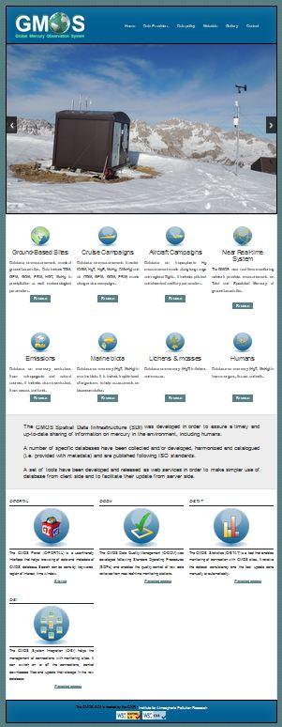

Mercury Observation around the Globe
The long story of mercury monitoring was stretched to a breaking point in 2010 when EC funded GMOS (Global Mercury Observation System) project.
www.gmos.eu

Slide 5
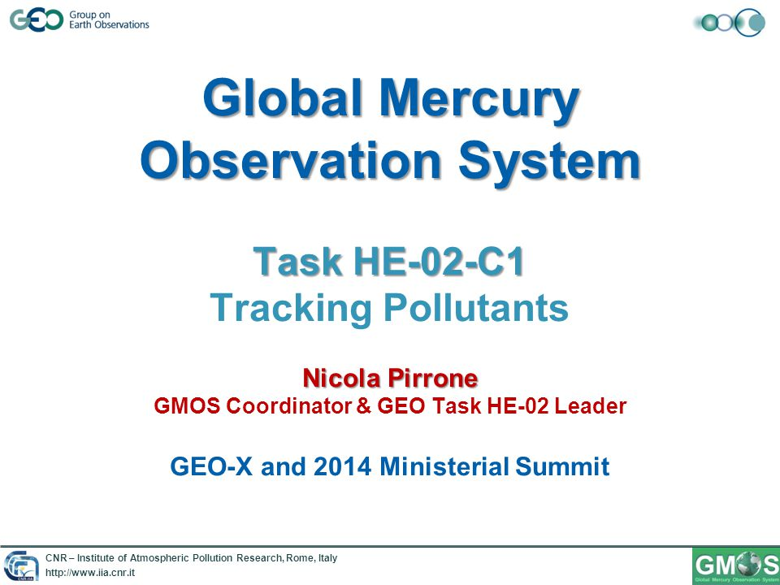
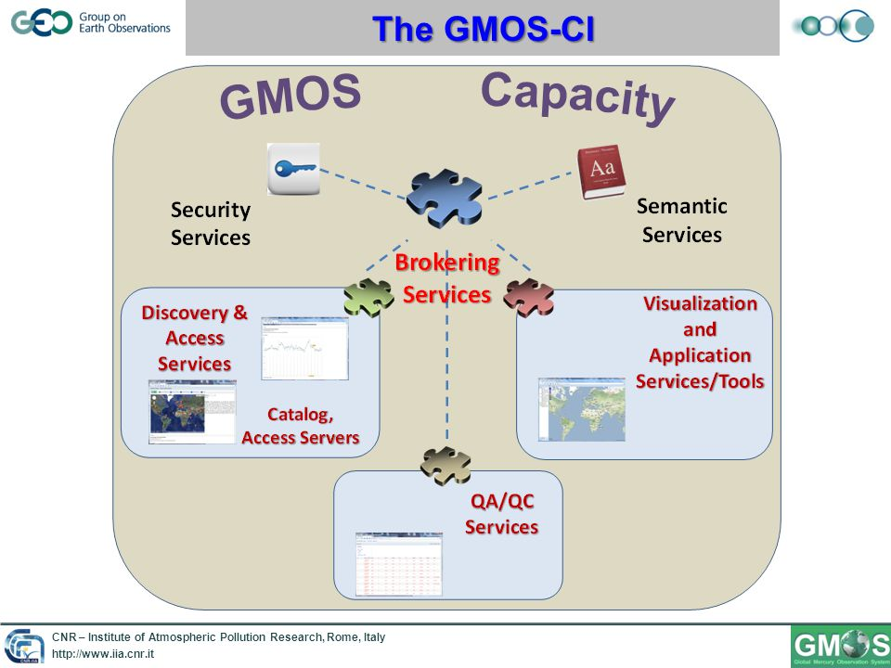
GMOS and GEO Work Plans 2009-2015
GMOS was part of the Task HE-02 "Tracking Pollutants" aimed to develop a global observation system for mercury & POPs.

Slide 6
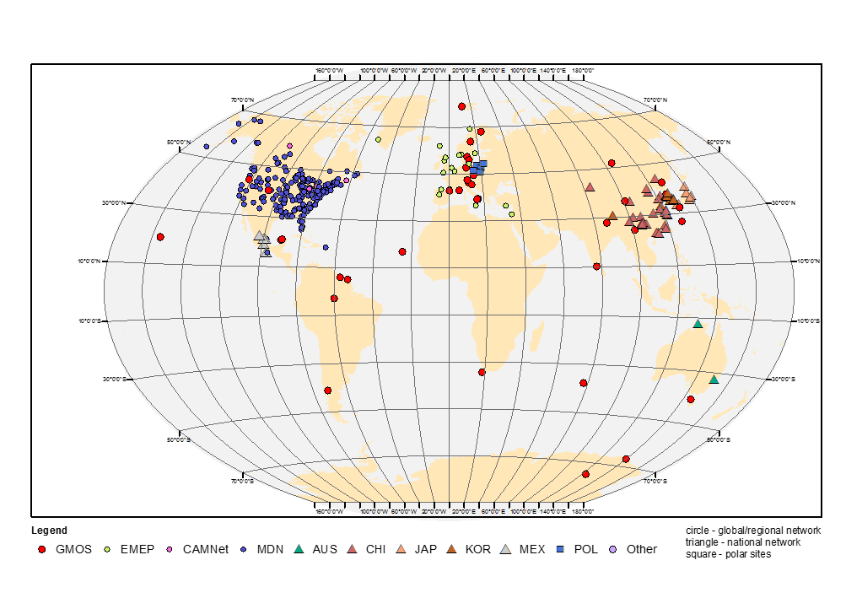
Users’ needs
To integrate existing mercury monitoring networks
To increase the availability and quality of EO data
To support harmonized metadata production
To develop advanced services
To endorse full and open access of EO data
To broaden GEOSS and the Copernicus user base
To engage relevant user communities
To support UN environment and Nations to evaluate the effectiveness of measures undertaken

Slide 7





In-kind support to GOS⁴M from EU
The Integrated Global Observing System for Persistent Pollutant (IGOSP) project of ERA-PLANET
10 M€ (11.7 M$)
Technology

Slide 8










Processing information
Metadata
(ISO/TC211)
Data & Metadata
(WMS, WFS
ISO/TC211)

Slide 9




Resources mapped
 | Metadata | Map services
 | 1300 | 879
 | 746 | n/a

Slide 10
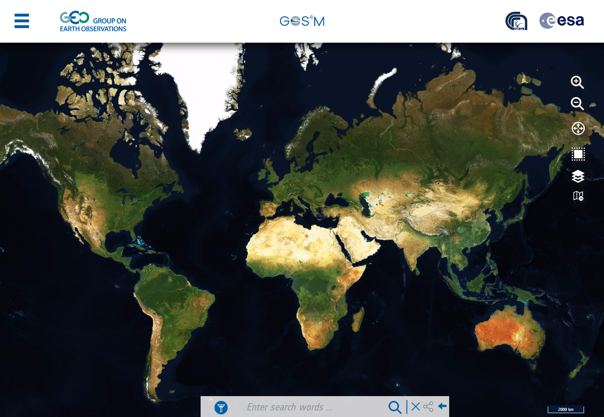
The GOS⁴M mirror portal
http://www.geoportal.org/community/gos4m
Reuse of GEOSS Portal functionalities
for GOS⁴M Portal
Align with GEOSS Look & Feel for a ‘one portal’ experience.
Better serve the scientific community
Easy implementation

Slide 11
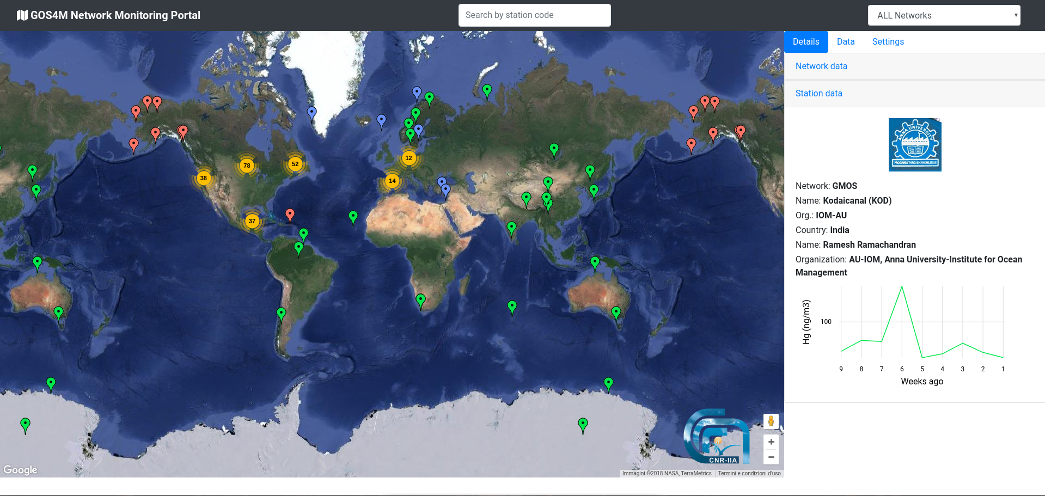








The GOS⁴M monitoring portal
under development
Powered by
Include all available information
Give information/statistic on monitoring sites
Provide advanced tools for analysis
observation
knowledge

Slide 12

section title / slide title
Thank you
gos4m.org

