Slide 2
Session 8 / User-Centered GEOSS: The customized dynamic approach
Slido: #2May_Session8
moderator
Guido Colangeli, ESA
speakers
Paola De Salvo, GEO
Roberto Roncella, CNR
Ketil Koop-Jakobsen, Atlantos
Stephan Dietrich
Eliana Lisanti

Slide 3
The GEOSS Platform
User Centric Approach
Guido Colangeli, ESA

Slide 4
St. Petersburg, Russia
November 9th, 2016 - 11:37 Zulu
A gentleman approaches
the ESA booth at the GEO-XIII
«I saw the GEOSS Portal demonstration.
It’s just what I need for my Community.
Can we reuse it?»

Slide 6
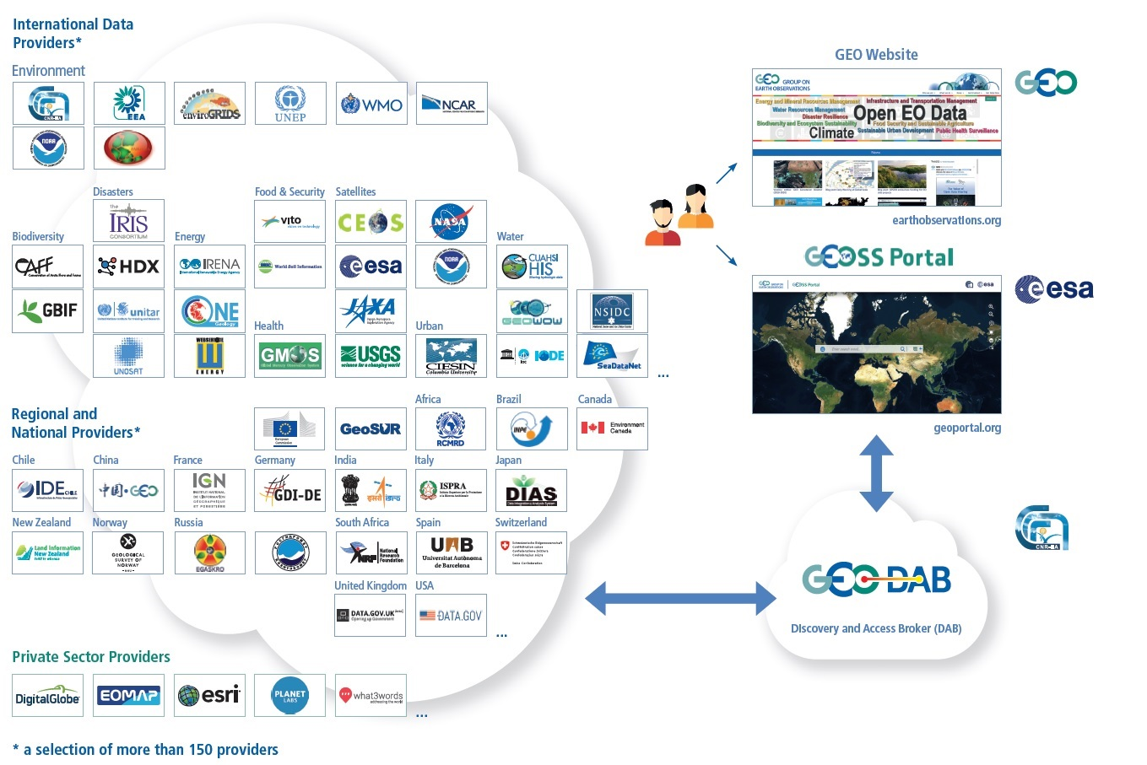
Moving towards a User-Centric
It’s all about what the users need
I need data for my community…
I want to use
My search parameters
My language
Selected GEOSS data-sources (and no others…)
GEOSS and my data sources (combine)
Functionality of interest to me…
My graphical user interface / portal …

Slide 7
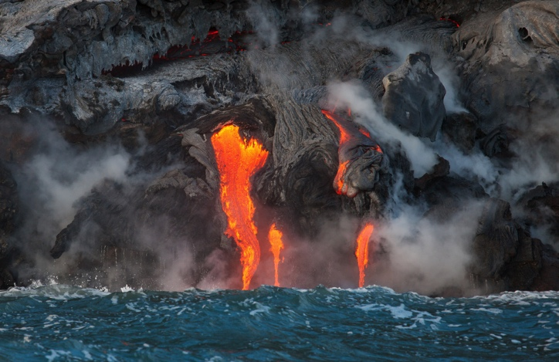
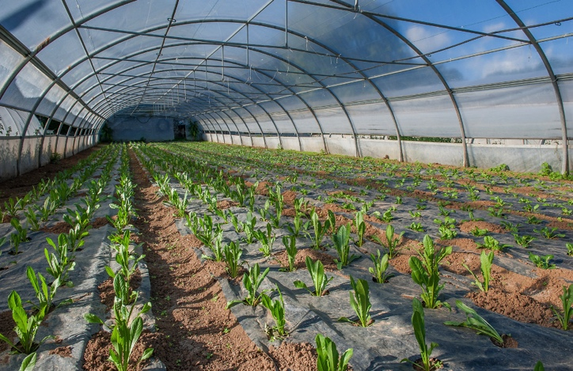
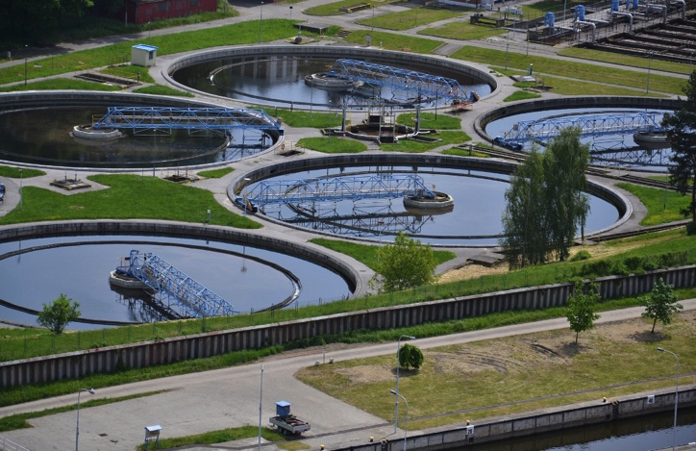
Climate
Societal Benefit
Areas

Slide 8
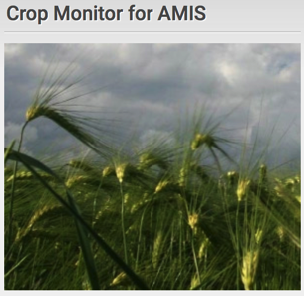
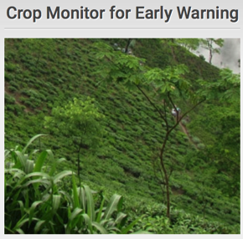
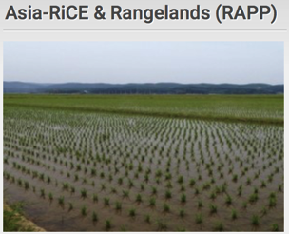
Initiatives
Biodiversity
Observation
Network
The Global Observation System for Mercury
Geohazard Supersites
and Natural
Laboratory Initiative
Notes:
How does GEO Respond to the requirements, e.g. via implementation of Initiatives/Flagships/…

Slide 9
Moving towards a User-Centric
I need data for my community…
Collaborate
Customise
Reuse
I want to use
My search parameters
My language
To me known GEOSS data-sources (and no others…)
GEOSS and my data sources (combine)
Functionality of interest to me…
My graphical user interface / portal …
Communities often use their own Data and Portals and have their own specificities
GEOSS shall respond to Users’ needs
A new concept in supporting User Communities has been developed
Tailored – user-centric approach

Slide 10
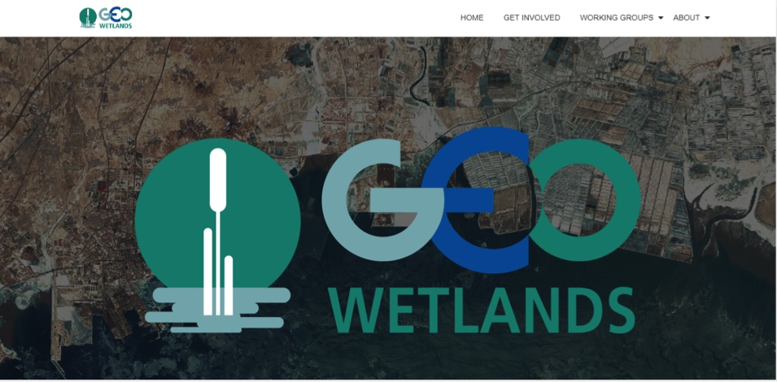
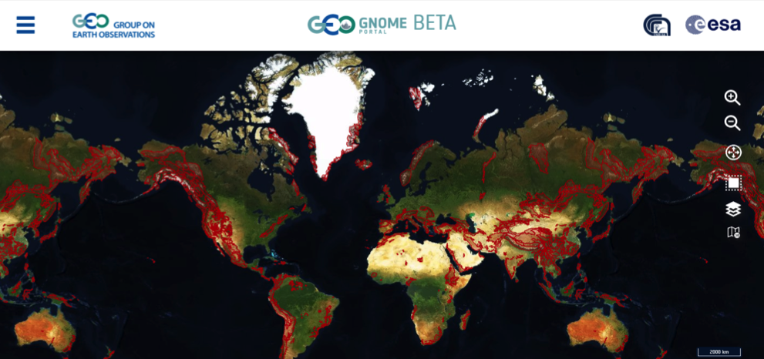
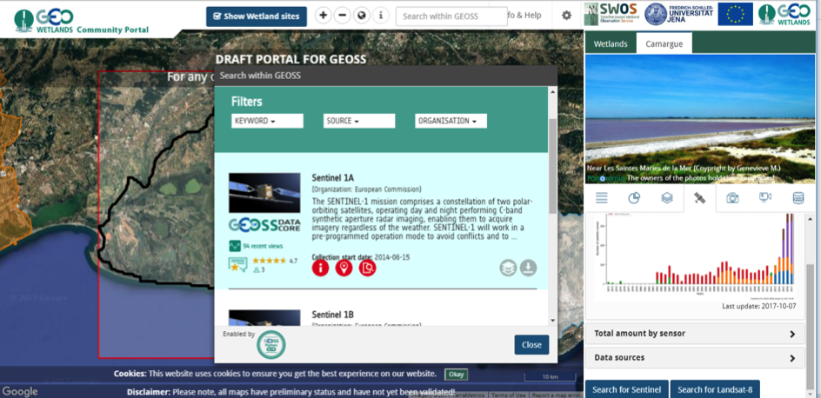
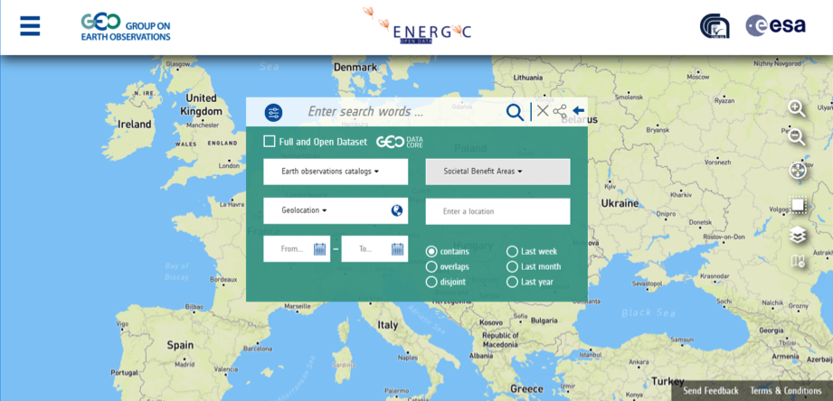
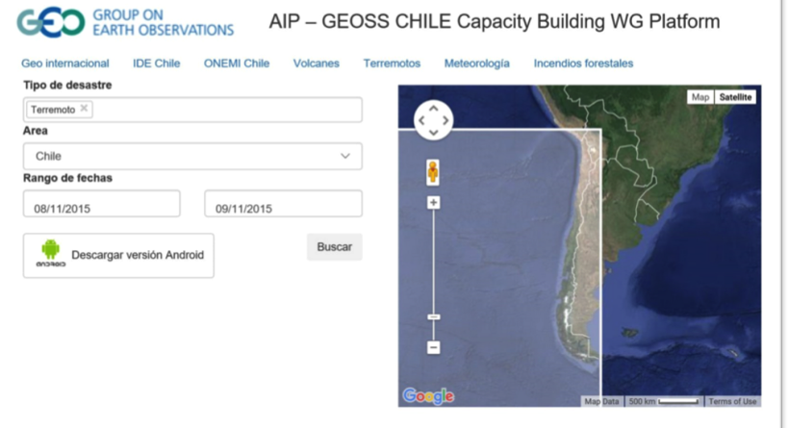
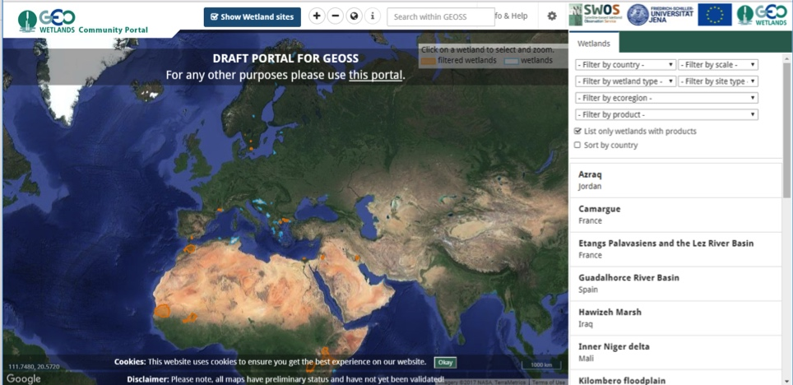
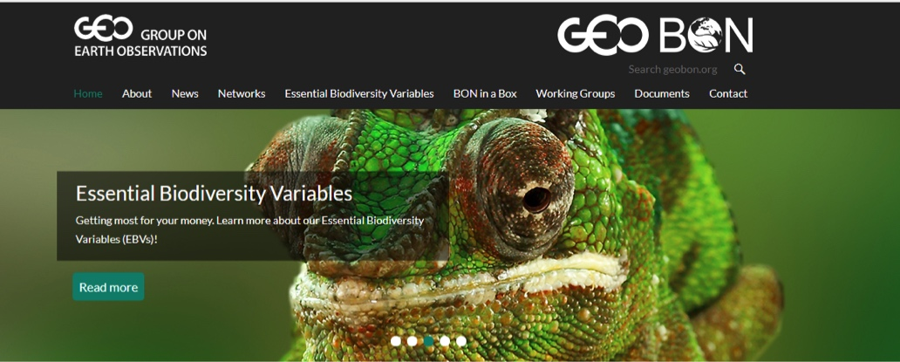
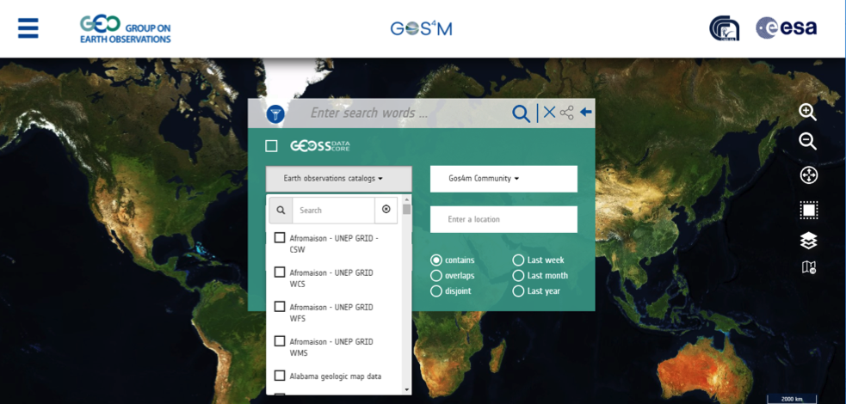
Moving towards a User-Centric
GEOSS View
GEOSS Widget
GEOSS Mirror
GEOSS API
To orient the whole GEOSS resources to the specialised themes the community is interested in
To reuse and embed in your own Portal some GEOSS key functionalities and GEOSS Portal look and feel
To reuse the GEOSS Portal as a whole, tailored to resources, themes and functionalities of the Community
High level open Application Program Interface to directly dialogue with the GEO DAB
GEO CRADLE
Disaster
GEOSS Like
GEO-GNOME Community Portal
GEOSS CHILE
To feedback, rate, comment, share resources
Water
ENERGIC Open Data Portal
GLOBAL OBSERVATION SYSTEM FOR MERCURY (GOS4M)
GOS4M Community Portal
GEO Wetlands Community Portal

Slide 11
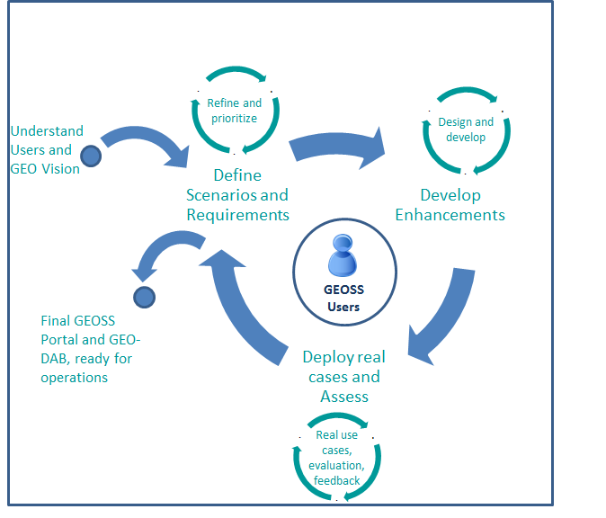
Approach
Agile development approach.
Based on repetitive circle of enhancements
With a full emersion of the GEOSS Users: developers and end-users (with different backgrounds)
In coordination with relevant stakeholders
1.
2.
GEOSS Platform ready for operations
3.

Slide 12
A User Centric Approach
→Build around three pillars
GEOSS Mirror
GEOSS
Status Checker
GEOSS View
GEOSS Like
Reuse
Collaborate
Customise
GEOSS Yellow
Pages
GEOSS Widget
GEOSS API
Thank you

