Slide 2
Federated Earth Observation (FedEO)
A. Della Vecchia, D. Guerrucci, M. Albani (ESA)
Yves Coene (Spacebel)

Slide 3
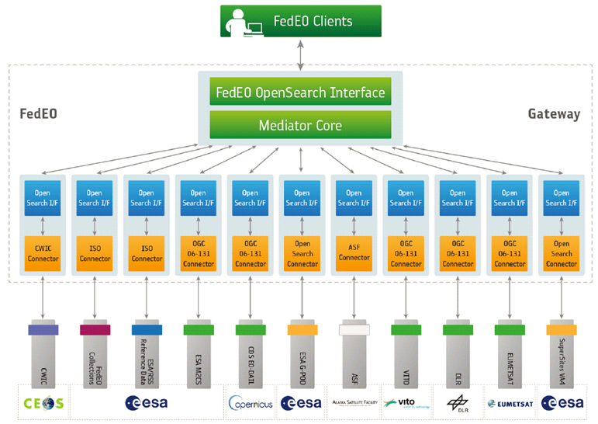
FedEO: Federated Earth Observation Gateway System
FedEO = Federated Earth Observation missions access
The FedEO system provides a unique entry point to a growing number of scientific catalogues and services for, but not limited to, EO European missions

Slide 4
Architecture Overview
FedEO is based on highly modular, standardised and interoperable SW architecture.
Visualization Layer
Client
Interoperable Metadata Encoding
DIF-10, ISO 19115-3, ISO MENDS
Gateway
Standardised Catalogue Interfaces:
OGC OpenSearch Specification [OGC13-026r8], [OGC 10-032r8]
CEOS OpenSearch Best Practice
Metadata Layer
Standardised Collection Metadata Model
ISO 19139-2
Standardised Product Metadata Model:
EOP O&M Metadata model [OGC10-157r4]
Collection Catalogue
Product Catalogue
Data Layer
Collection Metadata Ingestion Tool
Product Metadata Ingestion Tool

Slide 5
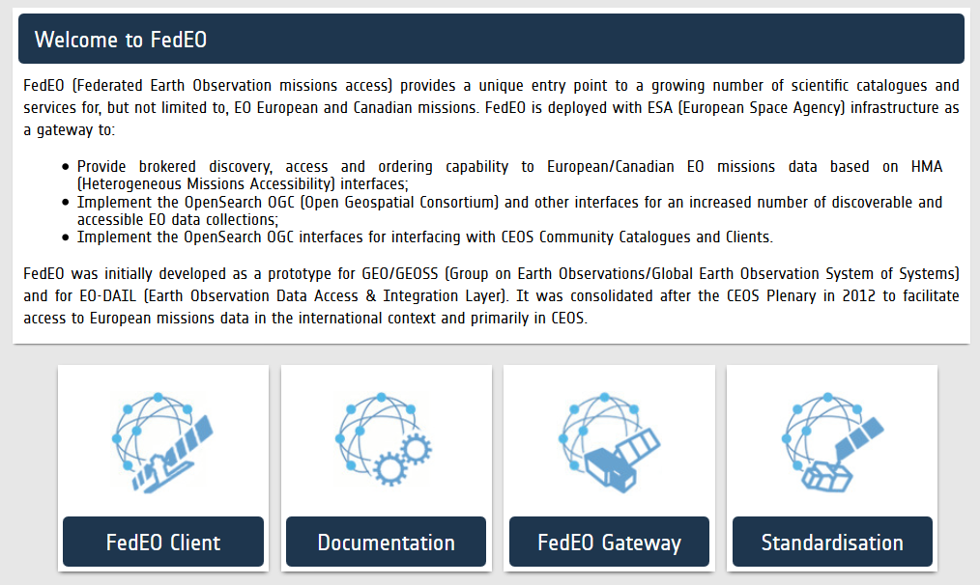
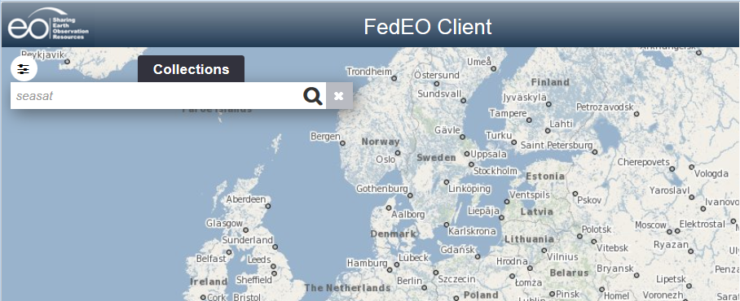
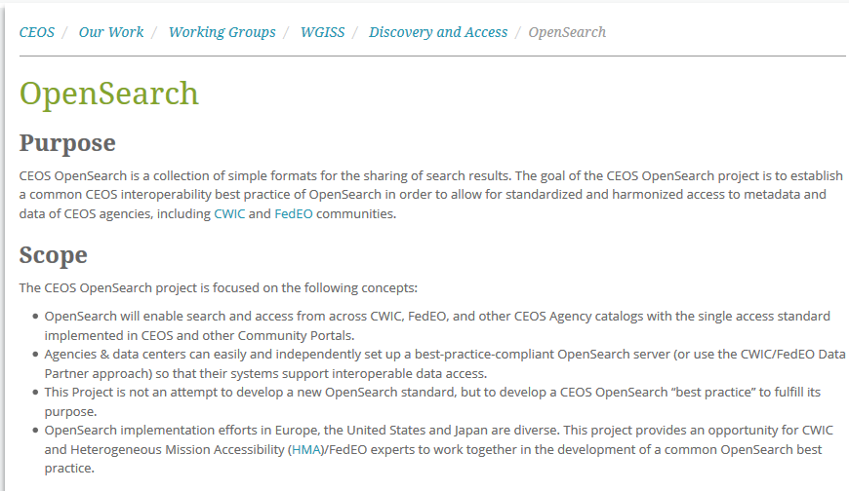
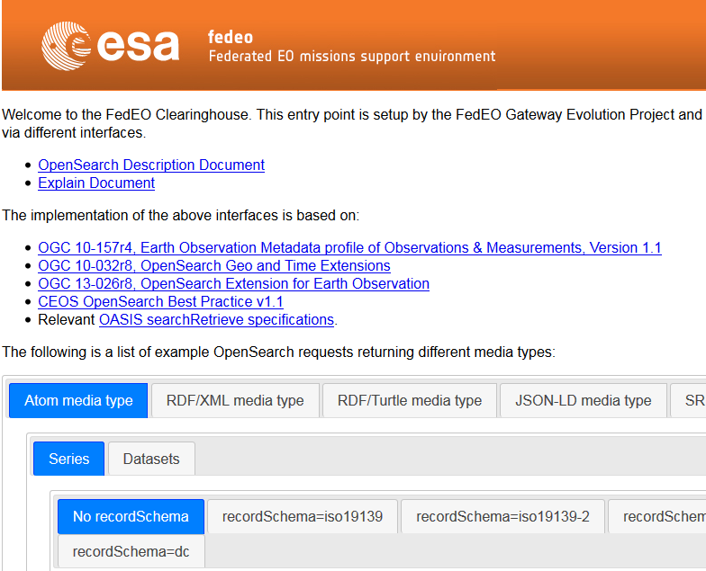
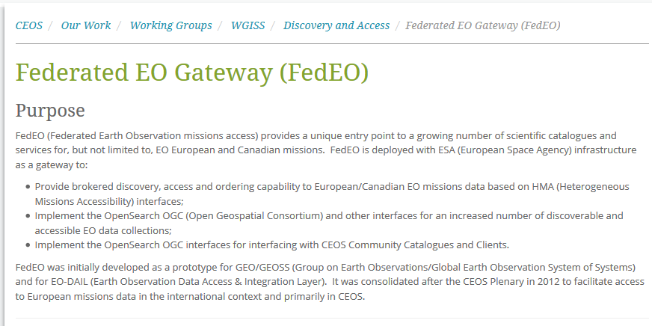
Client – FedEO Landing Page

Slide 6
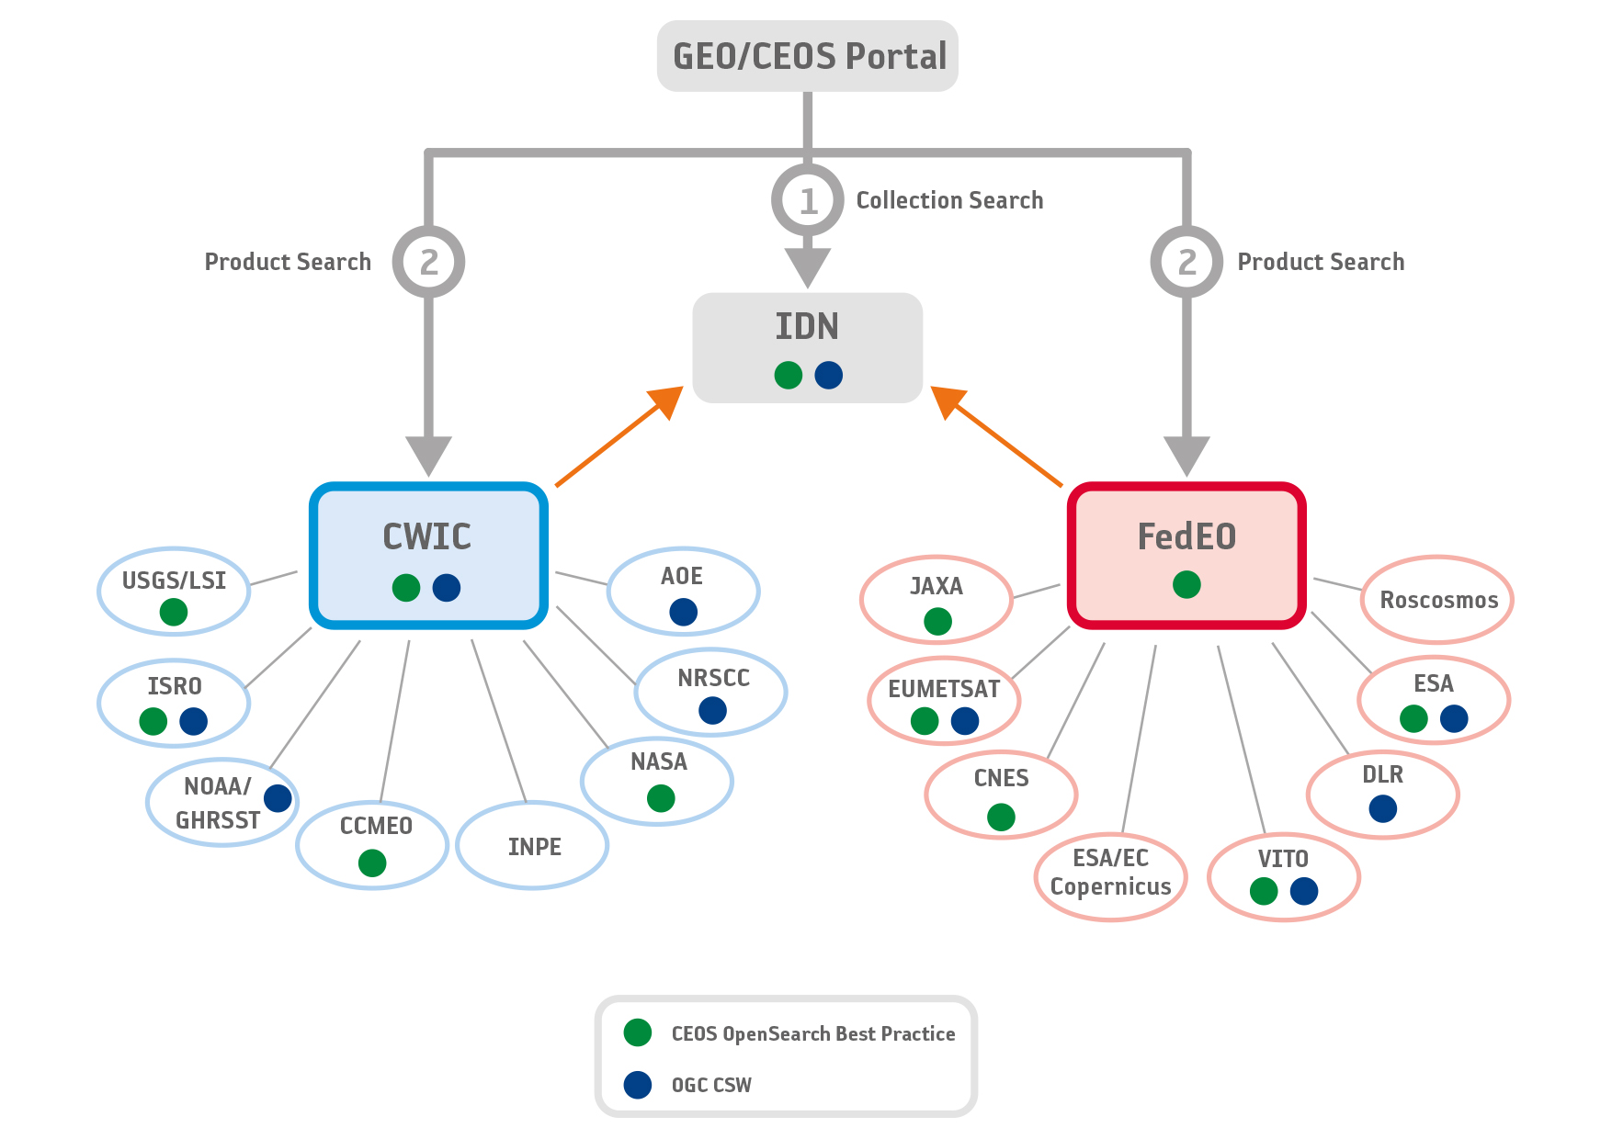
CEOS WGISS Objectives
CEOS Working Group on Information Systems and Services (WGISS) aims to:
Create and demonstrate prototypes to support CEOS and Group of Earth Observation (GEO) scenarios
Management of EO data and metadata, including creation of information systems and delivery of interoperable services
WGISS Connected Assets System Level Team aims to analyze the CEOS Data Assets, identify interoperability issues, propose solutions and feed CEOS standardization initiatives in synergies with OGC activities:
Consolidation and finalization of CEOS OpenSearch Best Practice document
Updating of the CEOS Developer Guide document in accordance with the BP finalisation
Start discussion about CEOS OpenSearch Conformance Tests document (in Q2 2018)
Next steps to be discussed:
Definition of Virtual Collection (e.g., Thematic collections, heterogeneous data collections)
Federation with non Earth Observation data providers (e.g., in-situ data)

Slide 7
FedEO Current Operational Set-up
FedEO Client Portal
https://eoportal.org/web/eoportal/fedeo
FedEO Readme Web Page
http://fedeo.esa.int/opensearch/readme.html
FedEO OpenSearch Description Document (OSDD)
http://fedeo.esa.int/opensearch/description.xml
FedEO documentation and information
https://wiki.services.eoportal.org/tiki-index.php?page=FedEO
http://ceos.org/ourwork/workinggroups/wgiss/access/fedeo/

Slide 8
Thank you
andrea.della.vecchia@esa.int
damiano.guerrucci@esa.int
mirko.albani@esa.int
yves.coene@spacebel.be

