Slide 2
The Water Information Network System - WINS
Sharing knowledge, Building capacity, Connecting people
Youssef Filali-Meknassi
Programme Specialist
International Hydrological Programme – UNESCO

Slide 3
http://ihp-wins.unesco.org/
Notes:
WINS is a open-access and participative online platform, which aims at sharing water-related information and bridging water stakeholders to support decision-making and build capacity. It builds on Geonode, and has been customized to fit the needs of IHP.
The idea is to offer the possibility to contributors (whether they are representatives of Member States, NGOs, organizations, specific projects, or the civil society) to share data and information, share knowledge on the platform, and connect with their counterparts.

Slide 4
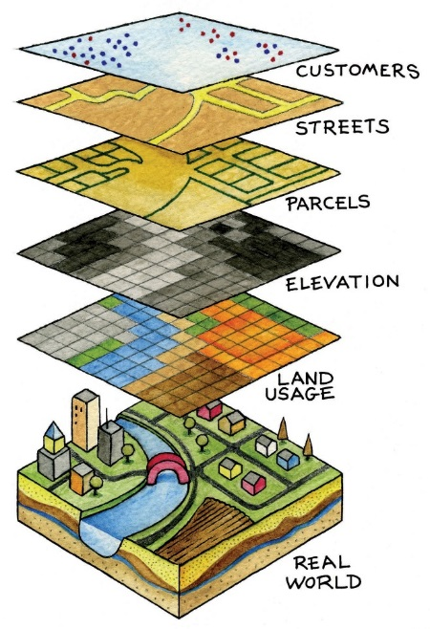
What is the Water Information Network System (WINS)?
Online participatory platform for sharing data, information and knowledge on water
A georeferenced information database
A networking hub
A knowledge sharing platform

Slide 5
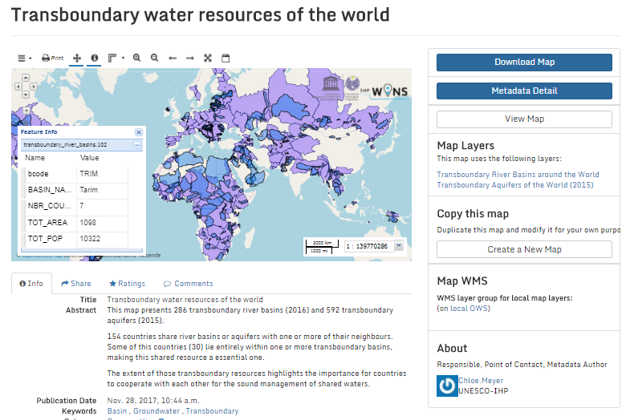
A georeferenced information database – Accessing data
Map viewer with several tools for analysis
Able to retrieve information from the layers
Open-access information that are freely available for download
Possibility to combine those layers with other information to create new maps
More information on the contributors who shared this map
Standardized metadata
Notes:
So first, the georeferenced information database.
WINS allows to store, combine from several sources, and share open data on water resources, at all levels (whether it be local, regional, global). It allows to visualize data and information through maps, in a form that can be easily understood and it provides clear and straightforward information. In that sense, this georeferenced database provides a sound basis for decision-making
Data are in the form of layers, which are georeferenced. This means that all information has coordinates, which allow to locate the information on the surface of the earth. Layers are uploaded on the platform by contributors. Unless otherwise specified, they can be freely viewed and downloaded by anyone using the platform, without an account. As a result, you can export the data in different formats, both data format (shapefiles, GML, GeoJSON) and images (pdf, jpeg,..).
Perhaps more interestingly, those layers, as the name would suggest, can be overlaid to create maps. By superimposing different layers, new information can emerge, and be tailored to the needs of the user. Similarly to the layers, the maps can be published on WINS by contributors, and can be exported/downloaded in image format by anyone else.

Slide 6
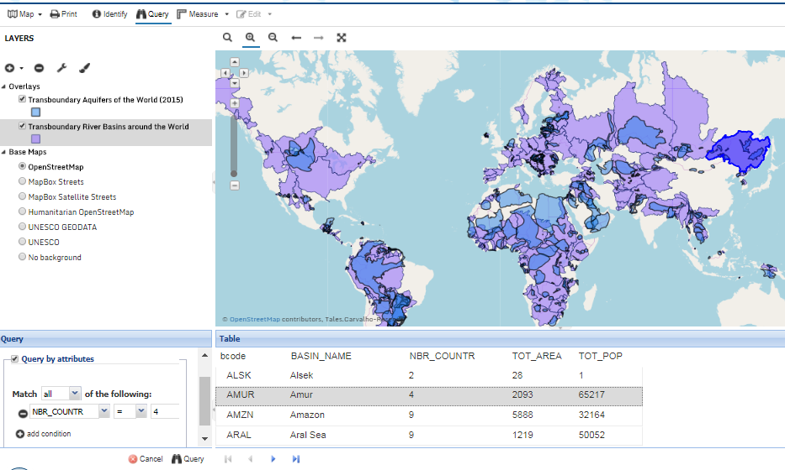
A georeferenced information database – Accessing data
Notes:
Retrieve information

Slide 7
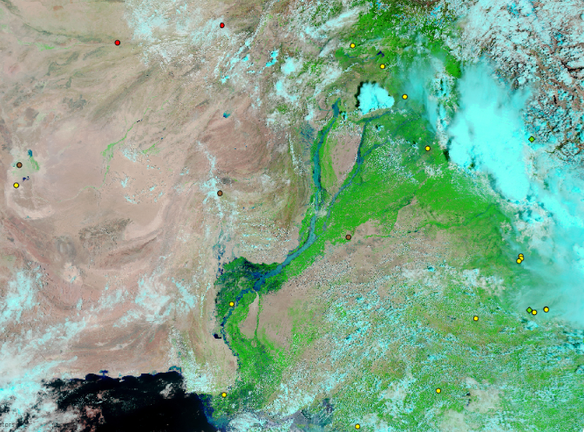
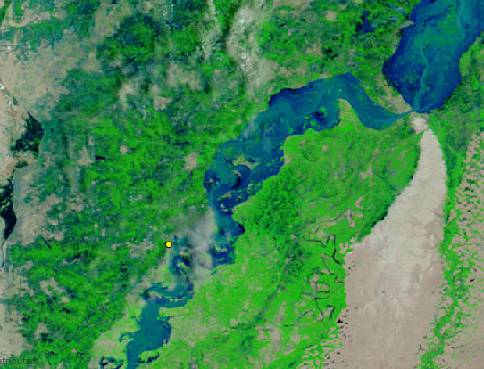
A georeferenced information database – Using earth observations
Biosphere reserve
World Heritage sites:
Satellite imagery of floods in Pakistan (August 2010) combined with UNESCO biosphere reserves and World Heritage sites
Notes:
This layer shows NASA's Earth Observing-1 (EO-1) satellite images of Pakistan on August 11, 2010, after two weeks of flooding had devastated the country.
In particular, the World heritage site of Moenjodaro is highlighted as located within the flooded area.
By early August 2010, two weeks of devastating monsoon rains had transformed the landscape of Pakistan, pushing rivers over their banks, inundating villages, washing away bridges and roads, destroying crops, and killing livestock. By August 12, 2010, more than 1,600 people had perished, according to news reports, and the United Nations Office for the Coordination of Humanitarian Affairs (OCHA) estimated that more than 14 million people had been affected in some way.
https://www.smithsonianmag.com/smart-news/flooding-in-pakistan-threatens-remains-of-4500-year-old-civilization-36140843/

Slide 8
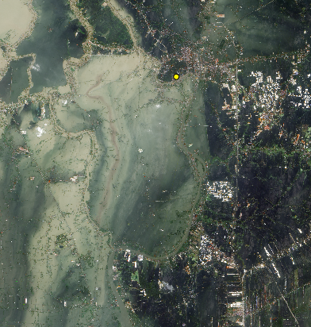
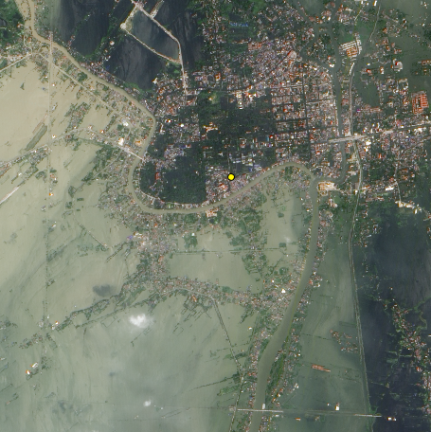
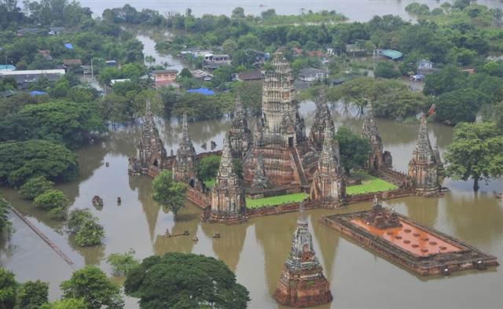
A georeferenced information database – Using earth observations
Satellite imagery of floods in Ayutthaya, Thailand (October 2011) combined with information on the location of UNESCO World Heritage site of the Historic City of Ayutthaya
Notes:
This layer shows NASA's Earth Observing-1 (EO-1) satellite images of Ayutthaya (Thailand) flood on October 23, 2011. Flooding forced the closure of manufacturing plants in Ayutthaya, according to news reports.
The city is a UNESCO World Heritage site. On 12 October 2011, UNESCO Bangkok announced a planned assessment of flood damage to Ayutthaya, requested by the government of Thailand.
https://www.express.co.uk/news/uk/735962/Ancient-Thailand-city-Ayutthaya-Unesco-world-heritage-site-danger-floods-ruins-Buddha

Slide 9
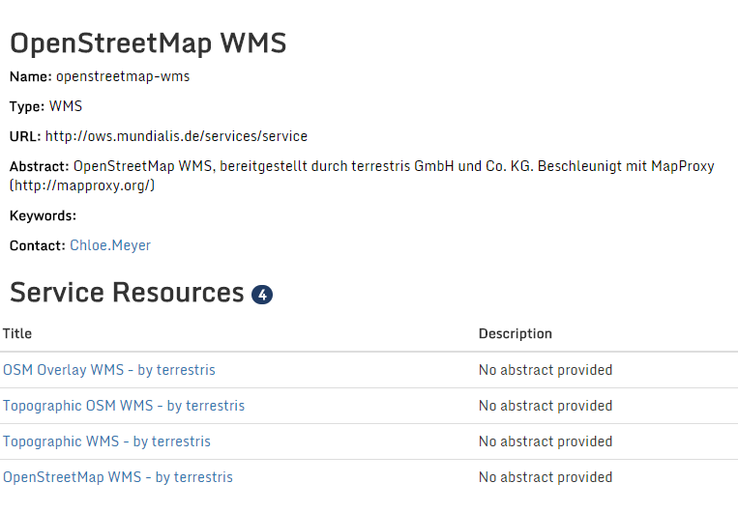
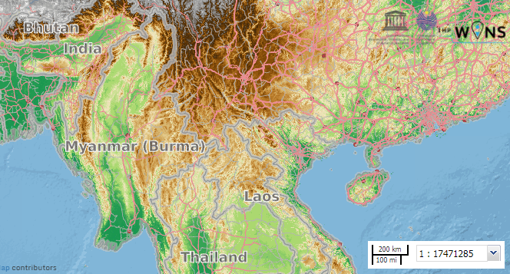
A georeferenced information database
Witnessing the evolution of data over time (the Time Series tool to create interactive maps)
WMS protocol to display external data and to offer WINS data for display on other platforms
Forthcoming: http://ihp-wins.unesco.org/geoserver/wms.
Notes:
Data are in the form of layers, which are georeferenced. This means that all information has coordinates, which allow to locate the information on the surface of the earth.
Layers are uploaded on the platform by contributors. Unless otherwise specified, they can be freely viewed and downloaded by anyone using the platform, without an account. As a result, you can export the data in different formats, both data format (shapefiles, GML, GeoJSON) and images (pdf, jpeg,..).
Perhaps more interestingly, those layers, as the name would suggest, can be overlaid to create maps.
By superimposing different layers, new information can emerge, and be tailored to the needs of the user.
Similarly to the layers, the maps can be published on WINS by contributors, and can be exported/downloaded in image format by anyone else.

Slide 10
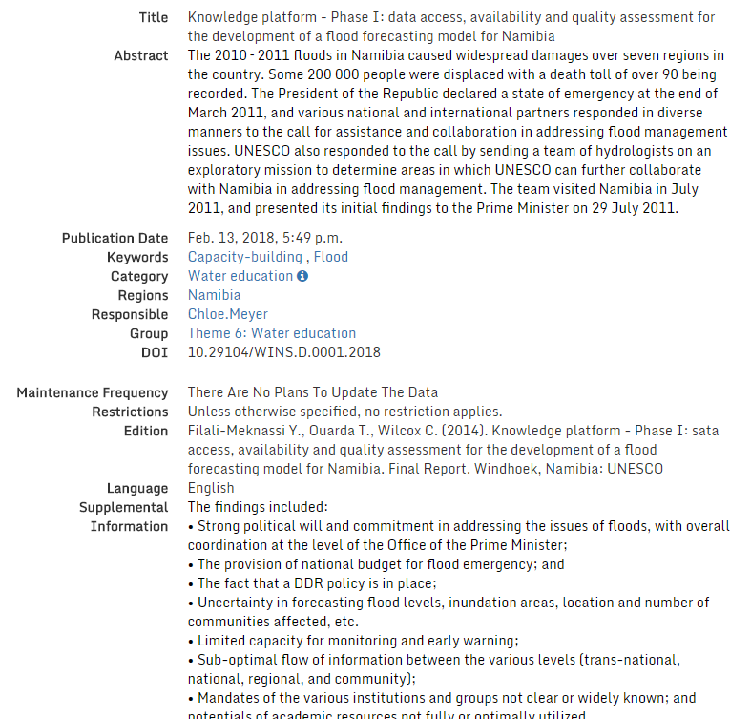
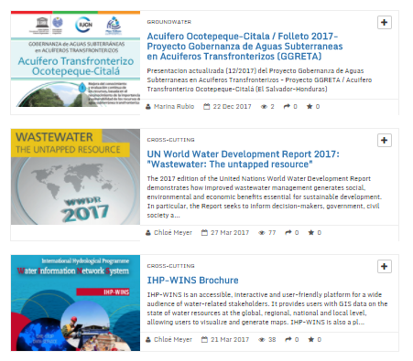
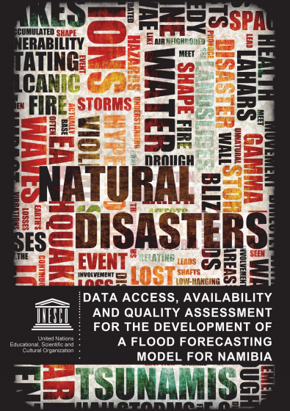
A knowledge sharing tool
Storing of several types of documents: INSTITUTIONAL MEMORY
Can be viewed and downloaded
Transparency and traceability:
A unique Digital Object Identifier is embedded in the metadata
True ID card for any document shared
Notes:
Now, the 2nd main aspect of WINS
To complement the georeferenced database and the visualization tool through maps, WINS offers a more general knowledge sharing platform. A sort of online library.
Similarly to the maps and layers, this pillar is based on open-access, to reduce the knowledge-access gap.
Further enhance transparency and traceability, we have also implemented a DOI. or Digital Object Identifier. It is a persistent identifier used to uniquely identify objects in a standardized format.
It is like an ISBN for books by the International Organization for Standardization (ISO).^{[1]} DOIs are in wide use to identify academic, professional, and government information, such as journal articles, research reports and data sets, and official publications though they also have been used to identify other types of information resources, such as commercial videos.
This allows for an accurate identification and crediting of any contribution, and easy later sharing.
This will allows us to track the maps and any other digital document uploaded on WINS and later on used

Slide 11
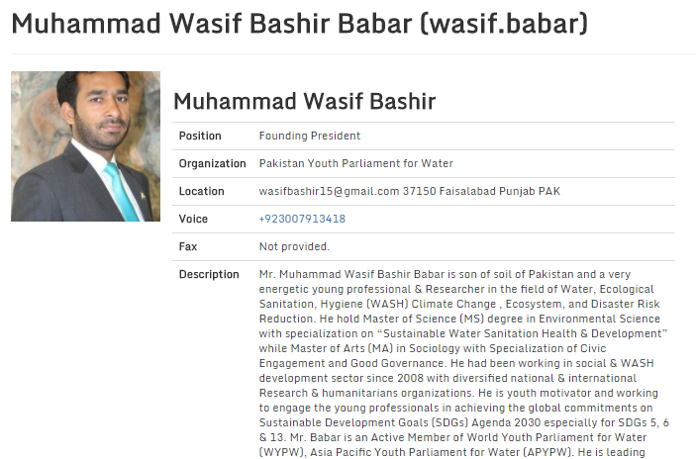
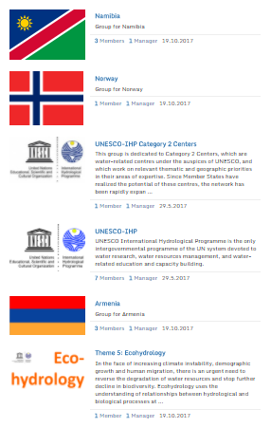
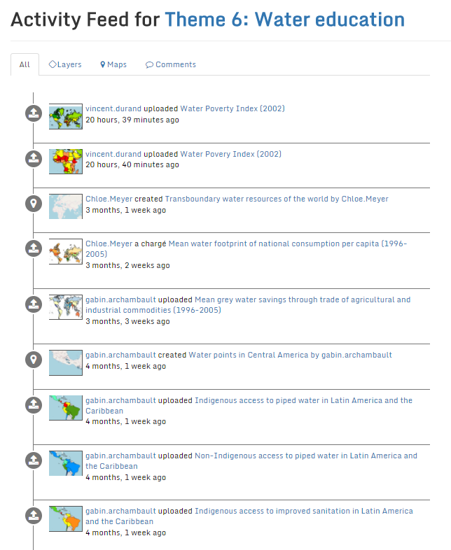
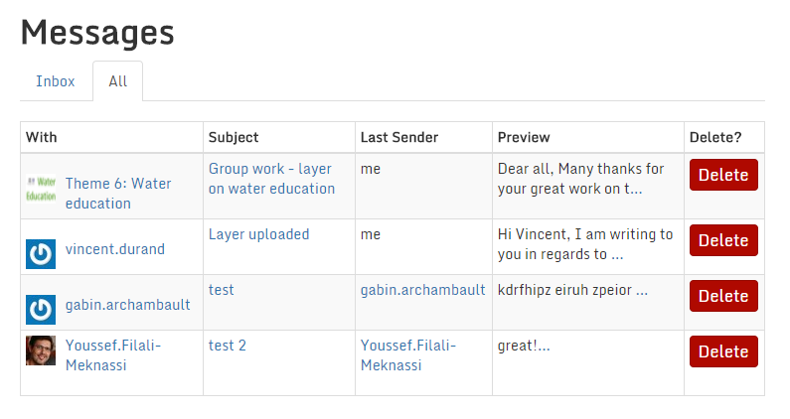
Username
A networking hub
Groups are administered by a MANAGER
Groups membership
Update on each other’s work and contributions
Details on the profile and activities
In groups, contributors can connect with each others
Exchange messages
Hello, …
Notes:
Last but certainly not least, WINS offers a networking hub to its contributors.
The idea is really to contribute to building capacity through this online community of practice, where various water stakeholders can connect and share their experience in different groups, which are really online working spaces.

Slide 12
In conclusion, WINS contribute to:
Worldwide efforts towards sound, science-based management of water resources
Bringing different water stakeholders (agencies, Member States, etc.) together to produce and circulate knowledge
Visualizing and sharing clear and understandable water-related information
Feeding decision-making and policy recommend-dations

Slide 13
Thank you
y.filali-meknassi@unesco.org

