Slide 2
Using Earth Observations for Statistical SDGs Indicators: Challenges for National Statistical Offices
Marie Haldorson / Director / Statistics Sweden
Alvaro Monett / Regional Expert / ECLAC

Slide 3
Outline
The SDG Indicators – on Global and National Level
Capabilities
An Assessment in Latin America and the Caribbean
Swedish SDG Reporting
Increase the National Uptake of Earth Observations?

Slide 4
The SDG Indicators – on Global Level
Country owned and country led reporting
National vs. Global data sources
Globally agreed frameworks, standards, methods, definitions…
UN Custodians in charge of indicator metadata development

Slide 5
IAEG-SDG Working Group on Geospatial Information
Reviewed the global indicators incl. metadata through a ‘geographic location’ lens
Shortlist with 24 indicators
“Where is the data?”

Slide 6
Next Step: Building Capacity for National Reporting
National Statistical Systems
National Spatial Data Infrastructures
Cooperation mechanisms
Capabilities to work with new data sources (e.g. geospatial and earth observations) for statistics

Slide 7
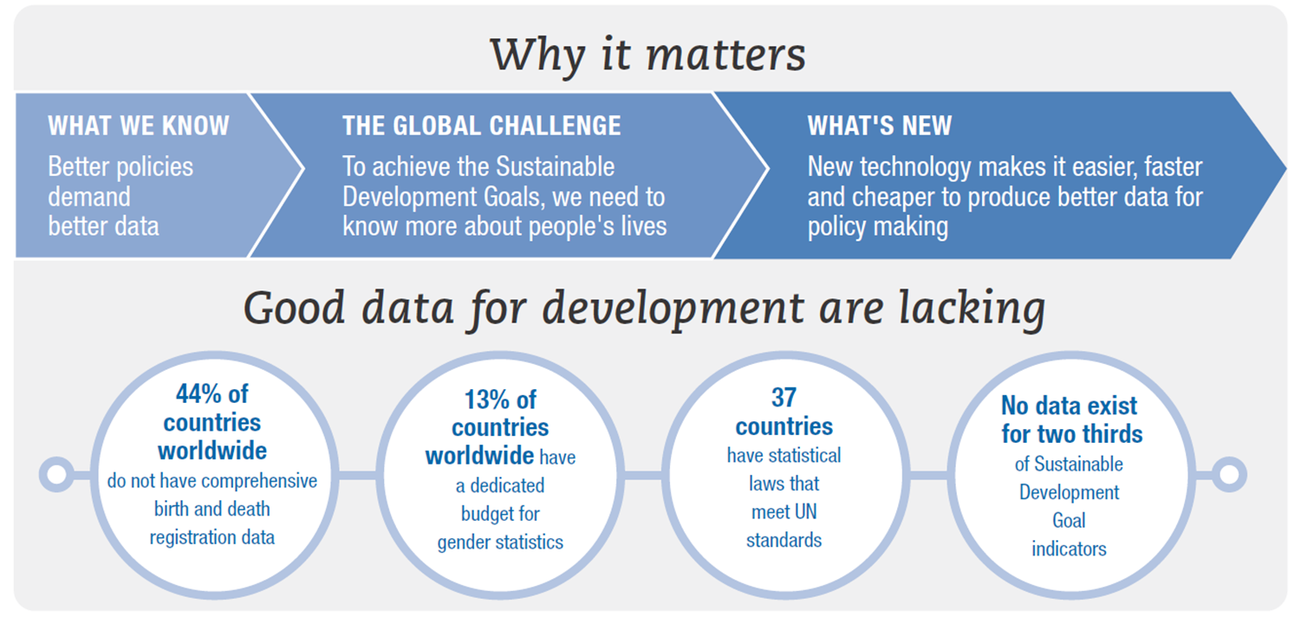
Bridging the data divide
Source: OECD (2017), Development Co-operation Report 2017: Data for Development

Slide 8
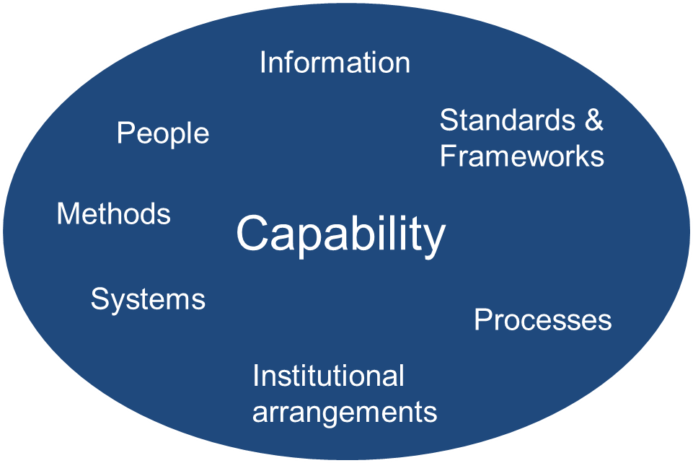
Capability to work with Geospatial Information and Earth Observations

Slide 9
The ECLAC Assessment: Questionnaire applied in Oct-Nov 2017

Slide 10
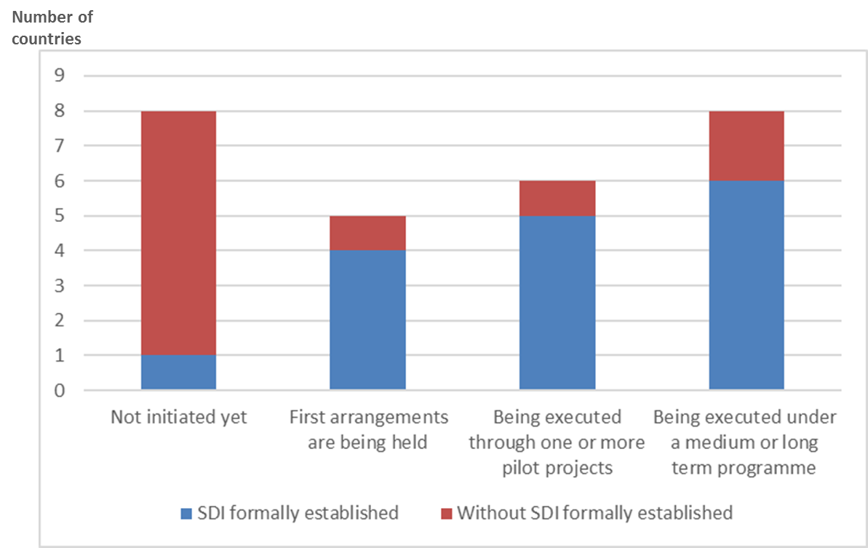
The process of integration of statistical and geospatial information in relation to the existence of a National SDI

Slide 11
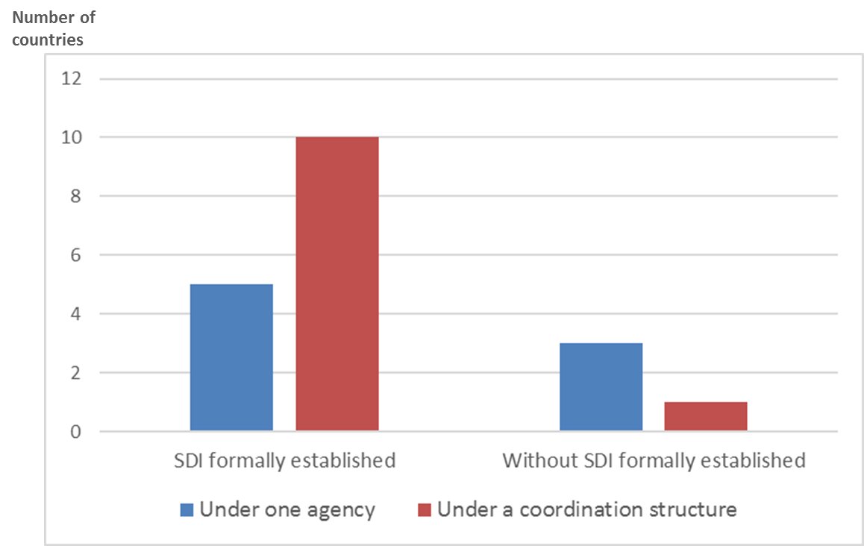
Conduction of the integration process of geospatial and statistical information in relation to the existence of SDI

Slide 12
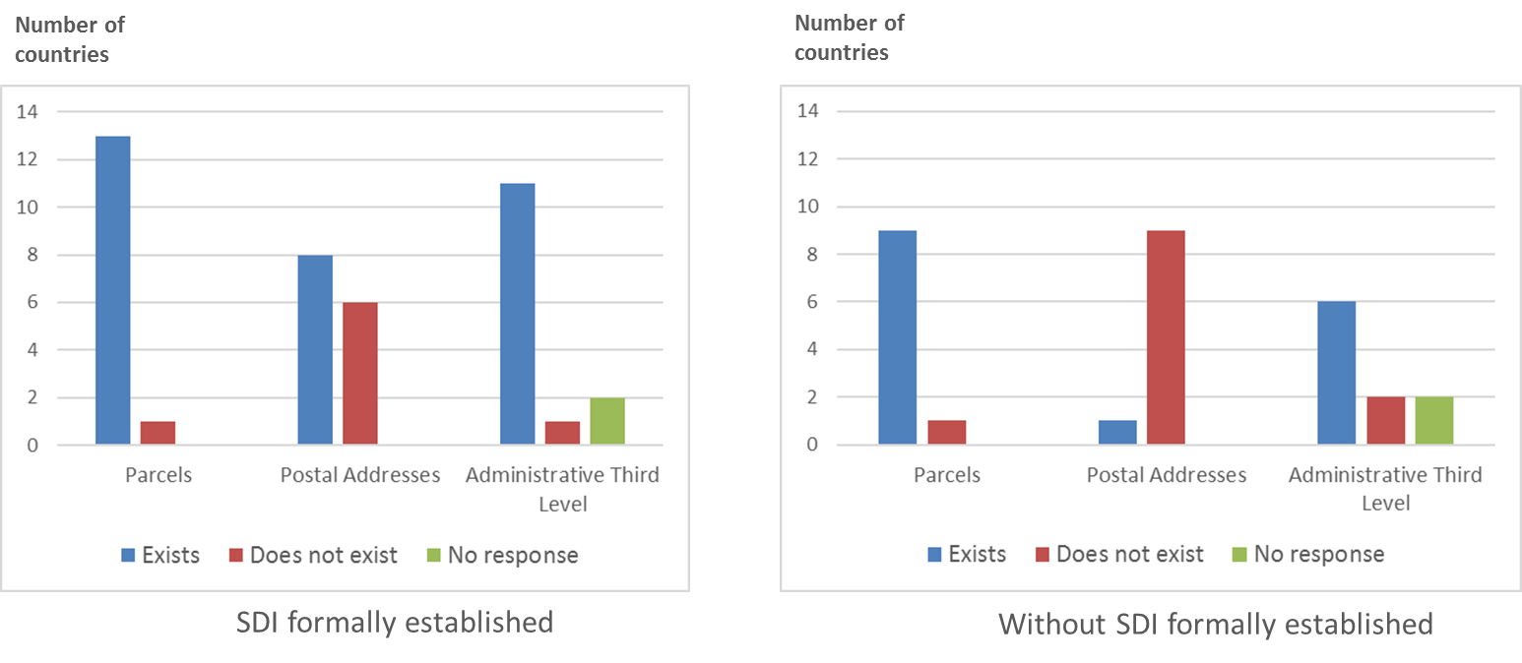
Fundamental geospatial data for the integration of geospatial and statistical information

Slide 13
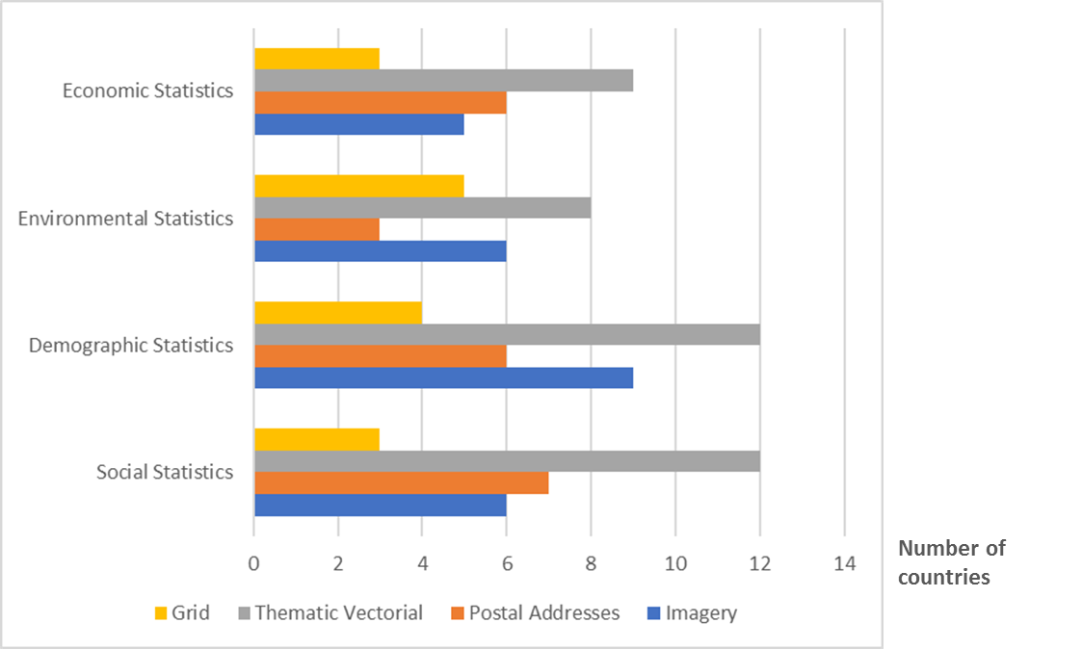
Progress in the use of geospatial information for the production and dissemination of statistics

Slide 14
Roadmap towards the integration of statistical and geospatial information in Latin America and the Caribbean
Complete the diagnosis on the integration of geography and statistics and produce an official document with the results and analysis
Prepare a regional strategic plan for the integration based on the Global Statistical Geospatial Framework, Agenda 2030 and the Census Round 2020.
Promote and support the formulation of national plans for the integration of geography and statistics.
Establish a data base of good practices and national experiences in the integration of statistical and geospatial information.
Advance in the diagnosis of the national geospatial capacities for supporting the Agenda 2030 implementation. Look further into the use of Earth Observations.

Slide 15
Swedish SDG Reporting

Slide 16
Preparing for the Swedish SDG Reporting
Possible to report or already being reported
Possible to develop: data integration needed or changes to current surveys
Very difficult to report, no current survey, no available method
Not relevant for Sweden / Global data enough
Assessed the global indicators, added national indicators for targets of national policy relevance

Slide 17
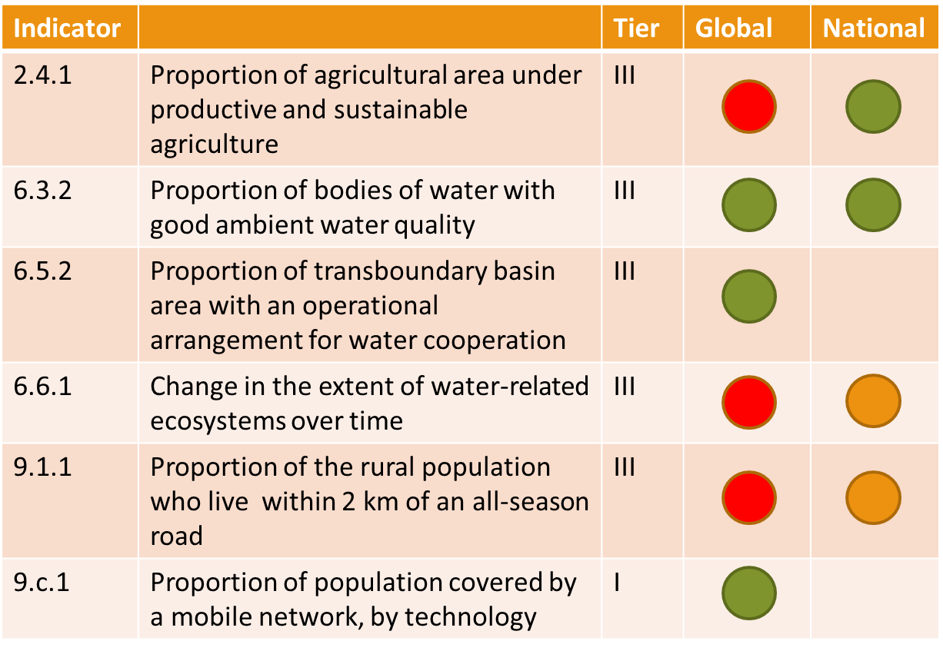
Assessment of the IAEG-SDG WGGI Shortlist
Examples

Slide 18
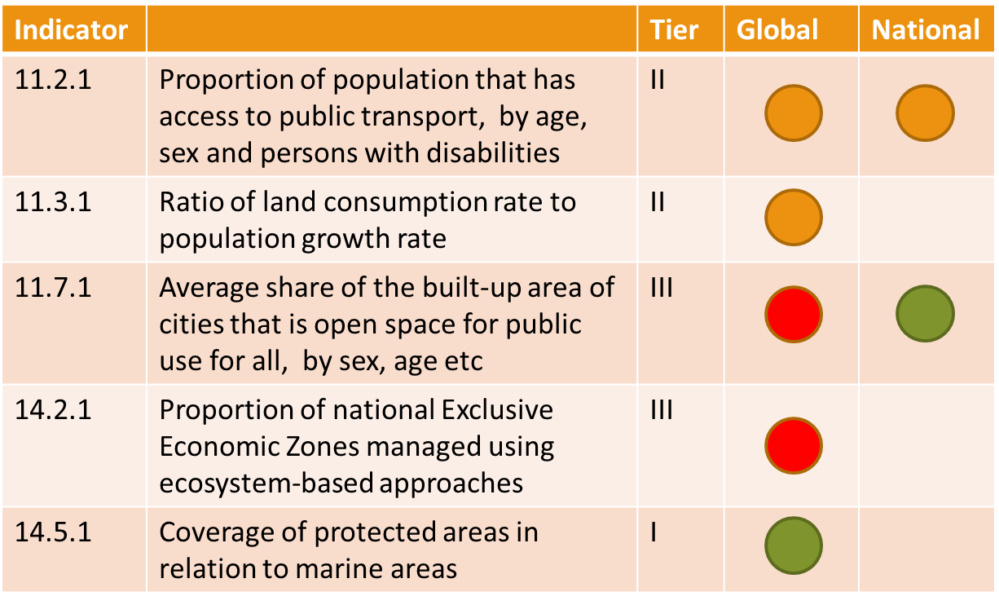
Assessment of the IAEG-SDG WGGI Shortlist
Examples

Slide 19
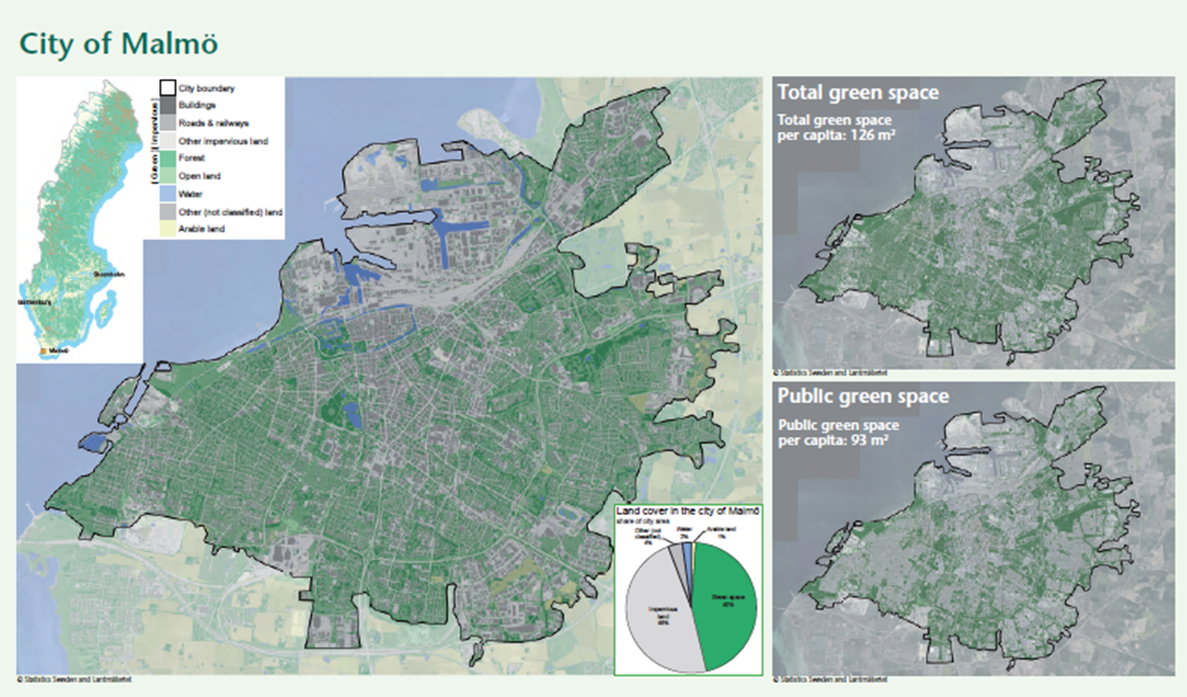
Assessment of the IAEG-SDG WGGI Shortlist: 11.7.1 National indicator on Access to Public Greenspace
Statistics Sweden will build future production of green space statistics on the new National Land Cover Database
Based on Copernicus data (Sentinel) and the findings in a pilot project funded by ESA (CadasterENV)

Slide 20
Government Agencies responsible for ”Geospatial Indicators”
Statistics Sweden is one of nine agencies proposed to report on ”geospatial indicators”
A challenge to have the right expertise on how to use geospatial data and earth observations in many agencies
Five of these agencies are also members of the National Copernicus Cooperation: finding a way to share expertise?

Slide 21
You need to walk before you can run..
..but what about to leapfrog?

Slide 22
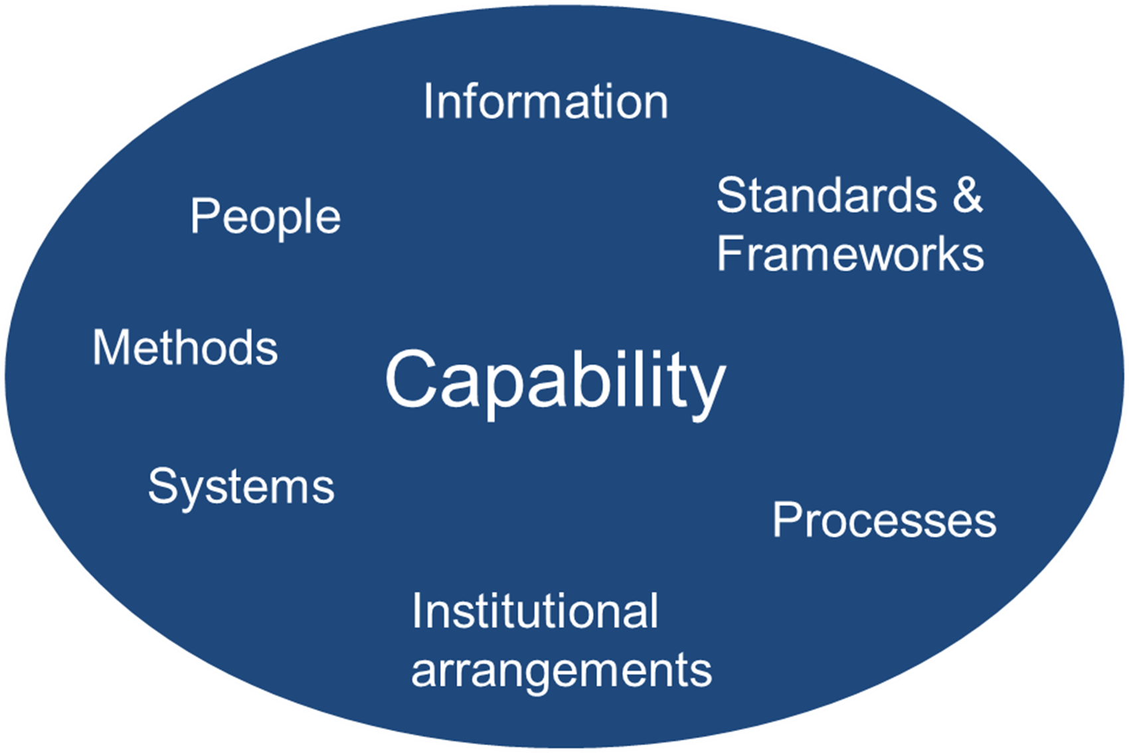
Increase the National Uptake of Earth Observations?
Satellite data needs to be calibrated and validated, complementing in-situ measurement
Data are large and complex: even analysis-ready data require considerable knowledge, expertise and resources
SDGs require long time series and continuity of data
Modernisation of statistical production

Slide 23
Increase the National Uptake of Earth Observations?
Leaving no one behind: disaggregation by location;
Consider disaggregation techniques (top-down), involving different data sources including earth observations, as well as aggregation (bottom-up);
Providing IAEG-SDG with national experiences and identifying exemplars, develop good practices guides including referencing national exemplars and case studies.
IAEG-SDG WGGI
Workplan 2018-2019
Task Stream #1

Slide 24
Increase the National Uptake of Earth Observations?
Give advice to the IAEG-SDGs building on existing feasibility studies, demonstration projects, pilot projects. Help building broader understanding on the application of analysis-ready satellite earth observations;
Leverage partnerships with Space Agencies through GEO and EO4SDGs;
Focus on six indicators: 6.3.1, 6.3.2, 6.6.1, 9.1.1, 11.3.1 and 15.3.1.
IAEG-SDG WGGI
Workplan 2018-2019
Task Stream #2

Slide 26
Thank you
marie.haldorson@scb.se / ggim.un.org/UNGGIM-wg6
alvaro.monett@cepal.org

