Slide 2
World Meteorological Organization Information System
– GEOSS Interoperability
Dr. Hermann Asensio, Deutscher Wetterdienst

Slide 3
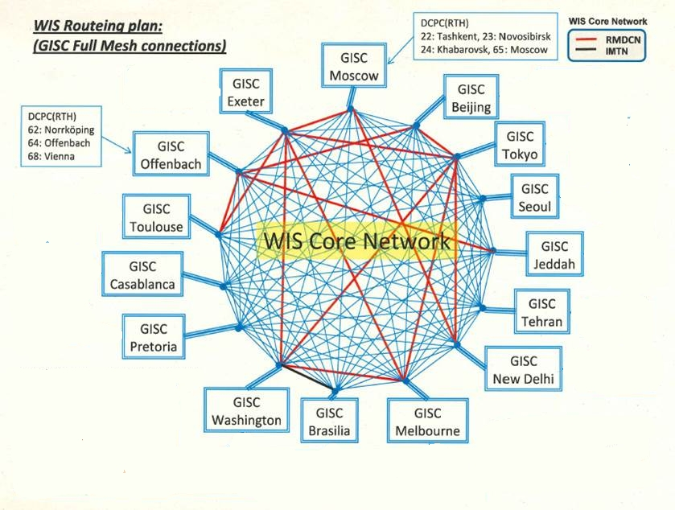
World Meteorological Organization Information System
WIS
WMO Information System
GISC
Global Information System Center
DCPC
Data Collection / Production Center
NC
National Center

Slide 4
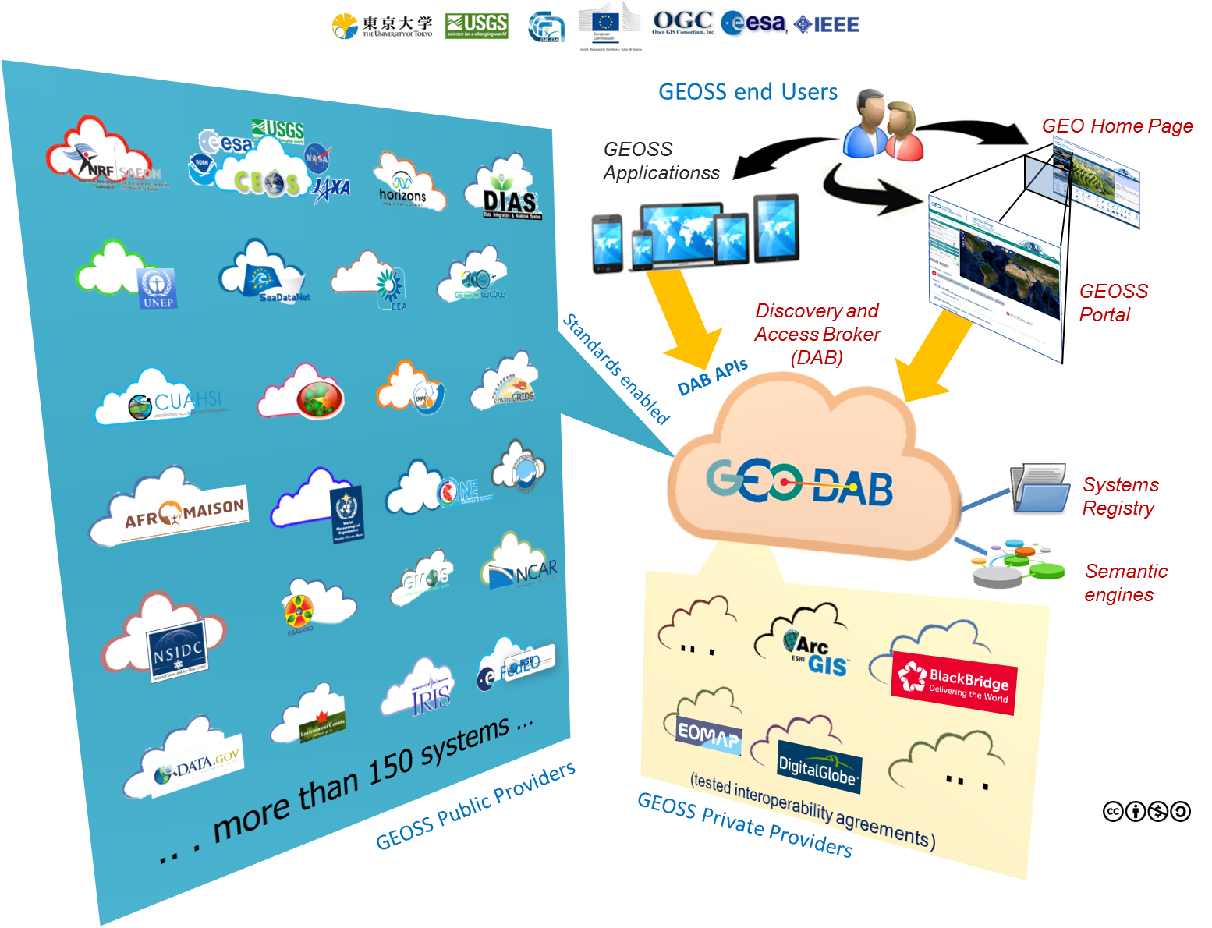
GEOSS Common Infrastructure
Source: Stefano Nativi

Slide 5
Supermarket without metadata
Source: WMO Core Metadata Profile v1-2 Guidance Documentation v0.1

Slide 6
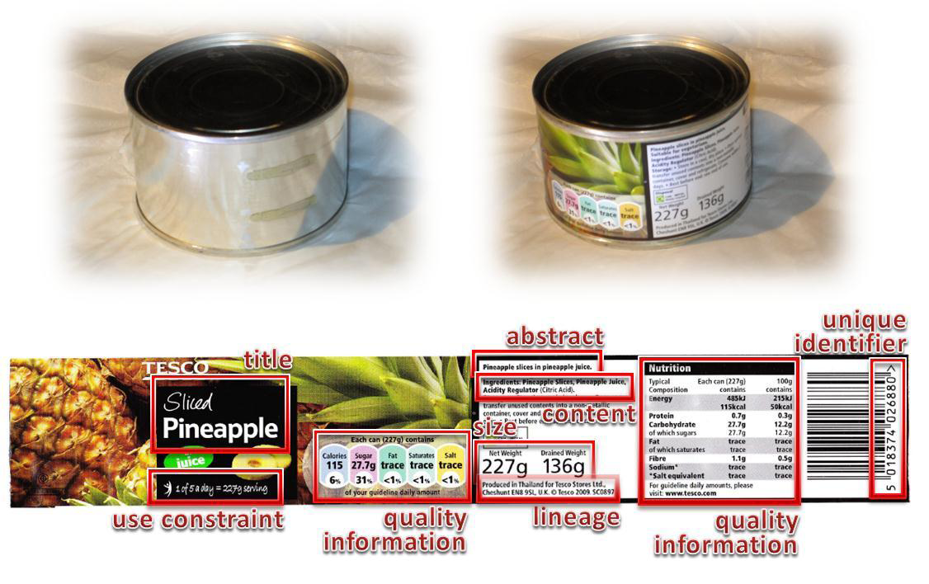
Supermarket with metadata
Source: WMO Core Metadata Profile v1-2 Guidance Documentation v0.1

Slide 7
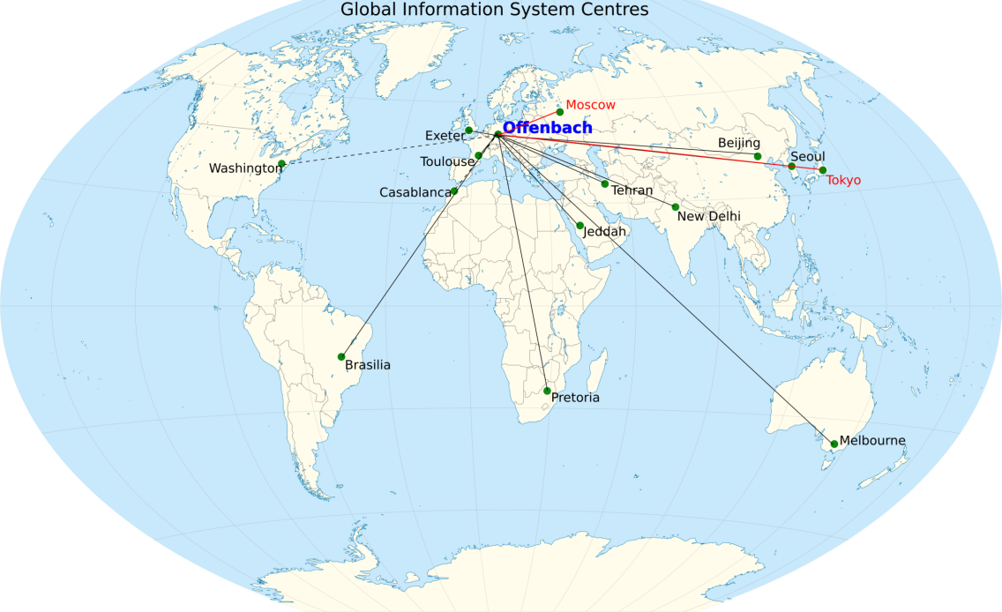
World Meteorological Organization Information System
Global Information System Center
Hold global metadata catalogue
Upload metadata for area of responsibility
Distribute (global exchange) data to other GISCs
Provide (global exchange) data to area of responsibility
Ad hoc and subscription data supply
Ensure area of responsibility has effective telecommunications

Slide 8
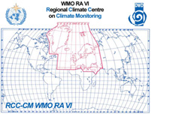
World Meteorological Organization Information System
Data Collection / Production Center
Programme function:
World Weather Watch regional telecommunications hub
World Data Centre
Provide metadata
Provide data

Slide 9
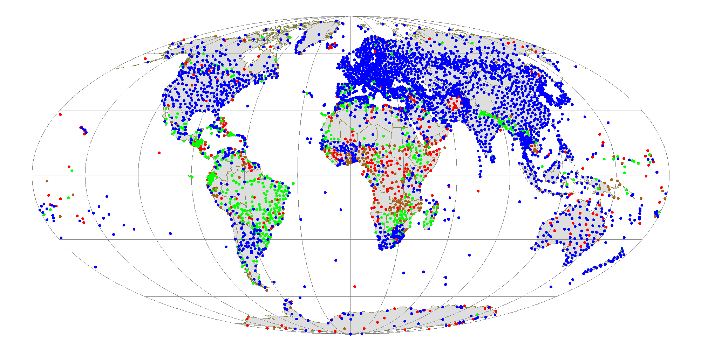
World Meteorological Organization Information System
National Center
Collect and pass national data to WIS
Receive data from WIS for national users
Provide metadata to WIS
Main source of information for national purposes
SYNOP reports from RBSN stations

Slide 10
WIS Discovery Metadata
What datasets contain
Who is responsible
How to get datasets
Image by Tim Parkinson from http://www.flickr.com/photos/timparkinson/320165882/ under the creative commons licence http://creativecommons.org/licenses/by/2.0/

Slide 11
Metadata synchronization
OAI and FTP
WIS core network
DKRZ
AWI (PANGAEA)
DLR
EUMETSAT
National Meteorological Centres,
e.g. Austria, Croatia, …
connected to GISC Offenbach as external DCPC
DKRZ
DLR
AWI Bremerhaven (Pangaea)
EUMETSAT
connected to GISC Offenbach as internal DWD centre:
GCC, Global Collection Centre
GPCC, Global Precipitation Climate Centre
GRUAN, GCOS Reference Upper-Air Network
RCC-CM, Regional Climate Centre on Climate Monitoring for Europe

Slide 12
GeoPortal –ranking search results
Source: Stefano Nativi

Slide 13
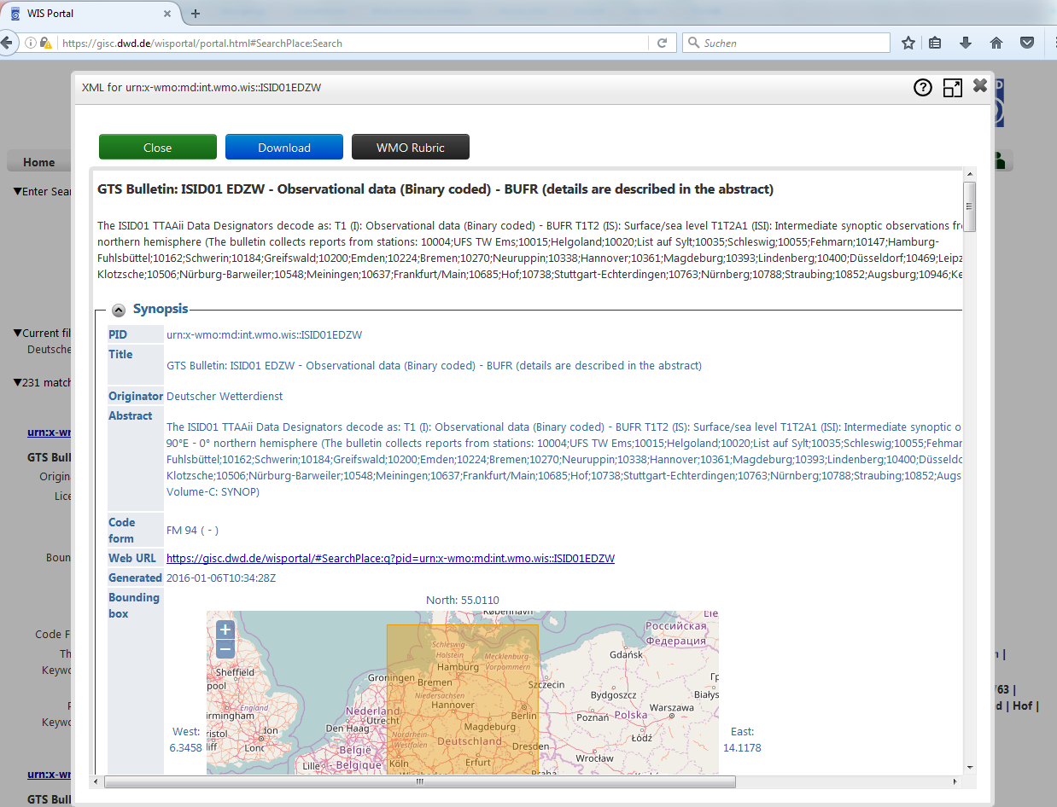
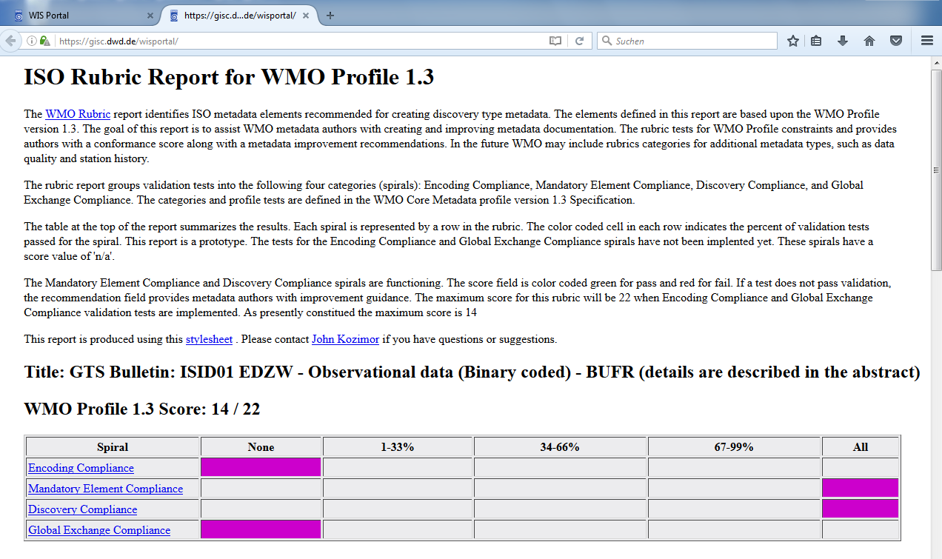
Metadata Quality in WMO Information System
NOAA provides a “WMO Rubric Report” (xsl transformation) http://www.ngdc.noaa.gov/metadata/published/xsl/wmoRubricReport.xsl
Useful tool to monitor metadata quality, build into Web-Frontend GISC Offenbach gisc.dwd.de

Slide 14
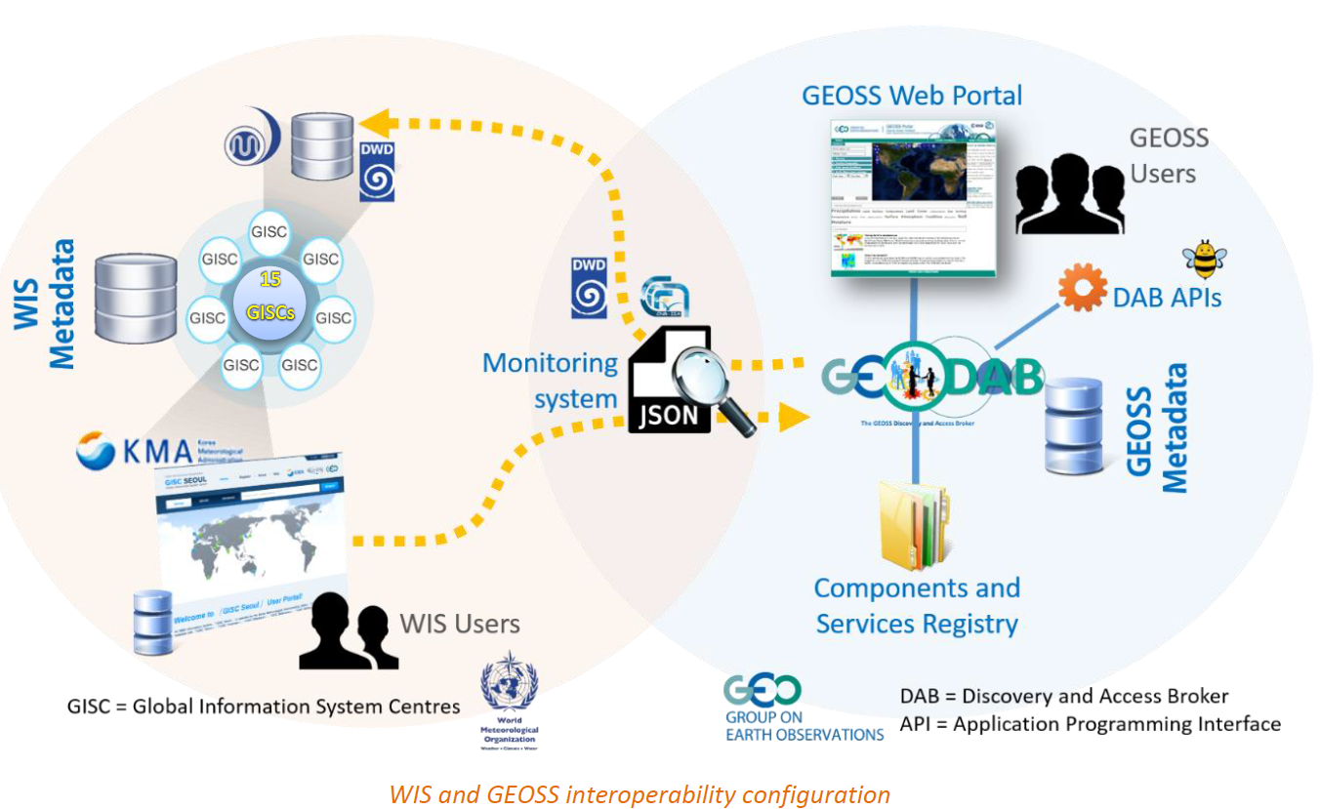
Interoperability WMO Information System – GEOSS

Slide 15
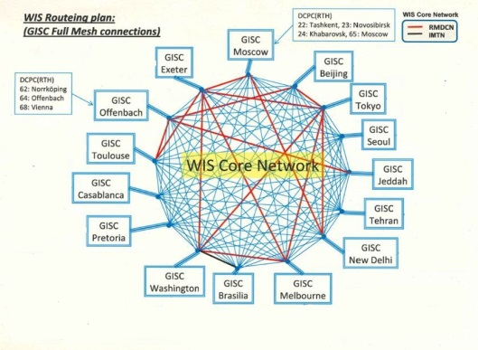
Summary
Metadata quality is essential for user experience in catalogue systems
Interoperability WMO Information System – GEOSS

Slide 16
Thank you
Hermann.Asensio@dwd.de

