Slide 1
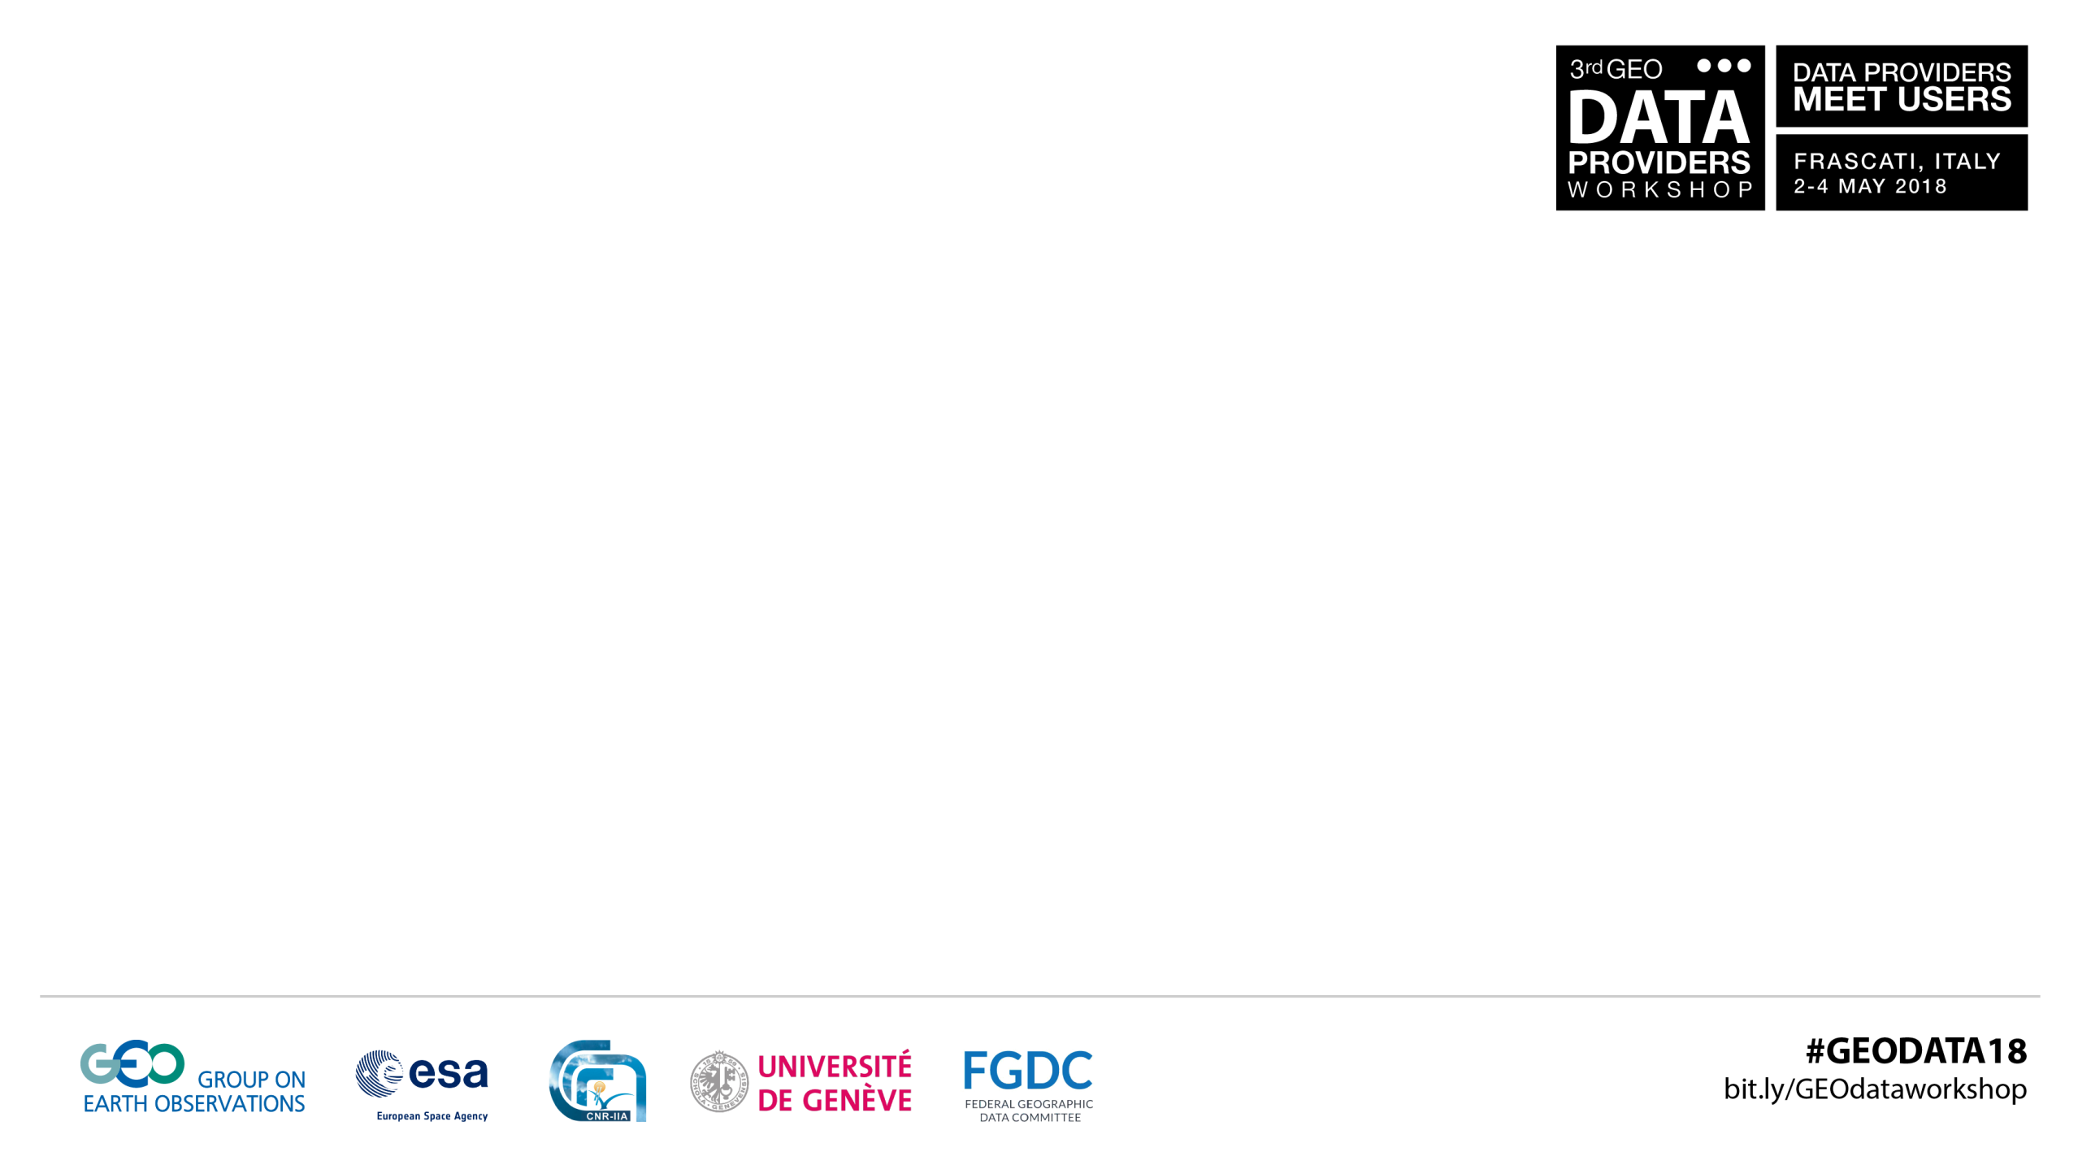


Slide 2

GEOSS Portal reuse for
  Lianchong Zhang, Guido Colangeli
  RADI/CAS, ESA
  May 4, 2018

Slide 3

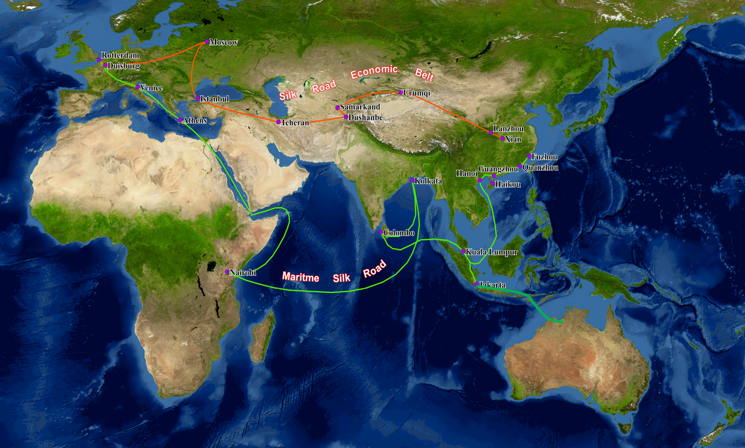

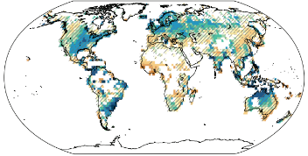
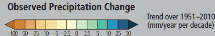
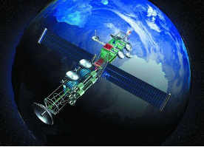
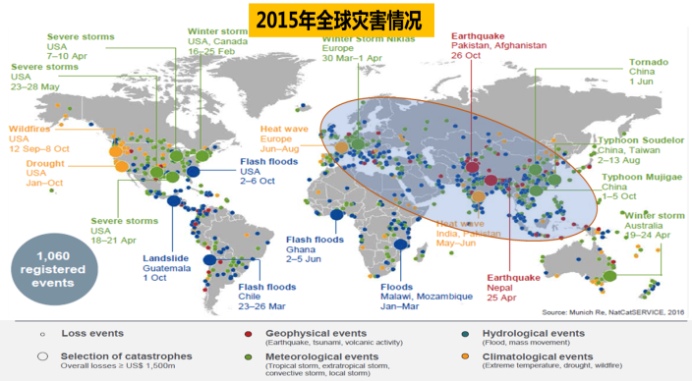
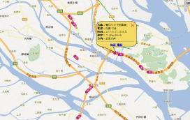
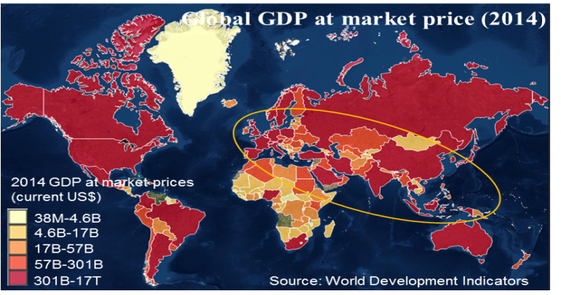
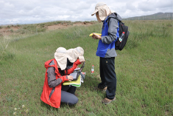

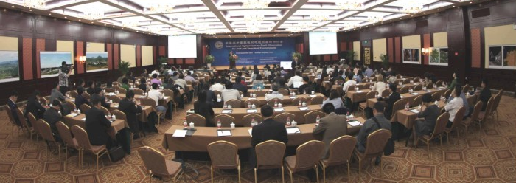
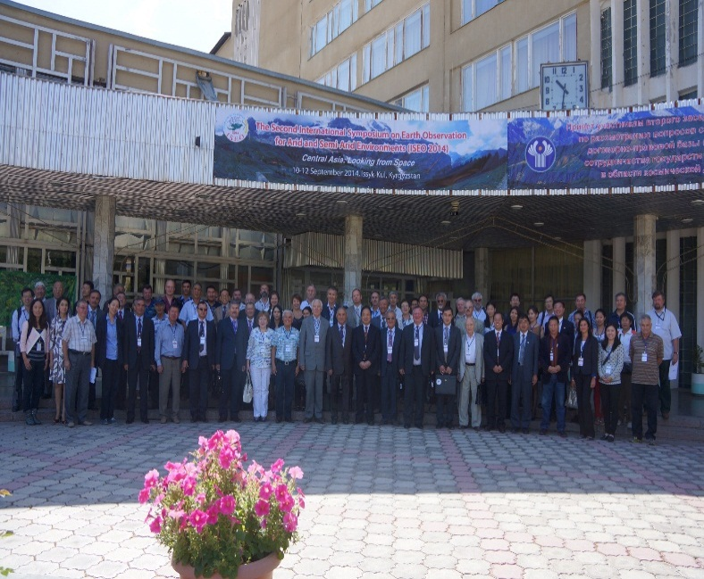
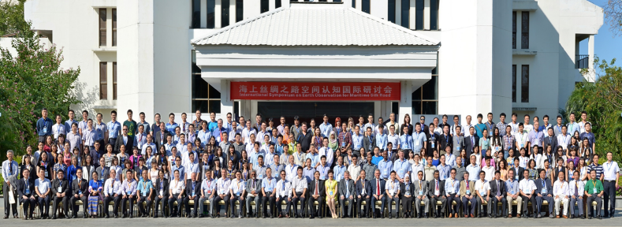
Social-economic
Environmental
Change
Satellite
Disaster
Navigation
In-situ
Unbalanced
Development
A COMMON VISION
TO ADVOCATE FOR ADVANCED TECHNOLOGY
IN DESIGN AND PLANNING OF ALL DEVELOPMENT, ENVIRONMENTAL PROTECTION AND RESOURCE MANAGEMENT ACTIVITIES AT
MULTIPLE SCALES UNDERTAKEN WITHIN THE B&R INITIATIVE.

Slide 4

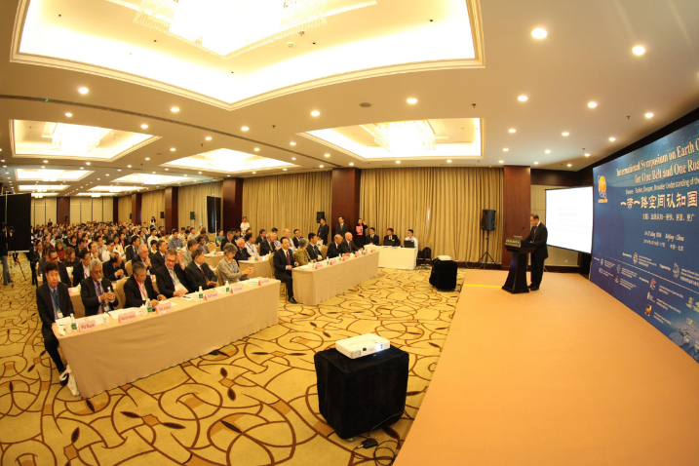




















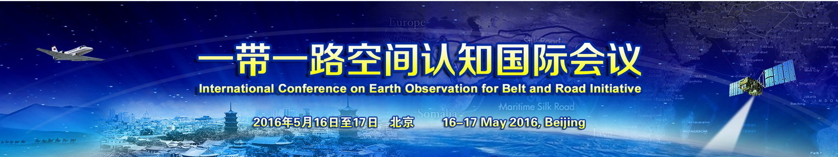
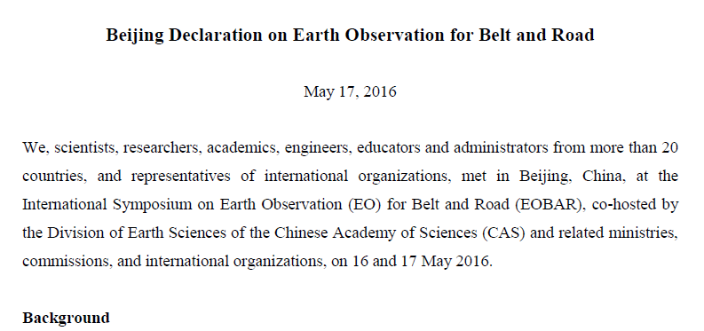
“Digital Belt And Road (DBAR)” Program
Initiated at EOBAR, to be given full support by more than 20 countries

Slide 5
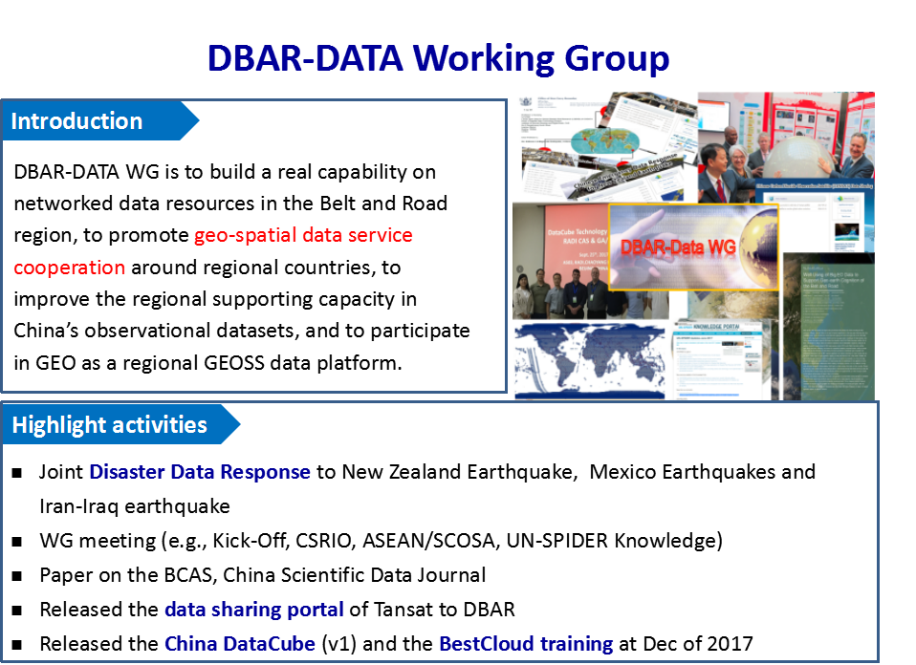

Slide 6
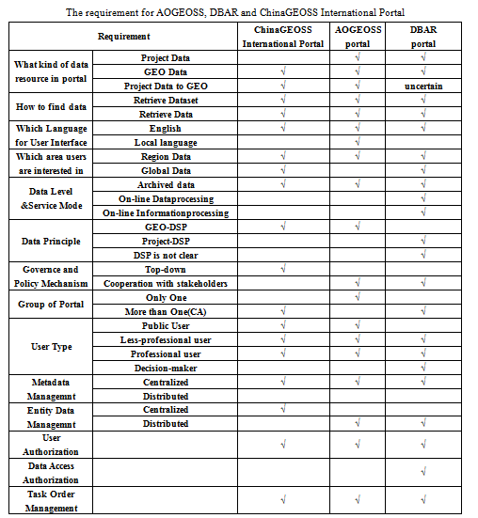



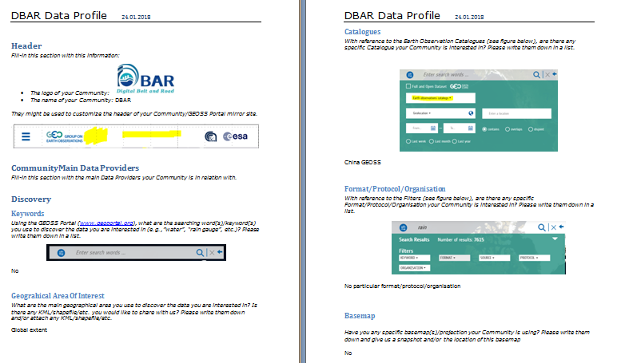
DBAR Data Portal is under development by
RADI, CNR and ESA
with the reuse of GEOSS Platform components
2017-11-09, RADI reaches agreement with ESA to reuse the technology and
system of GEO Portal in AOGEOSS and DBAR as community portals.
2017-11-28, web call #1: Introduce the GEOSS Platform Reuse
2017-12-19, web call #2: Discuss DBAR/AOGEOSS portal requirements
2018-01-12, web call #3: Discuss DBAR Data Profile
2018-02-06, web call #4: Confirm DBAR relevant information
2018-03-13, the cooperation web call #5: Deploy DBAR mirror
2018-04-10, the cooperation web call #6: Introduce DBAR portal
2018-04-19, the cooperation web call #7: Modify DBAR portal

Slide 7
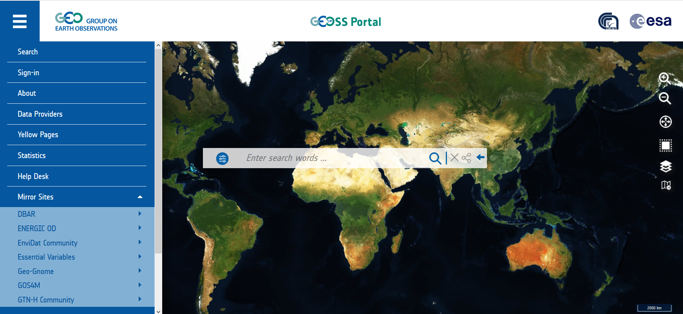
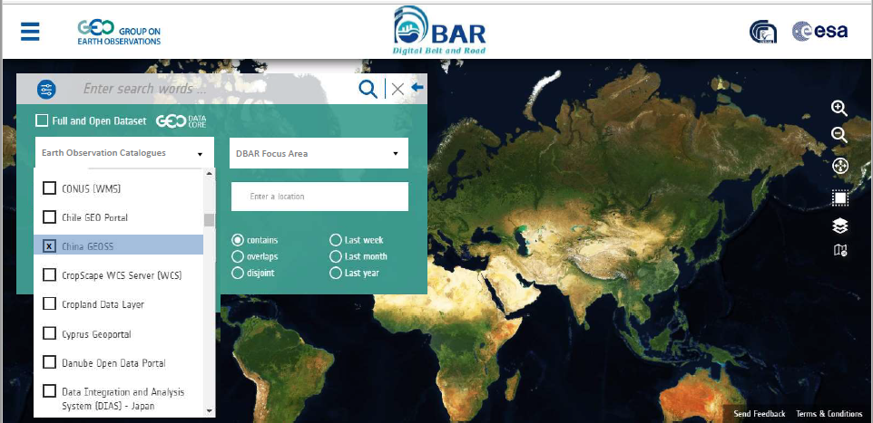
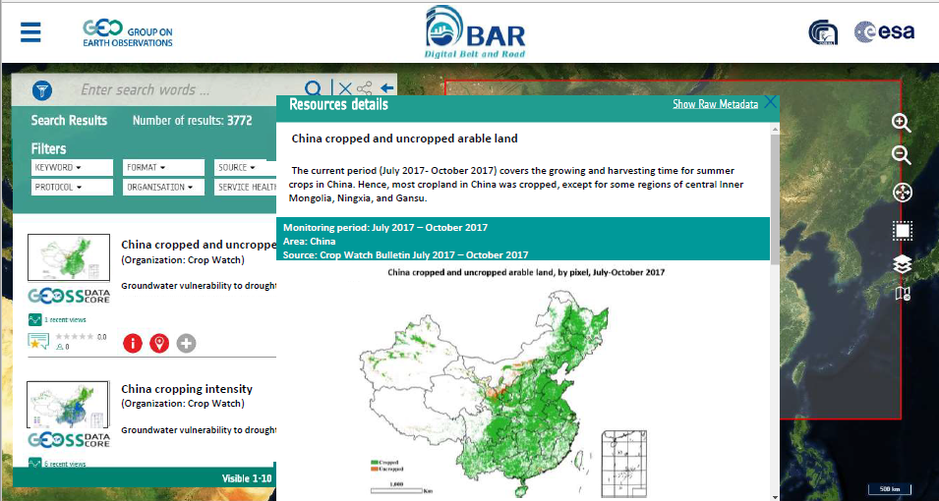

Slide 8
Thank you
zhanglc@radi.ac.cn，guido.colangeli@esa.int

