Slide 2
Day 2 - Session 8
Other infrastructures : how they are or will be
connected to the GEOSS Platform
Introduction
Paolo Mazzetti CNR-IIA

Slide 3
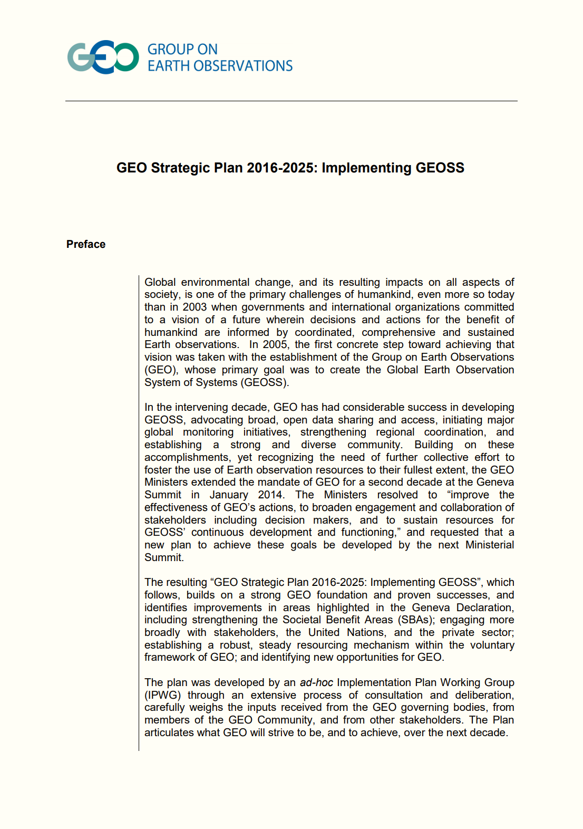
Other infrastructures / Rationale
The GEO Strategic Plan (2016-2025) reaffirms and strengthen the focus of GEO on
“improve[ing] the evidence base and implementation of environmental decision-making, both in private and public sectors”
by
“delivering data, information and knowledge critical to informing decision making”

Slide 4
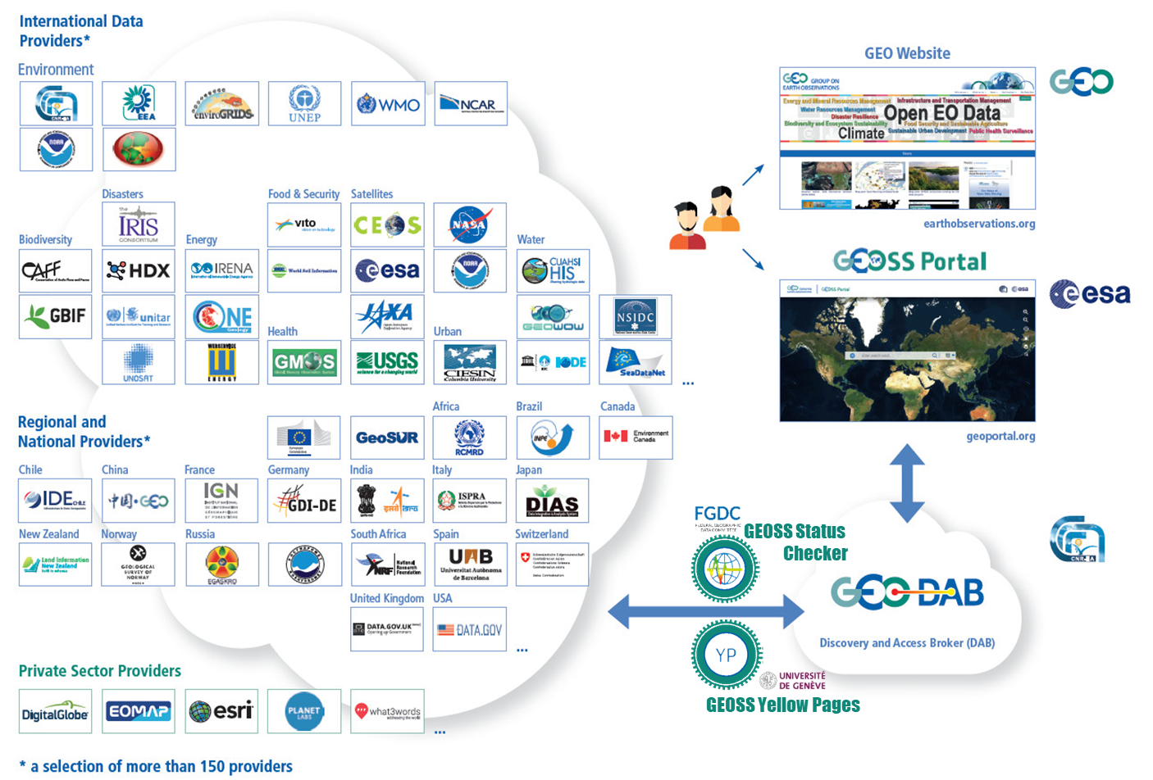
Other infrastructures / Rationale
In the first decade of activities (2006-2015) GEO has built GEOSS by brokering more than 150 existing data infrastructures
What about information/knowledge?
Dedicated actions in GEO Flagships, Initiatives and Communities, and Foundational Tasks
See Session 2-1 on GEO Flagships, Initiatives

Slide 5
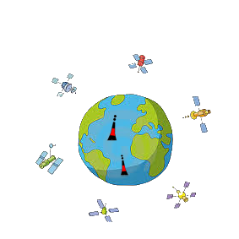
Other infrastructures / Rationale
In the second decade, one of the GEO big challenges is moving from data sharing to knowledge provision.
Policy (SDG Goals, International treaties)
EO & Socio-economic Data
Essential Variables
Primary Indicators
Targets
Data
Information
Knowledge
Wisdom

Slide 6
Other infrastructures / Rationale
This decade has been characterized by new technologies, new capabilities and even revolutionary paradigms for the generation of knowledge and insights:
Big (Earth) Data from high-resolution satellites, low-cost in-situ sensor networks, Internet-of-Things (IoT), crowdsourcing platforms, social networks
Cloud Computing
Datacubes
Data Mining/Machine Learning techniques
Semantics technologies and (soft) Artificial Intelligence

Slide 7
Other infrastructures / Rationale
There are existing infrastructures and platforms providing related services. The GEOSS Platform should connect with them for exploitation and leveraging the existing resources (replicating the work done with data systems)
This opens GEO to new users and providers:
Decision-makers, policy-makers as end-users
Knowledge providers (scientists, experts, practitioners)
Service providers (IaaS, PaaS, datacubes, Machine Learning SaaS)

Slide 8
Other infrastructures / Rationale
How does this scenario affect GEO/GEOSS?
See also session 2-2 on GEOSS Platform and its future journey - GEOSS EVOLVE
From the GEOSS Common Infrastructure to the GEOSS Platform
Moving towards a GEO/GEOSS Ecosystem
GEO Flagships & Initiatives
GEO Community Portals
Other
Apps
APIs
APIs
APIs
APIs
GEOSS Platform
Datacubes & Big Data Analytics systems
Thematic/International Federation systems
APIs
APIs
APIs
APIs
GEO Regional Data Hubs
APIs
APIs
APIs
APIs
Data systems
[ from GEOSS-EVOLVE ]

Slide 9
Other infrastructures / Session topic
Other infrastructures:
how they are or will be connected to the GEOSS Platform
What kind of functionalities should be shared?
How to achieve interoperability?
What kind/level of APIs to use/develop?
GEO Flagships & Initiatives
GEO Community Portals
Other
Apps
APIs
APIs
APIs
APIs
GEOSS Platform
APIs
APIs
APIs
APIs
Datacubes & Big Data Analytics systems
Thematic/International Federation systems
GEO Regional Data Hubs
APIs
APIs
APIs
APIs
Data systems

Slide 10
Other infrastructures / Session Programme
INPE E-Sensing and Machine Learning Methods for Classification of Dense Satellite Image Time Series - Gilberto Camara
Swiss Data Cube - Gregory Giuliani
Data4SDGs - Adrian Laurenzi
Radiant Earth - Daniel Lopez
EOSC- Science Cloud - Tiziana Ferrari
Questions and Discussion
Slido
#3May_Session8

Slide 11
Thank you
paolo.mazzetti@cnr.it

