Slide 1
JAXA’s New Earth Observation
Data Distribution Plan
GEO 3rd Data Providers Workshop
2nd – 4th May, 2018
Akiko Noda
Japan Aerospace Exploration Agency (JAXA)
Satellite Applications and Operations Center (SAOC)
Space Technology Directorate I

Slide 2
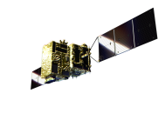
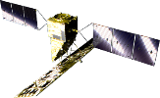
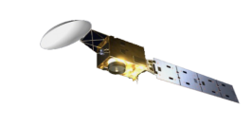
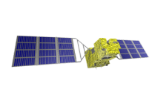
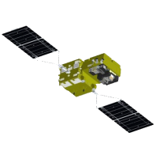

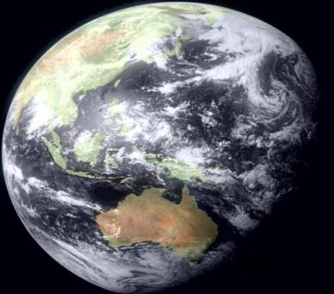


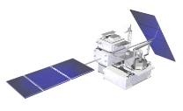

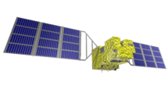
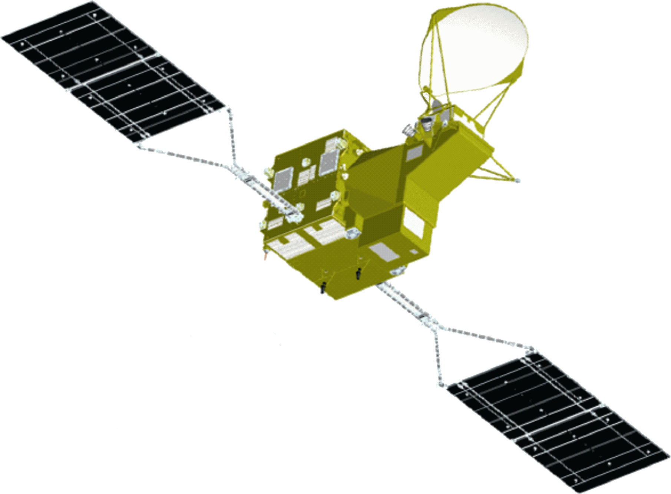
JAXA’s EO Satellites/Sensors
Past, Current and Future
Advanced Radar Satellite
Advanced Optical Satellite
(JFY 2020)
Earth CARE/CPR
(JFY 2020)
GOSAT-2
(JFY 2019(TBC))
(JFY 2018)
GCOM-C (Shikisai)
(CY 2017)
ALOS (DAICHI)
ALOS-2 (Daichi-2)
(CY 2014)
(CY 2006)
Aqua/AMSR-E
GPM/DPR
(CY 2014)
(CY 2002)
ADEOS/ADEOS-Ⅱ
(CY 1996/CY 2002)
GCOM-W
(SHIZUKI)
TRMM/PR
JERS-1
(CY 1997)
MOS-1/MOS-1b
GOSAT (IBUKI)
(CY 1992)
(CY 1987/ CY 1990)
(CY 2012)
(CY 2009)

Slide 3
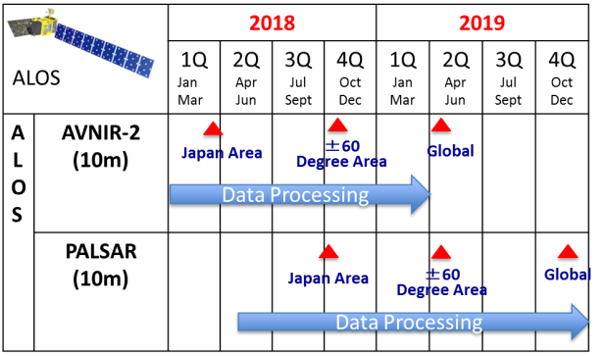

JAXA’s New EO Data Distribution Plan
To be open upon processed
Promote Open and Free
  ALOS/ALOS-2 series was exception
Available Spatial resolution
  5 meter resolution or Coarser
Enhance provision of available products on the internet
ALOS-2
(ScanSAR(100m),Fine Mode(10m))
Started negotiation with PD
G-Portal R will connect GEOSS portal

Slide 4
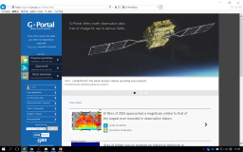




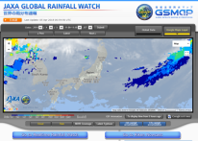


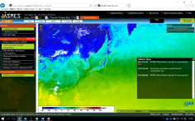



JAXA’s Open and Free EO Data and Services
 | Portal Name and URL | Coverage update | Related GEO WP
 | G-Portal R* | Global daily | Multi purposes Etc.
 | A main gateway to JAXA's EO satellite data products (GPM, GCOM-W, GCOM-C**, GOSAT)and data archive (MOS-1/1b, JERS-1, ADEOS, ADEOS-II, Aqua/AMSR-E, TRMM/PR).
 | https://gportal.jaxa.jp/gpr/
 | * Fully operational in July 2018, ** Released in December 2018
 | GSMaP: Global Satellite Mapping of Precipitation | Global every four hours
 | Provides hourly Global Rainfall Map in Near-Real-Time. (based on GPM-Core and several difference satellites/sensors)
 | http://sharaku.eorc.jaxa.jp/GSMaP/index.htm
 | JASMES: JAXA Satellite Monitoring for Environmental Studies | Global daily | Multi purposes
 | Provides climate variables (solar radiation, cloudiness, snow and sea ice cover, dryness of vegetation, soil moisture, wild fire, precipitation, land and sea surface temperature).
 | http://www.eorc.jaxa.jp/JASMES/index_map.html
 | GDAS: GOSAT Data Archive Service | Global daily
 | Provides GOSAT products (Methane and CO2). Operated by National Institute for Environmental Studies.
 | https://data2.gosat.nies.go.jp/gallery/L4B/concmov/concmov.html
G-Portal R will connect GEOSS portal
(CY 1992)
(CY 1987/ CY 1990)

Slide 5
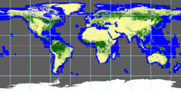


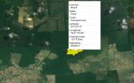



Free and Open Value added products and Portals
 | Portal Name and URL | Coverage Update | Related GEO WP
 | Global PALSAR-2/PALSAR/JERS-1 Mosaic and Forest/Non-Forest map | Global yearly
 | Seamless 25m-resolution mosaic and global forest/non-forest map(based on L-band SAR image).
 | http://www.eorc.jaxa.jp/ALOS/en/palsar_fnf/fnf_index.htm
 | JJ-FAST: JICA-JAXA Forest Early Warning System in the Tropics | Tropical forests area every 1.5 month
 | 50m resolution tropical forest cover change map (based on L-band SAR image) in 77 countries. Easily accessible and downloadable either with PCs or with mobile.
 | http://www.eorc.jaxa.jp/jjfast/
 | JASMIN: JAxa's Satellite based MonItoring Network system for FAO AMIS Market Monitor | SE Asia & Japan every half month
 | Aagrometeorological information (soil moisture, solar radiation etc.) of Indonesia, Thailand, Vietnam, Philippines and Japan.
 | http://suzaku.eorc.jaxa.jp/JASMIN/index.html
 | ALOS World 3D - 30m: ALOS Global Digital Surface Model(DSM) | Global no update | Multi purposes
 | Global DSM dataset with a horizontal resolution of approx. 30-meter mesh (1 arcsec) .
 | http://www.eorc.jaxa.jp/ALOS/en/aw3d/index_e.htm

Slide 6
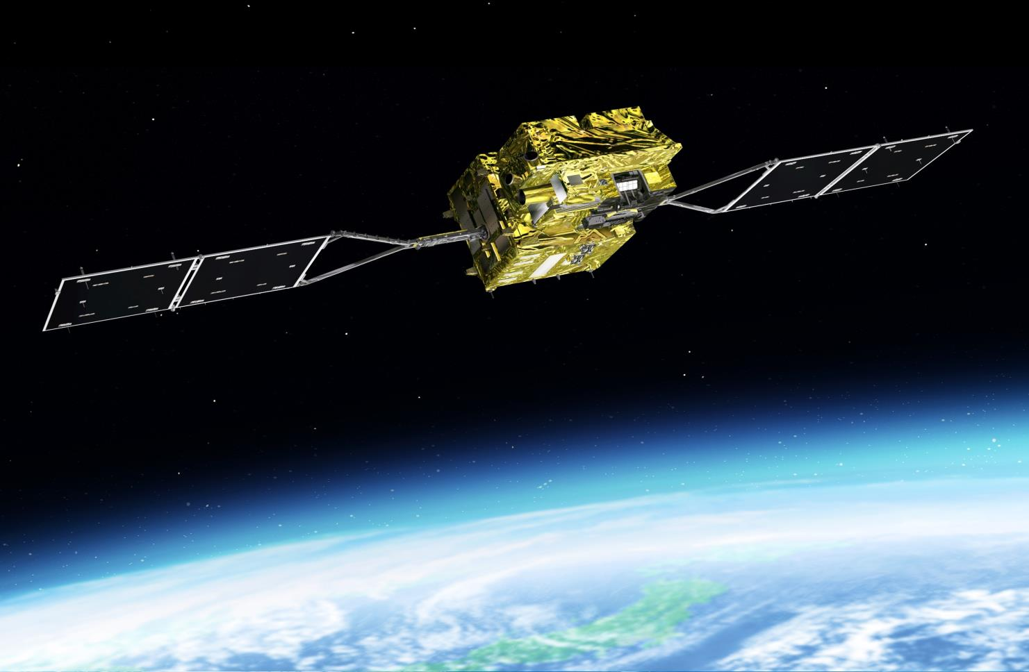
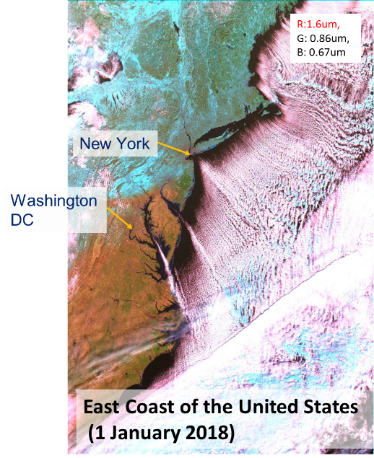
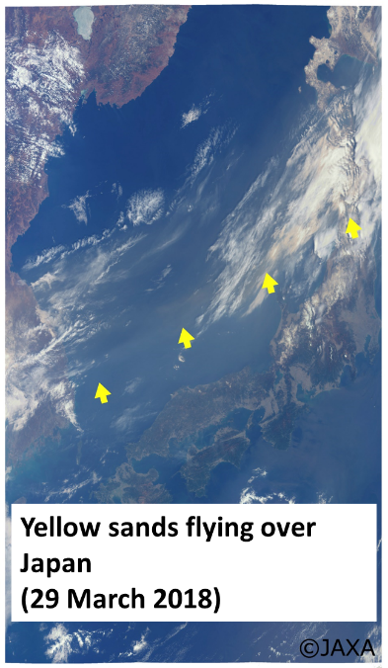
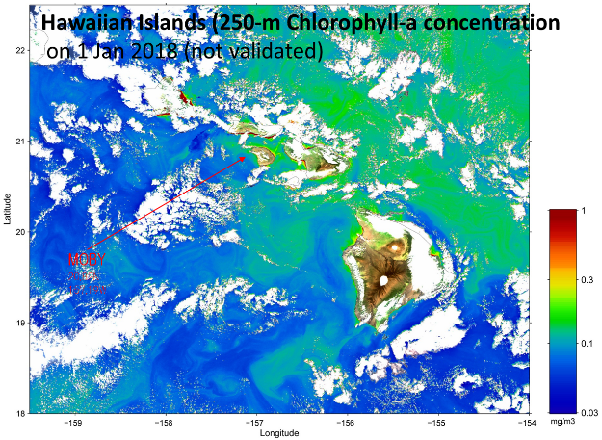
GCOM-C (Global Climate Observing Mission-Climate)
Launched in December 2017
6
6

Slide 7
Thank you
noda.akiko@jaxa.jp / anoda@geosec.org
http://global.jaxa.jp/

