Slide 1
Analysis -
Application -
AI -
ready data

Slide 2
If Siri can’t access your data, then it probably won’t be part of the data revolution.
Notes:
If you want your data to be used it need to be accessible to Siri (or alexa, google assistant, clippy)

Slide 4
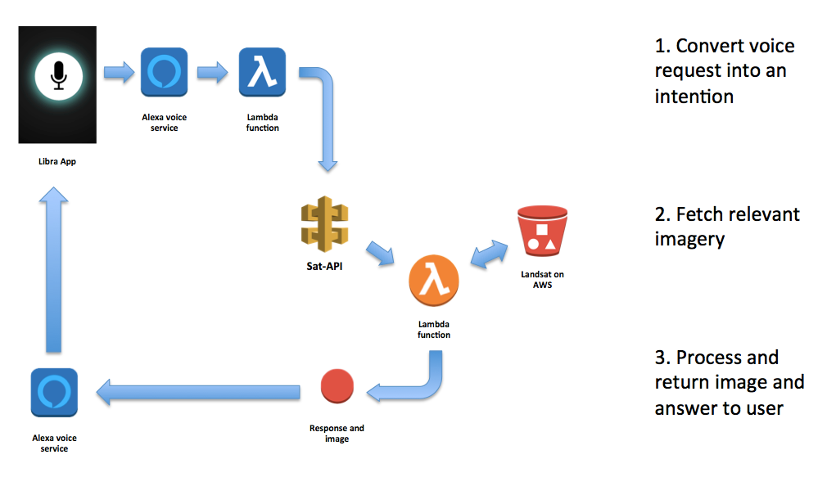
Under the hood
1. Convert voice request
into an intention
2. Fetch relevant
imagery
3. Process and return
image and answer to
user
Notes:
Seth spent a few days on this.
In Florence I proceeded to tell everyone why i couldn’t use their data (same as bethesda)
We are using Landsat on AWS because it is easy and fast to access programmatically and allows us to get just the bands that we want
We aren’t using Sentinel on AWS because it doesn’t allow windowed reads, we’d have to process full scenes

Slide 5
Under the hood
1. Convert voice request
into an intention
2. Fetch relevant
imagery
3. Process and return
image and answer to
user
Notes:
Seth spent a few days on this.
In Florence I proceeded to tell everyone why i couldn’t use their data (same as bethesda)
We are using Landsat on AWS because it is easy and fast to access programmatically and allows us to get just the bands that we want
We aren’t using Sentinel on AWS because it doesn’t allow windowed reads, we’d have to process full scenes

Slide 7
Under the hood
Cumulus
VIIRS
COGs
Notes:
We are using Landsat on AWS because it is easy and fast to access programmatically and allows us to get just the bands that we want
We aren’t using Sentinel on AWS because it doesn’t allow windowed reads, we’d have to process full scenes

Slide 8
Under the hood
Cumulus
VIIRS
COGs
Notes:
We are using Landsat on AWS because it is easy and fast to access programmatically and allows us to get just the bands that we want
We aren’t using Sentinel on AWS because it doesn’t allow windowed reads, we’d have to process full scenes

Slide 9
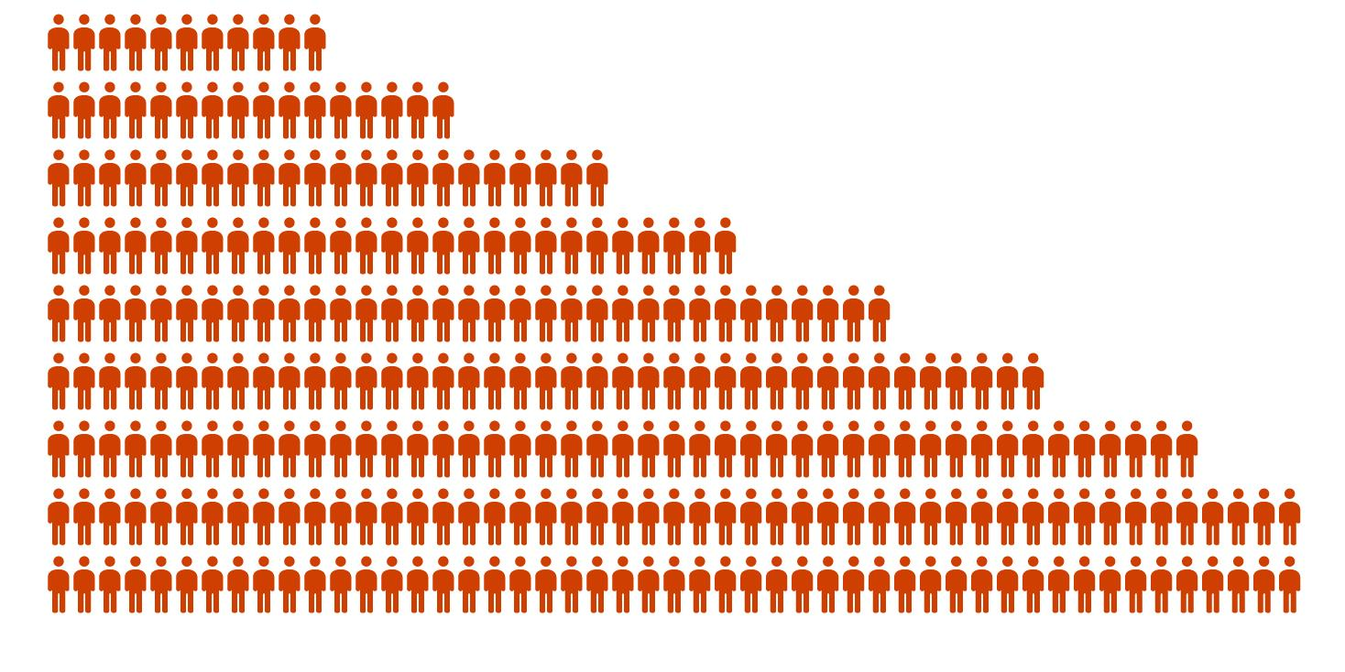
Who Uses EO Data?
Casual Users
Students / Researchers
EO specialists
Traits
• Low/no EO skill
• Low EO skills
• High EO Skills
• No time/interest to learn
a platform
• Time/interest to learn and
explore
• Has specific tools and
workflow
• Producing for others
Want
Answers
Exploration
Ready to use data
Tool
Fit for purpose app
Data exploitation platform
Analysis ready data
Millions to billions
Thousands

Slide 10
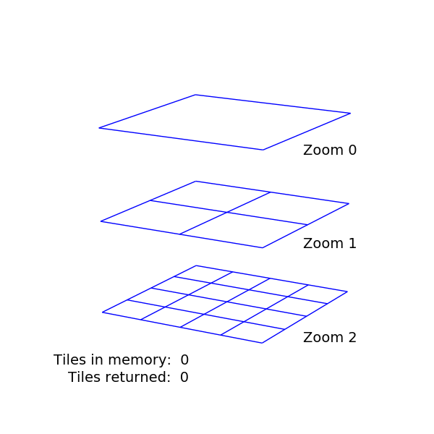
Analysis
Ready Data
Prepping Pixels

Slide 11
• Time Series Data
• Coregistered
• Pixel alignment
• Consistent Surface reflectance
• Sensor alignment
Notes:
What do we need to do to our data to make it ready for modern uses. I’ll talk about three concepts.
And then I offer some

Slide 12
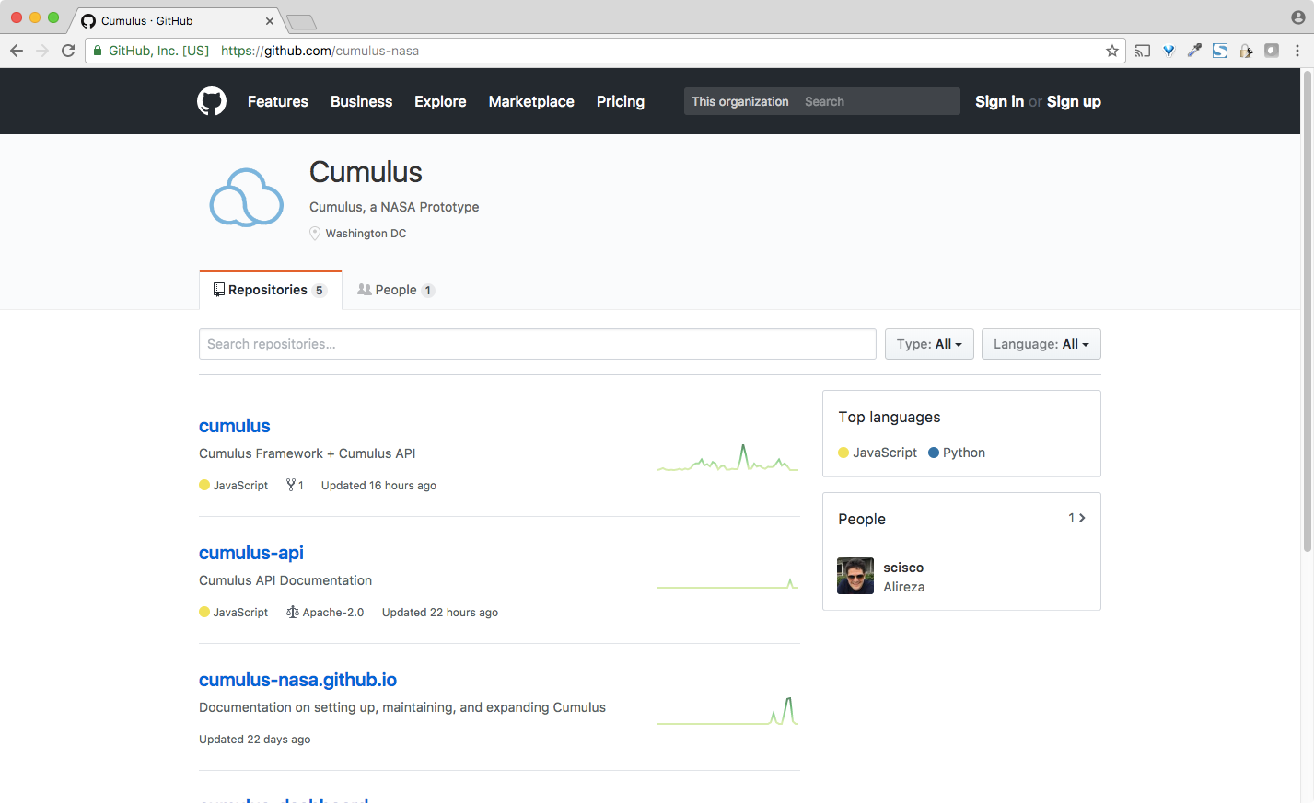
Notes:
Cumulus is open source.
The bigger points here are this:
NASA and others will use cumulus and frameworks like it to move archiving and operations into the cloud, that opens up possibilities, but data format matter
Dan Pilone’s notion of archive of convenience
Cumulus gives remarkable ability to create archives of conveneince

Slide 13
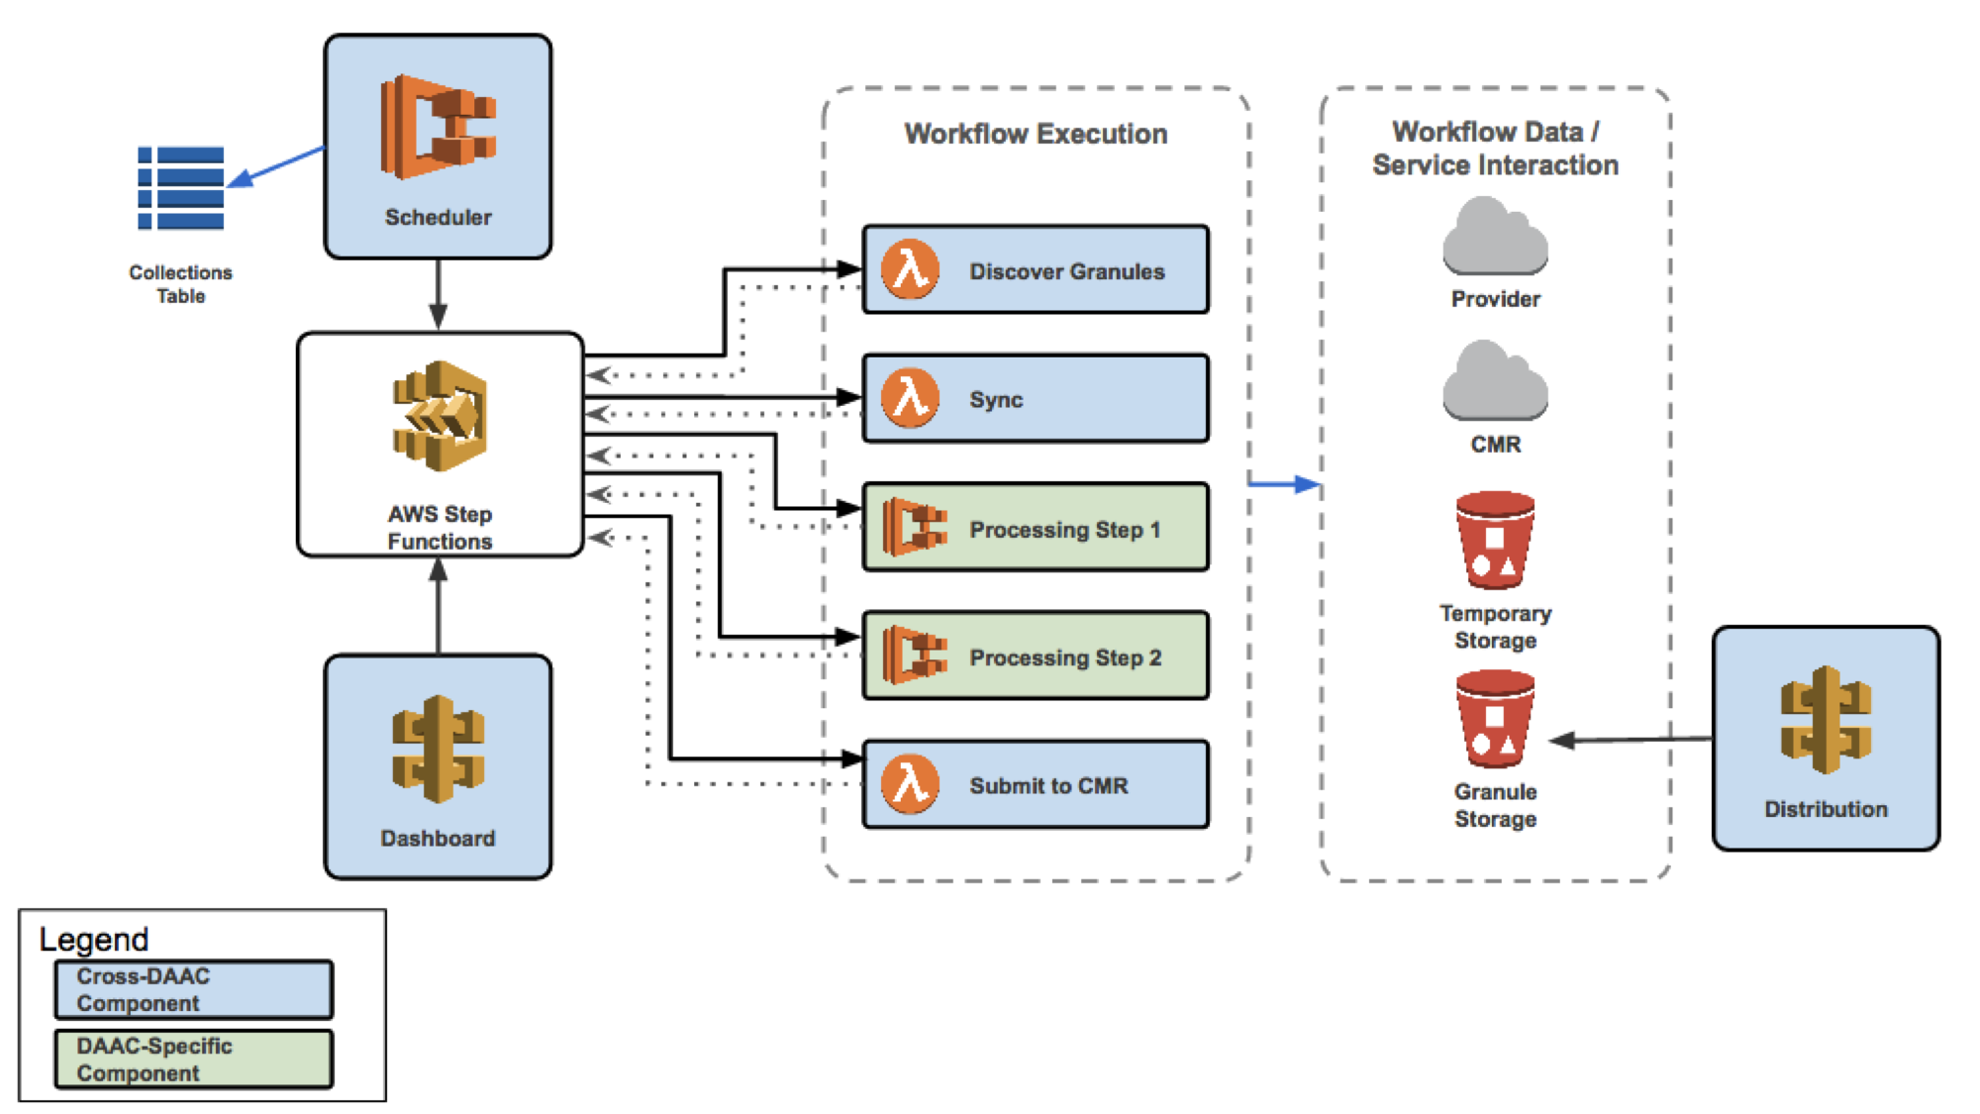

Slide 14
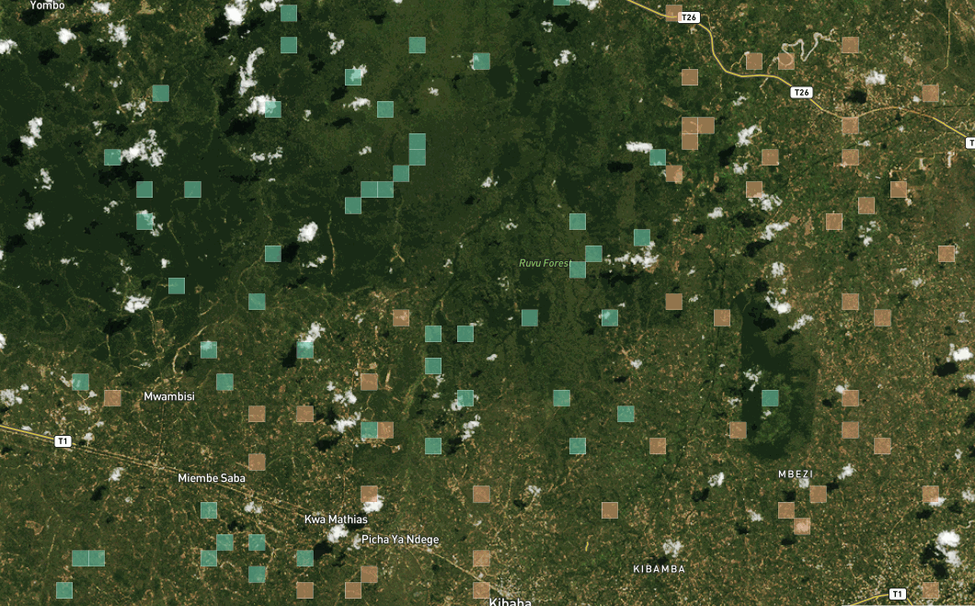
Application
Ready Data
Liberating Pixels

Slide 15
• Object Storage
• Windowed Reads
• Web native formats
• ML Ready Data
• Publicly available cloud
Notes:
What do we need to do to our data to make it ready for modern uses. I’ll talk about three concepts.
And then I offer some

Slide 16
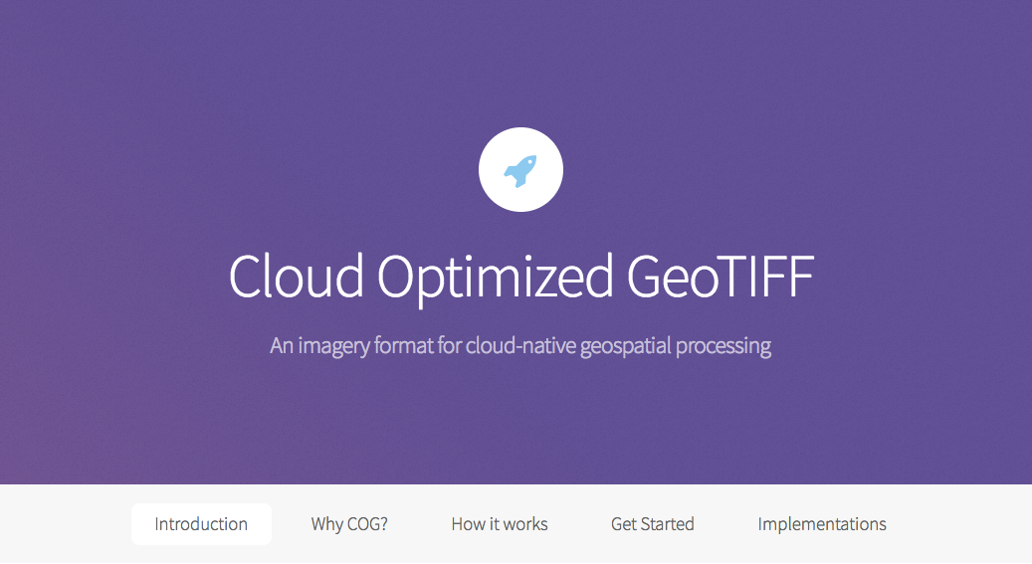

Slide 17
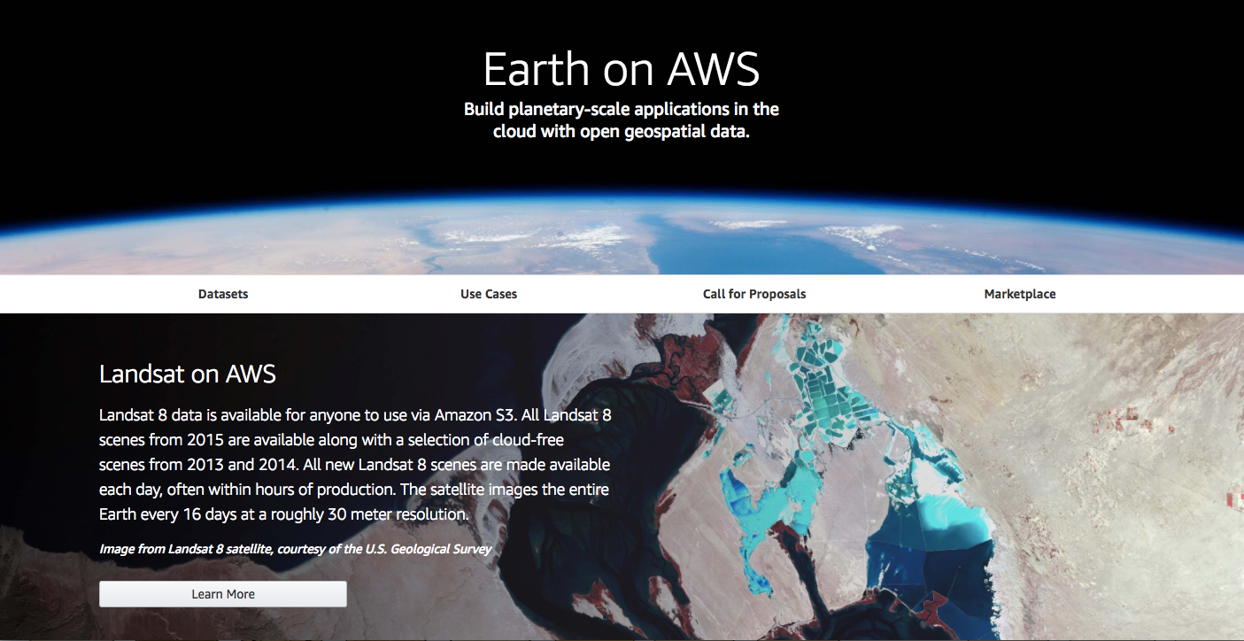

Slide 18
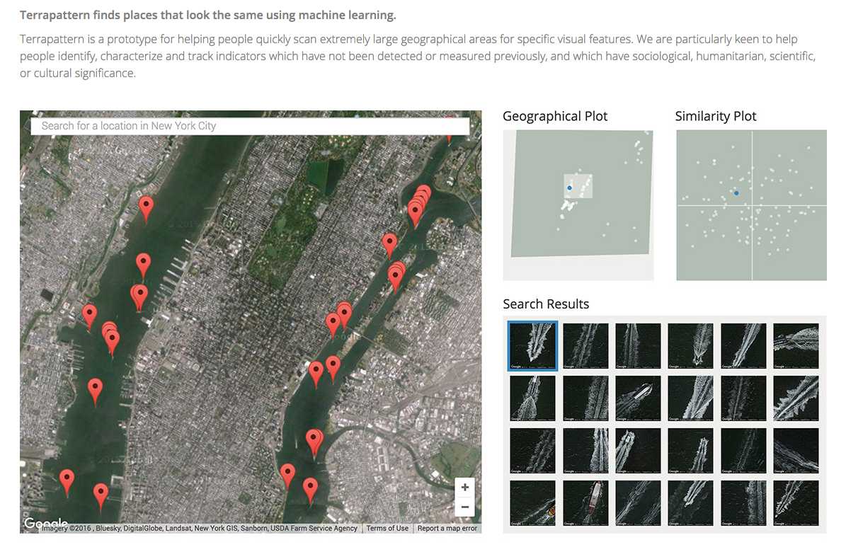
http://www.terrapattern.com/
Notes:
but maybe your users don't really care about a place over time. maybe they mostly care about places that are similar to eachother. in which case it might make more sense to store simple indexable representations of areas that can easily be sorted and compared (like terrapatern)
SO! if you don't know anything about the type of analysis that people will want to do, then you could do a lot worse that organizing your data in the lightest way possible
... app-ready data

Slide 19
Machine Learning Ready Data

Slide 20
Applying ML/DL to images
1. Classification:
Detect if an object is in an image
2. Object detection:
location, extent, and type of each object
3. Segmentation:
Label every pixel of every object

Slide 22
What we need:
• Open AARD data with global coverage
• Global high quality label data
• Label generation interfaces
• Training data generation & evaluation tools
Notes:
What do we need to do to our data to make it ready for modern uses. I’ll talk about three concepts.
And then I offer some

