Slide 2
Landsat : Analysis Ready Data for Decision Making
Ivan DeLoatch / Executive Director / Federal Geographic Data Committee
Pete Doucette / Associate Program Coordinator / National Land Imaging Program, USGS
#ARD4Decisions
Notes:
Pete Doucette
Associate Program Coordinator
National Land Imaging Program

Slide 3
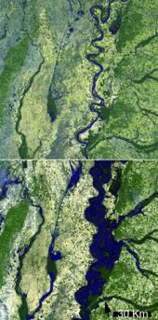
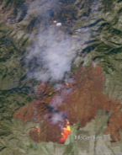
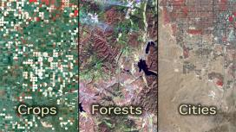
Landsat / End-user Application(s)
“Moderate” resolution
8-day global landmass refresh for monitoring seasonal change
The “gold standard” of data calibration (radiometry/geometry)
Flooding Wildfire Crops Forests Cities
Notes:
Discuss some of the End-User Applications and benefits.

Slide 4
Data science 80/20 rule
Landsat / End-User Needs
Users spend 80% of their time finding, cleaning, and reorganizing huge amounts of data, and only 20% of their time on actual data analysis that informs decision making.
Data
Prep
Analysis
Notes:
Users spend 80% of their time finding, cleaning, and reorganizing huge amounts of data, and only 20% of their time on actual data analysis that informs decision making.

Slide 5
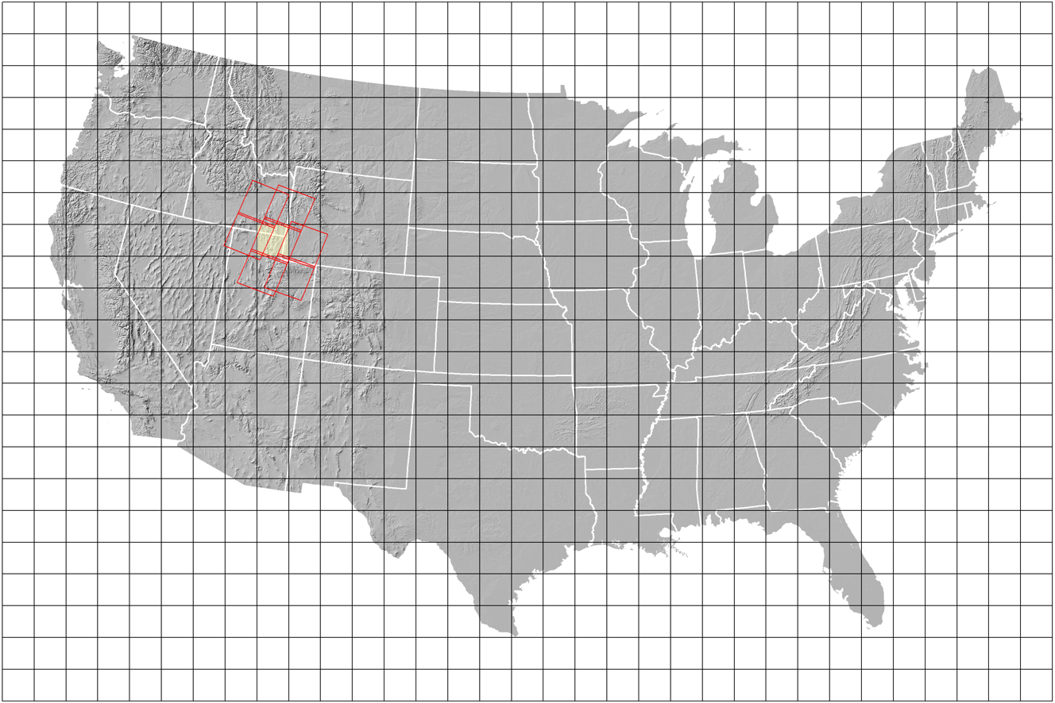
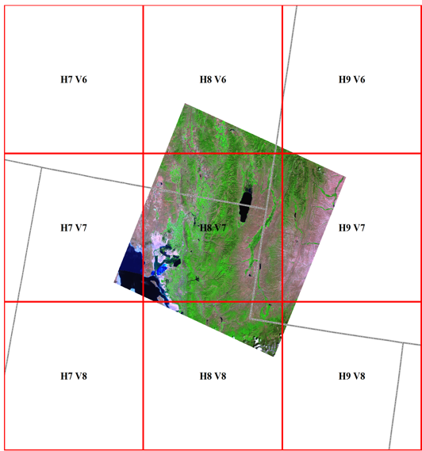
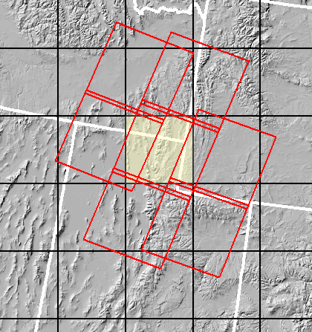
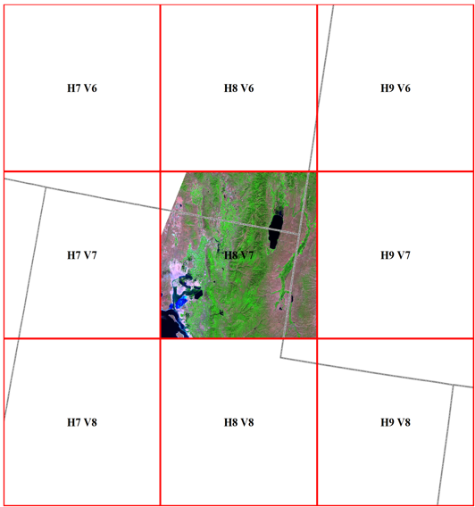
Landsat / Analysis Ready Data Grid System
Grid cell: 5k x 5x 30m pixels Projection: Albers equal area
Source: Dr. Doug Ramsey, Director of the Utah State University Remote Sensing/GIS Laboratory in Logan, Utah
Notes:
The Landsat team has worked hard over the past few years in developing “analysis ready data” (ARD) for the Landsat archive.
This is a tremendous way to ‘unleash’ the power of the Landsat archive ‘out of the box’ for users. CAVEAT—ARD is currently available (as of Nov 2017) for the 50 states only.
The other major aspect of ARD is going from a ‘scene-based’ access (as in slide 6), to a fixed and seamless grid system. Moreover, the Landsat data are stacked in time (and all consistently calibrated over time) for each grid tile, such that the user can access a time ‘stack’ for any given tile, and unpack the stack to perform time-series analysis.

Slide 6
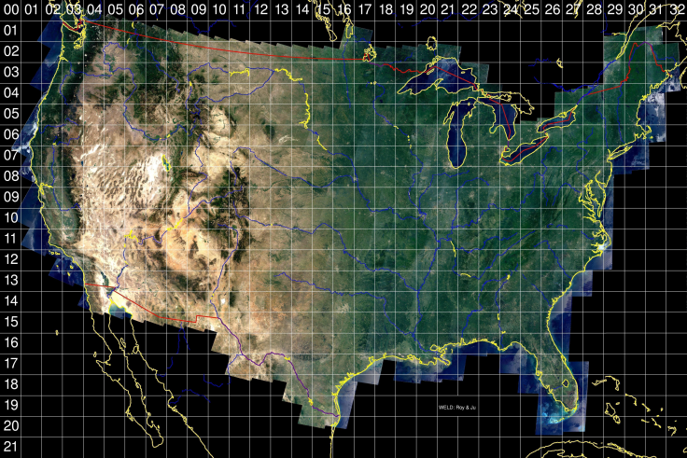
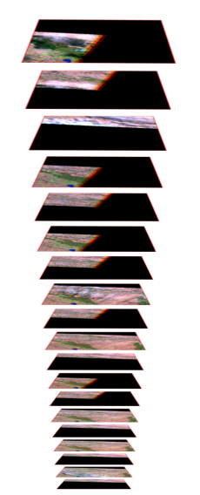
Landsat / Analysis Ready Data
Time
Fixed grid cells: 5,000 x 5,000 (30m pixel) on Albers Equal Area Conic/WGS84
Facilitated
time-series
analysis
The Web-Enabled Landsat Data (WELD) tiling scheme for the conterminous U.S. being adapted for the LCMAP ARD (graphic courtesy of David Roy, SDSU).
A consistently processed
“collection” with geometric and radiometric calibration
1972
Notes:
Moreover, the Landsat data are stacked in time (and all consistently calibrated over time) for each grid tile, such that the user can access a time ‘stack’ for any given tile, and unpack the stack to perform time-series analysis.

Slide 7
Landsat / ”Continuous” Change Detection & Classification (CCDC)
Time T(1)
Time T(2)
CCDC Pairwise vs. ARD Threshold & Intensity to detect change
Land class_1
Land class_2
Surface reflectance
Plot one pixel’s observation for each image
1984
1988
1992
1996
2000
2004
2008
2012
Graph adapted from C. Holden, Boston University
Time
Zhu, Z. and C.E. Woodcock. 2014. Continuous change detection and classification of land cover using all available Landsat data. Remote Sensing of Environment 144:152–171.
Notes:
ARD allows users to think well beyond the more conventional thinking of image ‘pairwise’ change detection, in which change is detected by thresholding differences between intensity values for a pair of images as scene here.
‘continuous change detection and classification’ or CCDC, which was developed by researchers at Boston University (see paper citation), and which is being adapted by scientists at USGS EROS for land cover product generation across time. It is a ‘continuous’ change detection in that it uses all available observations in the archive (note that some observations are outliers, and need to be filtered out).

Slide 8
Landsat / ”Continuous” Change Detection & Classification
Integrated Monitoring and Forecasting Products
ARD Products allow users to assimilate and take advantage of a variety of products to support analysis
Socio-culture and economics
Data Assimilation
Fauna
Geology & Geomorphology
Soils
Ground & Surface Water
Flora
Atmosphere, Ocean, Ice
Land Cover & Land Use
Spatial
Temporal
Notes:
ARD products are not offered as ‘perfect’, but rather as an analysis ready alternative to users, many of which will be more than happy to take advantage of.

Slide 9
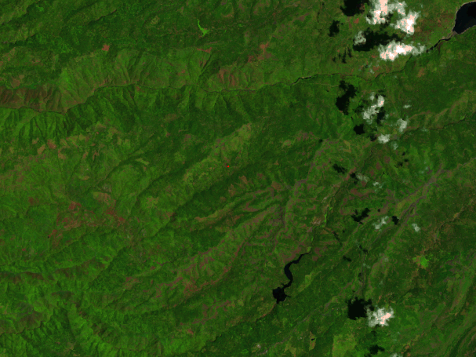
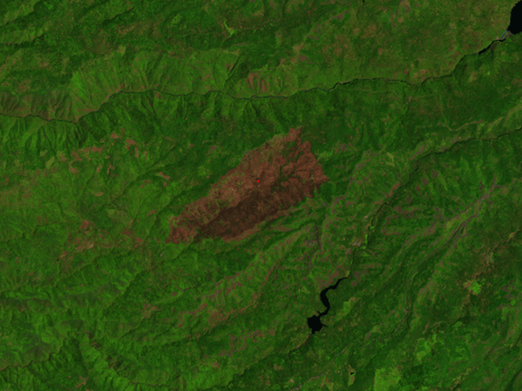
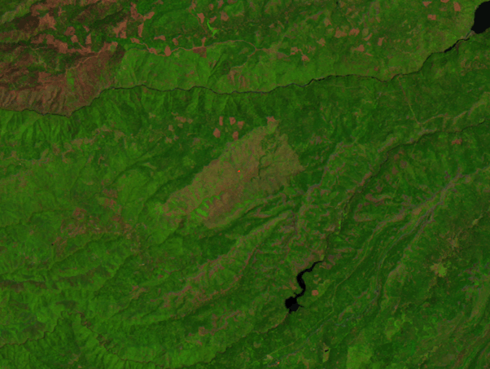
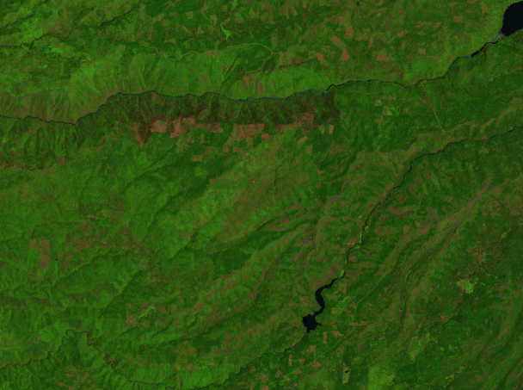
Landsat / A Pixel in Time––Going through fire”
Year fire occurred
Post-fire recovery
Longer-term recovery
Pre-fire
Change over time
Mid-IR band
A pixel history in
Stanislaus National Forest, California
Regrowth trend
Reflectance (scale factor 0.0001)
1984 1986 1988 1990 1992 1994 1996 1998 2000 2002 2004 2006 2008 2010 2012
Date
Notes:
Example #1 using the Change Detection & Classification system a user can monitor pre-fire, response and recovery efforts.

Slide 10
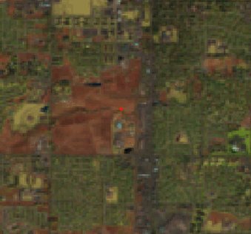
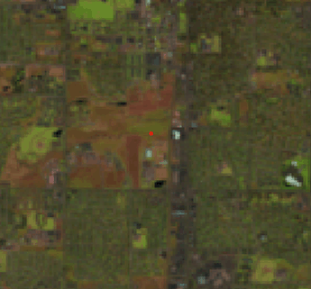
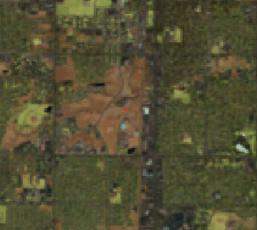
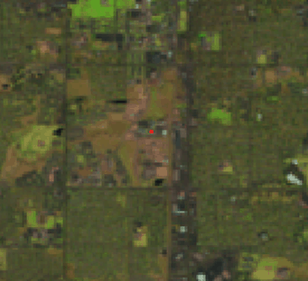
Landsat / A Pixel in Time––Land Use Change”
Cropland
Hay/Pasture
In conversion
Developed
A pixel history of land use change in
Fort Collins, Colorado
Change over time
Mid-IR band
Ft. Collins USGS
Reflectance (scale factor 0.0001)
Class 1
Class 2
Class 3
Class 4
1984 1986 1988 1990 1992 1994 1996 1998 2000 2002 2004 2006 2008 2010 2012
Date
Notes:
Similarly
Example #2 using the Change Detection & Classification system a user can monitor and anlalyze land use changes

Slide 11
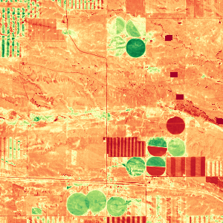
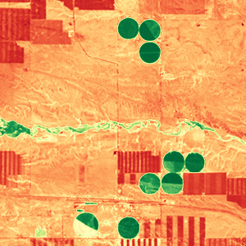
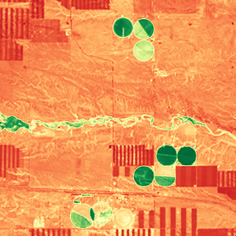
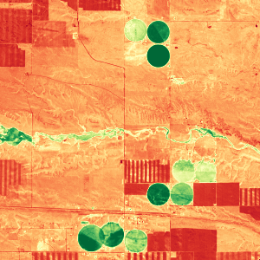
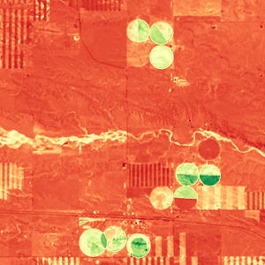
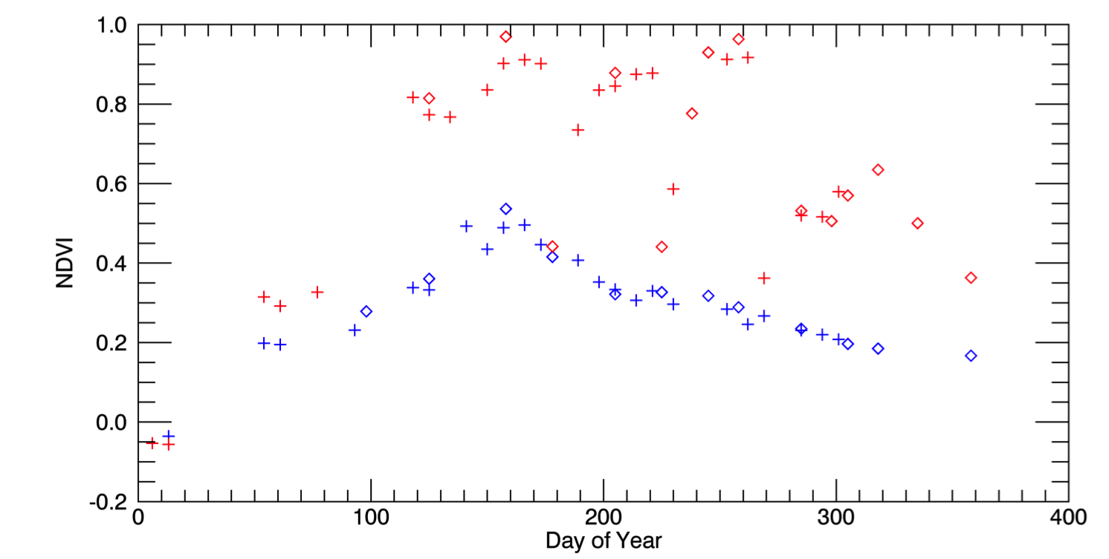
Landsat / Harmonizing Landsat and Sentinel Products
May 4, 2016 (S2)
Aug 8 (L8)
Aug 17 (L8)
Sep 1 (S2)
Oct 20 (L8)
Harmonized Landsat / Sentinel-2 Products
Laramie County, WY
3km
0.1 NDVI 0.9
Slide borrowed from
Jeff Masek, NASA
Sentinel-2 Landsat-8
Seasonal phenology (greening) for natural grassland and irrigated alfalfa fields observed from Harmonized Landsat/Sentinel-2 data products.
+
Alfalfa
The high temporal density of observations allows individual mowing events to be detected within alfalfa fields. HLS Products available from: https://hls.gsfc.nasa.gov
NDVI
mowing
Grassland
Day of Year
Notes:
Point out collaboration efforts underway to harmonize landsat and sentinel data. Example showing seasonal phenology for natural grassland and irrigated alfalfa fields.

Slide 12
Landsat / End-user Application(s)
“Moderate” resolution
8-day global landmass refresh for monitoring seasonal change
The “gold standard” of data calibration (radiometry/geometry)
Flooding Wildfire Crops Forests Cities
Notes:
Much has been accomplish can be applied to many applications – Currently US only → Next step Global ARD

Slide 13
Thank you
Landsat : Analysis Ready Data for Decision Making
Ivan DeLoatch / Executive Director / Federal Geographic Data Committee
Pete Doucette / Associate Program Coordinator / National Land Imaging Program, USGS
#ARD4Decisions

