Slide 1
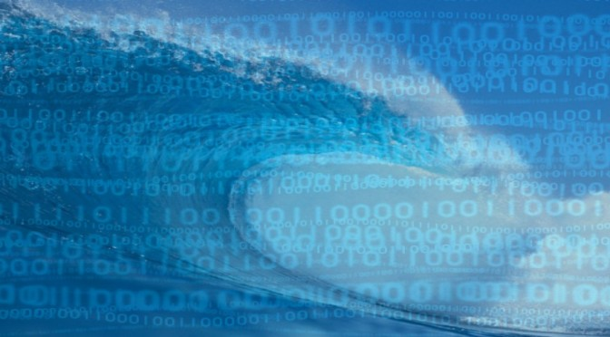
Lightning talk
AtlantOS data use and applications
Ketil Koop-Jakobsen – Bremen University
Photo: mghpcc

Slide 2
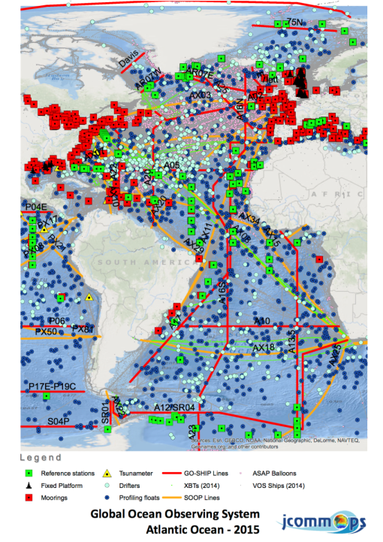
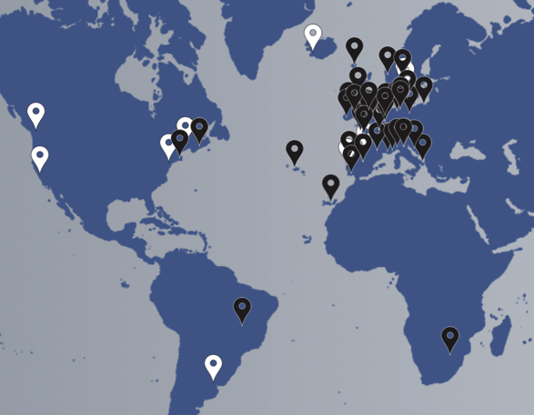
The AtlantOS Project A H2020-project
Budget: 21 Mio. Euros in 4 years
Coordinator: GEOMAR; Partner: 62
SCOPE: Integration of ocean observing activates across all disciplines for the Atlantic, considering European as well as non-European partners.
AtlantOS members (white) and 62 H2020 consortium partners (black)

Slide 3
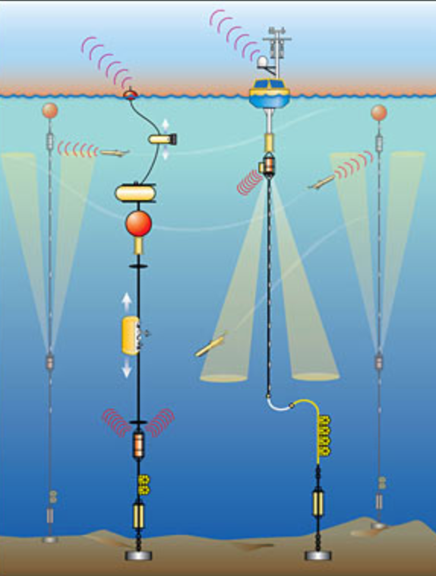
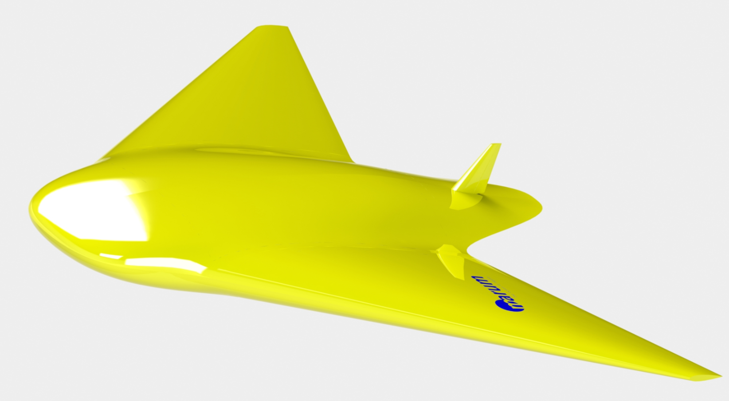
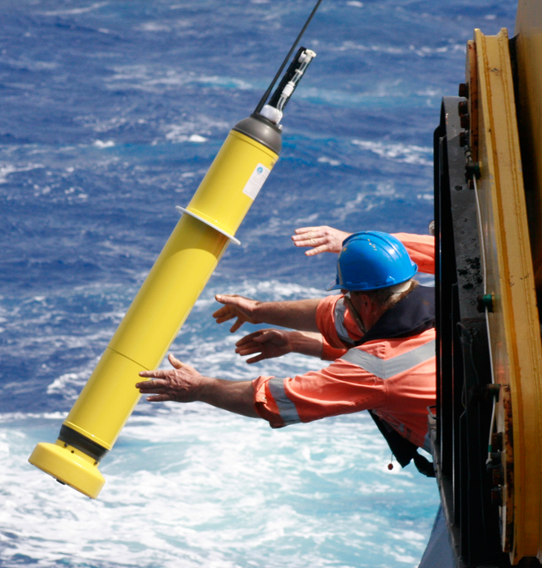
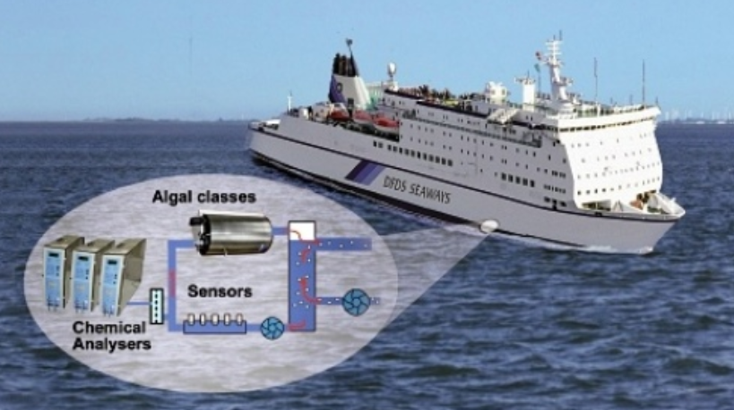
Ocean Monitoring Platform
Moorings
Gliders
Ferrybox
Argo-Floats

Slide 4
The Data:
Essential Ocean Variables
Physical data:
Temperature
sea surface
Salinity
sea surface
column
Current
Sea Level
bottom depth
Turbidity
Biogeochemistry data:
Oxygen
Chlorophyll
Fluorescence
Nutrients
Carbonate system
Organic Matter
N₂O
Biological data:
Zooplankton
Phytoplankton
Species
Eggs and larvae

Slide 5
SCOPE:

Slide 6
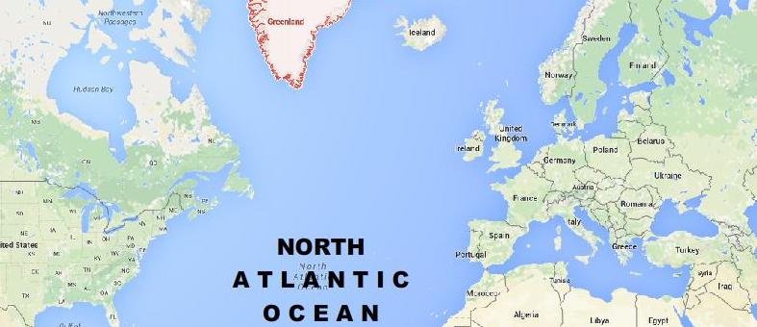
Example: Why connect Ocean data-providers across the Atlantic?
In Europe:
European Multidisciplinary Seafloor and water-column Observatory (EMSO) has an array of fixed-point observatories.
EMSO Observatories

Slide 7
Example: Why connect Ocean data-providers across the Atlantic?
European Multidisciplinary Seafloor and water-column Observatory (EMSO) has an array of fixed-point observatories.
EMSO Observatories

Slide 8
Example: Why connect Ocean data-providers across the Atlantic?
In North America
OOI, NOAA, WHOI and others have an array of fixed-point observatories.
EMSO Observatories

Slide 9
Example: Why connect Ocean data-providers across the Atlantic?
EMSO (EU) + OOI, NOAA etc (USA)
Combined a better spatial resolution of the ocean observation in the North Atlantic
EMSO Observatories

Slide 10
AtlantOS will allow users to harvest Atlantic Ocean data from
Europe and North America
Africa and South America
GEOSS can facilitate the integration of data resources from Data Providers on different continents
…
Ocean observatory
EUROPE
Ocean observatory
USA
Source: www.applied-maths.com/

