Slide 1
Global Collaboration (with information) for Impact
Barbara Ryan / Secretariat Director / Group on Earth Observations

Slide 2
1 / The enabling power of GEO
Global vision and coordination,
regional and local implementation.

Slide 3
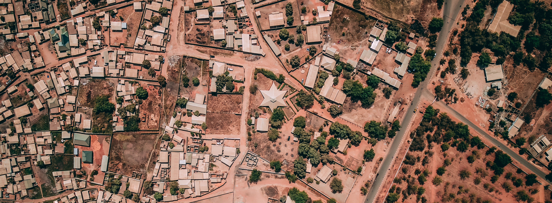
2 / GEOSS for Global Challenges
Open data, sustained observations, & integrated information is crucial for achieving
international targets.
Climate Change / Disaster Risk / SDGs / Mercury & more

Slide 4
3 / Evolving needs & services
GEOSS: 10 years of evolution
in response to user needs.

Slide 5
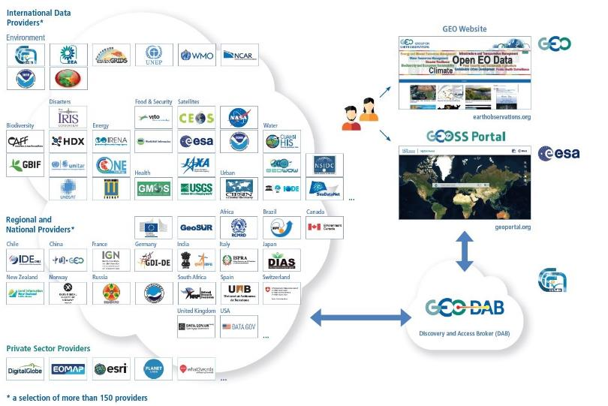
The GEOSS Platform

Slide 6
GEOSS Platform Use
(# of Queries -- People and Machines)
1,923,990
30 March 2018

Slide 7
Top Institutional Use (2017)
Entities Submitting Queries | Number of Queries | Order of Magnitude
WMO Information System | Very High | > 1 M
Cloud Infrastructures | High | > 100 K < 1 M
ESRI ArcGIS Online | Medium | > 10 K < 100 K
US GEO | Medium | > 10 K < 100 K
EC H2020 Projects | Medium | > 10 K < 100 K
China GEO | Medium | > 10 K < 100 K
CEOS Water Portal | Low | > 1 K < 10 K
UNEP GRID | Low | > 1 K < 10 K
Int. Orgs
GEO Members
Private Sector
Other
Notes:
WMO is the largest user of the GCI.
It is largely by WMO Information System (WIS) -- machine to machine extractions.
WIGOS is (or could be) using WIS to exchange all information not currently in WIS, so if WIGOS does indeed use WIS, they are already benefitting from GEO's information through the GCI.
7

Slide 8
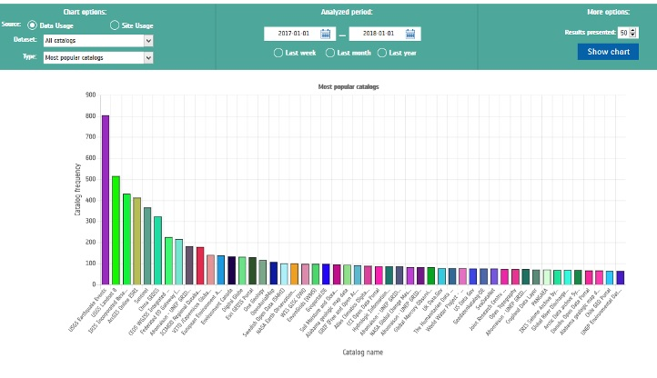
Most Popular Data Catalogs (2017)

Slide 9
4 / The GEO community
The right partners
for impactful collaboration.

Slide 10
GEO’s Participating Organizations

Slide 11
6 / Towards the GEO vision
Towards a future of more informed
and purposeful decision-making
for our planet and people.

Slide 12
Thank you
secretariat@geosec.org / earthobservations.org / @GEOSEC2025

