Slide 2
GEOSS Platform
The Brokering process
Paola De Salvo /GEO Secretariat & Roberto Roncella/ CNR - IIA

Slide 3
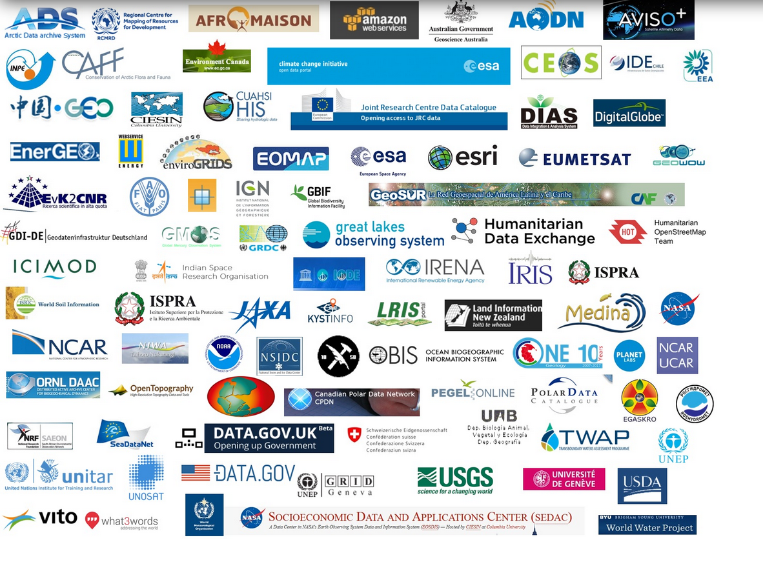
The GEOSS Platform Numbers
The GEOSS Platfom presently
brokers more than 172 open data catalogs and information systems, comprising over 414 million data and information resources.
35 Languages
7000 + Contributing organizations
200,0000 Keywords
415,000,000 Open EO Data resources
……..and many more….

Slide 4
Building GEOSS: The GCI Journey
“The vision for GEOSS is to realize a future wherein decisions and actions for the benefit of humankind are informed by coordinated, comprehensive and sustained Earth observations and information.
2005
2008
2010
2012
2016
2018
First GEOSS Portal
Launch of the new GEOSS Portal
Birth of the GCI as
Clearinghouse catalogue
GEO DAB as a new component. Evolving GCI into a Brokering Infrastructure
The GCI becomes
a GEOSS Platform
The Group on Earth Observations (GEO) was established as an intergovernmental mechanism for coordinating all existing and future Earth observations systems and implementing GEOSS.
Launch of the new Registration process with the GEOSS Yellow Pages

Slide 5
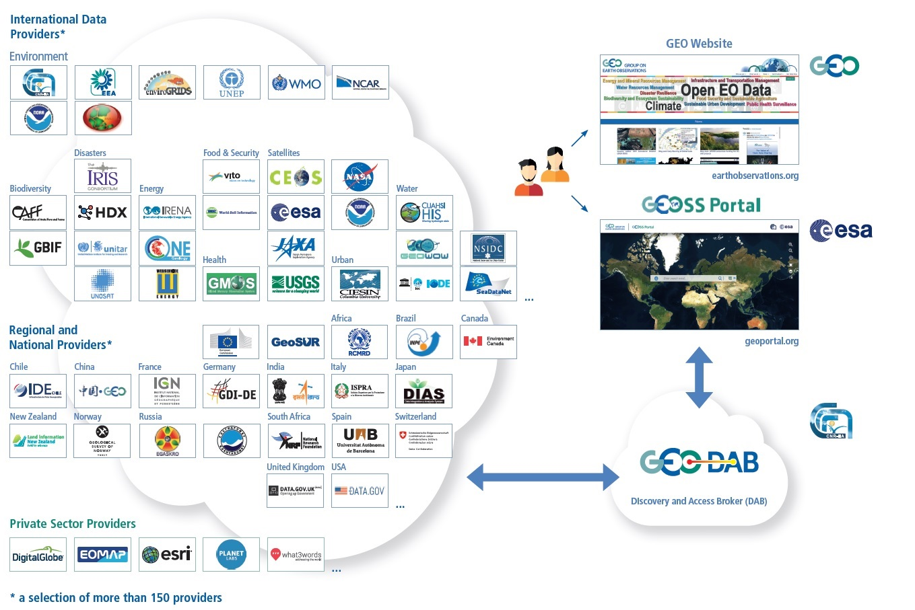
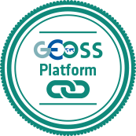
The GEOSS Platform
Enhanced functionalities
GEOSS Yellow Pages
GEOSS View
GEOSS Status Checker
GEOSS Widget
GEOSS API
GEOSS Mirror
GEOSS
Like

Slide 6
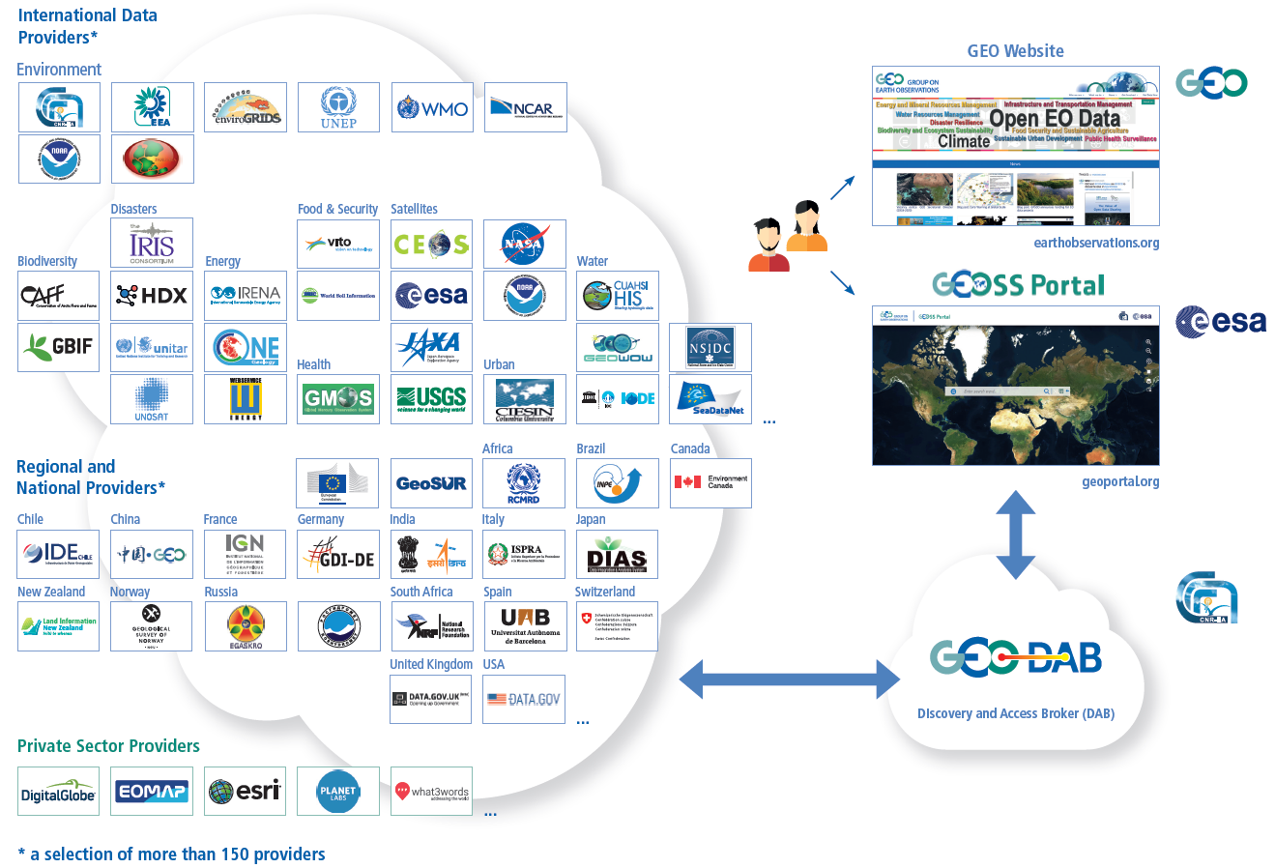
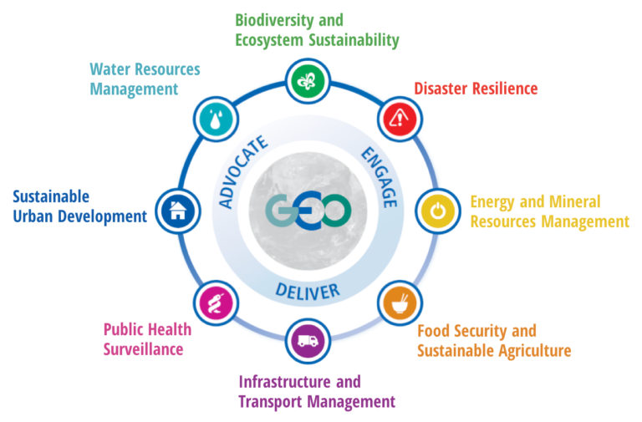
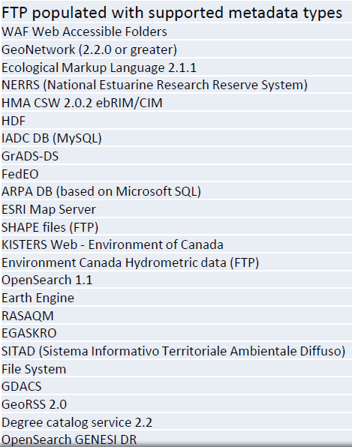
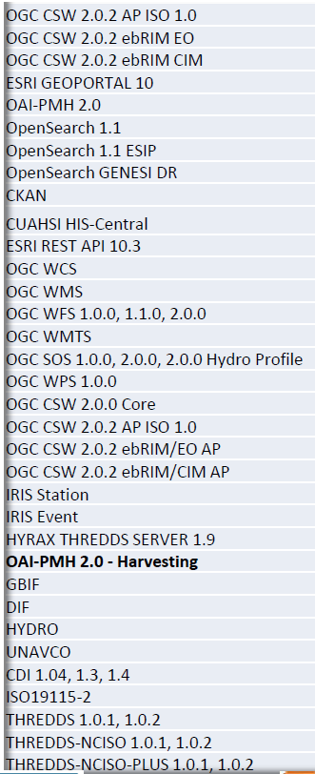
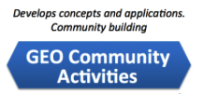
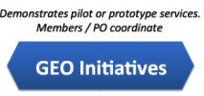
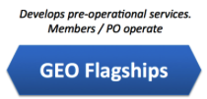
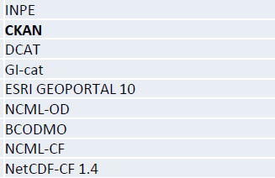
The GEOSS Platform Registration & Brokering Process
Asset to be registered
Administrative Phase (GEO Sec)
Data Provider fills in a GEOSS Yellow Page form
GEO Sec team validates the entry
Users
The Asset is now accessible from the GEOSS Portal
Supported
Standards
Brokering Phase (GEO DAB)
Webservice end point URL to GEO DAB Team
Interoperability
tests
GCI
GEOSS

Slide 7
The GEOSS Platform Registration & Brokering Process
GEOSS Yellow Pages

Slide 8
High-level Workflow Brokering Process
Provider sends a set of technological (URL) information to the GEOSS Platform/GEO DAB Team
GEO DAB Team runs interoperability test and sends the results to Provider and GEO Sec
To address possible issues, GEO DAB Team and Provider work together
GEO DAB Team adds Provider’s system to GEOSS Platform and informs GEO Sec and Provider

Slide 9
GEO DAB Interoperability test
GEO DAB tries to harvest the provided catalog
GEO DAB Team produces a test report with the following information:
Discoverability Test Results:
Number of harvested resources
Main metadata fields (Title, Abstract, Geographical Area, Graphic Overview, etc.)
Accessibility/Visualization Test Results:
Available data for downloading
Data Visualization on the map
GEO DAB Team sets up a dedicated test instance allowing Provider to verify the results
If Provider approves the current implementation, GEO DAB Team moves to environment production the Provider’s system

Slide 10
Brokered Data System (from the last year Provider Workshop)
New added
Moldova Geo Portal
JAMSTEC
Global Facility for Disaster Reduction and Recovery (GFDRR)
EartH2Observe
Water Switch-On
Cyprus Geoportal
Healthsites
ISRIC - World Soil Information (WDC-Soils)
DEIMS-DIP
EURAC Reasearch
Copernicus Atmosphere Monitoring Service (CAMS)
Food and Agriculture Organization (FAO)
HydroShare
VITO/Copernicus Global Land Services
ECOWAS Centre for Renewable Energy and Energy Efficiency
Environmental Data Portal (EnviDat)
AtlantOS
Climate Change Centre Austria (CCCA)
Sierra Nevada Global Change Observatory (iEcolab)
Notes:
They are about 20 . Then there are some systems updates (explain – already brokered system which need some fine tuning) and some other that are tested but not moved into production (explain – policy or

Slide 11
Brokered Data Systems (from the last year Provider Workshop)
Updated
USGS Earthquake Events
European Environment Agency SDI Catalog
CEOS WGISS Integrated Catalog (CWIC)
Global Mercury Observation System (GMOS)
Data Integration and Analysis System (DIAS) – Japan
Joint Research Centre Data Catalog
Copernicus Atmosphere Monitoring Service (CAMS)
DEIMS-DIP
ArcGIS Online ESRI
Notes:
They are about 20 . Then there are some systems updates (explain – already brokered system which need some fine tuning) and some other that are tested but not moved into production (explain – policy or

Slide 12
Brokered Data Systems (from the last year Provider Workshop)
In progress
VITO - Vlaamse Instelling voor Technologisch Onderzoek (PROBA-V)
United Nations Office for Outer Space Affairs / UN-SPIDER
Schedule
EOMAP GmbH & Co.KG
Japan Aerospace Exploration Agency (JAXA)
Copernicus Marine Service
ESRI ArcGIS Living Atlas of the World
…
A list of about 30 new data provider systems
Notes:
They are about 20 . Then there are some systems updates (explain – already brokered system which need some fine tuning) and some other that are tested but not moved into production (explain – policy or

Slide 13
Brokering Pipeline Report Period 2017-2018

Slide 14
The GEOSS Platform Registration & Brokering Process
Frequently Asked Questions
Who becomes the owner of my data?
If I have a Catalogue of Catalogues, my contributors will be visible?
Do I loose ownership of the EO shared via the GEOSS Platform?
Do I get more exposure and visibility to my data?
How do I know the Users metrics of my data catalogue?
http://www.geoportal.org/community/guest/yellow-pages

Slide 15
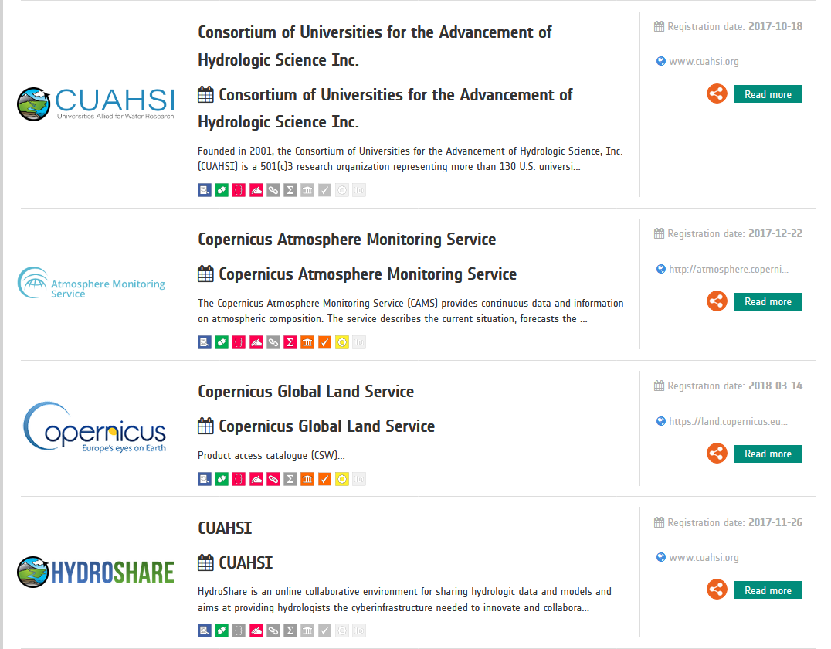
The GEOSS Platform Registration & Brokering Process
How is my organization becoming visible in the GEOSS Platform?
http://www.geoportal.org/community/guest/yellow-pages

Slide 16
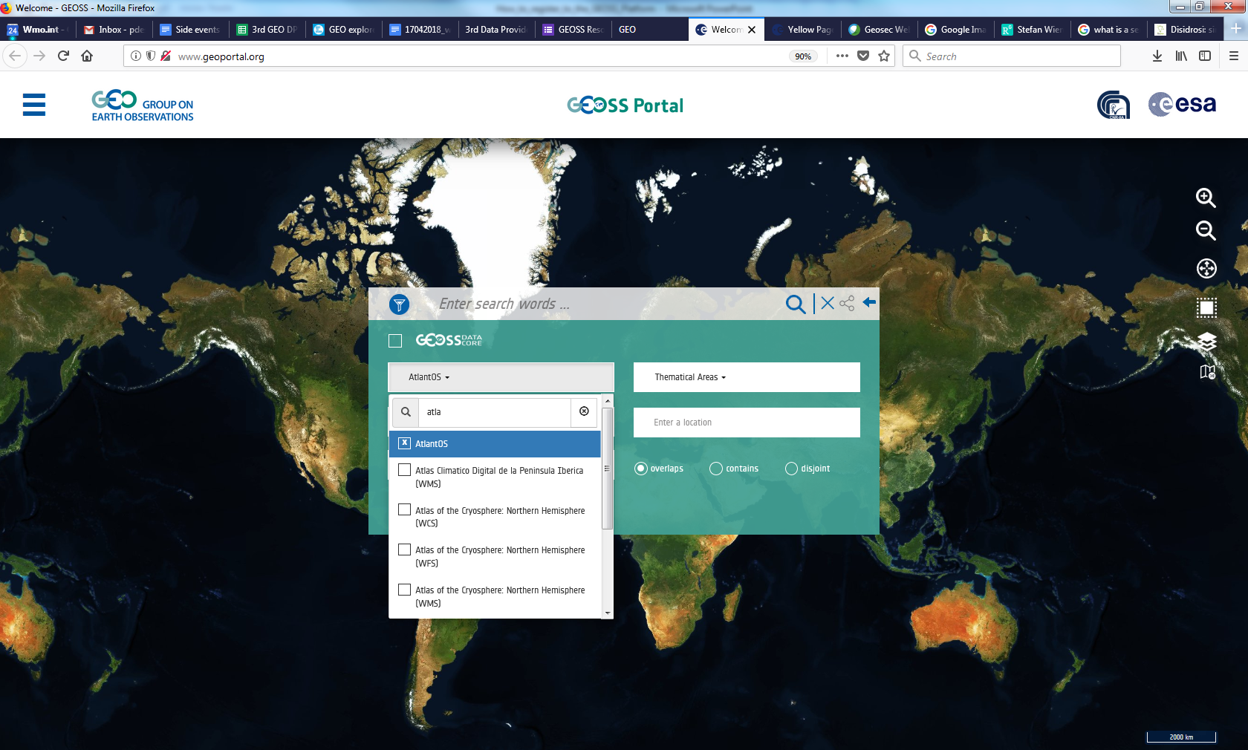
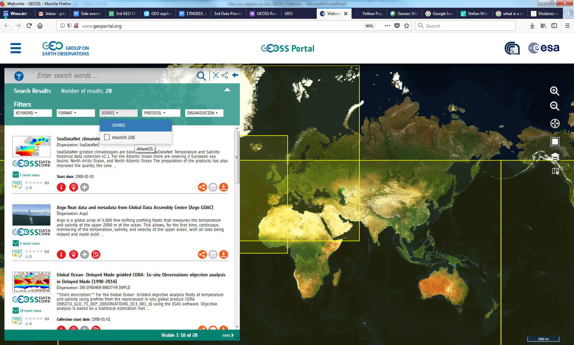
The GEOSS Platform Registration & Brokering Process
How is my organization becoming visible in the GEOSS Platform?
http://www.geoportal.org/community/guest/yellow-pages

Slide 17
What Data providers say about Interoperability test
I found the interoperability test very easy and smooth.
Structuring metadata for GEOSS is indeed a good exercise which improves the quality of the service to the end users
The interoperability test is a critical step that help us enourmously improve the discoverability, accessibility and usability of the Earth Observations to the Users, via the GEOSS Platform.

Slide 19
Thank you
pdesalvo@geosec.org
r.roncella@iia.cnr.it

