Slide 1
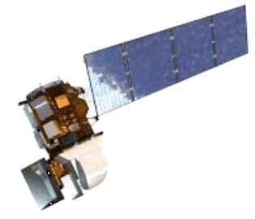
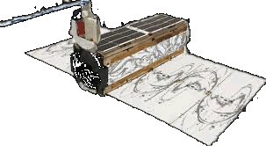
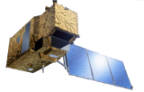
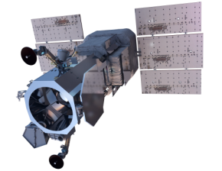
Mapping and monitoring aquatic environments worldwide
Success story of an SME working with open data, and GEOSS
Dr. Thomas Heege, CEO
EOMAP GmbH & Co.KG
Germany | Australia | USA
www.eomap.com

Slide 2
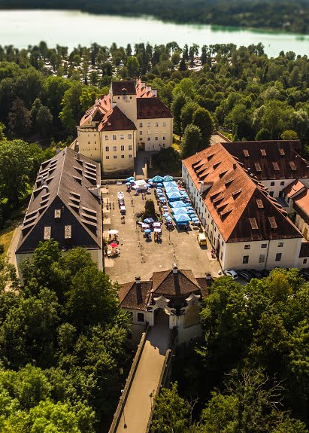

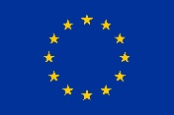
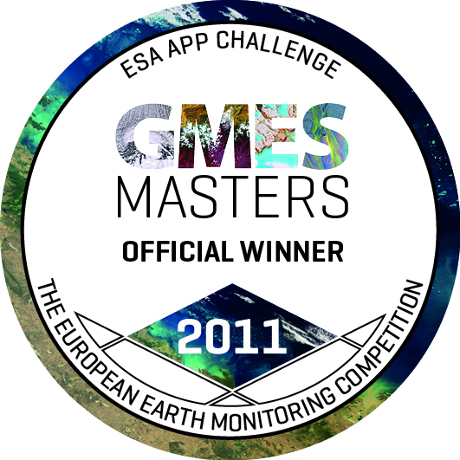
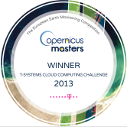




About us
Mapping & monitoring aquatic environments worldwide
Service provider to coastal and offshore industry, academia and governmental entities
Award winning cutting edge technology & services
EU SME
champion
Copernicus awards for outstanding technology
Information
Program Partner
Solution
partnership
Data
provider
EOMAP HQ
Schloss Seefeld, DE

Slide 3
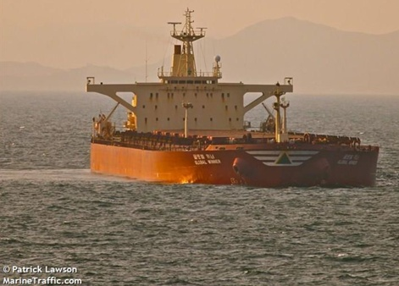
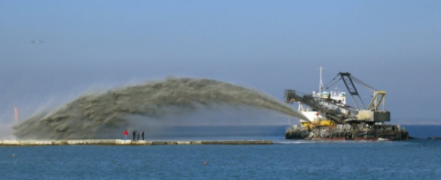















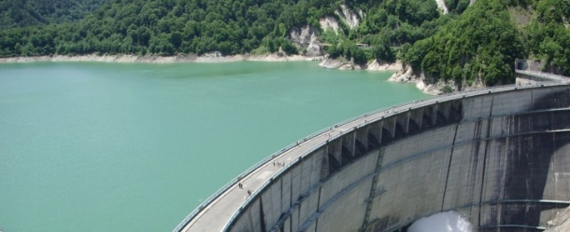


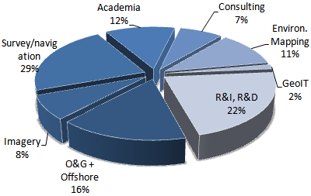





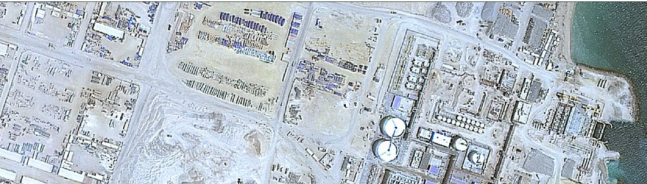















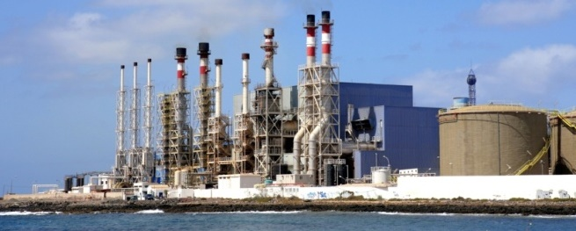






Market and client groups

Slide 4
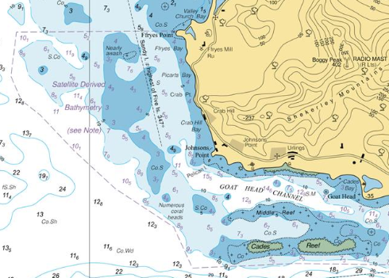
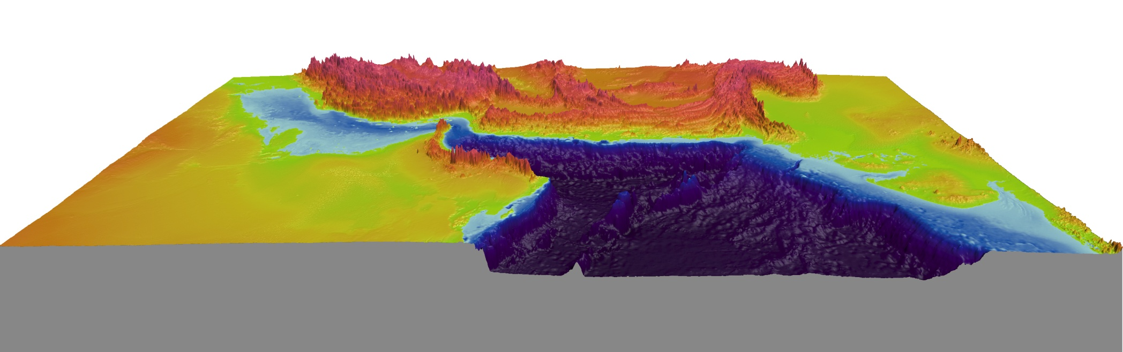
Satellite derived bathymetry (SDB)
Improving safety and coastal planning, updating navigational charts
UKHO British Admiraltiy chart 2066 Southern Antigua
Satellite data source: EOMAP
Assimilated land-underwater elevation model for Tsunami risk modelling, Kuwait Institute
SDB for New Zealand Government

Slide 5
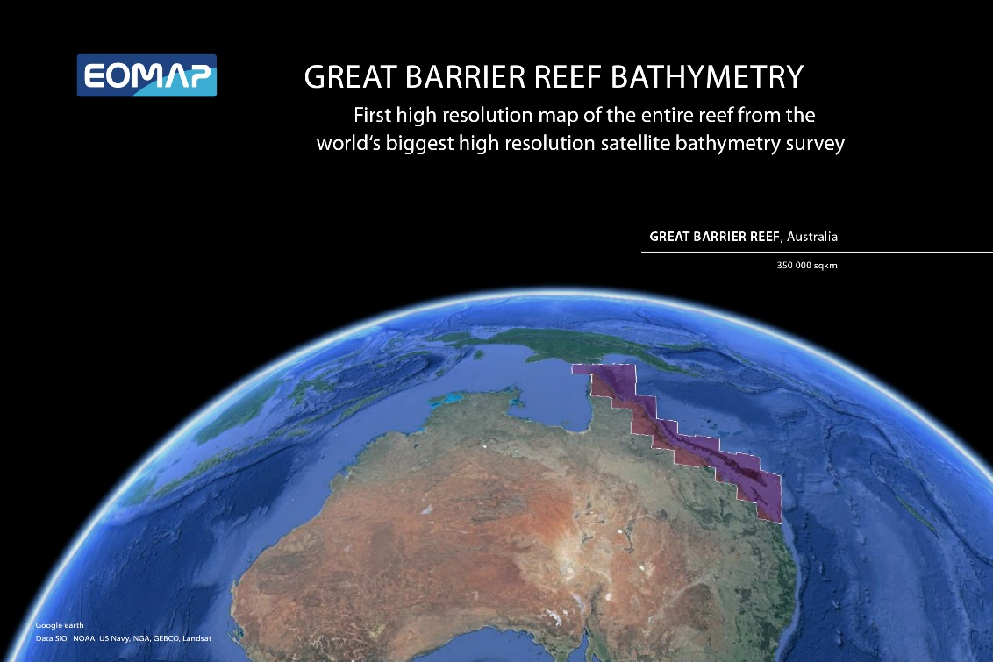
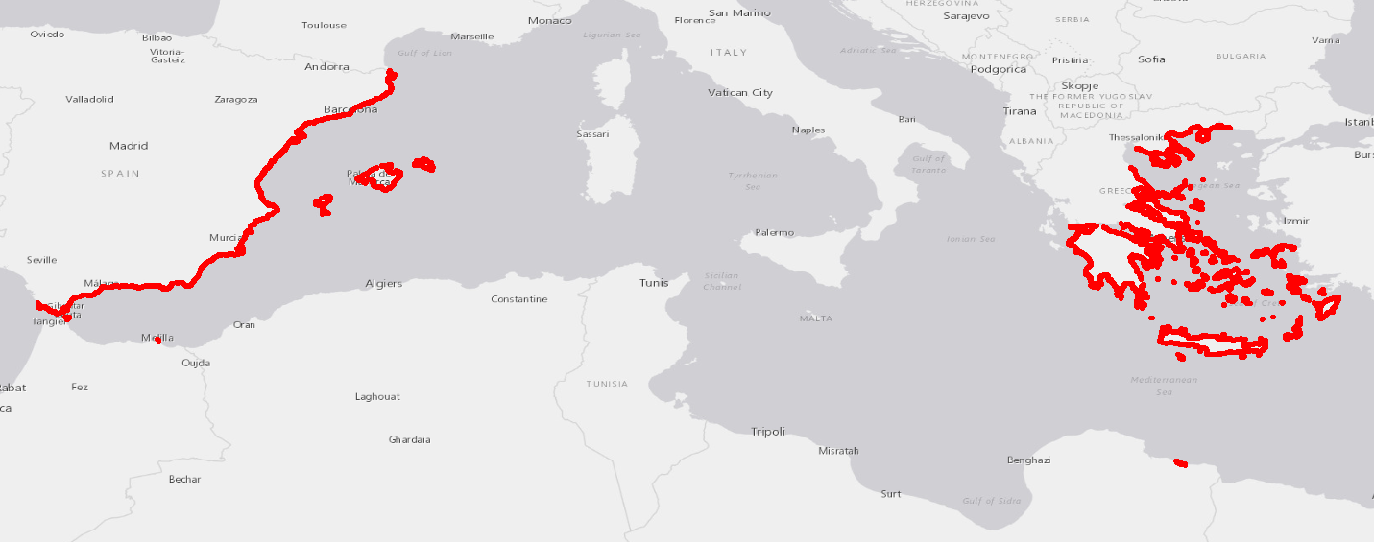
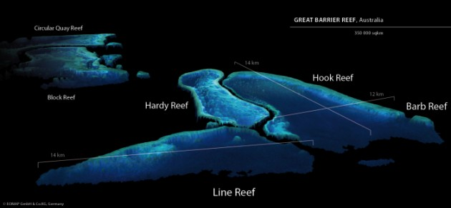
Flagship projects on Satellite derived bathymetry (SDB)

Slide 6
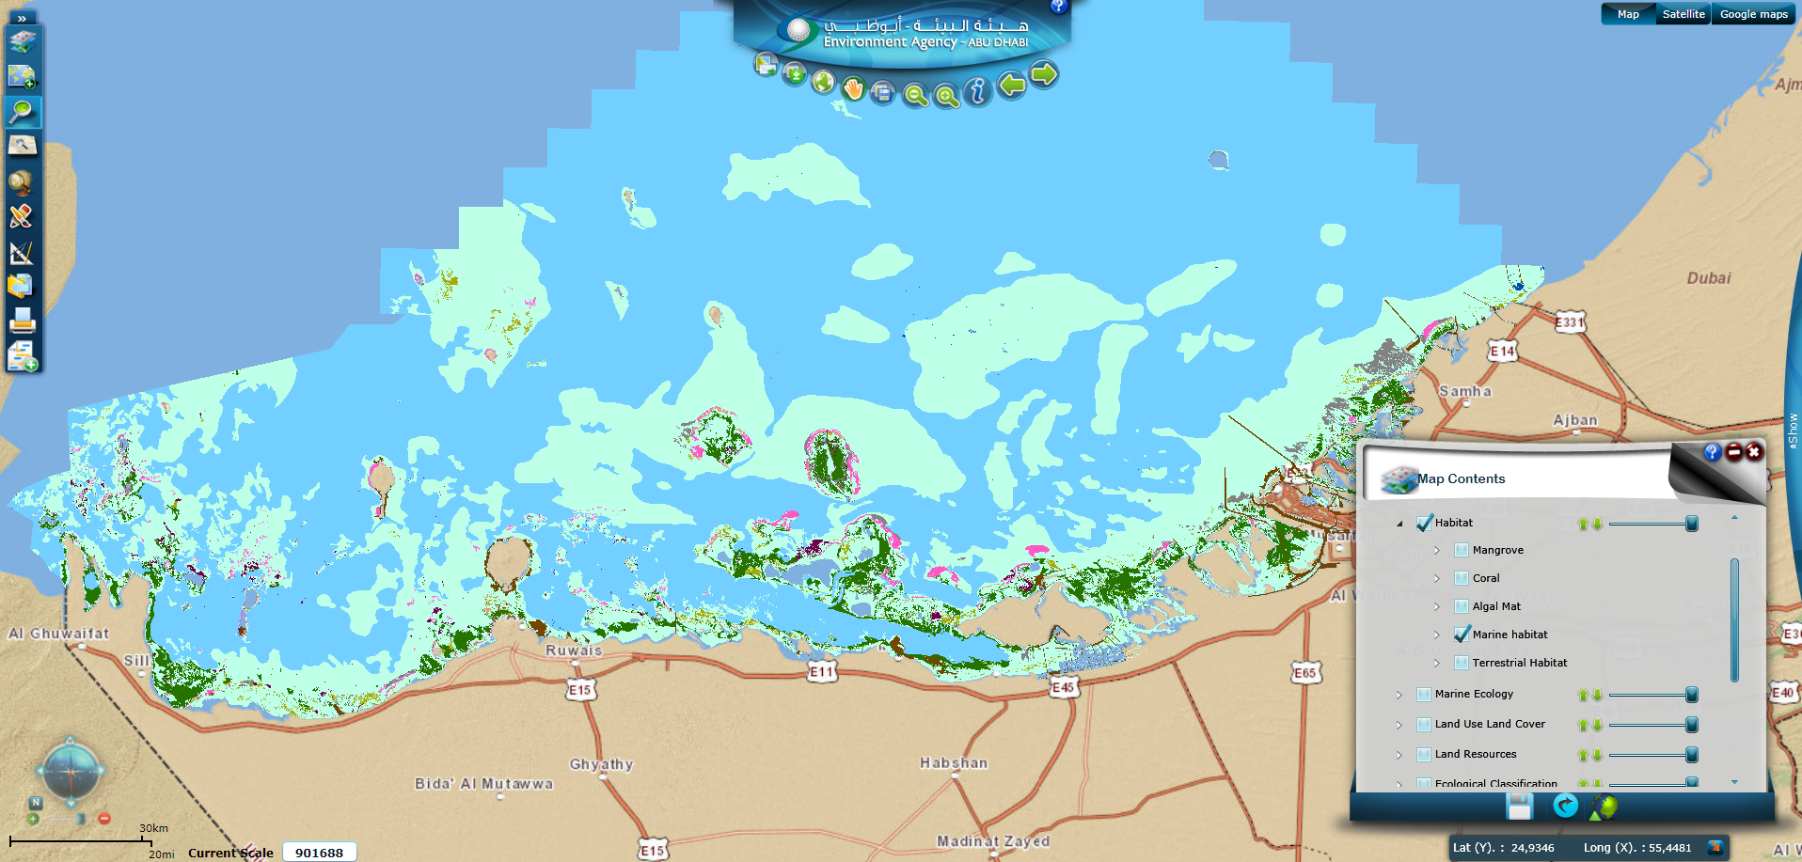
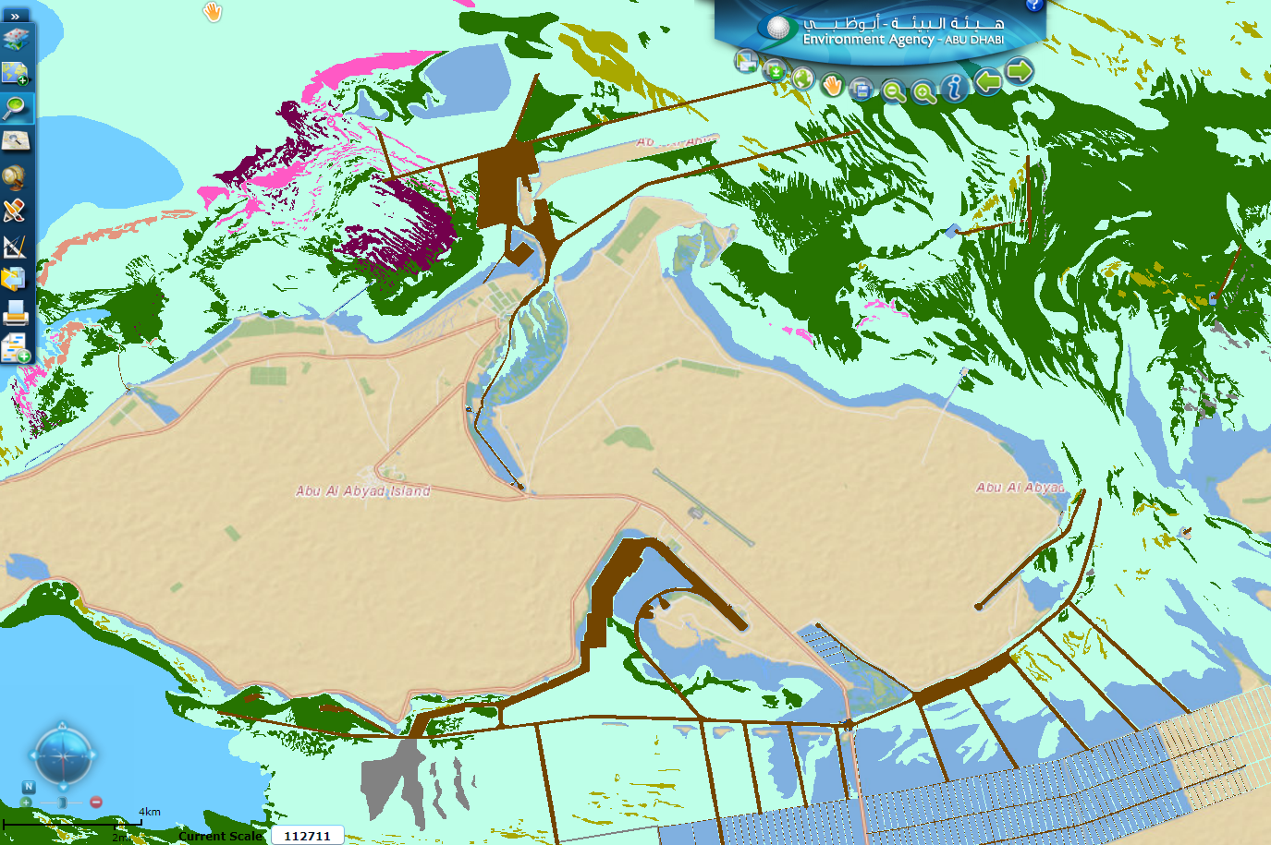
Benthic Habitat Atlas for Abu Dhabi Environmental Agency
Baseline maps for governmental regulations and coastal planning
National habitat Atlas Abu Dhabi:
Satellite based and generated by EOMAP
Cost-effective, area-wide, fast turn around
EAD database: http://enviroportal.ead.ae/mapviewer

Slide 7
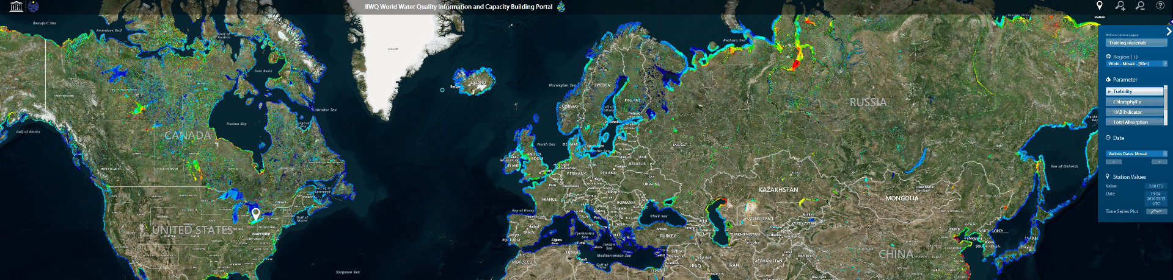
Flagship: Global water quality portal for UNESCO
First global water quality survey for lakes and rivers
Capacity building for policy makers, agencies and water industry
Demonstrating effective monitoring and reporting mechanism

Slide 8

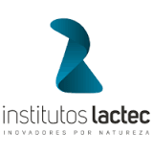
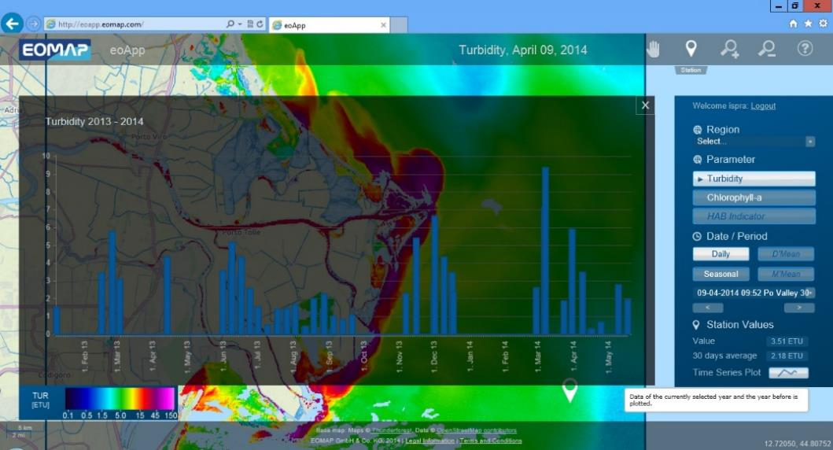
Use cases: eoWater environmental monitoring services
Impact Assessment: e.g. of a power plant in river Po/ Italy, for the National Italian Institute for Environmental Protection and Research – ISPRA Italy
Water Quality Monitoring: Long-term monitoring of trophic status in lakes for Amec-Foster-Wheeler / USA
Environmental evaluation of seasonal sediment flows for hydropower planing in Georgia for Stucky Ltd./Switzerland
Disaster Impact assessment of Rio Doce Desaster for Lactec/Brazil
http://mundo.sputniknews.com/americalatina/20151112/1053575772/brasil-samarco-peces-intoxicados.html

Slide 9
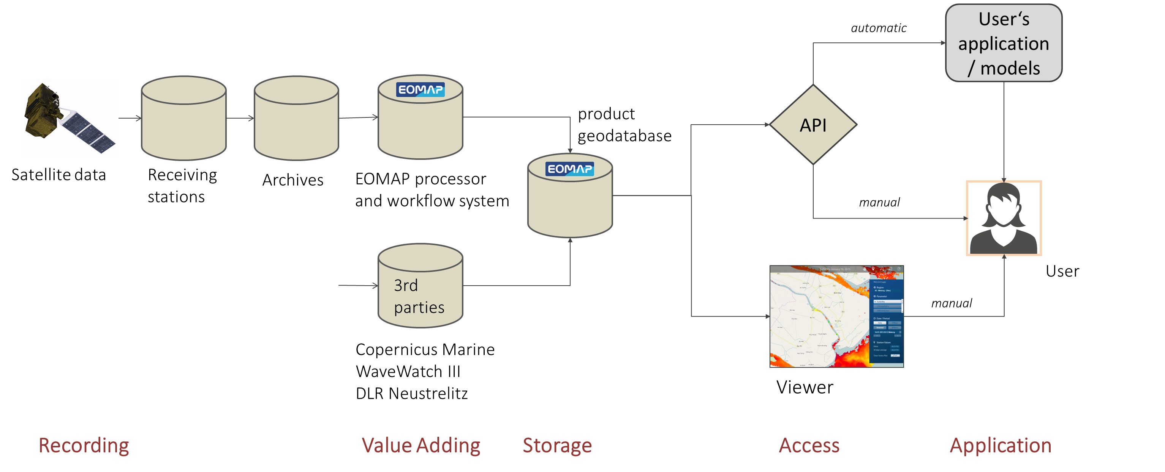
Distributed data processing, hosting, dissemination
Operational, Integrated, on-demand

Slide 10
Key success factors
  Key success factors to global growth of EO business
Alignment to client and market demand, growing industrial services
=> Reliable, cost-efficient and quality assured products and services
=> Market driven innovation
Awareness, capacity building, marketing, e.g. global flagship showcases

Slide 11


Key success factors
Drivers:
Value of information services to clients, client financed, demand triggered
Free market competition & market driven innovation
Enablers: role of GEOSS, Copernicus, Space Agencies
Connecting global communities, fostering global intercomperability
Efficient access to public financed data, e.g. Sentinel data
Fostering competative free market mechanisms
Interference:
Designing services and leading innovation – role of gov. institutions?
=> Regulations requesting data and exchange, stimulating competitive innovation

