Slide 1

Exploring the depths of GEOSS
3rd GEOSS Providers Workshop
Frascati (Italy) 02-04 May 2018
Jiri Hradec , Max Craglia, Stefano Nativi
(European CommissionJRC)
and
Mattia Santoro
(CNR-IIA)

Slide 2
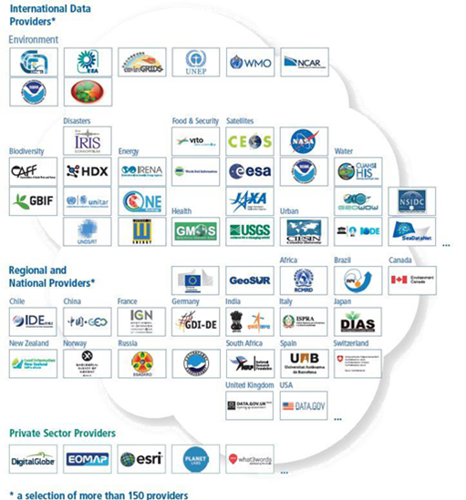


Bottom up voluntary process:
Big Data Platform
Major effort over the last 10 years, …an emergent system, need for a holistic view to help shape its future evolution.
Exploratory project by JRC and CNR, building on a similar analysis done on the INSPIRE geoportal.
We have just started scratching the surface
Users
GEOSS Platform
About 170 Data
Providers
More than 400 million Granules
More than 45 million
Datasets

Slide 3
The What
Analyzed 1.8 million metadata records harvested by the GEODAB.
These include all the large data collections except GBIF and HIS (in-situ hydrological data)
As the MD of the collection represents well the MD of the siblings: e.g. CEOS has about 4300 MD records of collections and about 286M MD records of individual scenes which are not harvested, the MD used represents about 85% of all data in GEOSS

Slide 4
The How
Analyzed each record for language IDs
Machine translated all records not in English
Parsed the content of the MD records, analyzed counts, frequencies, and semantic relations among the 195,000 keywords, and text in title and abstracts using neural networks
Use ML technology to recognize recurrent patterns –i.e. Concepts similarity and clusters
Analyzed GEO DAB Logs to recognize unique IP addresses –i.e. clients

Slide 5
Languages as identified by python polyglot library
POSITIVE
90% in English, 6% German, …
Surprisingly high language consistence
NEGATIVE
Mix of languages (English/Spanish, English/German) makes language identification more challenging
Logarithmic scale

Slide 6
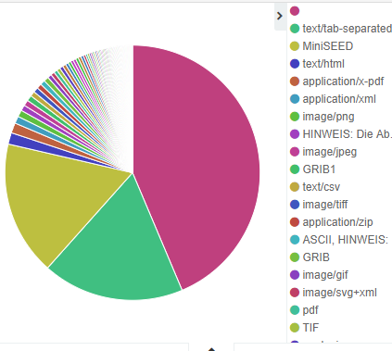
Data content and services heterogeneity
Challenges: from heterogeneity to dead services and unknown formats
POSITIVE
They exist
They actually allow user to download data
NEGATIVE
Mostly, formats point to text files like PDF instead of actual data

Slide 7
Who are the Providers?
A very good question….
  Sometimes difficult to distinguish between roles – data provider, data distributor, data center, contributor, author etc. Meanings of these key words differ greatly among data hubs.
  There seem to be more than 3500 data providers (originators) but some are organizations, others are data hubs with other organizations inside.
  More than 10,000 contact orgs but many thousands are the URL of individual images!
  5-10% of institutions do not exist but we do not know whether it is because the institution has changed name or because it is archived data from the past.
Notes:
Organizations connections: Publishers, Providers, Authors, Collaborators , etc.

Slide 8
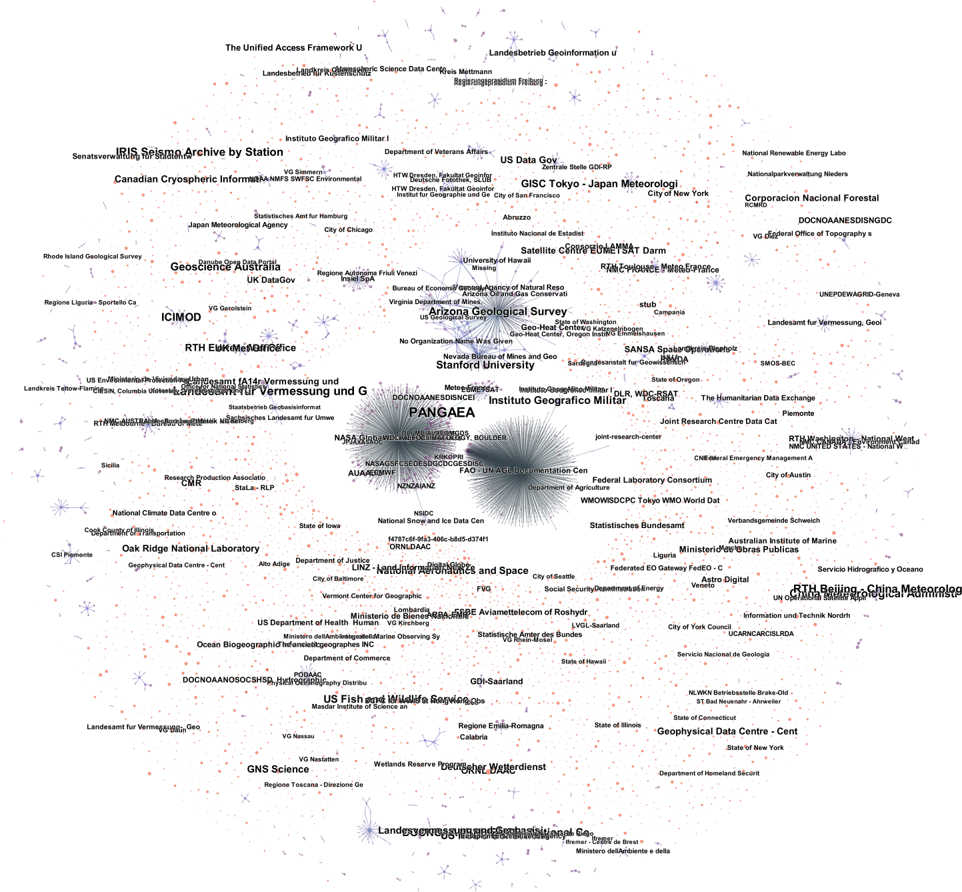
Step 1: connect Providers
Connected
Contact Organizations
and
Distributor
Notes:
Key distributors of GEOSS resources
No much connections among Distributors

Slide 9
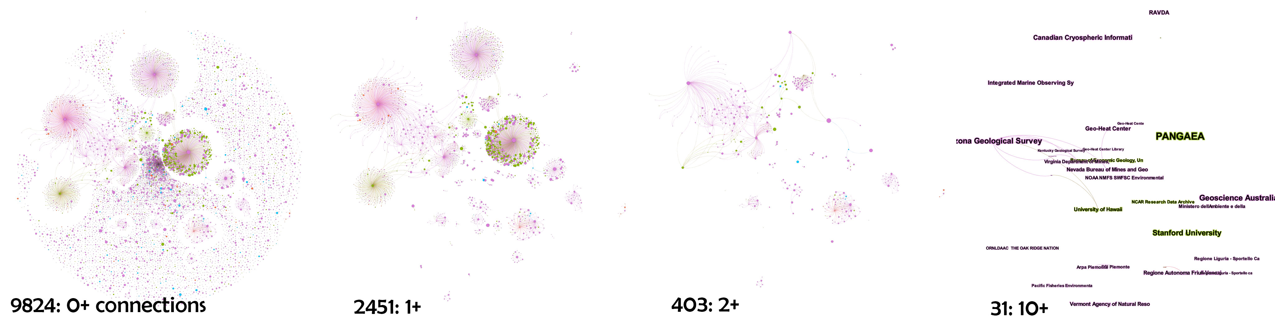
Step 2: geocoded and filtered by strength of connectedness
Notes:
The same network above, showed differently: the most connected ones
0+ is the overall picture
1+ is those who have more than 1 connection
Only 31 had more than 10 connections

Slide 10
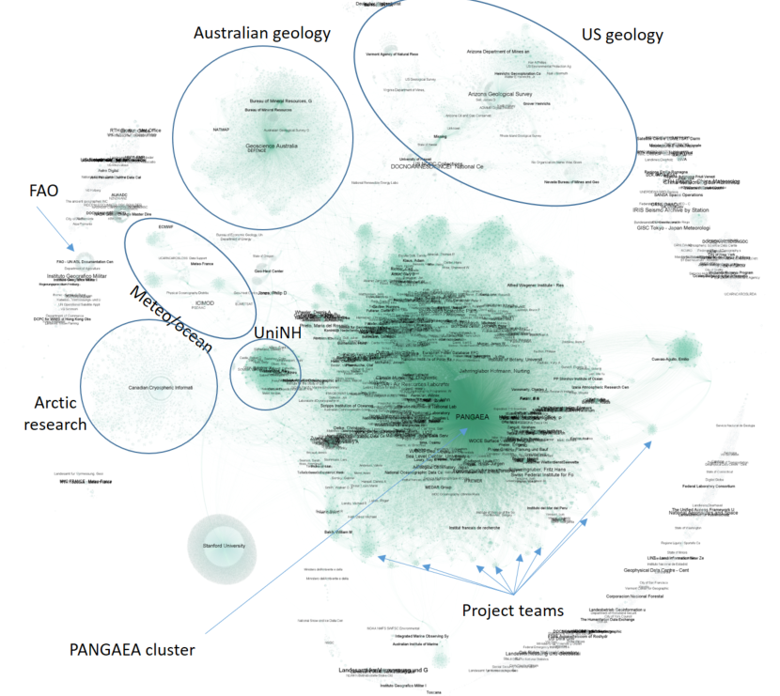
Step 3: Citations among Organizations
Considering all the record fields (e.g. Title, Abstract, keywords, etc.)
66,000 nodes
350,000 edges
The emergence of Project Teams
People play an important role to connect
Notes:
Map of the citations among all fields.
Linking people as well and not just organizations

Slide 11
Thematic Coverage
At least 1 keyword in each
MD record up to 666
Total number of keywords = 198,000
Huge variety due to the lack of a shared Thesaurus to help describe the most common concepts.
Abstracts are the richest source of knowledge
  Unstructured data !
10 most frequent keywords
Baseline Surface Radiation Network BSRN) | 132,785
World Ocean Circulation Experiment (WOCE) | 59,766
Ocean Drilling Program (ODP) | 45,707
Historical and Postglacial Tree Ring Archive of Hohenheim (HISTRA) | 41,858
Joint Global Ocean Flux Study (JGOFS) | 28,819
Deep Sea Drilling Project (DSDP) | 21,890
Meteorological Long-Term Observations @ AWI | 20,791
Northern Hemispheric Dendroclimatological Network | 16,259
geossNoMonetaryCharge | 14,976
geossDataCore | 14,915

Slide 12
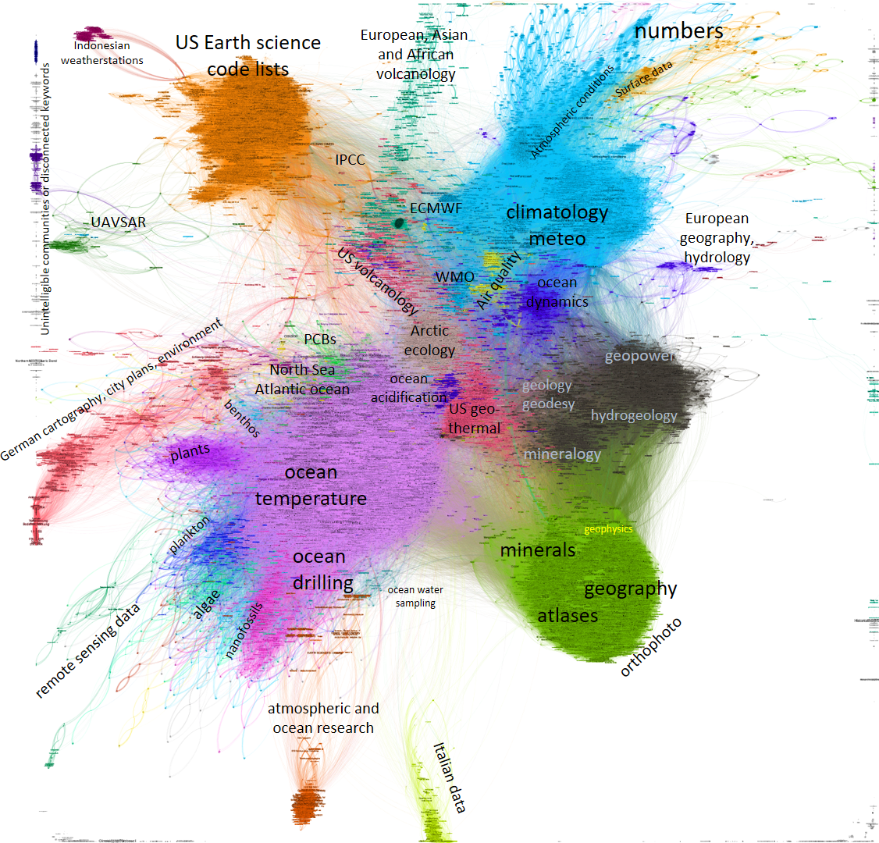
Keywords clustering 2/2
Graph analysis of the keywords belonging to the same record
filtered and cleaned
Notes:
Keywords are connected if they are belonging to the same record.
Graph analysis

Slide 13

Neural network analysis on Abstracts and Titles
1.8 M records
653 M lemmatized words
CBOW model to extract higher level concepts and relationships
  Unstructured data !
Notes:
Continuous Bag of Words model → deep learning

Slide 14
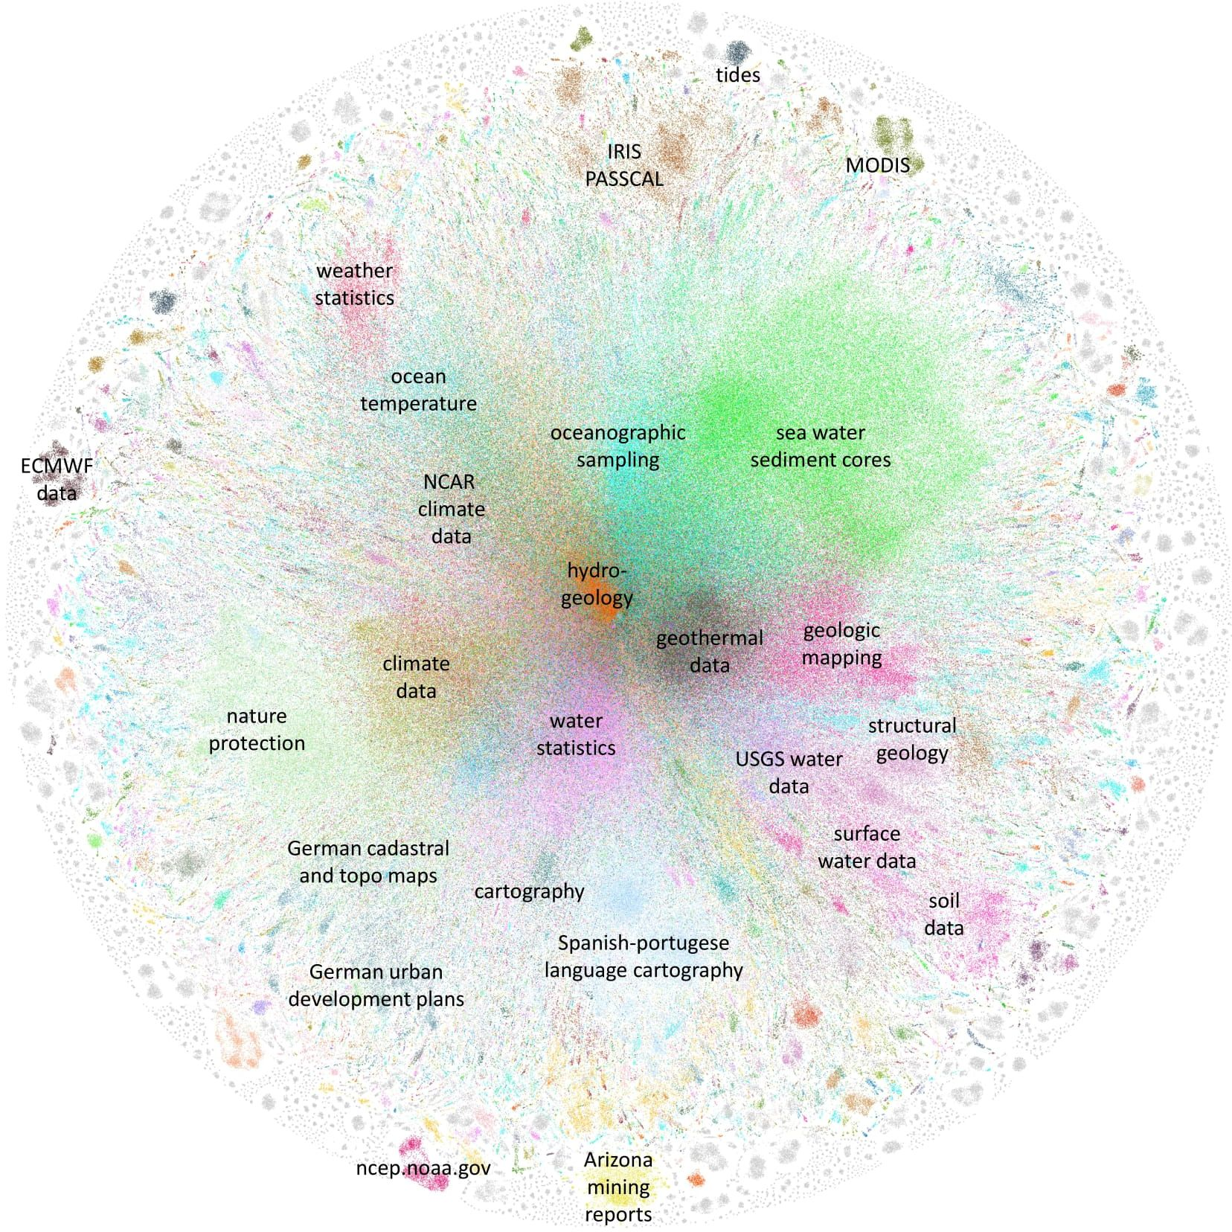

GEOSS data universe
Neural network analysis by the
European Commission Joint
Research Centre and the Italian
National Research Council of
the 635 million words in the titles
and abstracts of 1.8 million
metadata records in GEOSS
(representing 89% of all GEOSS
data)
Concepts similarity and clusters
Notes:
Connectivity, vicinity
Neural network created word vectors from the titles and abstrcts found in GEOSS metadata.
Concepts similarity and clusters

Slide 15
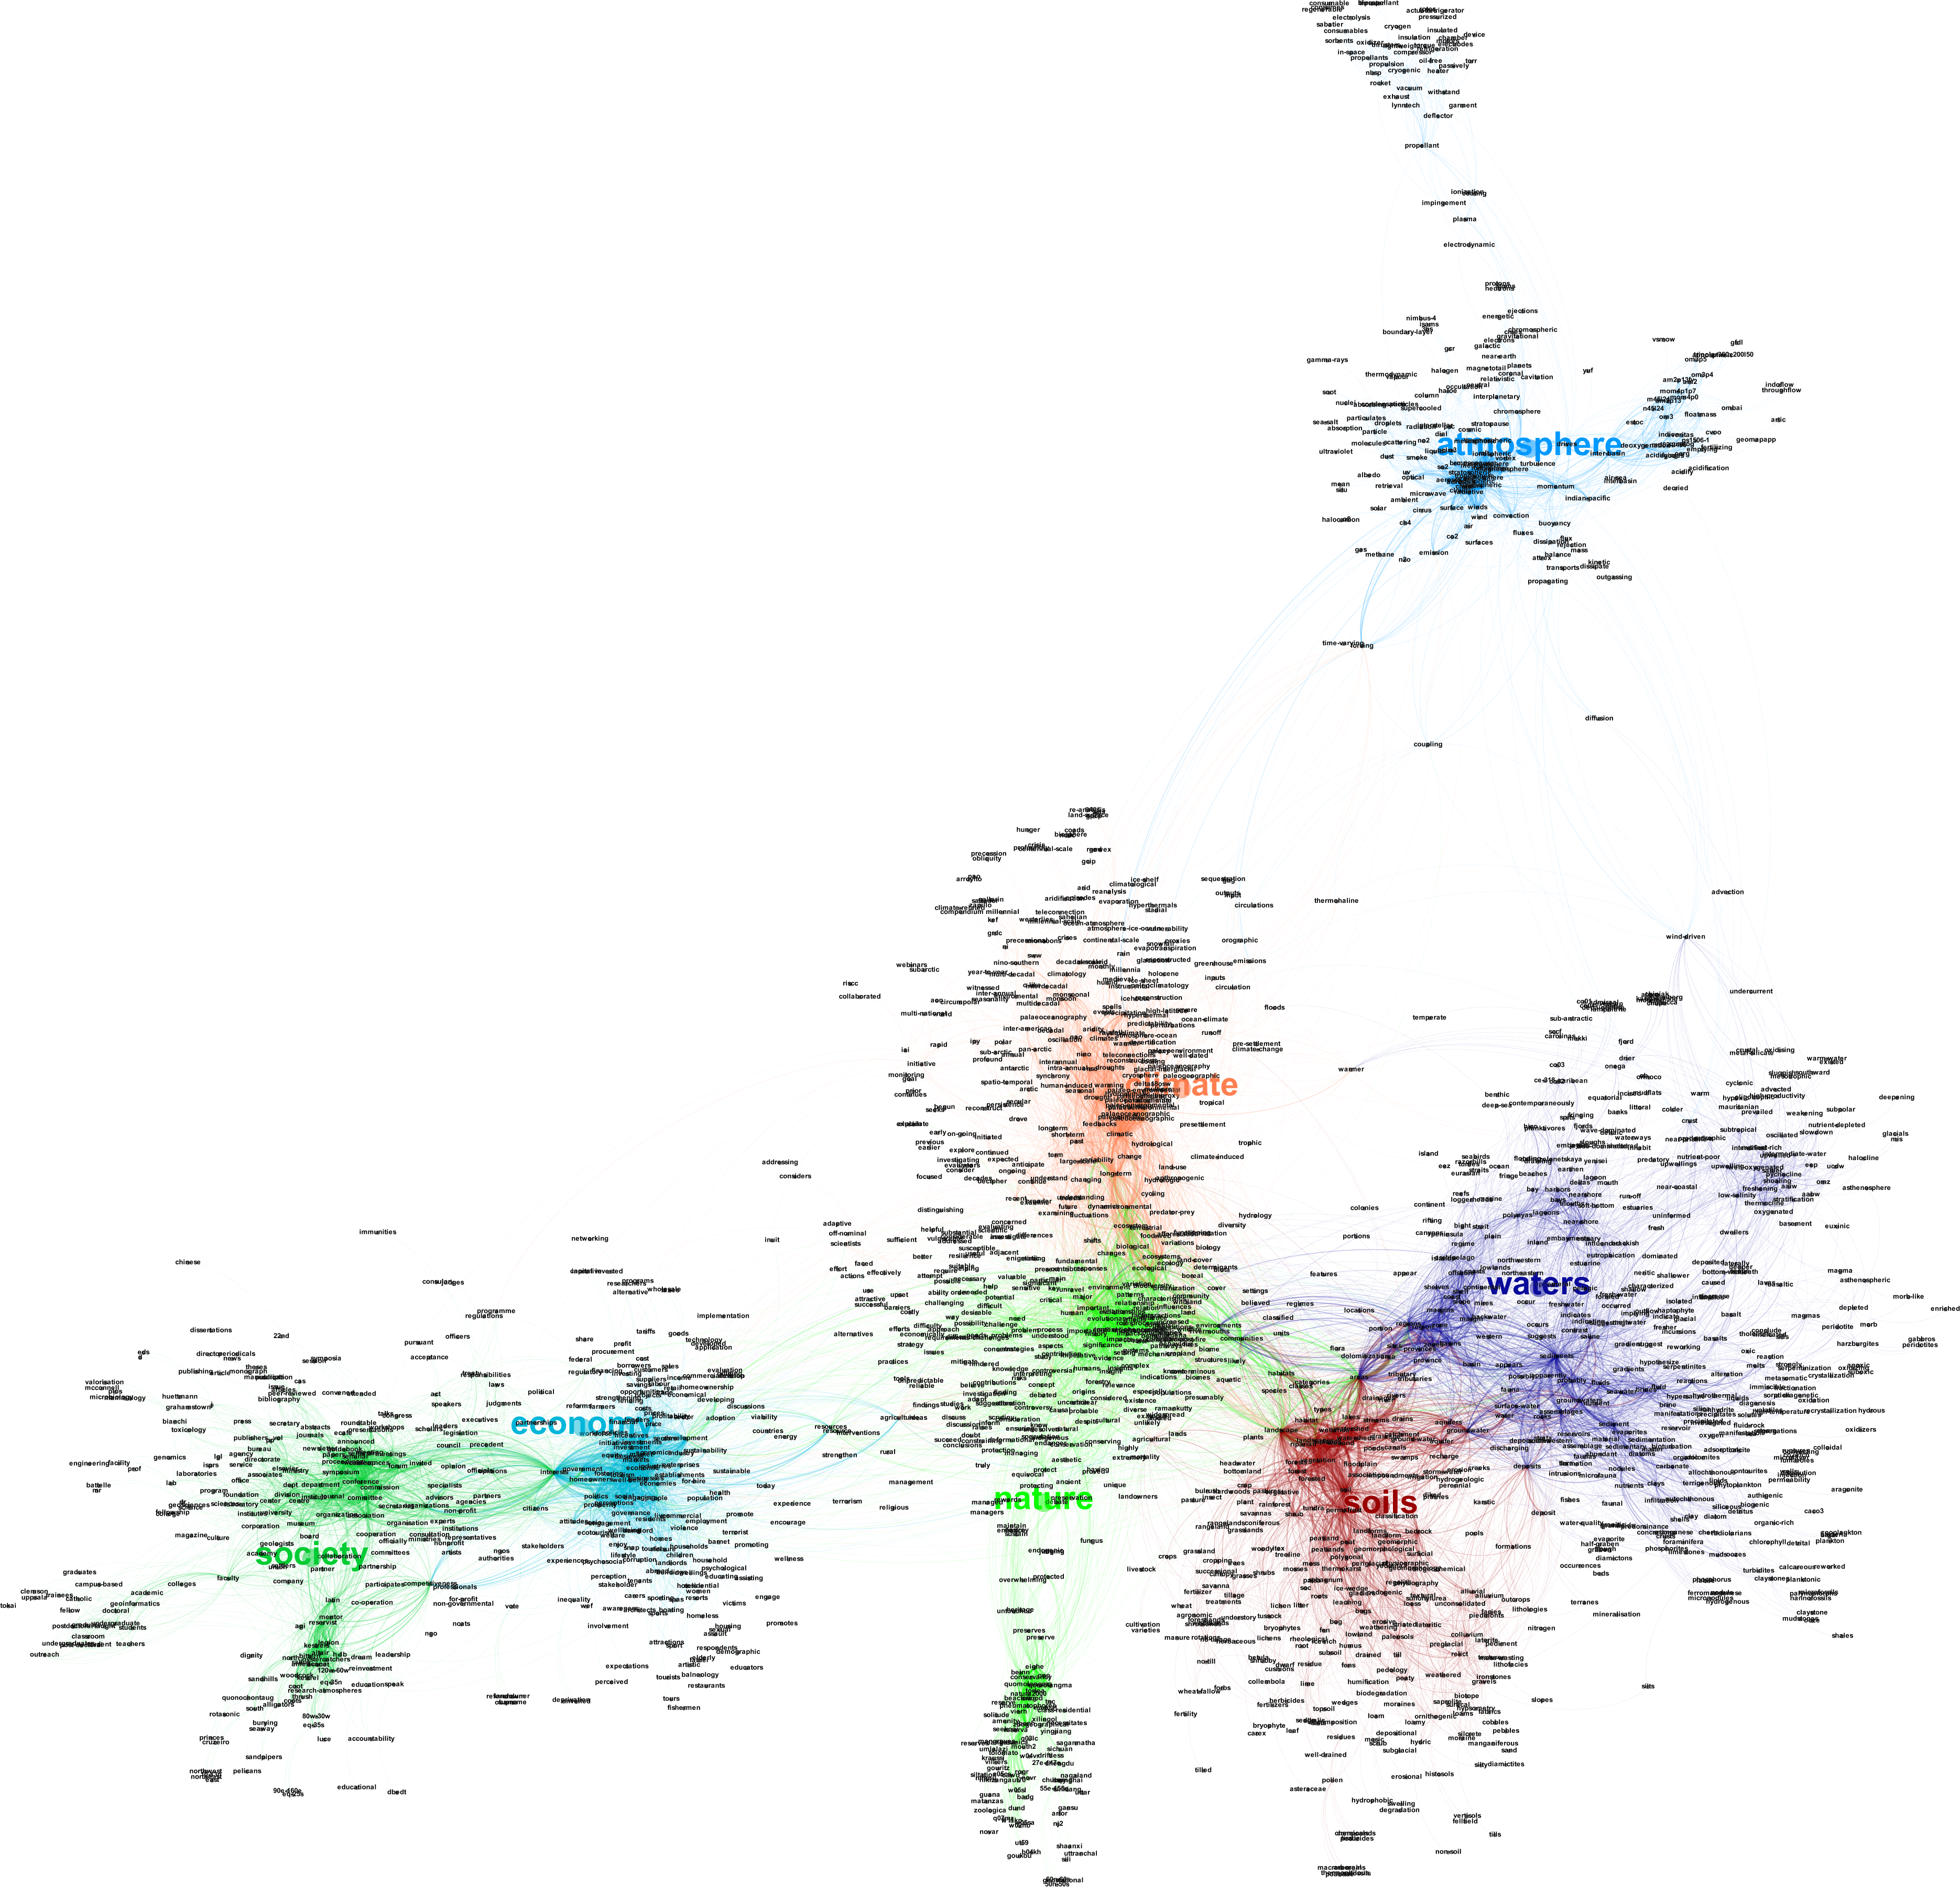
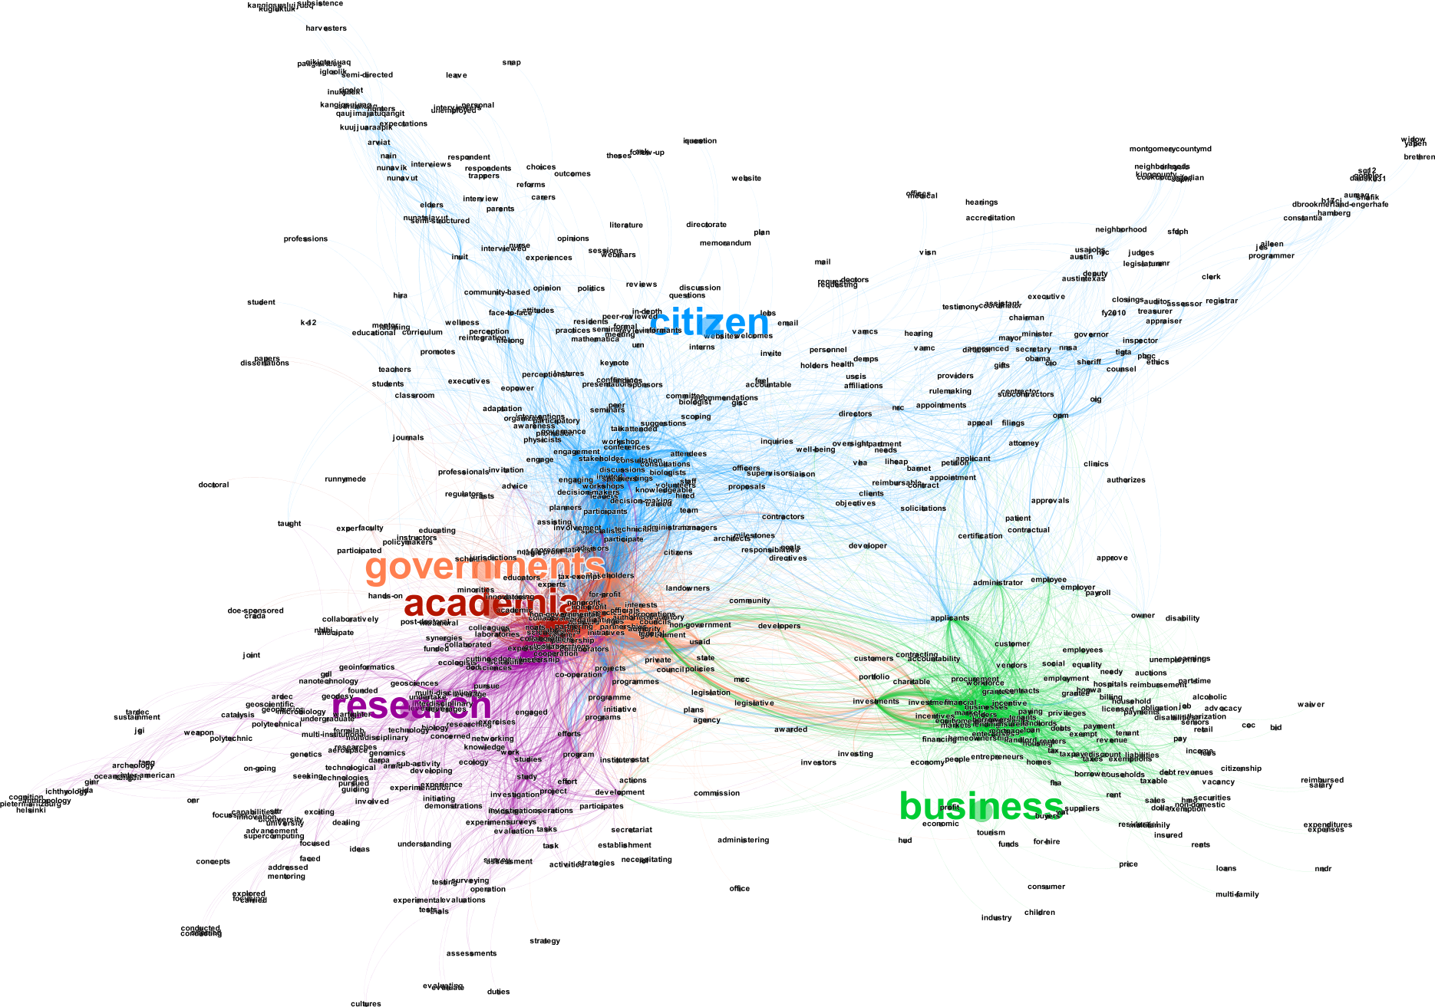
Semantic relationships in the abstracts
It is possible to appreciate how abstract creators captured Relations Between Domains
It is possible to appreciate Gaps
Atmosphere
Climate
Waters
Economy
Soil
Society
Notes:
Data content and subjects connectivity: e.g. atmospheric data do not seem to be well connected with the other environmental data.
It is possible to recognize the metadata providers understanding of how the subjects interrelate
It is possible to appreciate gaps
Neural network extraction

Slide 16
GEOSS Platform (GEO DAB) requests Log Analysis

Slide 17
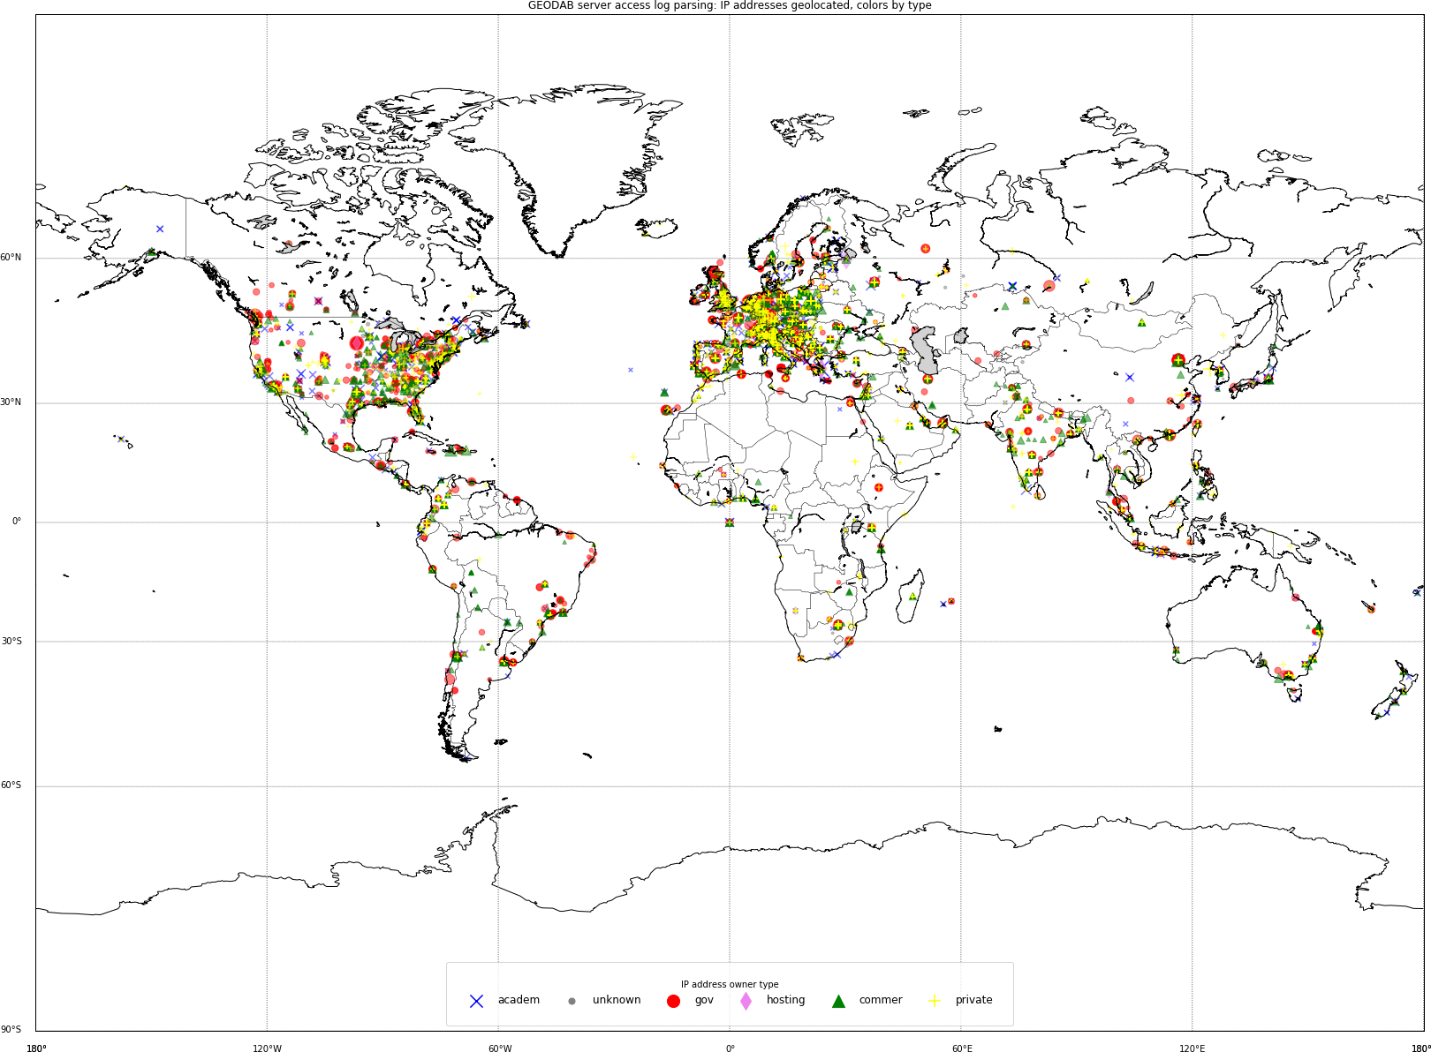
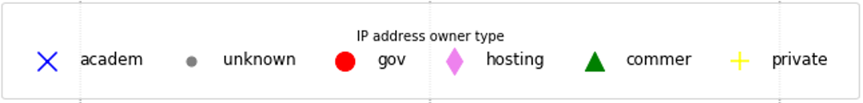
GEO DAB Log parsing: geolocation of unique IP addresses

Slide 18
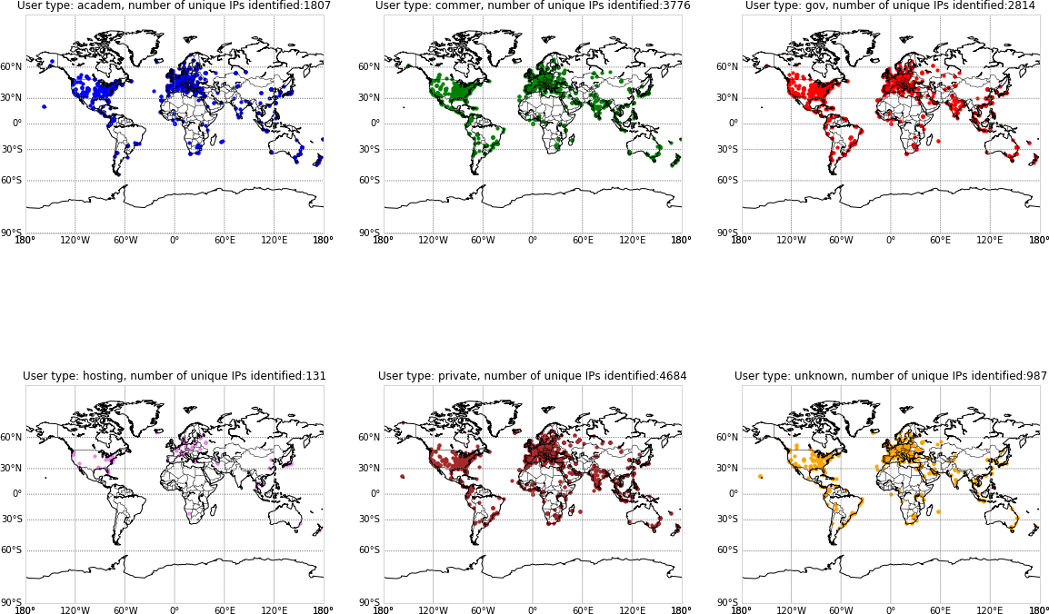
Academic User
Commercial User
Governamental User
Hosting User
Private User
Unknown User

Slide 19
Conclusions
To our knowledge first ever analysis of a global system of system of this size and complexity
Given its vary nature as System of Systems, heterogeneity is to be expected
The first level analysis shows some problems such as:
  lack of persistent IDs
  understanding data curacy and management level
  data are most in PDF format
Need to improve data management because in a distributed big data world we all depend on each other
Need to add more knowledge in the system on how to use the data with models and other processing to derive useful and actionable information
Since Abstract is the most valuable source of information, ML plays an important role

Slide 20
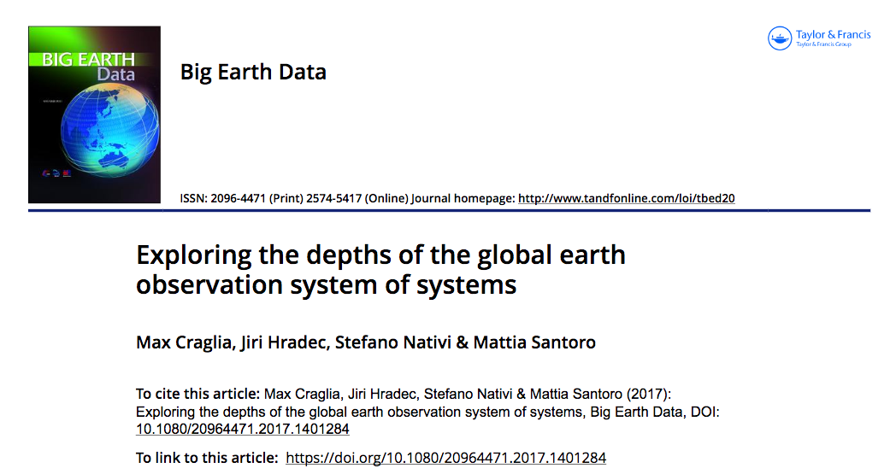
Any questions?
Massimo.craglia@ec.europa.eu
Stefano.nativi@ec.europa.eu
Jiri.hradec@ext.ec.europa.eu
http://www.tandfonline.com/doi/full/10.1080/20964471.2017.1401284

