Slide 2
CEOS ARD for Land - CARD4L
Overview
Dr Andreia Siqueira / Geoscience Australia Liaison Officer / LSI-VC
Mr Steven Hosford / CEOS Executive Officer

Slide 3
Presentation Outline
The evolving EO ecosystem
CARD4L Definition
CARD4L Framework
Product Family Specifications
-Background
-Documents
-Refinement
-Current Status

Slide 4
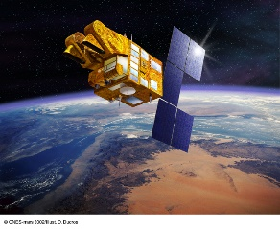
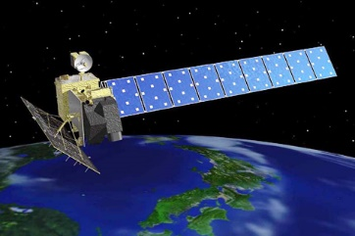
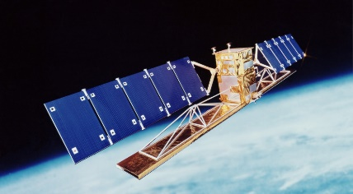
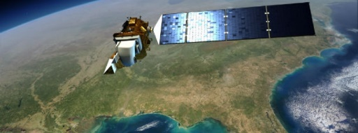
Land imaging… in 2006?
Exploitation Layer
Science
projects
Data
Data Generation Layer
Ground Segment Infrastructure
SPOT
Envisat
Terra,
Acqua
ALOS
Landsat
Radarsat
……

Slide 5
The evolving EO Ecosystem
Many “general
public” users
Complexity
++ less “sophisticated users”
Few sophisticated users
++ missions and ++++ data
“Small” data Big data

Slide 6
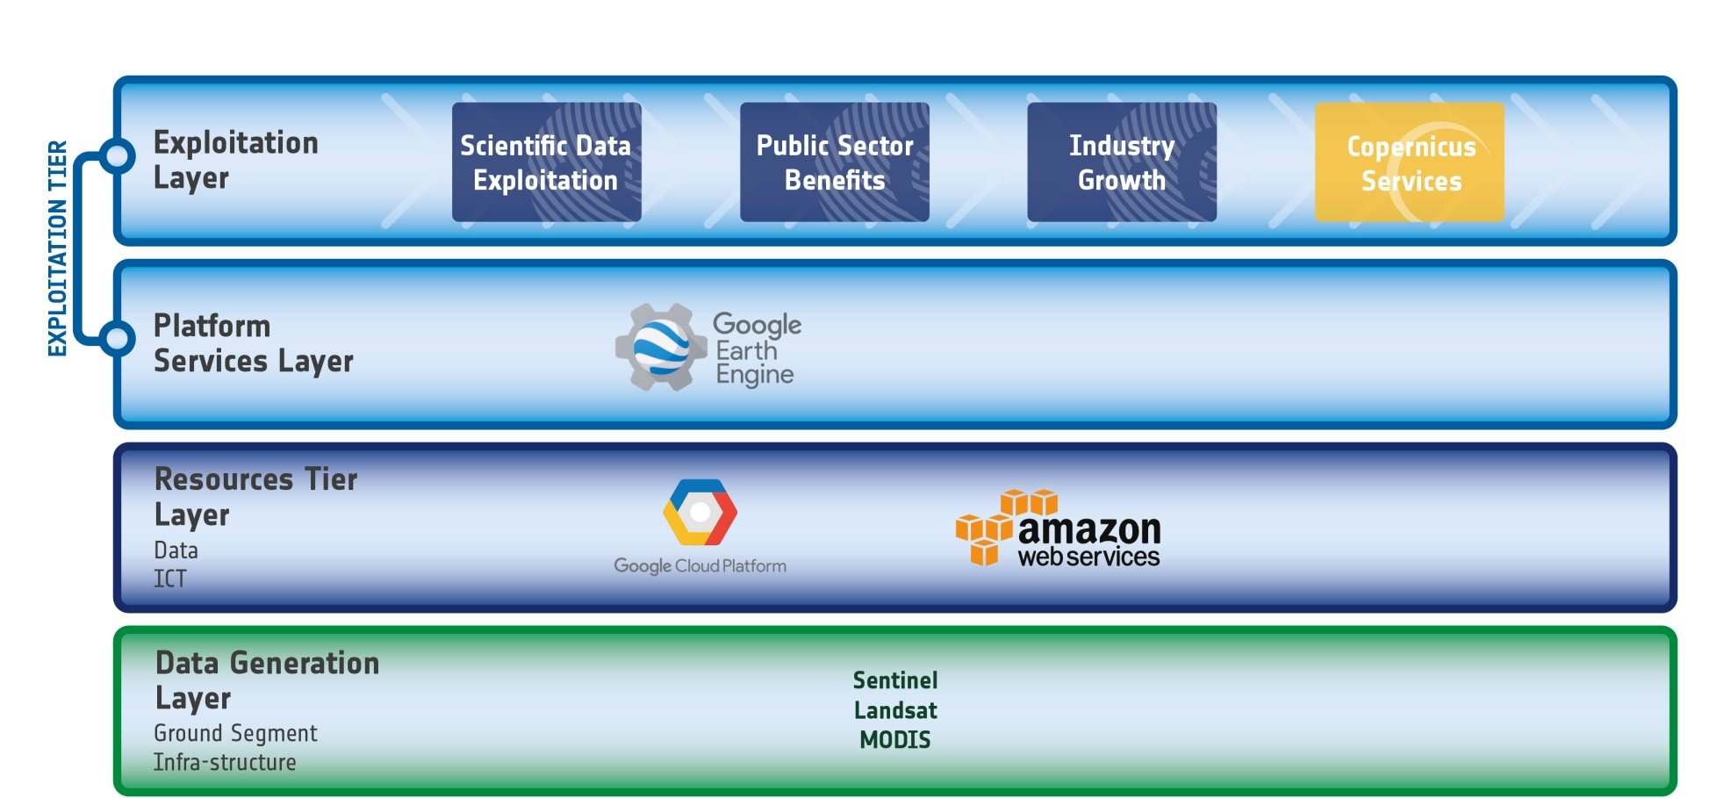
The evolving EO Ecosystem
IT Industry starts investing
…Google and Amazon start hosting US public missions and later Sentinel Data with Google providing a first cross-mission analysis environment

Slide 7
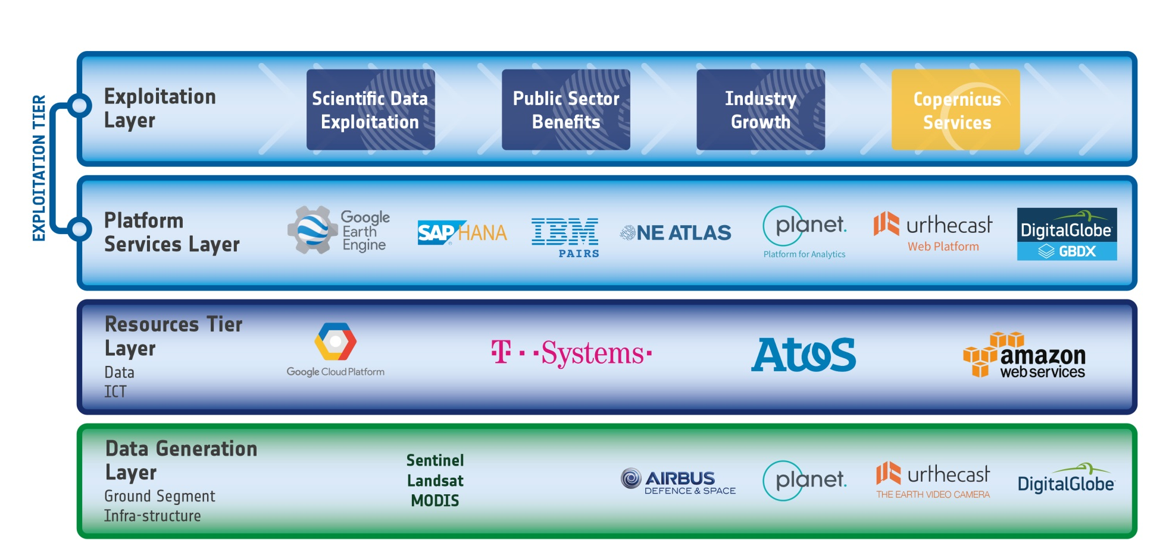
The evolving EO Ecosystem
The Established EO sector reacts
…and start using the new capabilities, with principally US and European actors addressing the EO market offering new Data Analytics capabilities

Slide 8
Where does Analysis Ready Data fit in?
ARD
ARD
ARD
ARD
ARD
ARD

Slide 9
Where does Analysis Ready Data fit in?
ARD
ARD
ARD
ARD
ARD
ARD

Slide 10
CEOS ARD for Land - Background
Future Data Architectures (FDA) and CARD4L
LSI-VC served as the forum for developing the CEOS Analysis-Ready Data definition (now known as CARD4L – CEOS Analysis-Ready Data for Land)
The CARD4L definition and the overall framework were endorsed by the CEOS Plenary in 2016
CARD4L underpins a large amount of the future data architectures work being progressed within CEOS
The PURPOSE of CARD4L is to allow many users to more rapidly use data. This also allows space agencies to maximise the potential of their data.

Slide 11
CEOS ARD for Land - Definition
CEOS Analysis Ready Data for Land definition:
CARD4L are satellite data that have been processed to a minimum set of requirements and organized into a form that allows immediate analysis with a minimum of additional user effort, and, interoperability both through time and with other datasets
CARD4L is a framework for establishing ‘minimum requirements’ for products that:
-Are ready for ‘immediate analysis’
- Require minimal additional user effort to prepare
- Interoperable with other CARD4L datasets

Slide 12
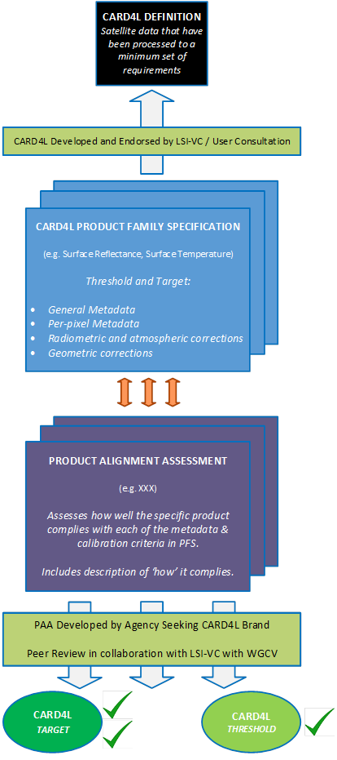
CARD4L Framework
Definition of CARD4L
Product Families Specifications
Self-assess
Product Alignment Assessment
Peer review
CARD4L stamp

Slide 13
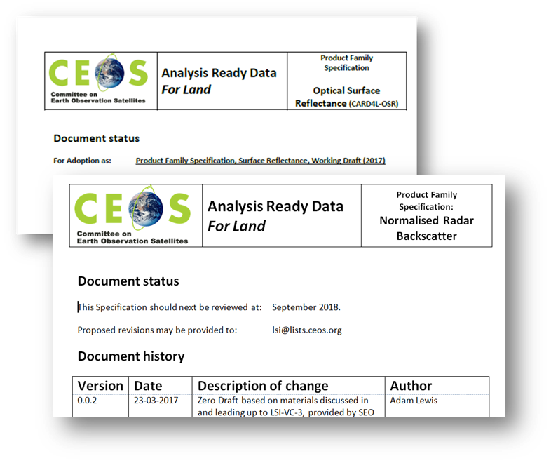
CARD4L Product Family Specifications - Background
Product Family Specifications (PFS) have been first developed (early 2017)
-Surface Reflectance
-Radar backscatter intensity
-Land Surface Temperature
Other PFS will probably emerge, e.g., Radar phase data, water leaving radiance
Product Family Specifications are technical documents and are intended to set outcomes, not methods
-PFS do require that some types of corrections are made (e.g., for the atmosphere)
-PFS do not prescribe the specific methods to use and are not method-specific
Detailed input to the draft CARD4L specifications was received in June - Sep 2017 and in Dec 2017 (technical teleconferences)
Very strong support for CARD4L is indicated by a range of experiences and activities (UK, ESA, USGS, NASA, Canada, GA, CNES, etc.)
http://ceos.org/ard/

Slide 14
CARD4L Product Family Specifications - Refinement
PFS may change over time in a controlled process, e.g.:
-Feedback gathered from technical experts
-Proposed changes are collated
-Proposed changes are submitted to CEOS (LSI-VC) for acceptance
Decision at LSI-VC-5 meeting:
-Evolutions will be possible when identified as necessary
-However PFS stability is to be prioritised

Slide 15
CARD4L Product Family Specifications - Current Status
LSI-VC will now move into an implementation phase with several objectives:
-“Road-test” the PFS, including through further technical teleconferences
-Develop the process for datasets to be assessed as CARD4L
-Identify data products that are on-track to become CARD4L
-Monitor and communicate progress of individual products toward CARD4L
-The PFS will continue to evolve as the LSI-VC gathers feedback in the Alignment Assessments

Slide 16
Summary
Analysis Ready Data is ‘the next step’
The ARD is sensor agnostic
CARD4L is CEOS Analysis Ready Data for Land
The CARD4L framework has 3 different components (definition, PFS and PAA)
CARD4L will help to limit a potential increasing disconnect between users and EO data

Slide 17
Thank you
andreia.siqueira@ga.gov.au

