Slide 2
Use case:
GEO-Wetlands Community Portal
Jonas Eberle / Friedrich Schiller University Jena, Germany

Slide 3
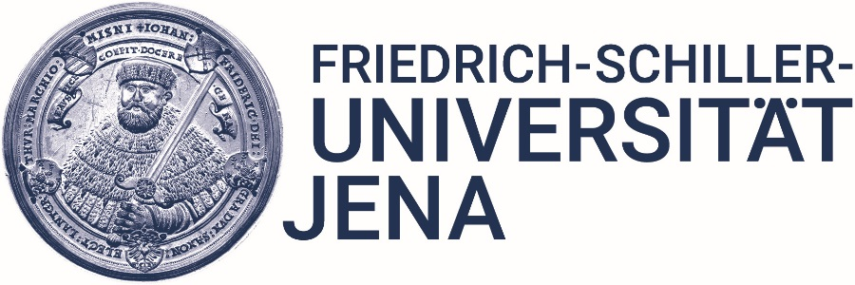
GEO-Wetlands Community Portal / Introduction
GEO Wetlands officially established as GEO Initiative in 2016
Portal development funded by the EU H2020 project SWOS (Satellite-based Wetland Observation Service)
Participation in further GEO activities (e.g., GEOSS Evolve, GEO Community Portal Team)

Slide 4
GEO-Wetlands Community Portal / Objectives
Provide a "knowledge hub" by collecting wetland-related data and information (maps, indicators, images, videos, etc.)
Wetland-related models using our SWOS software toolbox (e.g., derivation of geospatial products and indicators)
Visualization tools, continuous product updates
Map production assistance, use case demonstrator, best practices
Make external databases available, e.g. for map comparison and validation purposes
Provide an overview of free available satellite data
Simple access satellite time-series data

Slide 5
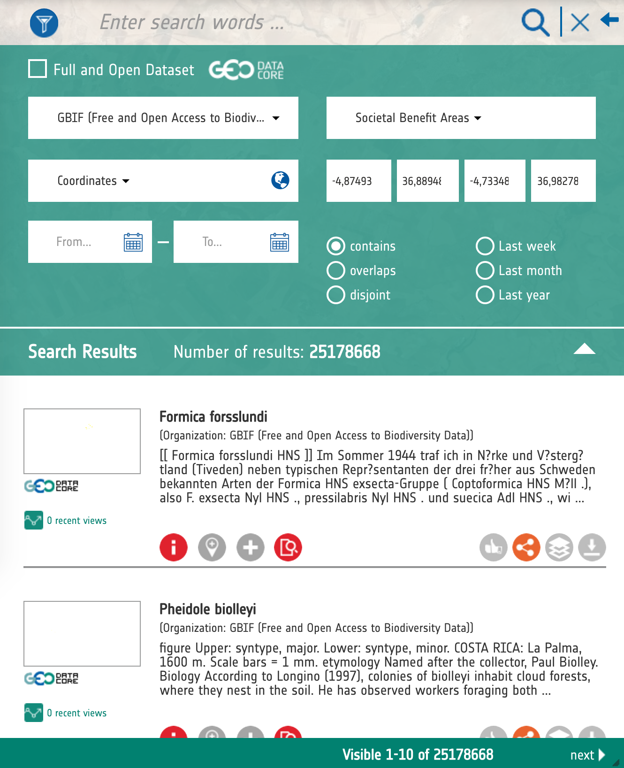
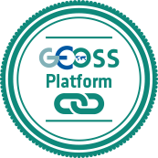
GEOSS / Requirements for GEOSS integration
Easy to integrate in own portal developments
Same look and feel like geoportal.org
Individual pre-defined filter capabilities
by geometry
by data source
by view, keyword
Interaction with own map viewer

Slide 6
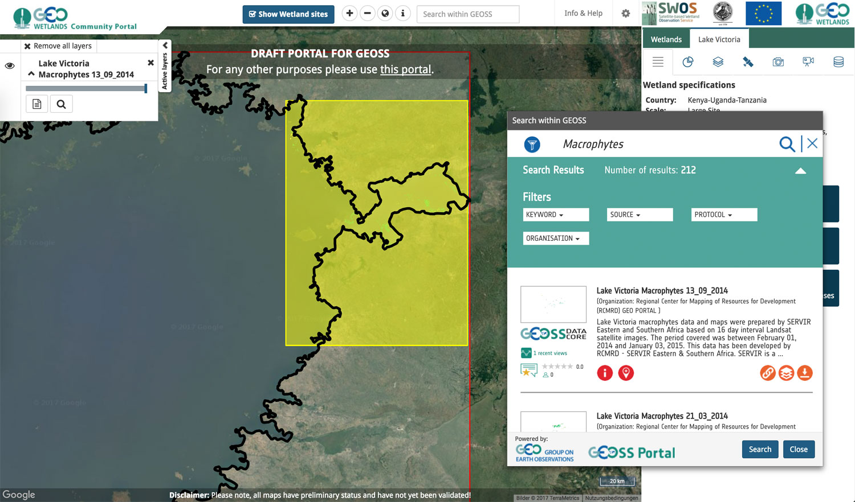
GEOSS / Integration of reusable GEOSS widgets
➔ http://portal.swos-service.eu

Slide 7
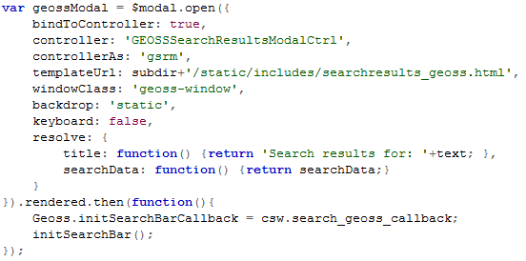
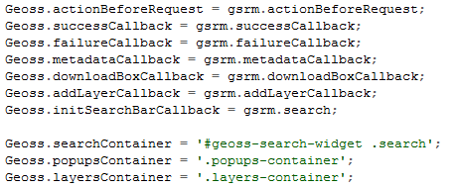
GEOSS & GEO-Wetlands / Integration of reusable GEOSS widgets
1
3
2
4

Slide 8
GEOSS & GEO-Wetlands / What is next?
Define GEOSS view for wetland users (e.g., what kind of data sources are relevant for our users?)
Make use of GEOSS search for country, continental and global views of the portal
Make own datasets available for GEOSS
ISO19115-compliant metadata is ready
OGC Catalogue Service for Web is ready
But: Who is able to host datasets and services with sustainable funding?
OGC Web Map Tile Service is needed (caching is important)
OGC Web Map (Tile) Service with TIME extension is needed
Data download (e.g., ZIP archive or OGC-compliant web service)

Slide 9
GEOSS & GEO-Wetlands / Conclusions
Easy to integrate and to use
Integration of external databases with a single step!
We can now concentrate on content and wetland-specific views
Further enhancements of metadata and data would be useful
Download only subsets of data
Show legend graphics of data
There are still some challenges
Find good descriptions of datasets (e.g., further documents are necessary)
How to “browse” through thousands of metadata results?
There are still some open questions: Who is the real user of the platform? – What kind of data should be available at the platform?

Slide 10
Thank you
jonas.eberle@uni-jena.de / www.eo.uni-jena.de / @jonaseberle
This project has received funding from the European Union's Horizon 2020 research and innovation programme under grant agreement No 642088.

