Slide 2
Climate
Change
Copernicus Climate
Change Service - C3S
Martin Suttie / Head of Copernicus Production / ECMWF

Slide 3
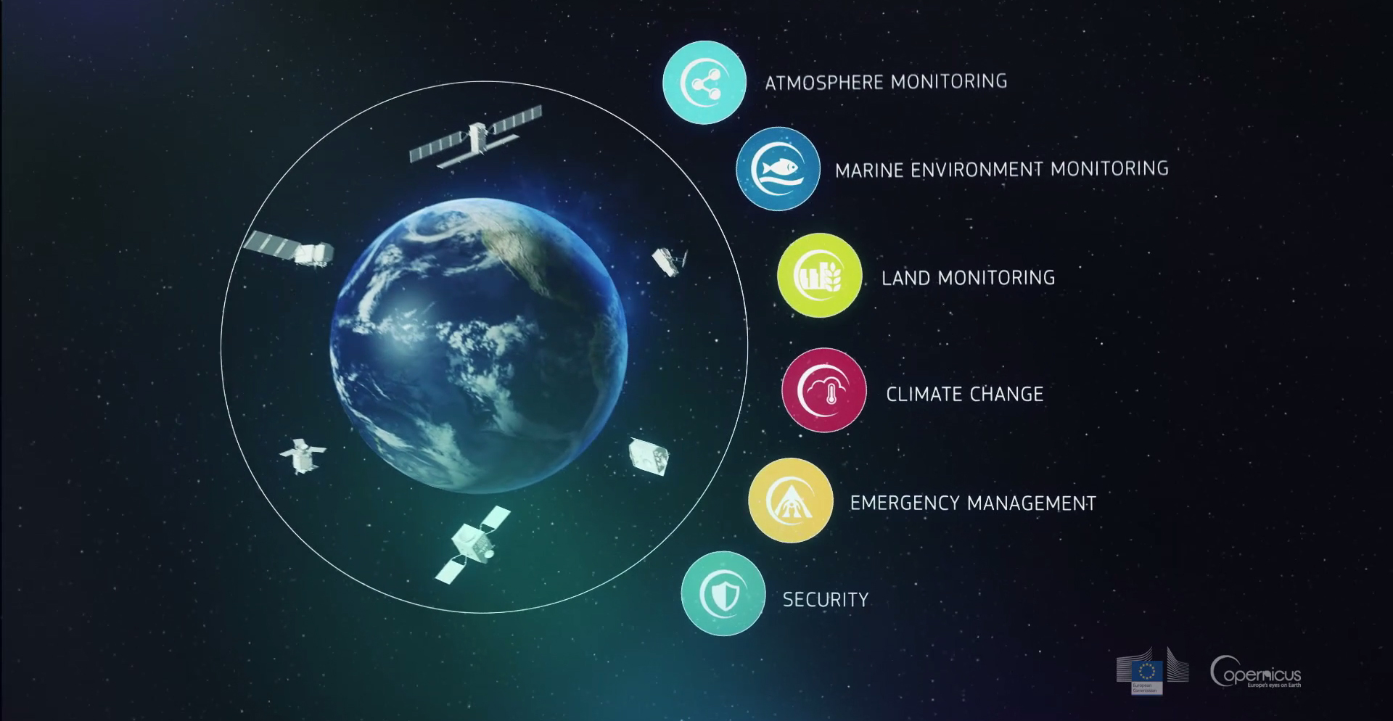
Copernicus: Earth observations and
information services
Climate
Change

Slide 4
The C3S mission
Climate
Change
To support European adaptation and mitigation policies by:
Providing consistent and authoritative information about climate
Building on existing capabilities and infrastructures
Stimulating the market for climate services in Europe

Slide 5
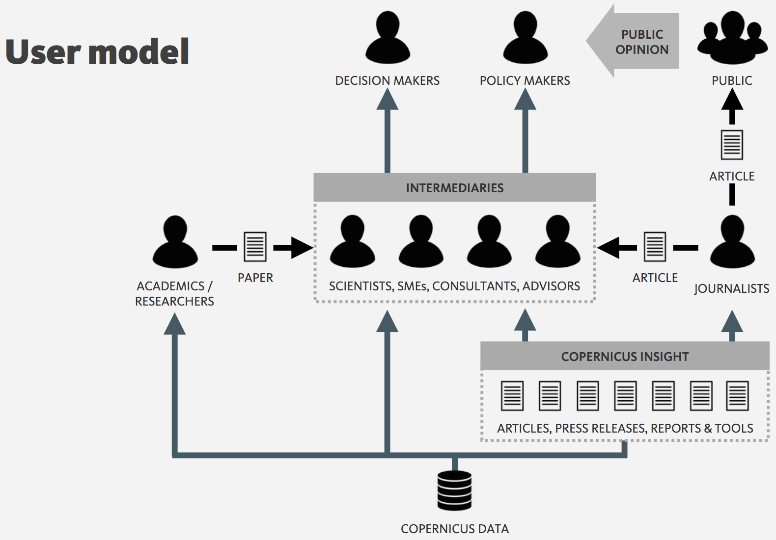
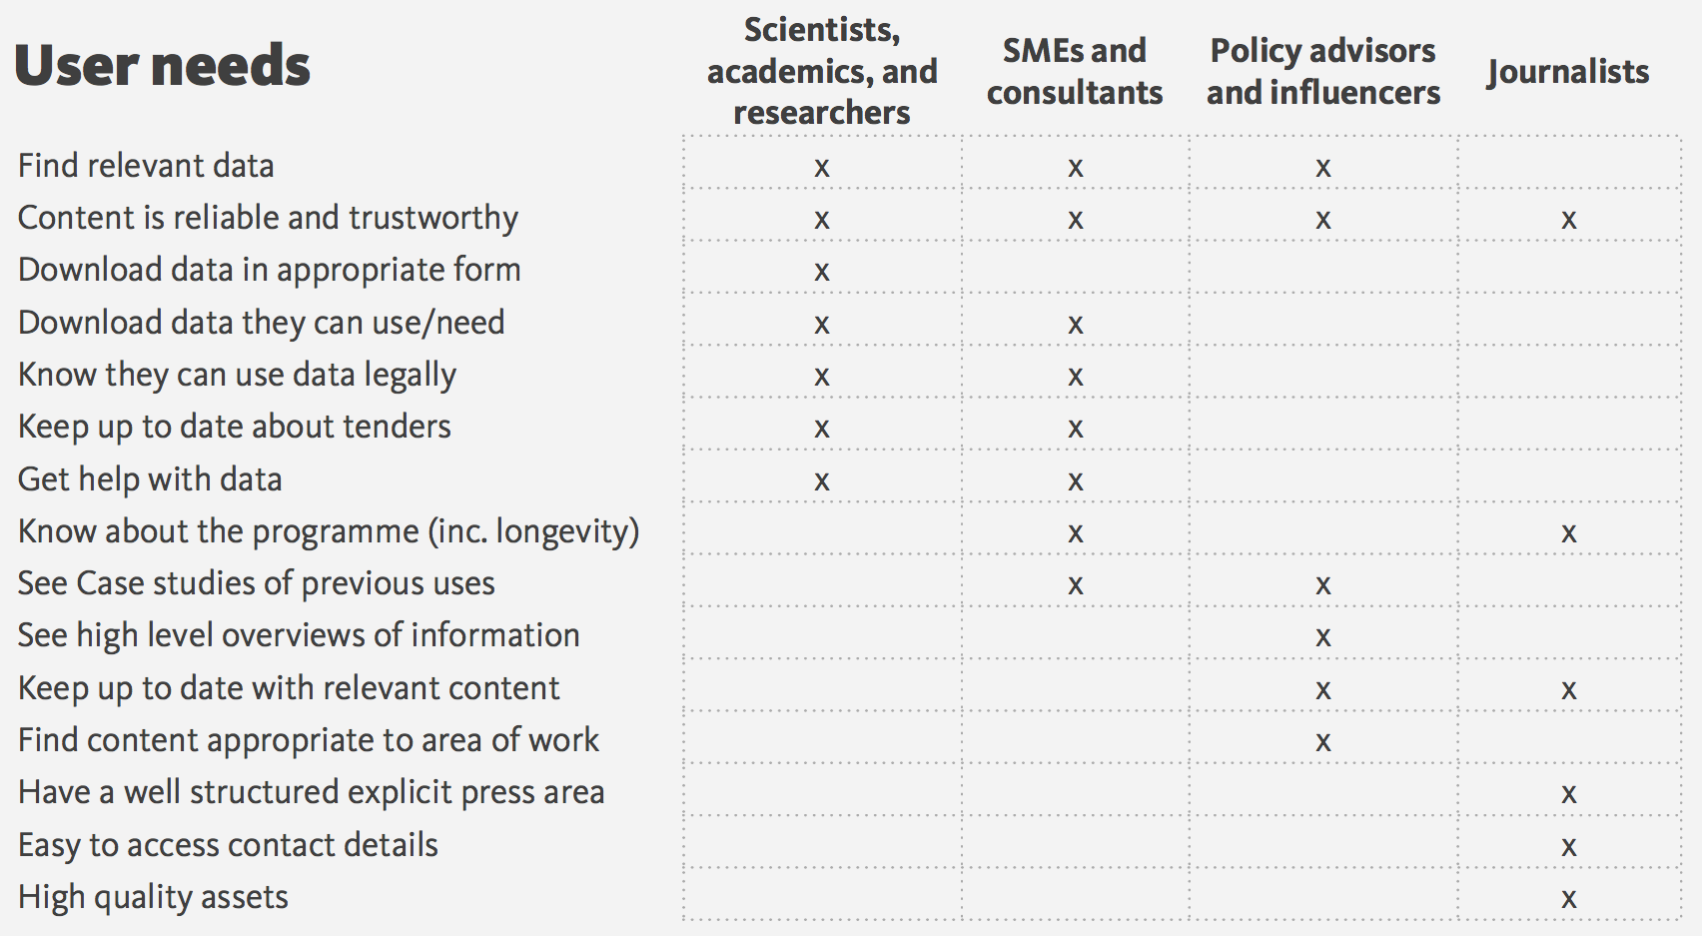
Who are the users and what do they want?
Climate
Change

Slide 6
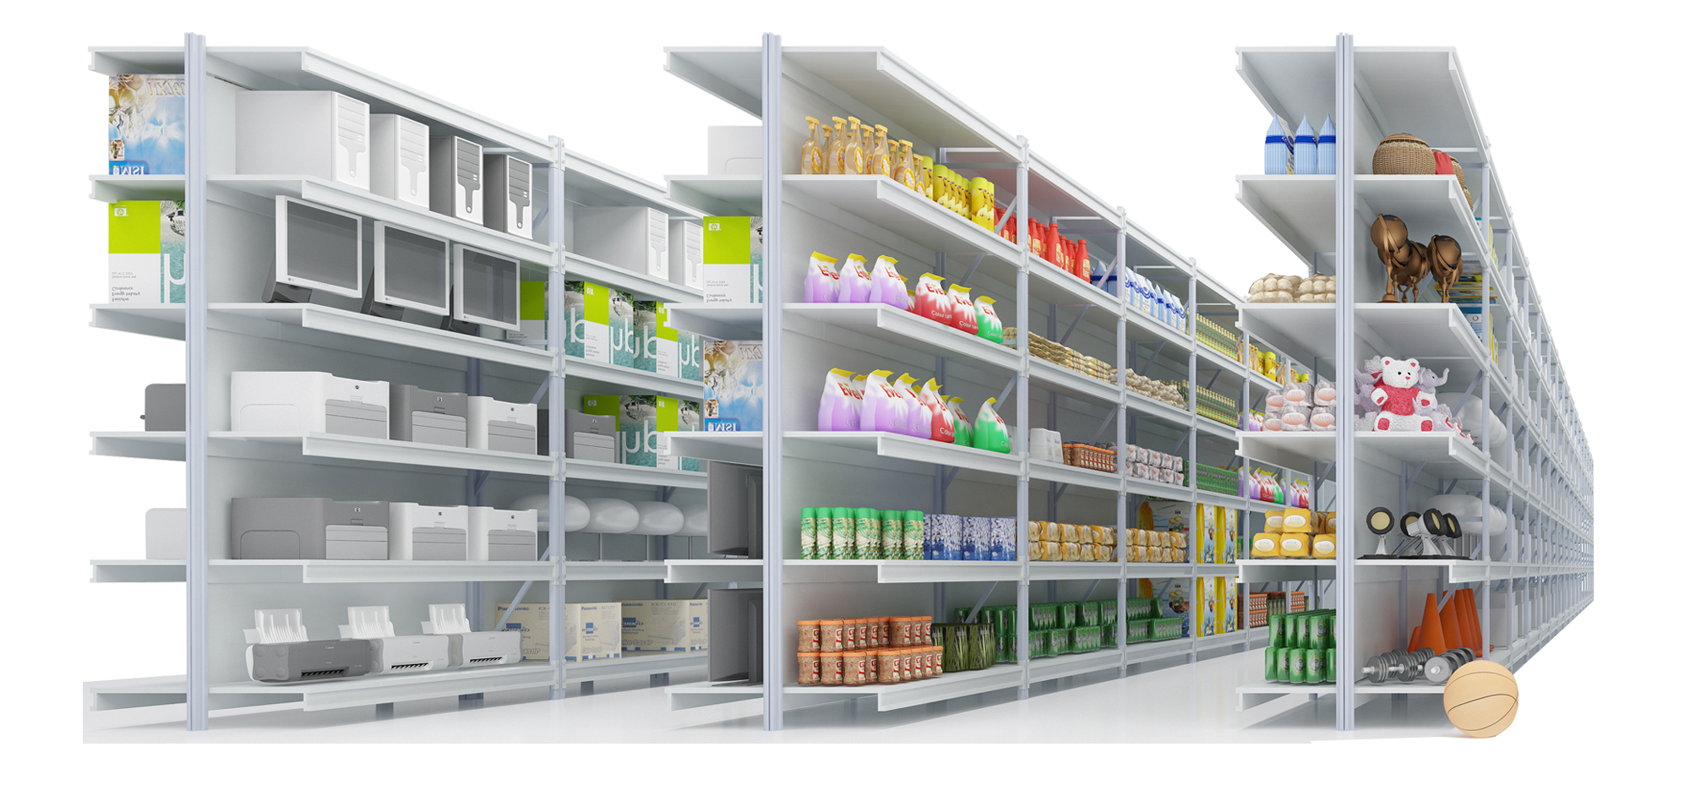
A one-stop Climate Data Store
Climate
Change
We are building a store.
We are putting products on the shelves.
Soon we will open the door to customers.

Slide 7
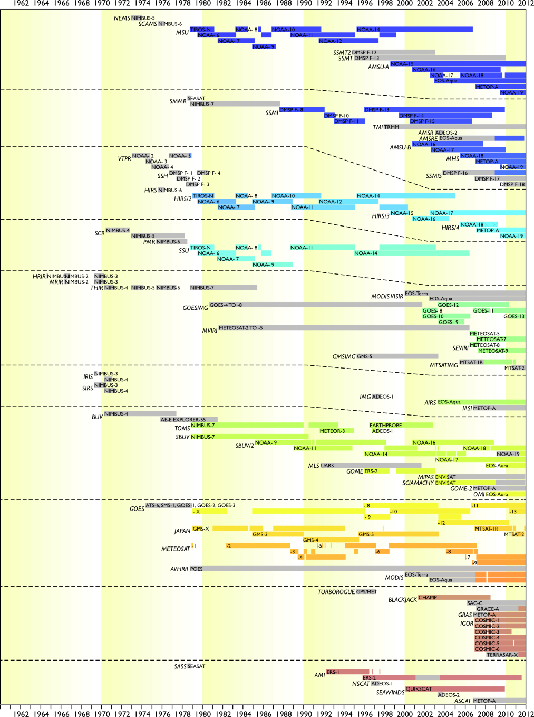
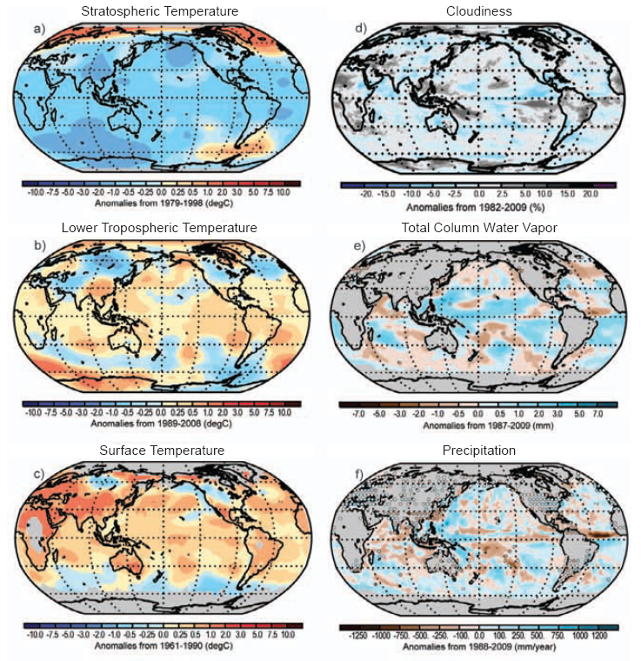
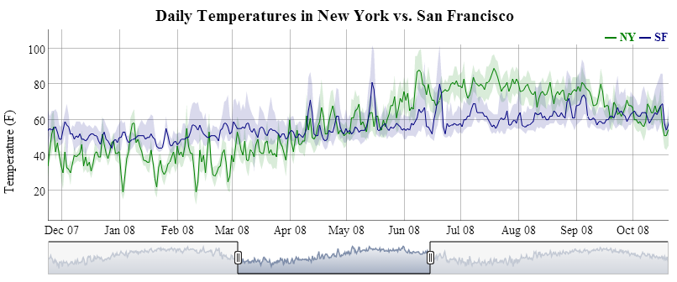
Access to observations and climate reanalyses
Climate
Change
Earth system models

Slide 8
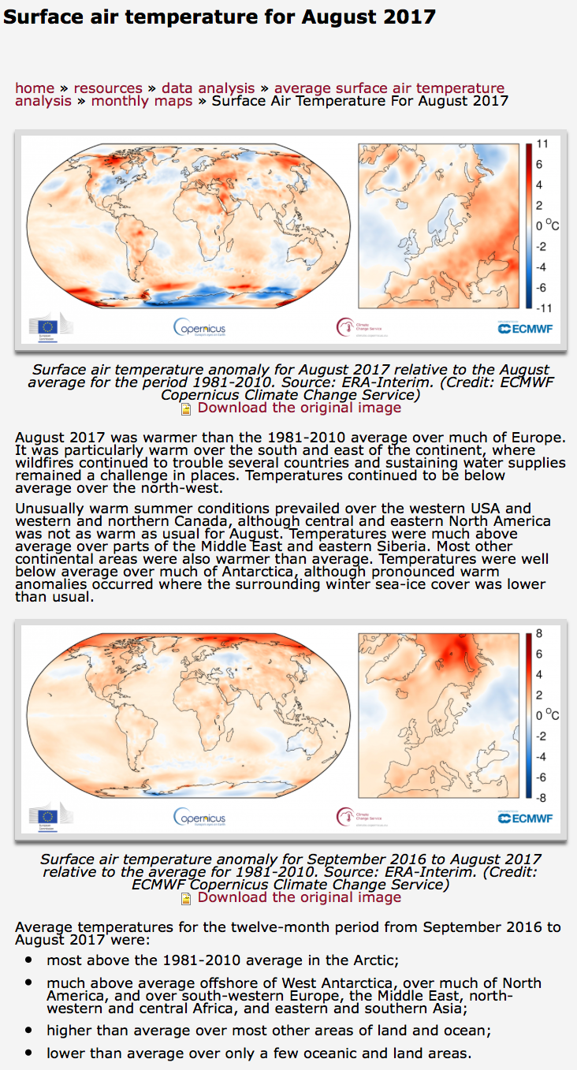
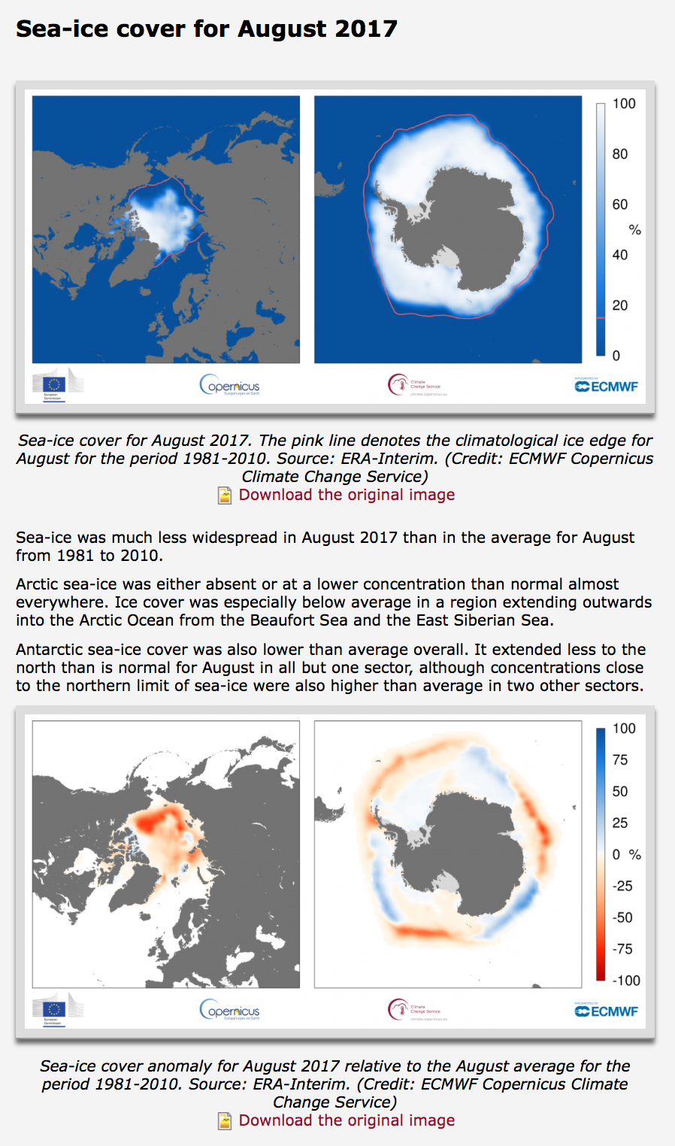
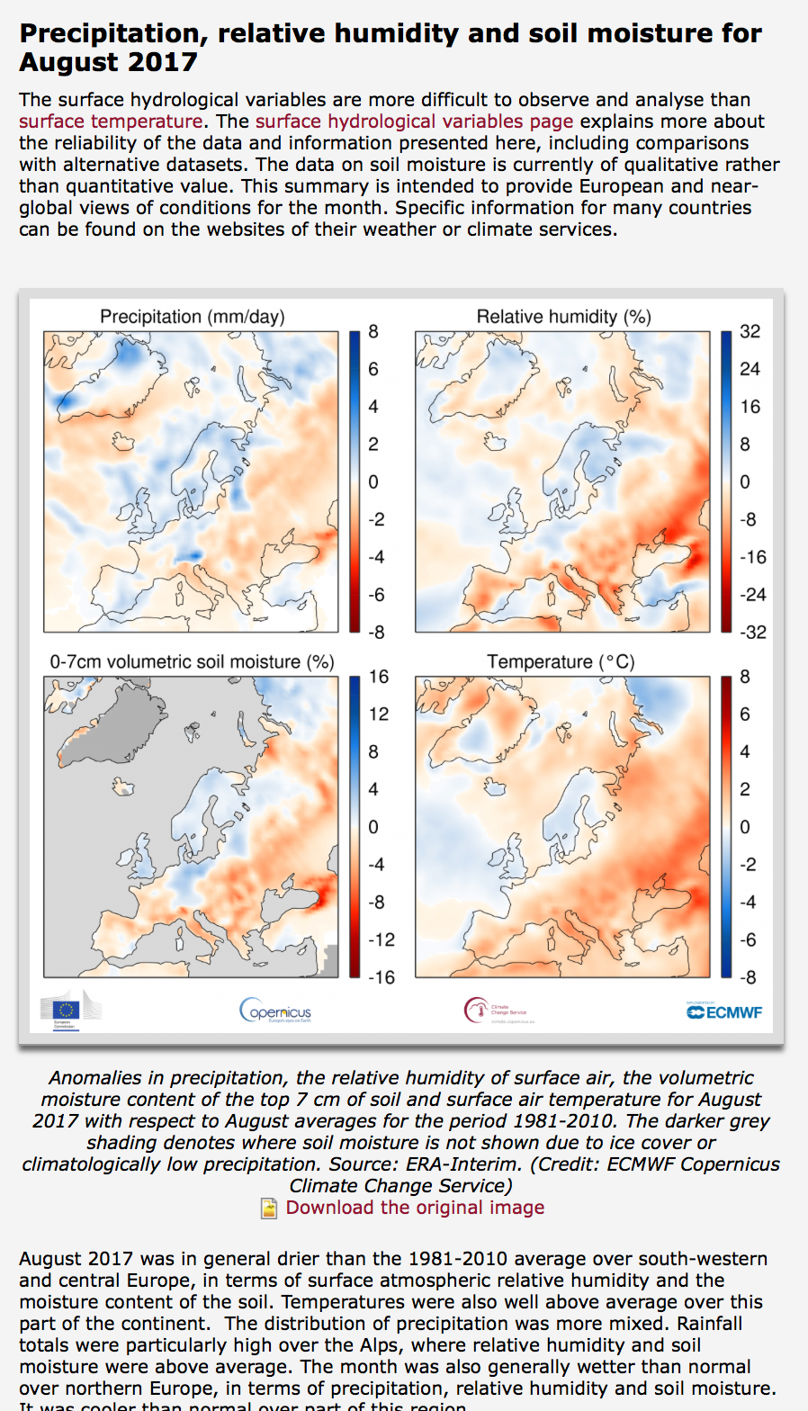
Monthly reports on the state of the climate
Climate
Change
climate.copernicus.eu

Slide 9
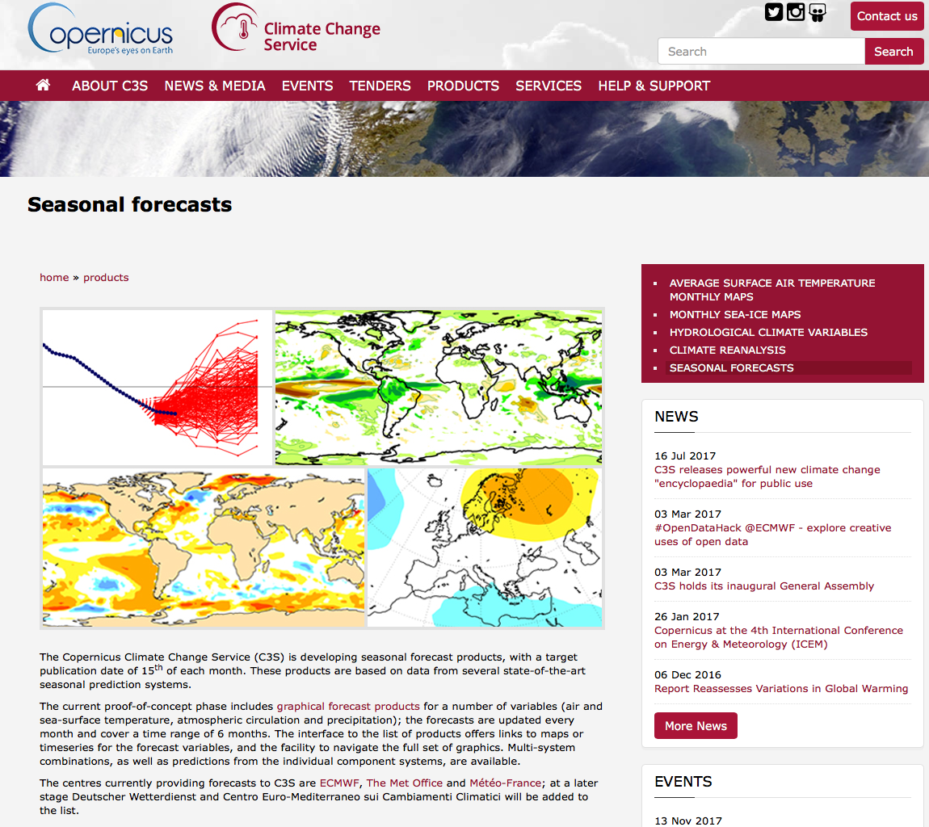
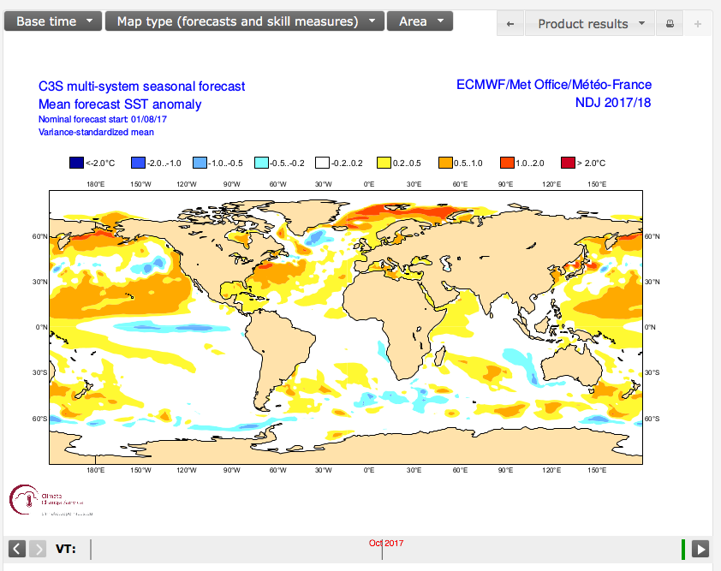
Access to seasonal forecast data and products
Climate
Change

Slide 10
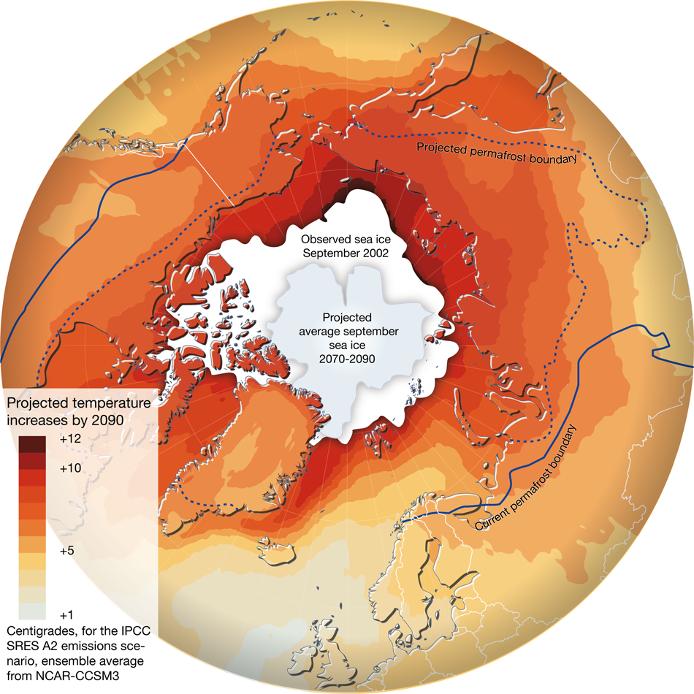
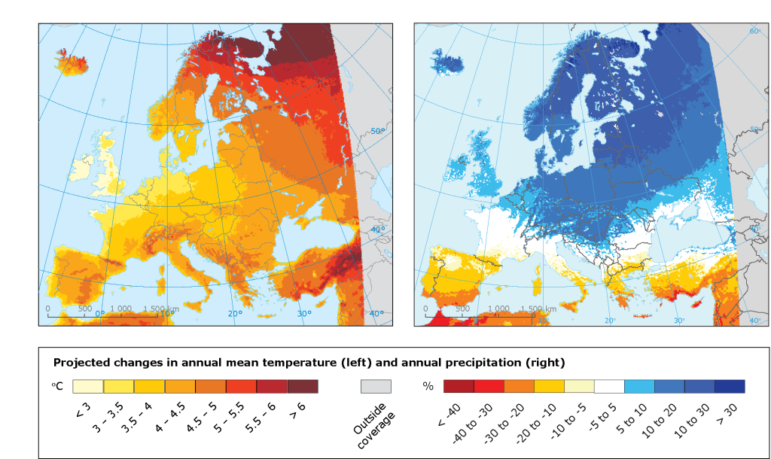
Access to climate model simulations
Climate
Change

Slide 11
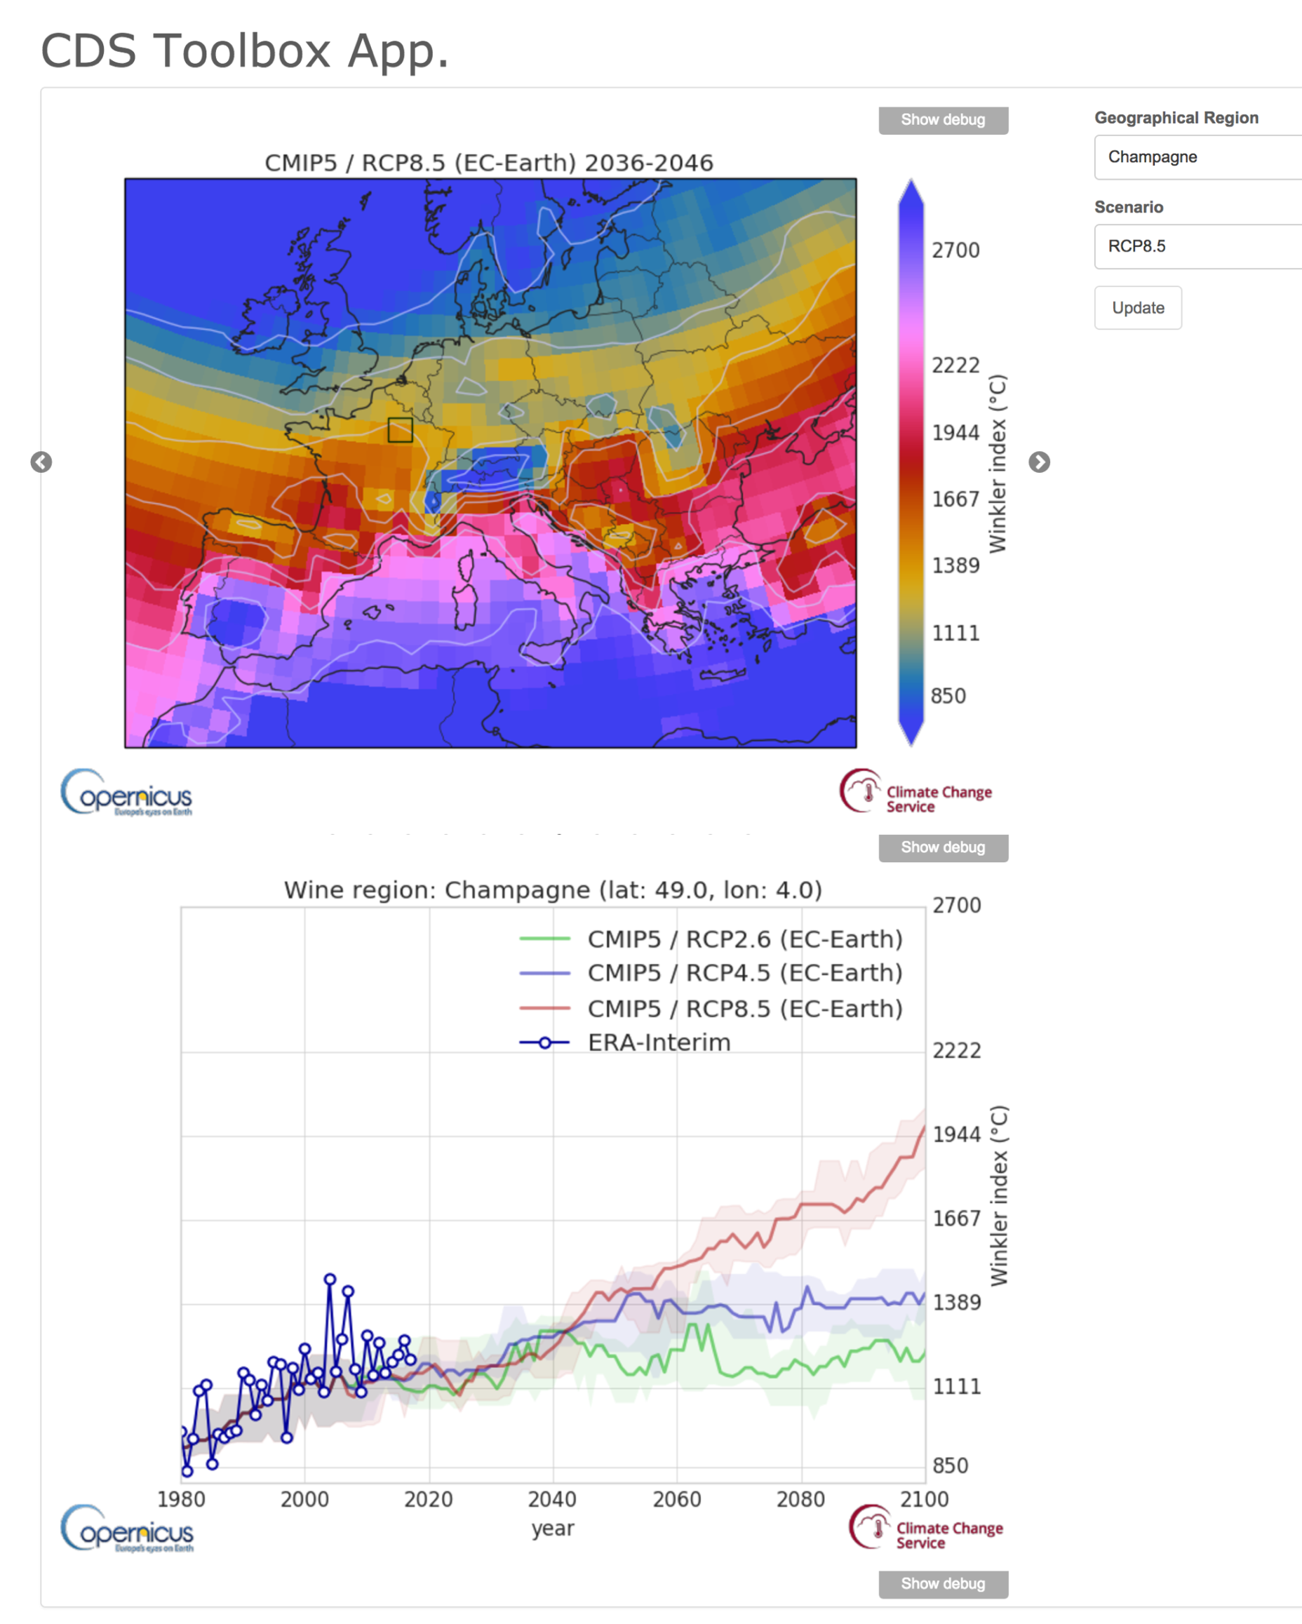
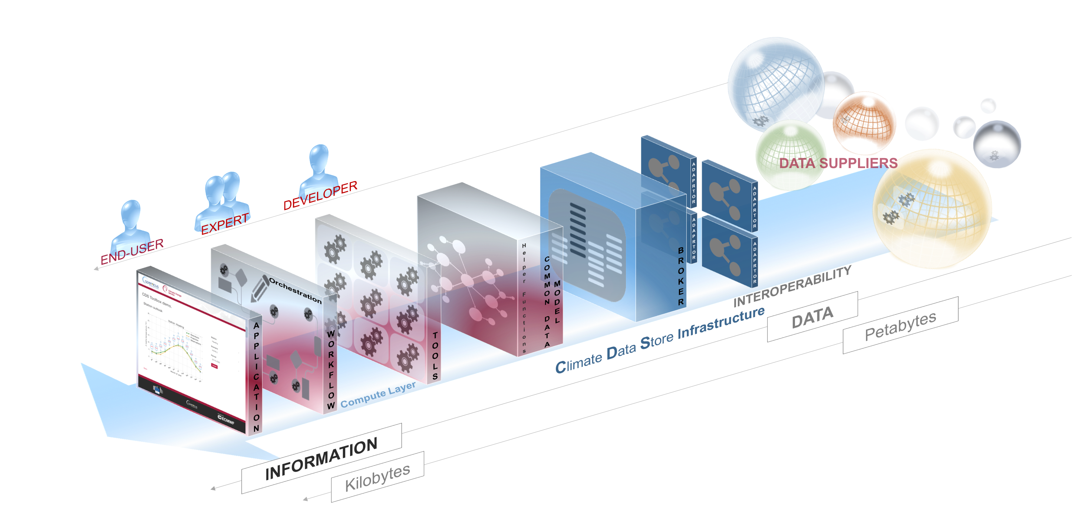
Access to tools, workflows and applications
Climate
Change

Slide 12
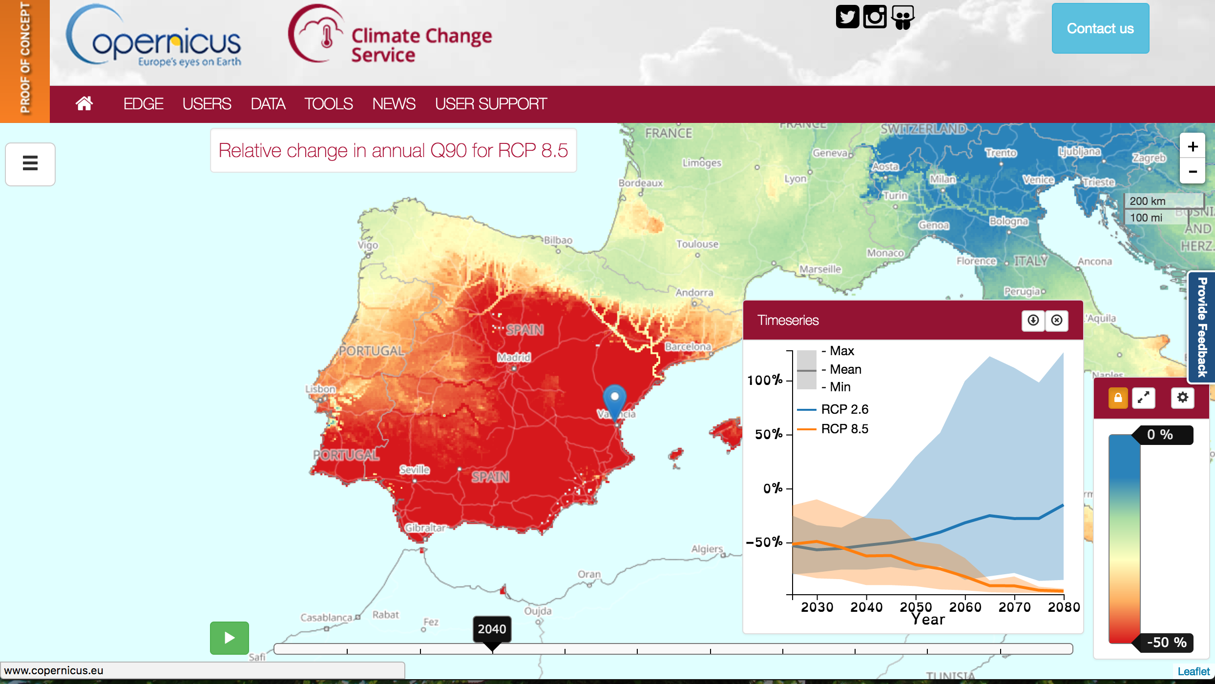
Sectoral indicators and tools to support adaptation
Climate
Change

Slide 13
Climate
Change
Thank you
martin.suttie@ecmwf.int / climate.copernicus.eu / @CopernicusECMWF

