Slide 2
The application of Earth Observation to help manage land use and land use change in Brazil : An analysis of user needs
Mercio Cerbaro / PhD student
University of Surrey/ University of Reading / INPE

Slide 3
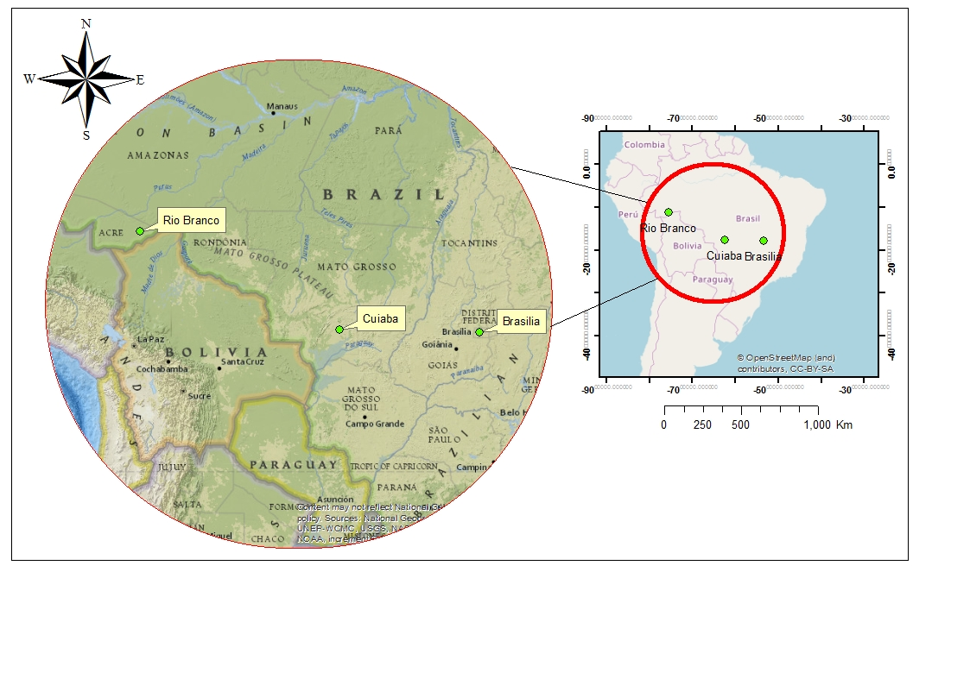
EO users needs research / An analysis of user needs in Brazil
53 semi-structured in depth interviews ( senior scientists, policymakers, GIS technicians, academics, environmental analysts, and many others end-users of EO data)
13 open questions and 2 structured questions
Main uses of EO data : to monitor deforestation, disaster management, environmental management, crop forecast and land use planning.
Field work locations: Brasilia (the capital of Brazil), Cuiaba (Mato Grosso) and Rio Branco (Acre) Sources : National Geographic and Open street map.

Slide 4
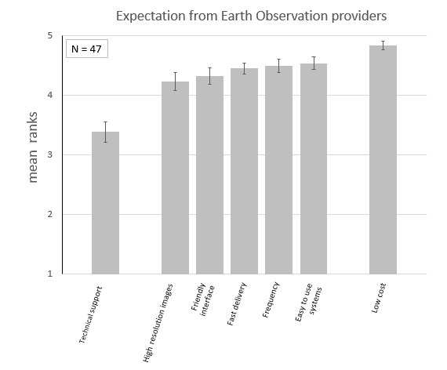
User needs regarding EO providers /
Expectation from EO data providers
“We want products already to use without the need of additional technical support from EO providers”
Senior coordinator, IBAMA remote sensing division in Brasilia.
“Internet with poor quality, it takes 12 hours to download an EO image Environmental analyst, ICMBIO ACRE

Slide 5
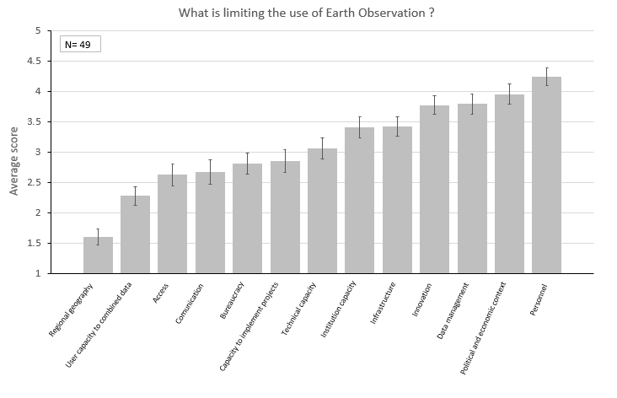
The factors that limit the use of EO data /
What is limiting the use of EO data in Brazil ?
“Personnel changes according to financial resources available to hire external staff. Budget, political and economic context are major issues ”
General coordinator, ICMBIO Brasilia.
“One suggestion for improvement is a tool to understand different EO data before the download. For example: Integrate EO data information for specific land uses with thematic maps ”
Embrapa director, Rio Branco , Acre

Slide 7
Thank you
m.cerbaro@surrey.ac.uk
Supervisors : Professor Stephen Morse (University of Surrey), Professor Jim Lynch (University of Surrey), Dr Geoffrey Griffiths (University of Reading)
Centre for Environment and Sustainability (University of Surrey)
https://www.surrey.ac.uk/centre-environment-sustainability
Funding : NERC SCENARIO

