Slide 2
UN-SPIDER &
GEOSS PORTAL
Radu Botez / Associate Information & Outreach Officer /
United Nations Office for Outer Space Affairs (UNOOSA)
Platform for Space-Based Information for Disaster Management
and Emergency Response (UN-SPIDER)

Slide 3
UN-SPIDER / Intro
Facilitator of capacity building and institutional strengthening
Bridge to connect disaster management and space communities
Gateway to space information for disaster management support
Established in 2006 by UN General Assembly
Programme of UNOOSA
Offices in Vienna, Beijing, Bonn
Mandate (A/Res/61/110): “... provide universal access to all countries and all relevant international and regional organizations to all types of space-based information and services relevant to support the full disaster management cycle ...“

Slide 4
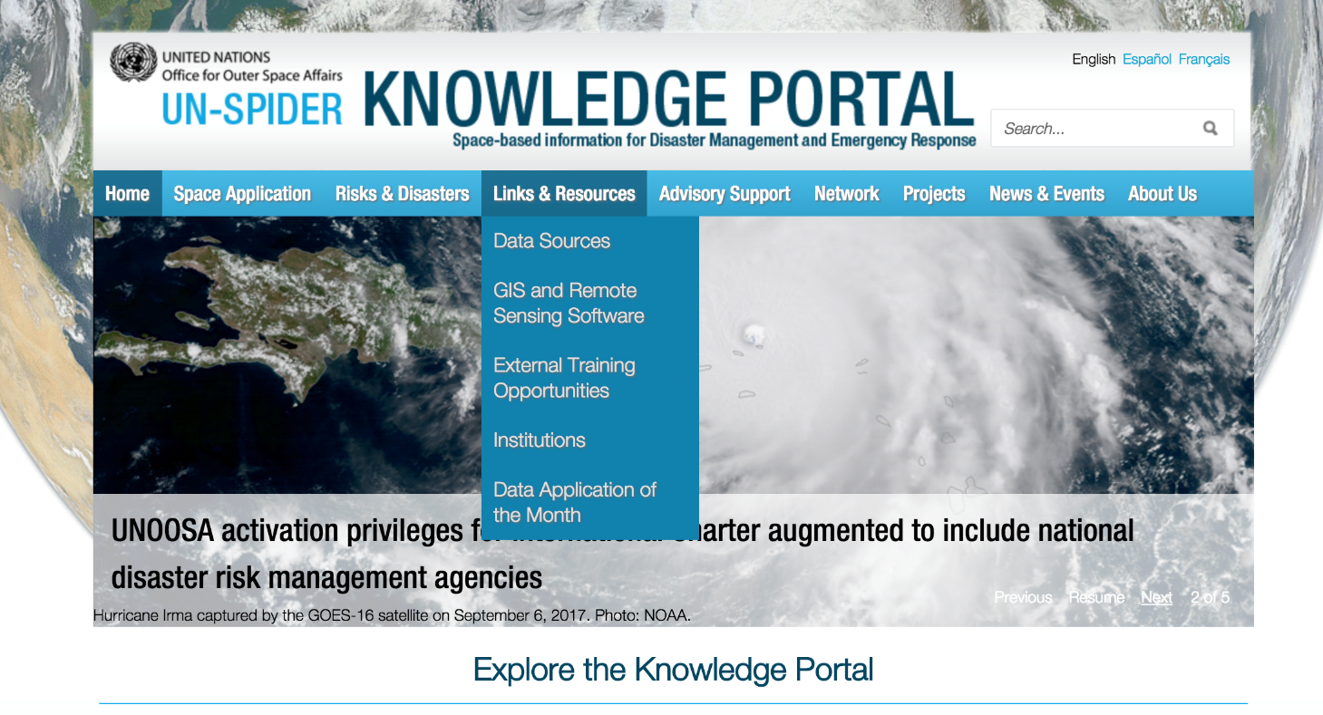
UN-SPIDER / Gateway
Awareness-Raising
Curated resources: data, software, news...
How-to: Guides on how to use data for mapping various hazards

Slide 5
Data exchange / Gateway
Extended reach & data discovery

Slide 6
Data exchange / Gateway
Integration & contextualization
of EO data sources

Slide 7
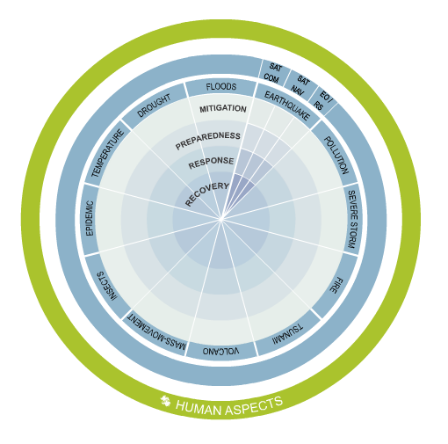
Data exchange / Gateway

Slide 9
Thank you
radu.botez@un.org / unoosa.org / un-spider.org / @unoosa / @un_spider

