Slide 1
Himalayan GEOSS
Sudip Pradhan Programme Coordinator, Regional Database System 3 May 2018

Slide 2
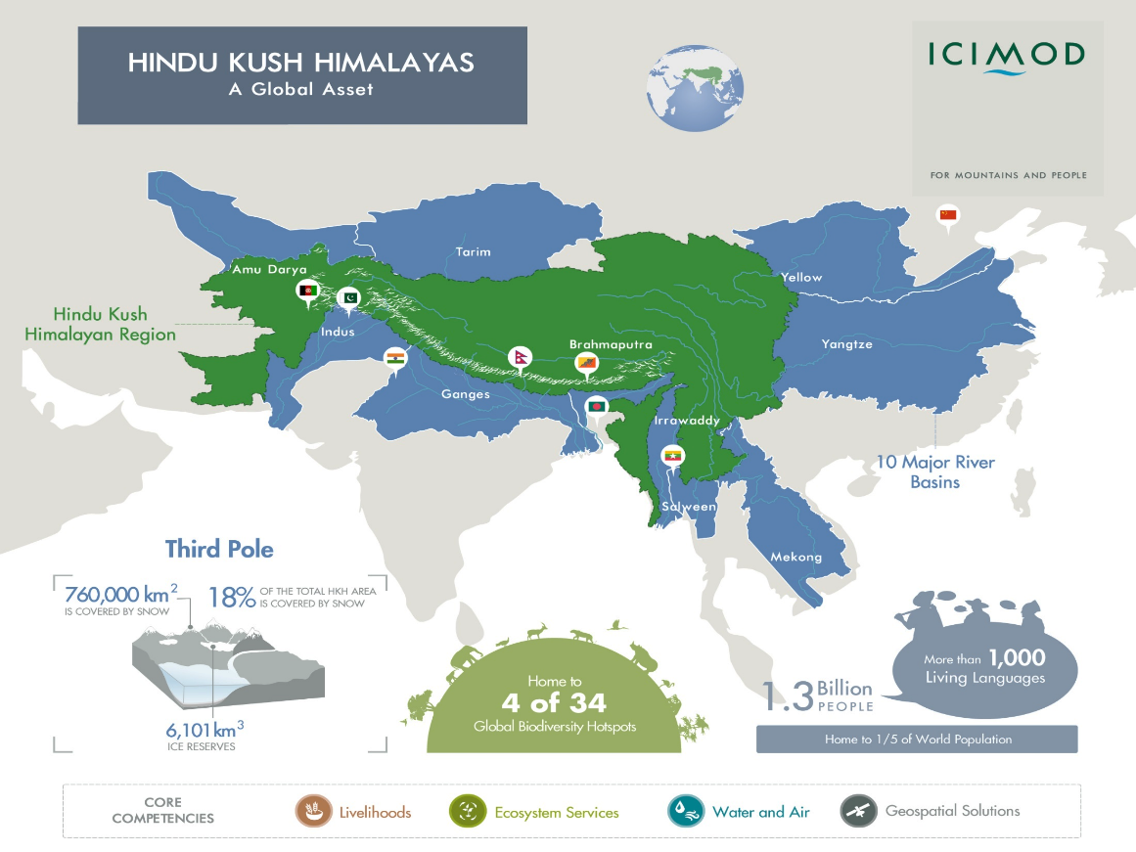
An inter-governmental regional mountain learning and knowledge centre

Slide 3
Himalayan GEOSS
A sub-regional GEOSS focussed on the Hindu Kush Himalayas with the aims to
Develop and implement innovative EO and geospatial solutions and services in combination with in-situ observation for mountain specific situations aligning with regional priorities and GEO societal benefits areas through a coordinated framework
Develop the capacities of the HKH countries in using the EO data and information and implement integrated and innovative geospatial solutions into developmental decision-making
Foster regional cooperation among the HKH countries and provide a regional platform on EO and geospatial information for mutual learning and sharing opportunities and contribute to global knowledge on the mountain systems
Promote a Himalayan Spatial Data Infrastructure (H-SDI) through its established networks of institutions in the region and strategic alliances and partnerships with international agencies/initiatives.

Slide 4
Himalayan GEOSS Activities
Brainstorming workshop on the operationalization of the concept of Himalayan GEOSS
Formation of a working group with representation of GEO member states and participating institutions
Regional workshop on Himalayan GEOSS
Formation of institutional mechanism and coordination framework
Develop detail strategy papers and work plan
Implementation of work plan activities
Notes:
Outcome - The Hindu Kush Himalayan countries are actively drawing upon EO and geospatial information and knowledge resources and integrating them into mountain development policies and practices with increased regional cooperation and ownership.

Slide 5
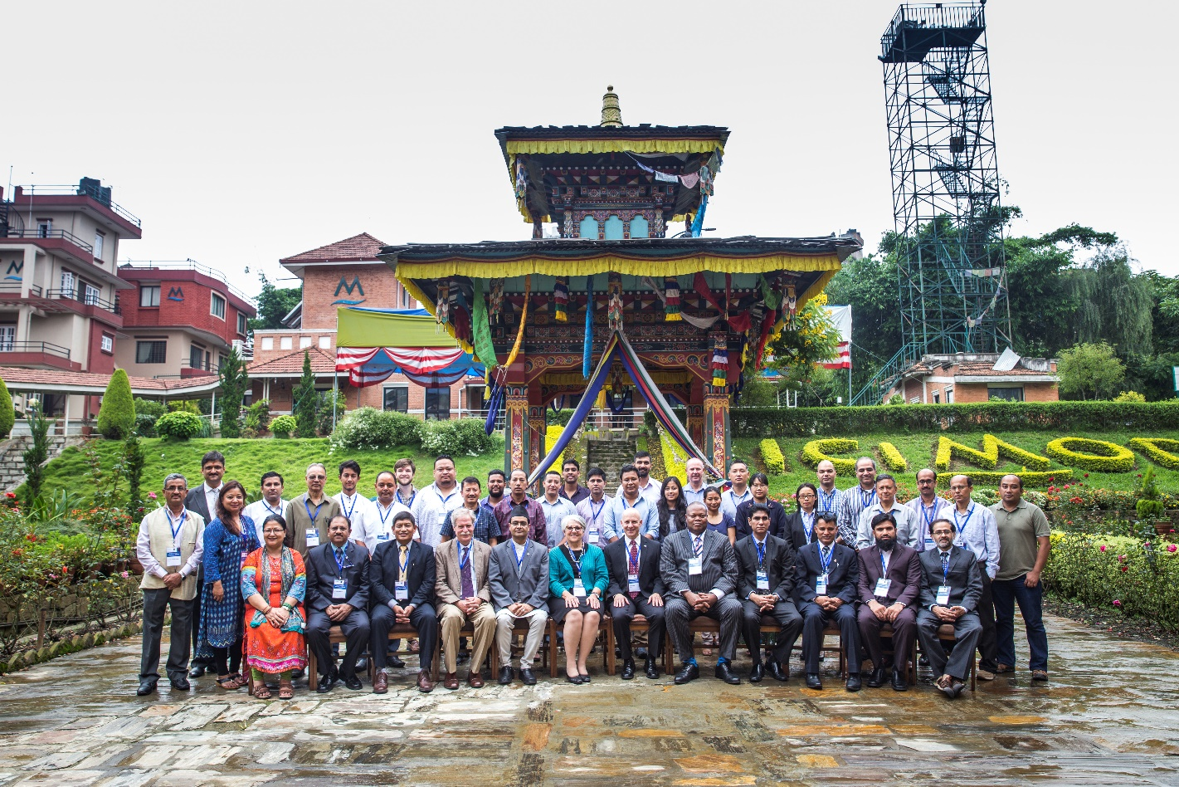
Regional Workshop on Himalayan GEOSS
Provided a platform for policy dialogue and exchange of technical knowledge focusing on operationalization of the Himalayan GEOSS Initiative.
Representatives from government, key regional and international partners working with EO and geo-information in ICIMOD’s RMCs
Notes:
A two-day workshop to facilitate the implementation of the Himalayan GEOSS
Identified capacity development, development and implementation of innovative EO and geospatial applications and services, provisioning of a regional platform for mutual learning and sharing opportunities, and regional collaboration in data and information sharing as areas for consideration under the sub-regional instrument.
All representatives agreed to support the implementation of the Himalayan GEOSS and commended ICIMOD and GEO’s commitment in bringing it to fruition.

Slide 7
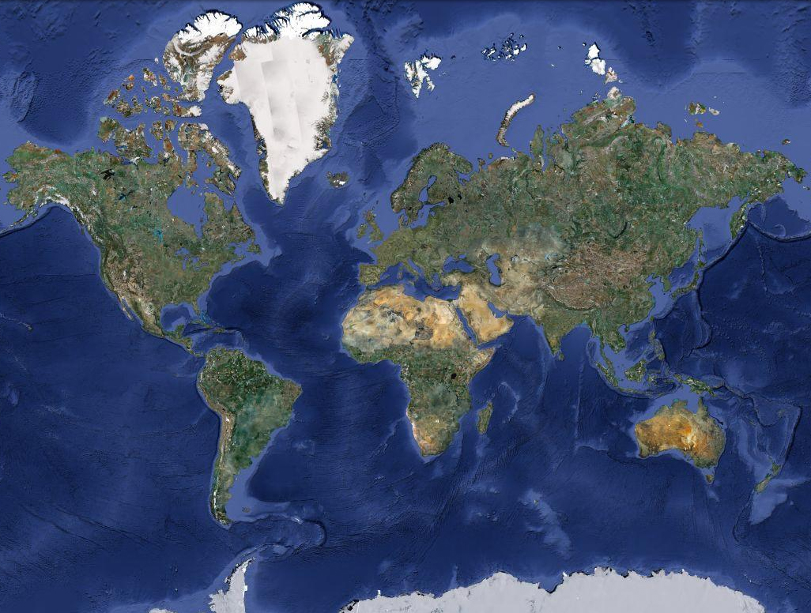
SCO NASA
HKH
West Africa
East Africa
Lower Mekong
A flagship NASA-USAID partnership to improve environmental management and resilience to climate change by strengthening the capacity of governments and other key stakeholders to integrate Earth observation information and geospatial technologies into development decision-making

Slide 8
SERVIR Focus
Improved hub capacity
Water resources
Ecosystems, land use and land cover
Improved capacity to use geospatial information
SERVIR-HKH
Food security and agriculture
Improved access to geoinformation
Hydroclimatic disasters
Weather and climate services
Provision of user-tailored data, products, tools and services

Slide 9
Ongoing Efforts
Agriculture and Food Security Regional drought monitoring and early warning system – Afghanistan, Pakistan and Bangladesh Agro-met advisory service in Nepal Food security vulnerability information system – Nepal In-season wheat crop sown area mapping – Afghanistan | Water Resources and Hydro-climatic Disasters Enhancing Flood EWS Flood Early Warning in Bangladesh and western Nepal Piloting landslide early warning system Development of flood plain management system in Nepal Comprehensive Streamflow Prediction and Visualization to Support Integrated Water Management in the Himalaya Region Managing the Changing Water Resources South of the Himalayas
Land Cover and Land Use Change and Ecosystems Regional and national level annual automatic forest and land cover monitoring (HKH level) Climate change vulnerability and adaptation planning for forest ecosystems (Nepal and Bangladesh) Assessment of Ecosystem services using ARIES platform (Nepal) | Weather and Climate Services Seasonal prediction of HKH Hydrological Extremes with the South Asia Land Data Assimilation System (SALDAS) Monitoring Intense Thunderstorms in the HKH Region

Slide 10
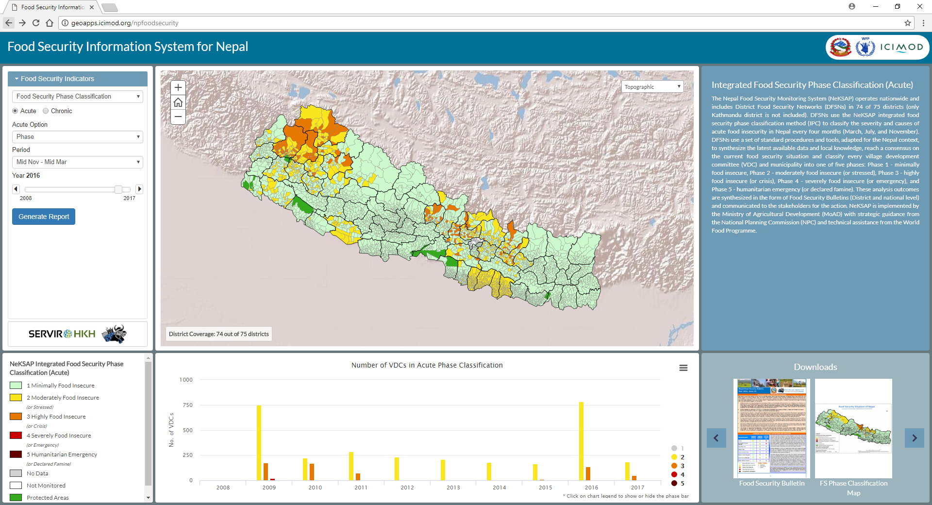
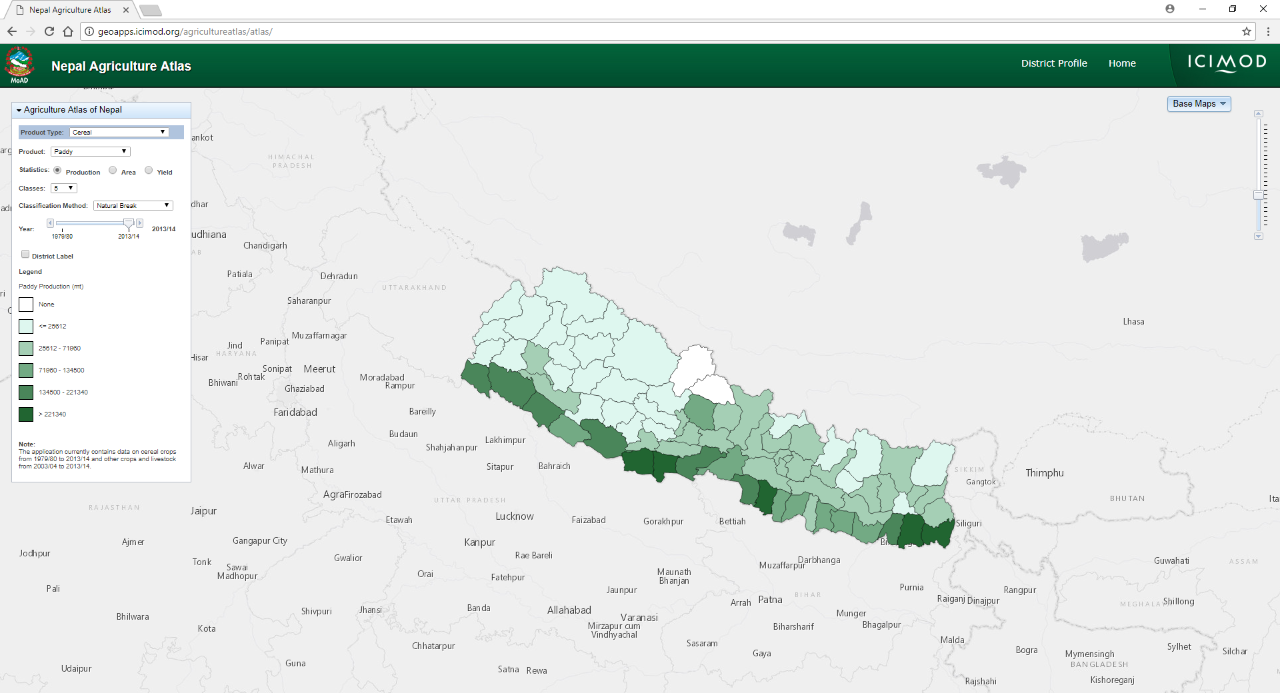
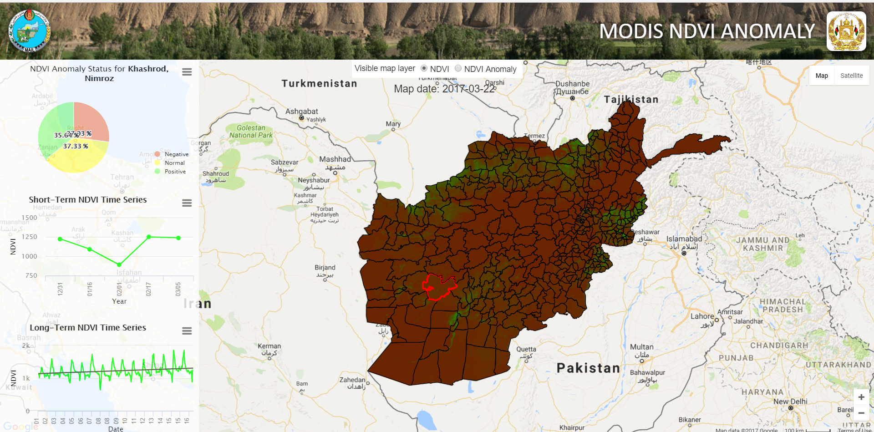
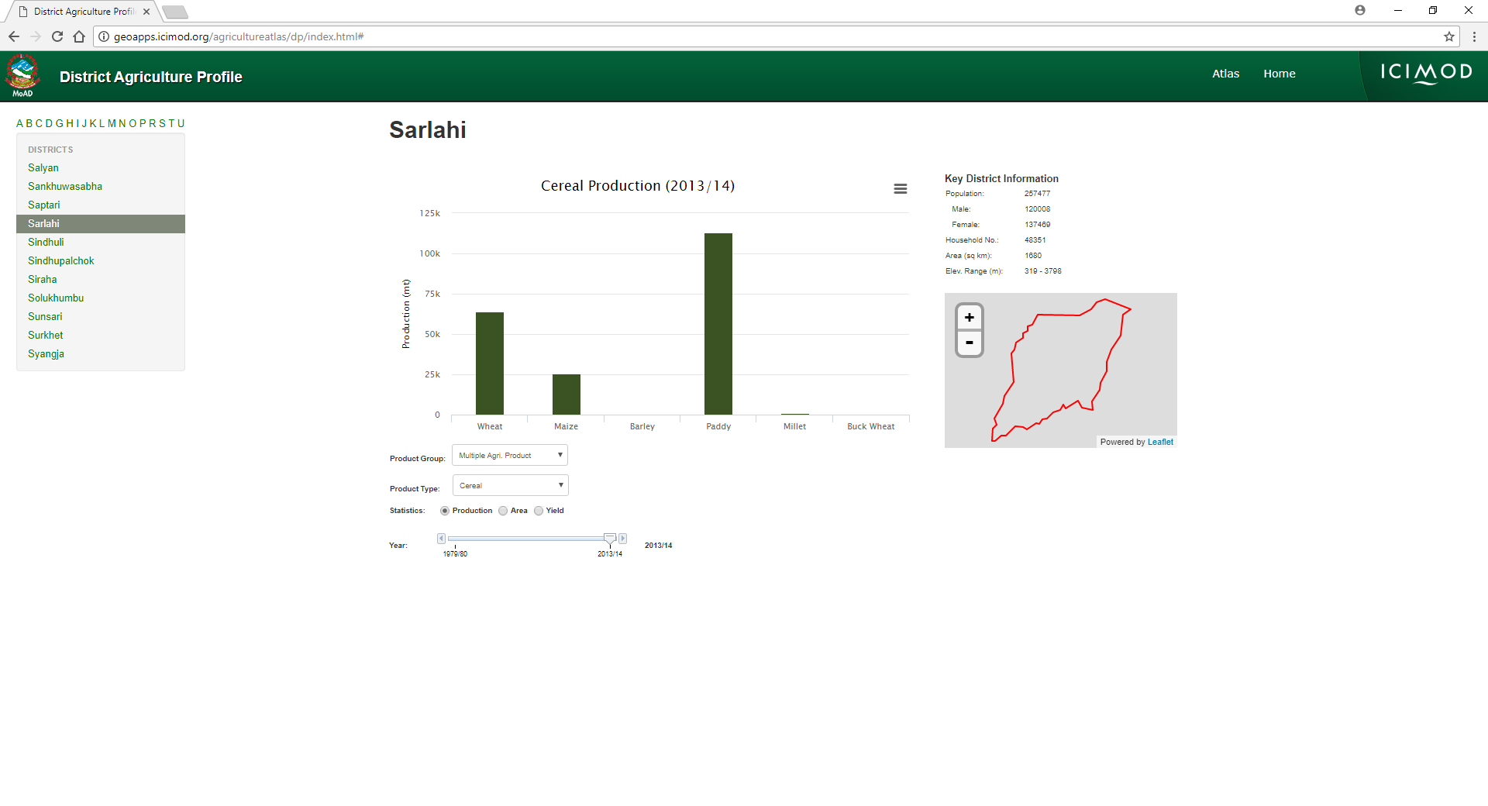
Agriculture and Food Security

Slide 11
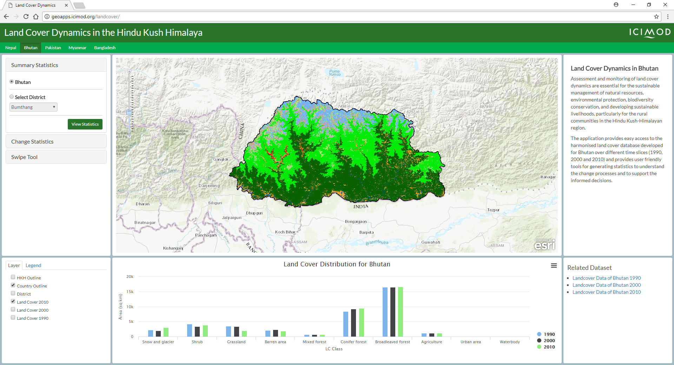
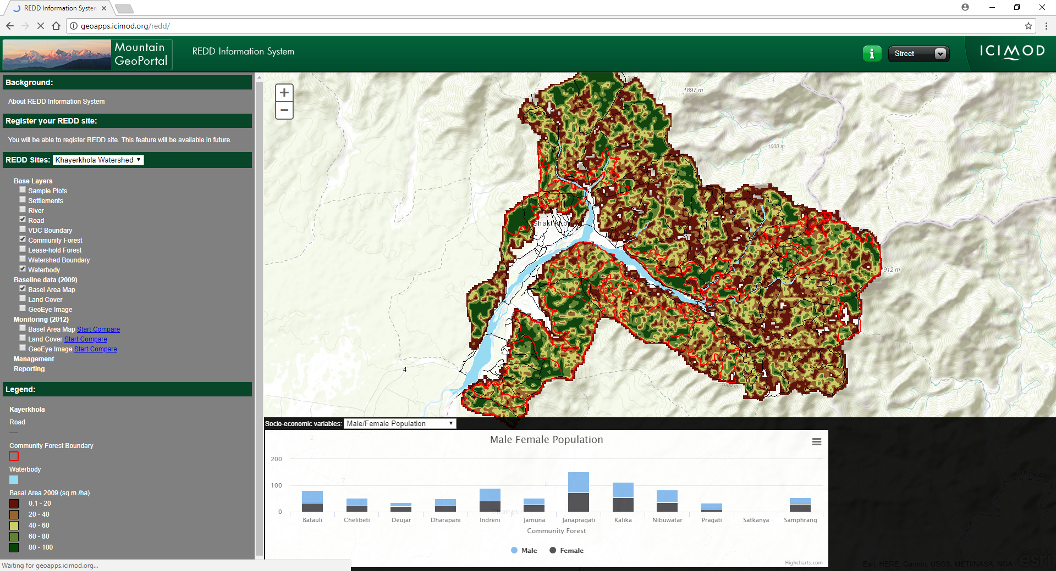
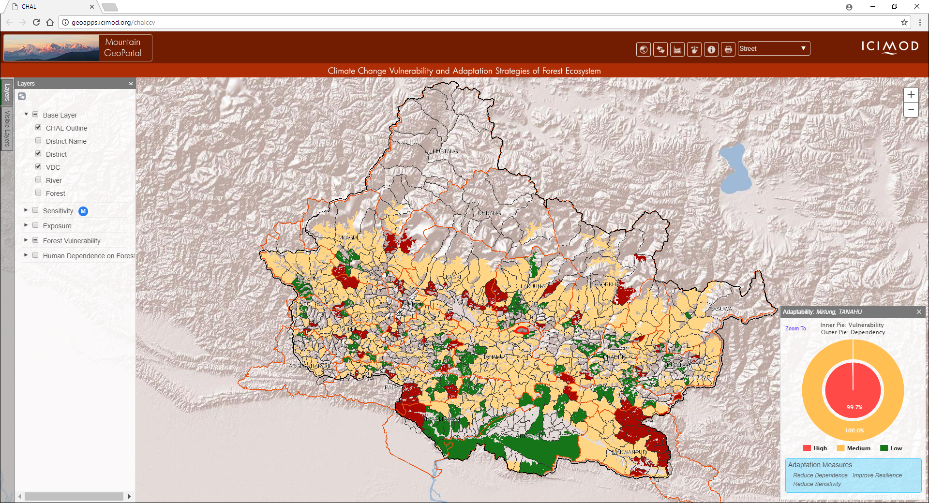
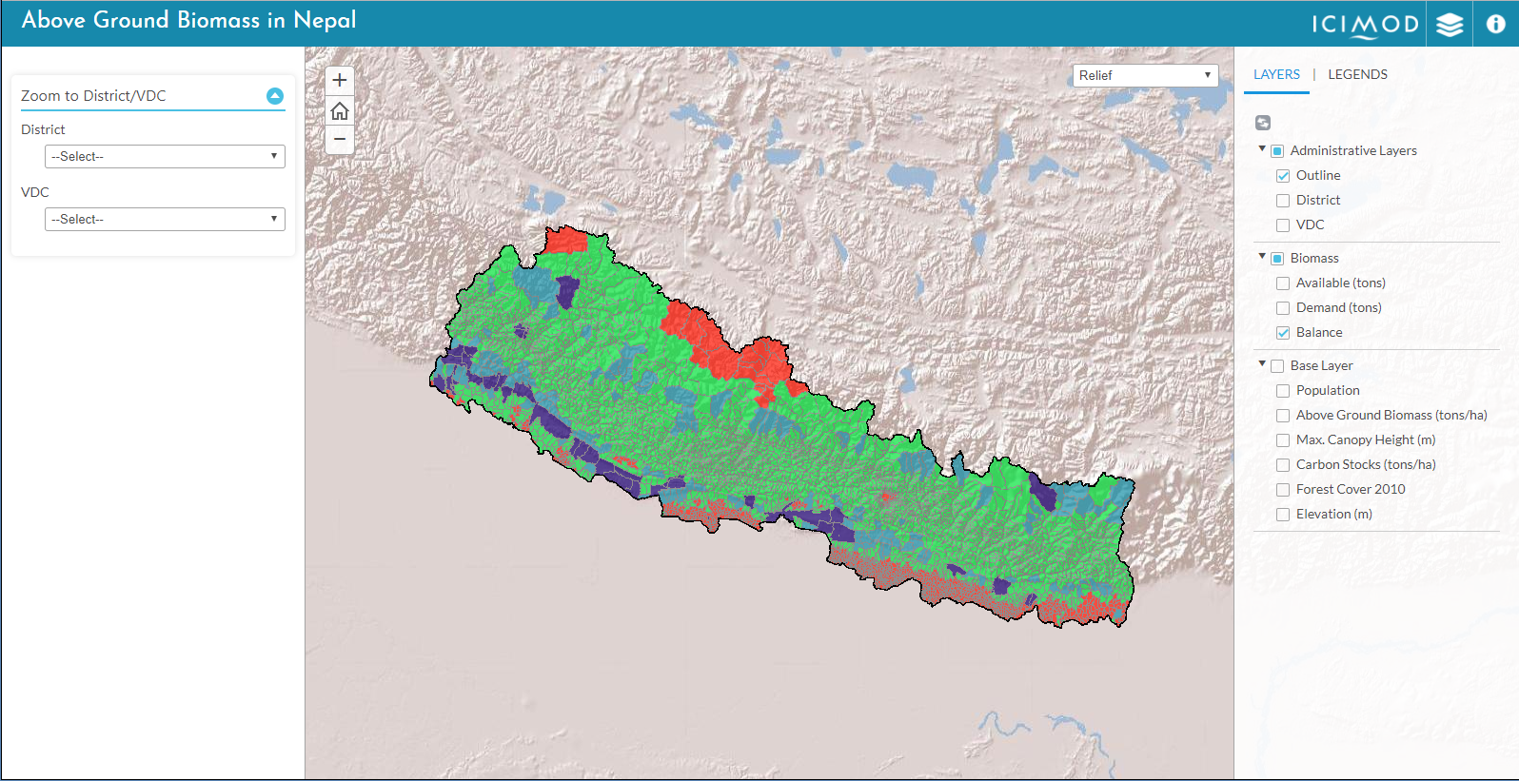
Land cover and Ecosystem

Slide 12
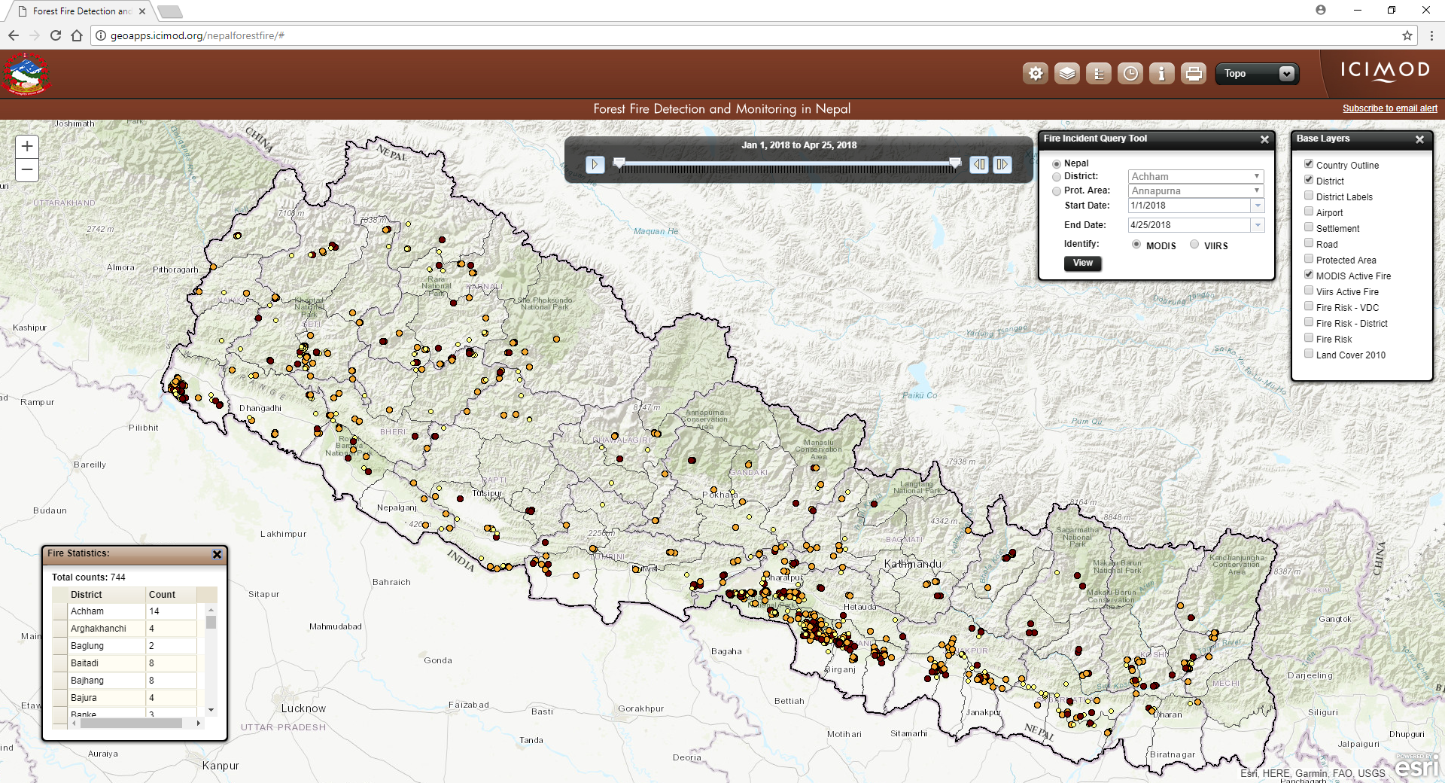
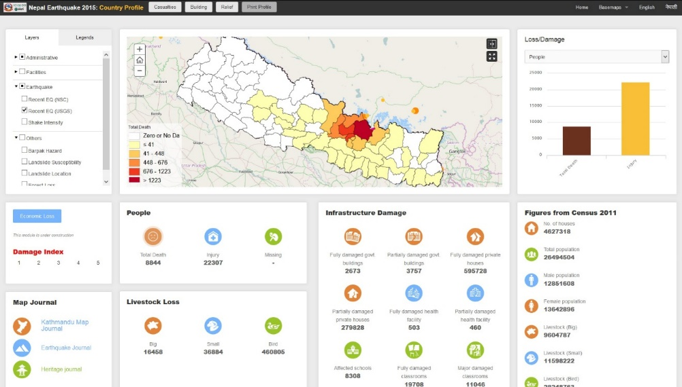
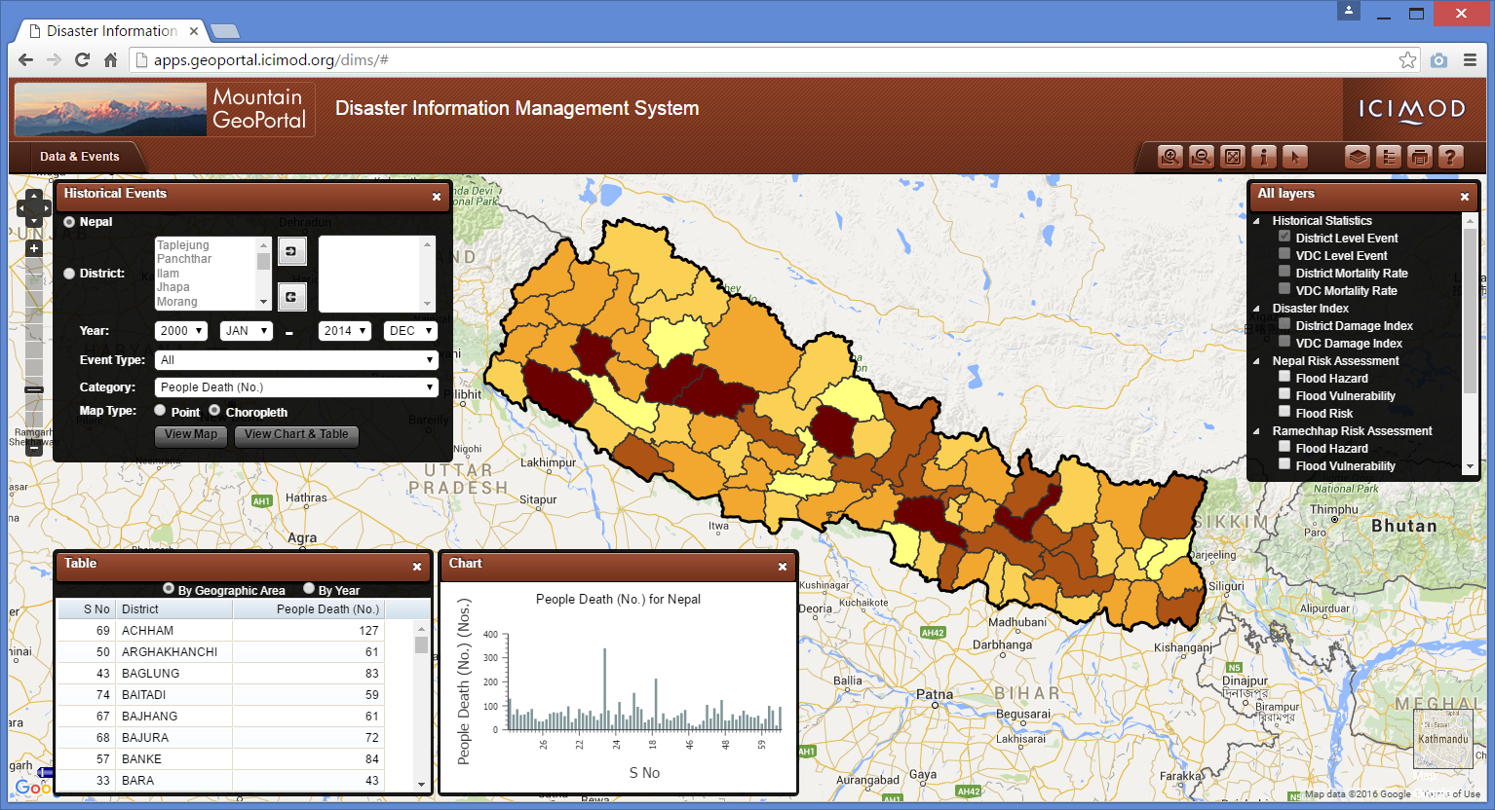
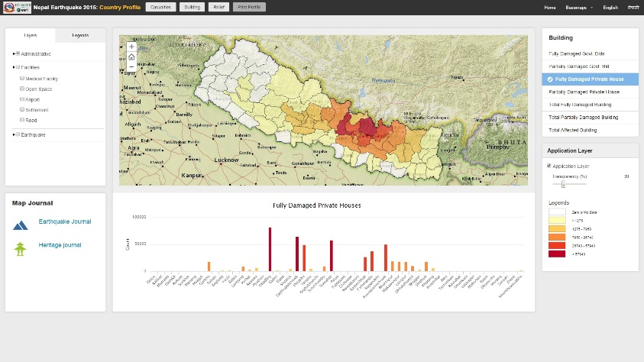
Disaster and Natural Hazards

Slide 13
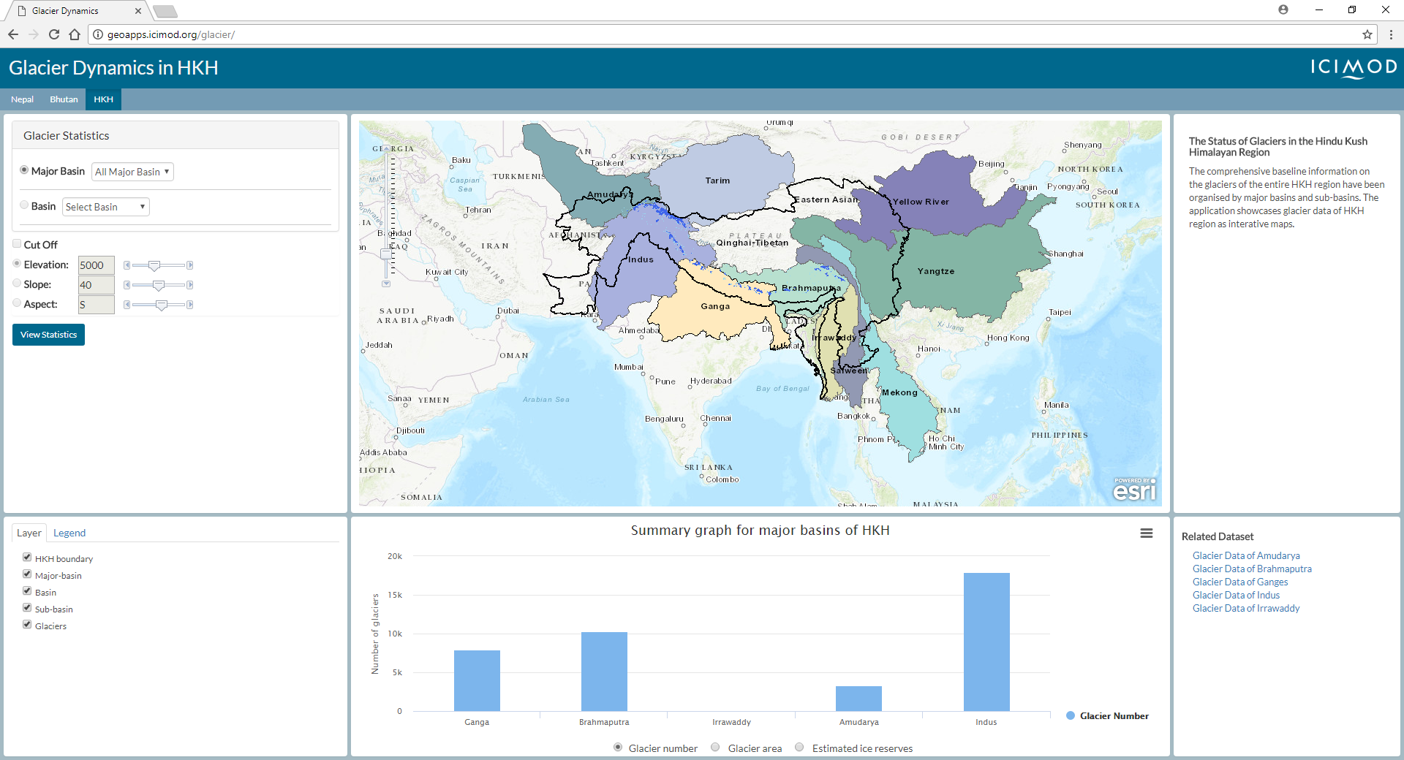
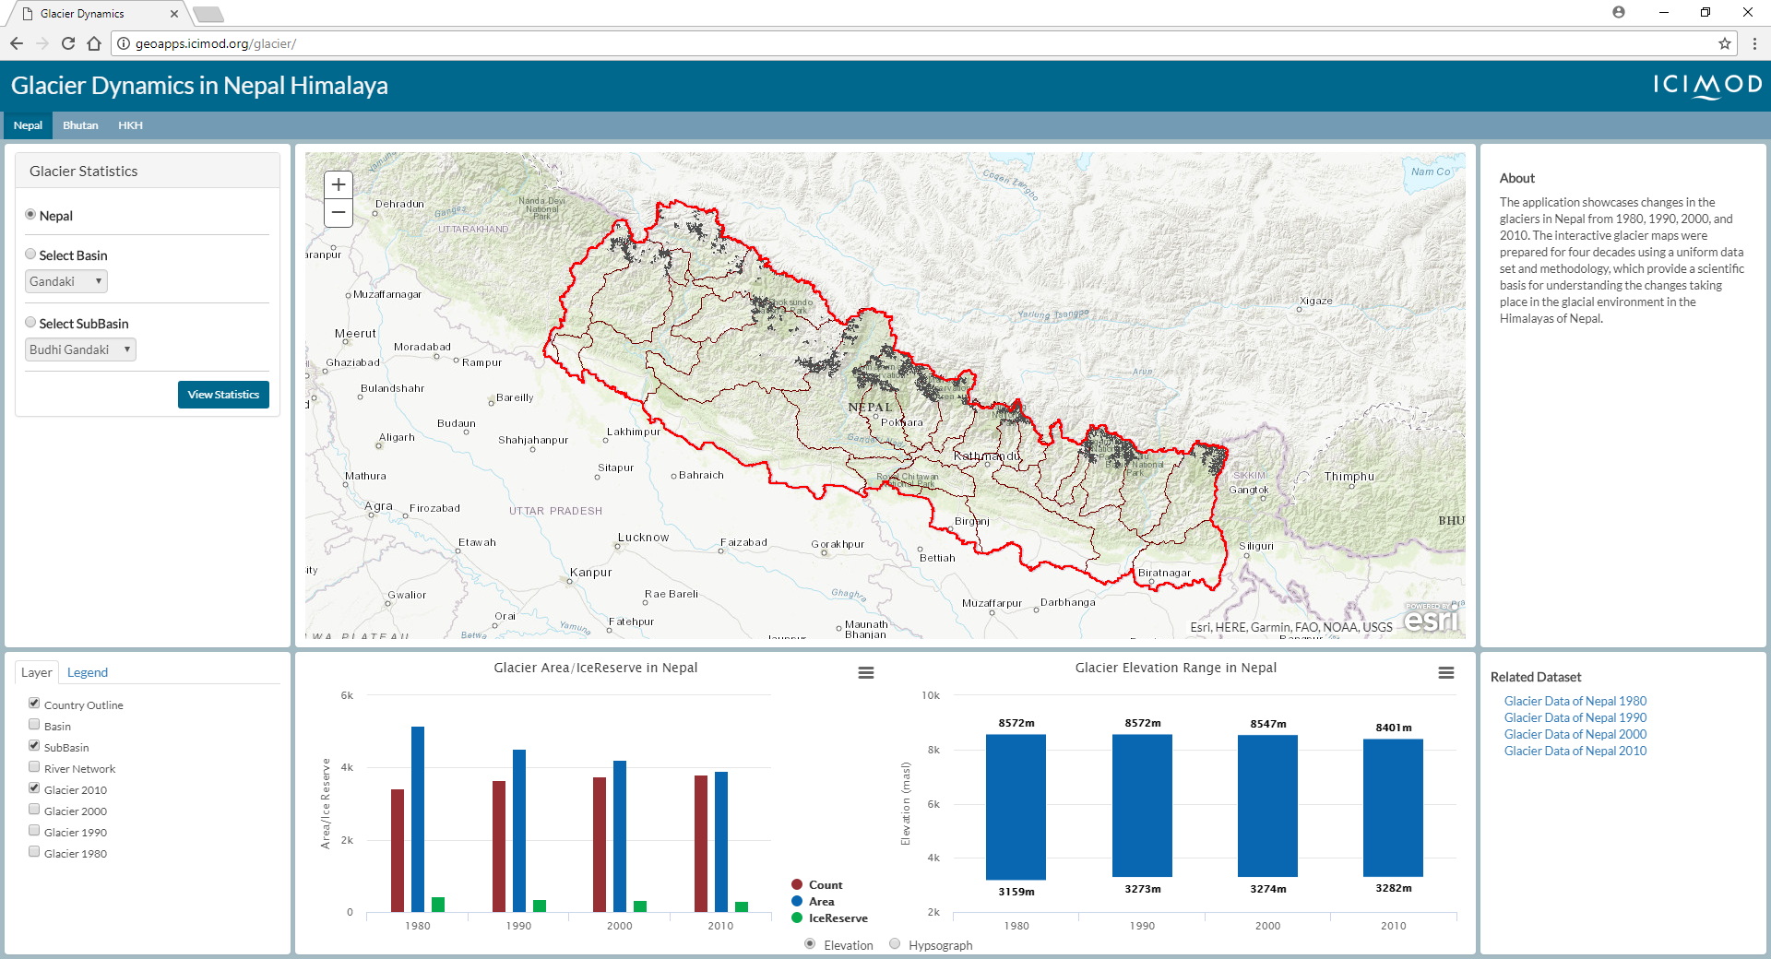
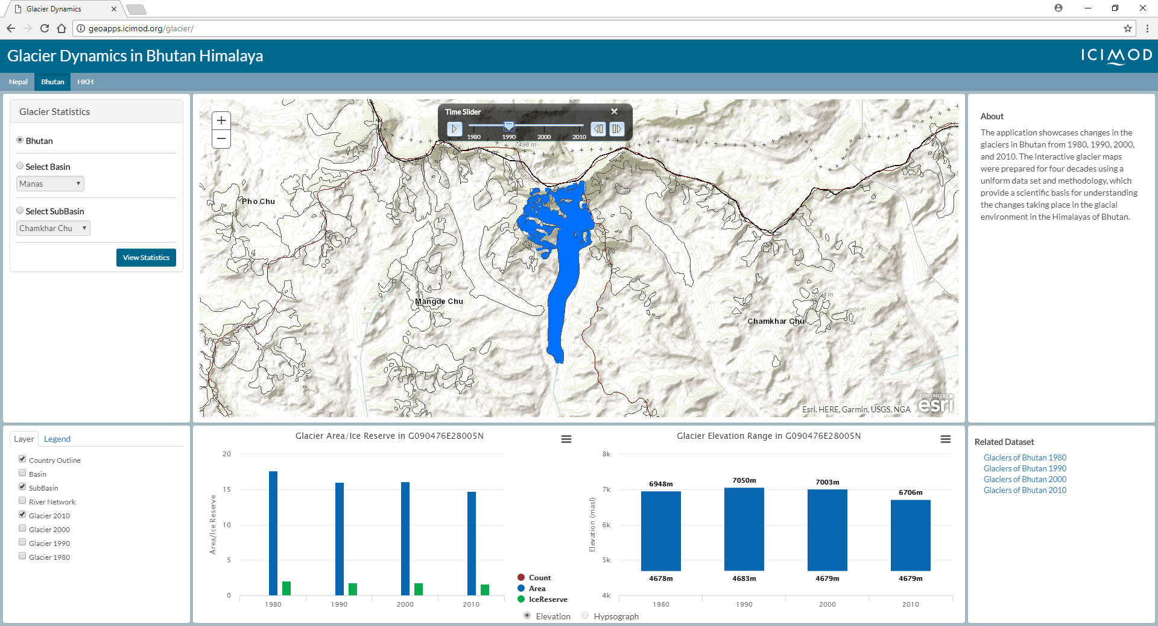
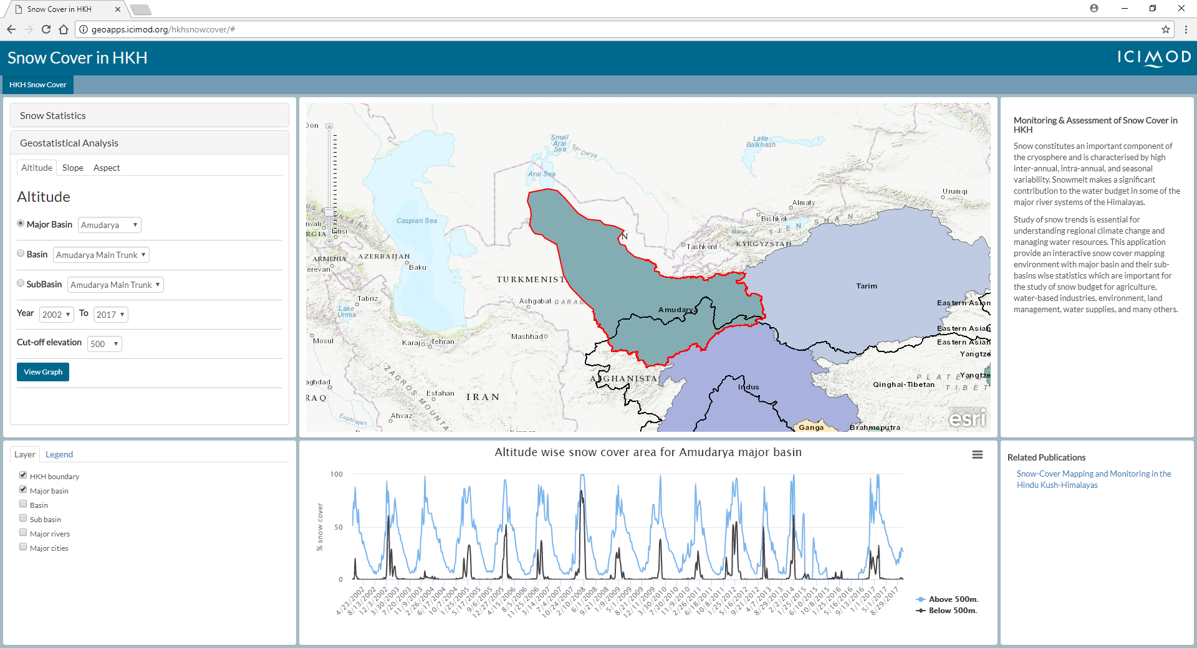
Cryosphere

Slide 14
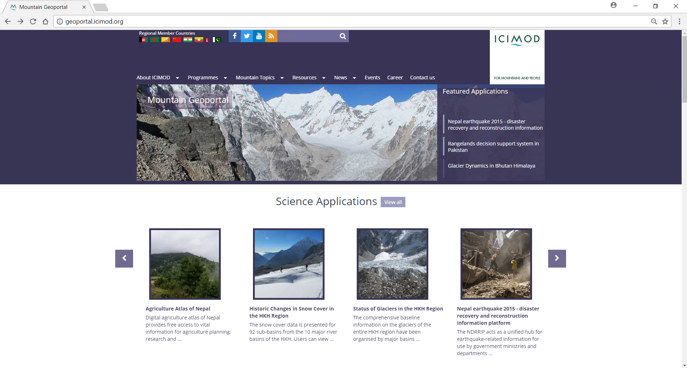

Slide 15
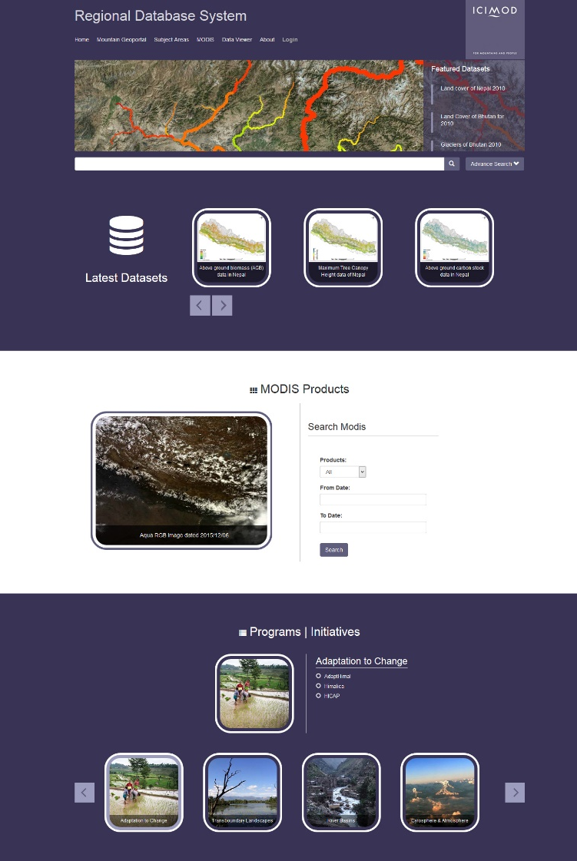
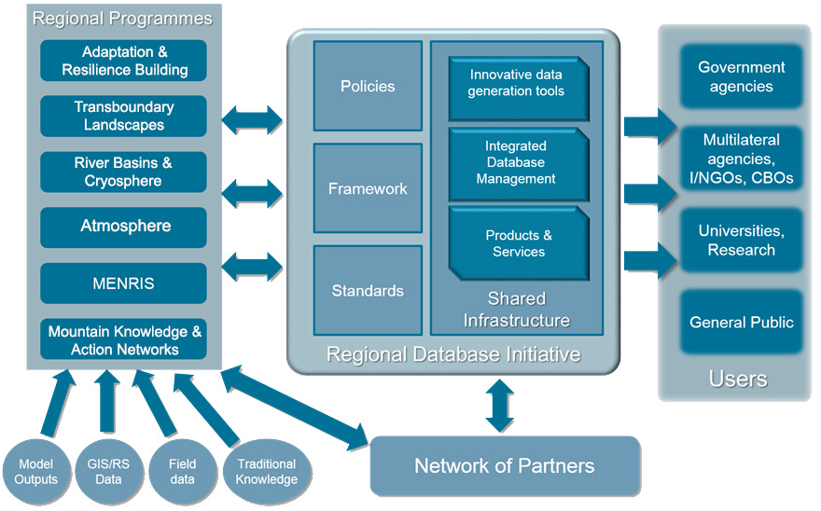
Regional Database System
A central data repository for different thematic areas in the Hindu Kush Himalayan (HKH) region
Provides easy access to the data through a web-based portal.
As part of establishing the RDS, ICIMOD has put in place:
Infrastructure to facilitate storage and management of data
Adoption of data and metadata standards
Data sharing policy and operation guidelines
Regional Database Framework
rds.icimod.org
Notes:
The Data Sharing Policy facilitates data sharing in the region and among the global community, enabling data use beyond the original research, and has been aligned with the philosophy of open and free access to scientific information and knowledge.

Slide 16
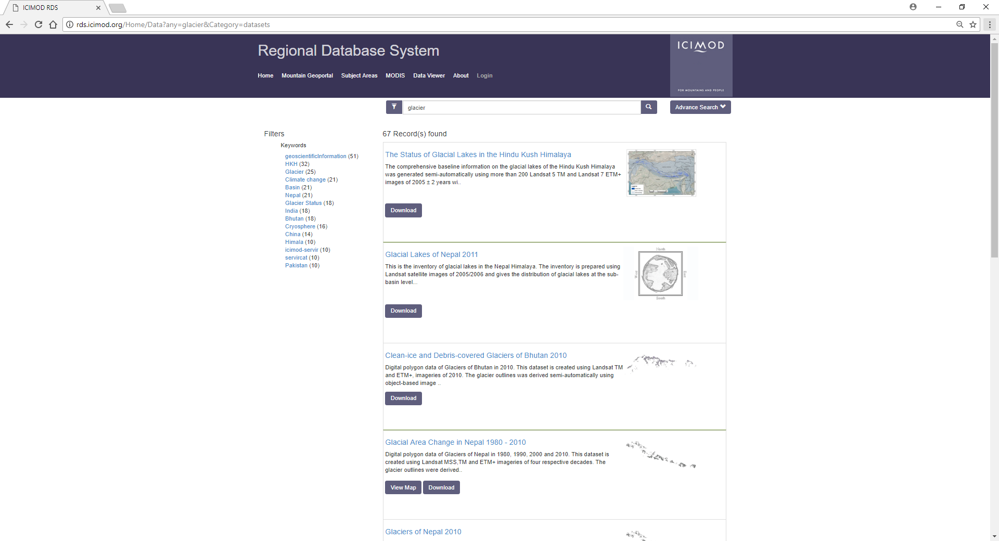

Slide 17
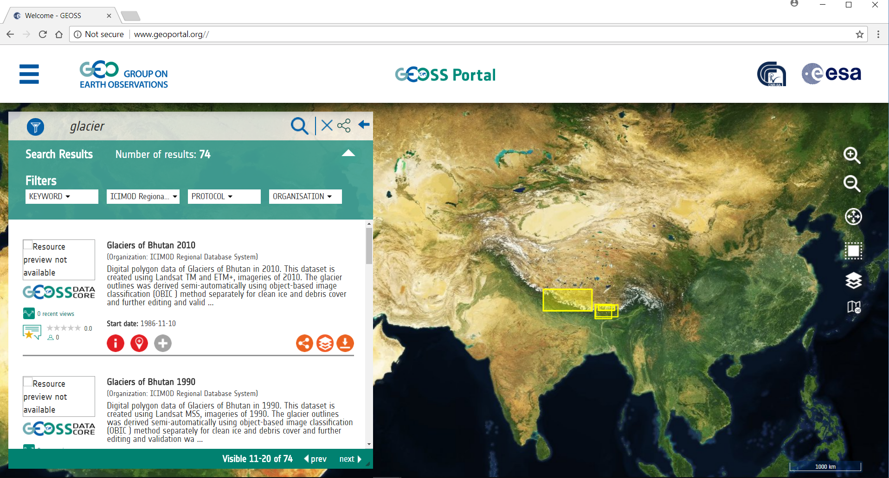
ICIMOD RDS datasets discoverable through GEOSS GeoPortal
Notes:
ICIMOD and GEOSS collaborated together to broker ICIMOD’s metadata catalogue through GEOSS Common Infrastructure allowing searching of datasets stored in ICIMOD’s Regional Database System (RDS) through the GEOSS GeoPortal

Slide 18
Thank You

