Slide 1
Session 5: The Role of Regional and National GEOSS
EUROGEOSS
Dr. Michel Schouppe, EO Research and Innovation Policy Officer, European Commission

Slide 2
Four Regional GEO Initiatives
AfriGEOSS (2014)
AmeriGEOSS (2015)
AOGEOSS (2016)
New: EuroGEOSS (end 2017)
EuroGEOSS seeks for cooperation with other regional initiatives to implement an all-encompassing GEOSS

Slide 3
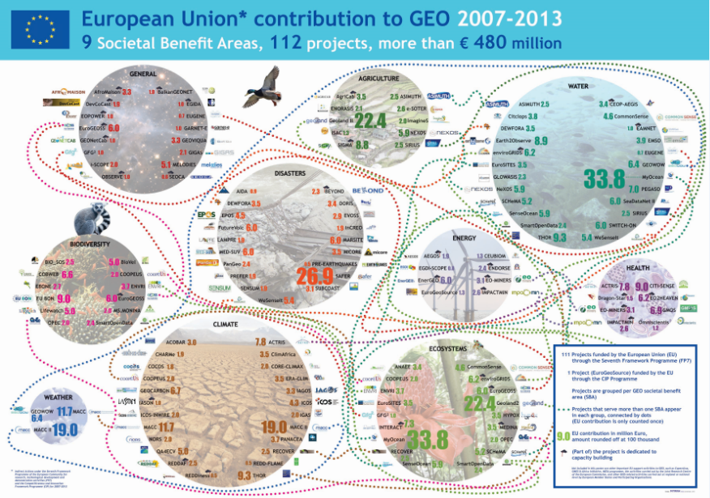

Slide 4
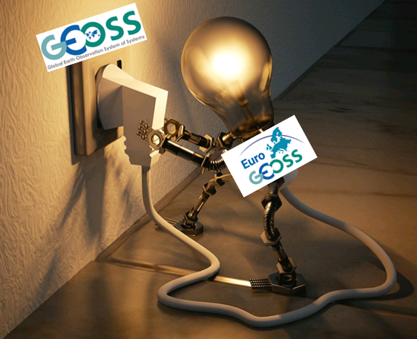
EuroGEOSS: the European gateway to GEO
Objective is to significantly increase the benefits for Europe and for GEOSS of its participation within GEO
Uptake of GEOSS assets by European users
Leverage internationally European EO assets
Application oriented, Reinforcement of a user-driven GEOSS
Based on existing developments, integrate scattered efforts (e.g. Horizon 2020, Copernicus, ESA, national initiatives)
Contribution to the SDGs, the Paris agreement, the Sendaï framework, the GEO SBAs and the implementation of EU (environmental) policies
Piloted by the European GEO Caucus and chaired by the Commission

Slide 5
Inventory of EO development & innovation actions
Up-scaling of EuroGEOSS pilot applications
Showcasing of European know-how with relevance to GEO
Linkages between EuroGEOSS applications and other GEO actions
Consolidation of national GEO management structures

Slide 6
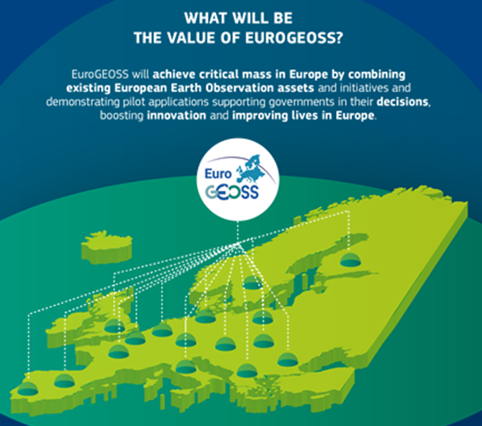
EuroGEOSS added value
Promote, demonstrate, scale-up EO applications benefiting from integrating datasets available through GEOSS
In association with European end users
Act as incubator with Copernicus

Slide 7
Key elements of EuroGEOSS-Copernicus interaction
The EuroGEOSS initiative has the potential to considerably enrich the downstream part of the Copernicus ecosystem by triggering a range of new applications for end users.
The GEOSS platform and the Copernicus DIAS (Data and Information Access Services) will enable the development of EuroGEOSS applications by providing the "back-offices" for discovering, accessing and processing Copernicus and other GEOSS data and products.
EuroGEOSS can "attract" additional GEOSS data (including in situ data) to the Copernicus innovation ecosystem in Europe.

Slide 8
Nine priority SDGs for EuroGEOSS
Strong environmental & geospatial dimensions
Big drivers for policy-related environmental information
Cover all GEO engagement priorities
Well correlated with GEO SBAs and the Copenicus Core services
Critical mass potential in Europe
Implications at European to local scales for civil society, public authorities and companies

Slide 9
Two complementary routes to help delivering EuroGEOSS applications
Fixed term projects from funding programmes such as:
Horizon 2020
Copernicus
Other EU programmes
ESA
National programmes
Open innovation partnerships
To collaborate, benchmark, combine existing developments
To leverage along the value chain
GEO collaborative spirit
9

Slide 10
EuroGEOSS Request for Expressions of Intent
To survey current EO innovation actions across Europe
To facilitate partnerships for scaling-up EO pilot applications fulfilling the EuroGEOSS selection criteria
Implemented via EO service Communities of practice to:
Accelerate innovation from demonstration to market
Improve ways to combine EO supply and demand
Break down research and innovation silo’s
Pool EO expertise / resources along the value chain
Mobilize stakeholders and users at EU and (sub)national levels
Make best use of existing R&I instruments in Europe

Slide 11
What EuroGEOSS deliverables??
Real life, user-driven demonstrated EO applications
Reviews of user-related experience and questions
Catalogues of good practices available in different languages
Strategies for scaling-up new services
Guidelines for business models, evidences on return on investment
Innovative procurements of interoperable innovative solutions
Innovation deals in the field of service solutions
Reference site with high potential for replication in Europe
Synergies with H2020 projects
Awareness raising campaigns, education and training modules
Emerging themes of novel interest for European R&I

Slide 12
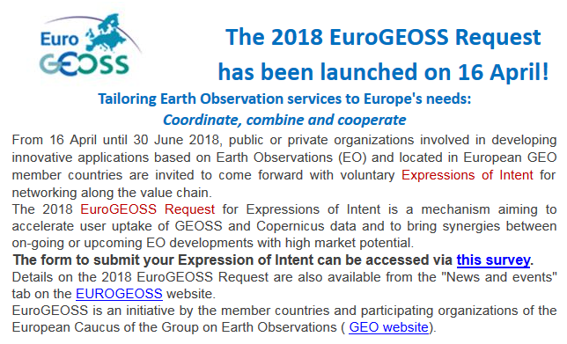
EuroGEOSS survey: https://ec.europa.eu/eusurvey/runner/EuroGEOSS2018survey

Slide 13
Thank you
Michel.Schouppe@ec.europa.eu

