Slide 1
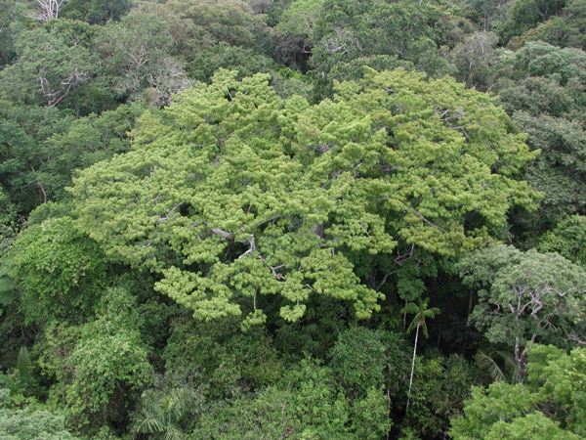

INPE’s Data Cube: results and perspectives
Gilberto Camara and
e-sensing and RESTORE+ project team

Slide 2
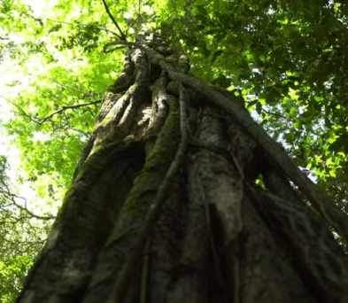
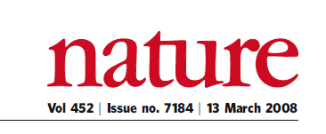
“A few satellites can cover the entire globe, but there needs to be a system in place to ensure their images are readily available to everyone who needs them. Brazil has set an important precedent by making its Earth-observation data available, and the rest of the world should follow suit.”

Slide 3
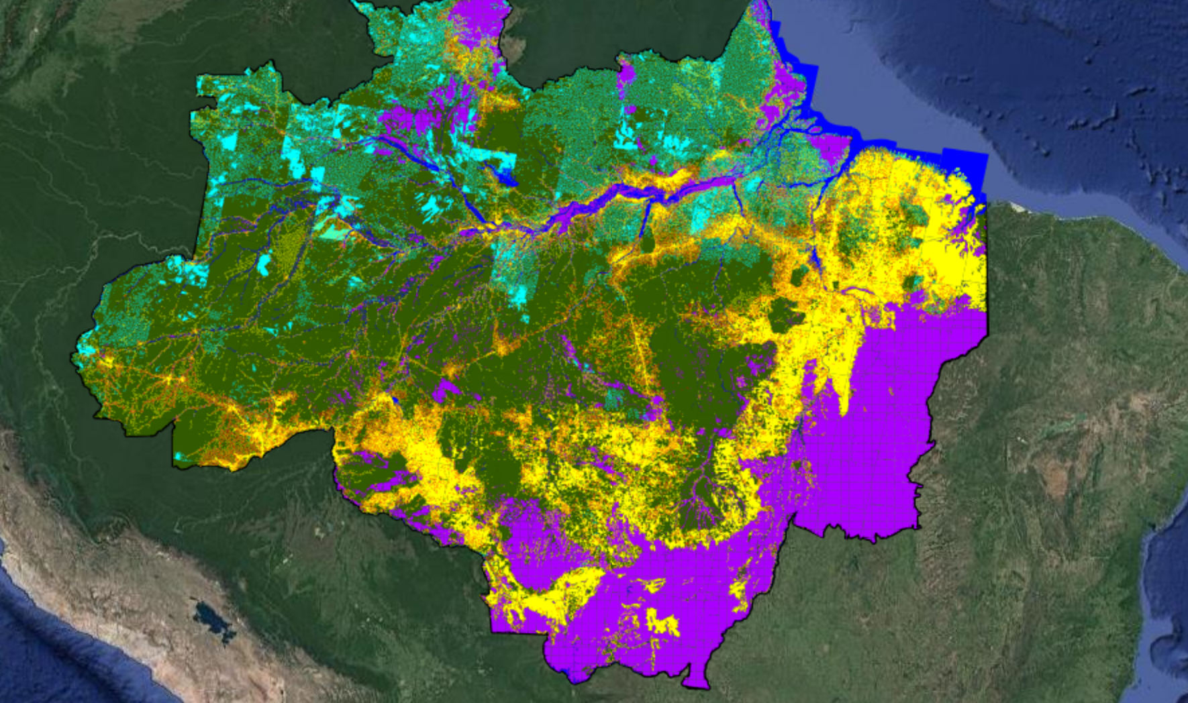
Transparency builds governance!
Science (27 April 2007): “Brazil´s monitoring system is the envy of the world”.
Notes:
Este slide mostra uma imagem CBERS-2B da região de Marcelândia, norte de Mato Grosso. A imagem foi composta por uma imagem monocromática de alta resolução HRC (2,5 m) com uma imagem multespectral CCD (20 m). A imagem mostra que é possivel identificar com o sensor HRC, alem de desmatamentos por corte raso (áreas claras na imagem), as áreas de degradação florestal (áreas verdes com partes claras).

Slide 4
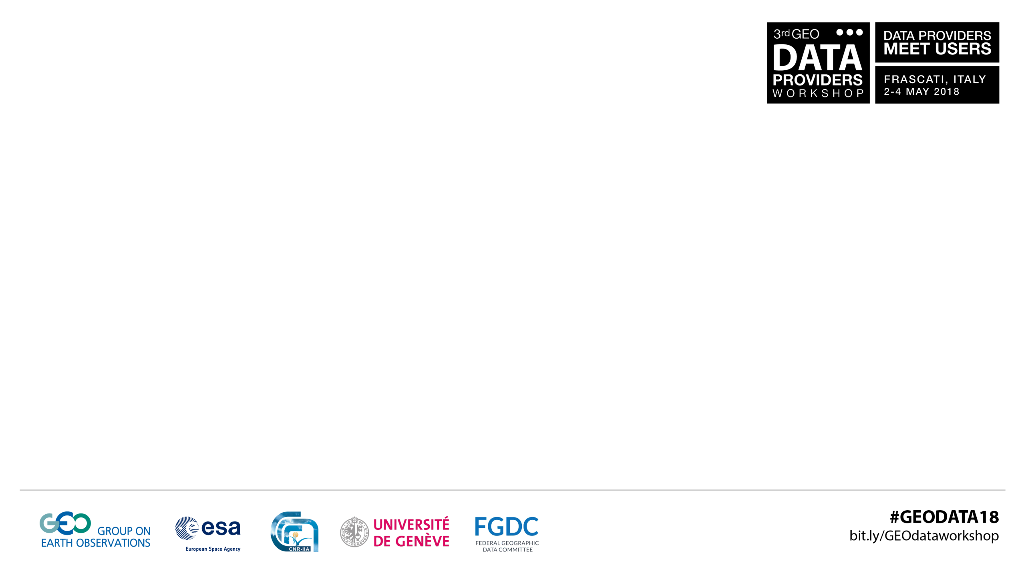

section title / slide title

Slide 5
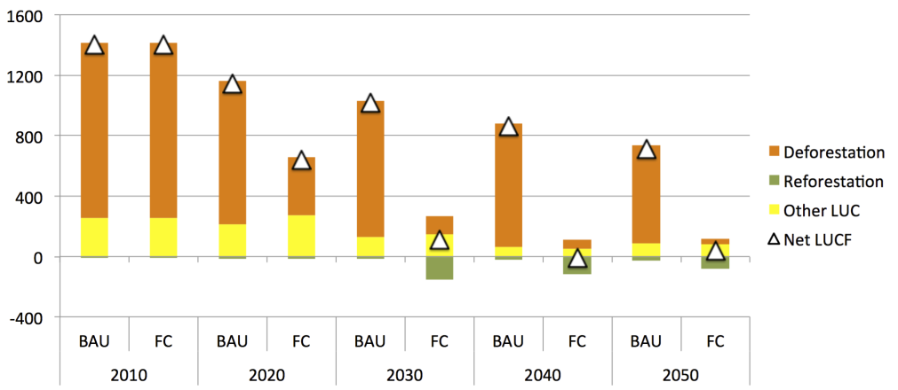
Brazil’s NDC (Paris Agreement): zero net deforestation

Slide 6
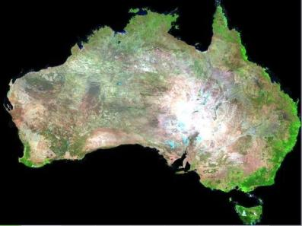


Big data requires new concepts
How best to use the information provided by big data sources to support public policies in Brazil?

Slide 7


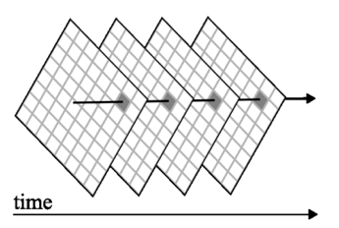
Needs
Design
Analytical scaling: from the desktop to the cloud
Image time series data analysis
Collaborative work: share results
Cloud computing
Replication: countries build their own infrastructure.
Data cubes optimized for time series

Slide 8
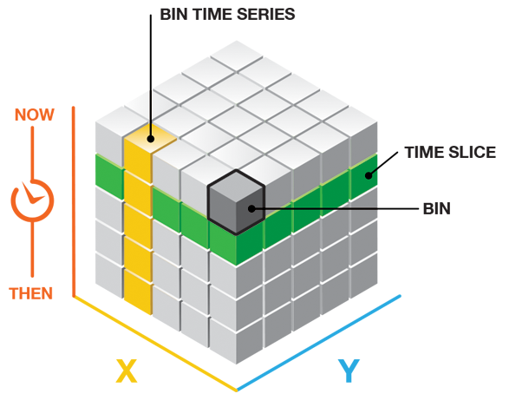
Not all data cubes are alike!
Google Earth Engine: 2D images over multiple machines (good for space-first, not fit for time-first)
INPE’s Data Cube: temporal bricks (good for time-first, not so good for space-first)

Slide 9
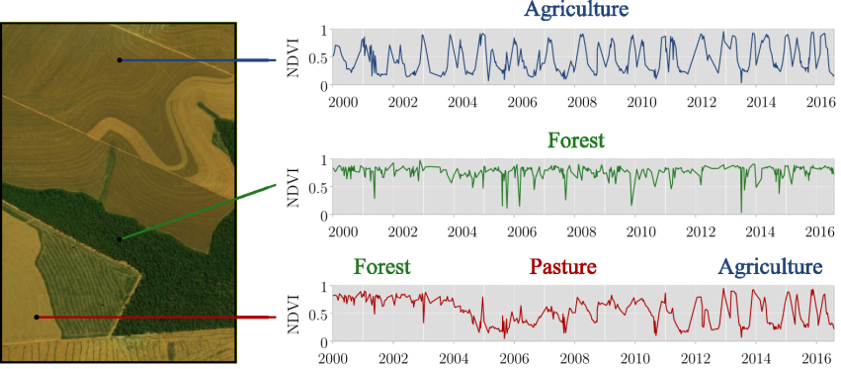
Land system trajectories

Slide 10
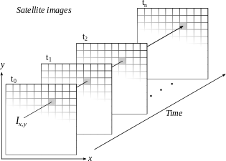
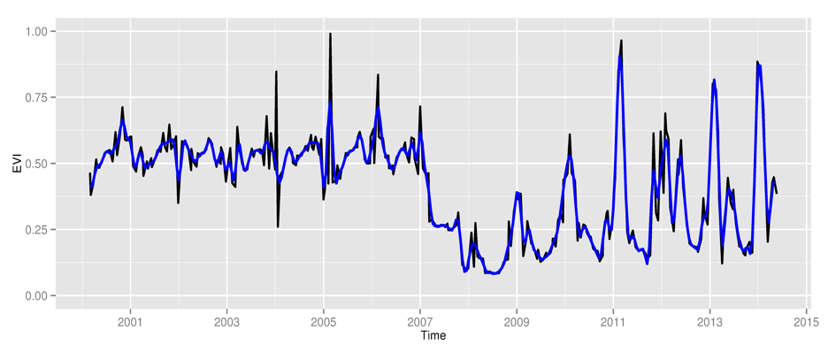
Space first: classify
images separately
Compare results in time
Time first: classify
time series separately
Join results to get maps

Slide 11
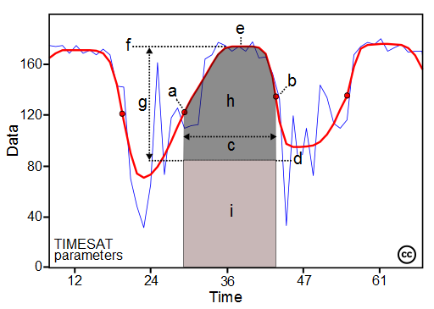
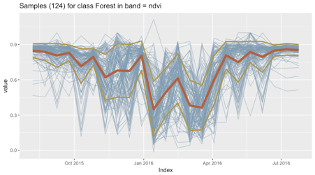
section title / slide title
Dimension reduction
(best pixel, inflection indicators)
High-dimensional space
(machine learning)
Use all of the data

Slide 12
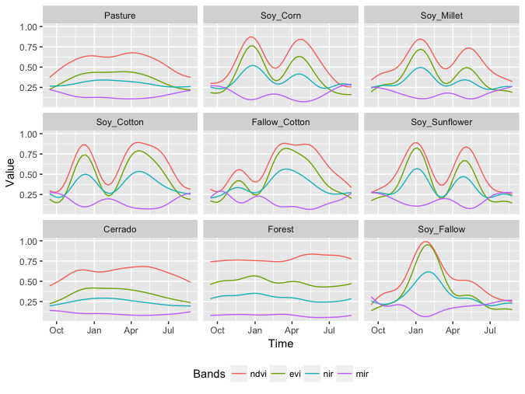
Temporal patterns of
different classes

Slide 13
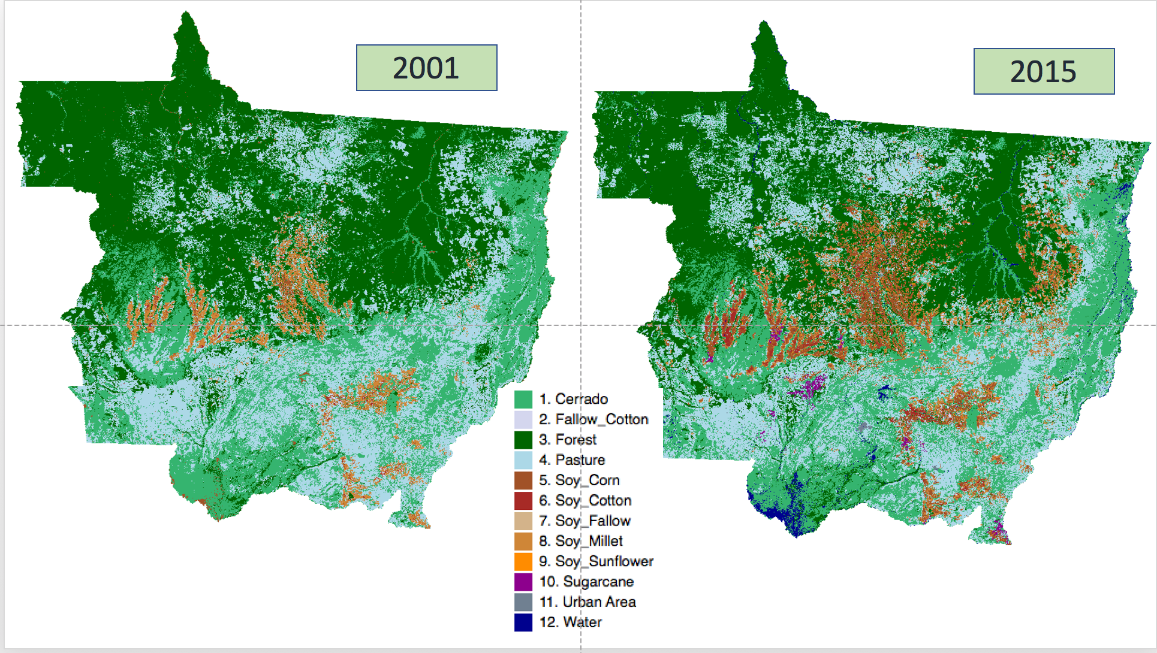
Mato Grosso: Brazil’s agro frontier

Slide 14
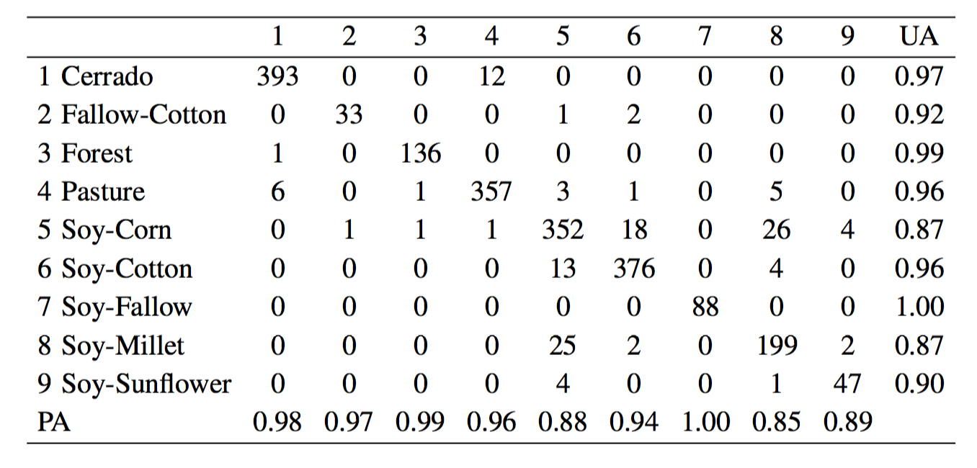
5-fold data validation
section title / slide title

Slide 15
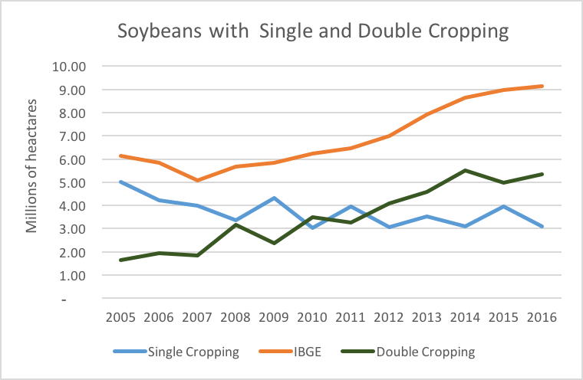
Impact of agricultural productivity

Slide 16
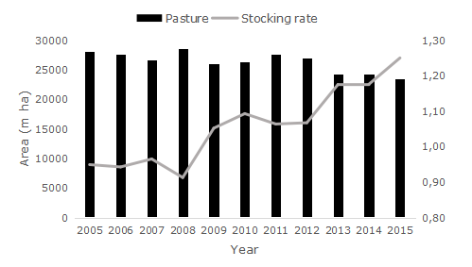
Pasture and stocking rate change

Slide 17
Vapnik: on solving complex problems
Einstein said “when the solution is simple, God is answering”. He also said “when the number of factors coming into play is too large, scientific methods in most cases fail”. (…) In a complex world one should give up explainability to gain a better predictability.

Slide 18
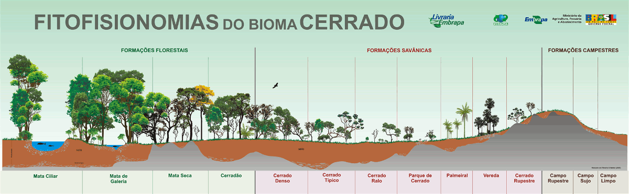
Cerrado: tropical savanna (2.0 million km²)

Slide 19
Samples for Cerrado (64,545): 5 layers of 512 neurons, ”elu” activation, dropouts (0.50, 0.40, 0.35, 0.30, 0.25, 0.20) adam_optimizer
section title / slide title
Estimated accuracy: 95.7%

Slide 20
1 year, 23 instances, 4 bands, 1 scene: 35.4 GB
65,530 samples, 13 LULC classes
1h30 processing in Amazon EC2/S3 (40 CPU, 160 GB)
90% match with visual interpretation
section title / slide title

Slide 21
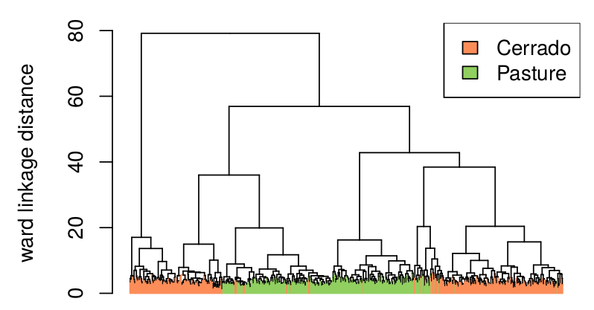
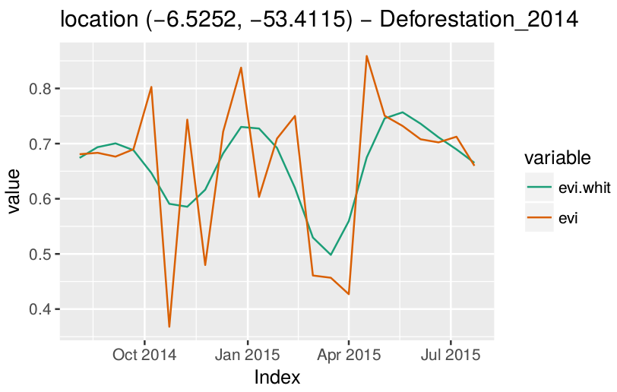
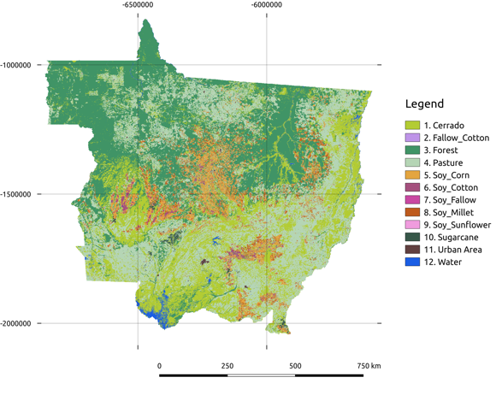
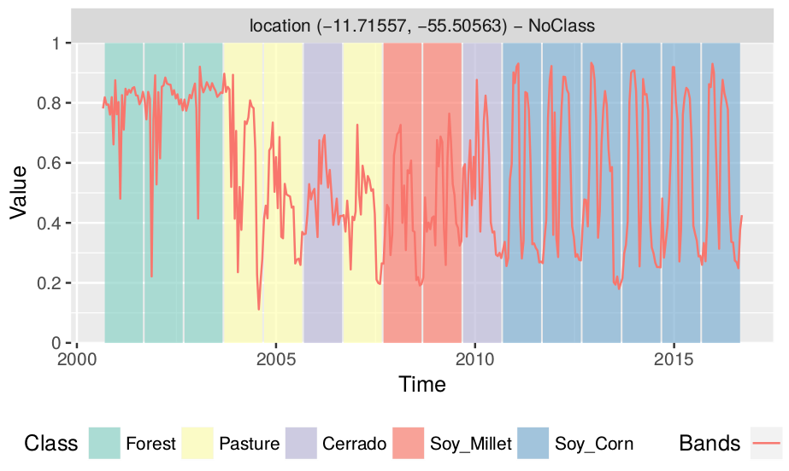
SITS – an R package for image time series
section title / slide title
https://github.com/e-sensing/sits

Slide 22
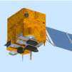
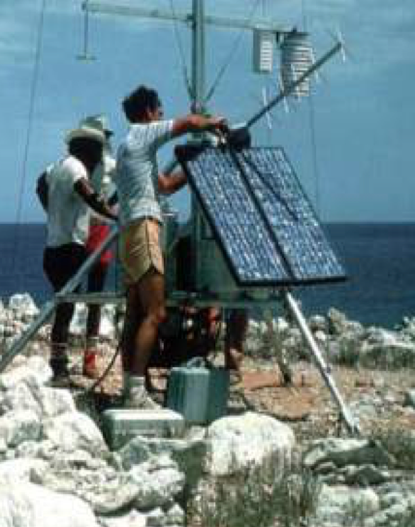
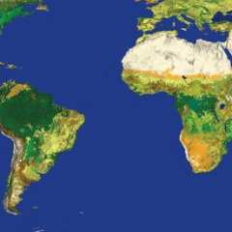
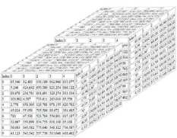


Multisensor data
Innovative, shared algorithms
Flexible data cube architectures
In-situ observations
Realistic case studies and research investment

Slide 23
Thank you!
Financing sources:
FAPESP (São Paulo Research Foundation): e-sensing project
ICI (Germany Int Climate Initiative): RESTORE+ project

