Slide 1
DIAS (Data Integration and Analysis System): Disaster Applications for International Collaboration Dr. Asanobu KITAMOTO, National Institute of Informatics, Japan

Slide 2
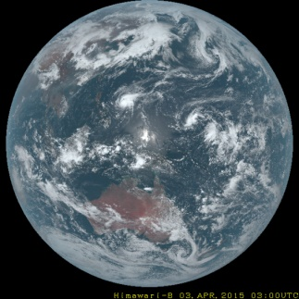
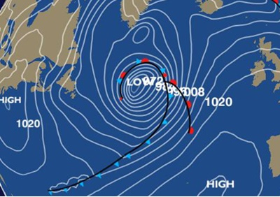
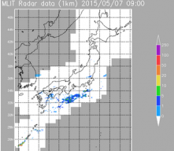
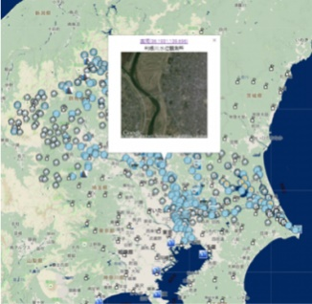
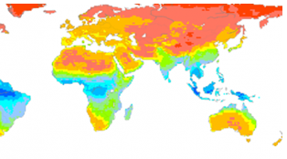
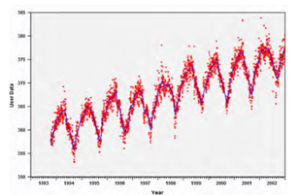
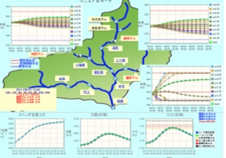
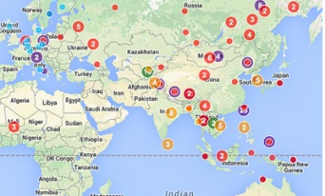
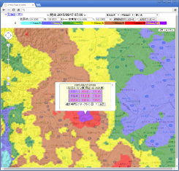
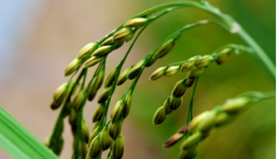
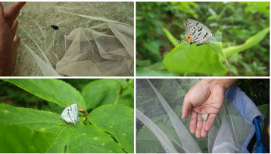
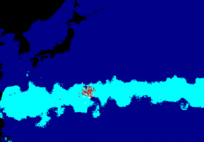
On-site, satellites, and simulations
Data Dissemination
Himawari-8 Satellite
Weather Forecast GPV
Radar Data
River Telemeters
1. Climate
2. Water
CMIP5 Model
Visualization Tools
Dam Control
Water Management
3. Agriculture
4. Biodiversity
Potential of Rice Crops
after Climate Change
Citizen science-based
observations
Fish eggs and growth
distribution
Accumulated radar rainfall

Slide 3
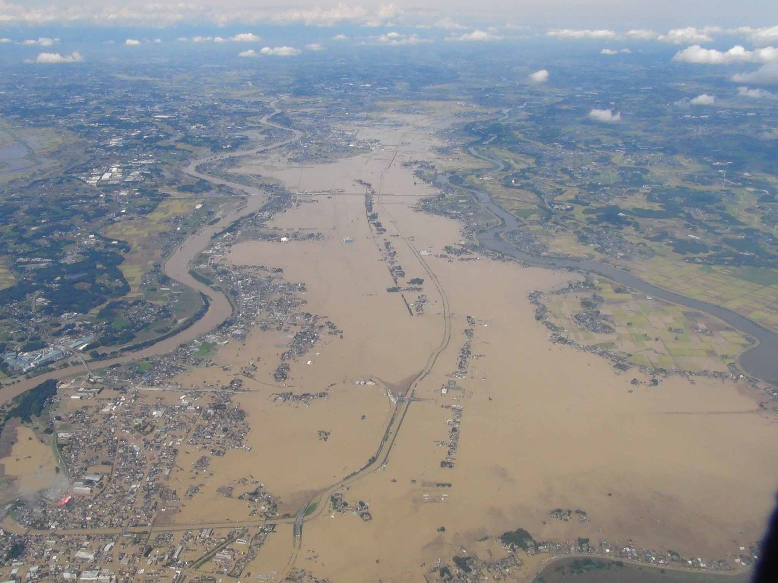
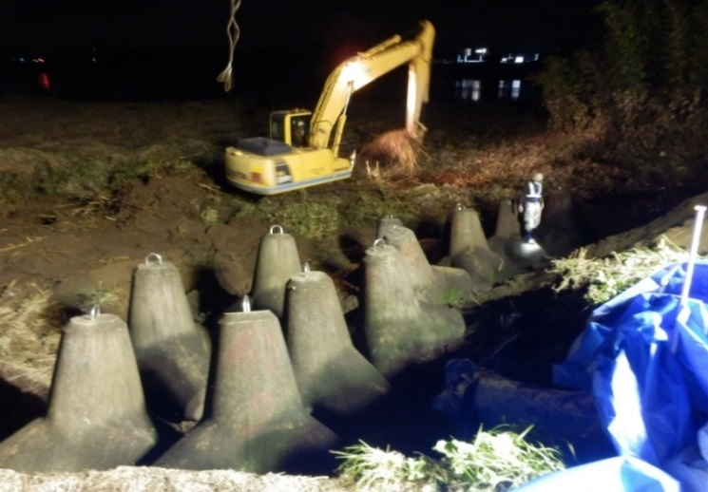
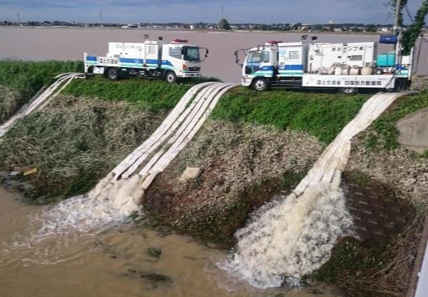
2015 Kinugawa River dike break (Dike rebuilding: 7 days, drainage: 10 days)
Break point
Kogaigawa Riv.
Kinugawa Riv.
Dike recovery work
Source: MLIT., http://www.mlit.go.jp/common/001105761.pdf
Drainage with pump

Slide 4
Realtime Data
Observerd by points
Radar, Numerical prediction
Telemeter data
Temperature
Radar Precipitation (C-band)
Numerical Weather prediction (GPV)
River flow/water level
Dam outflow
Wind Speed
Precipitation
Hours of sunlight
Dam water level
Amount of water reserved in dam
Realtime System
External force of model by Spatial Information processing
Prediction System
Soil moisture and river flow calculated on realtime system
Spatial information
Processing of C-band, GPV
Ensemble rainfall prediction
降水パターン1
WEB-DHM (Water cycle model）
降水パターン2
Rainfall Pattern N
Ensemble Flood prediction
Soil Moisture
River Flow
Statistical Analysis
河川流量1
河川流量2
River Flow N
Table of Estimated Prediction Error

Slide 5
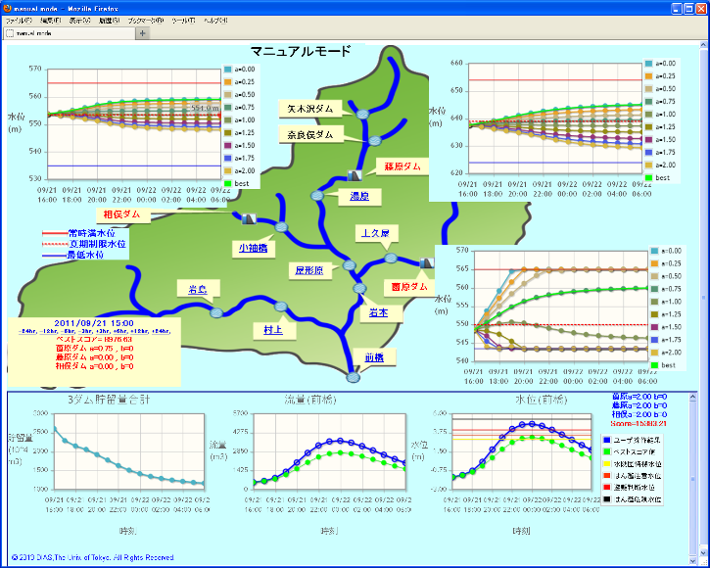
Simulator of Dam Operations

Slide 6
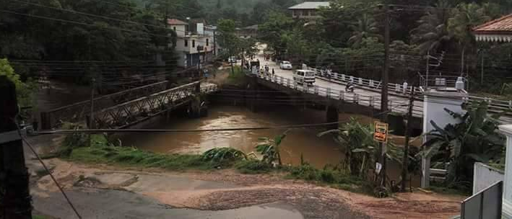
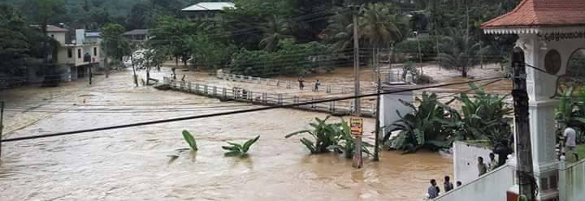
Heavy Rain and Floods in Sri Lanka (May 26, 2017)
08:00, 26May 2017
13:00, 26May 2017
Notes:
(画像を小池先生からいただきました)

Slide 7
Sri Lanka
Notes:
(このスライドは小池先生からいただきました。)
<Institutional Structure of the Platform on Water-related Disasters>
IFI(下記参照)でスリランカ政府として表明しているInstitutional Structure です。
この図は2017年の災害よりも前に作られていますが、たびたび起こる災害に対して、国際機関とコラボしてプラットフォームの構築の検討がされてきました。
International Flood Initiative (IFI) is a joint initiative in collaboration with such international organizations as UNESCO-IHP, WMO, UNISDR, UNU, IAHS and IAHR since 2005. ICHARM is the secretariat of IFI.
http://www.ifi-home.info/

Slide 8
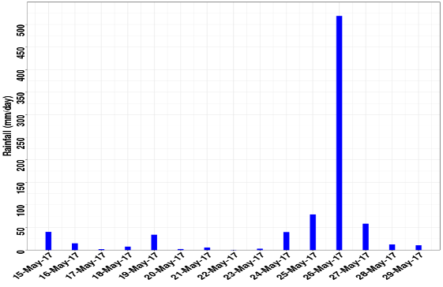
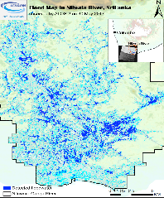
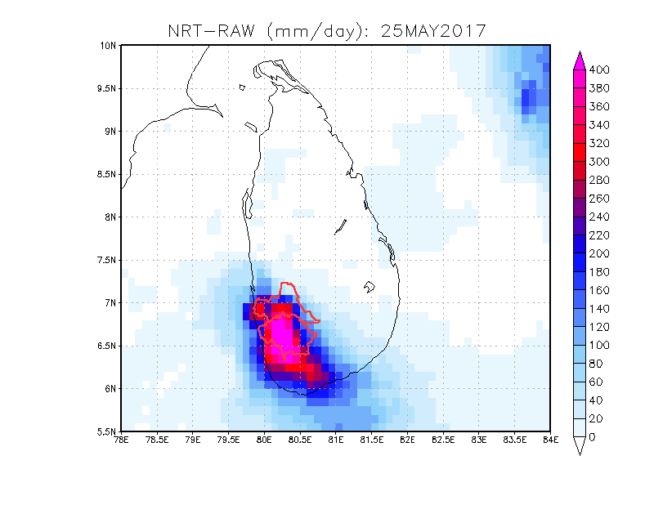
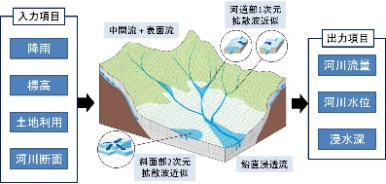
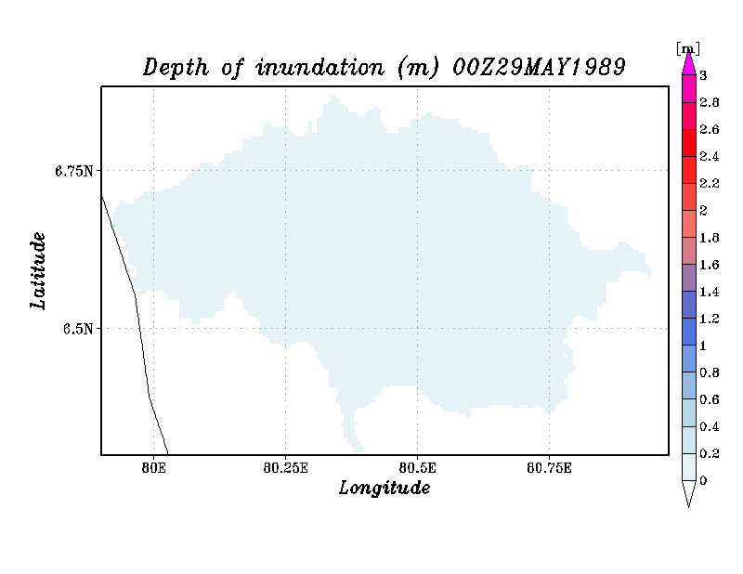
DIAS-ICHARM: Flood Information Sharing Support in Sri Lanka
Implemented by EDITORIA and ICHARM on DIAS
500mm
ALOS © JAXA (2016)
In-situ rain gauge data (6 numbers)
Satellite precipitation data（GSMaP）
Ensemble forecasting rainfall for the next 16 days (max)
Himawari-8 cloud images
Inundation map by satellite data (ALOS-2)
Real-time Rain Gauge Data
4 hr latency data (NRT)
Real time data (NOW)
Calibration
On-line Information provision on DIAS：In-situ rainfall, satellite rainfall, calibrated and forecast rainfall, inundation simulations
Inundation analysis by using RRI in DIAS
Concept of RRI model
Simulation and forecasting of river discharge, water level, inundation extent
Bias-corrected Satellite Rainfall
Inundation analysis results
Ensemble
Flood
Prediction
72hr
11ensemble
every 24hr
Issued on May 24
Issued on May 25
Inundation
Notes:
(このスライドは小池先生からいただきました。)
DIASはICHARMとコラボし、前スライド下側のターゲット１に対して、Flood Information Sharing Support を現在行っています。
(DIAS-ICHARMによるサポートの概要です)
＜アニメーション＞
雨量を観測し、
DIASにリアルタイムで転送し、現地観測以外の雲や降雨等の衛星データをDIASに蓄積を行ってステークホルダーにデータ提供を行います。
得られたデータから降雨マップのバイアス補正を行い、
現在の洪水深を計算します。
降雨予測データなどから72時間の洪水予測を行います。
これらの計算は全てDIASの計算機にて行われます。

Slide 9
Strength of DIAS
Data + Application: R&D community allows domain scientists to collaborate with computer scientists to create applications to solve new problems.
Diversity of Data: Ground observations to satellite data and simulation data are archived for data-driven decision making.
Data Management: our up-to-date metadata and data quality control lead to FAIR data.

Slide 10
Visit our Website!
http://www.diasjp.net/en/

