Slide 2
Data Providers Metrics Needs
Lionel Menard / Research Engineer / MINES ParisTech

Slide 3
From the ”Report of the 2nd GEO data Providers Workshop
Report on break-out sessions
Highlights the importance of statistics for providers (user contacts, search hits)
Having global statistics on data search (data type and location)
How data was used – statistics by who, from where
Statistics about number of dataset clustered by topic/region
Usability statistics
Important to have statistics and origin request
A Data providers dashboard showing statistics on my data catalogue including usage, data metadata quality metrics would be nice
Usage statistics sent via e mail to each provider including all errors regarding the datasets
Statistics: what type of users access which resources…
Statistics: no. of users accessing a given resource?
Compulsory: Access to the statistics has to be in real time for the data provider and for the operations
Researching the statistics of using of services – feedback;

Slide 4
Webservice-energy SDI
“GEOSS Facilitator” (We operate for the Energy community) since 2008
Gather, spread and promote the use of Earth observation data for Energy
Support GEO VENER (GEO Vision for ENERgy) initiative
Network of 20 resource providers
- Research & Gov. Ag., NGO, Industries, Companies, SMEs
SDI based on Open Standards (OGC, ISO, INSPIRE)
Link to GCI through our OGC/CSW Catalog
- Weekly harvested by the DAB -> GEOSS Portal

Slide 5
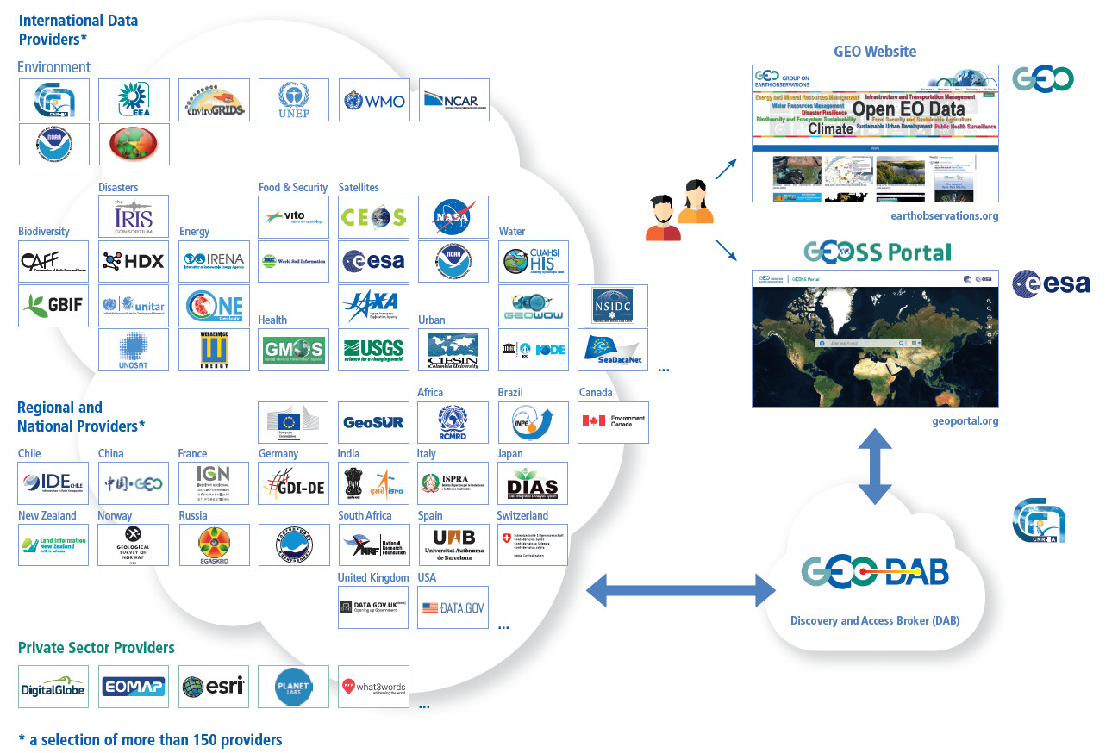
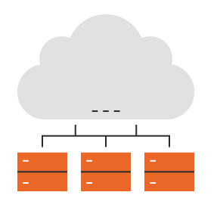
20 resource providers
80 harvested end-points
Over 1600 resources WS
95 % harvested

Slide 6
Current status regarding metrics
Quite good knowledge about webservice-energy SDI metrics
Internal statistical tools (GeoNetwork, Awstats, Google Analytics)
External status checker (FGDC Status Checker daily report)
GEO DAB statistics “big picture”
What I don’t know from the GEOSS Platform
Performance (metrics) of the information I provide or represent ?
Performance (metrics) of similar information (eg. Energy, solar, wind) ?

Slide 7
Data providers need for metrics
For any GEOSS registered data providers
Enable access to on-demand statistics of GEOSS Platform components
Expected benefits for data providers and GEO communities
Support data providers organization DMP (Discoverability, accessibility,…)
Reward data providers efforts regarding GEO recommendation on interop.
Better fine-tune information and metadata content
Improve global EO data quality

Slide 8
Thank you
Lionel.menard@mines-paristech.fr / webservice-energy.org / @OIE_MINESParis

