Slide 1
Coordinating and integRating state-of-the-art Earth Observation Activities in the regions of North Africa, Middle East, and Balkans and Developing Links with GEO related initiatives towards GEOSS
GEO-CRADLE
Addressing regional needs through DataHub
Dr. Panagiotis Kosmopoulos / National Observatory of Athens
The GEO-CRADLE project has received funding from the European Union’s Horizon 2020 research and
innovation program under grant agreement No 690133.

Slide 2
The GEO-CRADLE project
… is the only EU GEO funded CSA that runs over the
diversified territories of North Africa, Middle East and Balkans;
✔ Identifying common needs and regional priorities;
✔ Fostering the regional cooperation and integration of monitoring
capabilities and skills, and facilitating the networking of stakeholders;
✔ Defining coordination and support actions that are beneficial from societal
and market wise point of view, and also realistic and in line with the domestic priorities and user needs;
✔ Proposing/setting up large scale regional initiatives in Earth Observation (space based and in-situ)
relating to capacity building and delivery of services and innovative information in the thematic areas of the project such as:
Adaptation to Climate Change
Improved Food Security – Water Extremes Management
Access to Raw Materials
Access to Solar Energy
Objectives
Promote the uptake of EO services and data in
response to regional needs.
Support the effective integration of existing Earth Observation Capacities in the region.
Facilitate the engagement of the complete ecosystem of EO stakeholders in the region.
Enhance the participation in and contribution to the implementation of GEOSS and Copernicus in North Africa, Middle East and the Balkans.
Funded under H2020 - Climate action, environment,
resource efficiency and raw materials
ACTIVITY: Developing Comprehensive and Sustained
Global Environmental Observation and Information Systems
CALL IDENTIFIER: H2020 SC5-18b-2015 Integrating North African,
Middle East and Balkan Earth Observation capacities in GEOSS
Project GA number: 690133
Project coordinator: Haris Kontoes (NOA)
Total Budget: 2,910,800.00 €

Slide 3
GEO-CRALDE pilots
Adaptation to Climate Change (ACC)
Improved Food Security – Water Extremes Management (IFS-WEM)
Access to Raw Materials (ARM)
Access to Solar Energy (SENSE)
The Solar Energy Nowcasting SystEm (SENSE) pilot
Coordination of regional EO capacities & research activities (incl. Copernicus Space & Service Segment initiatives) for an operational, satellite-driven, real-time system for solar energy now-cast.
Purpose:
Demonstrate ways to maximize value and benefits at the Region of Interest.
Contribute to energy related capacity building.
Create synergies with public and private sector (solar plants, energy distributors, solar energy related end-users).
Provision of (tailored to end-user):
Now-casting and forecasting of solar radiation and solar energy
Long term solar energy atlases for various areas with high temporal and spatial detail
Solar radiation related products (real time and forecasts) related with: health (UV Index (melanoma), DNA damage, cataract, Vitamin D efficiency), agriculture (photosynthesis), scientific.
Showcase

Slide 4
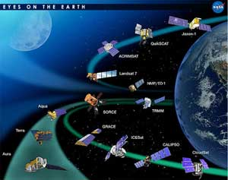
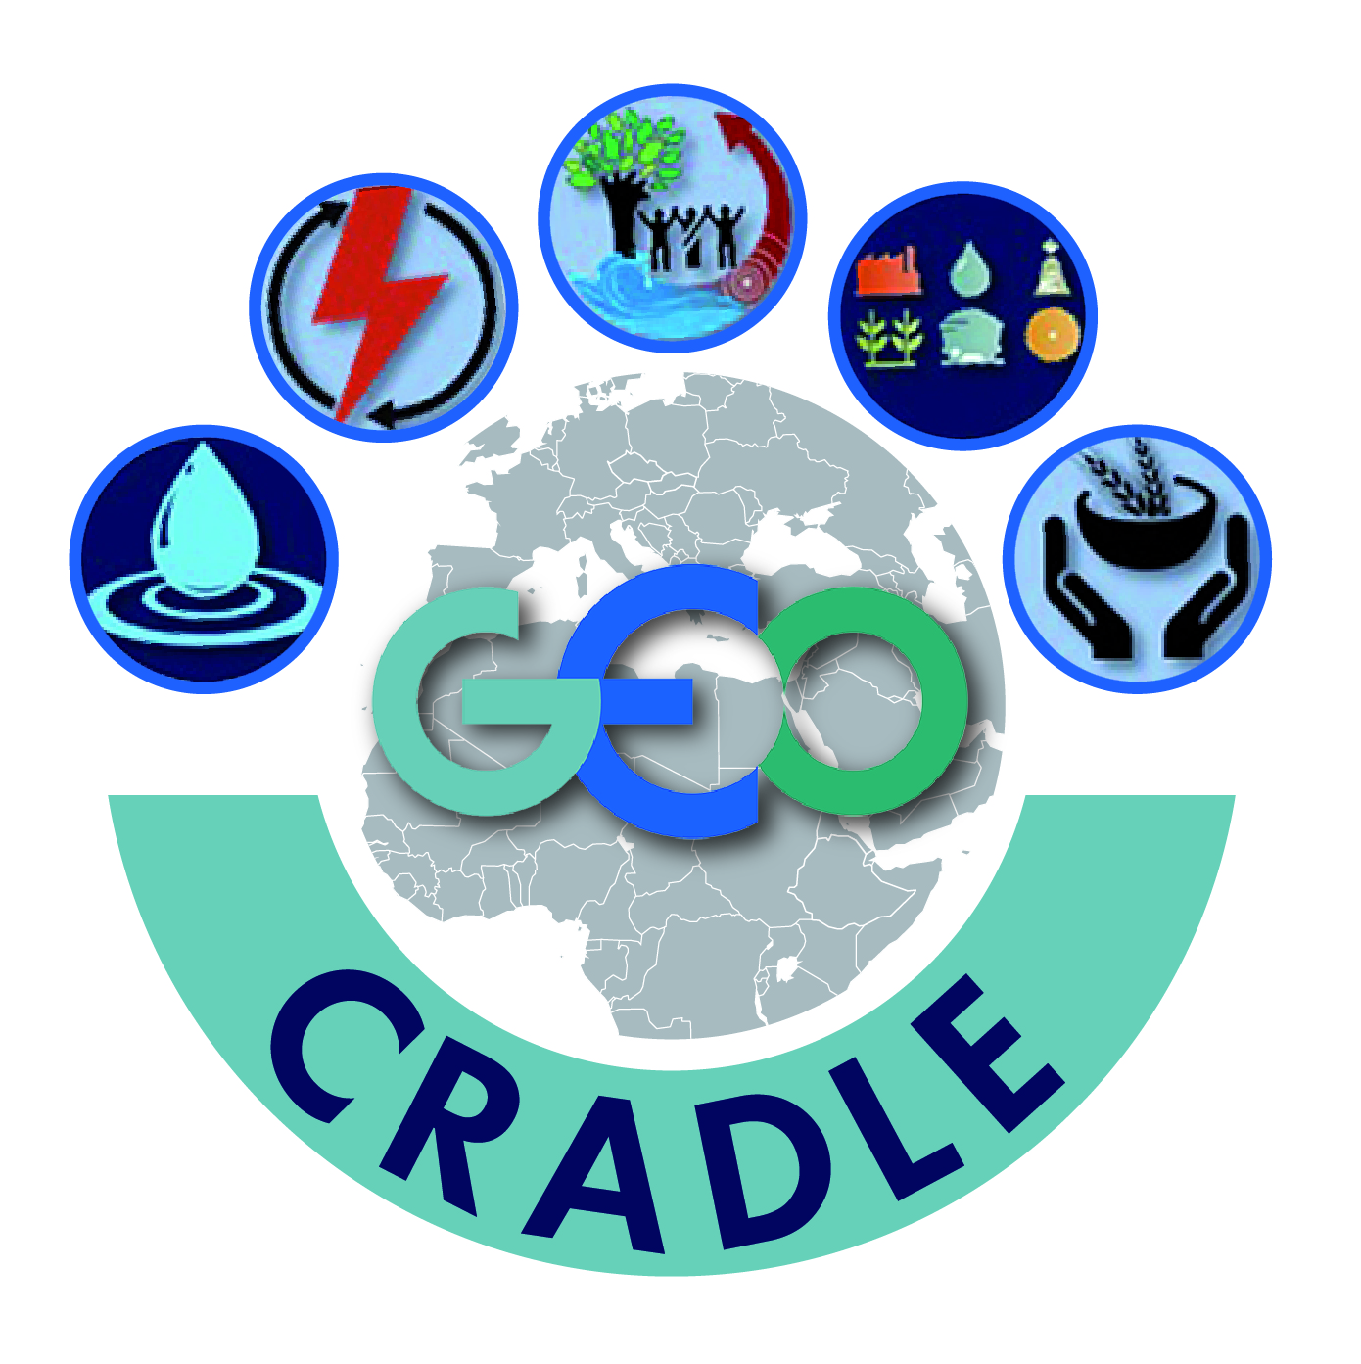
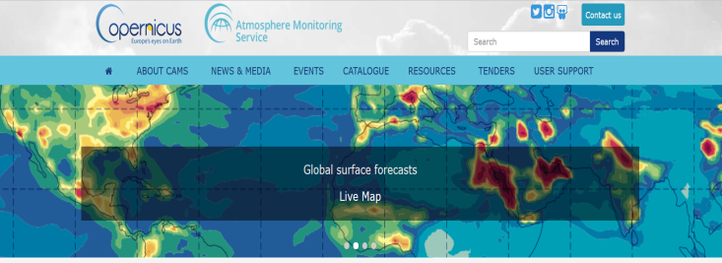
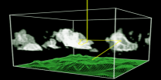
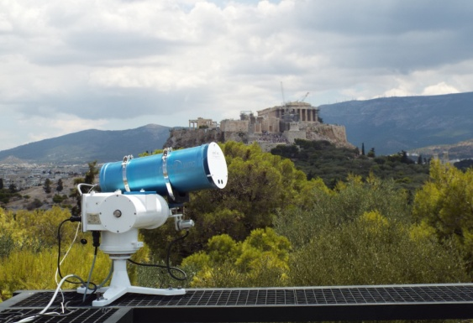
The SENSE pilot
Solar power production now-casting and forecasts, from t+0 min to t+2 hours ahead, with a time resolution from 5 minutes
Nowcasts and forecasts on different spatial horizons: from the local plant production to the country scale
integration in any already existing Information System. Possibility to add meteorological sensors on-site to optimize forecasts
Use of solar irradiance spectra for: Agricultural, health, biological and scientific application and studies
Users: Municipalities, private and government based Energy transmission operators, solar farms, renewable energy planning, smart phone apps, health and agricultural sectors, scientific community
Satellite Data
Radiative
Transfer
models
Neural
networks
End-users
Copernicus Atmospheric Monitoring Service
Actinometric platform

Slide 5
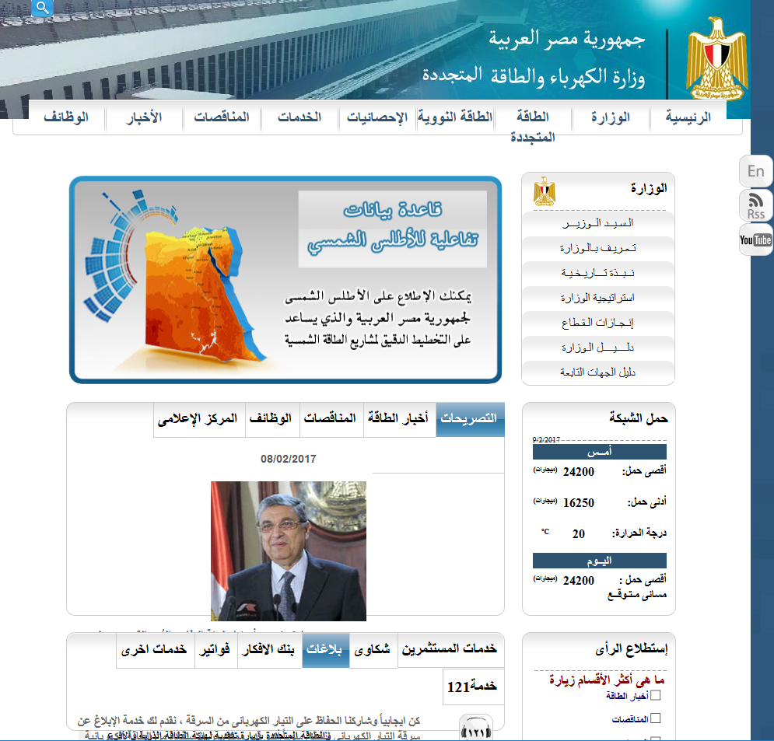
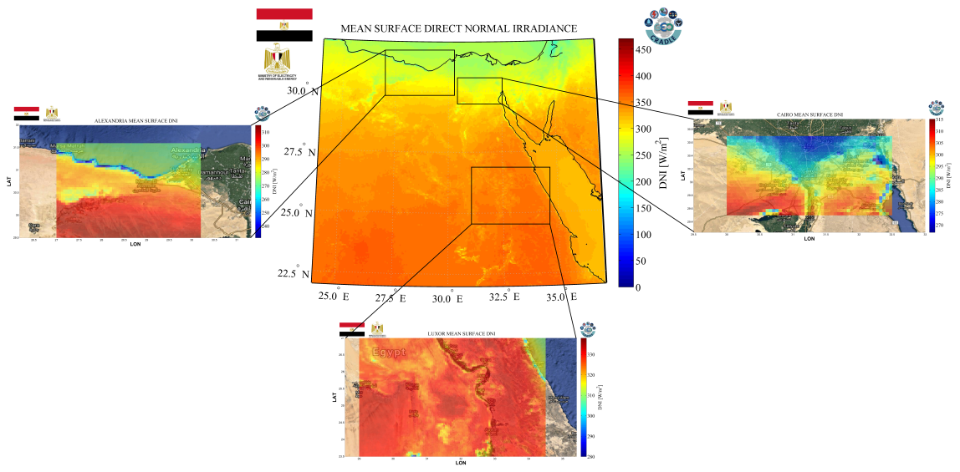
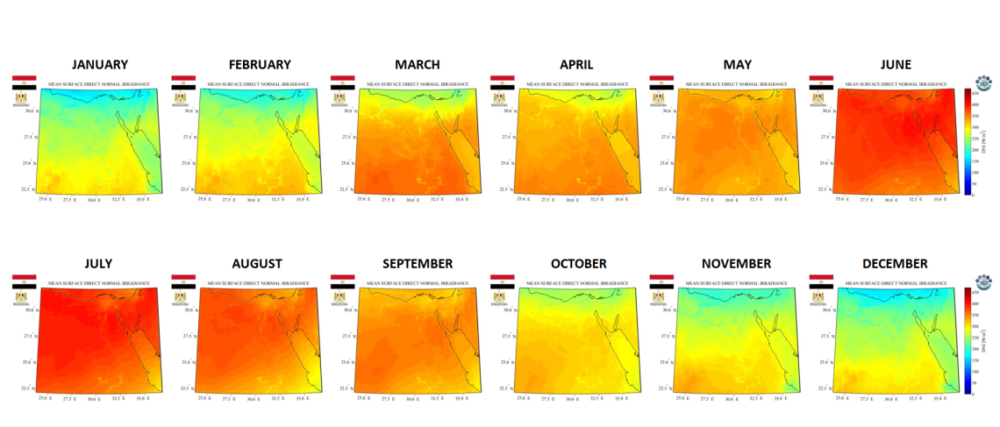
SENSE’s data provision
Real-time & solar atlas services

Slide 6
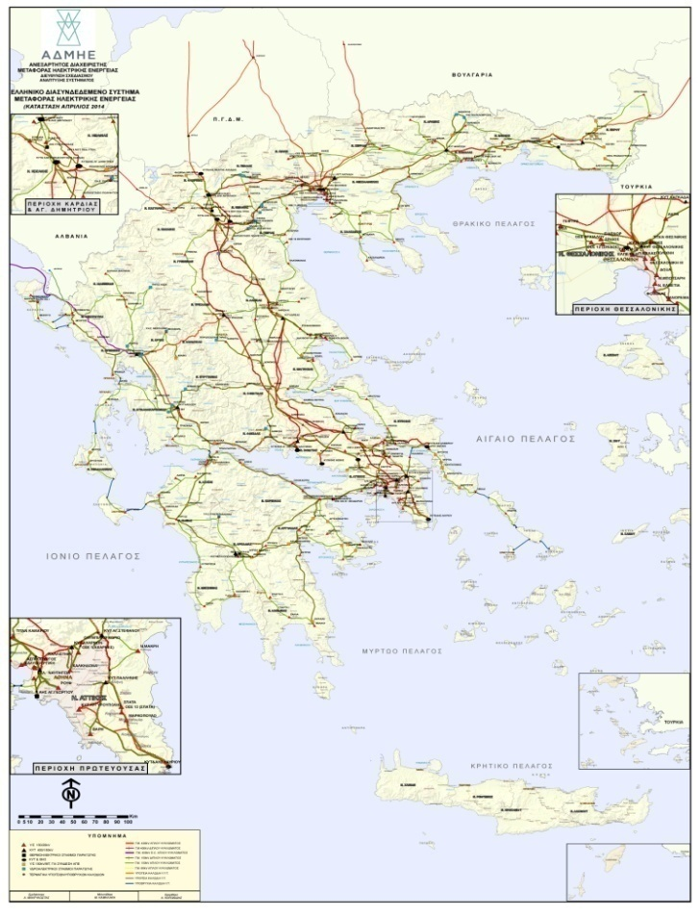
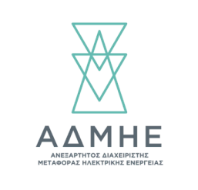
SENSE’s data provision
Solar Energy now-casting
IPTO is the Independent Power Transmission Operator for Greece
Control the energy demands

Slide 7
SENSE’s operational capabilities

Slide 8
Regional DataHub
http://datahub.geocradle.eu/

Slide 9
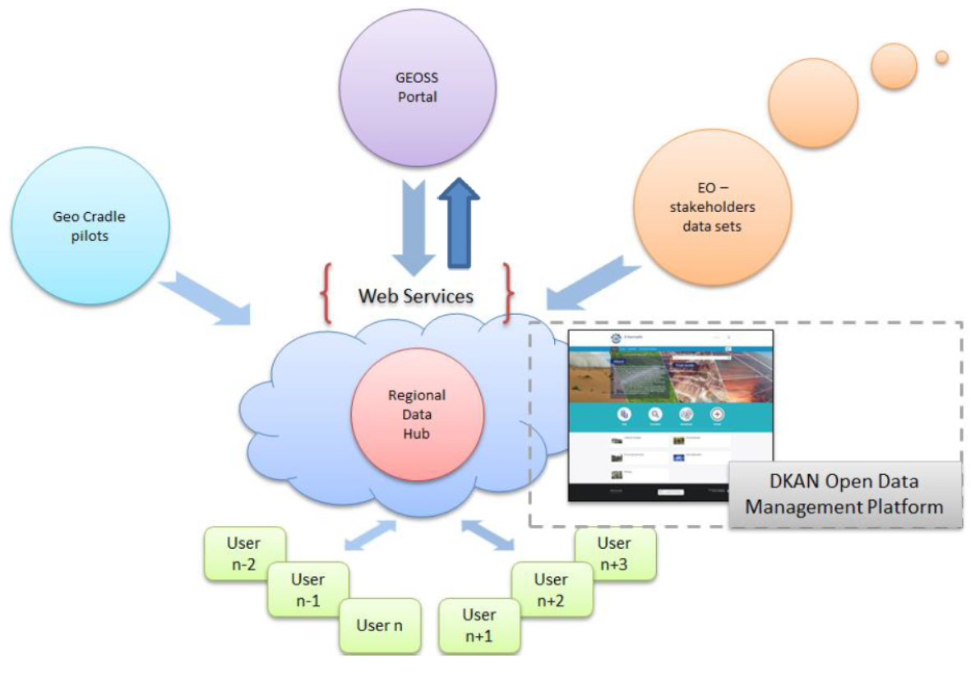
Regional DataHub – The Concept
DKAN = Drupal-based open data portal based on CKAN, the first widely adopted open source open data portal software.

Slide 10
Regional DataHub – The Solution

Slide 11
Regional DataHub – The Connection with GEOSS
DAB APIs = Discovery and Access Broker Application Programming Interfaces

Slide 12
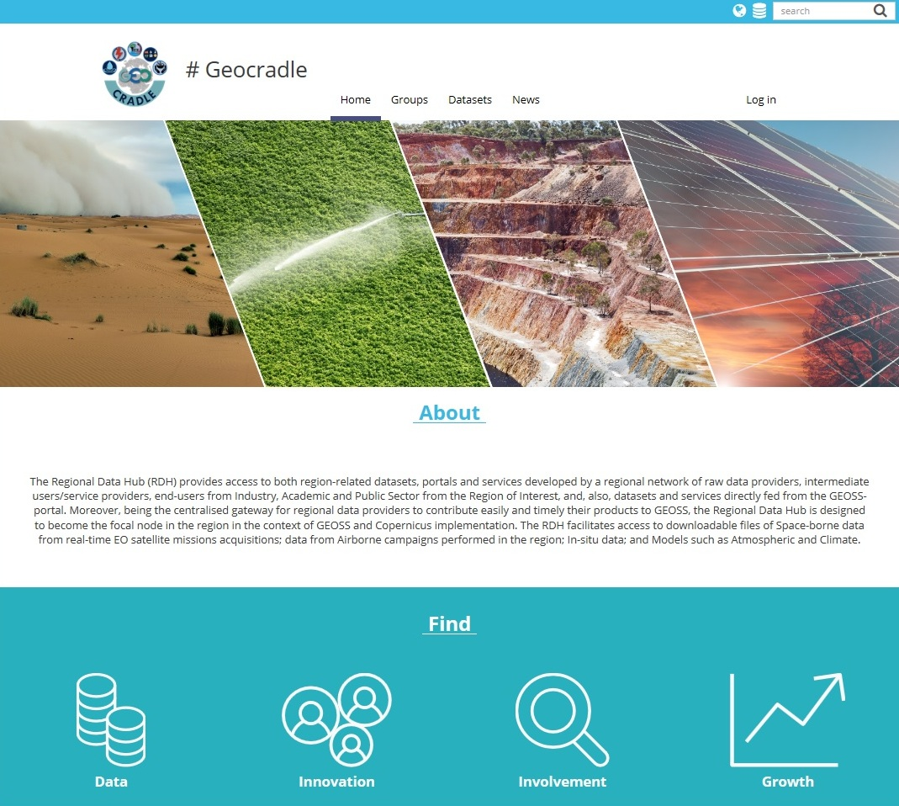
Regional DataHub – The Connection with GEOSS
http://datahub.geocradle.eu/
Stable service and full interoperability with GCI and GEO DAB APIs, as well as connection with data available through the project pilots.
Utilizing the GEO DAB APIs and DKAN for easy access and discovery of regional EO data
GCI = GEOSS Common Infrastructure

Slide 13
Regional DataHub – The Connection with GEOSS
Regional DataHub is designed to become the focal node in the region in the context of GEOSS and Copernicus implementation.
It is an open data web management tool / portal (developed using web technologies such as PHP, HTML5, JavaScript, CSS, etc.) that provides access to region-related datasets and services, directly fed from GCI, and at the same time being the central gateway for regional data providers to contribute easily and timely their products to GEOSS.
It advances the current state of the art by integrating DKAN, which is a complementary implementation of CKAN (Comprehensive Knowledge Archive Network) over Drupal/PHP, with the GEO DAB APIs. DKAN CMS (Content Management System) is an open-source data management platform that treats data as content, facilitating the subsequent publication, management, and maintenance of these, no matter the administration team, its size and level of technical expertise.

Slide 14
Regional DataHub – The Connection with GEOSS
Several achievements were accomplished for the Regional DataHub for the provision of up-to-date functionalities:
Search in multiple sources (although by default DKAN looks up for datasets and resources in a single local database).
Search for datasets in remote resources (integration of the GEO DAB APIs in the DKAN environment).
Display the remote datasets and resources on-the-fly and with high performance (using a rendering cache mechanism which also implements an Adaptive Time-to-Live consistency mechanism to periodically check the consistency of the cached rendering structures with the original data to assure that users do not receive stale data).
Cleaning data mechanism (cleans identical or duplicate data, discovers missing information for data, discovers URL that have changed or that are not working anymore, discards data with invalid URL schemes, etc.)
Preview mechanism (to preview data of various formats and services, such as CSV files, Web Map Services, Zip files, etc.)
An integrated Search and Display mechanism that offers the users unified, centralized and user-friendly interface.

Slide 15
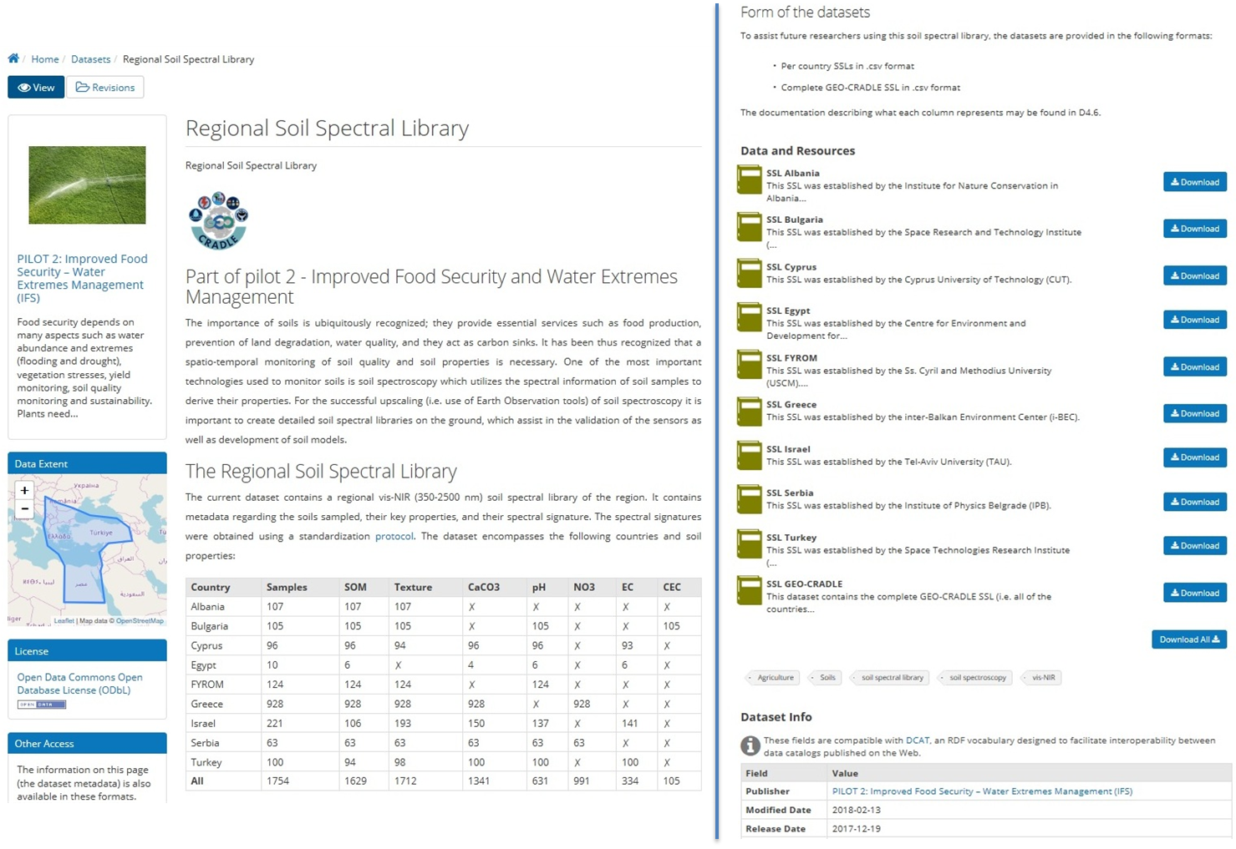
Regional DataHub - Examples

Slide 16
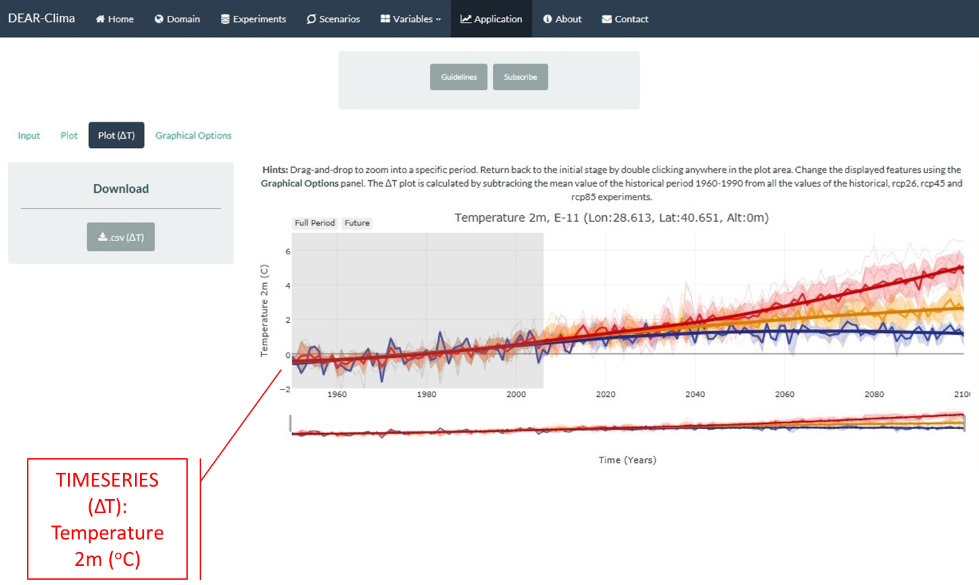
Regional DataHub - Examples

Slide 17
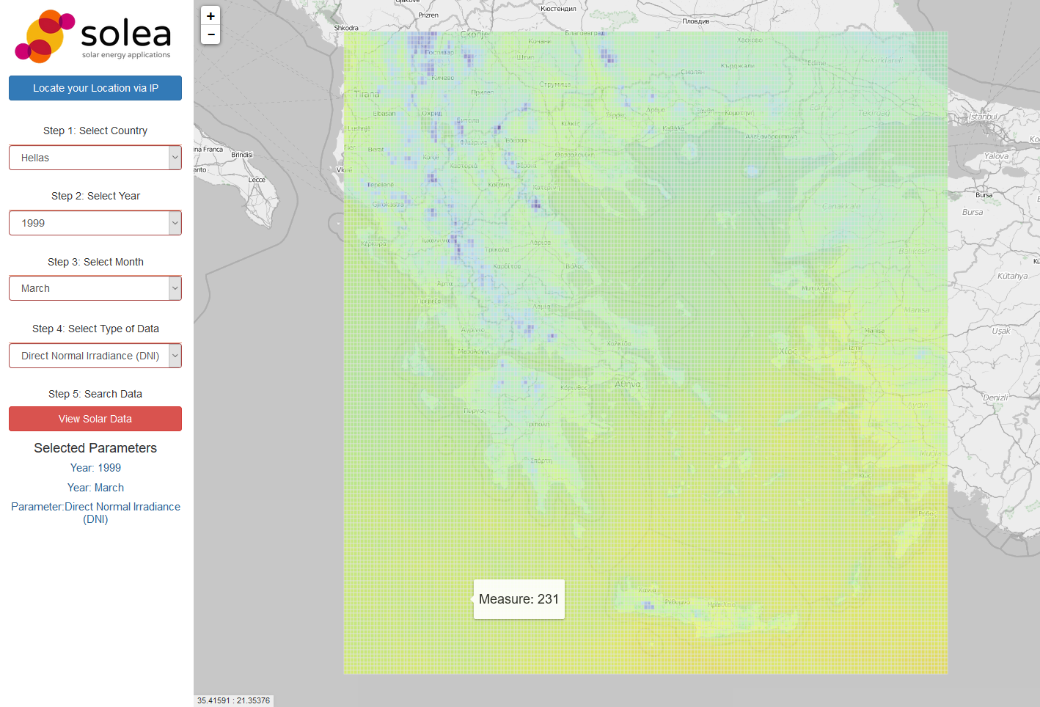
Regional DataHub - Examples
SOLar Energy Applications (SOLEA)
through GEOSS portal
EO-based SOLEA into a wider GEOSS driven system through the GEO-CRADLE project in the international scale.
http://solea.gr/

Slide 18
Contribution to EO market uptake
Submit a roadmap together with funding priorities in relation to capacity building, service delivery, filling in gaps (networks, infrastructures, data sharing, skills), training, education, service provision, and business uptake at regional level.
GEO-CRADLE will be a starting point for short future investments towards and beyond the implementation of GEO, GEOSS and Copernicus products and activities and visioning innovative high-end applications and technologies.
Long term funding: Science towards applications

Slide 19
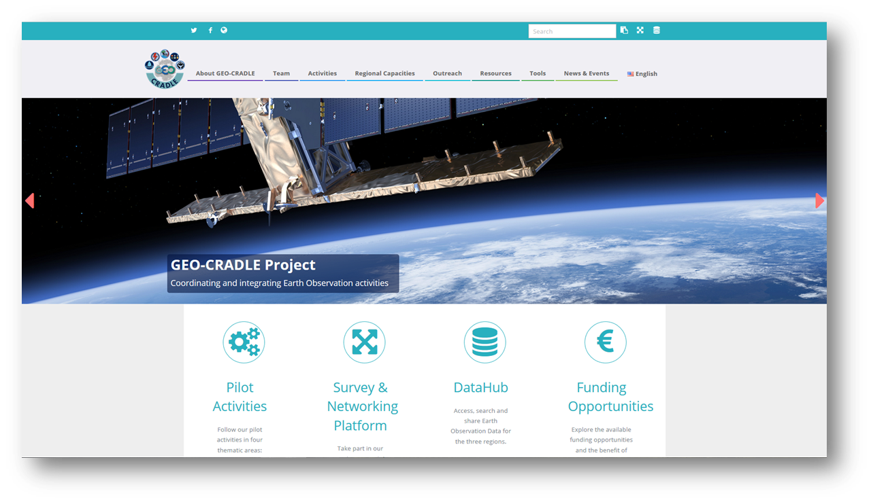
http://geocradle.eu/

