Slide 2
GTN-H: How we could benefit of the
GEOSS Platform
Stephan Dietrich / GTN-H coordinator / ICWRGC (UNESCO)

Slide 3
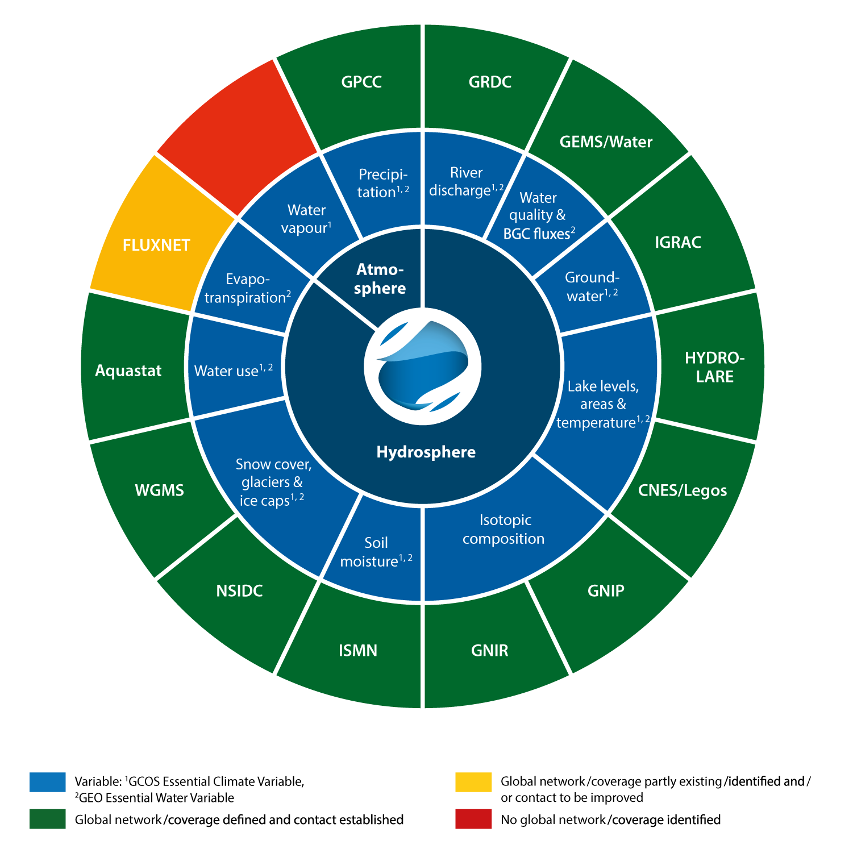
Introduction / Global Terrestial Network - Hydrology
GTN-H
is a joint project of the World Meteorological Organization (WMO) and the Global Climate Observing System (GCOS)
is a federated network of major global data centres, linking water-related observations at a global scale
(in-situ obs mainly until now)

Slide 4
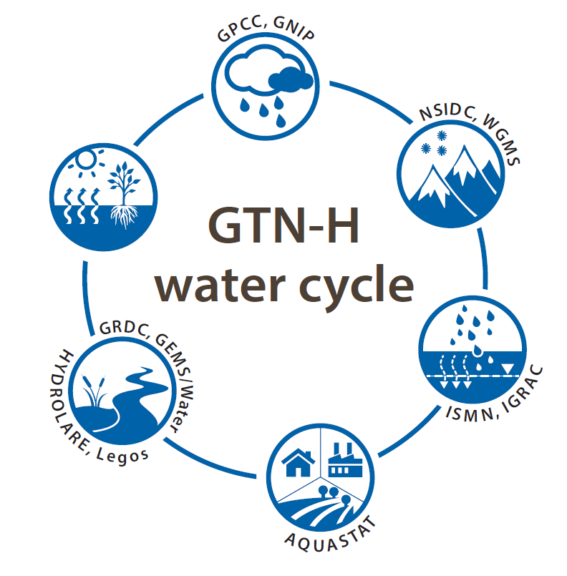
Introduction / Mission
Mission
GTN-H supports scientific advance and operational applications with regard to climate variability and change as well as water resources assessment and management.
Objectives
We support current and emerging technologies and standards, best practices and available infrastructure and develop integrated global and regional data products.
Goal
We generate integrative data products from GCOS Essential Climate Variables (ECVs) and GEO Essential Water Variables (EWVs).

Slide 5
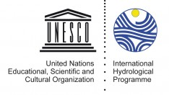
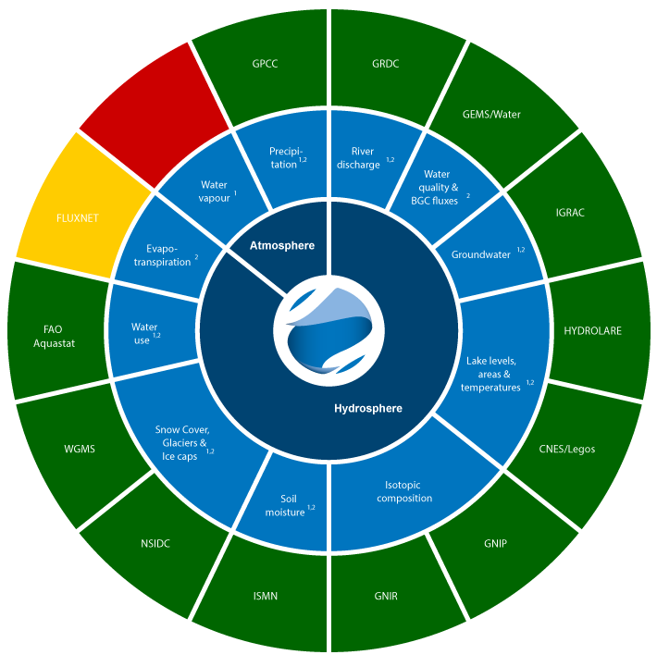
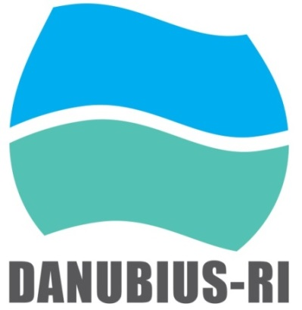
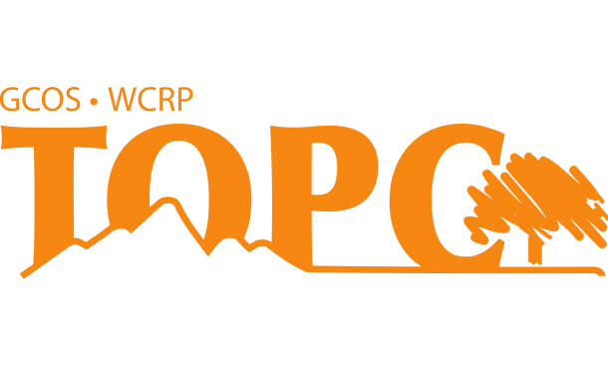
Synergies / Further links at the ICWRGC
WIS
IHP-WINS
“Water Information
Network System “
On ESFRI roadmap:
The international Centre
for advanced studies
on river-sea systems
IGWCO-CoP
GEO Initiatives
GEO Water Strategy
Terrestrial Observation Panel for Climate
international sediment initiatives

Slide 6
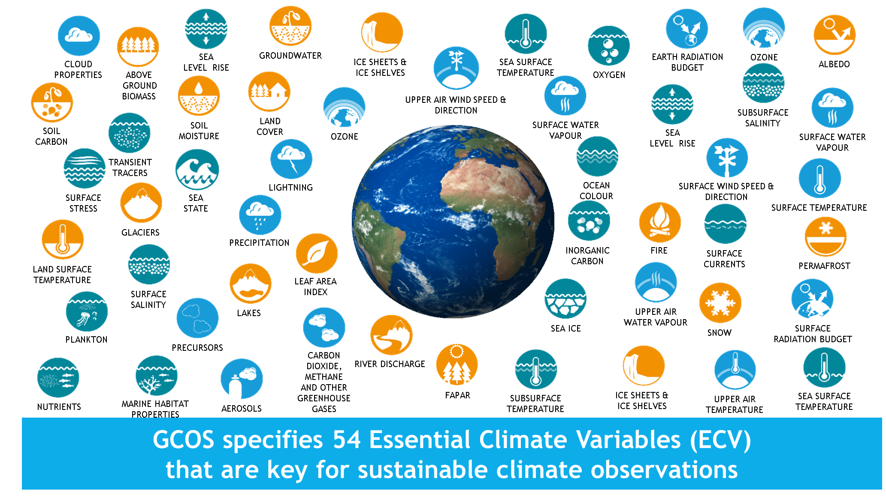
Synergies / Essential Variables: GCOS, GEO initiatives, …
GCOS specifies 54 Essential Climate Varibales (ECV) that are key for sustainable climate observations
GTN-H also adresses GEO Essential Water Varibales (EWV) and isotopic composition

Slide 7
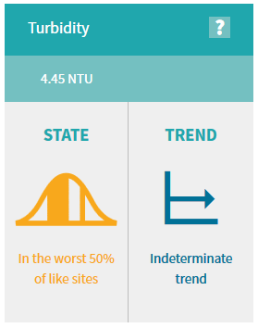
Future Development Plans / data products
We develop customized integrated data products:
The increasing importance of freshwater availability for water supply with sufficient quality,
as a nucleus for a Global Water Information Centre to become a one-stop shop for data, training, capacity building and policy advice.
stakeholder
Turbidity indicator, lawa.org.nz
For scientists
Relation between discharge and suspended sediment concentration., River Rhine (Hoffmann et al. 2017)

Slide 8
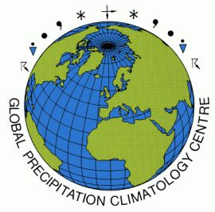
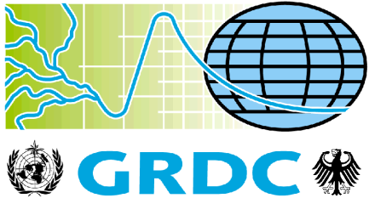
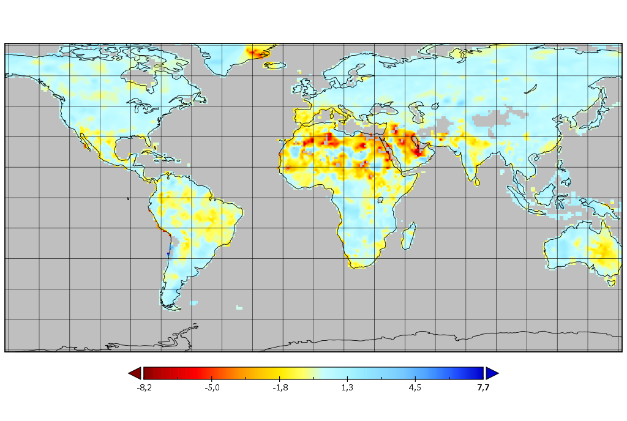
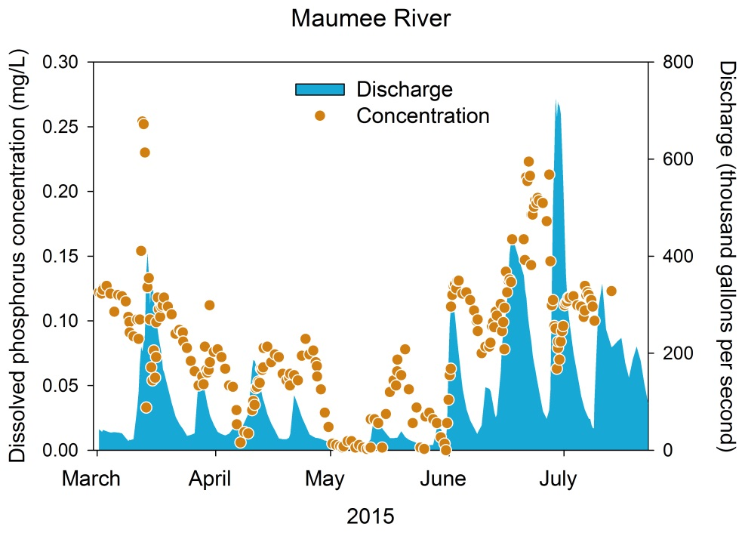
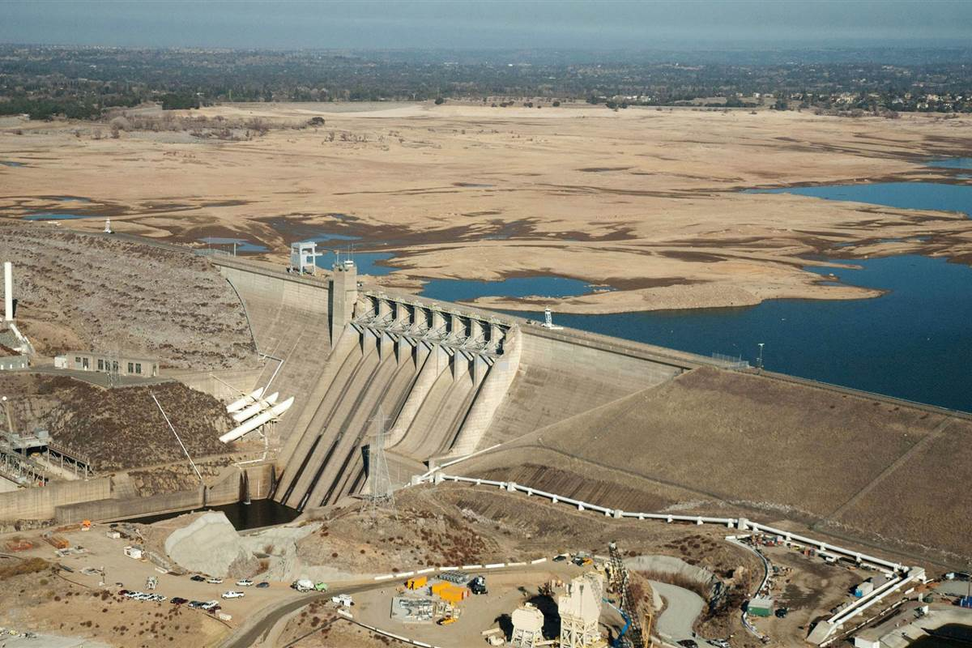
Future Development Plans / pilot studies
Pilotstudies are under development for
products based on the analysis of precipitation-ow relationships (GPCC - GRDC),
product to determine load rates (GEMS/Water - GRDC),
product on drought-water quality relationships (GPCC - GRDC - GEMS/Water).
GPCC drought index
Maumee River in NW Ohio, www.lakeeriealgae.com/
http:// www.nbcnews.com

Slide 9
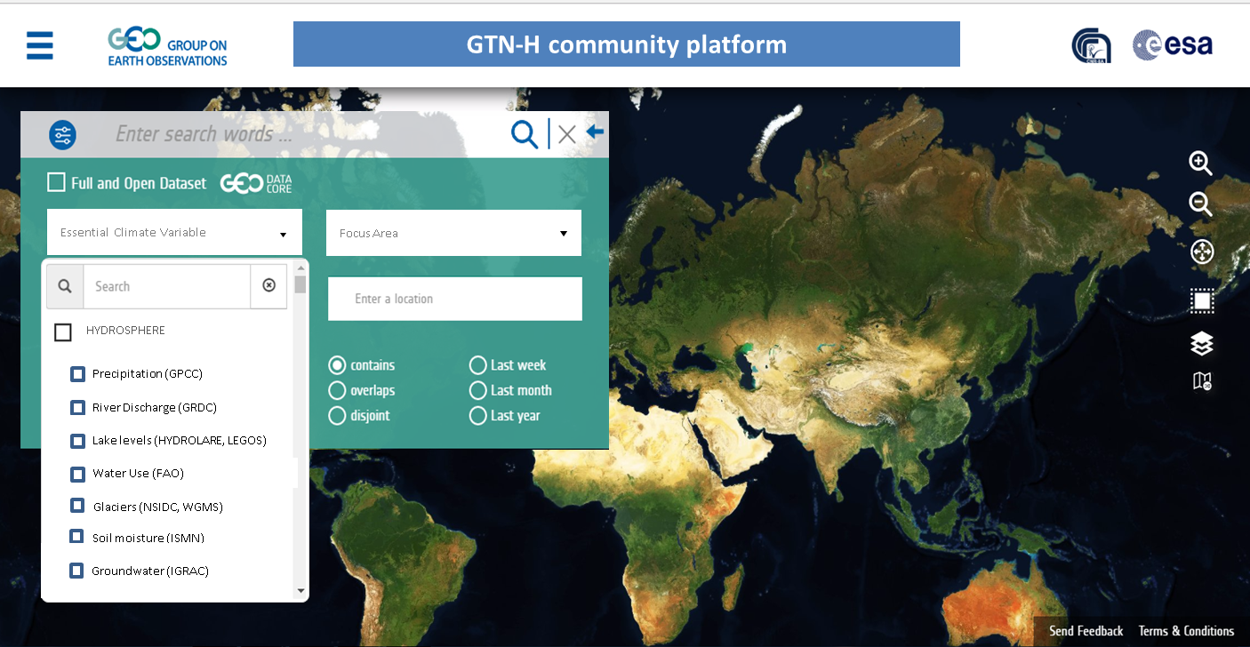
Future Development Plans / GTN-H community portal

Slide 10
Future Development Plans / interoperability status
Yesterday: agreement of (most) GTN-H members to register at GEOSS!

Slide 11
Synergies / GTN-H & GEOSS
How could GTN-H benefit from connecting to GEOSS
How could GEOSS benefit from connecting to GTN-H
1st version of Community Platform
bringing data together (learning in small steps)
GEOSS gives outstanding support
Synergetic achievements possible
Cooperation with GCOS:, see e.g. Session 8 (May 2nd): “Portal functionalities customization for GCOS ECVs” by Eliana Lisanti, Valentin Aich & Stephan Dietrich
Improving cooperation with GEO initiatives and related research programs like GEOessential, …
GTN-H covers global data centres linking water related in-situ observations
Including hydrological GCOS ECVs
as well as GEO EWVs
GTN-H will assist in registering member data centres at GEOSS
GTN-H collaborates with GCOS/TOPC, GEOGLOWS, IGWCO-CoP, AQUAWATCH
Supporting the GEOSS Water Strategy

Slide 12
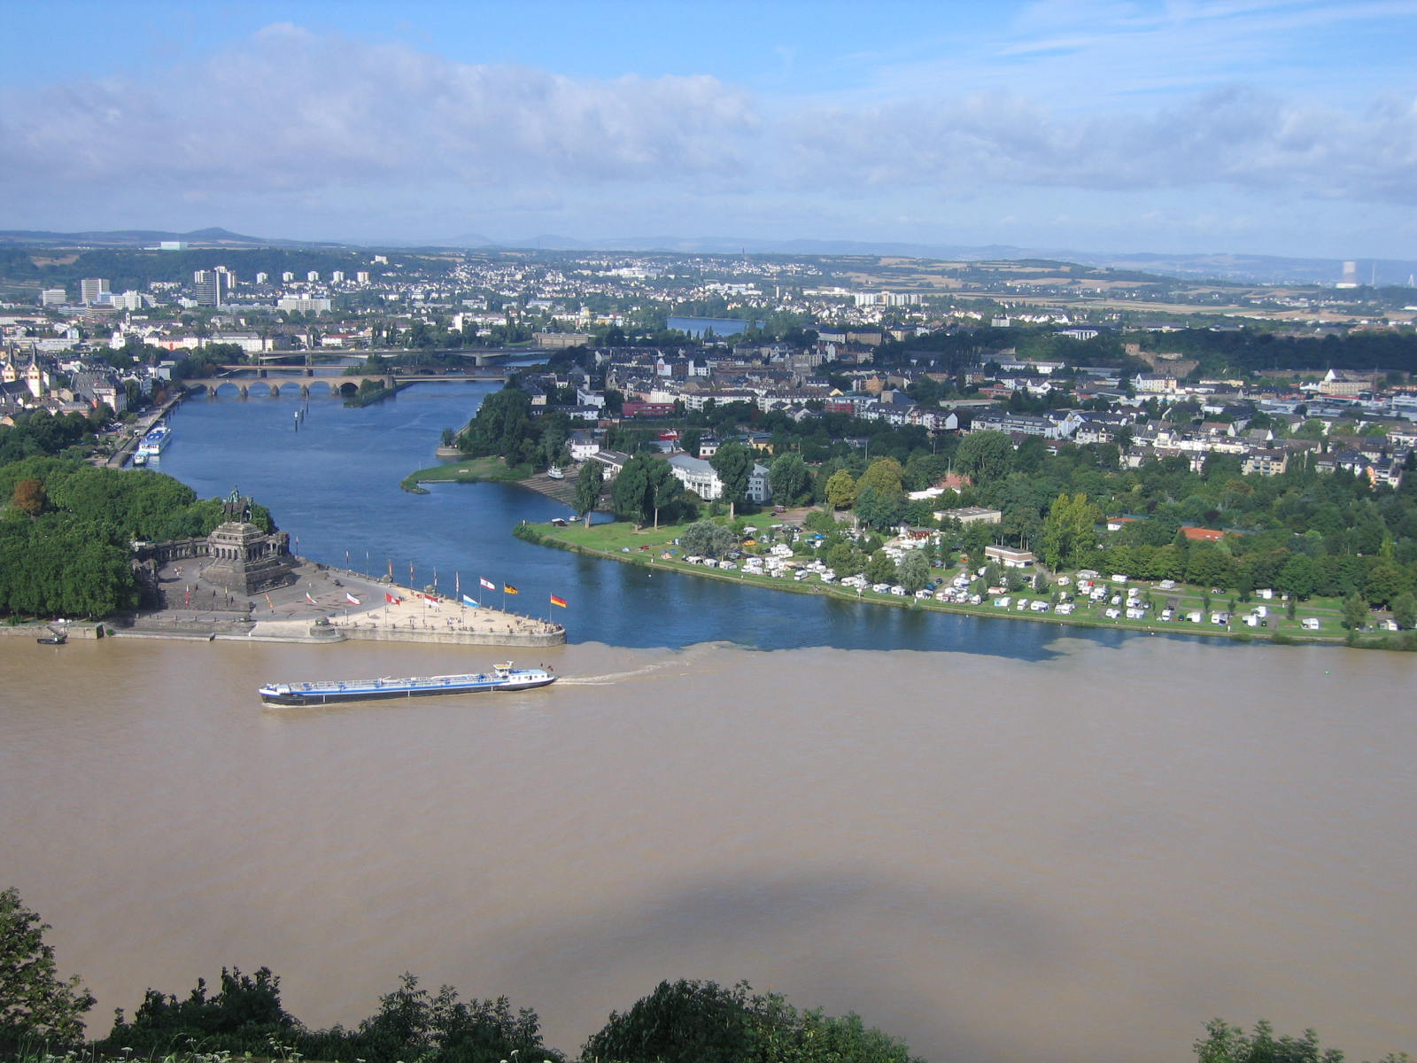
Thank you
Stephan Dietrich www.gtn-h.info
dietrich@bafg.de www.waterandchange.org

