Slide 1
Eo data linkages for renewable Energy in SDG’s
WEBSERVICE-ENERGY.ORG

Slide 2
SDG goal 7
« Ensure access to affordable, reliable, sustainable and modern energy for all »
Target 7.1
By 2030, ensure universal access to affordable, reliable and modern energy services
Indicators
7.1.1 Proportion of population with access to electricity
7.1.2 Proportion of population with primary reliance on clean fuels and technology
Target 7.2
By 2030, increase substantially the share of renewable energy in the global energy mix.
Indicator
7.2.1 Renewable energy share in the total final energy consumption

Slide 3
SDG 7 linkages
Environmental sustainability
By mitigating the local and global environmental impacts of energy consumption
Human development
By facilitating access to basic services improving human health and supporting income generation activities
Sustainable economic growth
By generating economic benefits such as new jobs and industries
IRENA - REthinking Energy 2017: Accelerating the global energy transformation

Slide 4
SDG 7 linkages

Slide 5

Cities can decarbonise their energy supply and use through renewables notably in buildings (for heating cooling cooking and

Slide 6

Scaling up renewable energy coupled with energy efficiency could put the world on track to keep the rise of temperatures within 2° Celsius in line with the Paris Agreement…

Slide 7
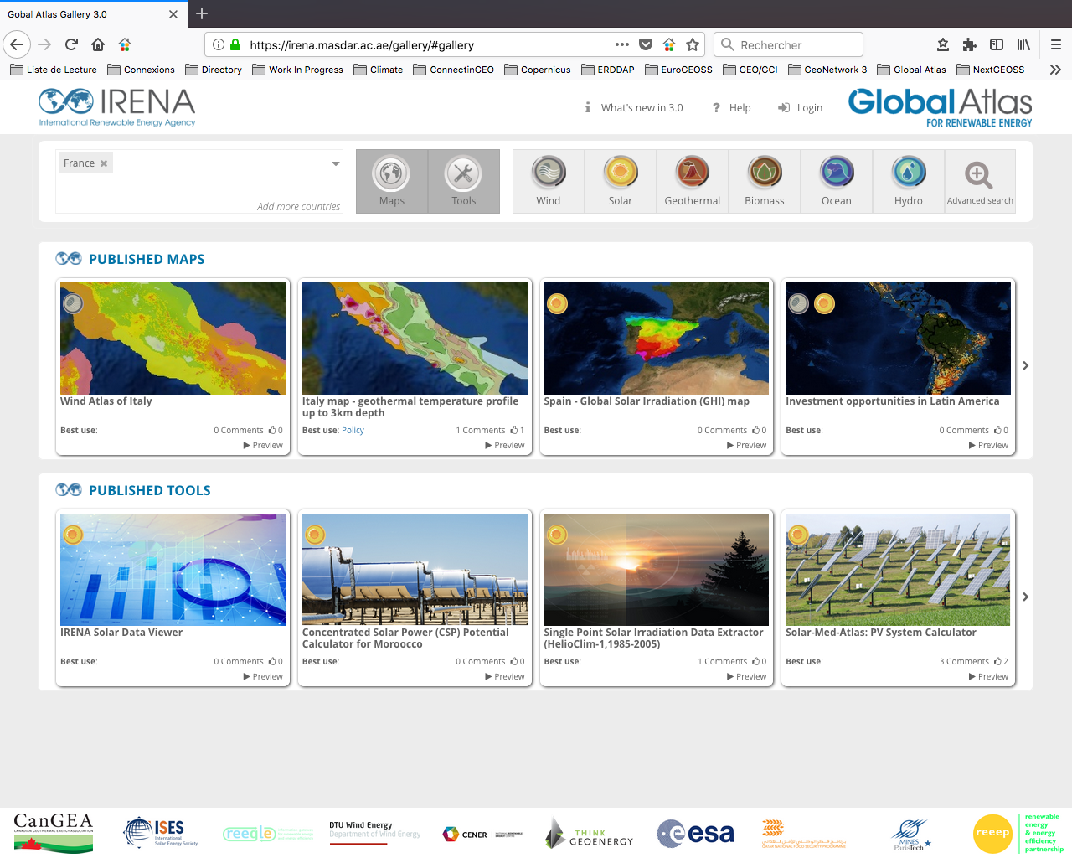
EO Data and SDG 7 linkage
IRENA Global Atlas for Renewable Energy is a web platform containing over 2000 maps and tools for renewable energy resources assessment across the world

Slide 8
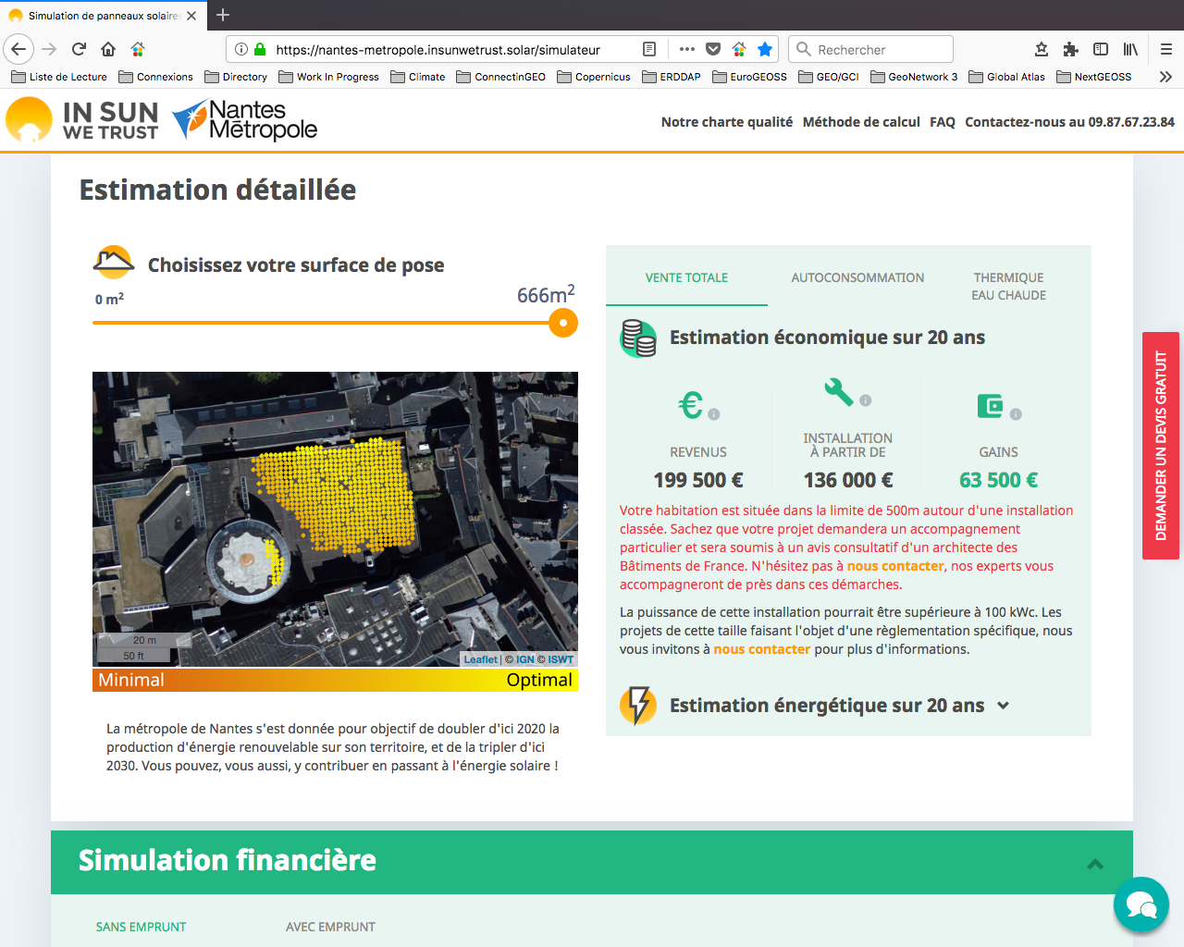
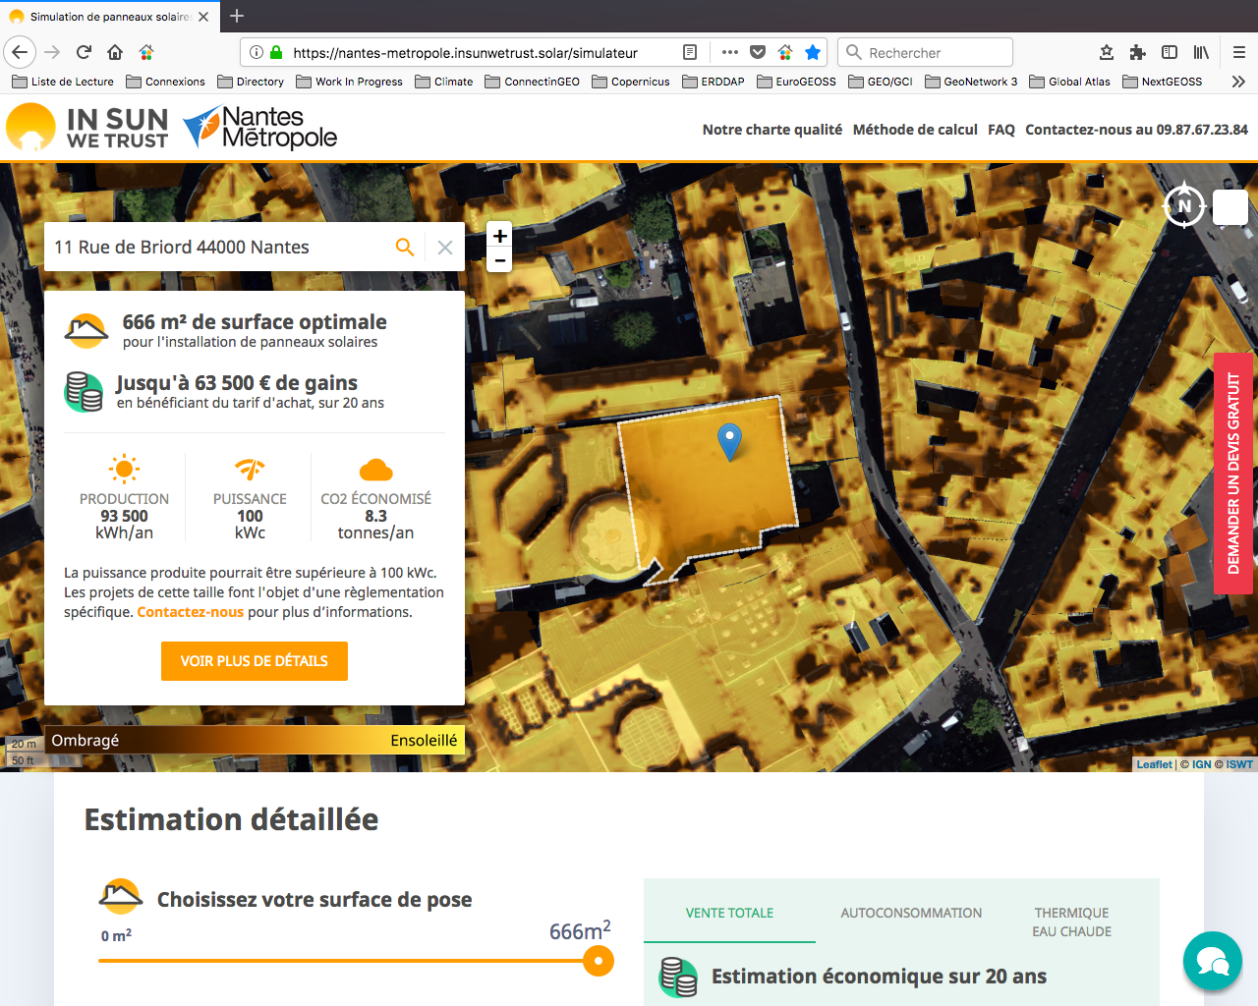
EO Data and SDG 11 linkage
InSunWeTrust
French SME providing services for solar roof-top business potential assessment

Slide 9
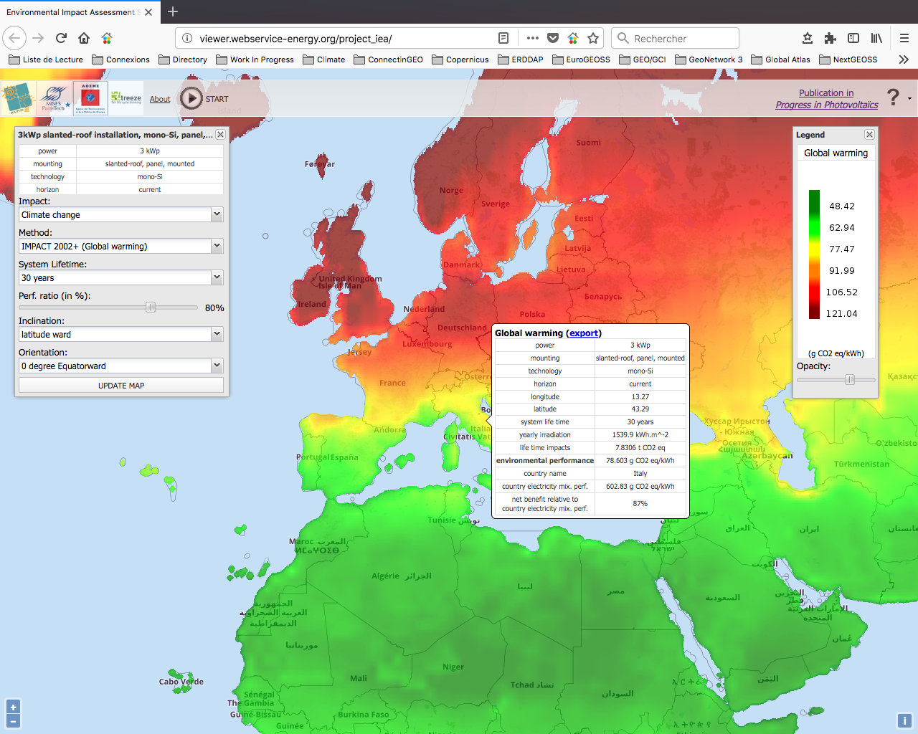
EO Data and SDG 13 linkage
IEA Task-12
current and prospective (2050) environmental performance of the production, transportation and use of photovoltaic systems for a worldwide coverage.

Slide 10
Follow us…
Contact: Lionel MENARD – lionel.menard@mines-paristech.fr
GEO Vision for Energy (GEO-VENER) - https://www.earthobservations.org/activity.php?id=121#
Webservice-energy – http://www.webservice-energy.org
IRENA - REthinking Energy 2017: Accelerating the global energy transformation - http://www.irena.org/publications/2017/Jan/REthinking-Energy-2017-Accelerating-the-global-energy-transformation

