Slide 1
The EPOS Integration
Plan: building the infrastructure for solid Earth science Massimo Cocco and EPOS Team
Notes:
DESCRIBE SOLID EARTH, SPECIFYING THAT:
WE STUDY THE WHOLE SOLID COMPONENT OF OUR PLANET (FROM THE INNER CORE TO THE SURFACE)
WE STUDY PROCESSESS EVOLVING IN VERY DIFFERENT TIME SCALES (from μιχρο−seconds to thousands years)
- WE STUDY PROCESSESS EVOLVING IN VERY DIFFERENT SPATIAL SCALES (from ΝΑΝΟΜΕΤΕΡΣ ΤΟ ΤΗΟΥΣΑΝΔΣ ΚΜ)

Slide 2
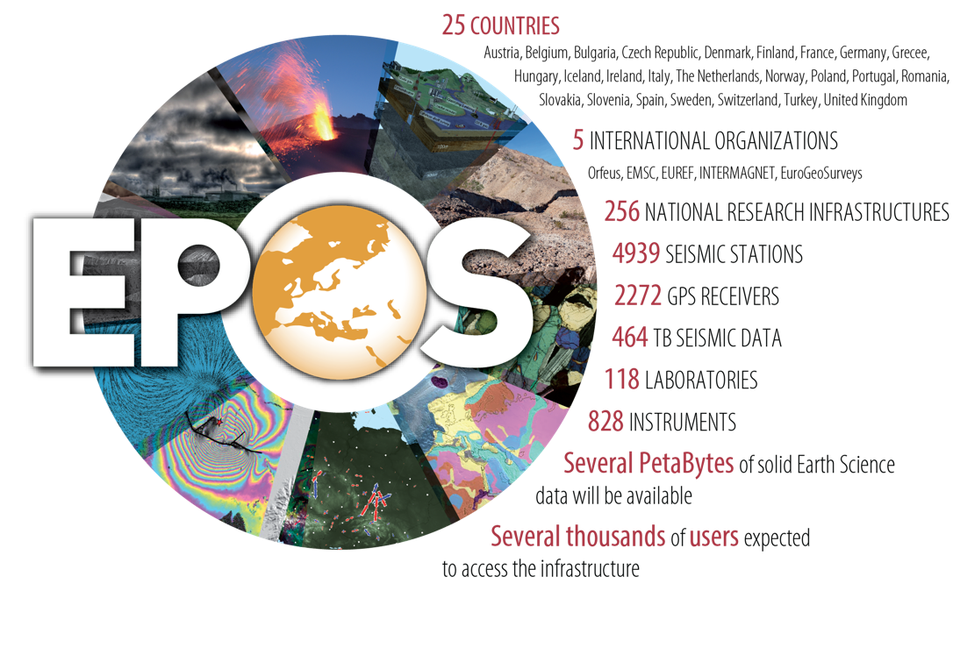
EPOS: an ESFRI Research Infrastructure
EPOS is a long-term plan for the integration of research infrastructures for solid Earth Science in Europe
EPOS integrates the
existing (and future)
advanced European facilities into
a single, distributed,
sustainable infrastructure
taking full advantage of new e-science opportunities
Notes:
Currently, EPOS means 25 countries involved, both at scientific and government level, 5 international organizations, more than 250 national research infrastructures sharing thousands of recording apparata such as seismic stations, GPS receivers, geochemical stations, all together producing several petabytes of data that in the next years, through EPOS, will be available for several thousands of users, including, but not limited to scientists.
EPOS integrates all this, the already existing, but also the future European research infrastructures for solid Earth into a single, but distributed, sustainable infrastructure that will take full advantage of all the new available e-science opportunities.

Slide 3
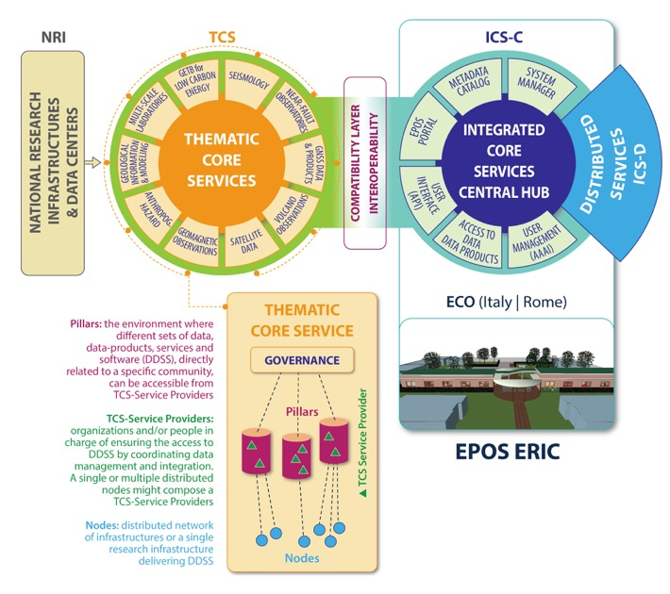
How EPOS works
novel e-infrastructure
Interoperability
Brokerage
Procurement
Policies
IT Resources
Preservation
Data generation
Data collection
Providing
sustainability
and operation
IPR
Metadata registry
Processing
Aggregation
Integrated analyses
Visualization
Data curation
Metadata
Data provision
Community Services
Standardization
Data policies
community-specific integration

Slide 4
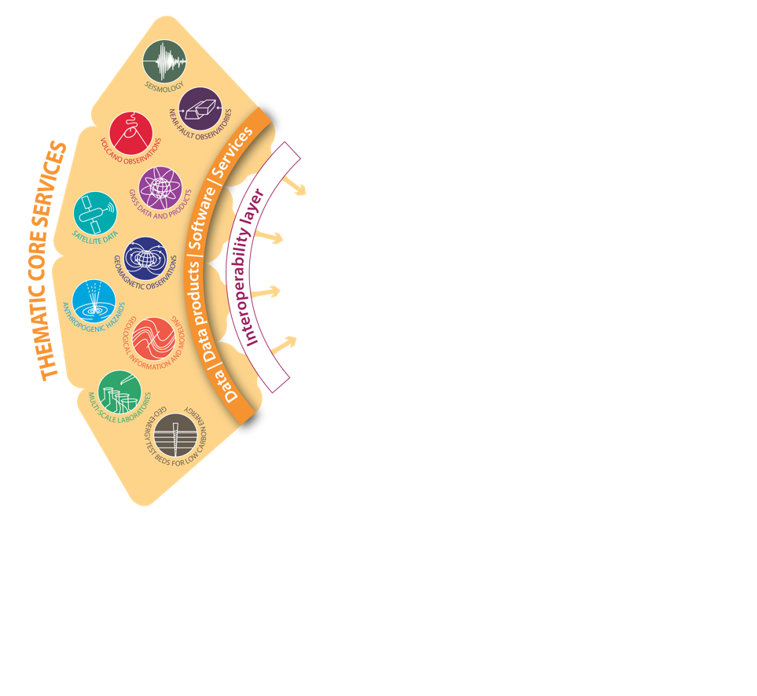
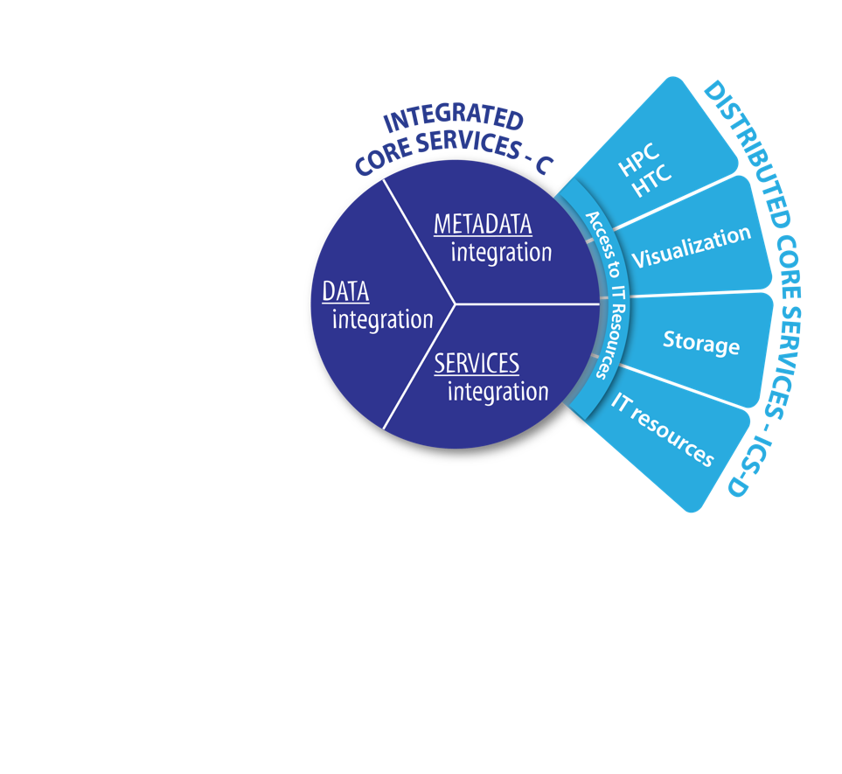
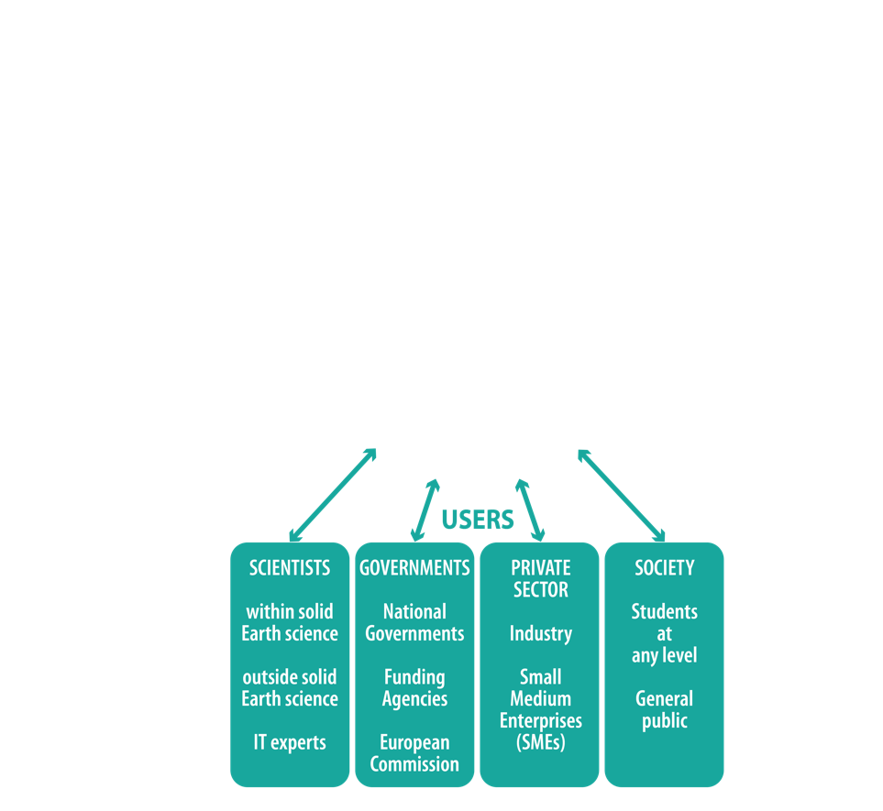
SUMMING UP
NRIs and scientific communities ensure the competences and resources for collecting and analysing data and for maintaining territorial observation systems
TCS are responsible for integrating data, metadata and services from various infrastructures for each discipline
ICS provide a new interface that
by adopting data access policies aligned to Open Science principles, provides data and products in a FAIR* form for users
Foster scientific, technological and ICT innovation for successfully addressing global grand challenges in Earth science
*Findable, Accessible, Interoperable, and Re-usable

Slide 5
Supersites: a federated e-infrastructure
decision-makers - civil defense
local authorities
GEOSS
Global Earth Observation System of Systems

Slide 6
Data lifecycle & Services to Stakeholders
Data lifecycle includes: acquisition, validation & standardization, collection & curation (PID, DOI) including long-term preservation;
Services for users are implemented to make data Findable, Accessible, Interoperable, Re-usable (FAIR): that is Data as a Service;
Services also includes workflows and computational resources: platform as a service and infrastructure as a service;
This implies technical, legal, governance and financial sustainability
Downstream services to stakeholders should not be implemented without taking care of the entire data and service lifecycle;
There is the risk to offer downstream services without dedicating the necessary attention to the sustainability of data and service lifecycles.

Slide 7
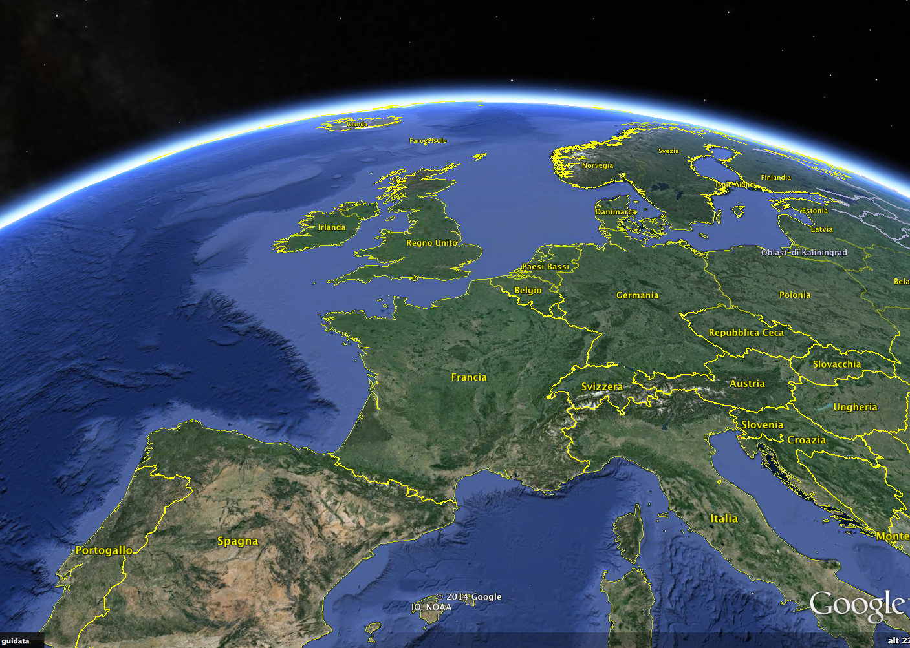
EPOS: a single, pan-European distributed RI
TCS Seism.
TCS GNSS Data
ICS-C
ICS-D
TCS Anthrop Hazard
TCS Geomag Obs.
TCS Volcano Obs.
TCS Subsur Data
TCS Geology
TCS Satellite Data
TCS Exper. Labs
ECO

Slide 8
EPOS: a single, pan-European distributed RI
TCS Seism.
TCS GNSS Data
ICS-C
ICS-D
TCS Anthrop Hazard
TCS Geomag Obs.
TCS Volcano Obs.
TCS Subsur Data
TCS Geology
TCS Satellite Data
TCS Exper. Labs
ECO
EPOS

Slide 9
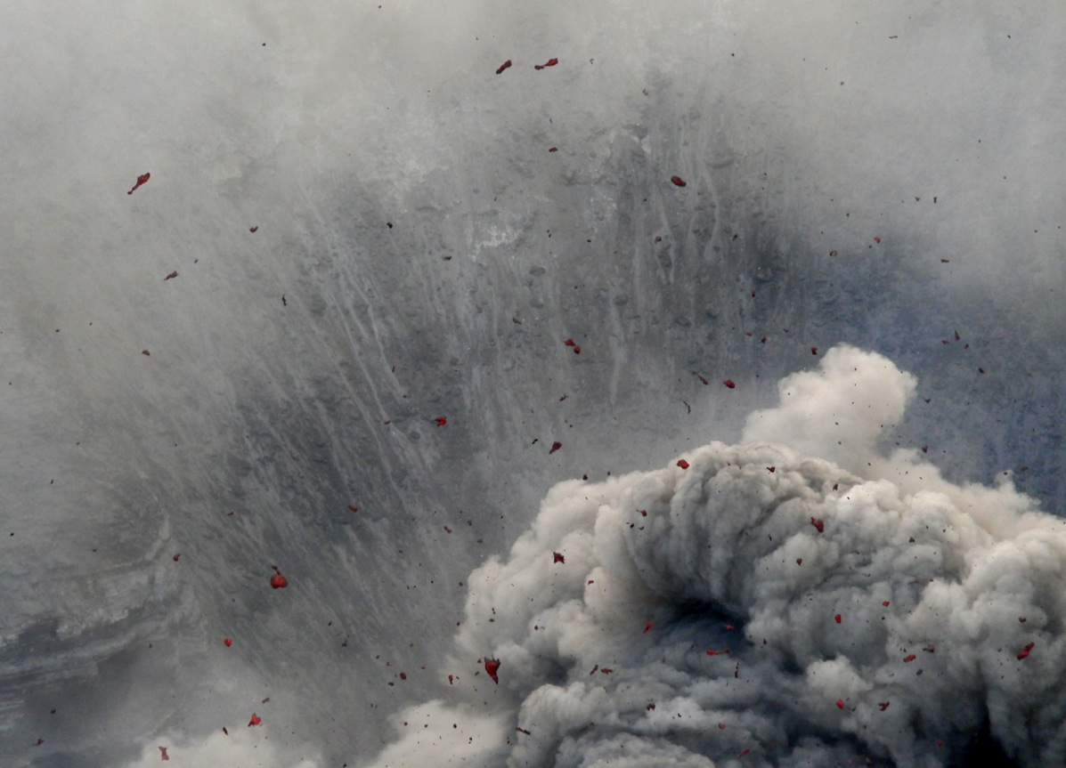
www.epos-eu.org
epos@ingv.it
Thank you

Slide 10
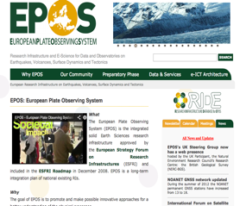
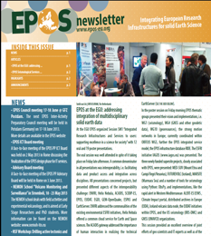
Thank You
WebSite
www.epos-eu.org
Newsletter
www.epos-eu.org/newsletter
Social

