Slide 1
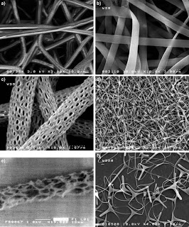
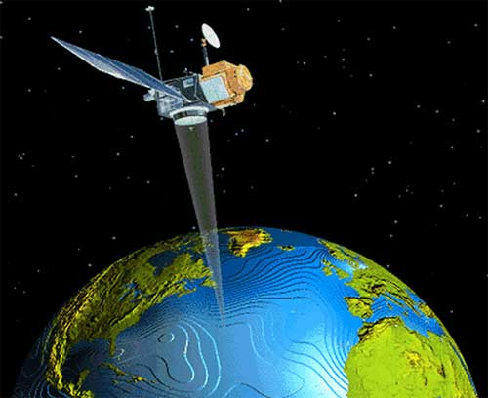


The CNR contribution to GEOSS
Nicola Pirrone
GEO Principal of Italy
Director, CNR-Institute of Atmospheric Pollution Research, Roma, Italy nicola.pirrone@iia.cnr.it
3rd GEO Data Providers Workshop
2-4 May 2018, ESA, Frascati
CNR – Institute of Atmospheric Pollution Research, Rome, Italy
http://www.iia.cnr.it

Slide 2
The CNR Contribution to GEOSS
In the framework of several FP7 and H2020 projects, CNR provided a substantial contribution in developing the GEOSS Platform (former GCI) – the previous workshop on Data Providers was co-organised and host by CNR in Florence
In developing the GEOSS Platform, the CNR jointly with ESA, USGS, University of Geneva, and GEO Sec have dedicated a significant effort to match the “User needs” with “Data and Information Providers”. The aim of today workshop is to discuss the outcomes, future needs and challenges.
The great and mutual beneficial cooperation with ESA-ESRIN has led to the EDGE (H2020) project which is aimed to improve the GEOSS Platform having in mind the “Needs” and “Contributions” of Users.
CNR coordinates GEO Italy (www.geoitaly.org) that involves the national scientific and data providers communities.
CNR – Institute of Atmospheric Pollution Research, Rome, Italy
http://www.iia.cnr.it

Slide 3
The CNR Contribution to GEOSS
The aim of CNR is to provide logistic models to gain knowledge from Big Data that can be acquired through GEOSS.
The CNR effort is supporting GEO in the implementation of the UN 2030 Agenda on SD – specifically through the participation to programs and initiatives that are strategic for GEO such as i.e., COP 21 Paris, DRR Sendai, Minamata Convention, UNECE just to cite a few.
CNR e GEO Italy support since the beginning the EuroGEOSS initiative aiming to reinforce GEOSS by advocating GEOSS and engaging the relevant regional and national organizations, understating their needs and possible contributions.
The CNR and the larger GEO Italy’s effort is aimed to foster data sharing and interoperability of models (including those related to Artificial Intelligence) that are needed to support Policy Makers. The great contribution of projects such as ECOPOTENTIAL, ERA-PLANET, EOSC-Hub are an example.
CNR – Institute of Atmospheric Pollution Research, Rome, Italy
http://www.iia.cnr.it

Slide 4
CNR contributes to the GEO Flagships
Geo Biodiversity Observation Network (GEO BON)
GEO Global Agricultural Monitoring (GEOGLAM)
Global Forest Observation Initiative (GFOI)
Global Observation System for Mercury (GOS⁴M)
CNR – Institute of Atmospheric Pollution Research, Rome, Italy
http://www.iia.cnr.it

Slide 5
GEO Italy contribution to GEO Initiatives
Earth Observations for Ecosystem Accounting (EO4EA)
Earth Observations in Service of the 2030 Agenda for Sustainable Development
GEO Carbon and GHG Initiative
GEO Cold Regions Initiative (GEOCRI)
GEO Geohazard Supersites and Natural Laboratories (GSNL)
GEO Global Ecosystem Initiative (GEO ECO)
GEO Global Network for Observation and Information in Mountain Environments (GEO GNOME)
Global Observation System for Persistent Organic Pollutants (GOS⁴POPS)
Oceans and Society: Blue Planet
CNR – Institute of Atmospheric Pollution Research, Rome, Italy
http://www.iia.cnr.it

Slide 6
GEO Fundational Tasks
GEOSS Platform (GCI) Development & Operations
Advancing GEOSS Data Sharing Principles
GEOSS Platform Operation
GEOSS In-Situ Earth Observation Resources
GEOSS Satellite Earth Observation Resources
GEONETCast Development and Operations
User Needs and Gap Analysis
Community Development
Capacity Building Coordination
Secretariat Operations
Management and Support
Communication and Engagement
Monitoring and Evaluation
CNR – Institute of Atmospheric Pollution Research, Rome, Italy
http://www.iia.cnr.it

Slide 7
From Data to Knowledge to support Policy Makers
CNR – Institute of Atmospheric Pollution Research, Rome, Italy
http://www.iia.cnr.it

Slide 8


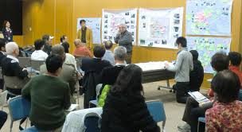

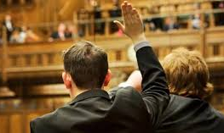
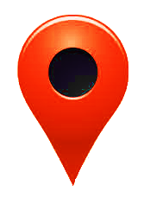



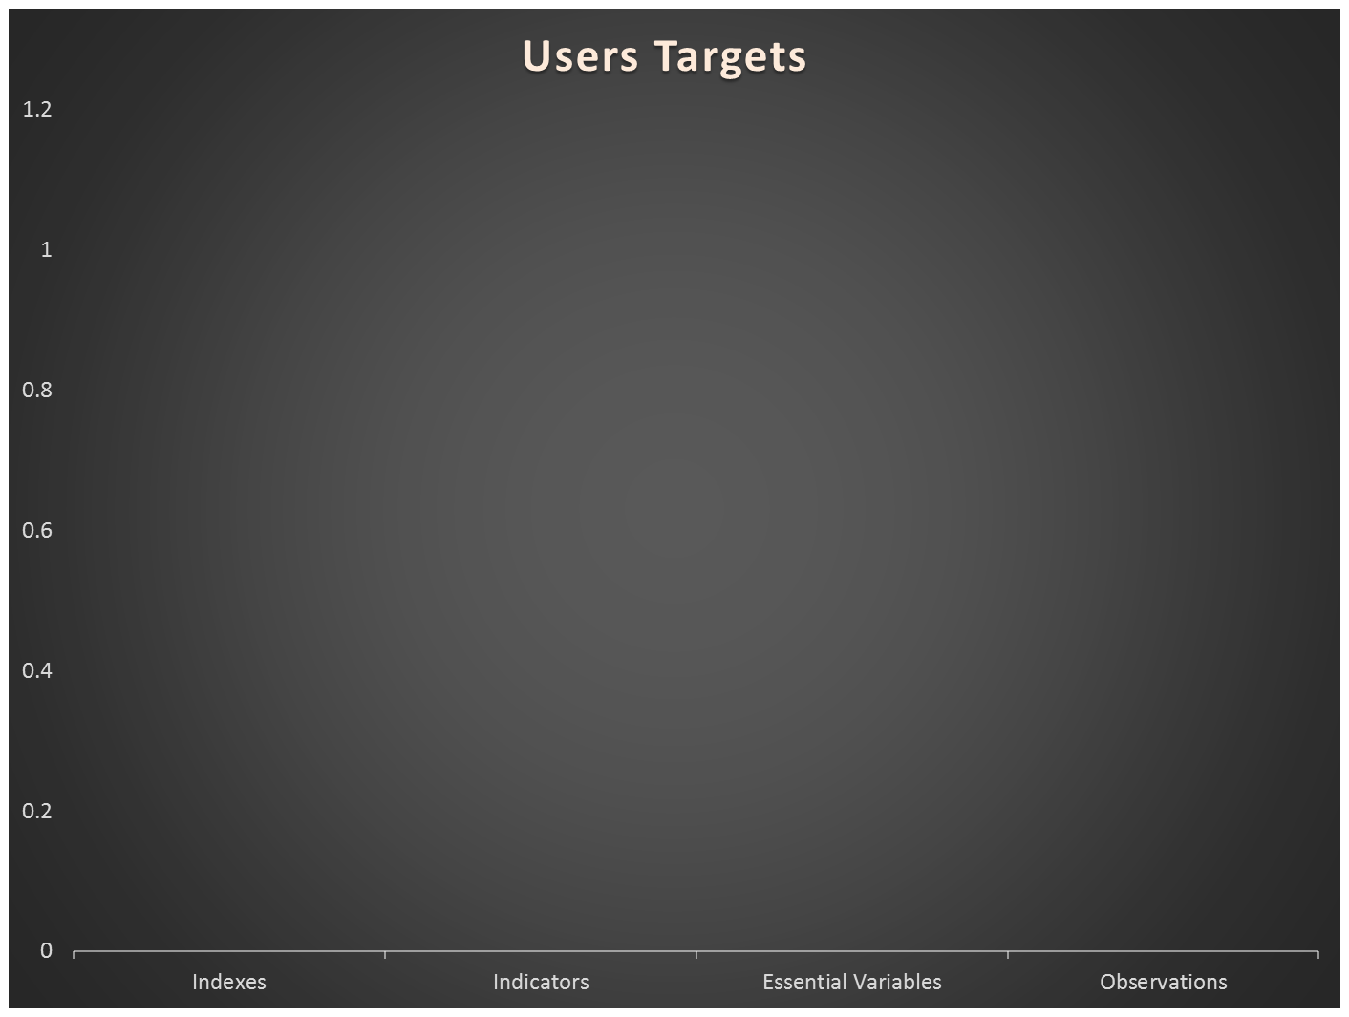
Data Volume
Users
EO Data Experts
(IT experts)
Environmental Experts
(Practitioners)
Global Change Experts
(Educators)
Policy Makers
(Citizens)
IT Experts
Non-IT Experts
Tomorrow
Re-use
Today
Inter
Interoperability Level
Access
Discover
Observations
Essential Variables
Indicators
(Sustainability) Indexes
Semantic content (From Data to Knowledge )
Notes:
Swimlane diagram

Slide 9
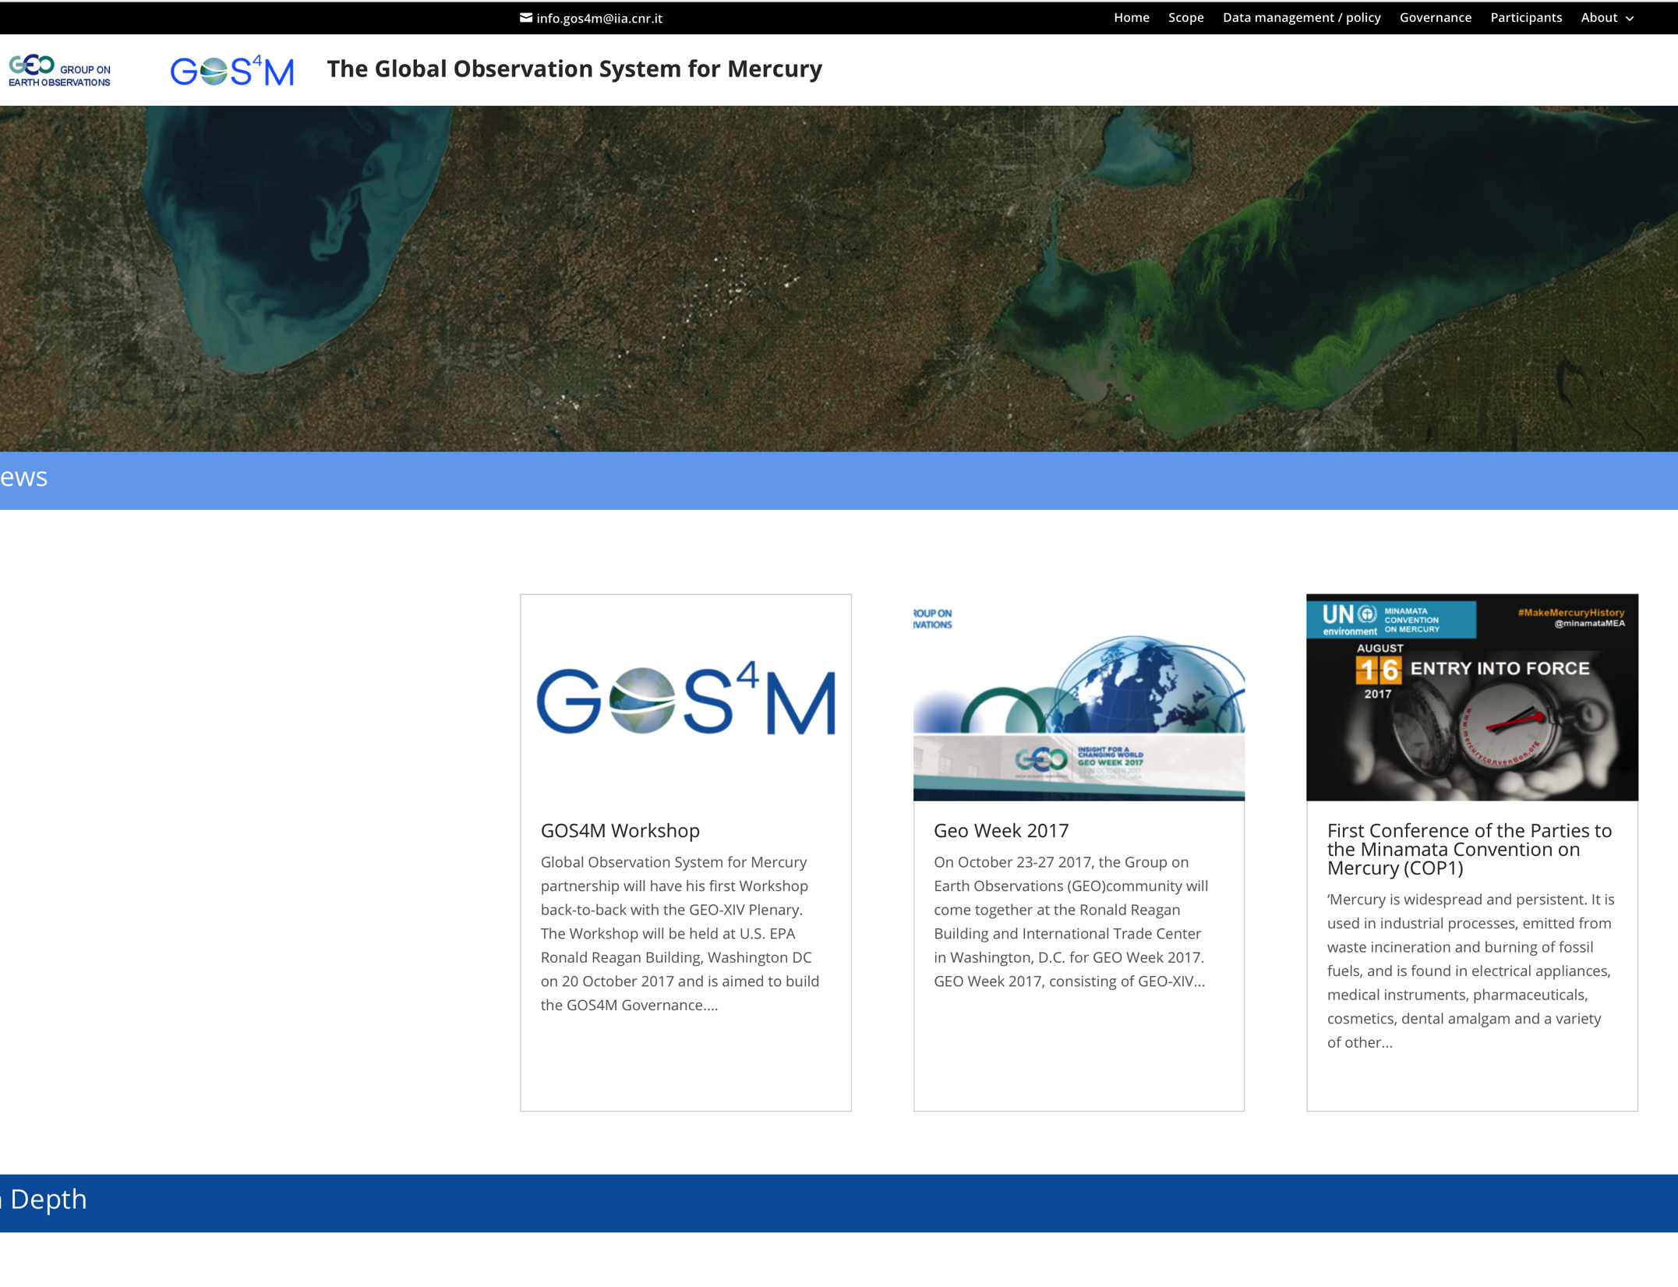
CNR coordinates the GEO Flagship on
Global Observing System for Mercury (GOS4M)
CNR – Institute of Atmospheric Pollution Research, Rome, Italy
http://www.iia.cnr.it

Slide 10
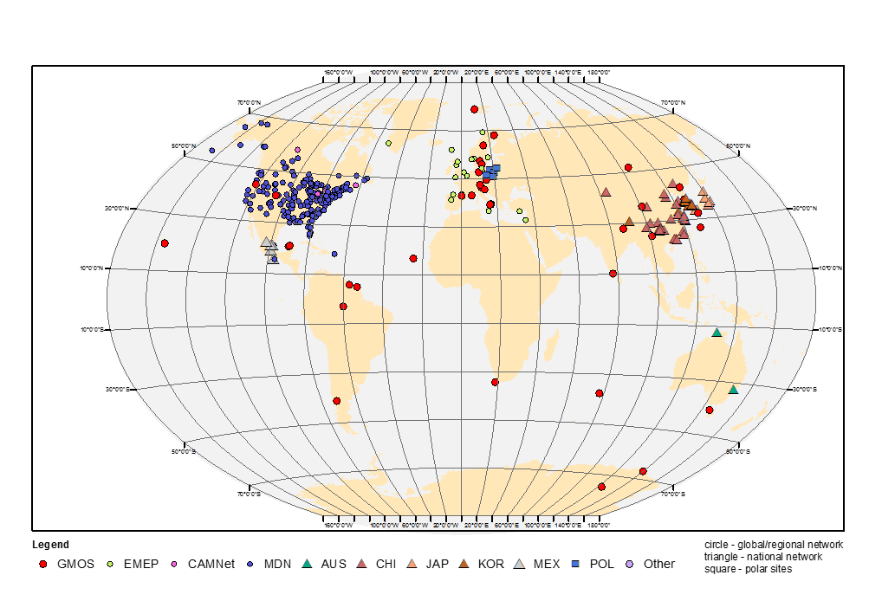
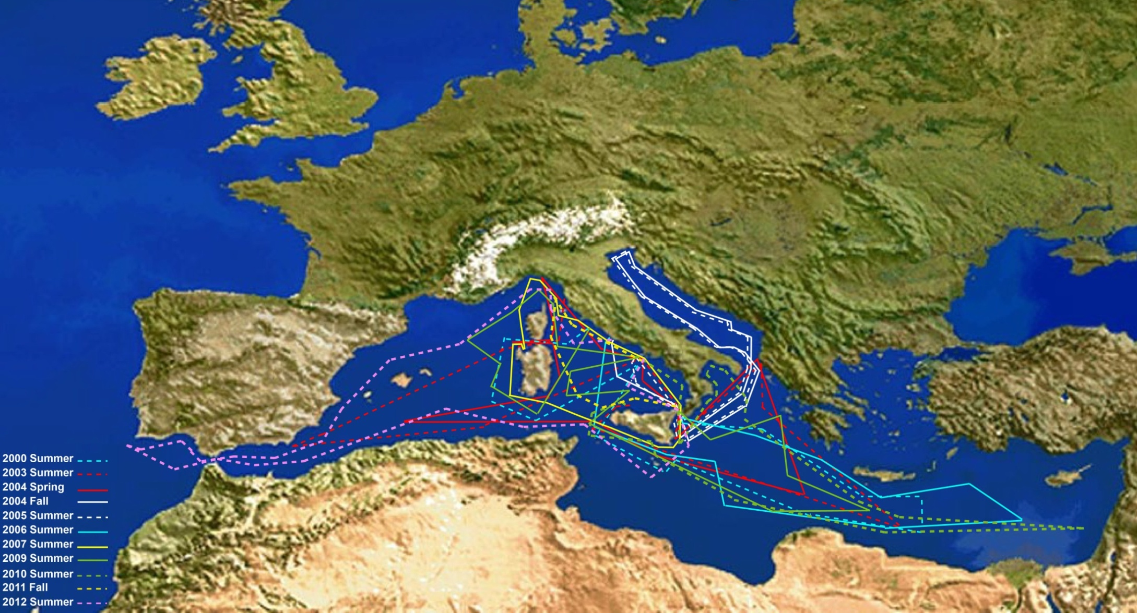
UNEP
Global Monitoring Plan
WHO
CNR
BRI
Nations
COP-2
(Nov. 2018)
CNR – Institute of Atmospheric Pollution Research, Rome, Italy
http://www.iia.cnr.it

Slide 11




CNR coordinates ERA-PLANET
www.era-planet.eu
CNR – Institute of Atmospheric Pollution Research, Rome, Italy
http://www.iia.cnr.it

Slide 12


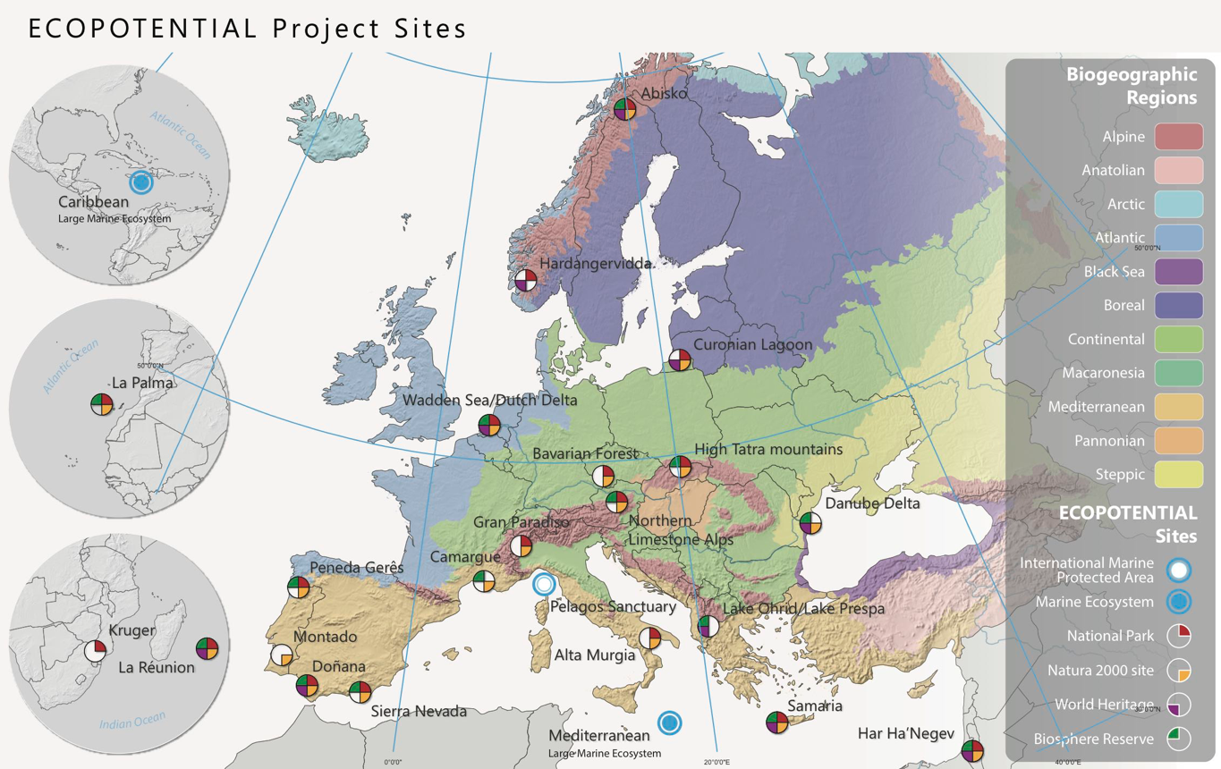
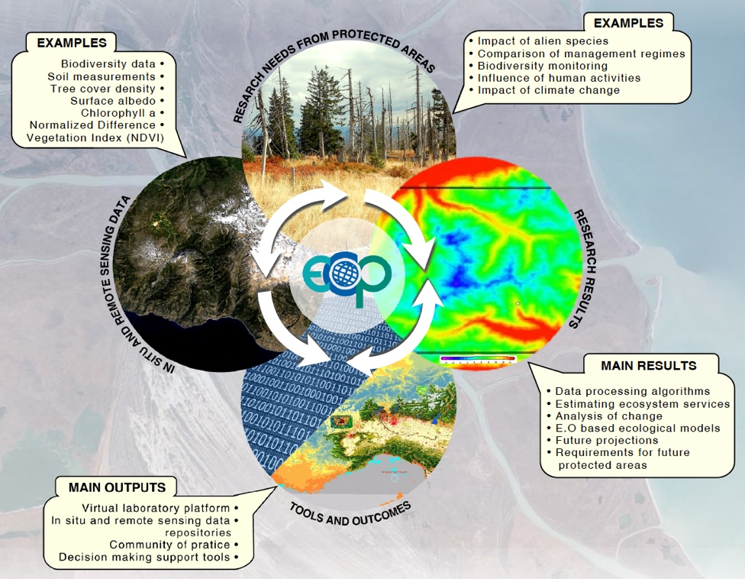
CNR coordinates ECOPOTENTIAL
Funded by the European Union H2020 programme under grant agreement No 641762
Coordinator: Antonello Provenzale
2015-2019 - 47 partners
Focus on 25 targeted set of Protected Areas in Europe and beyond
Mountain, arid and semiarid, coastal and marine ecosystems
Uses EO data for understanding ecosystems structure
Delivers EO data products to understand, model and monitor ecosystem changes and support the effective management of Protected Areas
Contributes to the GEOSS Platform through a Virtual Laboratory Platform
Contributes to GEO ECO & GEO GNOME - Builds a Community of Practice
www.ecopotential-project.eu
Notes:
ECOPOTENTIAL focuses its activities and pilot actions on a targeted set of internationally recognized Protected Areas in Europe and beyond, including mountain, arid and semiarid, and coastal and marine ecosystems that cover all the biogeographic regions of Europe (25 protected areas).
It is one of the largest H2020 projects, with 47 partners from research institutions, international organisations and SME. It is coordinated by the National Council of Research of Italy.
The project aims to deliver products of Earth Observation data to understand, model and monitor ecosystem changes and support the effective management of these Protected Areas, also extending its finding to future protected areas. The project products will be made available for the GCI through a Virtual Laboratory Platform.

Slide 13
CNR contribution to EuroGEOSS
Develop policy- (user-)driven show-cases and pilots to demonstrate how GEOSS may support the policy development and implementation
To push toward a full interoperability with GEOSS Platform and DIAS – the ongoing effort in ERA-PLANET, ECOPOTENTIAL, EOSC-Hub is a key contribution
Leverage and make European EO assets visible internationally
Contribute to the achievement of Sustainable Development Goals, GEO Societal Benefit Areas and GEO priorities having in mind the European context
GEO Italy coordinates the Italian effort in EuroGEOSS
CNR – Institute of Atmospheric Pollution Research, Rome, Italy
http://www.iia.cnr.it

Slide 14
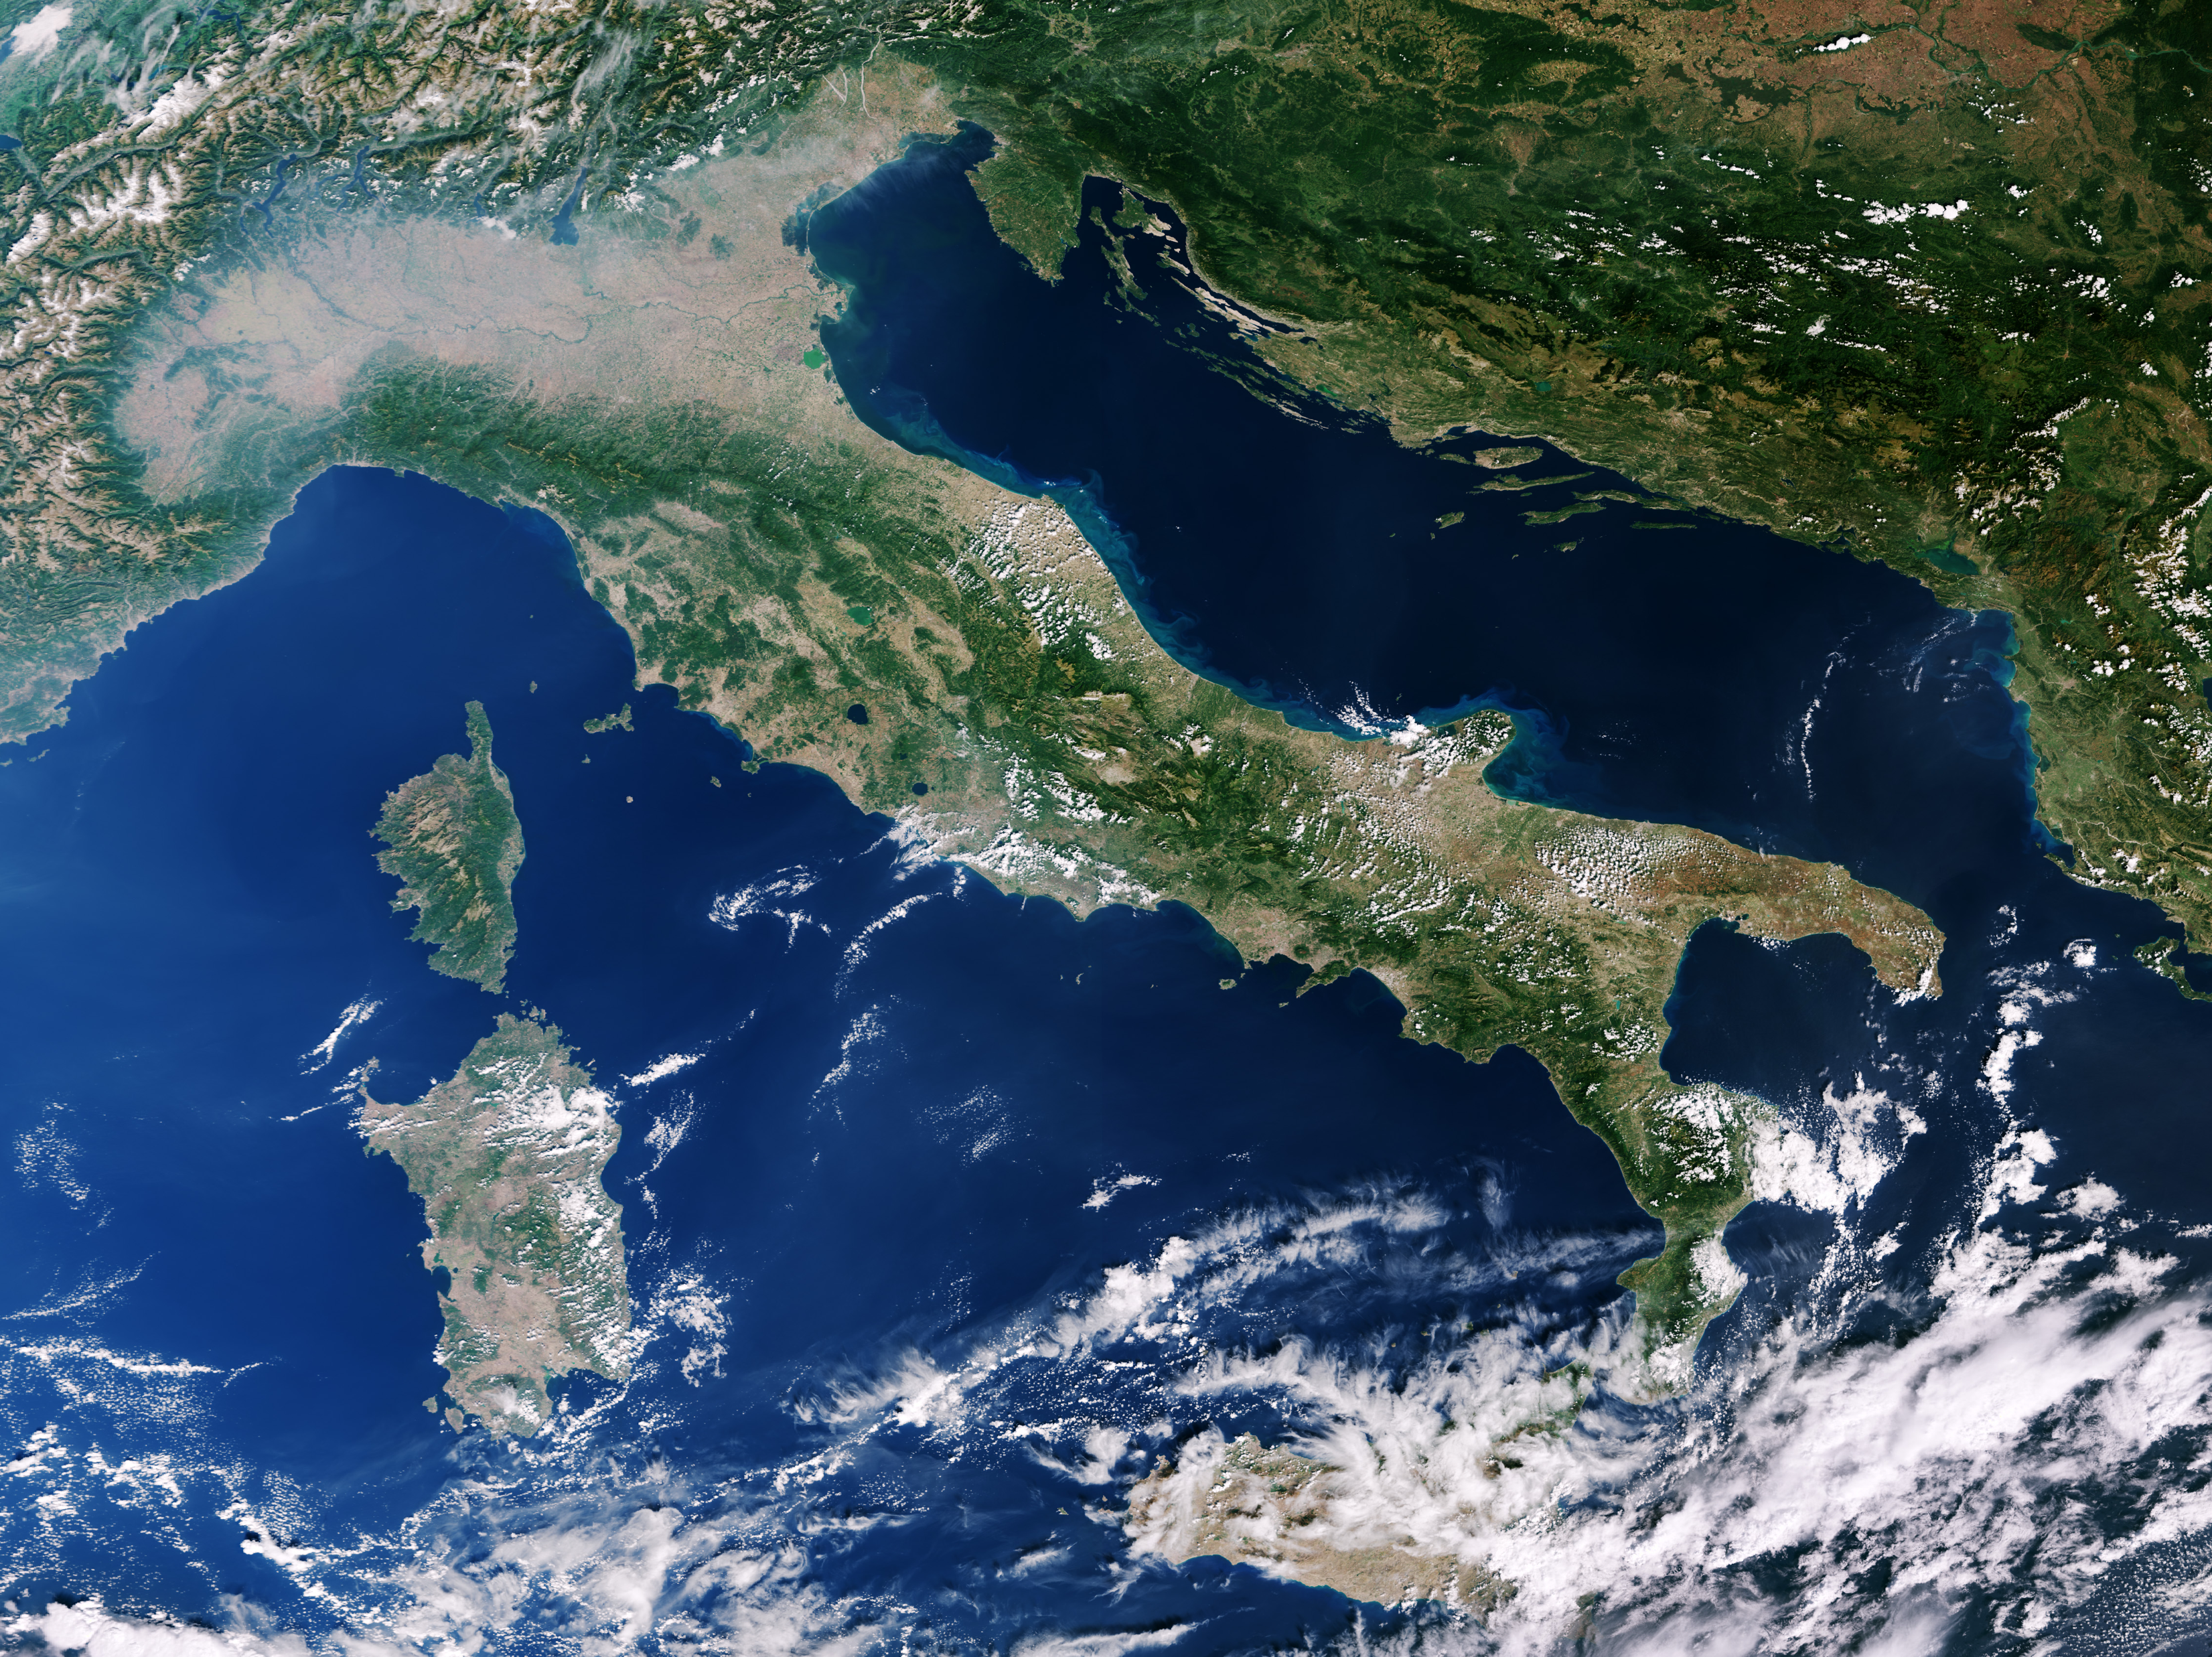
(Image: contains modified Copernicus Sentinel data (2016), processed by ESA)
Thank you….

