Slide 1
Notes:
Fistable i you'll like to give a special thanks to Paola de Salvo who gave me the opportunity to meet people as brilliant as you are. It is an honnor to be here.

Slide 2
What kind of data is still needed for International Disaster Risk Ranking ?
Alexandra Christin/ Master Student / University of Geneva

Slide 3
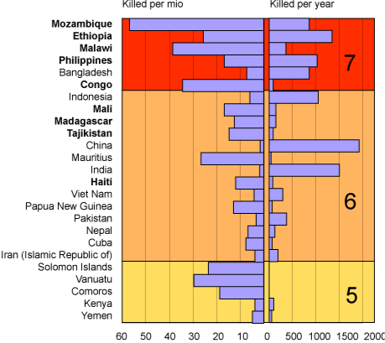
International disaster risk ranking
Erthquake,
Cyclone
Flood
Landslide,
Fire
Dought
Peduzzi, P., Dao, H., Herold, C., & Mouton, F. (2009). Assessing global exposure and vulnerability towards natural hazards: the Disaster Risk Index. Natural Hazards and Earth System Sciences, 9 (4), p.1157.
Notes:
Here is an extract of the disaster risk ranking provided in the disaster risk Index. On one hand we have the number of people killed per milion and on the other hand we have the average number of people killed per year; some other studies focus on economics damages and this two approches are complementary.
I coudn’t do both and I choose to look at the number of people who are potentially exposed. Actually when we look at the economics damage most of the time the value reflect the insurance value and many devlopping country most of people don’t have insurence. Focussing on the number of people mean that we assume that one life is one life .
It take into a count physical expusure and vulerability throught erthquake, cyclone, flood, landslide, fire and dought.
The ranking that we find in the Disaster Risk Index is based on several sources including the physical exposure data provied by the Global Risk Data Platform.

Slide 4
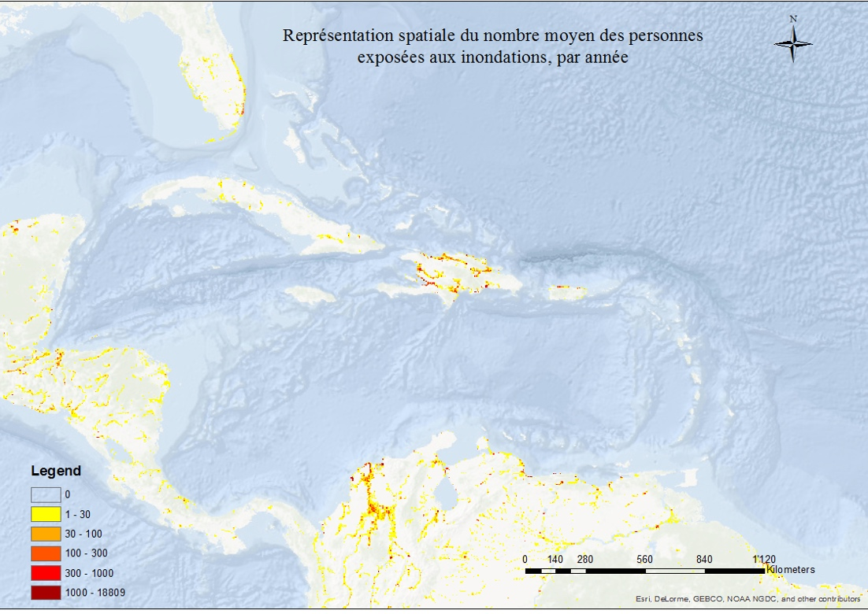
International disaster risk ranking/Flood data
Data source: http://preview.grid.unep.ch/index.php?preview=data&events=floods&evcat=3&lang=eng
Notes:
There each unit is expected average annual population exposed.

Slide 5
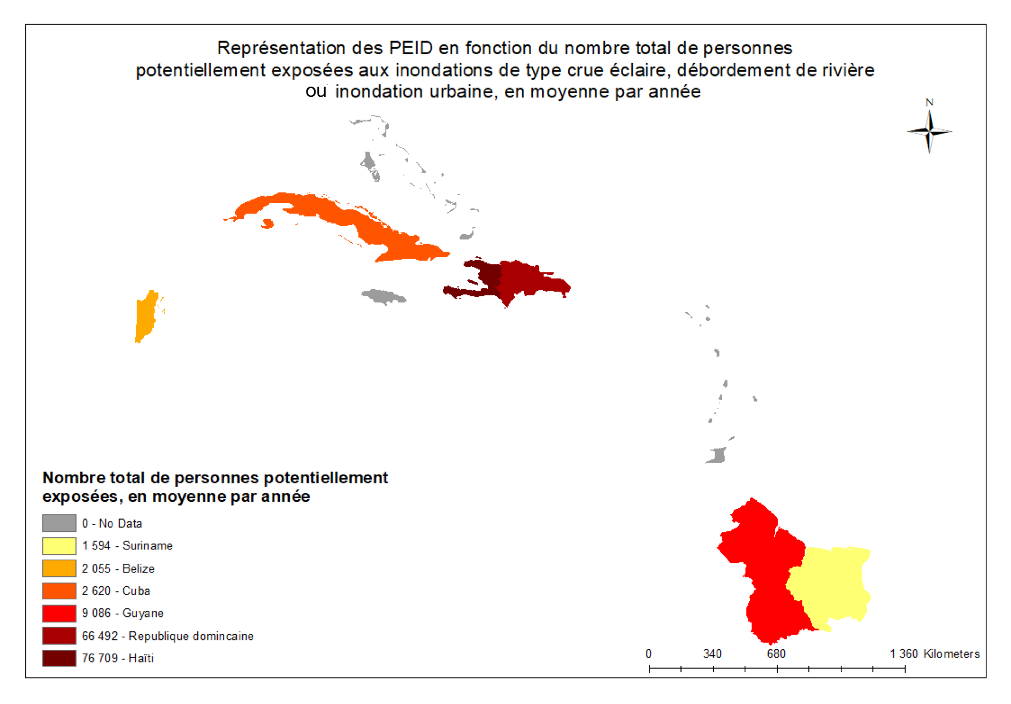
International disaster risk ranking/Flood data
Data source: http://preview.grid.unep.ch/index.php?preview=data&events=floods&evcat=3&lang=eng
Notes:
When we look at the small island developping state, we note the effective lack of data. We see that in the Carïbeean region, for seventeen territories, eleven are missing flood data. It’s thrue for flooding data and for ,cyclone too.
Then, when we look at the flood’s metadata we note that neither the coastal flooding categorie, neither sea level rise are mentionnate. This two parametters are important for all european country that have a costal line and you can esaly understand that there are crusial for island as the coastal area is all around the country. The type of data that exprime the annual average number of people potentially affected by coastal flood is a challenge.

Slide 6
International disaster risk ranking/Flood and sea level rise - Methode
Beck, M. W., Shepard, C. C., Birkmann, J., Rhyner, J., Welle, T., Witting, M., ... & Radtke, K. (2012). World risk report 2012. Berlin, Germany: UNU-EHS and the Nature Conservancy, p.12 ; Kirch, L., Luther, S., Mucke, P., Prütz, R., Radtke, K., Schrader, C. (2017). World Risk Report 2017, p.22
Notes:
As the WorldRiskIndex from Beck & al.,2012 and Kirch & al., 2017 are based on the GRID’s data to express the number of people in a country who are exposed to flood it can not take into a count the coastal flood category. But as sea level rise is becoming more and more important and directly link to climate change it’s figure since 2012 as an indicator (E). In this methodology, autors propose a projection of one meter rise and it is modeled by CReSIDS .

Slide 7
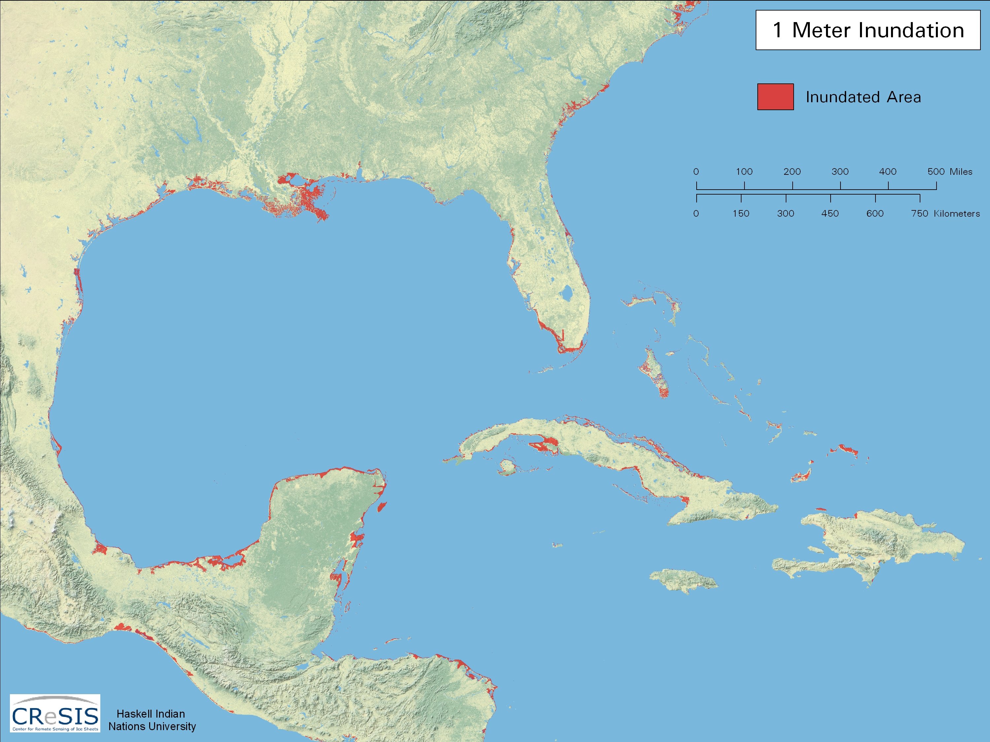
International disaster risk ranking/sea level rise

Slide 8
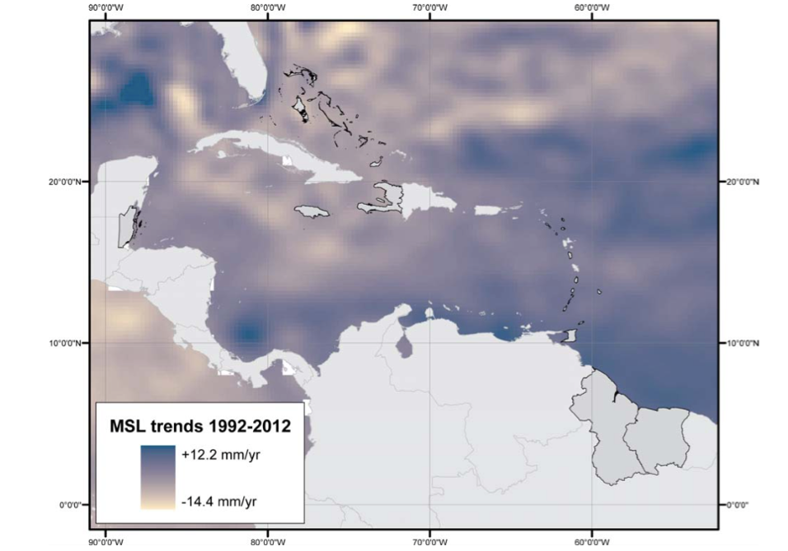
Actual Data/sea level rise
Chatenoux, B. and Wolf, A. (2013) Ecosystem based approaches for climate change adaptation in Caribbean SIDS, UNEP/GRID‐Geneva and ZMT Leibniz Center for Tropical Marine Biology, p.8.
Notes:
Now, if we want to repeat the metodology with acctual data, we can downlad the data-set provied by the GRID on theire SIDS’s section. Each cell represente the average speed over the periode 1992 – 2012 in mm/ year. Frome those datas wich express the Mean Sea Level rise and were modelised by AVISO based on Topex/Poseidon data, we can make our one mask.

Slide 9
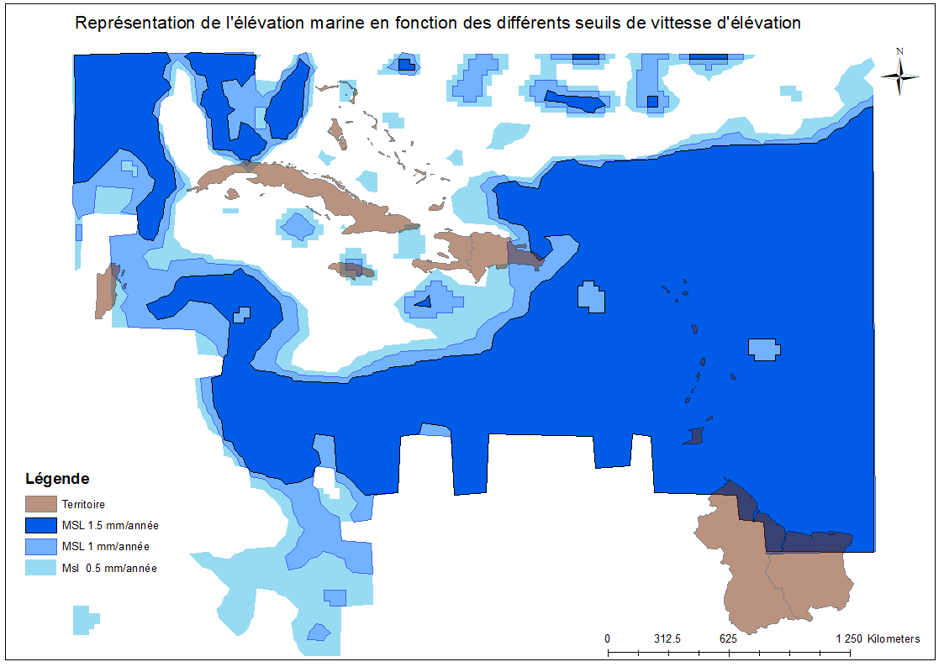
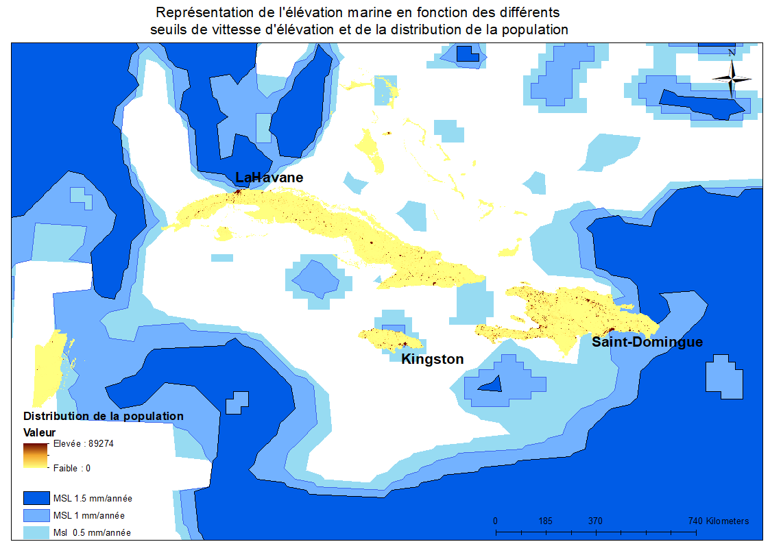
Results/sea level rise (actual)
Notes:
The dark blue patch show areas where the average of sea level rise is equal or uper 1.5 mm/year, then 1 mm/year, finally the clair blue patch selected areas where the average of sea level rise is equal or uper to 0.5 mm/year. All East territories are very afected. But,
for Dominican Republic, Jamaica and Cuba the number of peolpe that are affect will clearly depend on the seuil that we’ll choose. Peining attention on the serveral seuil show us which aera that are impacted first. By combing the population distribution we note that Capital are hot spot because physical exposure seams to heat there first and also it’s where that the concentration of people is the hieghest.
To repeat the metodology we choose the 0.5 seuil, raisonbly because with a speed of 0.5 mm/year, what was in 2012 - 0 - is now 3mm and we can read in the litterature that already 2 mm can cause disproportional damage.

Slide 10
Notes:
To conclued I would like to said that painig attention to Small Island Developping States it’s a step to (un pas vers) equity. Because disaster risks can disturbe water sanitation and water supply this kind of studies are link to the sustainable developpment goal number 6: « cleaar water and sanitation ». Finaly provied data wich are able to express the number of people poptentially exposed to coastal flood at the international level is a challange that will reguire partnership because we will all have to be agree on one methodoloy.

Slide 11
Thank you for listening
Alexandra.christin@etu.unige.ch

