Slide 1
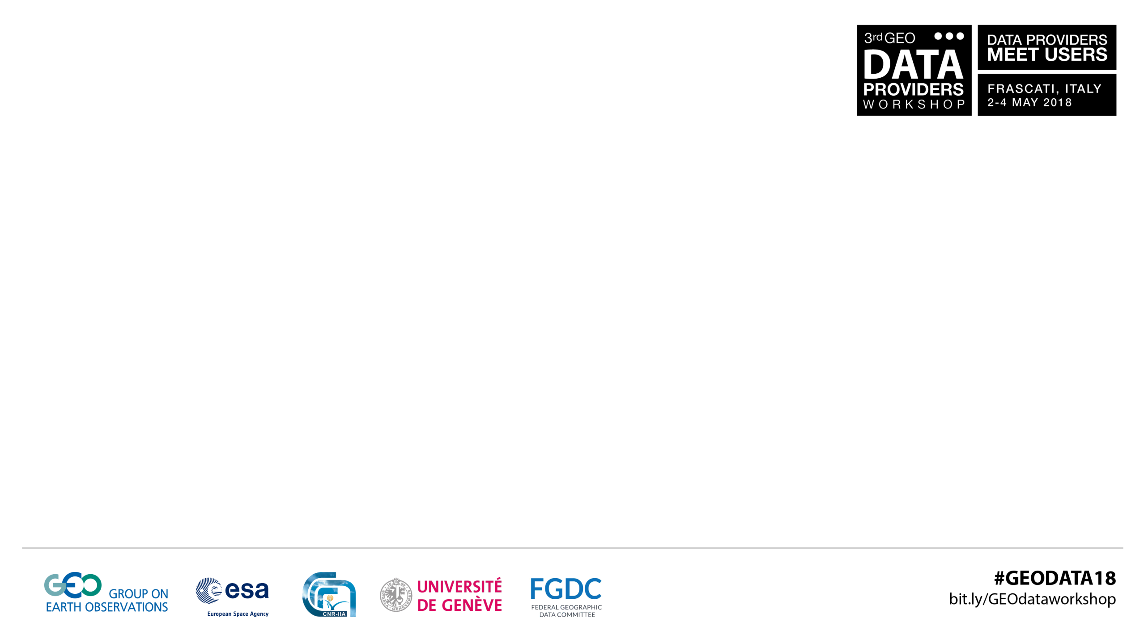
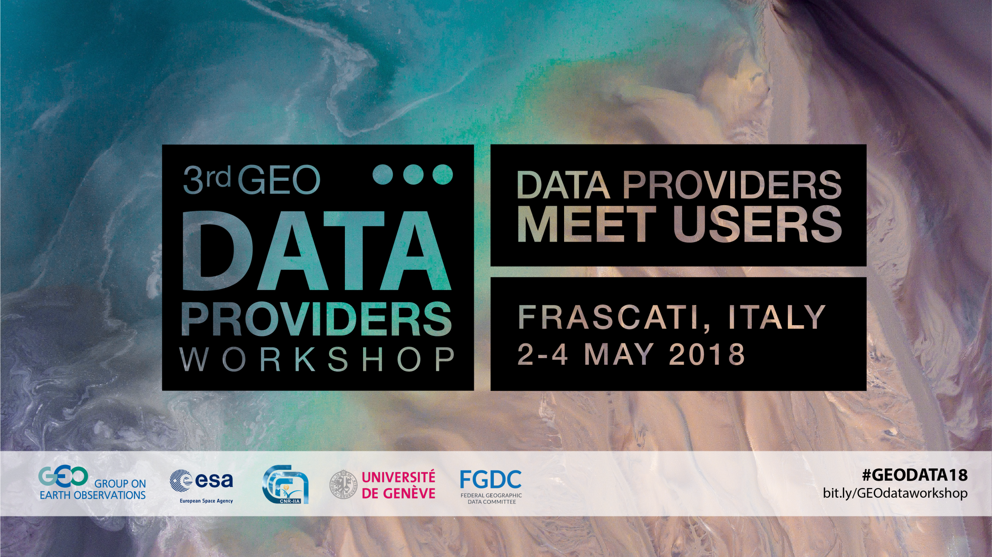

Slide 2
How much can I compress
Images before I lose information?
Bruno Sanguinetti / CBDO / Dotphoton

Slide 3
Motivation
Want to compress to save time and money
Want to guarantee that information is preserved
Because losing information is also expensive

Slide 4
image compression categories
Lossy
Nearly-lossless
Lossless
e.g. JPEG
Bad for processing
1:10 compression
Artefacts
e.g. FLIF
Identical data
1:2 compression
?

Slide 5

Lossy: why are there artefacts?

Slide 6
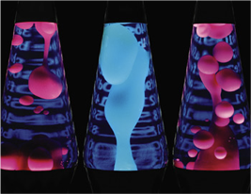
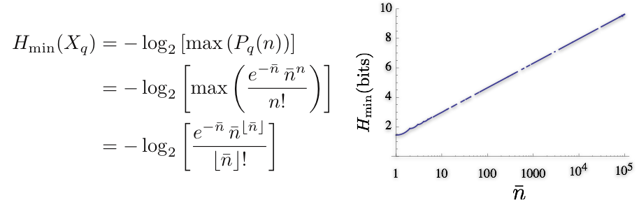
Lossless: why is it limited to 1:2?

Slide 7
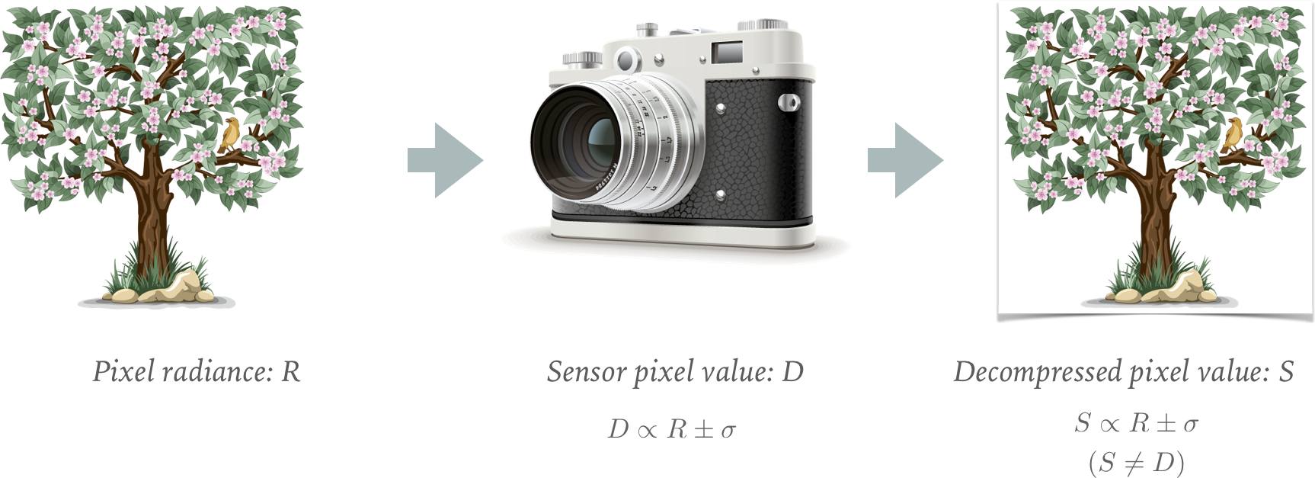
Data and information are not the same

Slide 8
Negligible loss:
Difference between original and compressed < uncertainty

Slide 9
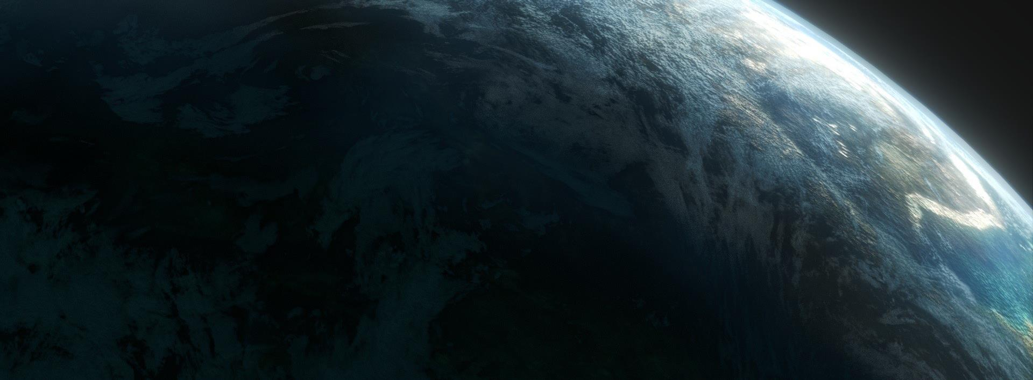
Comparison of errors introduced

Slide 10
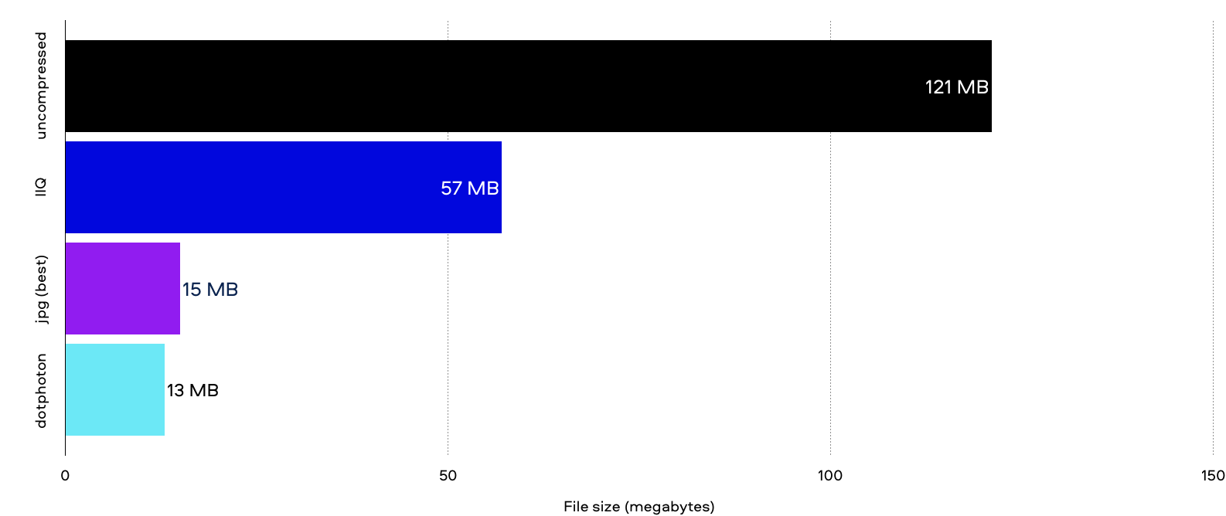
Size comparison

Slide 11
Conclusion
Theoretically possible to compress 10.76:1 with negligible loss
Dotphoton achieves up to 10.5:1 with negligible loss
Requires extremely accurate sensor calibration

Slide 12
Future applications
Obtain 10x the number of images from a satellite
Enable hyperspectral imaging
Share accurate, calibrated data easily

Slide 13
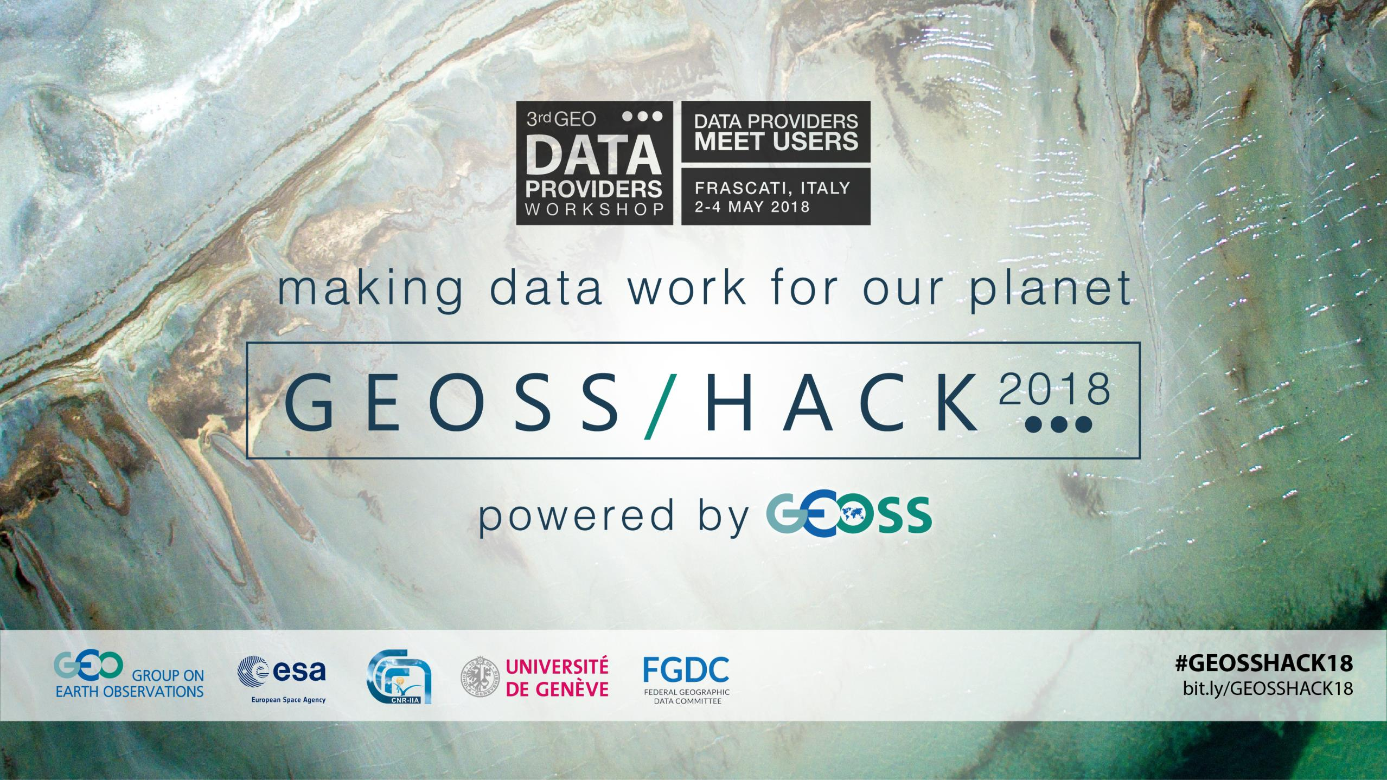

Slide 14
Thank you
Bruno.Sanguinetti@Dotphoton.com / Dotphoton.com

