Slide 1



Slide 2
Update of Data Sharing Activities in ChinaGEOSS
  Li Guoqing, Zhang Lianchong
  RADI/CAS
  May 2, 2018

Slide 3
Outline
  Framework of ChinaGEOSS Data Sharing
  Promotion to ChinaGEOSS Data Policy
  ChinaGEOSS DSNet Portals
  Integration of Data Resources
  Contributions to GEO related work

Slide 4
Framework of ChinaGEOSS Data Sharing Activity
Space Agency
Space Agency
EO Organization
EO Organization
Inter-Ministry Stakeholder Committee of ChinaGEOSS
ChinaGEOSS Office (MOST/NRSCC)
agency level
DS activities
ChinaGEOSS DSNet
project level DS activities

Slide 5
Promotion to ChinaGEOSS Data Policy
Lack of clear and detailed policy to apply for EO data sharing in China
ChinaGEOSS encourages adoption of GEO DSP and DMP
Different policy between its national and international missions
ChinaGEOSS Data Policy
metadata
open and free
published dataset
open and free
essential collection dataset (ECD)
authorized delivery
associated dataset
authorized delivery

Slide 6
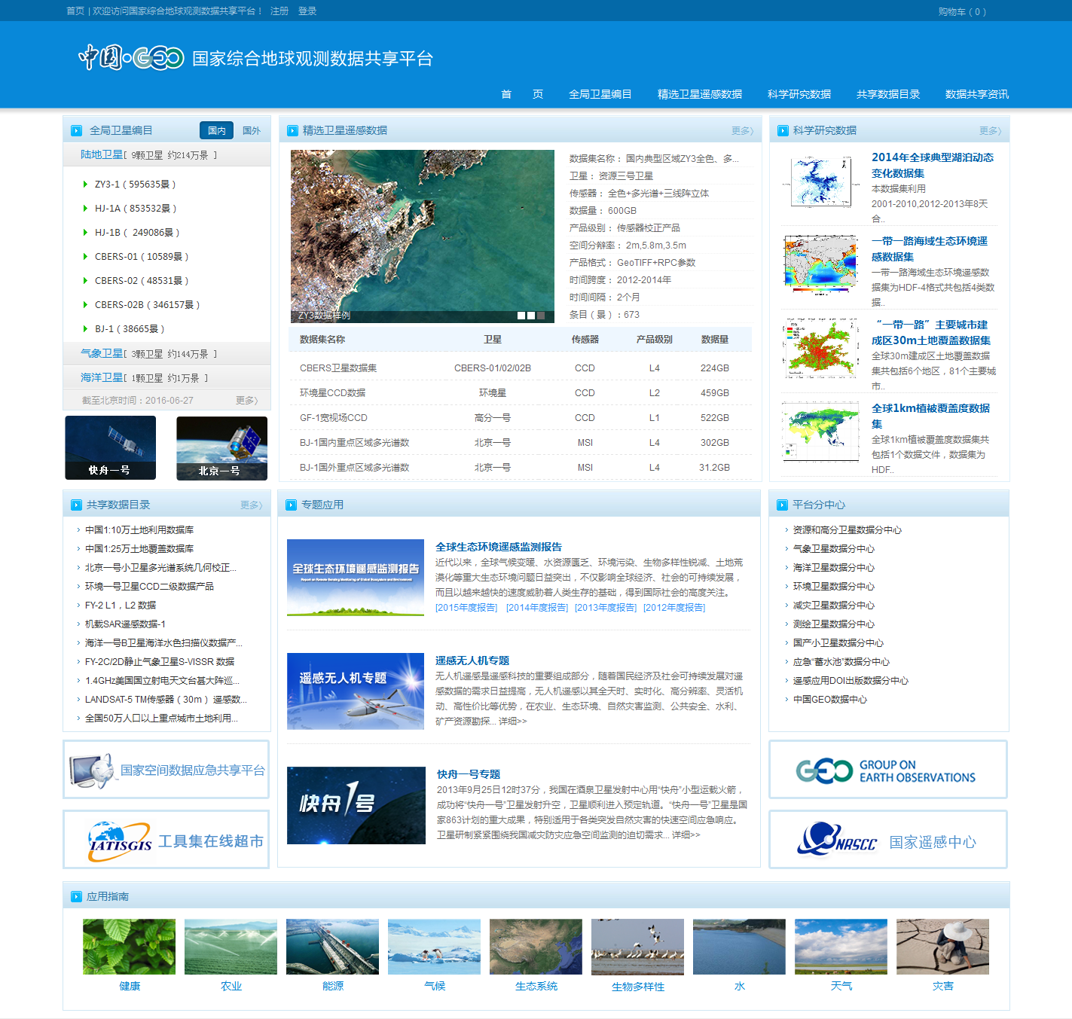
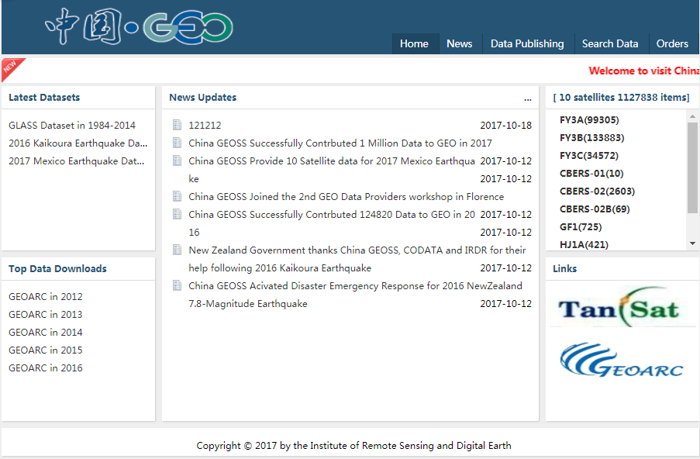
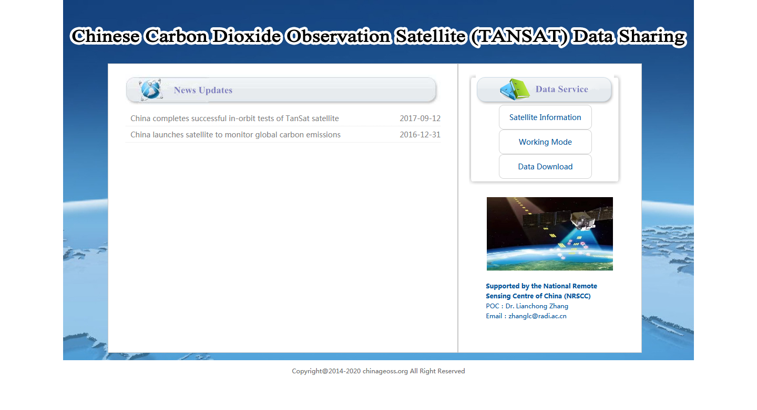



ChinaGEOSS DSNet Portals
Chinese Portal
http://chinageoss.org/
International Portal
http://chinageoss.org/en/index.html
Tansat Portal
http://chinageoss.org/tansat/index.html

Slide 7
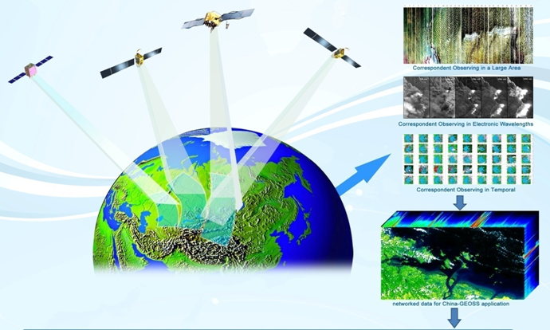
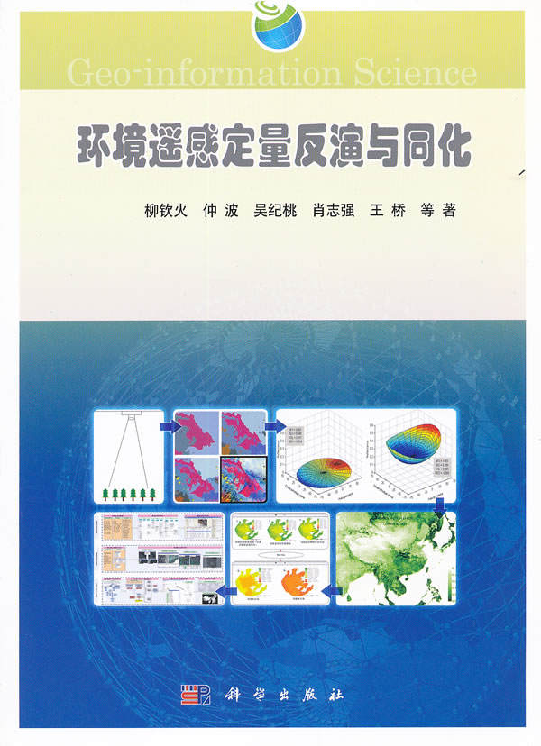
Integration of Data Resources
Chinese EO data
International EO data
Essential Collection
Dataset
Value-added
information data
(published)

Slide 8
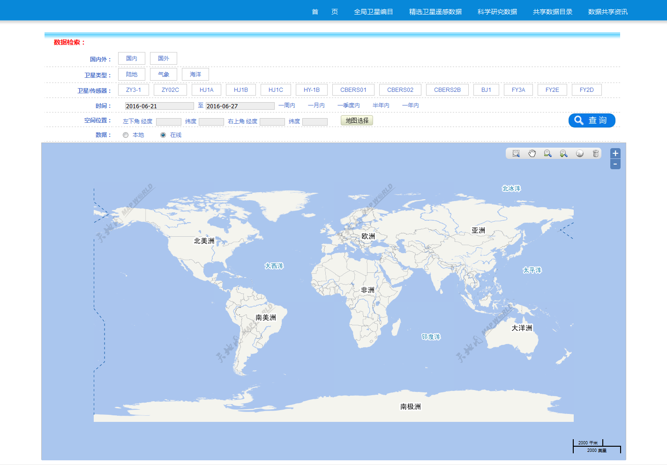
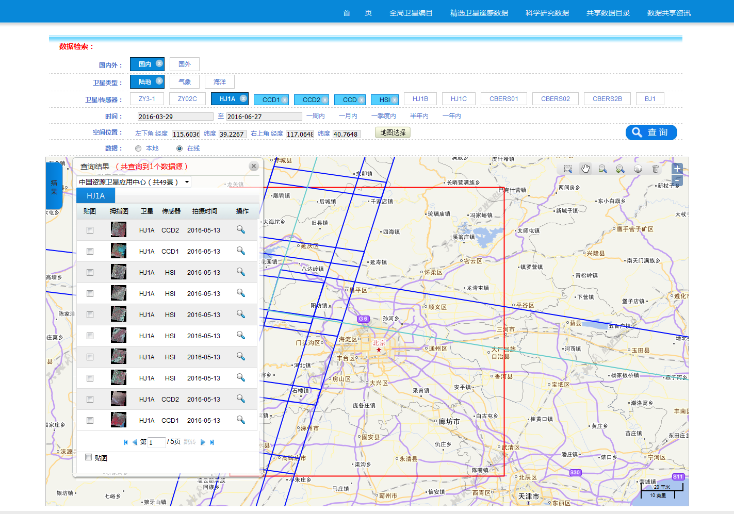
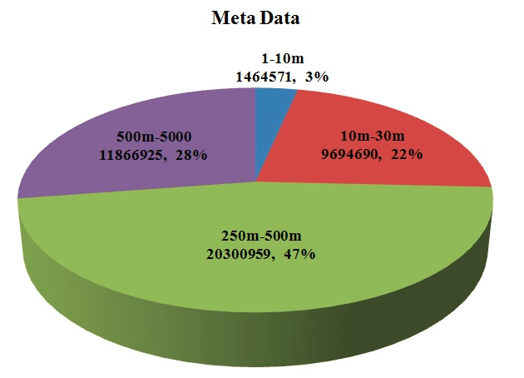
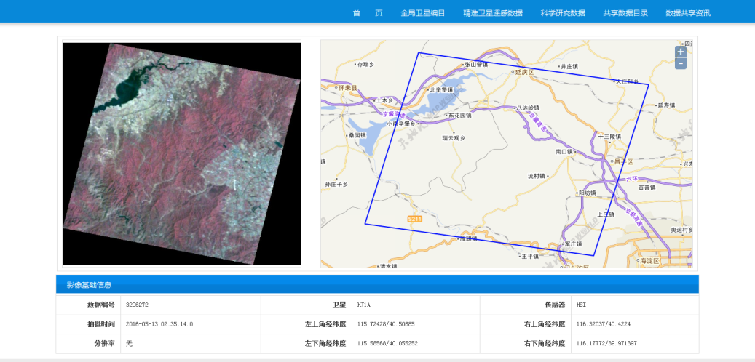
Metadata Harvesting
6 Chinese satellite data centers were connected by 2017
more than 30 millions metadata
are harvested in NRT

Slide 9
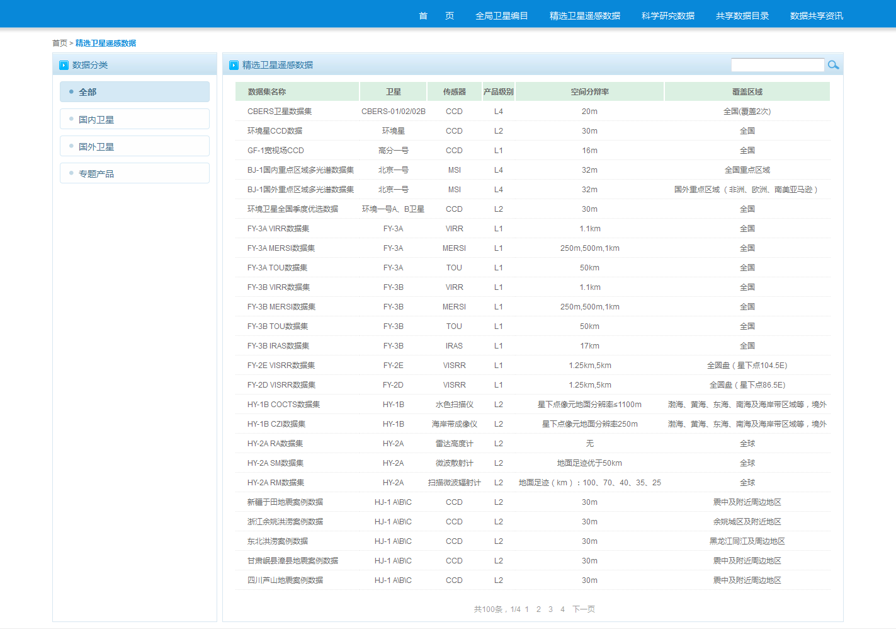
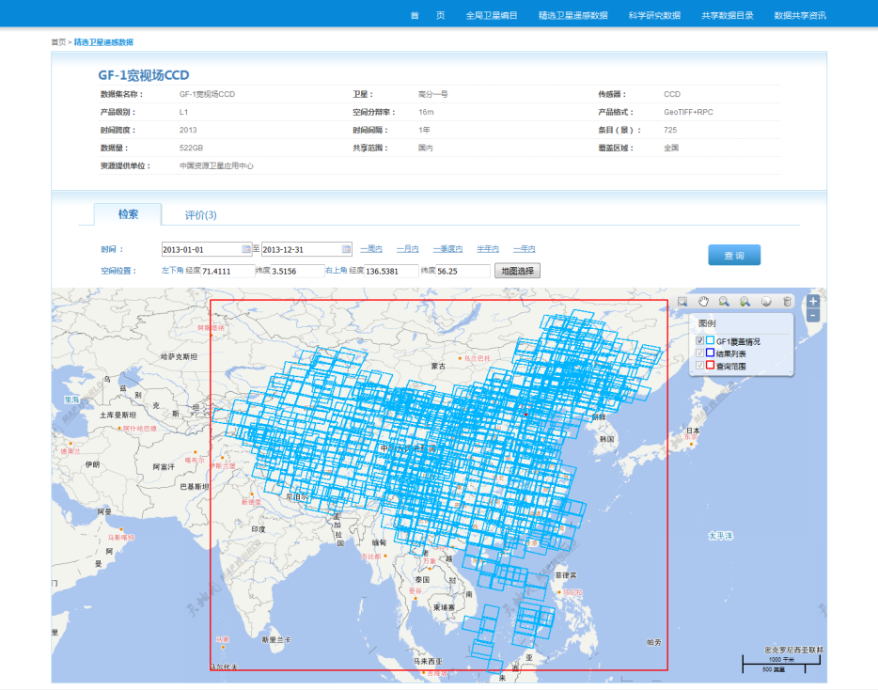
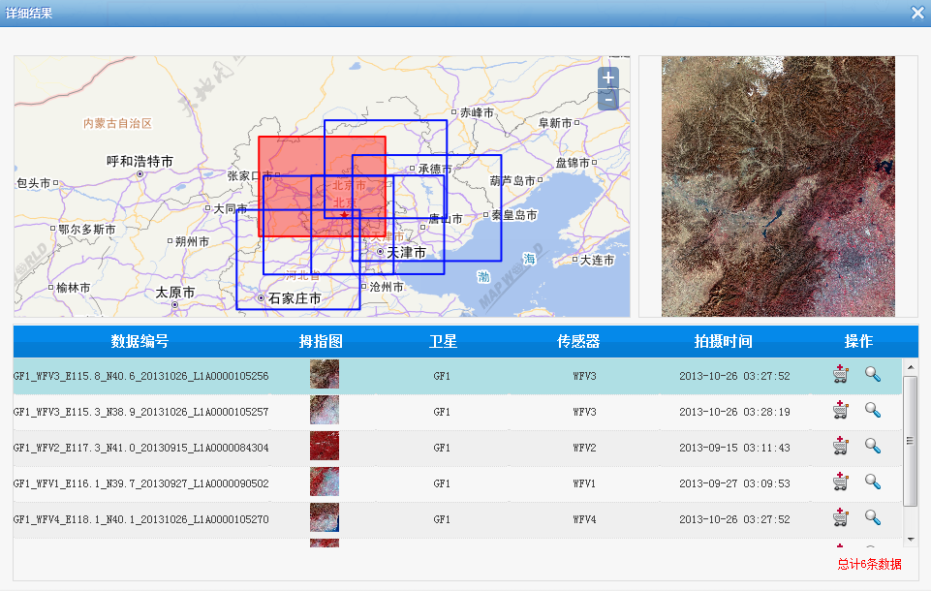
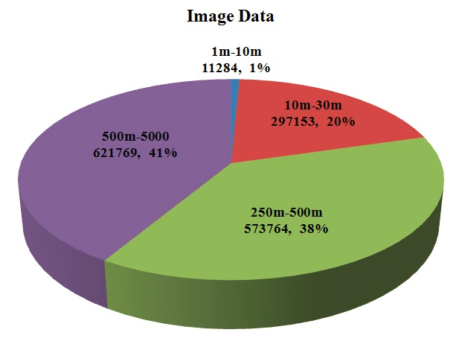
Essential Collection Dataset (ECD: 1% principle)
ECDs are contributed by each data centers regularly
more than 100 datasets have been harvested by 2017
  with metadata records as 9,499,527, and image files over 271TB
  including 6 China satellites (HJ-1A/B, ZY3-01, GF-1, CBERS02C, FY3)
95% ECDs have been authorized to open and free for GEO

Slide 10
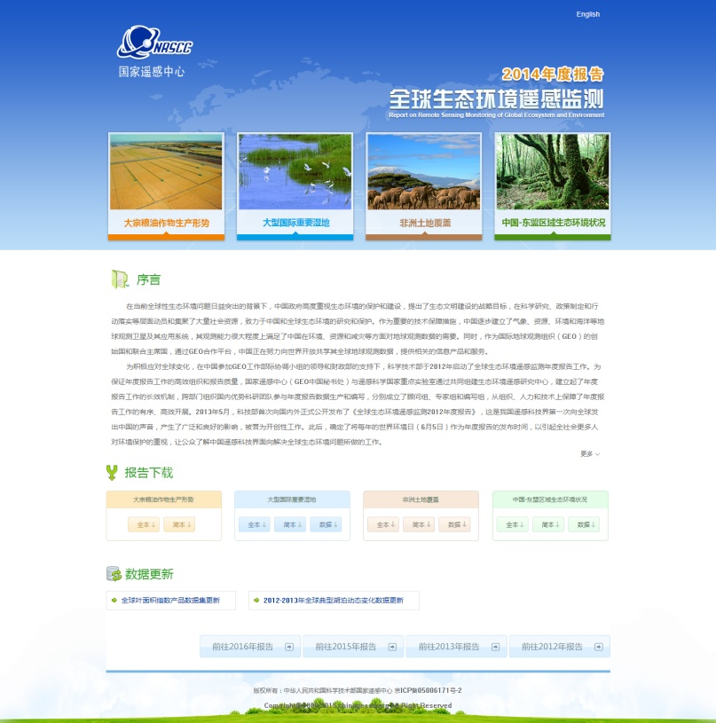
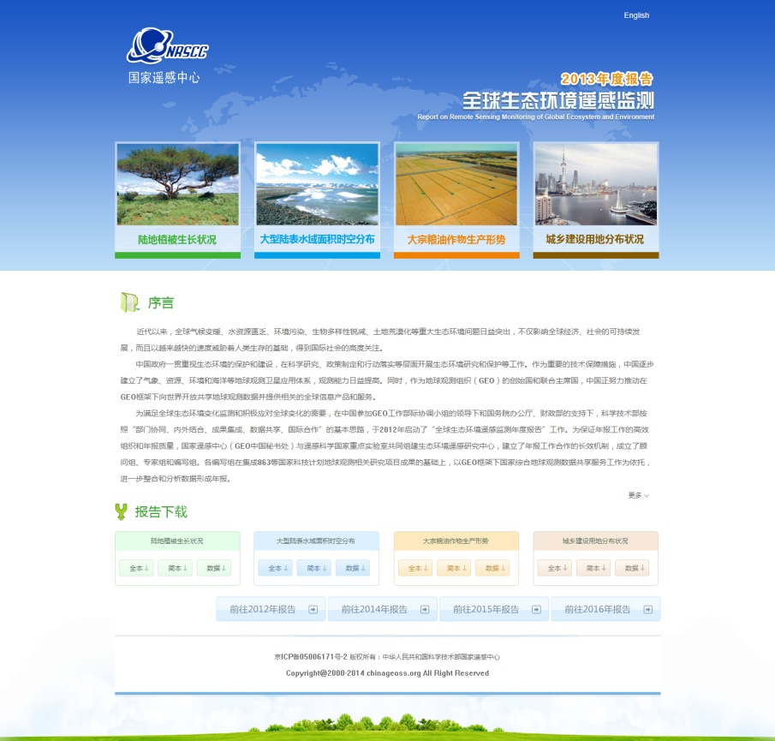
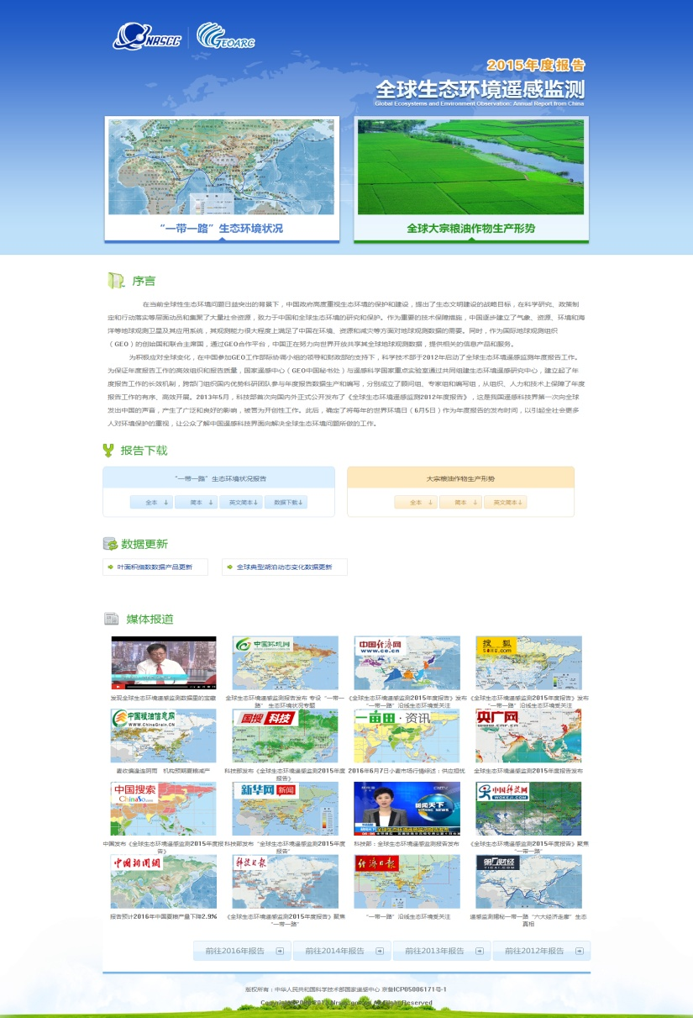
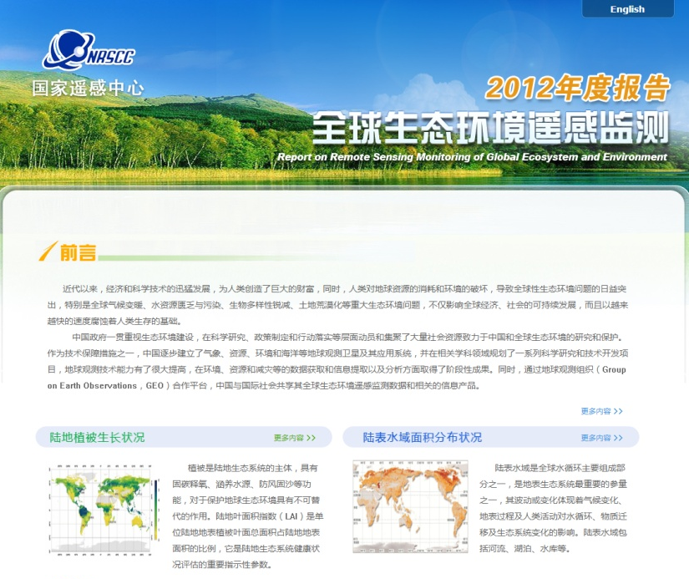
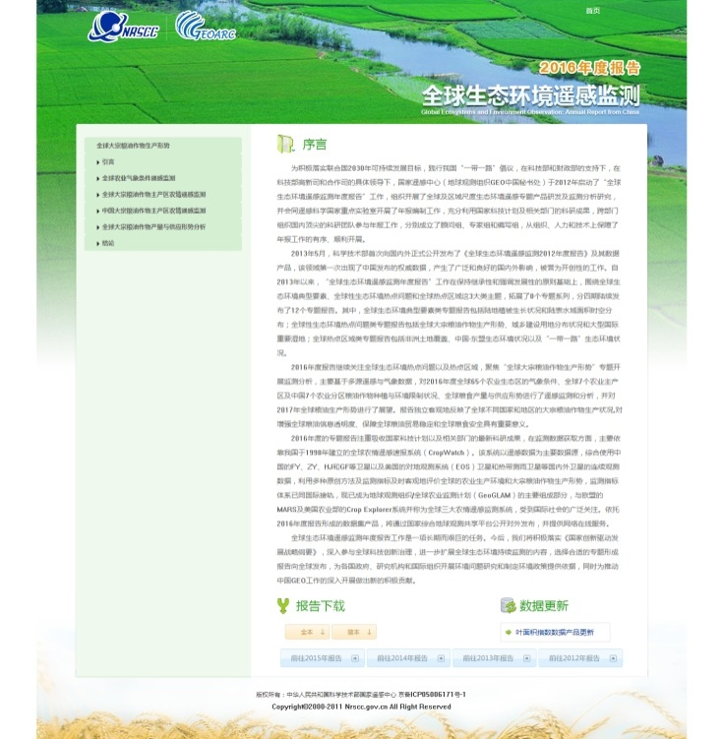
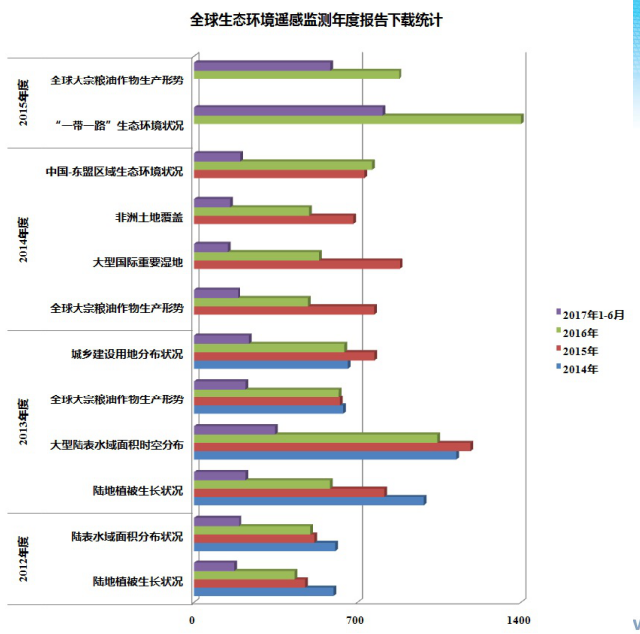
Publishing of annual GEOARC Reports
(GEOARC)
freely access to all of the reports and datasets through ChinaGEOSS DSNet Portal

Slide 11
Contributions to International Communities
AOGEOSS TG10
(Data Sharing TG)
DBAR WG01
(Big Earth Data WG)
GEO Data Portal &
GEOSS Evolve
ChinaGEOSS
DSNet
APSCO data portal
Disaster emergency response
Regional Data Sharing Facility

Slide 12

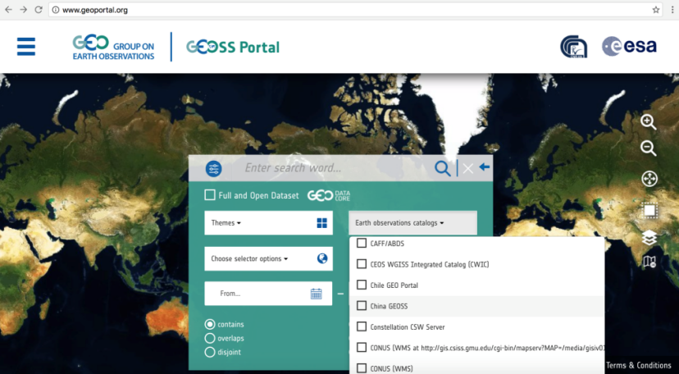
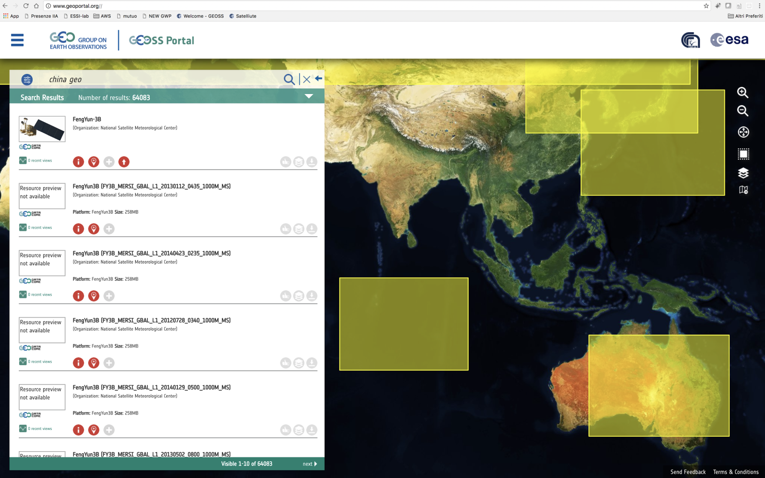
Contribution to GEO Data Infrastructure
ChinaGEO is encouraging member countries to contribute to GEO Data Portal.
Experts from China participated last GEO data provider workshop.
ChinaGEO DSNet has contributed 120k images to GEO Portal at 2016, more than 1 million images in 2017, and same number for 2018.
ChinaGEO Data Resources in GEO Portal

Slide 13

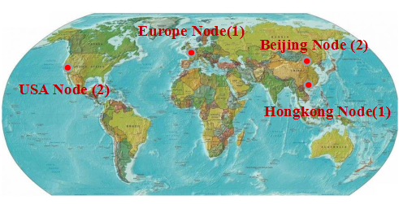
ChinaGEOSS Disaster Data emergency
Response mechanism (CDDR)
 | New Zealand 2016 | Mexico 2017 | Iran-Iraq 2017 | Gita Typhoon 2018
Satellite | 7 | 10 | 10 | 4
Images | 219 | 293 | 570 | 294

Slide 14
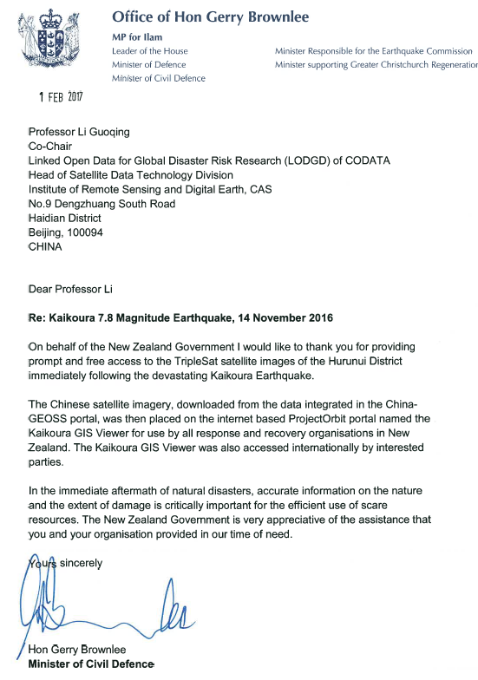
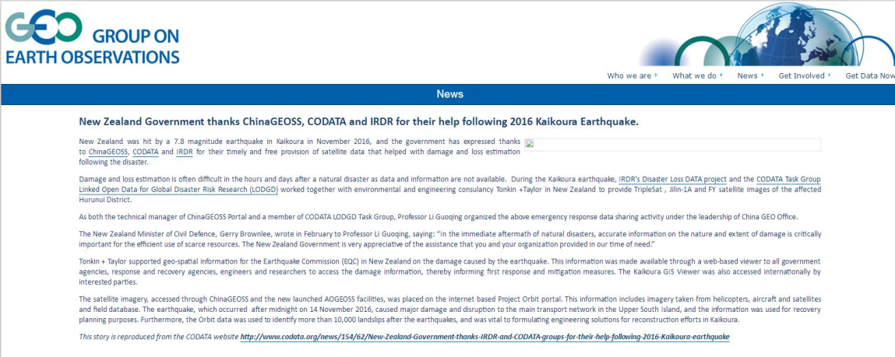
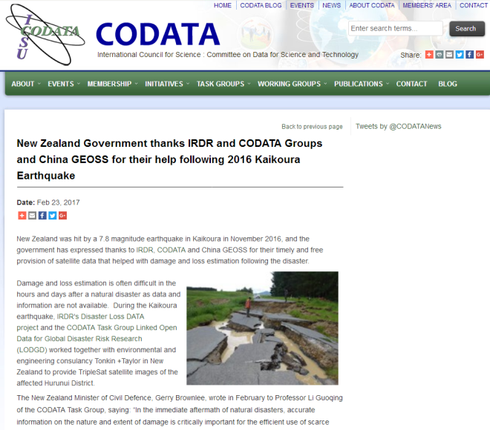
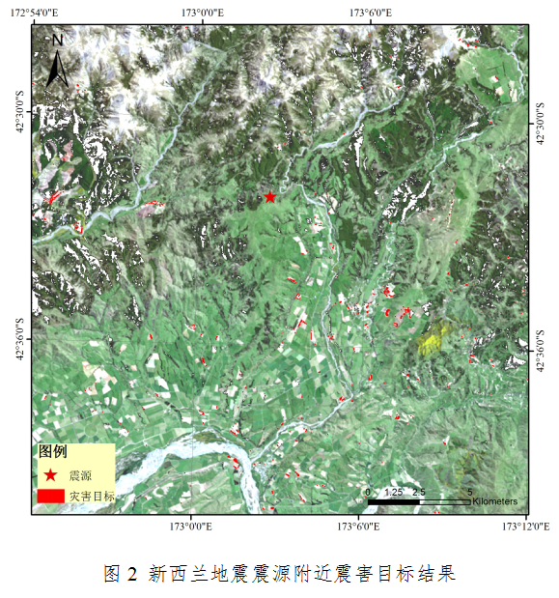
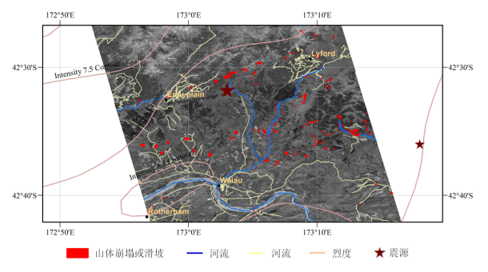
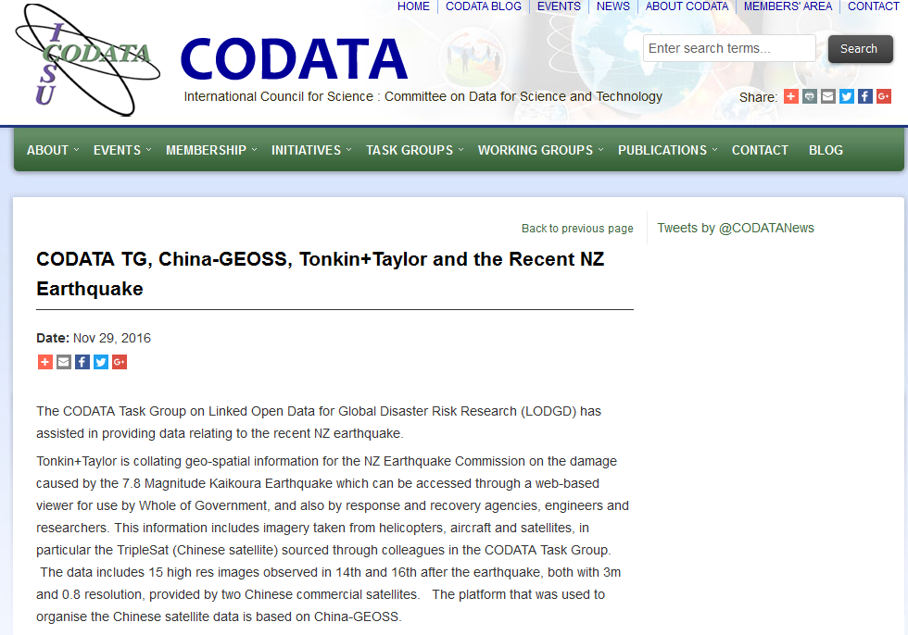
New Zealand Earthquake Emergency Response
Landslide mapping after earthquake by RADI team

Slide 15
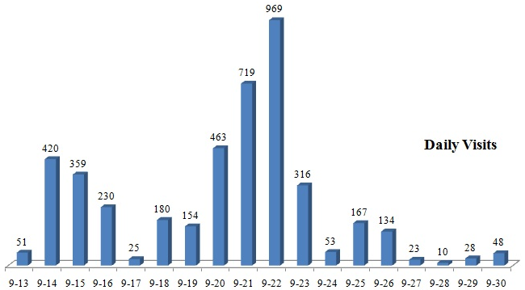
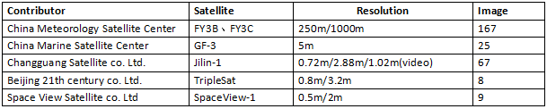
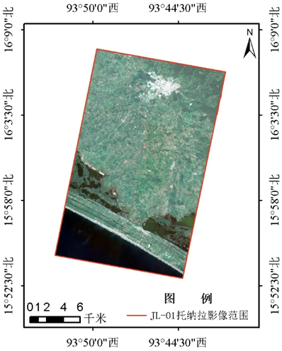
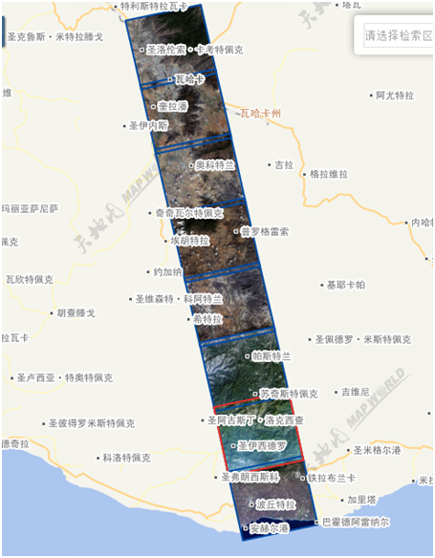
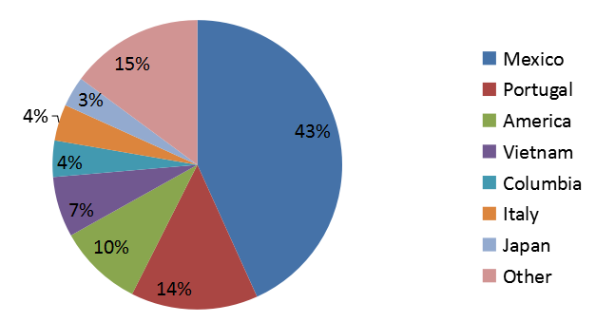
Mexico Earthquakes Emergency Response
During Mexico earthqauke emergency response at Sept 20-30, there were 4,351 visits to ChinaGEO DSNet portal and download 8.5TB images about this disaster events.

Slide 16
Iran-Iraq Earthquake Emergency Response

Slide 17
Iran-Iraq Earthquake Emergency Response

Slide 18
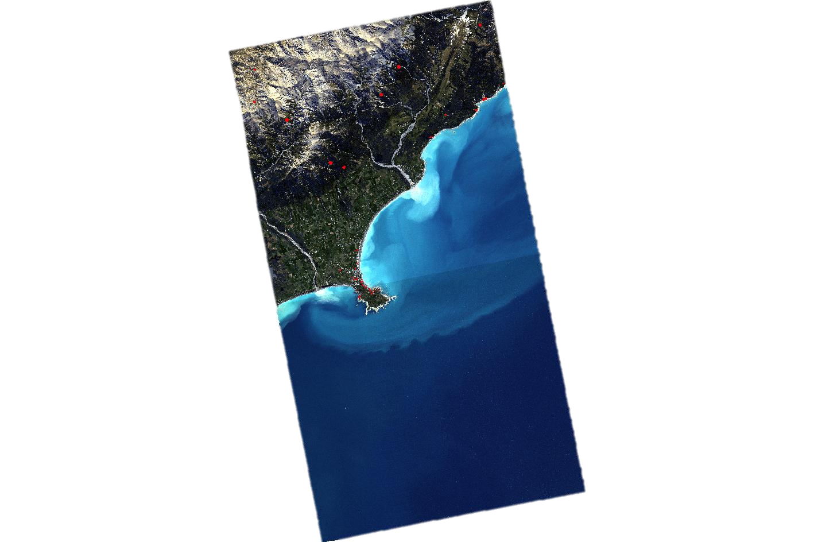
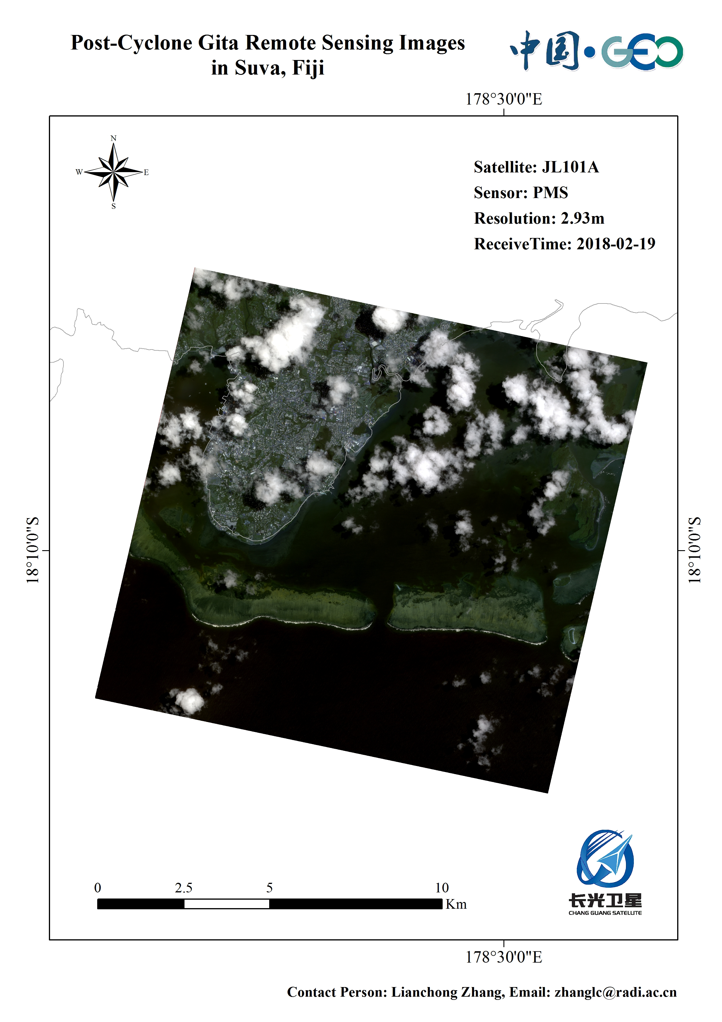
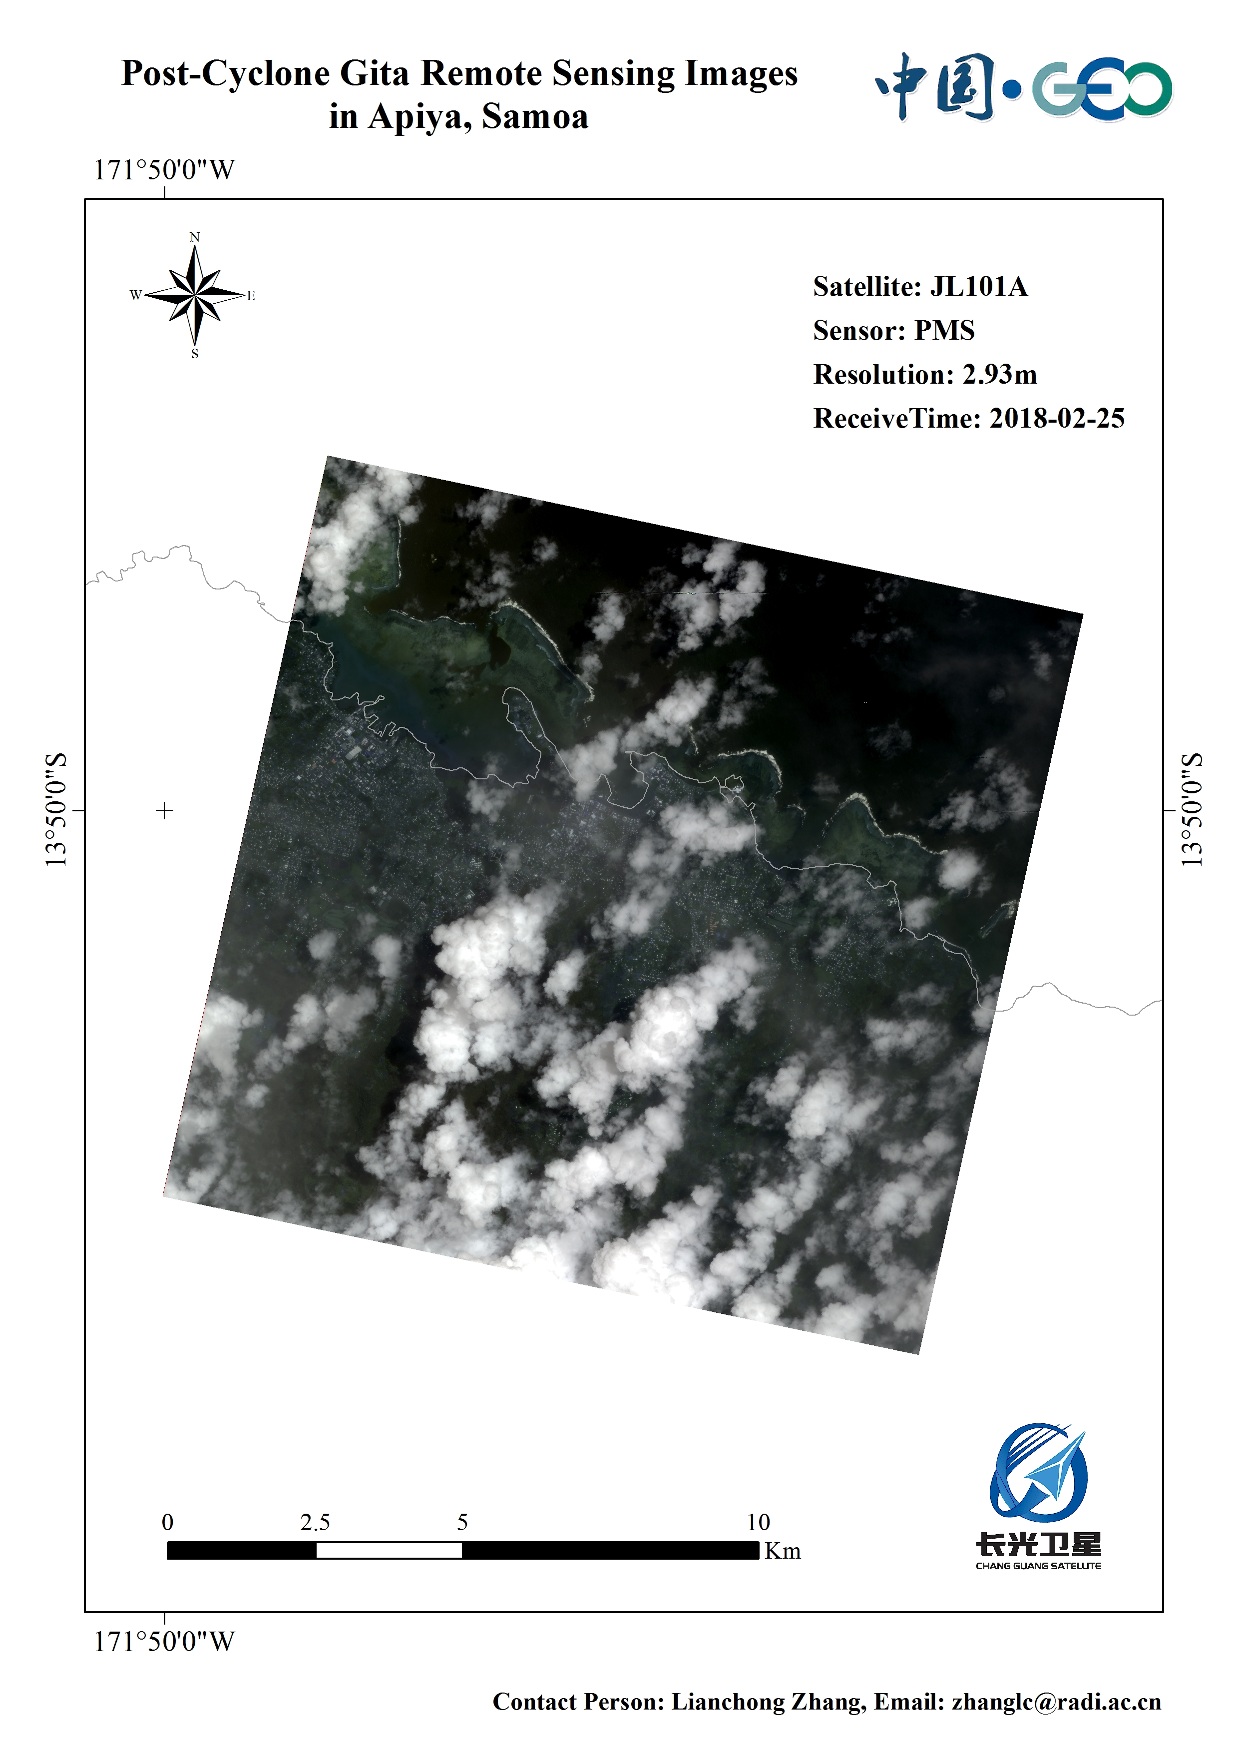
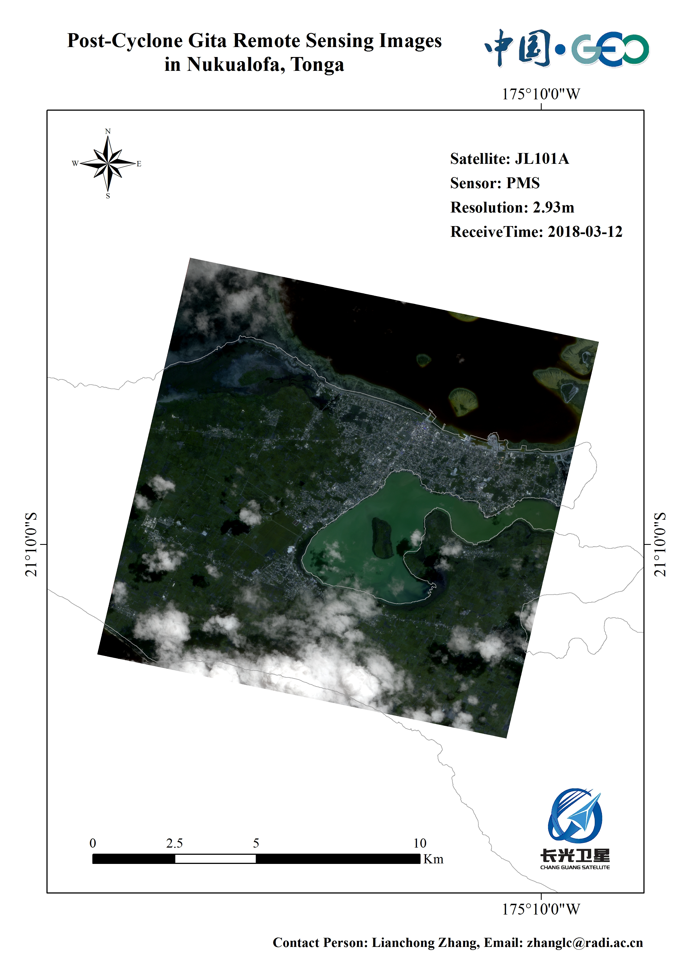
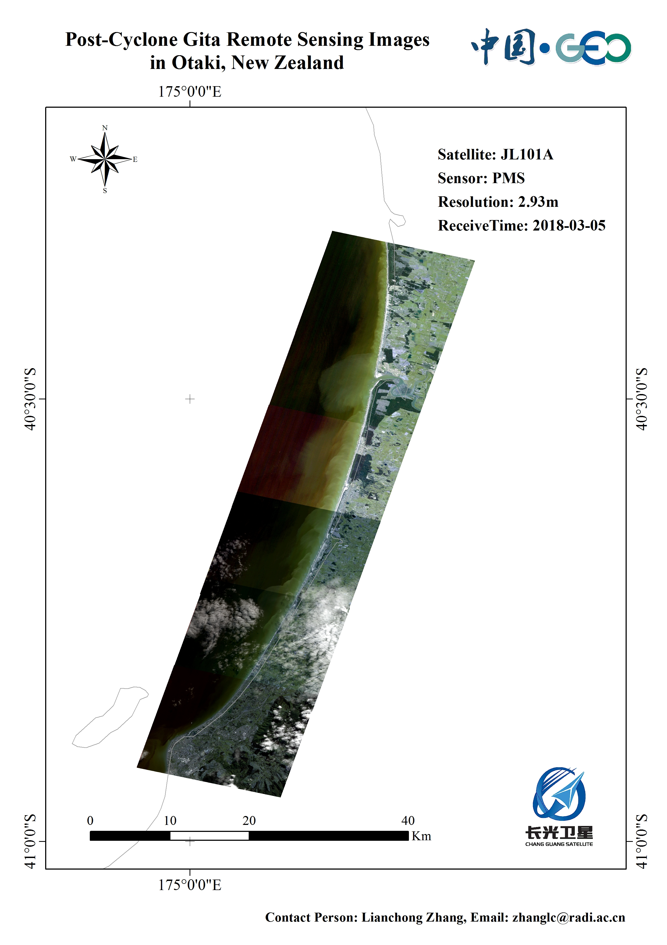
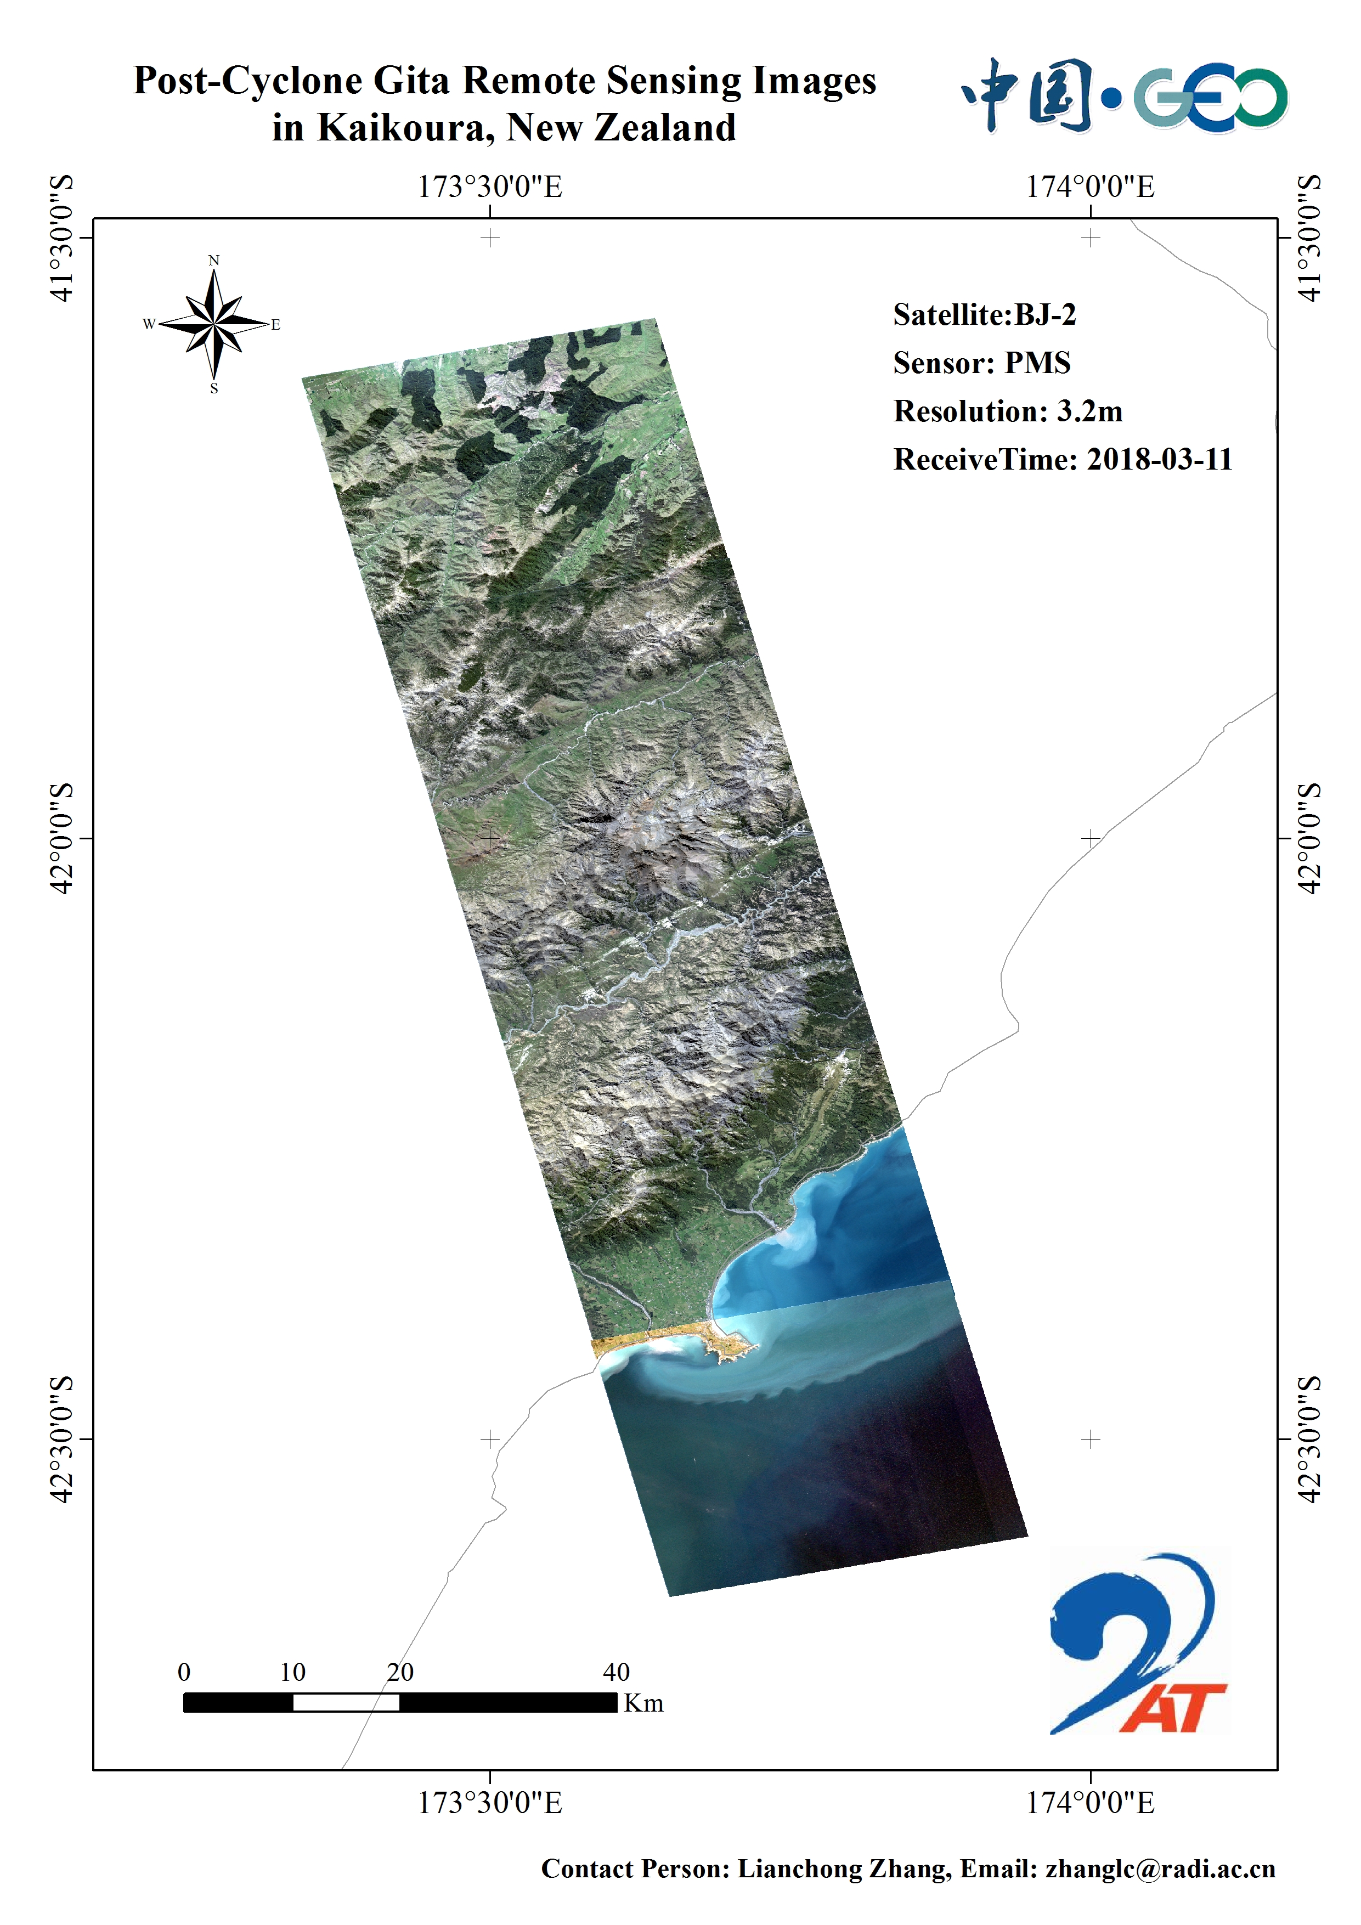
Gita Typhoon Emergency Response
Requested by ESCAP, Samoa and NZ, repsonse launched during Chinese New Year season, five sepcial observing were taken by high resolution Chinese satellites (JL, BJ-2). Lots of data has been pushed to the suffered countries.
With the analysis to the images (0.58 m) over NZ, the impact of Gita typhoon at Feb 20th has been detected. There are 43 damaged points, 1 for road damage, 26 for damaged house, and 16 for landslide or debris flow. ）

Slide 19
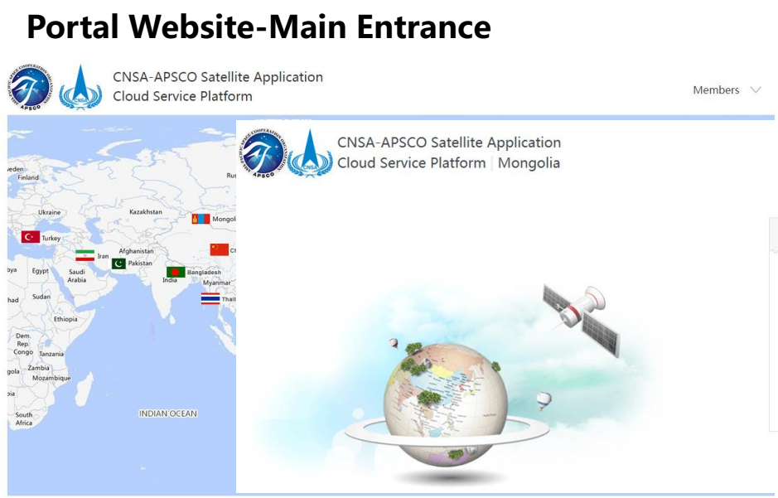
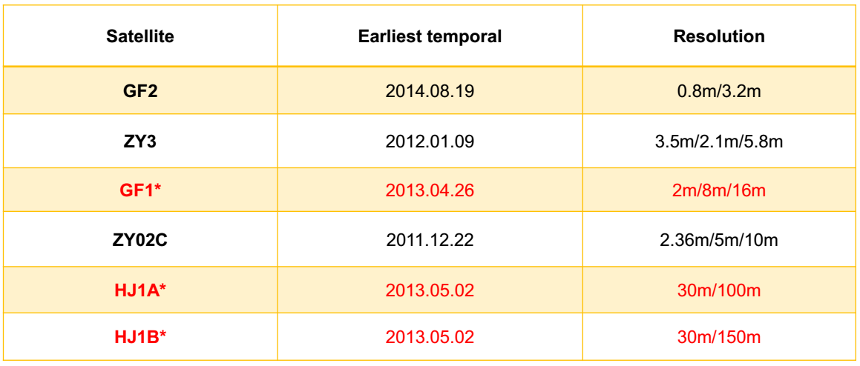
APSCO Data Portal by China Agency
it can provide high resolution images freely
China supported its portal development and main data resources

Slide 20
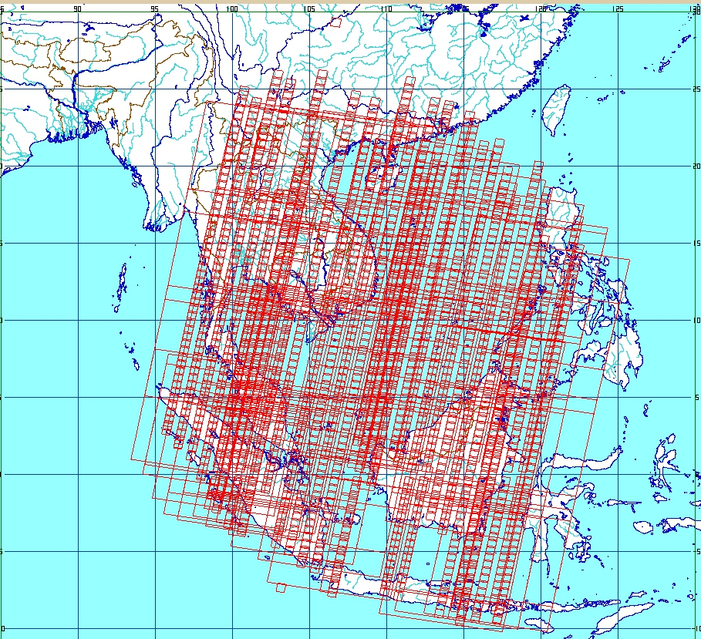
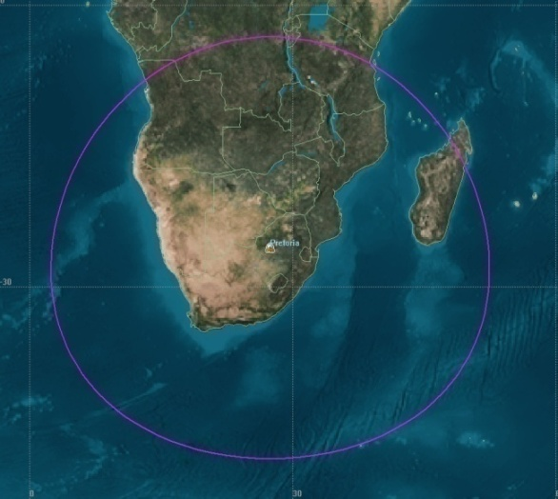
Regional Data Sharing Facilities
High Resolution Regional Land Surface Imaging - CBERS 04
5-10 meter res. freely access
Singapore Station (10 countries)
South Africa Hartebeeshoeck Station (13 countries)

Slide 21
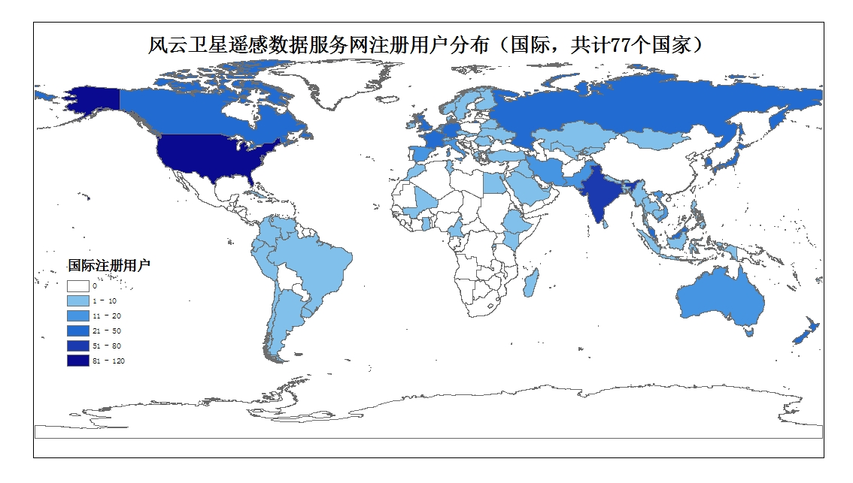
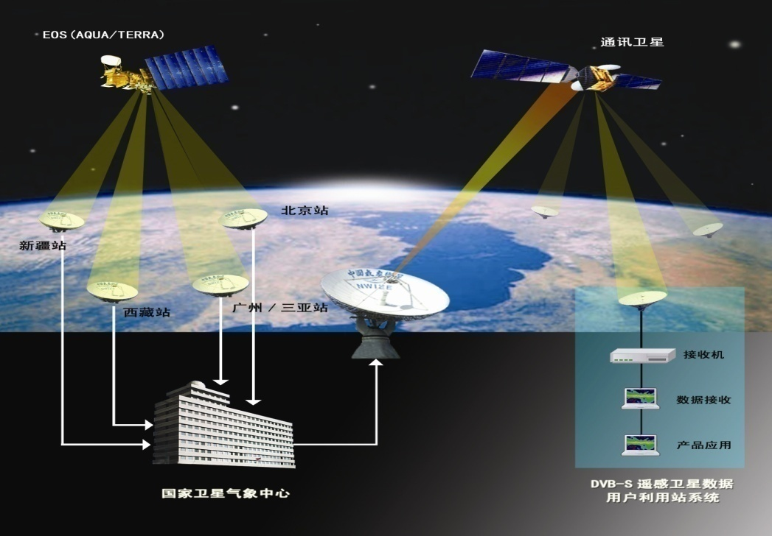
Castaneda user network
CMACast system
Over 8.5PB Data with 25 satellites, open and free
> 60 countries can receive FY data
> 90 countries are using FY data

Slide 22
Thank you
ligq@radi.ac.cn

