Slide 2
The Global Human Settlement Layer
the ICRC story
Martino Pesaresi / Scientific Official / European Commission, Joint Research Centre

Slide 3
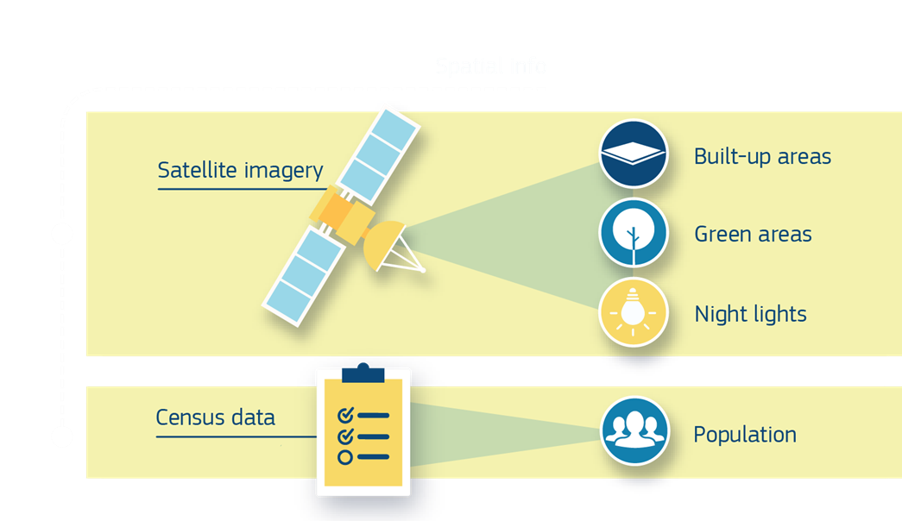
#2May_Session4 / The Global Human Settlement Layer basic
Symbolic Machine Learning
New approach inspired to DNA sequencing and characterization
Spatial-Temporal
Harmonized
Global
Data
(GRIDS)
Data4Policy
Public data for public policies
Evidence-based decision support
Spatial Data Modelling
New models facilitating the science2policy

Slide 4
#2May_Session4 / The Global Human Settlement Layer basic
Three main GIS GRID DATABASE products (R2016)
GHS-BU Density of roofed buildings 10-80m scale/detail → 250m → 1km
GHS-POP Density of resident people 250m scale/detail → 1km
GHS-SMOD Urban-Rural settlement classification 1km scale/detail
One new main GIS VECTOR DATABASE product (R2018)
The global urban centers database More than 10.000 individual cities > 50K reported, population, land cover/land use, environmental measures, exposure to natural hazards, in the city-specific geographical frame
All the above multi-temporal from 1975 until today (40 years time depth)
The data published on JRC Open Data Catalogue
brokered by GEOSS and other catalogues (Aug 2017):
GEOSS portal: http://www.geoportal.org/
The EU Open Data Portal http://data.europa.eu/euodp
the EU Data portal https://www.europeandataportal.eu/
The BioEconomy Data Catalogue: https://data-bioeconomy.jrc.ec.europa.eu/
The MIDAS catalogue: http://midas-portal.jrc.it/discovery/midas/
The Thomson Reuters Web of Knowledge: http://apps.webofknowledge.com

Slide 5
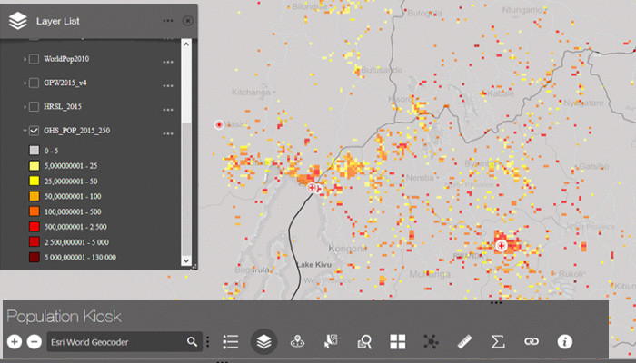
#2May_Session4 / Open population grid data
aids ICRC´s crisis response (Yann Rebois / August 22, 2017)
protect and assist the victims of the war and other emergency situations
be able to estimate the size of the populations affected by a conflict or disaster
reliable information from statistical or government bodies is often missing or fragmented in the areas where the ICRC is working
http://www.earthobservations.org/geo_blog_obs.php?id=243

Slide 6
#2May_Session4 / The Global Human Settlement Layer basic
Since first GHSL release October 2016 (19 months):
53,950 new accesses to the GHSL web platform
More than 3,600 full GHSL data package download from the JRC open Data Platform
More than 150 scientists and policy makers belonging to 85 different organizations (academies, international stakeholders, governmental bodies and the private sector) joined the GEO Human Planet Initiative

Slide 8
Thank you
martino.pesaresi@ec.europa.eu / http://ghsl.jrc.ec.europa.eu / twitter #GHSL

