Slide 1

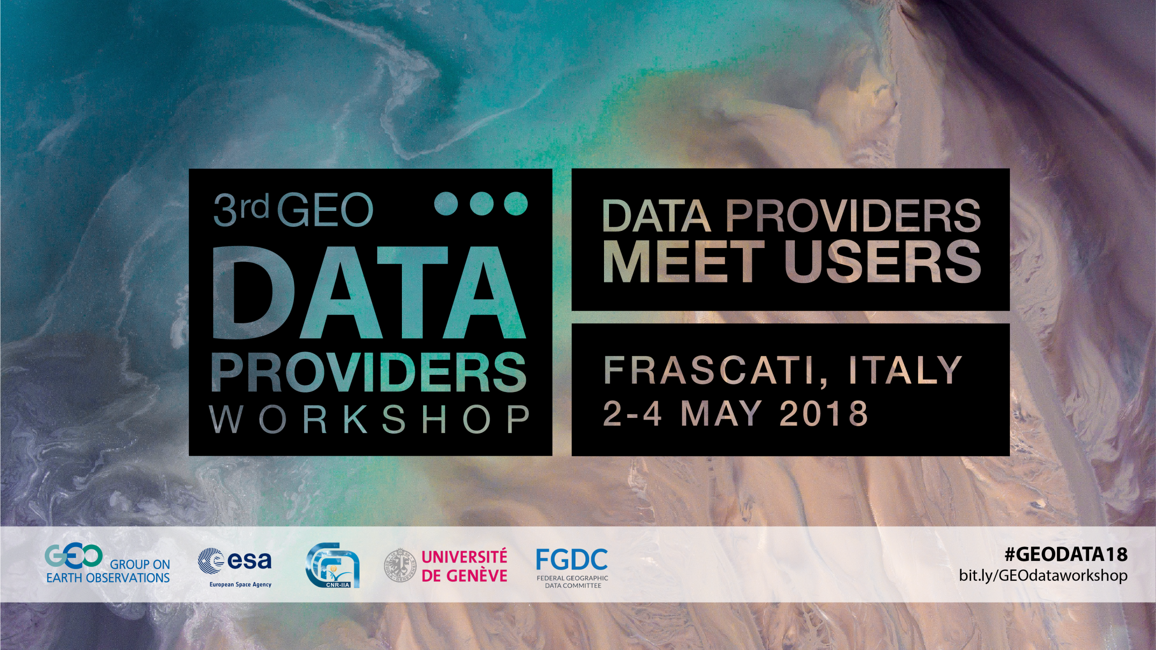

Slide 2

Day 2 - Session 1
GEO Flagships, Initiatives​
how they are or could be benefiting of the GEOSS Platform
Ecopotential
Paolo Mazzetti CNR-IIA
Authors:
P. Mazzetti (CNR-IIA), I. Manakos (CERTH), M. Santoro (CNR-IIA), P. Blonda (CNR-IIA), R. Lucas (UNSW), S. Nativi (EC-JRC/CNR-IIA)

Slide 3

GEO Flagships, Initiatives/ The ECOPOTENTIAL Project
ECOPOTENTIAL aims at creating a unified framework for ecosystem studies and management of protected areas (PA).
  Focus on internationally recognized PAs in Europe and beyond in a wide range of biogeographic regions
  Best use of Earth Observation (EO) and monitoring data through new EO ecosystem data services
  Support of modelling approaches including information from EO data
  Open and interoperable access to data and knowledge through a GEO Ecosystem Virtual Laboratory Platform, fully integrated in GEOSS.
ECOPOTENTIAL
Improving Future Ecosystem Benefits through Earth Observations
Funding programme: EC H2020
H2020 Topic: Societal Challenges - Climate action, environment, resource efficiency and raw materials
Call topic: Making Earth Observation and Monitoring Data usable for ecosystem modelling and Services
Duration: 2015-06-01 / 2019-05-31
Number of partners: 47
Estimated cost: 15,993,931.25 EUR

Slide 4


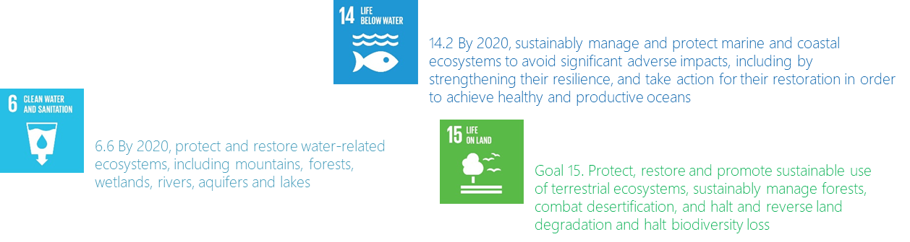
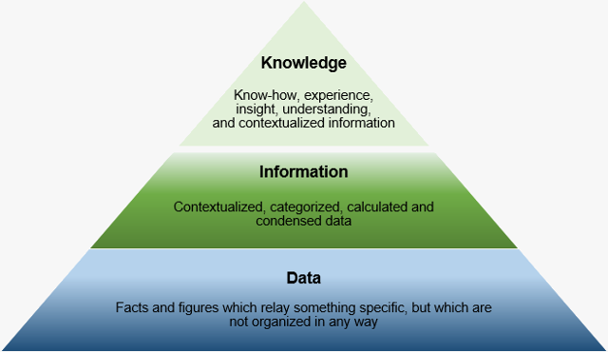
GEO Flagships, Initiatives/ The ECOPOTENTIAL VLAB
The ECOPOTENTIAL Virtual Laboratory is a virtual environment supporting the activities of the ecosystem community-of-practice
  From Science to Policy
    Generated knowledge targeted to policy-makers (e.g. PA managers)
  From Ecosystem Community to Society
    Integration with global efforts for Science-Based Environmental Policy
  From Data to Knowledge
    Generation of Essential Variables, Indicators and Indices from data
  From Open Data to Open Science
    Sharing of knowledge (ontologies), procedures (scientific business process), algorithms (source code) for reusability, reproducibility, etc.

Slide 5
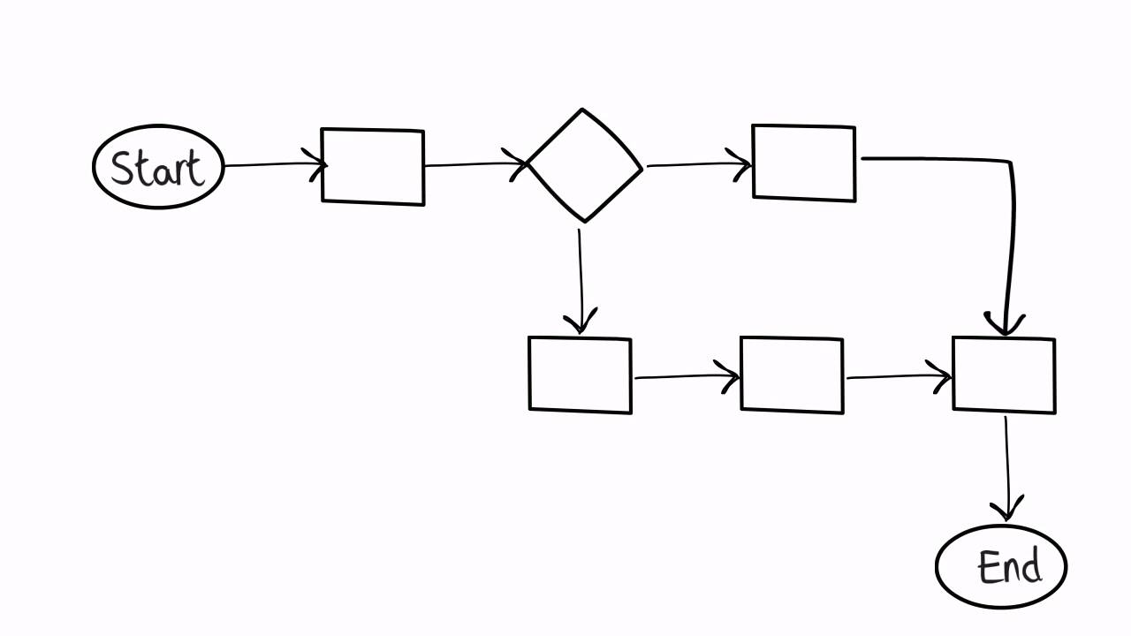


GEO Flagships, Initiatives/ The ECOPOTENTIAL VLAB
Main functionalities:
  Handling of different kind of resources: datasets, algorithms, workflows,…
    publishing, harmonized discovery, access and visualization
  Running workflows implementing scientific business processes
  Interaction through GUI (Portal) and APIs

Slide 6
GEO Flagships, Initiatives/
The ECOPOTENTIAL VLAB
Main concepts:
  Ecosystem
  Protected Area
  Storyline (scenario)
  Data/Observation
  Product / Essential Variable
  Workflow (scientific business process)
  Users

Slide 7












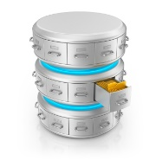








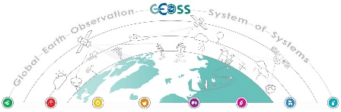
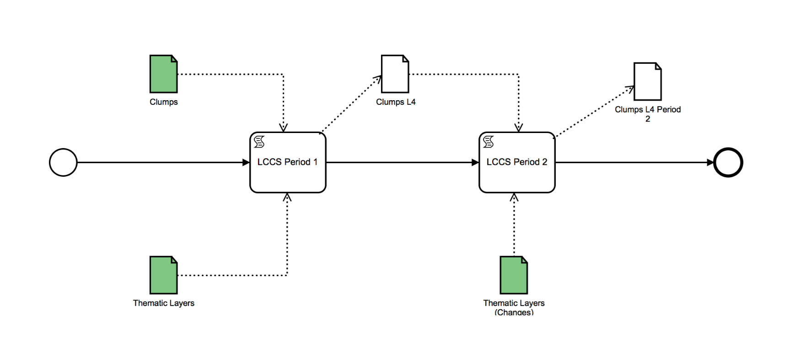















paolo.mazzetti@cnr.it
GEO Flagships, Initiatives
The ECOPOTENTIAL VLAB
Knowledge bases
EO products
EO Infrastructure
Datasets
Long-term preservation
archives
ECOPOTENTIAL
VLAB
Workflows
VLab APIs
VLab
Portal and apps
Source code
Remote processing services
ECOPOTENTIAL VLAB Architecture
VLab App Developer
VLab End User
7

Slide 8

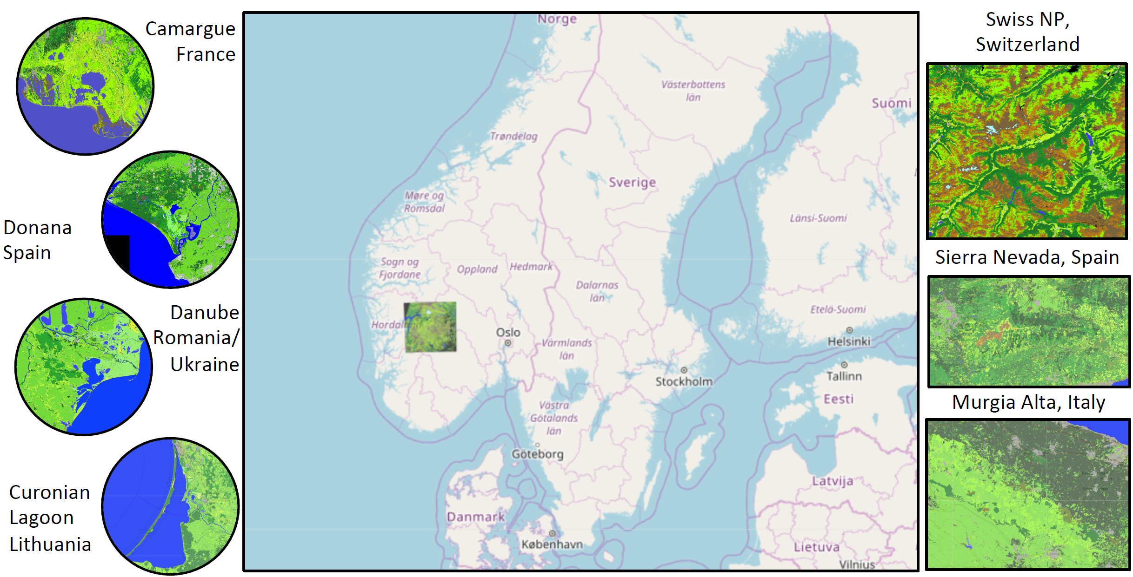
GEO Flagships, Initiatives/ The EODESM use-case
The Earth Observation Data for Ecosystem Monitoring (EODESM) system classifies land covers according to the Food and Agricultural Organisation’s (FAO’s) Land Cover Classification System (LCCS2) taxonomy.
The EODESM system can use, as input, any remote sensing or other spatial datasets and at any scale
Highly detailed and relevant classifications are generated for protected areas and surrounds
The system is designed for use by a wide range of users and is entirely open source and freely available.
Capacity for European Classification of Land Cover and Land Cover Change within the Virtual Laboratory: outputs of the EODESM model (Courtesy of Dr. Richard Lucas)

Slide 9
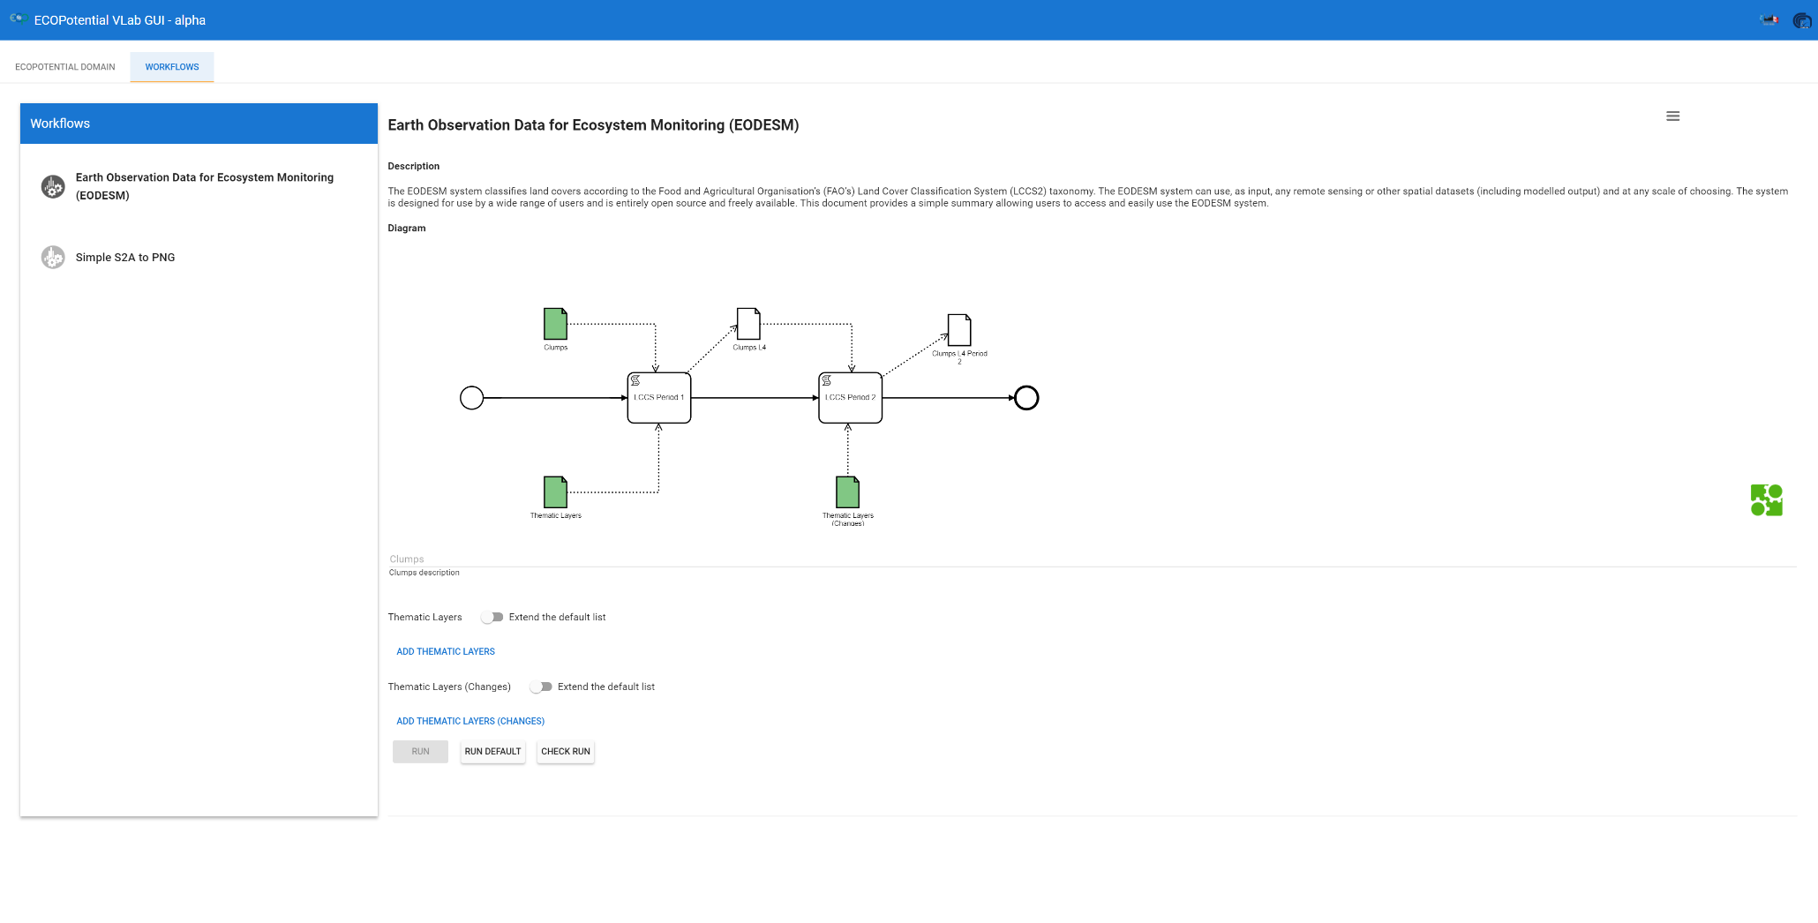
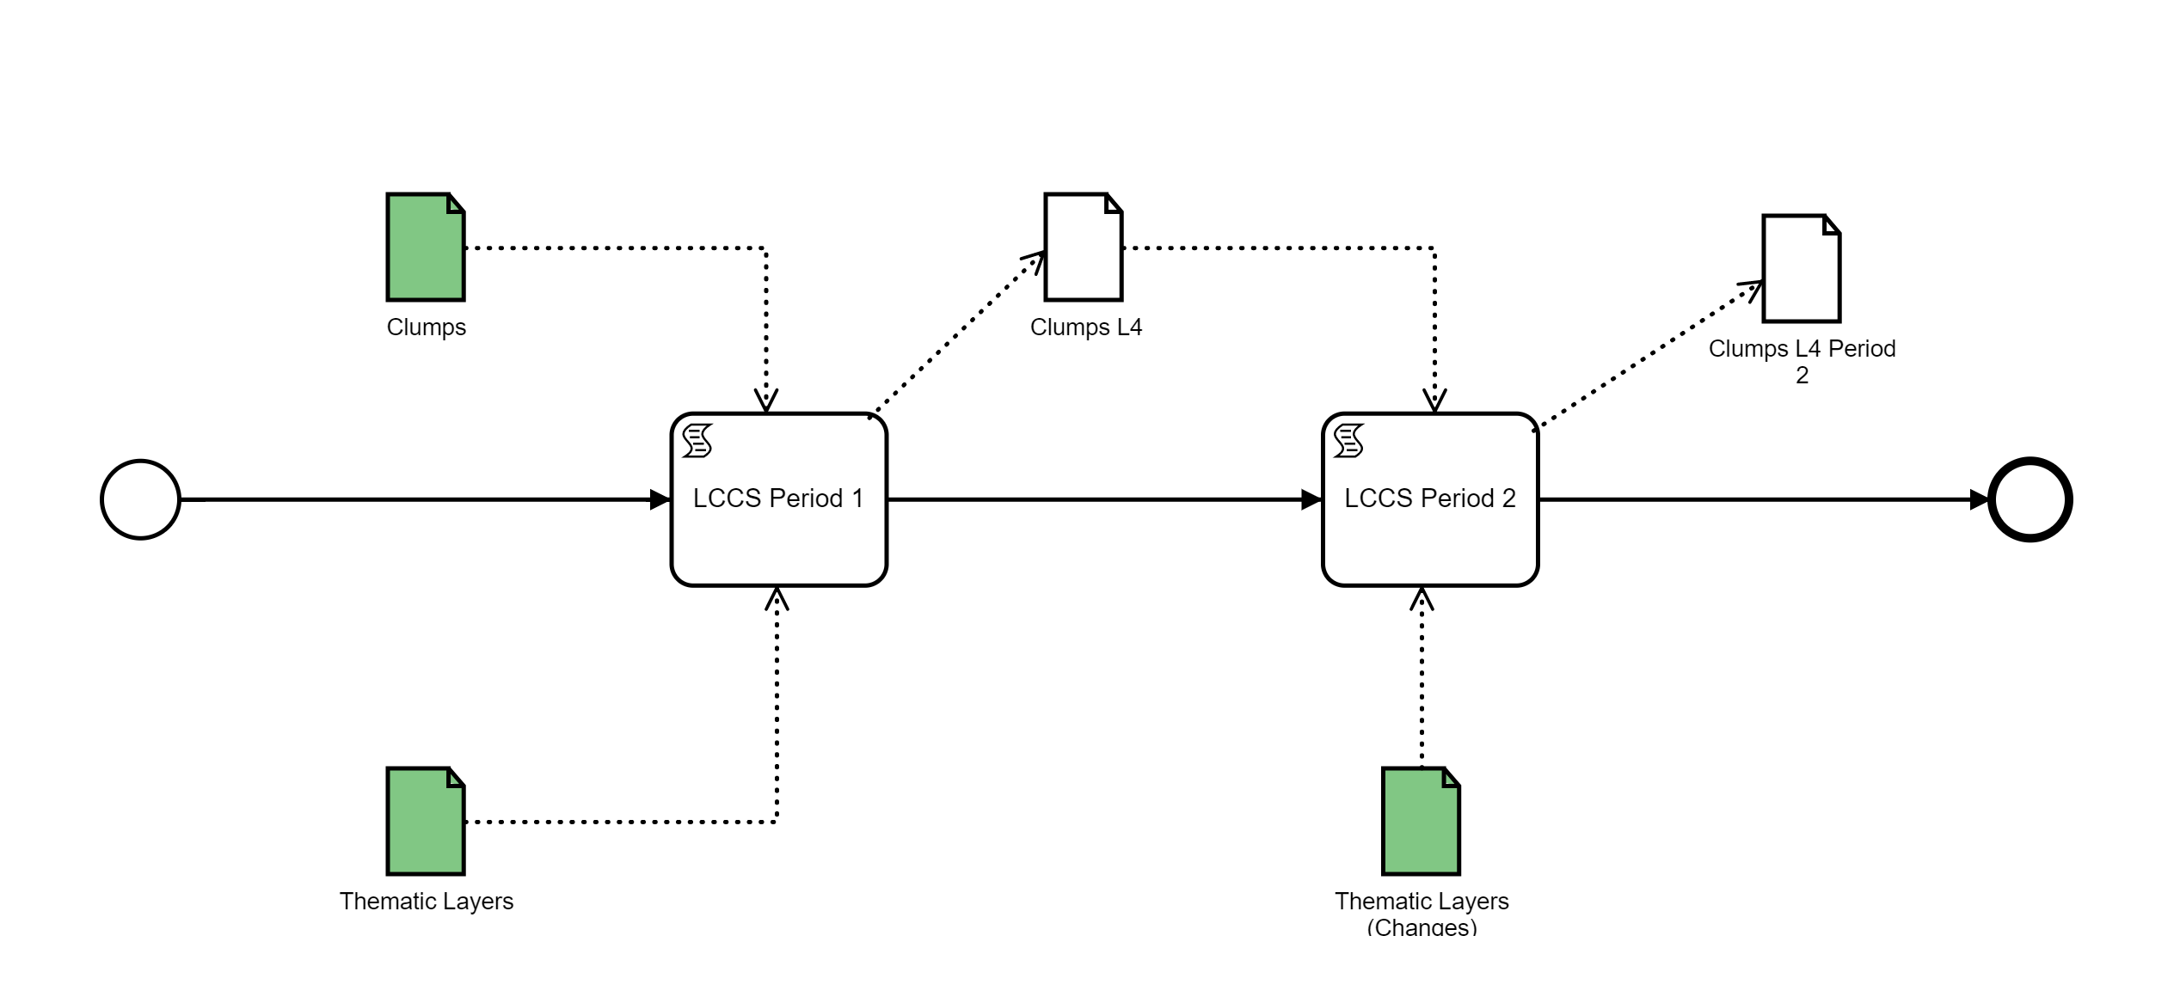
GEO Flagships, Initiatives/ The ECOPOTENTIAL VLAB
BPMN Diagram

Slide 10














GEO Flagships, Initiatives/ Interaction with GEOSS
Ontologies
Workflows
Products
GEOSS Platform
GEOSS Portal
ECOPOTENTIAL VLAB
GEO DAB
VLAB API
GEOSS API
Community Portal
datasets
SBA knowledge body
workflows, products
10

Slide 11
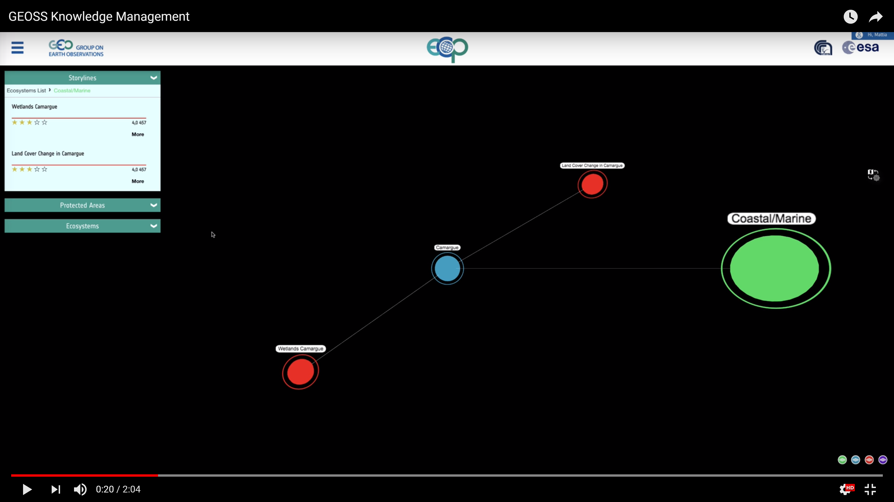






GEO Flagships, Initiatives/ ECOPOTENTIAL GEOSS Mirror Portal
GEOSS Mirrors
GEOSS Widgets
GEOSS Views

Slide 12
Thank you
paolo.mazzetti@cnr.it
http://www.ecopotential-project.eu
The ECOPOTENTIAL project has received funding from the European Union’s Horizon 2020 research and innovation programme under grant agreement No 641762

Slide 13
