Slide 2
EO and SDGs
on mountain areas
Roberto Monsorno/ Institute for Earth Observation/ Eurac Research

Slide 3
Agenda
Eurac Earth Observation
GEOSS Data provided
SDG indicators

Slide 4
Eurac Earth Observation / Our Mission
At the Institute for Earth Observation, we integrate remote sensing techniques with interdisciplinary approaches to monitor and to understand key environmental dynamics in mountain regions and related climate and disaster risks.

Slide 5
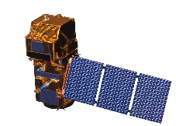
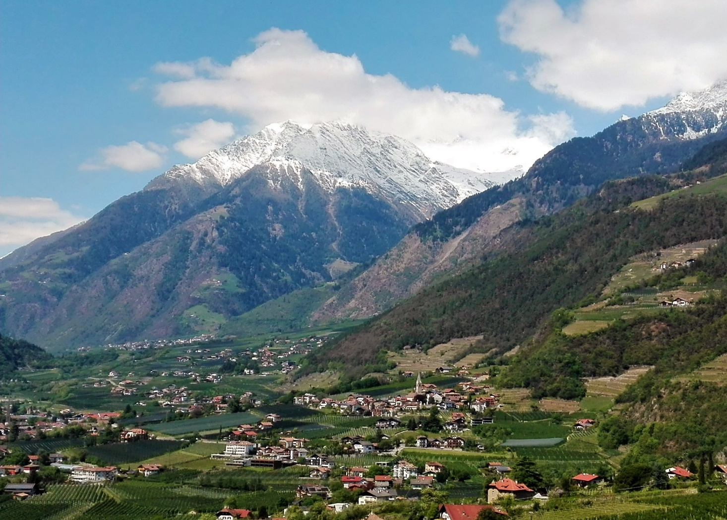
monitor and understand key environmental dynamics in mountain regions and related climate and disaster risks
EO + in-situ: key Environmental
Parameter and dynamics
Societal functions + Challenges
Climate (Change)
Climate Data
Society
Solar Radiation
Snow for winter tourism
Snow Cover
(Evapo-transpiration)
Water Cycle
Water Availability
Energy production
Soil Moisture
Land Cover + Ecossytems
Sustainable Forest Management
Ecosystem Dynamics
Vegetation Parameters
Natural Hazards
Disaster Risk Reduction and Climate Change Adaptation
Terrain Movement

Slide 6
Eurac Earth Observation/ The Sentinel Alpine Observatory
The Sentinel Alpine Observatory (SAO) is an initiative of the Institute for Earth Observation at Eurac Research. The aim is the development and provision of satellite products and services mainly based on data from the Copernicus Sentinel program (EC/ESA) for monitoring key environmental variables in South Tyrol and the European Alps

Slide 7
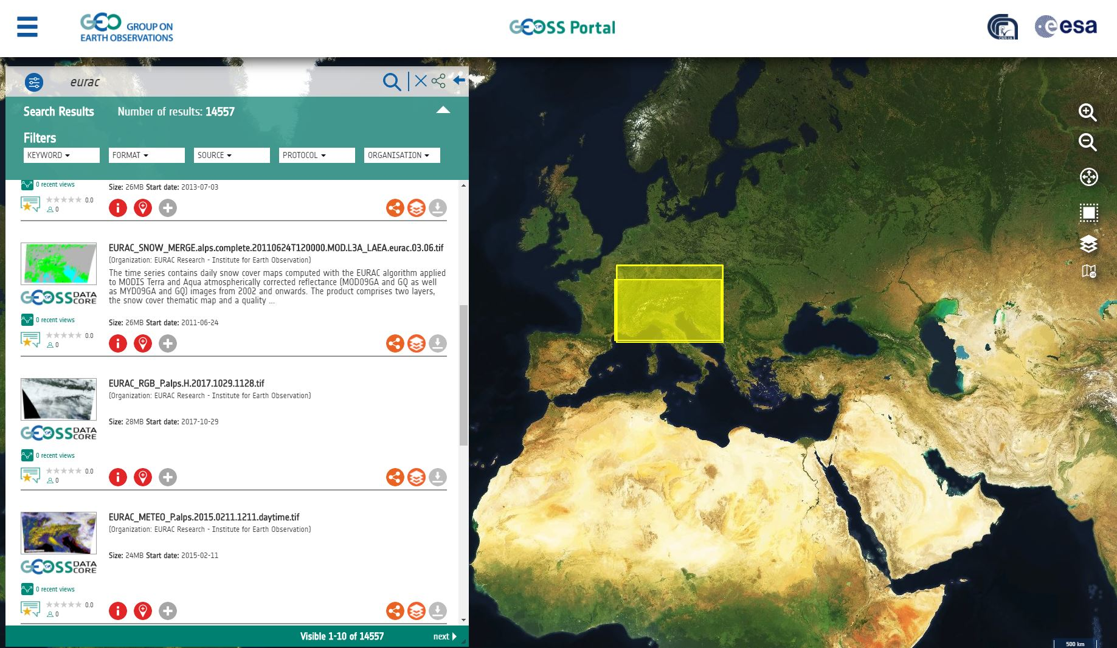
Eurac Earth Observation / GEOSS Data Portal

Slide 8
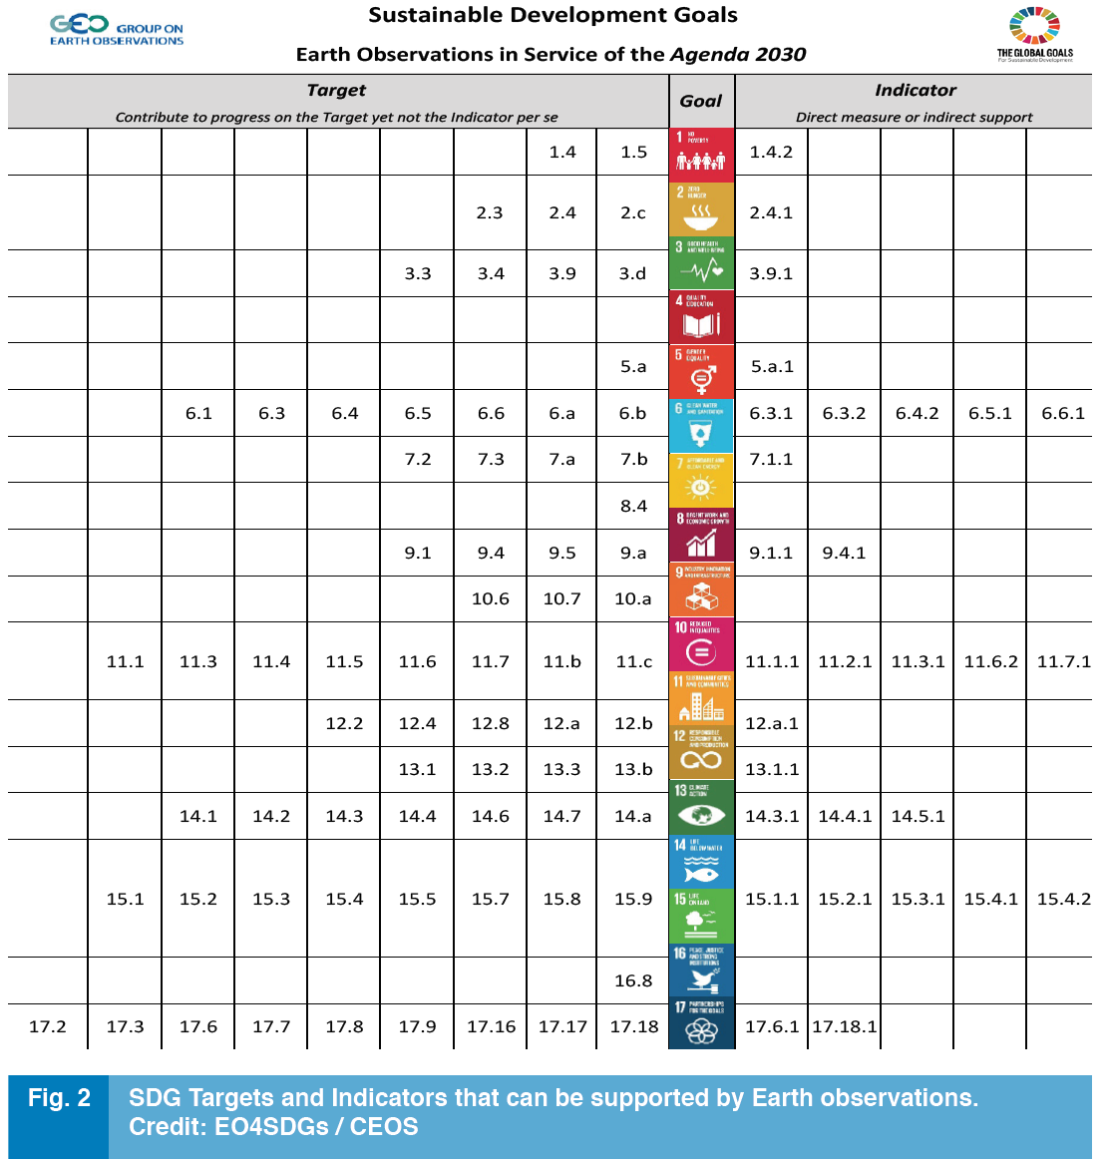
EO and SDGs / In Mountain Areas ?
“EO could contribute to ~ 70 targets
but not to the same number of indicators”

Slide 9
EO and SDGs / In Mountain Areas ?
SDG Indicators |  | From EO
2.4.1 Proportion of agricultural area under productive and sustainable agriculture |  | Agriculture Area
6.3.2 Proportion of bodies of water with good ambient water quality |  | Bodies of water, Water quality
6.6.1 Change in the extent of water-related ecosystems over time |  | Change of water related ecoystems
11.1.1 Proportion of urban population living in slums, informal settlements or inadequate housing |  | Type of housing
11.3.1 Ratio of land consumption rate to population growth rate |  | land consumption
11.6.2 Annual mean levels of fine particulate matter (e.g. PM2.5 and PM10) in cities |  | Air Quality
11.7.1 Average share of the built-up area of cities that is open space for public use for all (…) |  | Built-up area
15.1.1 Forest area as a proportion of total land area |  | Forest Area
15.1.2 Proportion of important sites for (…) biodiversity that are covered by protected areas, by ecosystem |  | Ecosystems
15.2.1 Progress towards sustainable forest management |  | State of forest
15.3.1 Proportion of land that is degraded over total land area |  | Land degradation
15.4.1 Coverage by protected areas of important sites for mountain biodiversity |  | Ecosystems
15.4.2 Mountain Green Cover Index |  | Land cover type, vegetation cover

Slide 10
SDGs are missing some important mountain aspects e.g. Water towers, glaciers, hazards, tourism, …
The potential of EO is not fully exploited for SDGs
→ specific Mountain SDGs could be defined?
New SDG monitoring Indicators?

Slide 11
Thank you
roberto.monsorno@eurac.edu / www.eurac.edu / @EURAC

