Slide 1
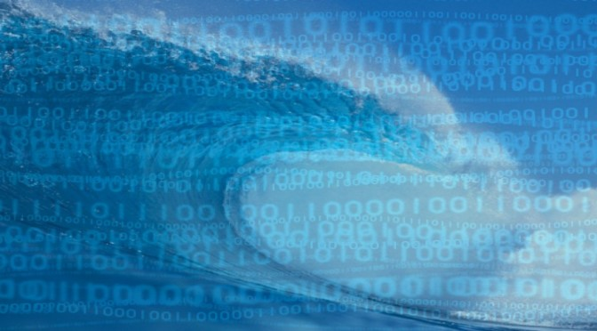
The Atlantos story
Our experience entering GEOSS
Ketil Koop-Jakobsen, AtlantOS
University of Bremen
Photo: mghpcc

Slide 2
An Optimized Integrated Atlantic Ocean Observing System to enhance the societal, scientific and economic benefit
#AtlantOS
Our Resources to contribute to GEOSS:
ENVIRONMENTAL DATA FROM THE ATLANTIC OCEAN

Slide 3
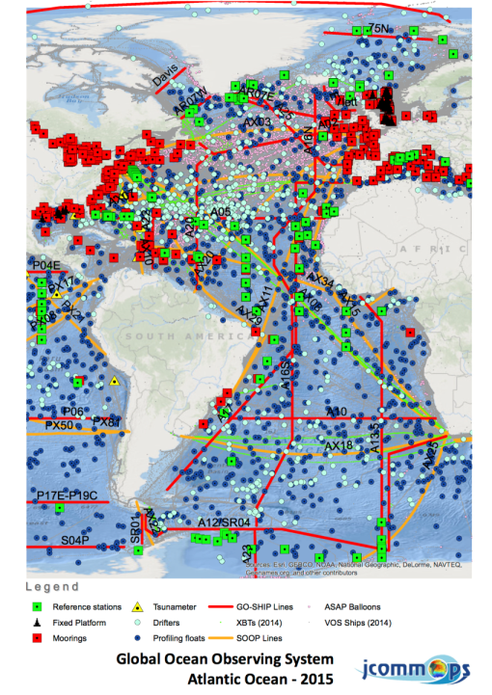
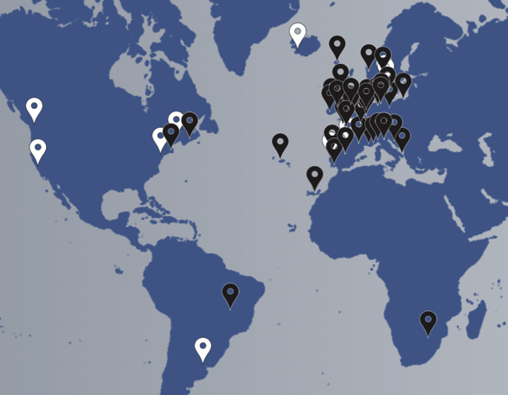
The AtlantOS Project A H2020-project – Who are we?
www.atlantos-h2020.eu
Budget: 21 Mio. Euros in 4 years
Coordinator: GEOMAR; Partner: 62
SCOPE: Integration of ocean observing activates across all disciplines for the Atlantic, considering European as well as non-European partners.
AtlantOS members (white) and 62 H2020 consortium partners (black)

Slide 4
The AtlantOS Project A H2020-project – Who are we?
www.atlantos-h2020.eu

Slide 5
AtlantOS - Data flow and data Integration
AtlantOS data networks: Key Ocean data providers in EU and partners on other continents
GOAL: Facilitate better integration of Atlantic ocean data
GEOSS:
Use GEOSS to Facilitate better integration of Atlantic ocean data
Use new opportunities in GEOSS portal to present AtlantOS as a community in GEOSS

Slide 6
AtlantOS - Data flow and data Integration
TASK 1:
Administering other peoples data
We integrate data, but we do not own the data
We have many data resources, but they are the property of individual data providers
Ocean observatory
EUROPE
Ocean observatory
USA
Source: www.applied-maths.com/

Slide 7
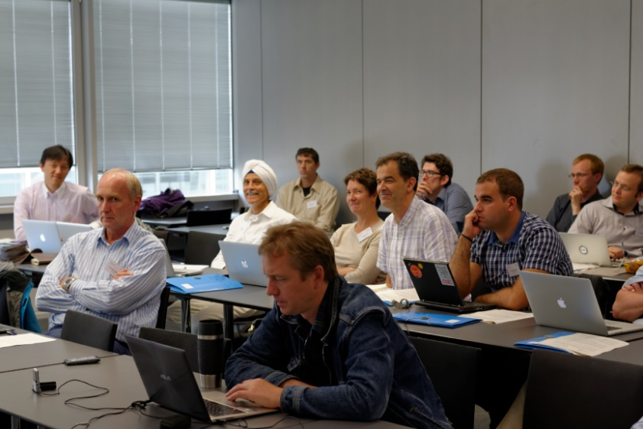
AtlantOS - Data flow and data Integration
TASK 2:
Getting data providers to register with GEOSS
Because we don’t own the data, we need our data providers to register and submit data to GEOSS
Practical GEOSS Workshop was organized for AtlantOS data providers
Large number of records have been provided to GEOSS
by partners of the AtlantOS network.
Still more to come.

Slide 8
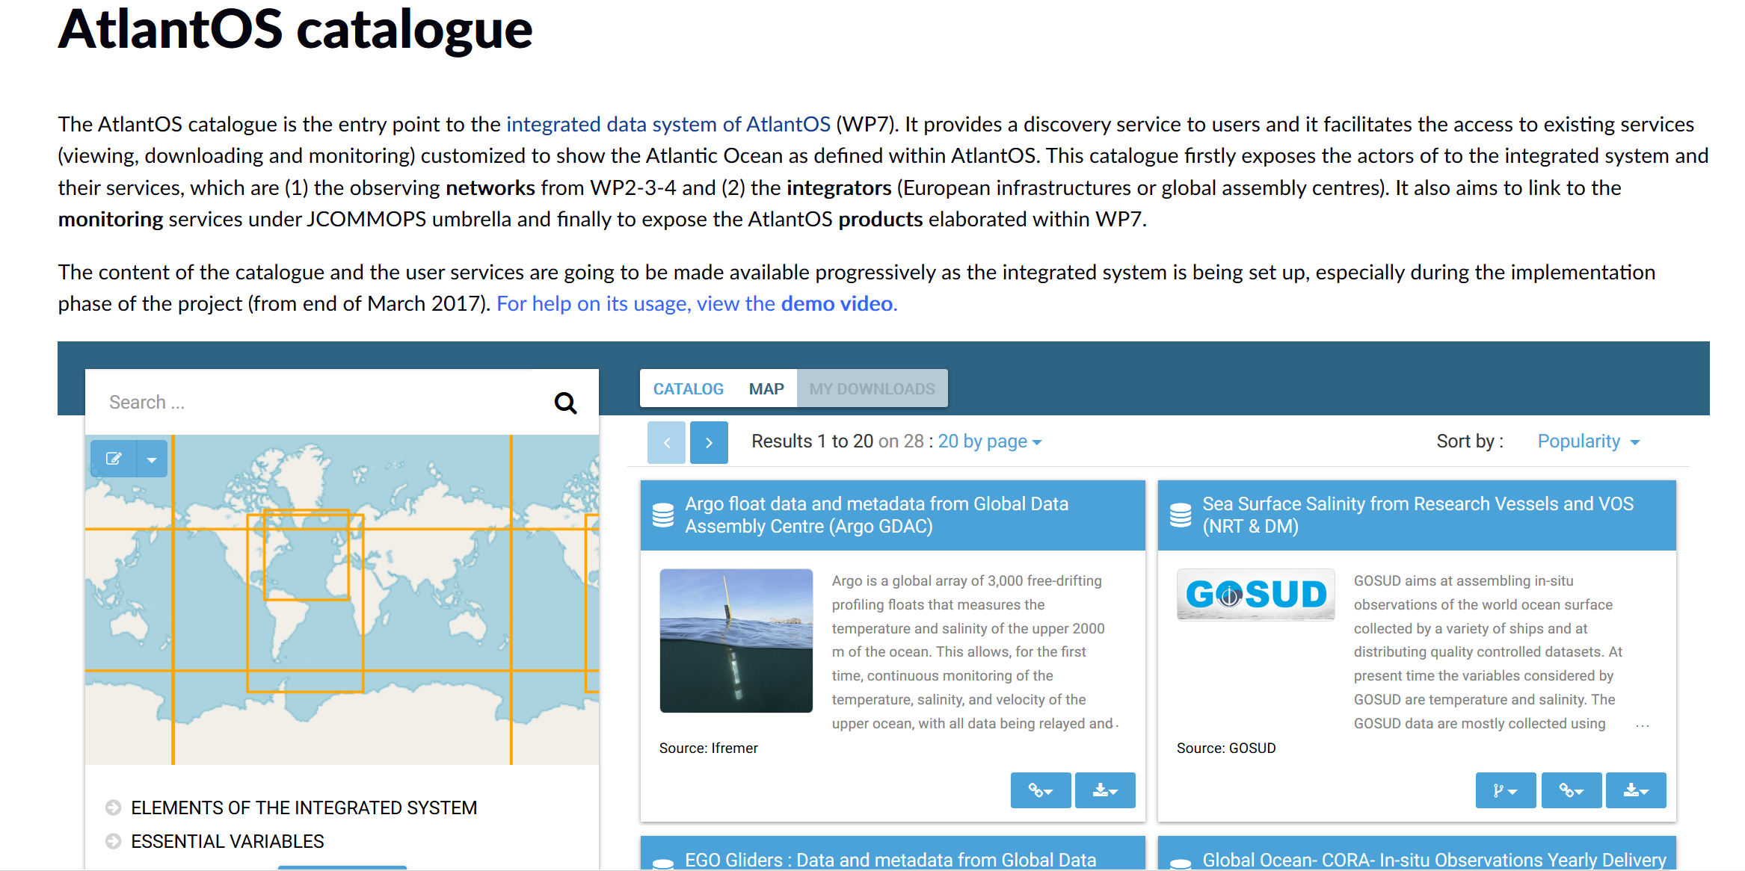
AtlantOS - Data flow and data Integration
TASK 3: Making a catalog
We want to integrate data without making yet another data repository!
Making a catalog with links to all data providers

Slide 9
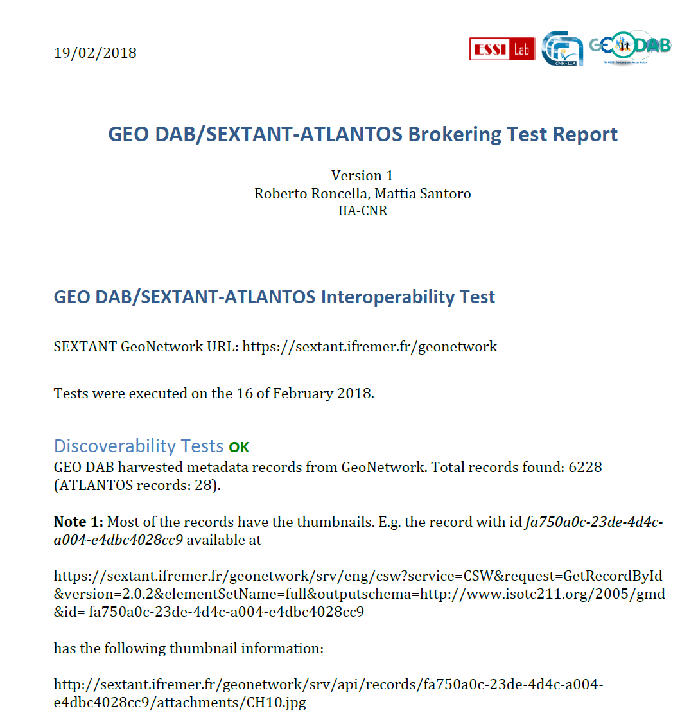
AtlantOS - Data flow and data Integration
TASK 4: Making catalog discoverable in the GEOSS portal
To harvest the resources available in the AtlantOS catalog. A GEOSS interoperability test
was initiated

Slide 10
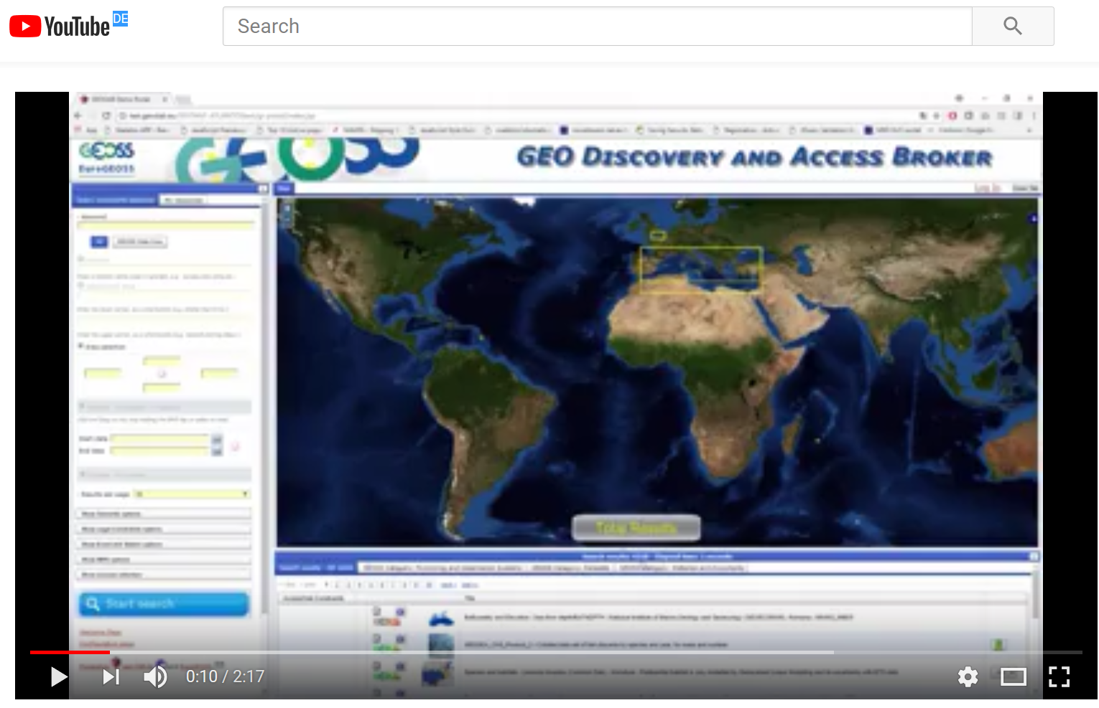
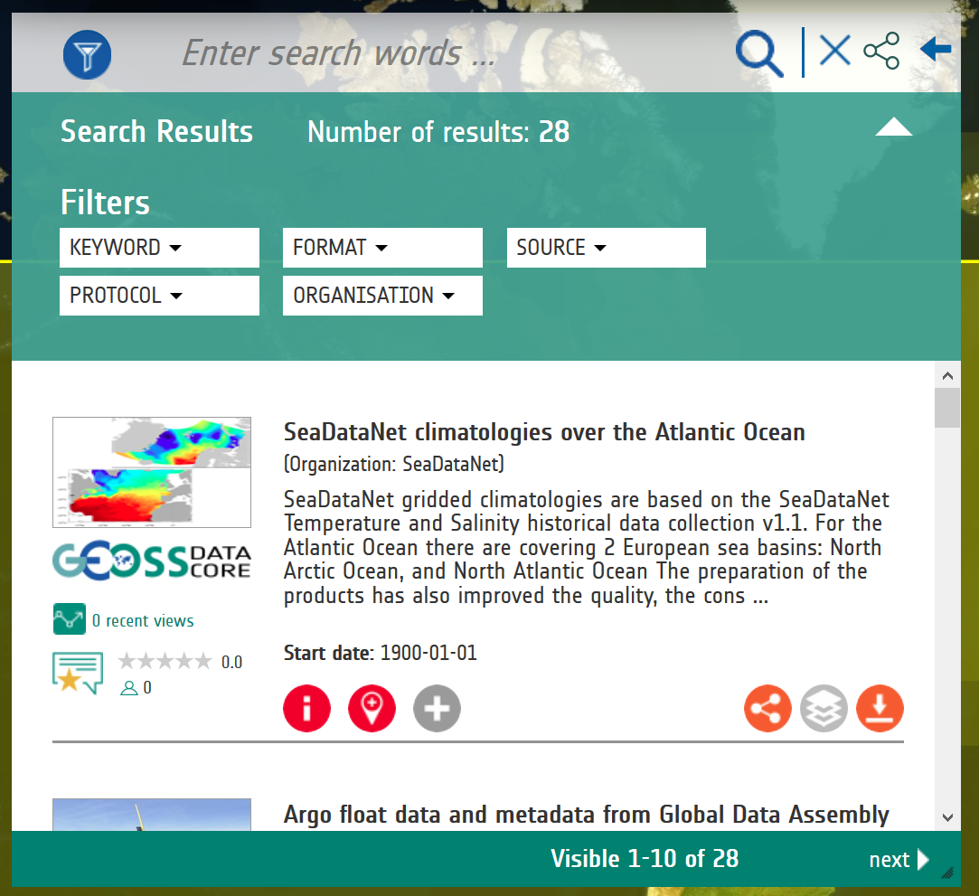
AtlantOS - Data flow and data Integration
TASK 4:
Making catalog discoverable in GEOSS portal
Test passed !!!!
A very easy process with assistance from GEOSS
Test-report and Video provided

Slide 11
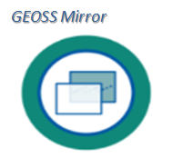
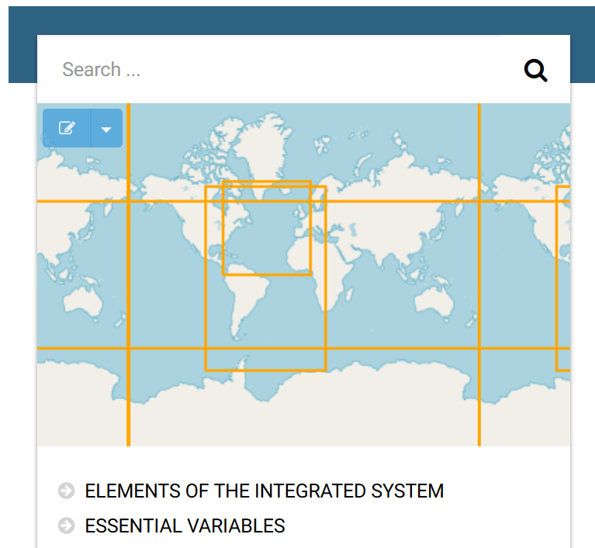
AtlantOS - Data flow and data Integration
TASK 5:
Presenting AtlantOS as a community within GEOSS.
What we are
Who we are
Our resources

Slide 12
AtlantOS - Data flow and data Integration
Task 5:
Presenting AtlantOS as a community
GEOSS Mirror is a GEOSS Portal site customization for communities as well as SBAs, Flagships, and Initiatives. It allows the community to configure a community customized entry point through the GEOSS

Slide 13
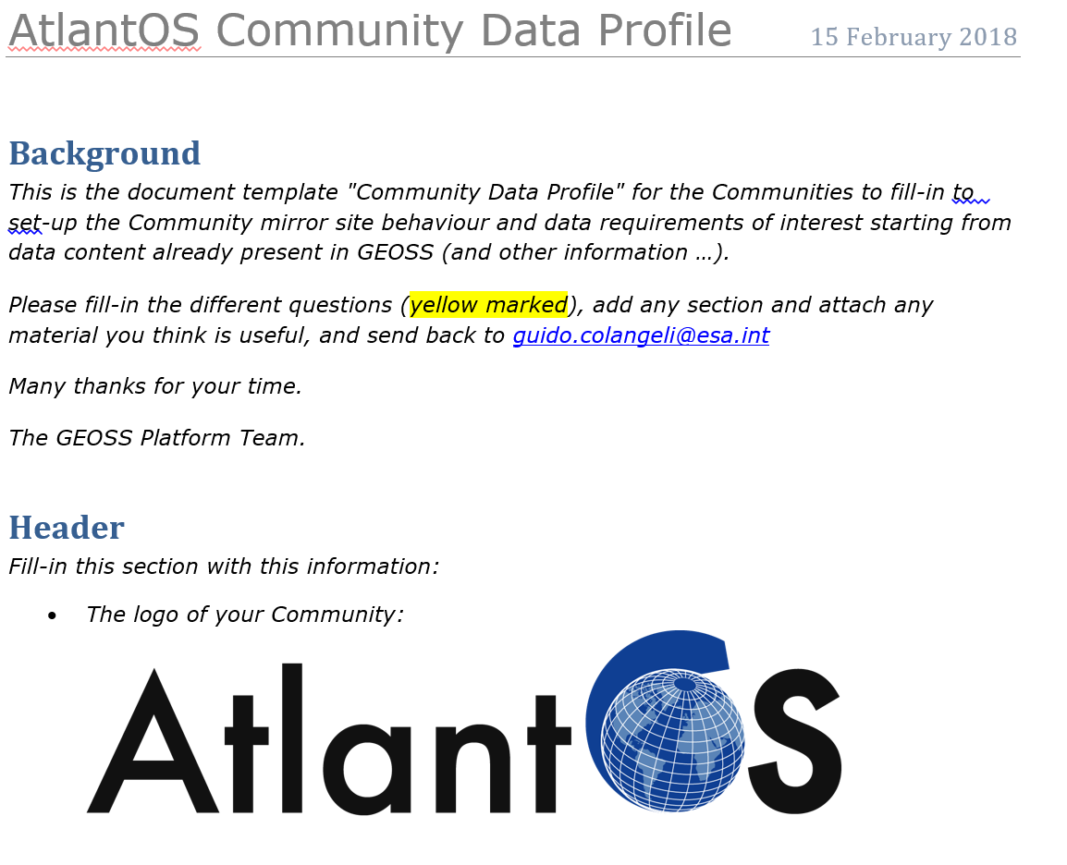
AtlantOS - Data flow and data Integration
Task 5:
GEOSS Portal mirror site
Information sheet processed
and submitted
Coming soon:
Portal: www.geoPortal.org/community/AtlantOS

