Slide 2
API Highways and GEOSS for Sustainable Development
Adrian Laurenzi / Data Scientist Global Partnership for Sustainable Development Data

Slide 3
What is API Highways? / Start
What is API Highways?

Slide 4
What is API Highways? / Problem
Data often unavailable in a form ideal for application/visualization development
APIs, documentation, examples are scattered and/or hidden

Slide 5
What is API Highways? / Our Solution

Slide 6
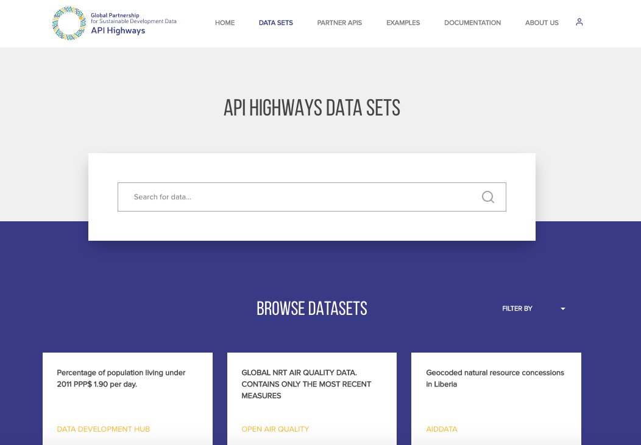
What is API Highways? / Our Solution
apihighways.org

Slide 7
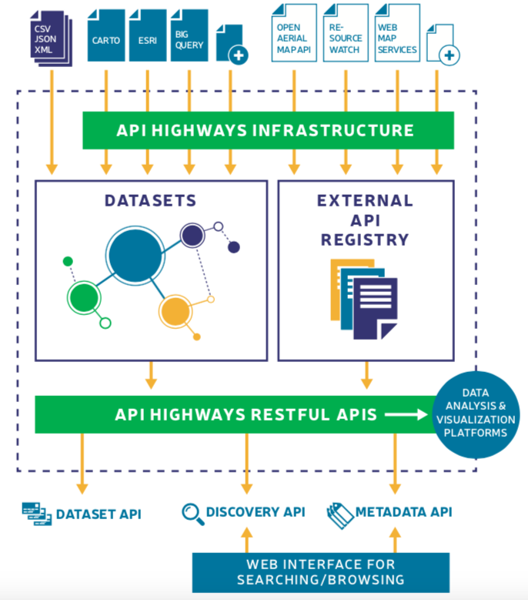
What is API Highways? / Architecture
Knowledge graph & tagging
API & dataset monitoring
Metrics
Data providers contribute datasets & APIs

Slide 8
What is API Highways? / Data Landscape
Geospatial (raster and non-raster)
WMS layers
Vector tile services
Non-raster (GeoJSON, CSV, etc.)
Non-Geospatial
Generic RESTful APIs
"API-ify" static/downloadable files:
CSV, JSON, and XML
Metadata
Keywords (for search), title, description,
Link to source webpage for complete metadata

Slide 9
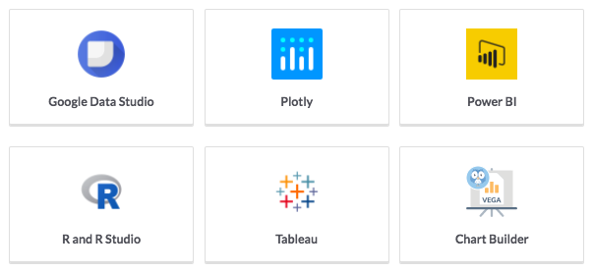
What is API Highways? / Connector Ecosystem
...plus a growing list of more integrations

Slide 10
Extending GEOSS Interoperability / Start
Extending Interoperability of GEOSS

Slide 11
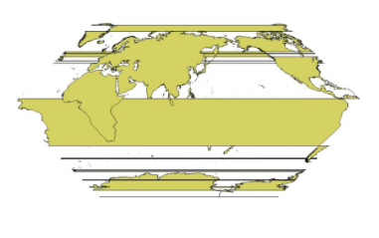
Extending GEOSS Interoperability / Barriers
Projection/datum incompatibilities
Issues with very large files (downloading, scaling, etc.)
Static files (database setup required)
Subscription costs/registration

Slide 12
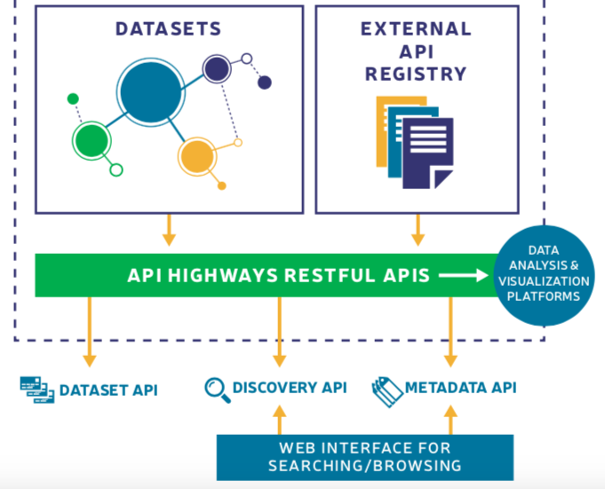
Extending GEOSS Interoperability / Connecting GEOSS
API-ify downloadable datasets
RESTful API
Javascript API
Example code/ visualizations

Slide 13
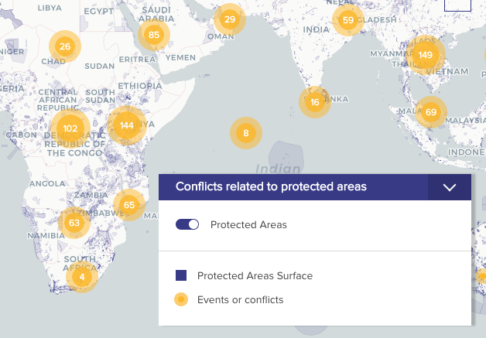
Extending GEOSS Interoperability / Examples
Geospatial
WMS layers
RESTful API
Import into CARTO
Non-geospatial

Slide 14
Extending GEOSS Interoperability / Examples
Repurpose tools/scripts for analysis
Make data products more re-usable for visualizations (e.g. map tile services)
Created by Edward Rowland UK Office of National Statistics
Link to code on GitHub

Slide 15
Extending GEOSS Interoperability / As a GEOSS provider?

Slide 17
Thank you
alaurenzi@data4sdgs.org / www.apihighways.org / @data4sdgs

