Slide 1



Slide 2
Strengthening Disaster Risk Reduction
Across the Americas Summit
Simulated Exercise 2018
Bart De Lathouwer (OGC) for David S. Green (NASA)

Slide 3
Goal
Strengthened the collective ability to share the many challenges of disaster risk reduction in Latin America and the Caribbean region.
Promoted the awareness and better use of earth observations.
Brought together disaster data providers with end users/practitioners helped identify best practices and information needs between stakeholders on both the provider and user side.

Slide 4
Summit
The Summit was co-organized by
NASA Applied Sciences Disasters Program
Comisión Nacional de Actividades Espaciales (CONAE)
Committee on Earth Observation Satellites (CEOS)
Group on Earth Observations (GEO)
Global Flood Partnership (GFP)
Open Geospatial Consortium (OGC)

Slide 5
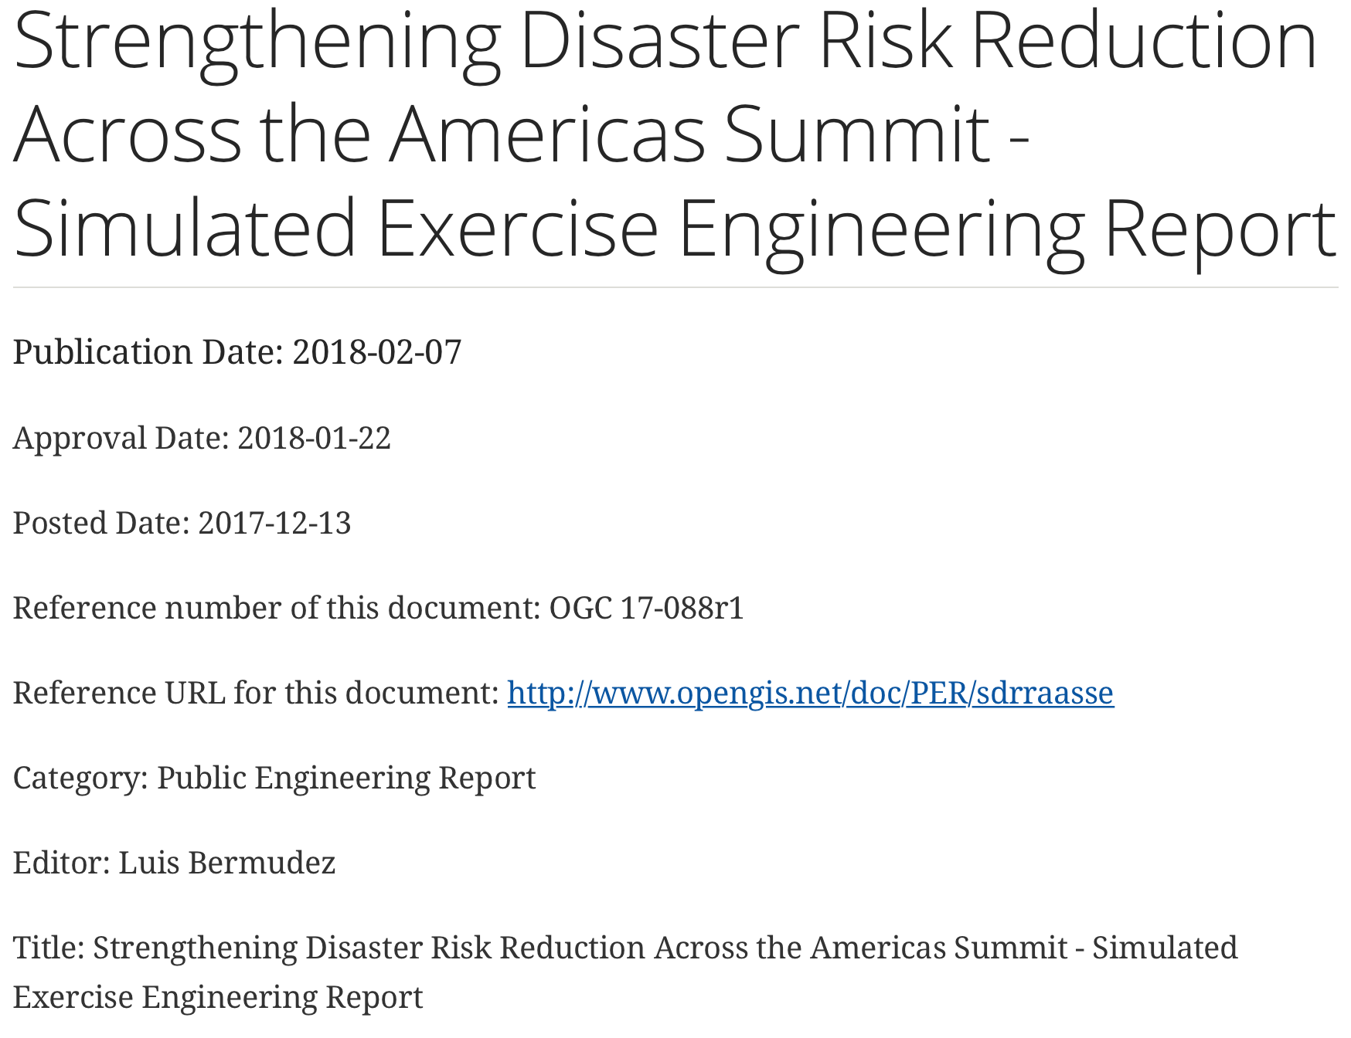
Report
Published in February
http://docs.opengeospatial.org/per/17-088r1.html

Slide 6
Key Findings
The overall evaluation results from the exercise confirmed that the following objectives were met.
  Demonstrate how the international EO community can support emergency management, response, and disaster risk reduction by providing timely, actionable, and relevant products and tools to improve decision making.
  Foster collaboration and learning between all stakeholders.
  Simulate a disaster scenario to test participants’ ability to adapt to rapidly changing conditions.

Slide 7
Exercise was helpful in identifying areas of collaboration.

Slide 8
How can we improve?
Collaboration
Real time data
Discovery and Access of Data

Slide 9
Participants Roles
Government
Emergency managers
Earth observation data providers
Researchers
Non-governmental organizations
Humanitarian international groups
Commercial companies

Slide 10
Group and supporting roles
130 participants
Notes:
The Director oversaw the conduct of the exercise (from setup to clean up), maintained contact with Controllers and Evaluators, and debriefed Controllers and Evaluators following the exercise.
Evaluators documented observations, captured unresolved issues, and analyzed exercise results. Evaluators did not interfere with exercise flow. Chosen based on their expertise in the specific functional areas.
Facilitators were responsible for keeping participant discussions on track with exercise objectives and ensuring all issues were explored as thoroughly as possible within the time constraints. They assisted and raised any issues to the Exercise Director, and controlled the flow of scenario injects. Facilitators communicate with Controllers and ensure that all SE player roles run as smoothly as possible.
Controllers directed the pace of exercise play, provided key data to players, and prompted or initiated certain player actions to ensure exercise continuity. Controllers issued exercise materials to players as required, monitored the exercise timeline, and supervised the safety of all exercise participants. Two Controllers were available for each sector. Controllers were responsible for ensuring that Injects (see below) were acted upon by players. Controllers communicated with the Facilitators and Exercise Director to resolve any problems.
Observers supported the development of player responses to the situation by asking relevant questions, delivering messages, or providing background references where required. Observers did not directly participate in the exercise. They observed selected segments of the exercise as it unfolded while remaining separated from player activities. Observers viewed the exercise from a designated observation area and are were to remain within the observation area during the exercise.
The Simulation Cell (SimCell) provided communications between players and a wide variety of simulated external agencies (e.g., first responders). The SimCell provided realistic, real-time, two-way communications (email for this exercise) between players and simulated response and support agencies. The SimCell controlled the flow of injects (e.g., timing of events related to the simulated disaster) to specific sectors and answered any requests directed to them by the players. The SimCell was physically separated from the main group of players.
The Situation Reporting Cell (SitRepCell) coordinated with the Controllers and the sector leads and note takers to keep a running report of sector progress through the scenario during exercise play. The SitRepCell monitored the note taker via shared documents (GoogleDocs in this case), SimCell emails, and queried sector Controllers, as necessary, to maintain the reports. They did not engage in exercise play.

Slide 11
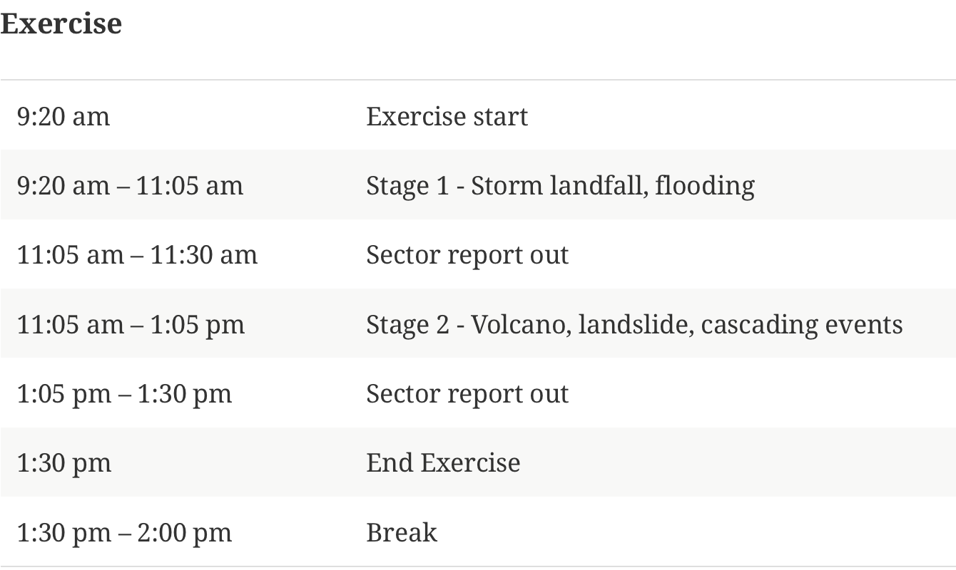
Agenda

Slide 12
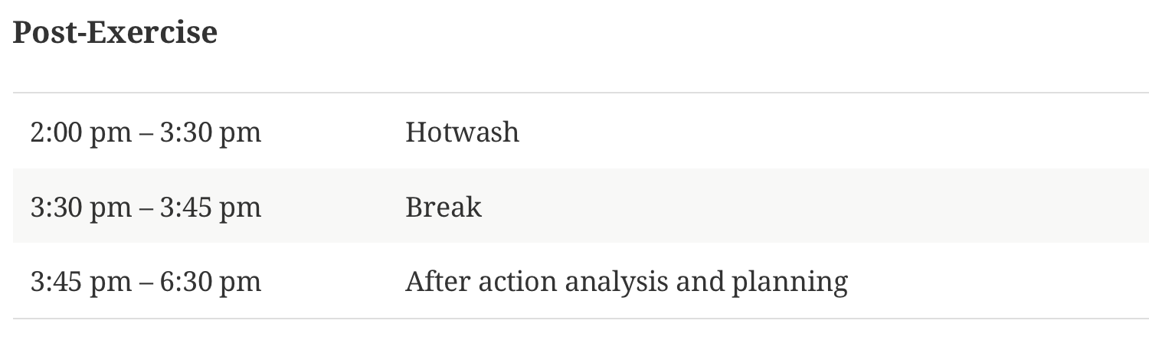
Agenda

Slide 13
Exercise
Fictitious Scenario:
Landfall and flooding
Volcano, landslide and cascading events
Disastrov
Notes:
The scenario used a fictitious region named Disastrov. The region had a coastline, high mountains with a volcano, and rivers. It was composed of a large urban center, a small urban center, and rural settlements. Infrastructure features were depicted such as an airport, port, dams, levees, highways, rail, and bridges.

Slide 14
Example Scenario 1
Background for Stage 1
High pressure front sat over western mountains portion
Day time high temperatures
Drought dry forest fuels conditions set the ground for forest fire (mineral soli created ideal conditions for landslides)

Slide 15
Stage 1
Tropical Depression forecasted to gross to tropical storm

Slide 16
Stage 1
Monsoon seasonal rainfall issued by the weather service call for excessive rain

Slide 17
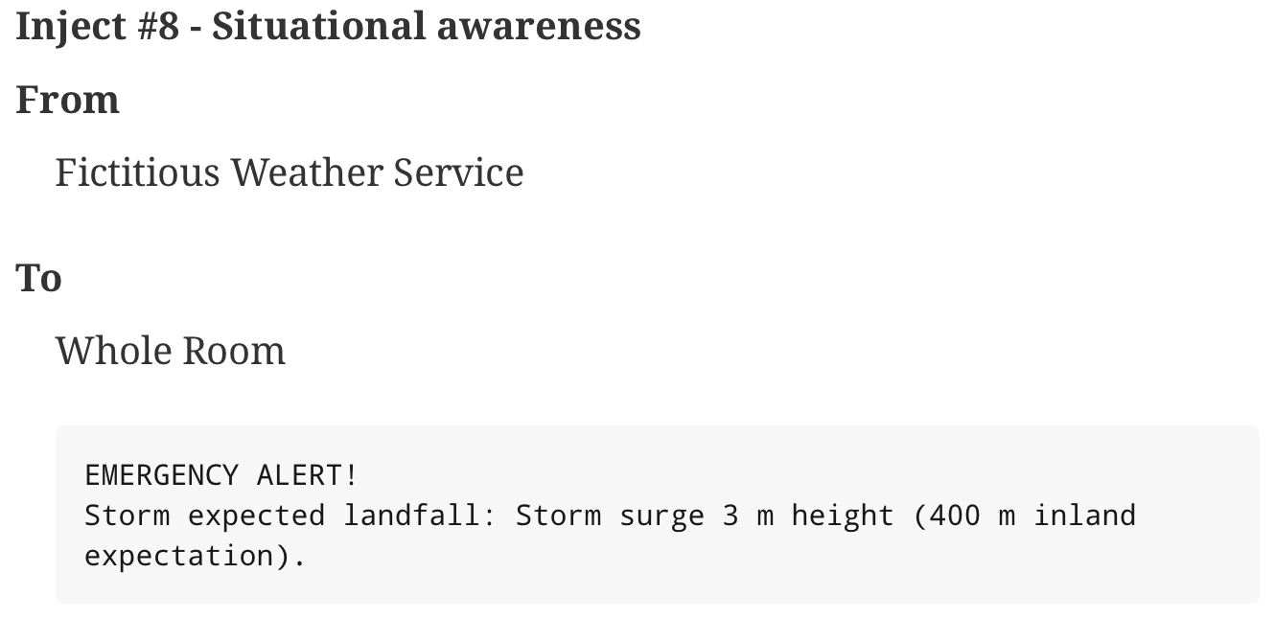
Example injects

Slide 18
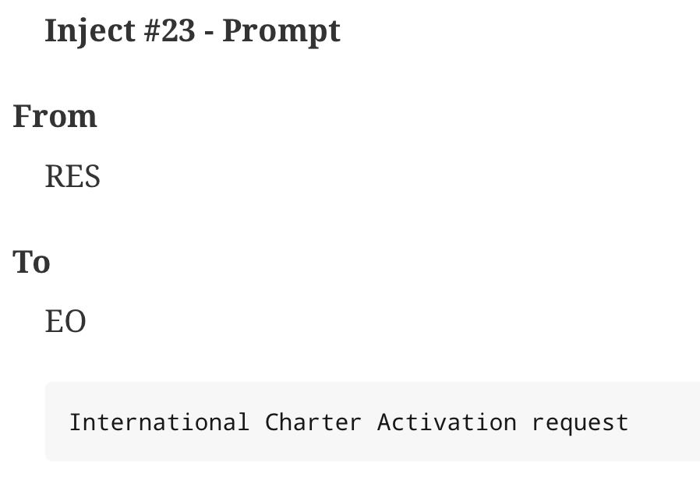
Example injects

Slide 19
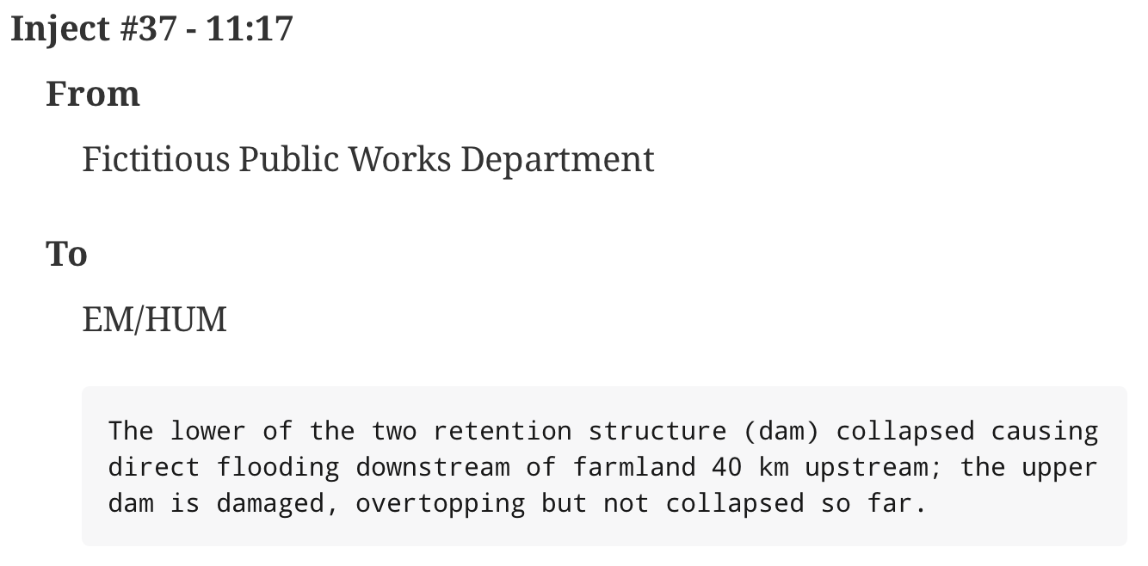
Example injects

Slide 20
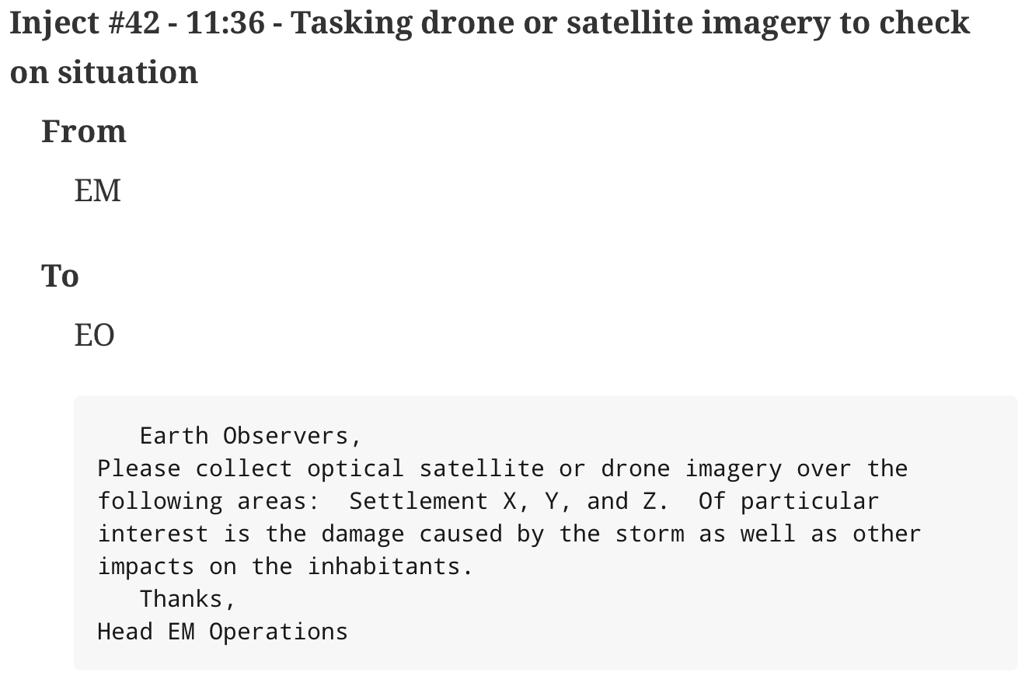
Example Injects

Slide 21
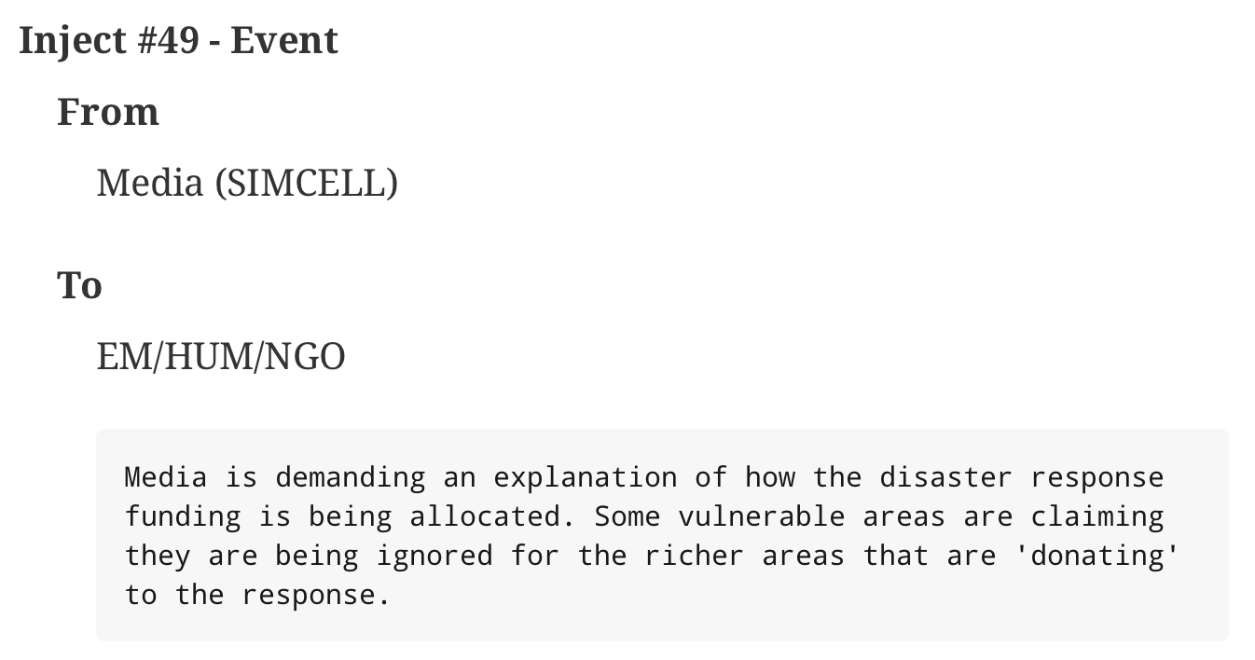
Example Injects

Slide 22
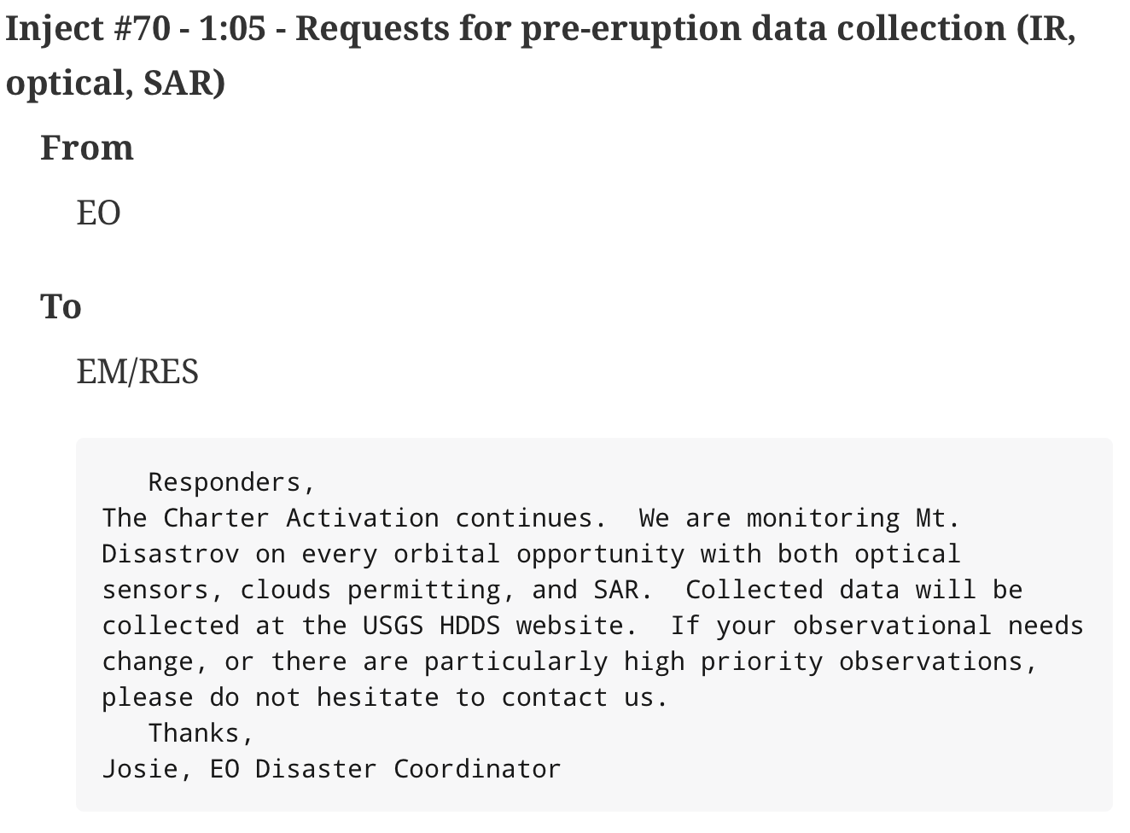
Example Injects

Slide 23
Next Steps
Developing the idea of a pilot to better advance the discovery and access of data when a disaster occurs
Running and supporting future exercises to further advance cross-collaboration among communities involved in disaster preparation and response.

Slide 24


Slide 25
Thank you
david.s.green@nasa.gov
efrazier@usgs.gov
lbermudez@opengeospatial.org
mvoidrot@opengeospatial.org
bdelathouwer@opengeospatial.org

