Slide 2
UNOOSA and Its Role in Advancing Open Data Policy
With the Commercial Sector
Lorant CZARAN / Programme Officer / United Nations Office for Outer Space Affairs

Slide 3
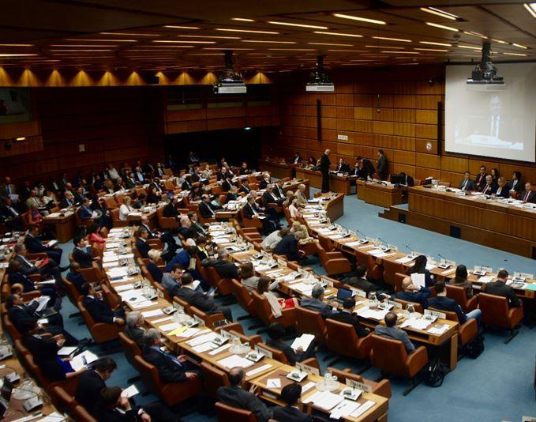
UNOOSA / About
VISION
Bringing the
benefits of space to humankind
MISSION STATEMENT
to promote
international cooperation
in the use of outer space
to achieve development goals
COPUOS 2016 in Vienna, Austria

Slide 4
UNOOSA / Unique Roles
CAPACITY-BUILDER: UNOOSA brings the benefits of space to humankind by building space capacity of non-space-faring countries.
GATEWAY TO SPACE: UNOOSA is the main UN agency on space matters and facilitates the coordination of UN activities using space technology to improve lives around the world.
GLOBAL FACILITATOR: UNOOSA plays a leading and facilitating role in the promotion of the peaceful uses of outer space.

Slide 5
UNOOSA / Our work, mandates
MAIN PROGRAMS AND PLATFORMS OF THE UNOOSA
Secretariat to COPUOS
Works with MS, IGOs, NGOs (space-related)
Programme on Space Applications
UN-wide coordination - UN-Space
UN Register of Space Objects
UN-SPIDER (36 advisory missions, ongoing FUP)
International Committee on Global Navigation Satellite Systems (ICG)
Space Mission Planning Advisory Group (SMPAG)…
More info: www.unoosa.org

Slide 6
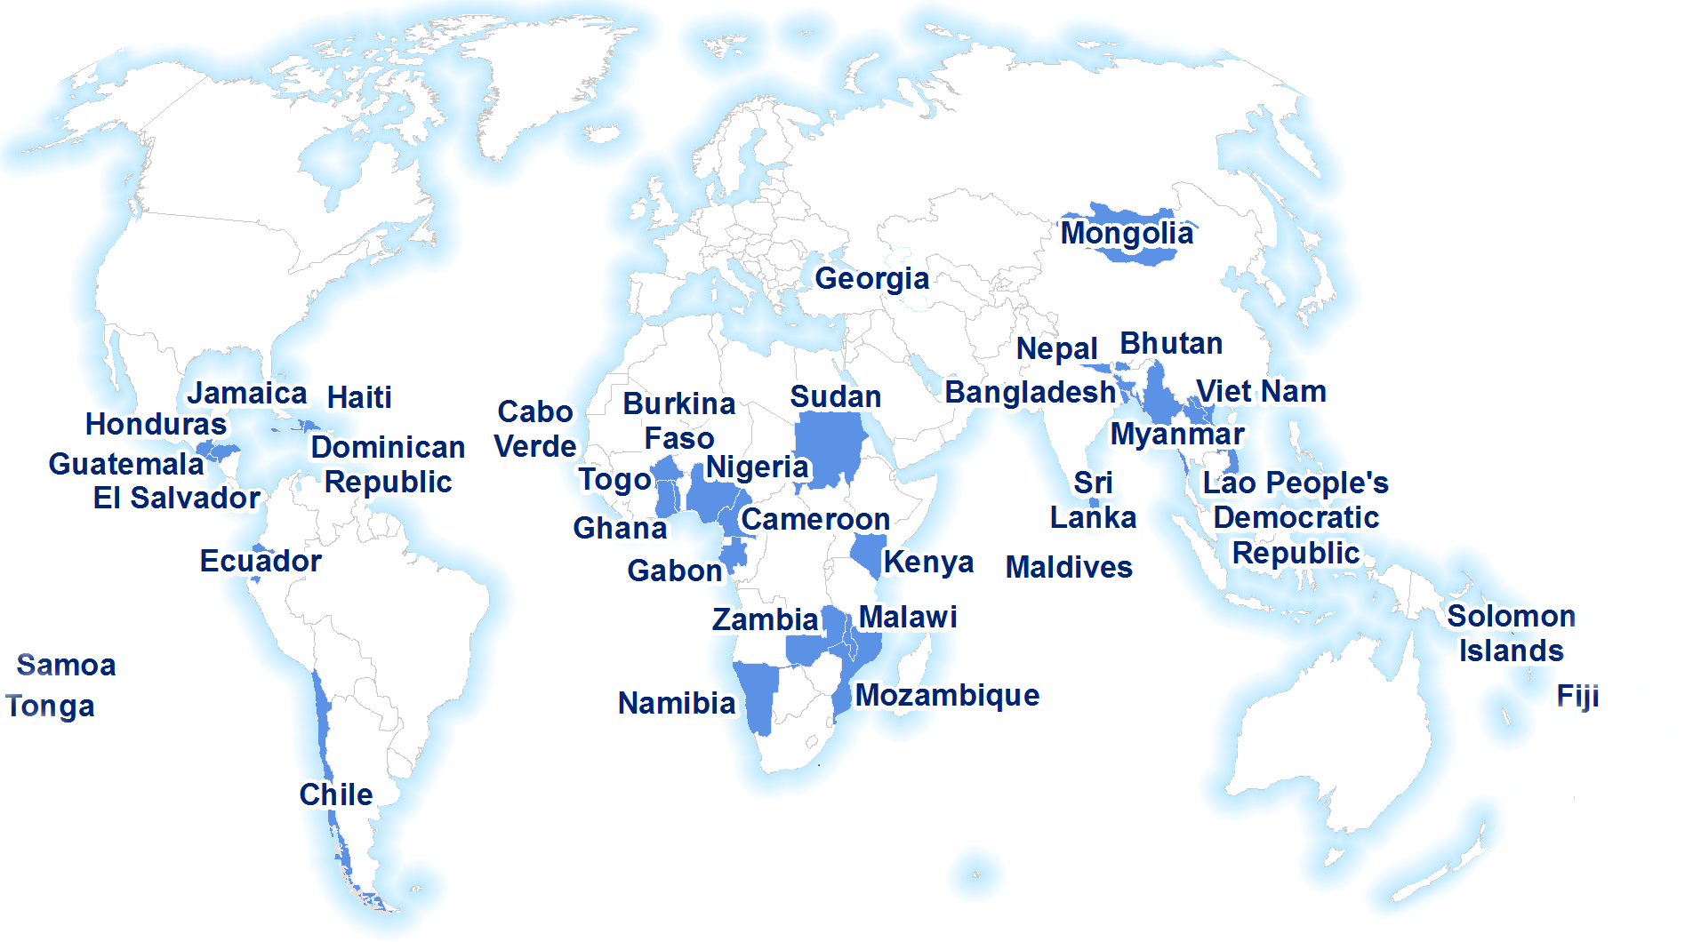
UNOOSA / UN-SPIDER advisory “footprint”
Over 55 countries supported
36 national Technical Advisory Missions (by end 2017)
Over 350 recommendations

Slide 7
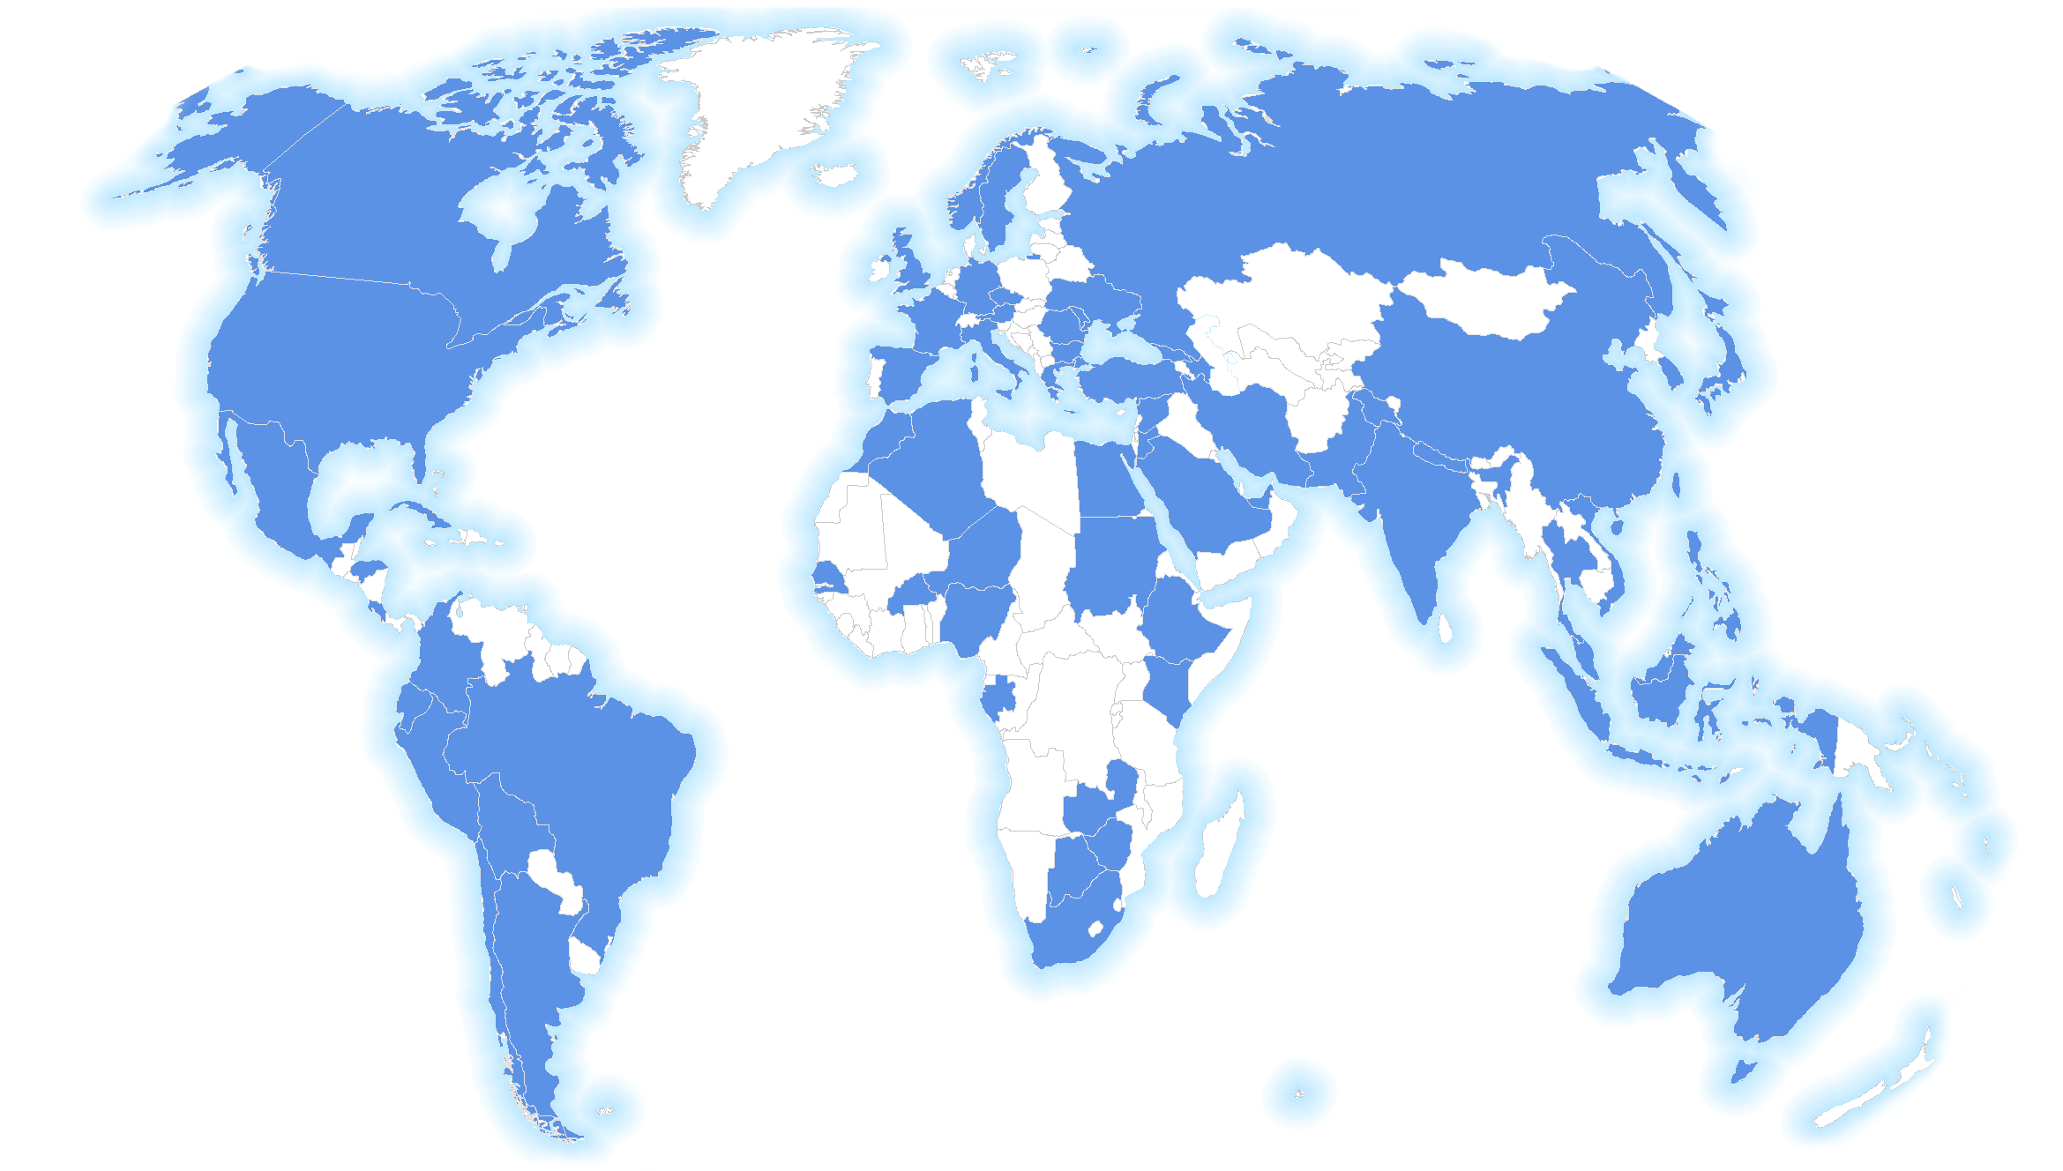
UNOOSA / Space Applications Programme, 1971-2017
Over 90 countries covered (on invitation)
Over 317 Expert Meetings, Workshops, Conferences
Over 23.000 participants consulted
Official UN reports with recommendations

Slide 8
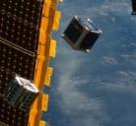
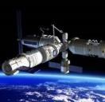
UNOOSA / Why partnerships are key?
Urgent action is needed to mobilize, redirect and unlock the transformative power of trillions of dollars of private resources to deliver on sustainable development objectives.
“Partnerships with the private sector will facilitate global engagement …bringing together Governments, the private sector, civil society, and the United Nations system.”
Long-term investments, including foreign direct investment, are needed in critical sectors, especially in developing countries.
UNOOSA intends to capitalize on technological and innovative skills of the private sector to benefit developing countries and to deliver the Access to Space initiative to address all 17 SDGs.
KiboCUBE
(JAXA)
CMSA
Space Station

Slide 9
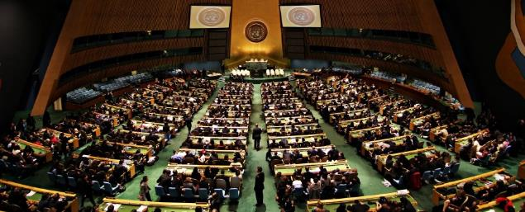
UNOOSA / Space and Private Sector
The General Assembly agreed that the Office should pursue greater engagement with industry and private sector entities to further their support for and contributions to the overall work of the Office (A/C.4/72/L.2)
The fulfilment of a possible Space2030 vision is greatly dependent on partnerships between the governments, the private sector and the civil society. These partnerships are needed at the global, regional, national and local level.

Slide 10
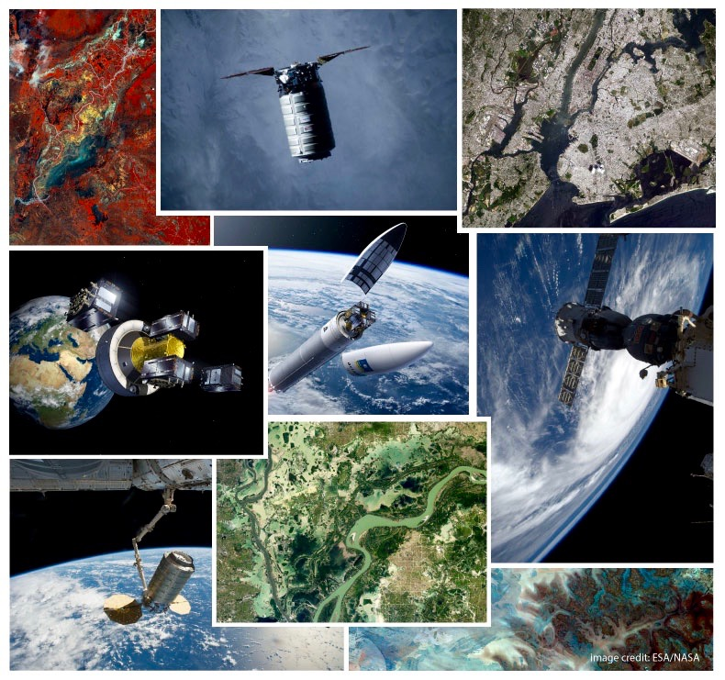
UNOOSA / Space and Private Sector 2
Space economy is the main driver for strengthening international cooperation, particularly, for the benefit of the developing countries;
Cooperation between the U.N. and the private sector is crucial for achievement of the SDGs;
Building markets, combating corruption, safeguarding the environment, reducing disaster risk, increasing food security and social inclusion are just a few of the many common objectives.

Slide 11
UNOOSA / Space and Private Sector - benefits
Strong partnerships would represent the bridge to other industrial sectors from energy, to agriculture, to transportation and several others;
Private investment would help fill the capability gaps;
In support of long term commitment, operational services would be provided;
Awareness of the industry’s technical capabilities would rise and ease the co-ordination between the interest of the public and commercial interest.

Slide 12
UNOOSA / DigitalGlobe partnership – an example
“UNOOSA and DigitalGlobe will stock their combined expertise in the use of the earth observation technologies for economic, social and scientific development and improved decision-making, particularly in the developing countries”;
Work together to develop an online platform to provide easy access to imagery catalogues as well as data and analytical services; (Open Data initiative!)
DigitalGlobe to provide advisory services on remote sensing imagery and geospatial analytics
“Seeing a Better World”

Slide 13
Working with Private Sector / opening access to VHR data
Private Sector already shares or offers imagery data openly in major disasters or crises, but many intermediaries in the past often delayed access
CSR taken seriously by most commercial entities
OOSA aims to work with the Private Sector to raise awareness of these opportunities, but to also provide advice on relevant and valid needs, through an established UN programmes (UN-SPIDER, PSA) that cover most vulnerable and developing countries
Private Sector also better recognized as contributor to the UN agendas, as a result

Slide 14
Working with Private Sector / agreements on VHR imagery
MoU with DigitalGlobe – ongoing
MoU with China National Space Agency (5-7 sensors, 30m LC data etc.) – ongoing (+BRICS)
MoU with UAE Space Agency (DubaiSat) – in preparation, data accessible
MoU with Kazakhstan (KazSat) – in preparation
MoU with Israel Space Agency and ImageSat (EROS) – in preparation, data accessible
MoU with Italian Space Agency (Cosmo-Skymed) – in discussion
MoU with Planet – in discussion
MoU with Airbus – to be signed at UNISPACE +50
MoUs with BlackSky, UrtheCast, ICEYE – in discussion (or past efforts)
Other informal agreements also with operators in Thailand, Venezuela, India, others
-> Aim: free access for disaster management, improved access for other applications

Slide 15
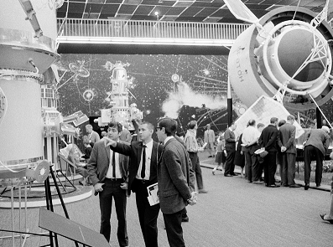
UNISPACE +50 / background and invitation
UNISPACE+50 will mark the 50th anniversary of UNISPACE I and will be the first event of this kind of the 21st century.
This milestone anniversary will renew and strengthen the mandate of COPUOS as a unique platform for interrelationship between major space faring nations and emerging space nations.
UNISPACE+50 will articulate the long term vision for space called Space2030 and will outline the vision for space as a commonly shared human experience.
1968 Conference on the
Exploration and Peaceful Uses of Outer Space

Slide 16
Thank you!
czaran@un.org / www.unoosa.org www.un-spider.org / @UNOOSA @UN_SPIDER

