Slide 1
ERA-PLANET: GEOEssential
Gregory Giuliani/ Lecturer / University of Geneva

Slide 2
The project aims at demonstrating the feasibility and generality of the concept of Essential Variables (EVs) across the Nexus of GEOSS Societal Benefit Areas (SBAs).
Sustainable and trustable sources of data and information to monitor the progresses made on environmental conditions
Cross-thematic workflows and knowledge base to evaluate, predict and monitor Sustainable Development Goals (SDGs)
Gaps and synergies for addressing the needs of environmental policy in agriculture, soil, water, biodiversity, energy, light, and raw materials
Notes:
GEO-ESSENTIAL is addressing the need for sustainable and trustable sources of data and information to monitor the progresses made on environmental conditions.
The project will demonstrate the feasibility and generality of the concept of Essential Variables (EVs) across the Nexus of GEOSS Societal Benefit Areas (SBAs).
It will create cross-thematic workflows to evaluate, predict and monitor natural resources to inform via Earth Observations a selection of targets from the Sustainable Development Goals (SDGs).
Existing structures and platforms will be analysed in order to identify substantial gaps and synergies for addressing the needs of environmental policy in agriculture, soil, water, biodiversity, energy, light, and raw materials and to develop the GEO-ESSENTIAL HUB.

Slide 3
Notes:
The project will demonstrate the feasibility and generality of the concept of Essential Variables (EVs) across the Nexus of GEOSS Societal Benefit Areas (SBAs).
It will create cross-thematic workflows to evaluate, predict and monitor natural resources to inform via Earth Observations a selection of targets from the Sustainable Development Goals (SDGs).
Existing structures and platforms will be analysed in order to identify substantial gaps and synergies for addressing the needs of environmental policy in agriculture, soil, water, biodiversity, energy, light, and raw materials and to develop the GEO-ESSENTIAL HUB.

Slide 4
Notes:
The project will demonstrate the feasibility and generality of the concept of Essential Variables (EVs) across the Nexus of GEOSS Societal Benefit Areas (SBAs).
It will create cross-thematic workflows to evaluate, predict and monitor natural resources to inform via Earth Observations a selection of targets from the Sustainable Development Goals (SDGs).
Existing structures and platforms will be analysed in order to identify substantial gaps and synergies for addressing the needs of environmental policy in agriculture, soil, water, biodiversity, energy, light, and raw materials and to develop the GEO-ESSENTIAL HUB.

Slide 5
Notes:
The project will demonstrate the feasibility and generality of the concept of Essential Variables (EVs) across the Nexus of GEOSS Societal Benefit Areas (SBAs).
It will create cross-thematic workflows to evaluate, predict and monitor natural resources to inform via Earth Observations a selection of targets from the Sustainable Development Goals (SDGs).
Existing structures and platforms will be analysed in order to identify substantial gaps and synergies for addressing the needs of environmental policy in agriculture, soil, water, biodiversity, energy, light, and raw materials and to develop the GEO-ESSENTIAL HUB.

Slide 6
Notes:
The project will demonstrate the feasibility and generality of the concept of Essential Variables (EVs) across the Nexus of GEOSS Societal Benefit Areas (SBAs).
It will create cross-thematic workflows to evaluate, predict and monitor natural resources to inform via Earth Observations a selection of targets from the Sustainable Development Goals (SDGs).
Existing structures and platforms will be analysed in order to identify substantial gaps and synergies for addressing the needs of environmental policy in agriculture, soil, water, biodiversity, energy, light, and raw materials and to develop the GEO-ESSENTIAL HUB.

Slide 7
Notes:
The project will demonstrate the feasibility and generality of the concept of Essential Variables (EVs) across the Nexus of GEOSS Societal Benefit Areas (SBAs).
It will create cross-thematic workflows to evaluate, predict and monitor natural resources to inform via Earth Observations a selection of targets from the Sustainable Development Goals (SDGs).
Existing structures and platforms will be analysed in order to identify substantial gaps and synergies for addressing the needs of environmental policy in agriculture, soil, water, biodiversity, energy, light, and raw materials and to develop the GEO-ESSENTIAL HUB.

Slide 8
Notes:
The project will demonstrate the feasibility and generality of the concept of Essential Variables (EVs) across the Nexus of GEOSS Societal Benefit Areas (SBAs).
It will create cross-thematic workflows to evaluate, predict and monitor natural resources to inform via Earth Observations a selection of targets from the Sustainable Development Goals (SDGs).
Existing structures and platforms will be analysed in order to identify substantial gaps and synergies for addressing the needs of environmental policy in agriculture, soil, water, biodiversity, energy, light, and raw materials and to develop the GEO-ESSENTIAL HUB.

Slide 9
Notes:
The project will demonstrate the feasibility and generality of the concept of Essential Variables (EVs) across the Nexus of GEOSS Societal Benefit Areas (SBAs).
It will create cross-thematic workflows to evaluate, predict and monitor natural resources to inform via Earth Observations a selection of targets from the Sustainable Development Goals (SDGs).
Existing structures and platforms will be analysed in order to identify substantial gaps and synergies for addressing the needs of environmental policy in agriculture, soil, water, biodiversity, energy, light, and raw materials and to develop the GEO-ESSENTIAL HUB.

Slide 10
GEOSS platform usage & benefits

Slide 11
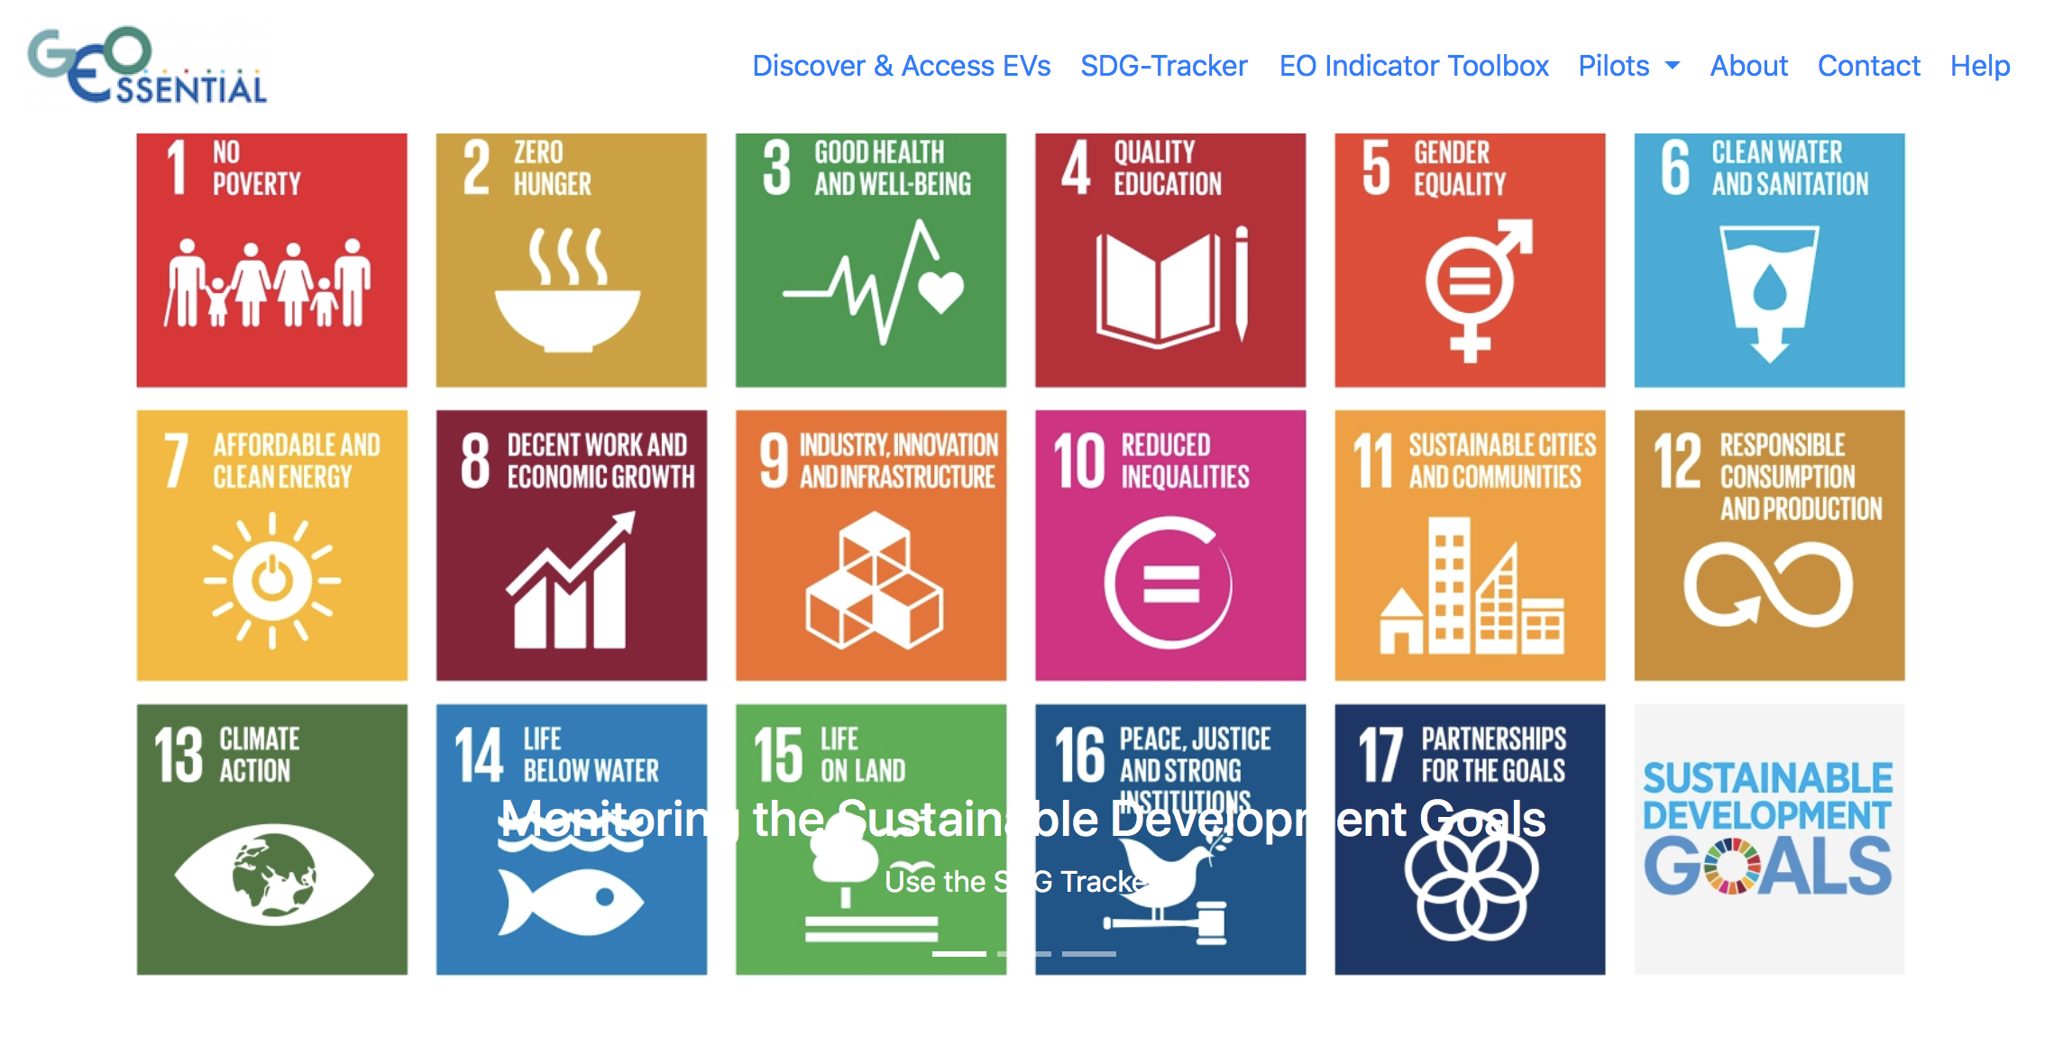
WP7: GEOEssential Dashboard
http://geoessential.unepgrid.ch/dashboard

Slide 12
GEOSS platform usage & benefits
GEOSS View
GEOSS Mirror

Slide 13
GEOSS platform usage & benefits
GEOSS API

Slide 14
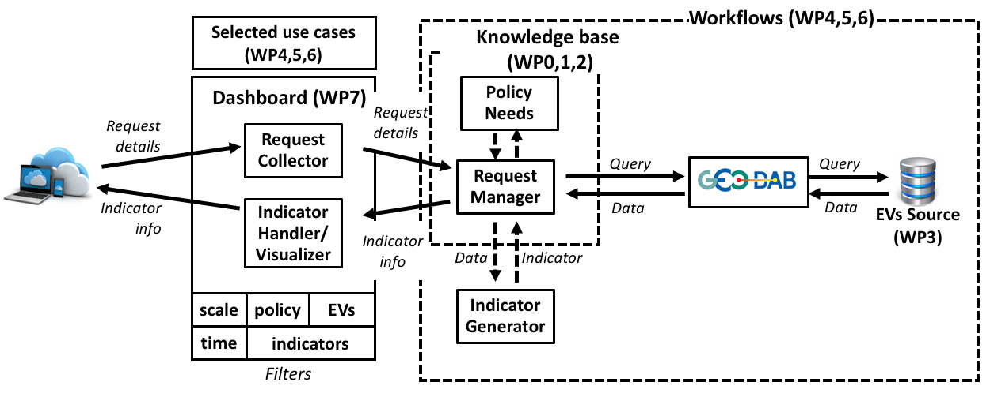
GEOSS platform usage & benefits
GEOSS Widget
GEOSS API

Slide 15
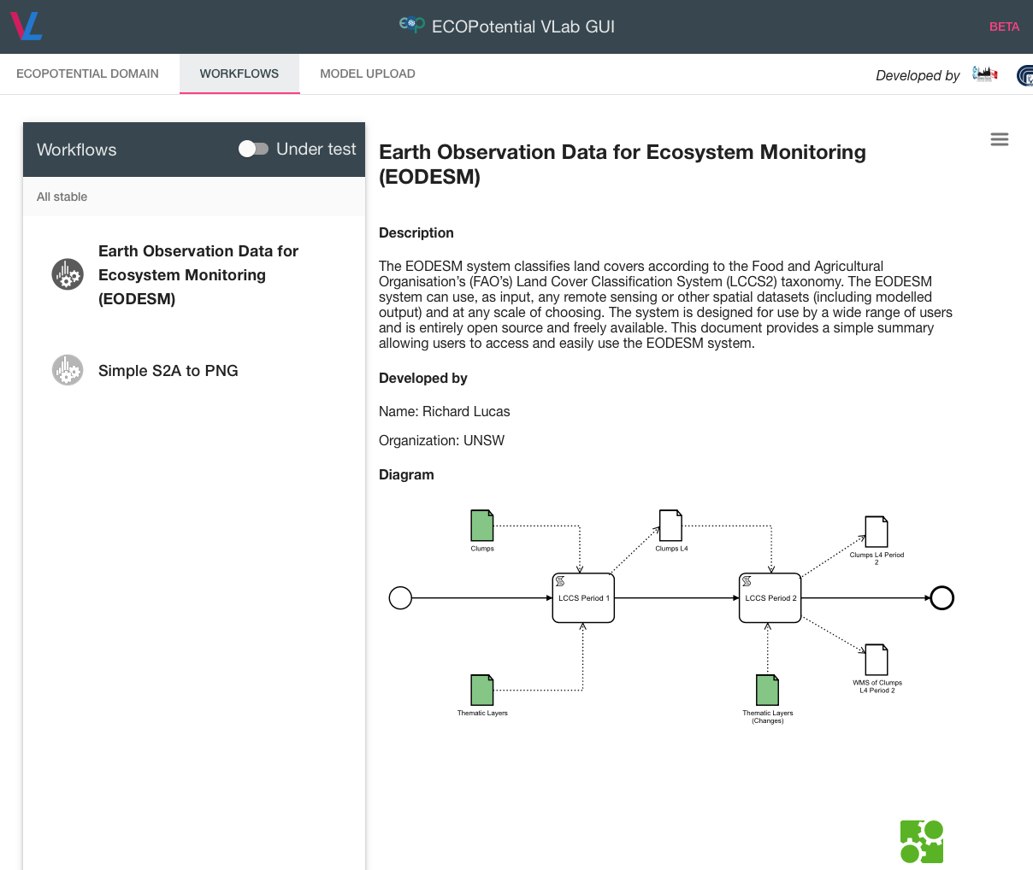
GEOEssential Virtual Laboratroy

Slide 16
Essential Water Variables
First EU-scale EWVs will be released in 2018…
And made available in the GEOSS platform

Slide 17
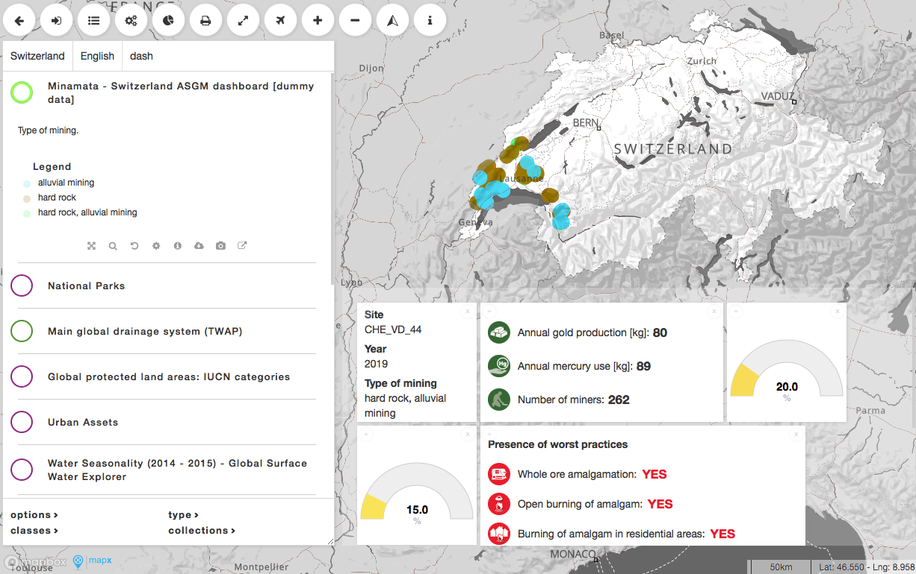
MapX: visualization & dashboard

Slide 18
Thank you
gregory.giuliani@unige.ch / http://www.unige.ch/envirospace / @greggiuliani

