Slide 2
Copernicus
Data and Information
Access Services (DIAS)
Jolyon Martin / Sentinels Data Access Manager / ESA

Slide 3
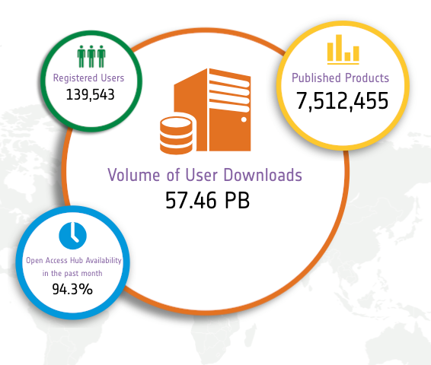
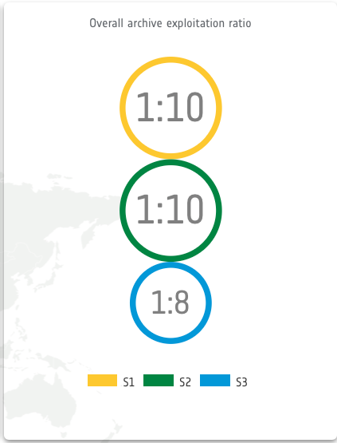
The new paradigm of the Sentinels operations, with more than 7 Million products available for download open & free for any users and a download ratio of 10 times the input volume per mission demands bringing together the data and the user processing.
DIAS Context and Objectives
Statistics on 2018.04.27

Slide 4
DIAS Context and Objectives
Copernicus DIAS procurement is one of the cornerstones of the partnership and aligned programming established between DG-GROW and ESA
DIAS: Creating and enabling a European EO Data ecosystem for research and business A common European approach to EO data exploitation with Copernicus data at its core

Slide 5
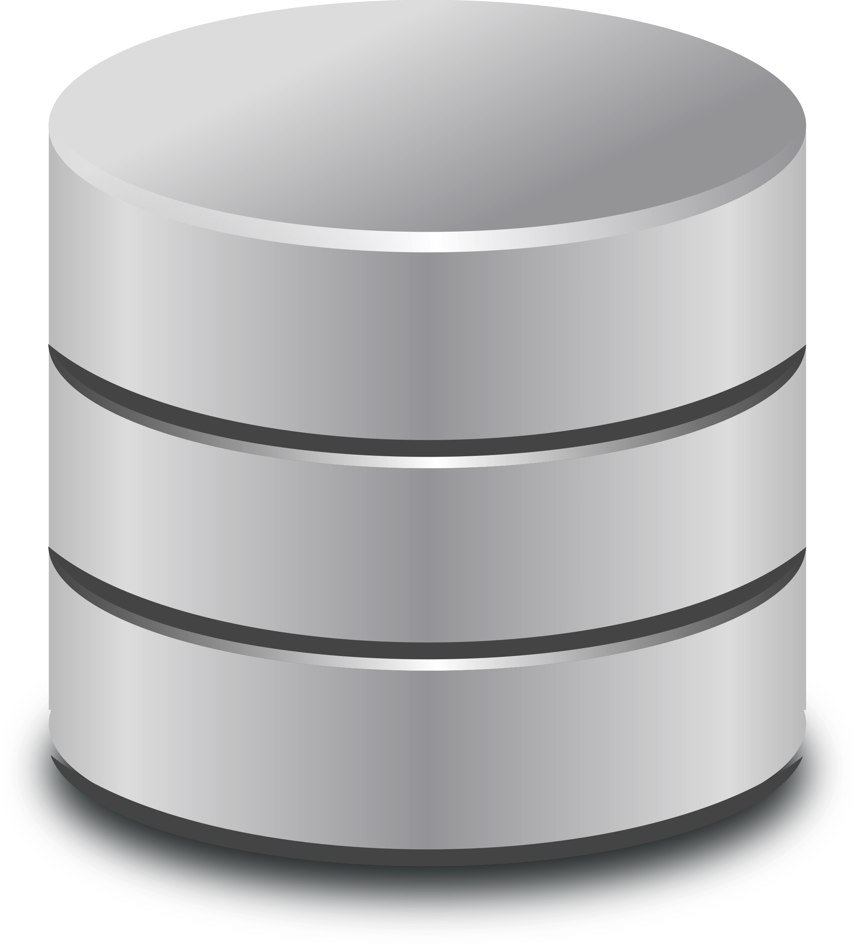
Overview and
key actors
End user
User of free DIAS services or of services provided by Third-parties
DIAS
DIAS Ecosystem
Third-Party: User implementing and/or operating an application or service using the DIAS computing and/or storage resources based on the data available on DIAS
Interface for storage access & processing and management
Copernicus DIAS interfaces
Scalable on-line storage
Copernicus DIAS Storage
DIAS Back-office
DIAS Provider: In charge of DIAS Back-Office Services & Interfaces operations & of providing Third-parties with the access to the DIAS computing and storage resources
Pg. 5

Slide 6
Data Offer by each DIAS will be public, each consortium will publish its data offer
All DIAS provide access to all Sentinel data for local processing & access to the Copernicus Services information with some particularities per each DIAS:
Different data offer implementation by each DIAS provider
Complementary data available, DIAS–specific (incl. e.g. ENVISAT, Landsat, commercial data with associated licencing, etc)
Data offers will evolve according to demand and Consortium strategy
COM & ESA enforce a minimum common basis of an equivalent of 2 years of ESA Sentinel core products
DIAS Pillars: Data Offer

Slide 7
DIAS Pillars: Service Offer
The DIAS service offer will be public, with all details and complementary support services documented and advertised by each DIAS provider
All DIAS provide access to resources for local processing of Sentinel data and Services information for any interested user:
Different IaaS computing/storage resources & PaaS options and costs
Common open and free support services for users (Discovery, Catalogue, View services,…) + Free download service with limited capacity
Services offer will evolve according to demand and consortium strategy
SLA towards DIAS users defined by each DIAS provider

Slide 8
Highlights from DIAS Provider Perspective
Common SLA between each DIAS and ESA to enforce the respect of announced services.
SLA towards users defined by each DIAS provider.
Strong emphasis on protection of user information and IPRs.
DIAS contracts do not include free resources to be allocated by ESA or COM to specific projects => each provider may offer special on-boarding conditions or free evaluation packages according to their own strategy.
Highlights from Third party point of view
On the basis of the data and service offers published by each DIAS, users are able to autonomously assess the most appropriated DIAS for their activities and autonomously start using the selected DIAS
Potential users are invited to contact the different respective consortium to clarify any specific conditions of use or any necessary potential support.

Slide 9
General Principle
The usage of DIAS services is directly engaged between a Third-Party user and a DIAS Provider on the basis of:
The services offered by the DIAS (Service Offer)
The data available through DIAS (Data Offer)
The Service Level Agreement offered by the DIAS provider
DIAS Public Service Offer
DIAS Public
Data Offer
Service Level Agreement
DIAS offering is public information accessible through each DIAS service portal.

Slide 10
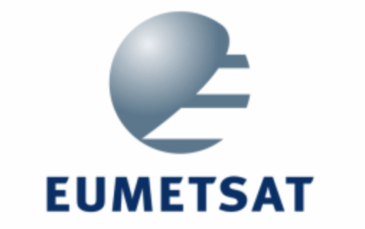
End user
DIAS Data Offer
ALL DIAS offer access to Copernicus Data and Information, including Sentinel data and the Copernicus services information.
Each DIAS may provide access to additional EO & non-EO data according to the respective DIAS business models.
Third-Party
Copernicus DIAS interfaces
Copernicus Data & Information
Other EO and non-EO data
Data Sources for Copernicus Data & Information
Other Data Sources

Slide 11
End user
Free DIAS Services
ALL DIAS allow users (end users and Third-parties) to freely:
discover available data & information
download available data & information
In addition, a View service is offered to browse images.
Data
Discovery
Data
View
Data
Download
Copernicus DIAS interfaces
Copernicus Data & Information
Other EO and non-EO data
Data discovery, view and download are interfaces available on each DIAS.
Additional services may be provided by any DIAS at any point in time according to the users demand and respective DIAS business models.

Slide 12
DIAS Service Offer
ALL DIAS offer cloud computing & storage resources to be procured by Third-parties for further data processing.
Part of the DIAS Service Offer
Copernicus DIAS interfaces
Additional interfaces and services available to store and integrate “user data” into the DIAS “data offer”.
Copernicus Data & Information
Other EO and non-EO data
Part of the DIAS Service Offer
User data integrated into DIAS
All DIAS offer IaaS resources and additional services to Third-parties under a publically available service offer.
Each DIAS publishes its own commercial offer for Third-parties.
Each DIAS may offer additional services at any point in time depending on the respective business model and user needs.

Slide 13
DIAS Interfaces for local
processing
Each DIAS offers standard OGC interfaces, popular cloud APIs (e.g. swift), and/or new innovative solutions (e.g. ENS, data cube, etc.) to access the Data Offer.
Copernicus DIAS interfaces
Copernicus Data & Information
Other EO and non-EO data
Each DIAS publishes a documented interface service offer for Third-parties.
Each DIAS may offer additional interfaces at any point in time depending on the respective DIAS business models and user needs.

Slide 14
Front
office service
DIAS Ecosystem
Front
office service
Front
office service
Front
office service
Front
office service
Front
office service
Front
office service
Front
office service
Front
office service
Front
office service
Front
office service
Copernicus DIAS interfaces
Copernicus Data & Information
Other EO and non-EO data
User data integrated into DIAS
Third-party services can build up on the DIAS relying on the Data Offer, the Service Offer and the underlying DIAS/User SLA.

Slide 15
Why several DIAS contracts?
Multiple DIAS:
Ensure competition to increase attractiveness and fosters innovation
Increase the probability to have a sustainable model/solution(s) at the end of the contract
Provide national and technical diversity, easing the onboarding of national entities and choices for interested third parties

Slide 16
DIAS Contact Points
Alek Cesarz
alek.cesarz@creotech.pl
Anne Chanié
anne.chanie@airbus.com
Guido Vingione
guido.vingione@serco.com
Jean-Baptiste Lavedrine
jean-baptiste.lavedrine@atos.net

